Slide 1
Economic Costs and Benefits of Road Pricing
Douglass B Lee Jr
Volpe Center

Slide 2
Questions
Does pricing generate benefits in excess of costs for operation of a given stock of capital?
Does pricing provide the means for planning new capacity in all related modes?

Slide 3
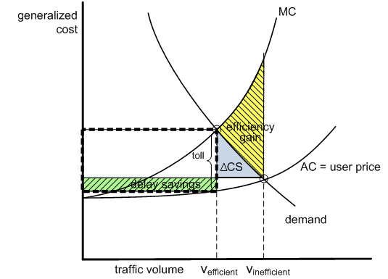
The Standard Model
CP > no CP
delay and operating cost savings as valued by users (CS) > deterred vehicle trips as valued by users
assumes pricing is costless

Slide 4
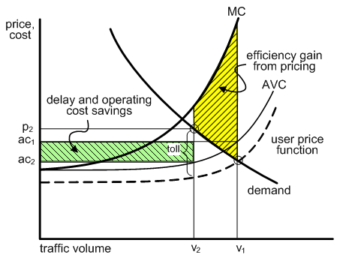
Modified Standard Model

Slide 5
Extensions
Network
pricing expressways is effective
diversion to other expressways doesn’t avoid toll
could have two networks
arterial diversion is manageable
arterial capacity is limited
traffic management limits substitutability
Area Pricing or Cordon Pricing
reasonably close to standard model
depends on efficient use of revenues
reveals preference for substitute alternatives

Slide 6
Multi-Class Service
Holding capacity constant
HOV < no HOV
2-class service with 1 priced > HOV
2-class service with 1 priced <?> 1-class no CP
2-class with both priced > 2-class only 1 CP
2-class both priced <?> 1-class CP

Slide 7
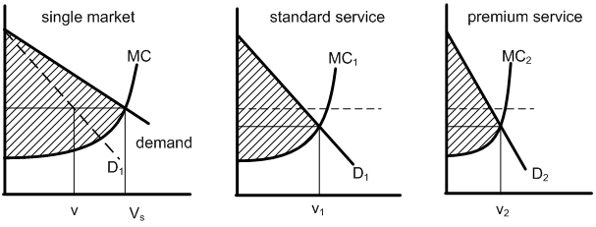
Benefits of 2-Class Service
generalized price is lower for both classes, but money price for premium service is higher
for 2-C > single, sum of 2 areas > single

Slide 8
Add Capacity
standard model
if incremental SR profit > annualized capital cost
cordon model
compare investment in substitute modes
multi-class model
revenues insufficient to signal
capital costs enlarged
occupancy is critical (BRT)

Slide 9
Conclusions
congestion pricing generates net benefits if properly applied
HOT lanes an interim step
evidence of user WTP is required for investment
full facility pricing is probably most efficient
selected private concessions can be shortcut
devolution seems unavoidable

