Slide 1
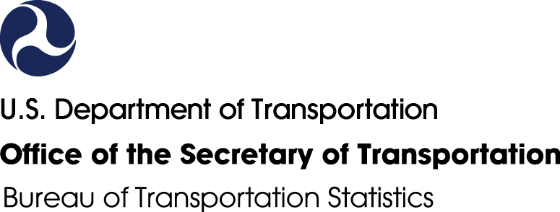
The National Transportation Library
Spring Depository Library Council Virtual Meeting
Rosalyn Alleman
Reference Librarian
rosalyn.alleman@dot.gov
March 4, 2026

Slide 2
About the National Transportation Library
Transportation Equity Act for the 21st Century (TEA-21) (1998)
“establish and maintain a National Transportation Library, which shall contain a collection of statistical and other information needed for transportation decision making at the Federal, State, and local levels.”
Moving Ahead for Progress in the 21st Century Act (MAP-21) (2012)
Acquire, preserve and manage transportation information and information products and services for use by DOT, other Federal agencies, and the public;
Serve as the central repository for DOT research results and technical publications; and,
Serve as the central clearinghouse for transportation data and information of the Federal Government
Foundations for Evidence-Based Policymaking Act of 2018, Title II: The Open, Public, Electronic, and Necessary Government Data Act (OPEN Government Data Act)
Codifies and superseded M-13-13, making public and open the government default for data derived from research projects
2026: Infrastructure and Jobs Act of 2021 (current surface transportation reauthorization bill) expires 9/30/26.
Notes:
The National Transportation Library was established in 1998 as 1 of the 5 U.S. national libraries, along with:
Library of Congress
National Library of Education
National Library of Medicine
National Agricultural Library
NTL provides access to:
Digital collections
Data services
Reference and research services
Networking
We are an open access digital repository. All items are in the public domain and available for reuse without restriction.
NTL Operates under the following mandates:
Transportation Equity Act for the 21st Century (1998)
“establish and maintain a National Transportation Library, which shall contain a collection of statistical and other information needed for transportation decision making at the Federal, State, and local levels.”
Moving Ahead for Progress in the 21st Century Act (MAP-21) (2012)
Acquire, preserve and manage transportation information and information products and services for use by DOT, other Federal agencies, and the public;
Serve as the central repository for DOT research results and technical publications; and,
Serve as the central clearinghouse for transportation data and information of the Federal Government
Foundations for Evidence-Based Policymaking Act of 2018, Title II: The Open, Public, Electronic, and Necessary Government Data Act (or OPEN Government Data Act)
Codifies and superseded M-13-13, making public and open the government default for data derived from research projects

Slide 3
Library Services at NTL
Library Services
Reference
Outreach
Digital Repository: ROSA P
Collection Development
Special Collections/Archives

Slide 4
Reference Services
Ask-A-Librarian
LibGuides
Other services
Email Reference
Live Chat
Voicemail
FAQs
Reference Hot Topics
Aviation
Passenger Travel
NTL hosts LibGuides for NTL patrons and NTKN partners
Examples:
USDOT History (DOT Archivist)
Bicycle & Pedestrian Transportation (MnDOT)
Extreme Event Preparedness & Response for Operations (NTKN)
Section 508 Accessibility (NTL)
Basic assistance with BTS data products
ROSA P search help
DOT office referrals
In-house literature searches
New DOT employee training
Provide contracted commercial database access to DOT staff
Resources at: https://transportation.libanswers.com/
Resources at: https://transportation.libguides.com/

Slide 5
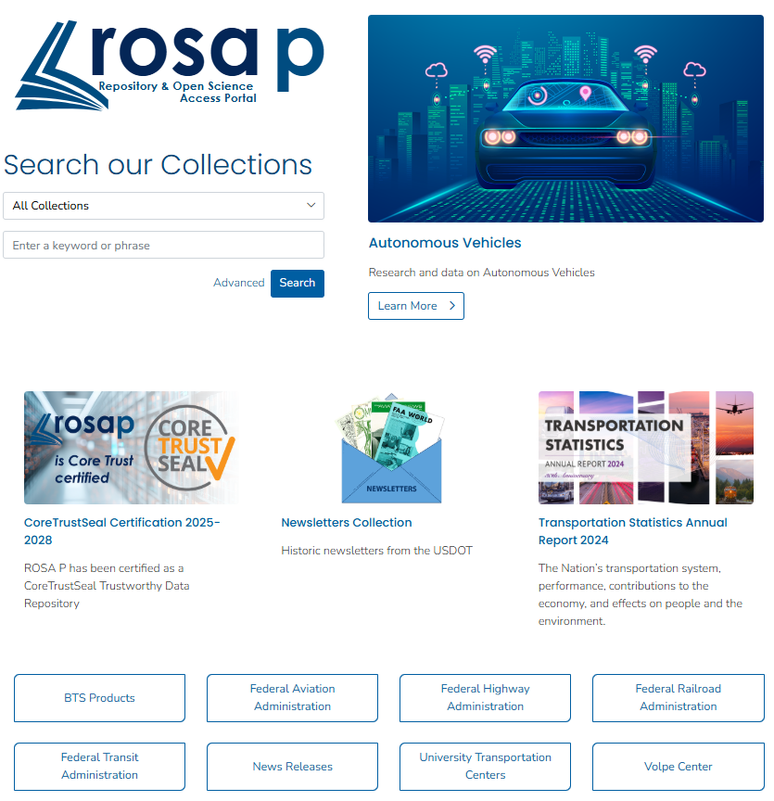
Repository & Open Science Access Portal (ROSA P)
ROSA P is the National Transportation Library's Repository and Open Science Access Portal. The name ROSA P was chosen to honor the role public transportation played in the civil rights movement, along with one of the important figures, Rosa Parks. It contains 48 collections on various themes.
Visit ROSA P at: https://rosap.ntl.bts.gov/welcome

Slide 6
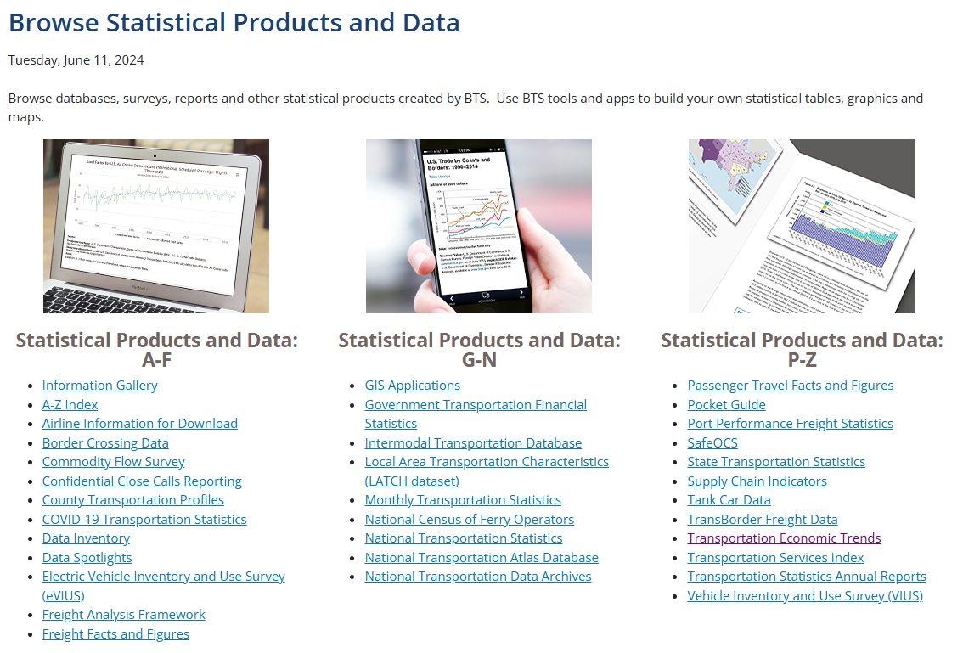
BTS Support
Data Product Support
Reference Team offers web form and chat at transportation.libanswers.com
Airline traffic, financial and on-time performance data
Referrals to BTS specialists and non-BTS sources as needed
Assists BTS public affairs clients, such as media and government personnel

Slide 7
USDOT Support
Some major sources:
National Center for Statistics and Analysis (NHTSA) – highway safety statistics
Highway Statistics (FHWA) – statistics on the number of drivers and vehicles, miles of roadway, conditions
Manual on Uniform Traffic Control Devices (FHWA) – manual on highway signs, markings, etc.
Analysis and Information (FMCSA) – data on federally-regulated motor carriers
Emergency Response Guidebook (PHMSA) – guide to responding to emergencies involving hazmats
OPSNET (FAA) – airport traffic statistics (includes general aviation, military)
Check out our brochure on finding transportation statistics at transportation.libanswers.com!
Reference Team offers web form and chat at transportation.libanswers.com
Referrals to DOT specialists and non-BTS sources as needed
Non-DOT sources of transportation information include: DOE,
DOC/Census,State Dept., TSA, Customs, State DMVs

Slide 8
The TRID Database
TRID: https://trid.trb.org Transportation Research Board’s (publicly available) bibliographic database, with some full-text links to ROSA P. Types of materials indexed:
Journal Articles
Government Reports
Datasets
Book Chapters, and more
Resources available for TRID users:
Frequently Asked Questions
About TRID
Documentation & Training Materials
TRID Search Help
TRID Coverage
TRID Serials
TRB Research in Progress
TRT - Transportation Research Thesaurus
International Transport Research Documentation (ITRD)
Literature Searches and Literature Reviews for Transportation Research Projects
Questions or comments? E-mail tris-trb@nas.edu
(From the Transportation Research Board) Content may be available in full text. TRID is an integrated database that combines the records from TRB’s Transportation Research Information Services (TRIS) Database and the OECD’s Joint Transport Research Centre’s International Transport Research Documentation (ITRD) Database. TRID provides access to 1.5 million records of transportation research worldwide.
Notes:
Create accounts

Slide 9
Outreach
Transportation Librarians Roundtable
National Transportation Knowledge Network
The Transportation Librarians Roundtable (TLR), a monthly web conference series.
The TLR is an initiative of the National Transportation Library (NTL).
Co-sponsors include:
American Association of State Highway and Transportation Officials (AASHTO),
Transportation Research Board (TRB),
The Special Libraries Association's Transportation Division.
NTKN leads, supports, and guides the nation’s transportation knowledge networks in their efforts to organize, share, and preserve transportation information, data, and knowledge for their stakeholders in the transportation community.
Communities of Practice:
Library Advocacy
508 Accessibility
Cooperative Digitization
Artificial Intelligence
TLR at: https://transportation.libguides.com/TLR
NTKN at: https://transportation.libguides.com/NTKN

Slide 10
Collection Development
Sources of Material
Works Categories
Access & Rights
Documents, datasets, & products, funded and/or produced by:
U.S. DOT agencies
State DOTs, local agencies, metropolitan transportation organizations (MPOs), tribal road agencies, etc.
Other federal agencies
Universities and university transportation centers (UTCs)
Professional organizations
Private-sector sources
Documents, datasets, & products, funded and/or produced by:
Textual works
Still images
Maps & GIS data
Audio works
Moving image works
Datasets
Websites
Software
ROSA P is indexed by popular internet search services, including:
Google
Bing
Science.gov
Google Scholar
Google Dataset Search
Selected items indexed in TRID https://trid.trb.org/
All items in Public Domain or given explicit permission
Visit our policies page at: https://ntl.bts.gov/policies

Slide 11

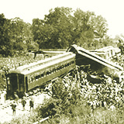


Digital Preservation
Investigations of Aircraft Accidents 1934-1965
791 Civil Aeronautics Board Aircraft Accident Reports, dating from 1934 to 1965
ROSA P is home to a number of digitized historic document collections, with more on the way
ROSA P holds a growing number of digital datasets
NTL works with off-site contractors for digitization services, in addition to some historical items done in-house.
Investigations of Railroad Accidents 1911-1993
4178 United States Interstate Commerce Commission railroad accident reports, dating from 1911 to 1993
DOT Administrators' Speeches and Writings
Speeches, statements, remarks, manuscripts, and papers by U.S. Department of Transportation administrators.
Newsletters
Digitized newsletters published by and for employees across the U.S. Department of Transportation.

Slide 12
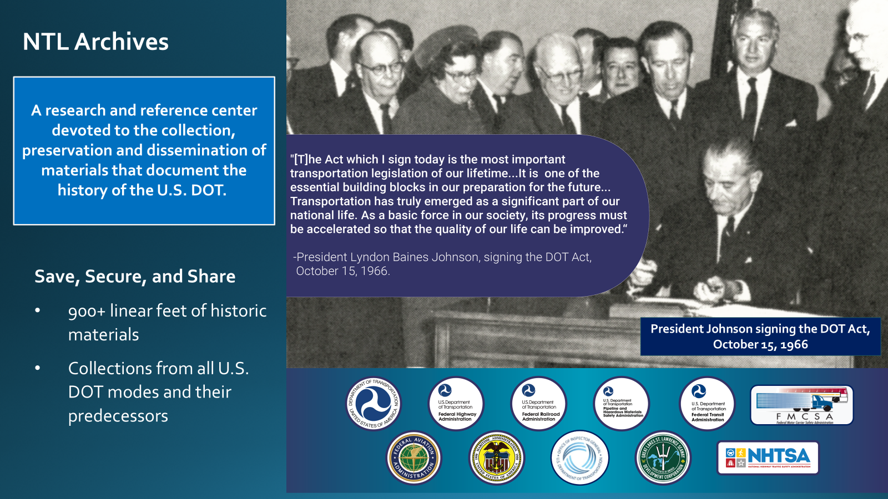

Slide 13
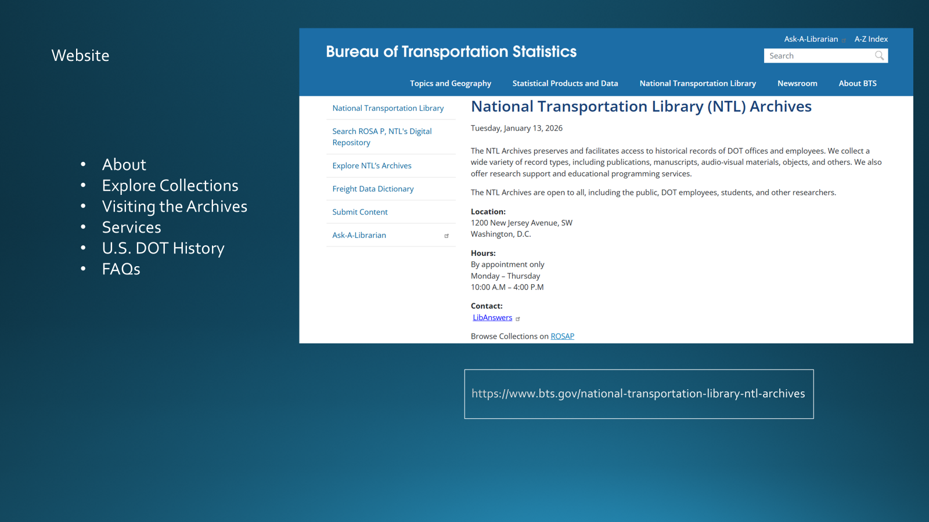

Slide 14
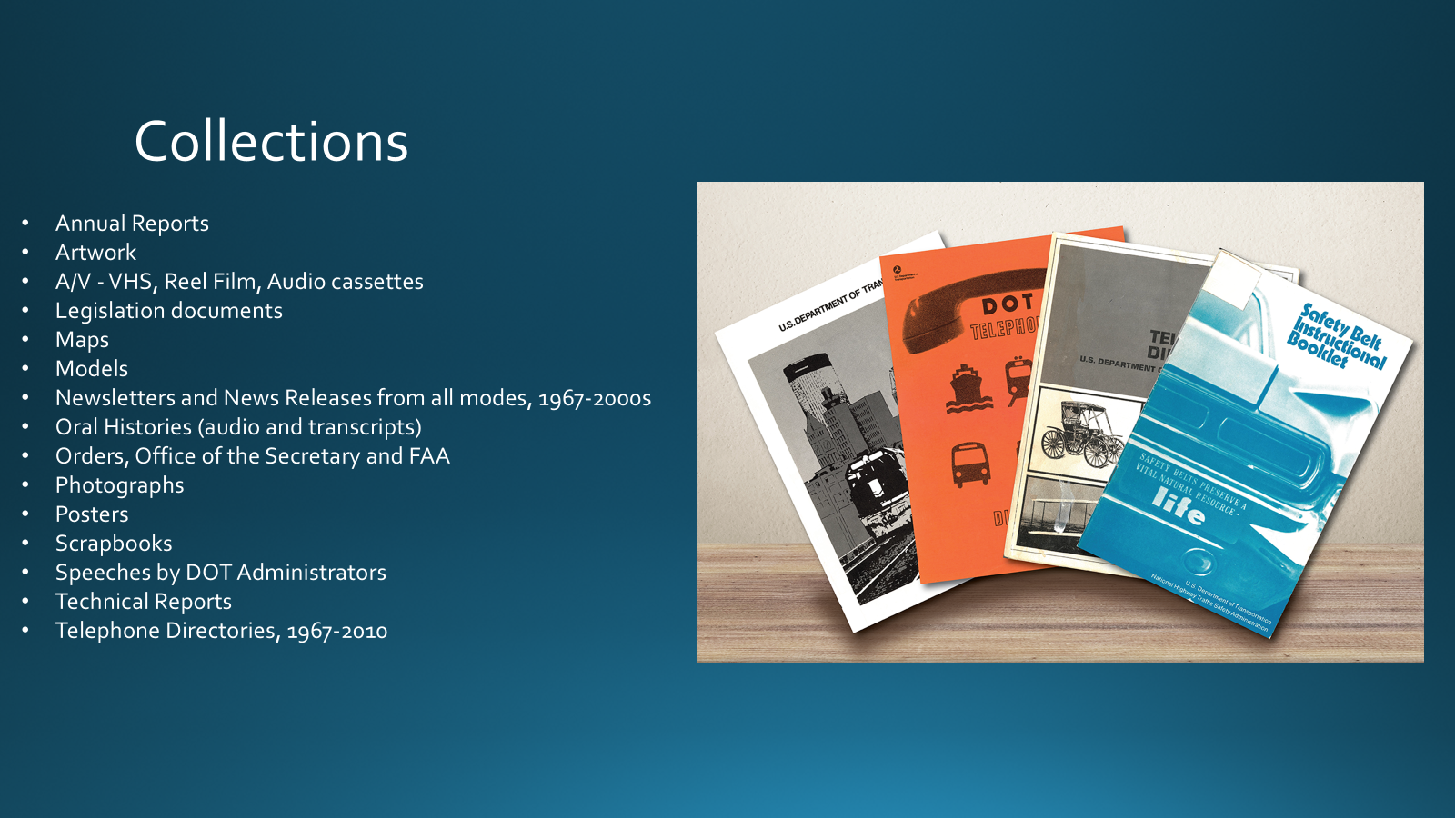

Slide 15
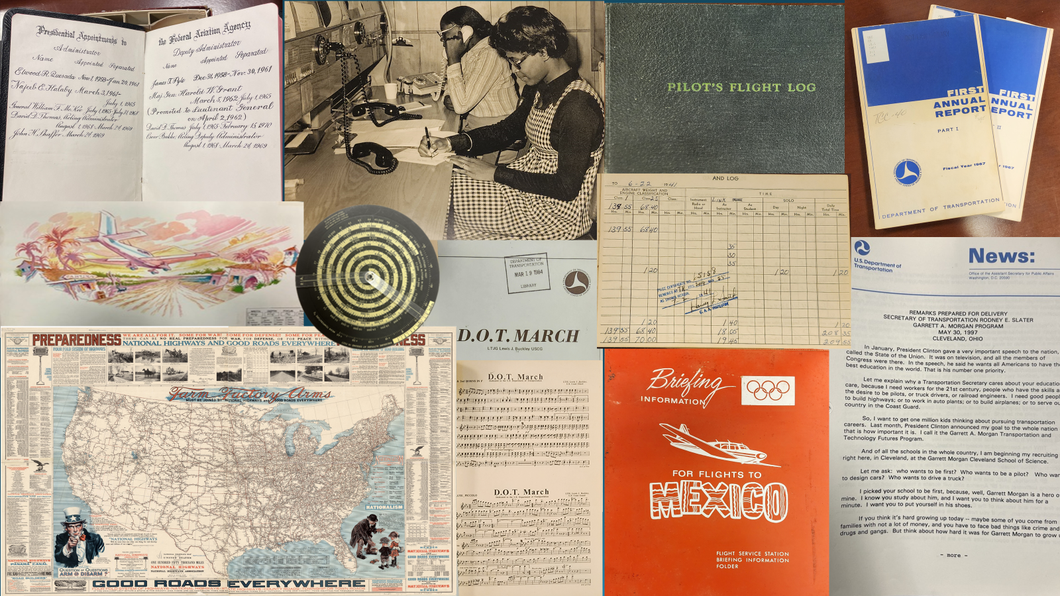

Slide 16
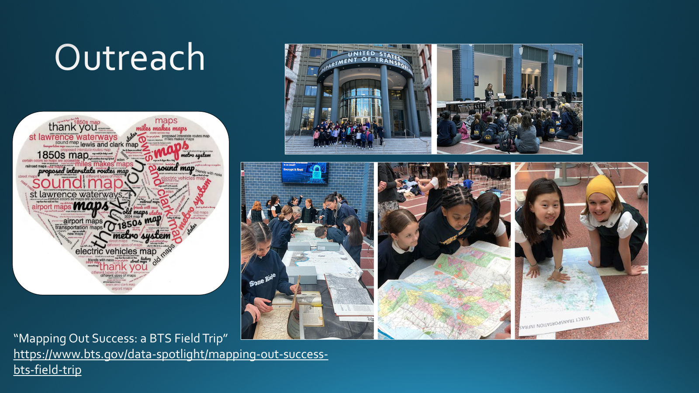

Slide 17

Thank you!
Questions?
Follow us on Twitter
https://twitter.com/USDOTNTL

