Slide 1
Legal Considerations in Access Management
Module 8

Slide 2
Learning Objectives
Describe the difference between police power and eminent domain.
Summarize important legal considerations related to the application of access management.
Explain how a regulatory process can impact the legal viability of an access management program.

Slide 3
Introduction
Laws vary from state to state.
Attorneys must be consulted for specific legal advice.
Today’s lecture reviews typical guidelines and examples from a review of state and national literature and selected cases.
Notes:
In the early 1900s (1907) the US Supreme Court held that states should determine access rights of abutting owners by their own laws and not by federal law. As a result, each state is unique in its interpretation of laws relative to access and how they choose to balance public and private rights in these matters.

Slide 4
Overview
Access Management:
Coordinated planning, regulation, and design of access between roadways and land development
The management of the location, spacing, design and operation of access
Includes service roads, street network connectivity, and unified access and circulation
Accomplished through:
Eminent domain (e.g., acquisition of access rights, ROW)
Police power (e.g., plans, policies, regulations, permits)
Roadway design and reconstruction (e.g., auxiliary lanes, medians)
Partnering and coordination (e.g., IGAs)
Notes:
Definition of access – managing elements of property access and good network planning.
It’s accomplished through both through eminent domain and police power strategies, as well as design and partnering.
It involves two areas of law with different legal implications - Eminent domain (take private property for public use with just compensation) and police power (regulation of private property for public health safety and welfare). Regulatory taking – government regulations go too far and limit use of private property to such a degree that the landowner is essentially deprived of all economically reasonable use or value of property. Inverse condemnation cases arise when the government takes or damages property without filing a condemnation action. In both cases compensation is required.

Slide 5
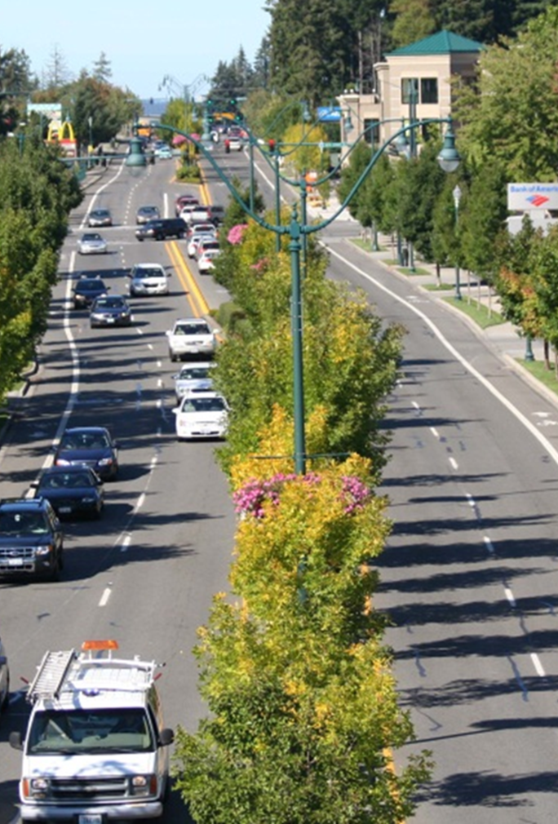
Access Management and Police Power
Access management regulations have been found to be a legitimate application of the police power.
Public purposes behind access management include:
  improved safety of vehicular and pedestrian travel
  preservation of roadway quality/level of service and efficiency
  orderly growth and development
  enhanced livability and community character
Notes:
AM has been found to be a legitimate application of police power for public health, safety and welfare. Regulations should nonetheless clearly define the public purposes.
Over two decades of research on the benefits of access management to safety of vehicular and pedestrian travel,
Promotes good operations and reduces delay which protects both the public investment in highways and supports the economy,
It promotes orderly growth and a coordinated consideration of both transportation and land use objectives, and
Enhances livability and community character by providing more area for landscaping and promoting the organization of land uses on a street network or unified circulation system, and discourages commercial strip development.

Slide 6
A Balancing of Interests
The public’s right to safe and efficient movement
The landowners right to suitable and sufficient access
Private rights of access are generally subservient to the public’s right to free and safe use of public streets
Notes:
Access is considered a property right, so as with other types of regulations that impact private property, access management involves a balancing of public and private interests. The landowners right to suitable access and the publics right to safe and efficient movement. In a court of law, private rights of access are generally subservient to public rights to free and safe use of public streets.
These are the right of access to one’s land is a property right. Anhoco Corporation v. Dade County, Fla. 1962, 144 So. 2d 793,

Slide 7
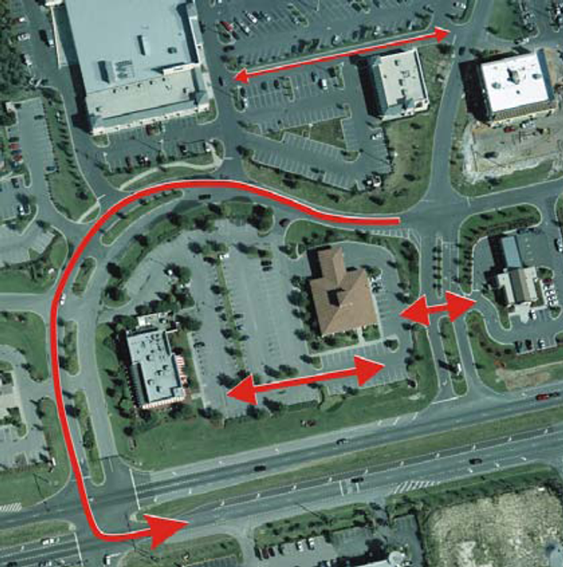
Reasonable Access
Property right is typically one of reasonable access
  Has access been substantially diminished?
  Evaluated on a continuum
  Cannot cause a property to be landlocked – complete loss of access is always a taking
Notes:
In the majority of states, the property right of access has been defined as one of reasonable access to the abutting system of public ways.
In construing reasonable access, courts look to whether access has been substantially diminished. Because circumstances of individual properties vary widely, the availability of reasonable access has to be determined on a case-by-case basis.
Whether access has been substantially diminished is evaluated on a continuum from relatively minor route changes, which are not usually compensable, to extremely circuitous rerouting of access, or complete denial of access to a public street, which are compensable
Complete loss of access is always a taking

Slide 8
Circuity Alone is not Compensable
“The fact that a person loses the most convenient method of access is not …different in kind from damages sustained by the community at large where the property has suitable access from another street even though the alternate route is longer.”
  - Pinellas County v. Austin, 323 So. 2d 6, 8-9 (Fla. 2d DCA 1975)
Loss of the most convenient access is not compensable where other suitable access continues to exist.
Notes:
But loss of the most convenient access, or an increase in circuity of access, is not usually compensable where other suitable access continues to exist. In evaluating this, Courts do look at whether the change in access is somehow different than that experienced by the community at large. Austin - Street vacation that diminished the quality of the Austin's access that due to the details of the case was different than that of the public at large because it now required them to use an old wooden bridge that could not sustain trucks like garbage trucks and fire trucks and an alternate potential access required them to cut down trees for nursery stock to connect.

Slide 9

EXAMPLE
State Highway Access Management Authority
Annotated Code of Maryland grants MDOT SHA the right to:
Limit the design, width, and location of existing commercial or industrial access points
Prevent an entrance from any commercial or industrial property into any highway unless and until an access permit has been issued
Deny new commercial or industrial access along any primary State highway (with AADT>2000 vpd) if reasonable access to another public road is available to and from the property.
Such denial is an exercise of the police power and does not require compensation
─ §8-625
Notes:
In Maryland, the state highway administration (MDOT SHA) is authorized under Maryland Law to control access along State highways “to provide a safe, properly functioning highway system” through both permitting and the acquisition of property rights. I want to point out use of the term reasonable access and the authority to deny direct highway access where access is available to another public road as a legitimate exercise of the state’s police power. The implication is that Maryland is a state that applies the principles of reasonable access.
Control of access is accomplished through statutory and regulatory mechanisms, including acquisition of certain real property rights and the access permit process. § 8-625. Permit required to make entrance from any commercial or industrial property to certain State highways
https://govt.westlaw.com/mdc/Document/N84927CA09CE811DB9BCF9DAC28345A2A?viewType=FullText&originationContext=documenttoc&transitionType=CategoryPageItem&contextData=%28sc.Default%29

Slide 10
EXAMPLE
State Highway Access Management Authority
However, the State [Maryland] may not deny access to a state highway if the property is within the boundaries of a municipal corporation unless:
    (i) The property abuts another public road to which reasonable access can be granted;
    (ii) The denial is based on an access management plan that has been agreed to by the Administration and the municipal corporation; or
    (iii) The Administration pays just compensation to the property owner as part of the exercise of eminent domain powers.
─ §8-625
Notes:
These rights are curtailed in incorporated municipalities except again if there is reasonable access, or an Access Management Plan adopted by both parties or the state purchases it.

Slide 11
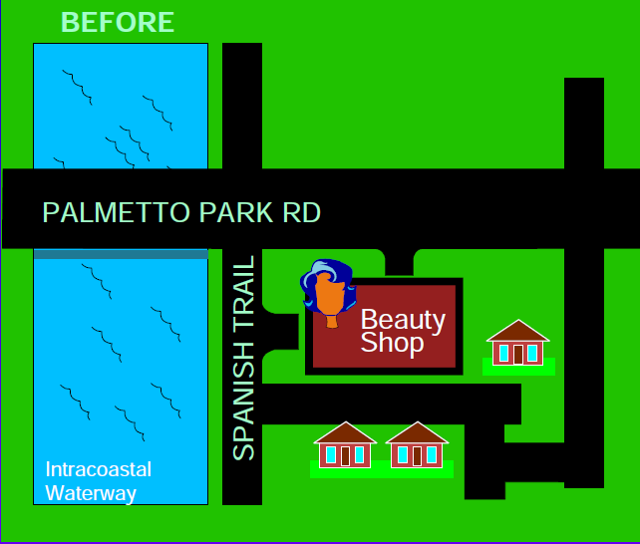
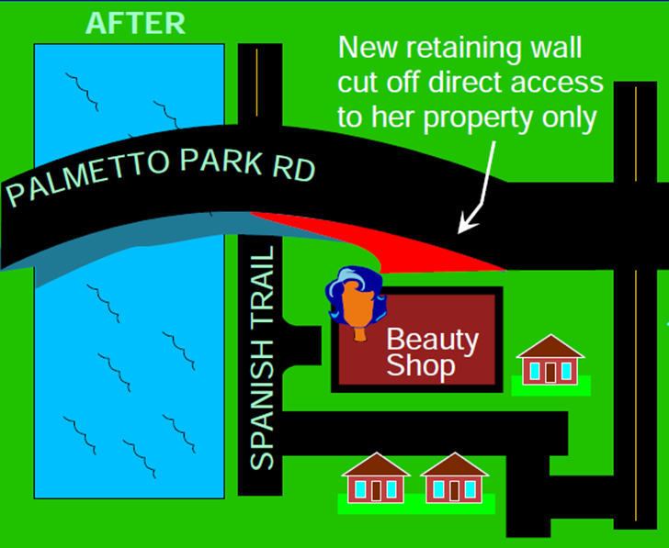
Palm Beach County v. Tessler
Beauty shop in home
Retaining wall eliminated direct access to Palmetto Park Rd
Sign no longer visible from Palmetto Park Road
Customers must travel 600 yards through a residential neighborhood
Palm Beach County v. Tessler, 538 So. 2d 846 (Fla. 1989)
Source: Florida DOT “Legal Considerations in Access Management”
Notes:
Now let’s consider a few cases. This is a 1989 Florida case but it is still instructive. FDOT as part of a road improvement project built a new retaining wall. No ROW was taken. But the wall eliminated direct access and the sign is no longer visible. Customers had to wind through neighborhood to find the beauty shop.

Slide 12

Palm Beach County v. Tessler
COURT: A taking occurred
When governmental action causes a substantial loss of access, even though no physical appropriate of the property itself, there is a right to be compensated.
The plaintiffs lost more than their most convenient method of access.
A complete loss of access is not necessary, but access must be substantially diminished.
Palm Beach County v. Tessler, 538 So. 2d 846 (Fla. 1989)
Notes:
Court determined this was a taking as they lost more than their most convenient method of access and the damage to Tessler was different from damages sustained by the community at large. It was circuitous. And compensation was warranted even though there was no property taken.

Slide 13
Damages
A substantial loss of access to private property may result in a taking and warrant compensation, although no physical appropriation of property has occurred.
  Sanderson v. Mayor & City Council of Baltimore (1920): change in grade rendered property inaccessible, taking that required compensation.
Damages must be peculiar to that property and not common to the public at large for compensation to be paid.
Recoverable damages are limited to the reduction in property value caused by the loss of access, but if the property is landlocked the entire parcel may have to be purchased.

Slide 14
A Left is not a “Right”
Government may alter traffic flow
  Medians and median opening redesign or closures
  Pedestrian safety crossing islands
Courts also typically land on the side of public safety
  “…preventing left-turns except at intersections is an obvious safety device to reduce traffic hazards.” (NC Supreme Court, 2005)
Public opposition requires early and ongoing involvement
Statutory changes and caselaw in some states are impacting this authority
  Utah: if a median project also involves ROW taking, loss of access due to the median is now considered in assessing damages
Notes:
Another example of this balancing act is when a property experiences changes in access as roads are redesigned and a median, one-way street or other traffic controls are imposed to address growth. Generally, the courts do not protect property owners from changes in highway design and operation. Roadside land owners are expected to bear these costs and hardships. There are many cases that address this and the courts typically land on the side of public safety with regard to medians. (“preventing left-turns except at intersections is an obvious safety device to reduce traffic hazards (NC Supreme Court, 2005).
Public does tend to become upsent (especially business owners) when a median is installed or opening is closed, making early and ongoing involvement essential and its critical to have your ducks in a row and be able to clearly explain the rationale for the changes and how it will impact each property. (have guidance on this issue).
But such disputes, if not effectively addressed can and are leading to changes to state laws or caselaw that adversely affect AM authority or increase situations whereby the state must compensate property owners for median projects, thereby significantly increasing the costs of these projects. In Utah, for example, if a median project also involves the taking of right of way, loss of access due to the median is now considered a part of the damages associated with the value an appraiser assigns to the ingress and egress. the passage in Utah of H.B. 266 in early 2018 amended provisions to access public highways. The bill states that the highway authority is not permitted to close a legal point of access to the public highway unless “the property has reasonably equivalent access to the public highway after the legal access is closed or the highway authority acquires the legal point of access by gift, agreement, purchase, or eminent domain.” The bill has served to prevent UDOT from requiring property owners with existing access to the state highway system to build a new access at the appropriate location, appropriate spacing, or consolidate access during redevelopment. When UDOT determines that it is necessary to improve site access, they must compensate property owners instead of requiring the change as a part of the permit.

Slide 15
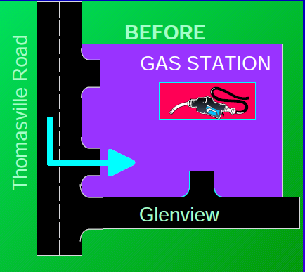
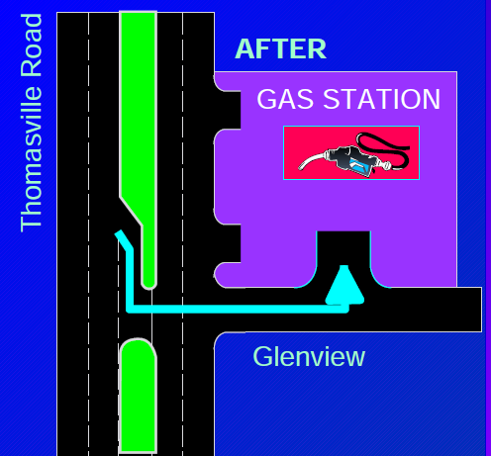
DOT v. Capital Plaza, Inc.
COURT: A taking did NOT occur.
Landowner has no property right in the continuation or maintenance of traffic flow past his property. Impairment of traffic flow is not recoverable.
DOT v. Capital Plaza, Inc. 397 So 2d 682 (Fla 1981)
Source: Florida DOT “Legal Considerations in Access Management”
Notes:
Let’s look at a typical median case. Roadway reconstruction from 2 lane to multilane with median and ROW was purchased.
No left turn into gas station.

Slide 16
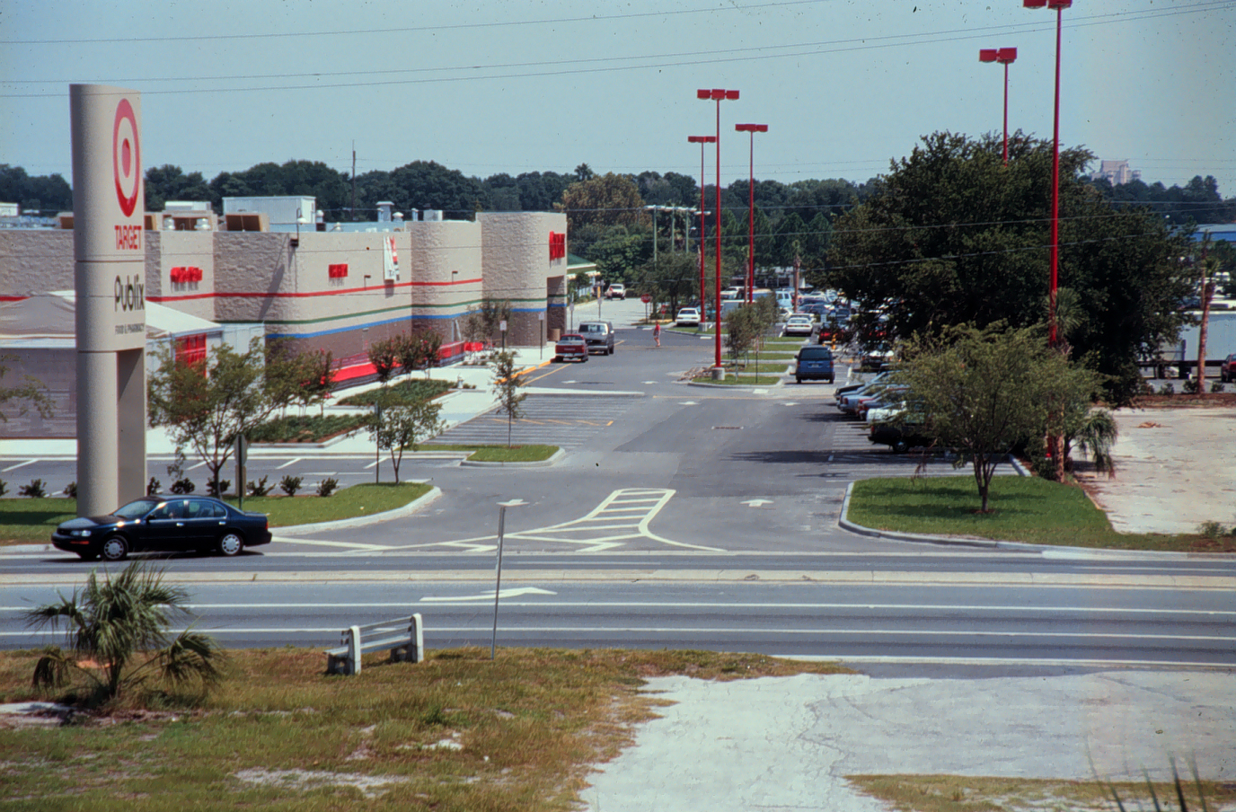
Joint Access
Property owners may agree to joint access
  For more turning movements
  To share a median opening
If the subdividing agency may condition approval on providing future joint access (state may condition access permit)
Property under common ownership or consolidated for development may be treated as one property for access review.
Notes:
Also, there may be situations where one imposes an access management plan, overlay zoning, or systemwide regulation that requires joint and cross access in certain areas or situations that grant enough authority based on a plan.
Local agencies have considerable authority to accomplish joint access in the context of a clear plan and implementation process.
Kostenborder v. City of Salem (Or. LUBA 440, 1993) - a municipal decision to condition a land division approval along a major arterial upon the consolidation of four access drives into a single drive furthered valid public purposes founded in the local comprehensive plan and land development code to “facilitate safety and traffic on the fronting arterial,” “minimize the adverse impacts of traffic on residential areas,” and “limit or control access wherever possible” along principal arterials.

Slide 17
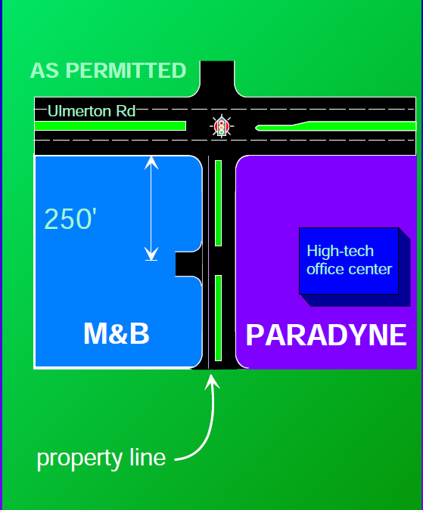
Paradyne Corp v. DOT
1981 access permit. One median opening was provided. Permit required joint access.
Paradyne agreed to joint access with M&B through company holding option to build shopping center
Option was dropped and Paradyne refused to deal with M&B owner.
As constructed, connection only provided access to Paradyne.
Source: FDOT“ Legal Considerations in Access Management”
Paradyne Corp v. DOT, 528 So 2d 921 (1st DCA) rev denied 536 So. 2d 244 (Fla. 1988)
Notes:
Authority to require Joint access is a bit more tenuous if one tries to implement it on a case-by-case basis or from the perspective of a state dot.

Slide 18

Paradyne Corp v. DOT
FDOT revoked Paradyne’s access permit and required a redesign.
Paradyne failed to submit the redesign – would be subject to redesign by FDOT to include 250’ drive for joint use with M&B.
Redesign required Paradyne to allow M&B to use Paradyne’s property.
Source: FDOT “Legal Considerations in Access Management”

Slide 19
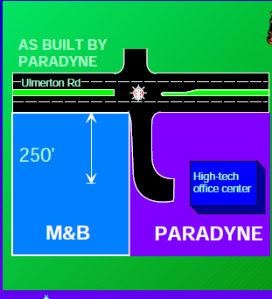
Paradyne Corp v. DOT
The DOT can ask for (but not force) joint access.
The DOT has the right to revoke the permit because the connection was not constructed as permitted
The DOT cannot make a property serve someone else unless in furtherance of a public purpose
The DOT does not have to permit access if it would not be safe.
Source: FDOT “Legal Considerations in Access Management”
Notes:
Many agencies have the express authority to alter or close a connection when they identify a potential safety or operational problem. The primary consideration must be the safe and efficient operation of the highway. (e.g., FDOT Racetrac Rule Challenge

Slide 20
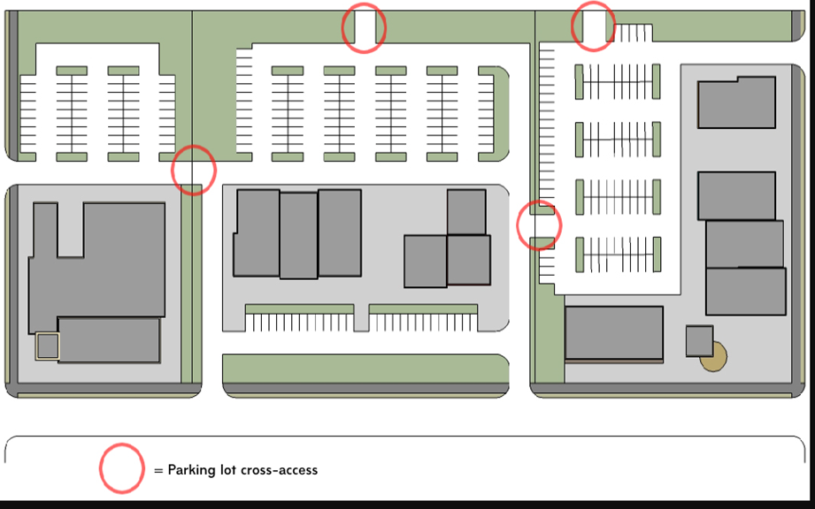
Parking Lot Cross Access
Development approval conditioned on the provision of interconnected parking lots and common access drives along a portion of an arterial:
  "is not inherently confiscatory. The burdened property is capable of a reasonable return and no evidence has been presented by the petitioners to contradict this conclusion."
Condition based solely on “vague concept plan” that failed to address how the requirements would be applied to individual properties.
  The court directed the town to prepare a clear implementation strategy.
- Holmes v. Planning Board of the Town of New Castle, (NY AD. 1980)

Slide 21
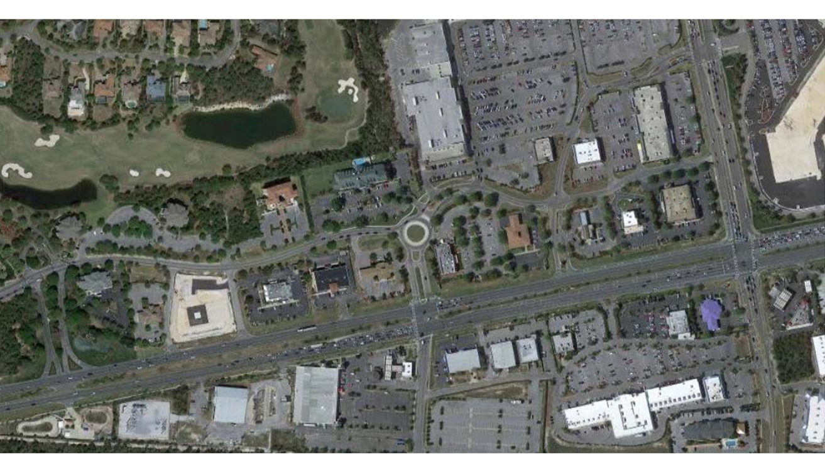
Access Mgt and ROW Dedication
Subdivision roads and site-related improvements
Thoroughfares
  Reasonably connected to need and benefits accrued
  Proportionate to the impact
  Compensation for additional ROW needs
Mitigation measures
Notes:
Agencies can and do require dedication of ROW as a condition of plat or site plan approval. Clear authority to require dedication of subdivision roads and site related improvements (differs from state to state – in Michigan state has to build turn lane where in Florida this is site related and must be provided by the developer).
For thoroughfares or other types of streets it’s a bit different
Per Dolan v. City of Tigard, US 1994 U.S. Supreme Court burden on government agency to demonstrate a “rough proportionality” between the impacts of the development and the nature and degree of the exactions. The exactions must be both proportional and reasonably connected (have a rational nexus) to the need for the transportation improvement to accommodate the increase in demand from the new development and the mobility benefits the development receives from providing the ROW or paying the fee.
Utah case - application of rough proportionality to right-of-way exactions. B.A.M. Dev., L.L.C. v. Salt Lake County, 2006 Utah Supreme Court. requires prospective developers to dedicate land to the county to improve abutting public streets in the context of a Transportation Master Plan. constitute a development exaction subject to the "rough proportionality" standard
There are a variety of mitigation measures that can be employed to make a property owner whole and the property owner/applicant must pursue a permit and allow the agency to provide relief before a case is ripe.
Many measure can be used to mitigate adverse impacts on property owners. Agencies can:
Compensate property owners as appropriate through impact fee credits, density transfers, cash, or combination of methods.
Modify alignments where appropriate
Provide a variance where necessary
Negotiated exactions - Market value of donations may be counted by state transportation agencies toward the local matching share on federal-aid projects; Dedication of ROW in advance of development can be credited against current year income

Slide 22
Murphy Auto Grp v. FDOT
Request for driveway connection permit
Required to dedicate 12 feet of frontage for drainage improvement
Murphy sued, asserting that the drainage improvements exacted by FDOT were not roughly proportional to the project's drainage impact
Court: FDOT required to determine essential nexus and rough proportionality between the exactions and effects of Murphy's development project
- Murphy Auto Grp., Inc. v. Fla. DOT, 310 So. 3d 1066, 2020
Notes:
Sometimes this comes up in the context of driveway permits. FDOT claimed that Nolan/Dolan did not apply as it was exercising its proprietary (not regulatory) power and claims for damages were barred by sovereign immunity. The 2nd District Court of Appeals of Florida disagreed stating “FDOT's position involved permitting decisions made in connection with its regulation of a landowner's right of access to the State Highway System. Thus, the trial court was required to apply the unconstitutional conditions doctrine to determine whether there was an essential nexus and rough proportionality between the monetary exactions and the effects of Murphy's development project.” The Court reversed and remanded this case.

Slide 23
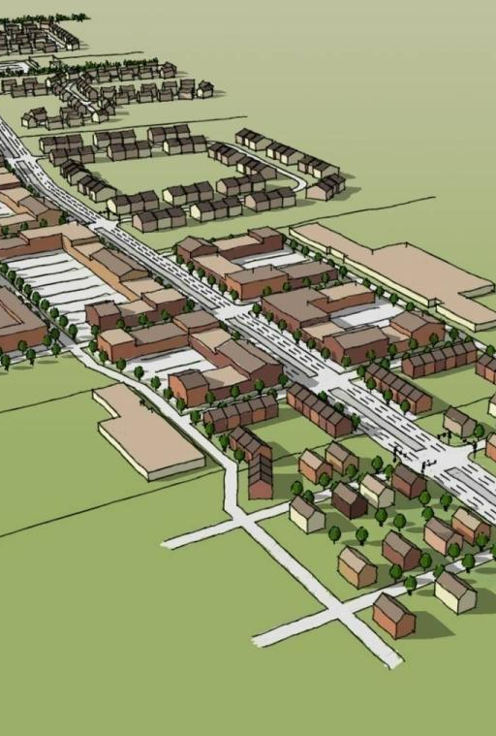
Access Roads
Florida county required Budget Inns to dedicate right-of-way for frontage road along arterial highway and build road in future as condition of building permit.
  Court: No present need or reasonably immediate future need for frontage road (fails to meet rational nexus test).
  County must show development impact on arterial requires present or reasonable immediate future need for frontage road.
- Hernando County v. Budget Inns of Florida, Inc., 555 So. 2d 1319 (Fla. 5th DCA 1990)
Notes:
In Budget Inns there wasn’t an adequate nexus to uphold a requirement involving dedication of ROW for a frontage road . Nonetheless, many service roads have been built along the highway. This one would have been in an area with no surrounding frontage roads.

Slide 24
Access Roads
An Ohio court upheld Planned Unit Development zoning that required installation of a shared rear access drive along a highway corridor on the basis that:
  "the ability to control all of the traffic serving the subject site and the 11 lots north of the site is greatly enhanced by the use of the access roads and the single traffic light...Such circuity of access and the resulting inconvenience is not a compensable taking."
-O' Neal, et al. vs. City of Sharonville, (1992 Ohio App)
Notes:
Improves access to the area and provides safe left turns at a signal. Joint and cross access case.

Slide 25
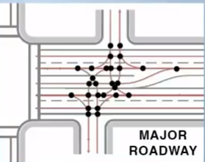
Tort Liability for Unsafe Access
Can we hold the property owner accountable?
Is the agency accountable?
Driveway owner’s exposure to liability differs from regulating agency
  “Every state’s common law says that if an owner knows about a dangerous condition they have a responsibility to fix it or may be held responsible for injuring someone.” E. Alvino
Agency immunity differs from state to state
  Agencies typically have immunity for issuing a permit that results in a dangerous condition on the permittee’s property (but no immunity for creating a dangerous condition in the ROW and not acting to correct it)
Unsafe condition
Source: E. Alvino, Jr. Esq. “Do Property Owners Assume Liabilities and Duties When They Have a Driveway?” Presentation, 2018 National Access Management Conference
Notes:
Recently there have been cases against owners and in some cases the agency permitting the driveway.
A driveway in a functional area of an intersection allowing lefts-in and out with no control measure to reduce conflicts is fundamentally dangerous. Personal injury attorney sued commercial owner for crash and motorcycle crash involving severe injury/death when truck turned left and hit motorcyclists.
(grandfathering driveways protected state from taking but does not protect owner from liability) (Tenants have even less protection than owners against the idea that agency is liable as the permit is issued to the owner and not tenant)
National sources and agency documents acknowledge that certain access configurations are dangerous.

Slide 26
Proof of Necessity
The burden of proof should be on the landowner to prove the necessity of any deviation from access management standards.

Slide 27
Standards versus guidelines
Clear rationale and procedures
Written records of decisions and discussions
Consistent decision-making, especially deviations from standards
State/local coordination and consistent standards
Training, public involvement, and effective communication
Improving Enforceability
Notes:
Reasonable consistency of standards (state and local) and good procedures for review of deviations with criteria that lead to consistent decisions goes a long way in strengthening and AM program. Safety decisions have the greatest likelihood of being upheld if challenged. Document specifics.

