Slide 1
Corridor Access Management Plans
Module 7

Slide 2
Learning Objectives
Identify existing corridor conditions and land use context.
Develop conceptual corridor access management and complete streets concepts.
Explain how to implement a corridor access management plan.

Slide 3
Corridor Evaluation

Slide 4
Why Prepare a Corridor Management Plan?
Proactive, coordinated planning for future development and access needs
Focus state and local government authority on achieving common AM objectives
  Guide for local capital improvements and street network planning
  Guide for future access and development permitting
  Guide to developers, improves compliance
Basis for agreements, helps define agency roles
Notes:
Corridor access management plans provide an opportunity to enhance current practice

Slide 5
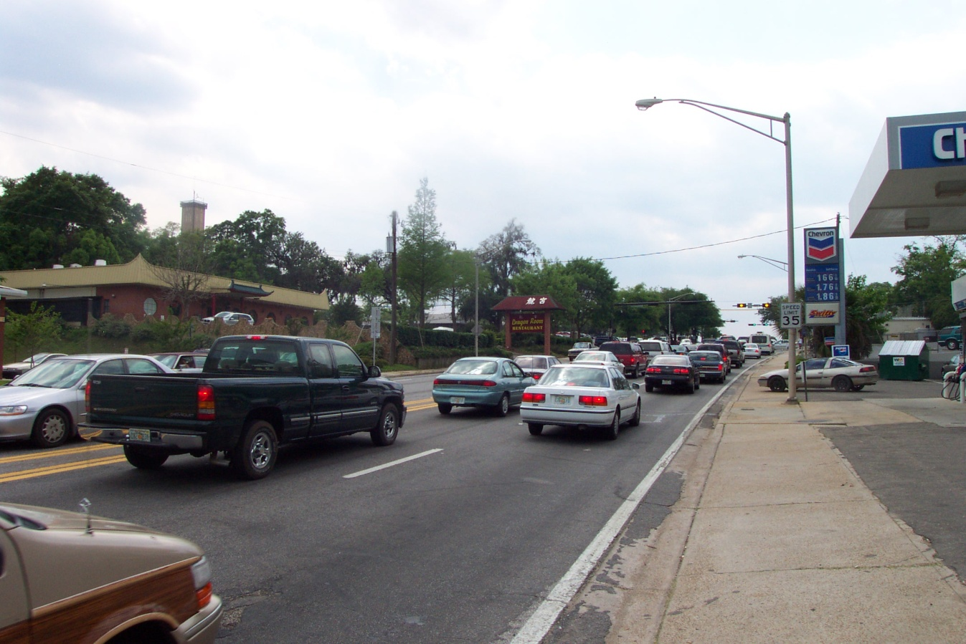
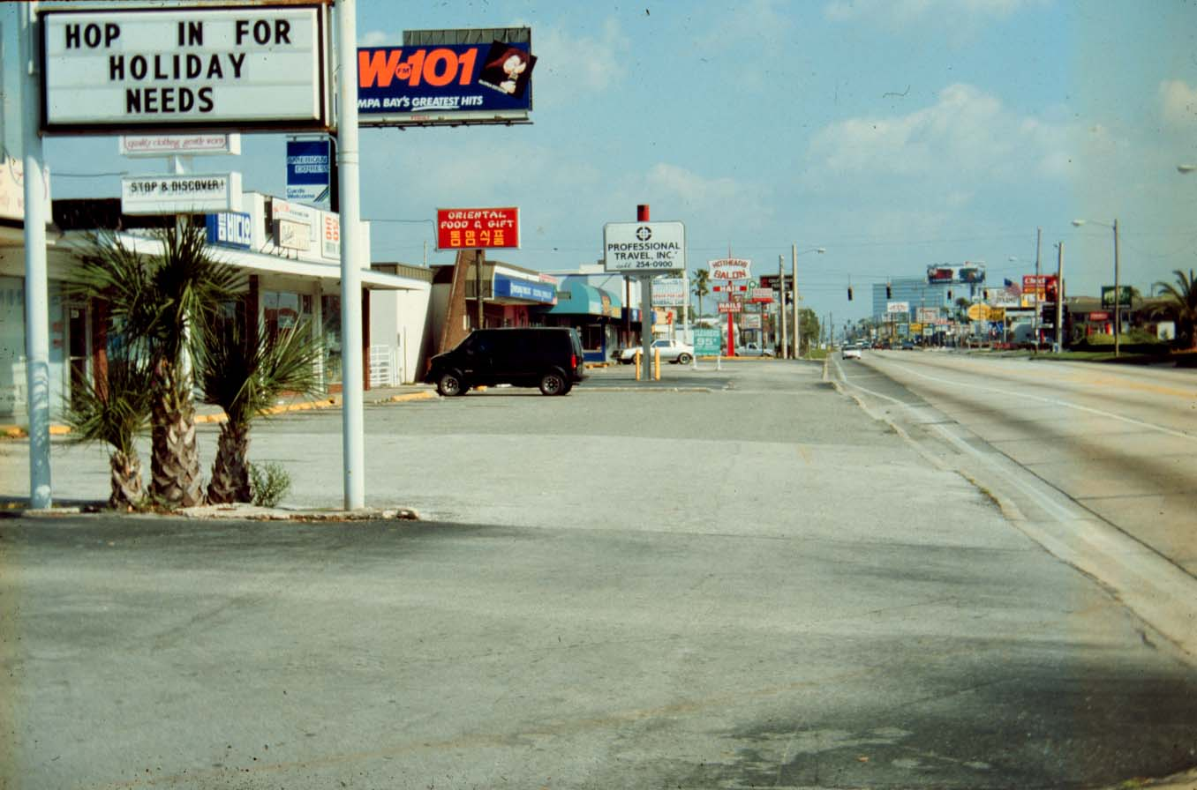
Typical Corridor Problems
Numerous, poorly designed driveways
Notes:
These are pictures from Tampa, Florida on Hillsborough Avenue illustrating typical corridor issues.

Slide 6
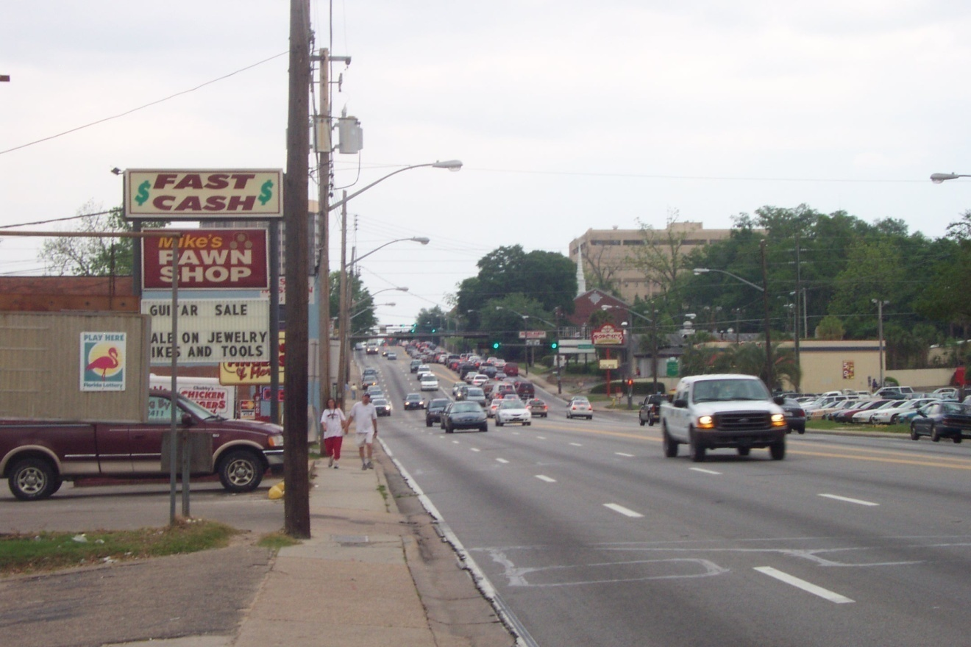
Typical Corridor Problems
Closely spaced signals and median openings
Notes:
These are pictures from Tampa, Florida on Hillsborough Avenue illustrating typical corridor issues.

Slide 7
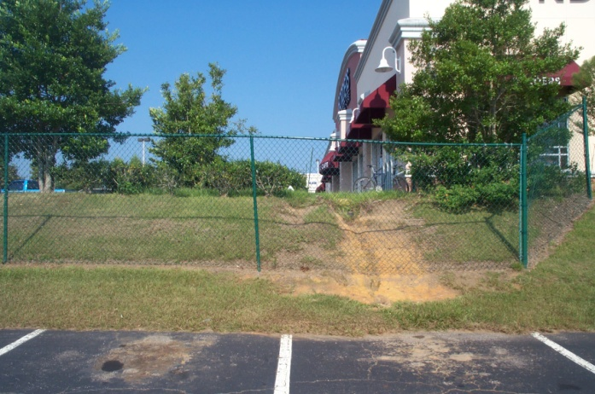
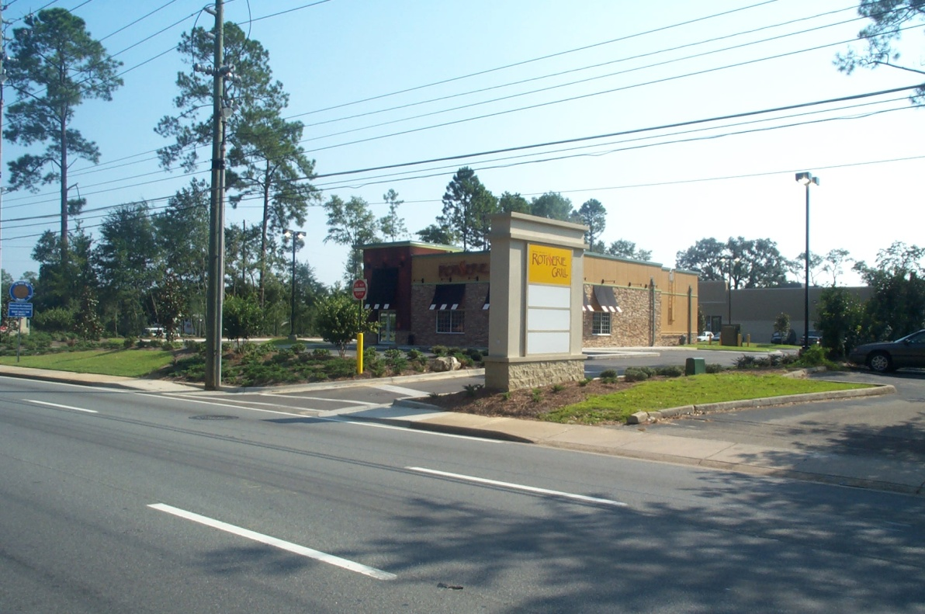
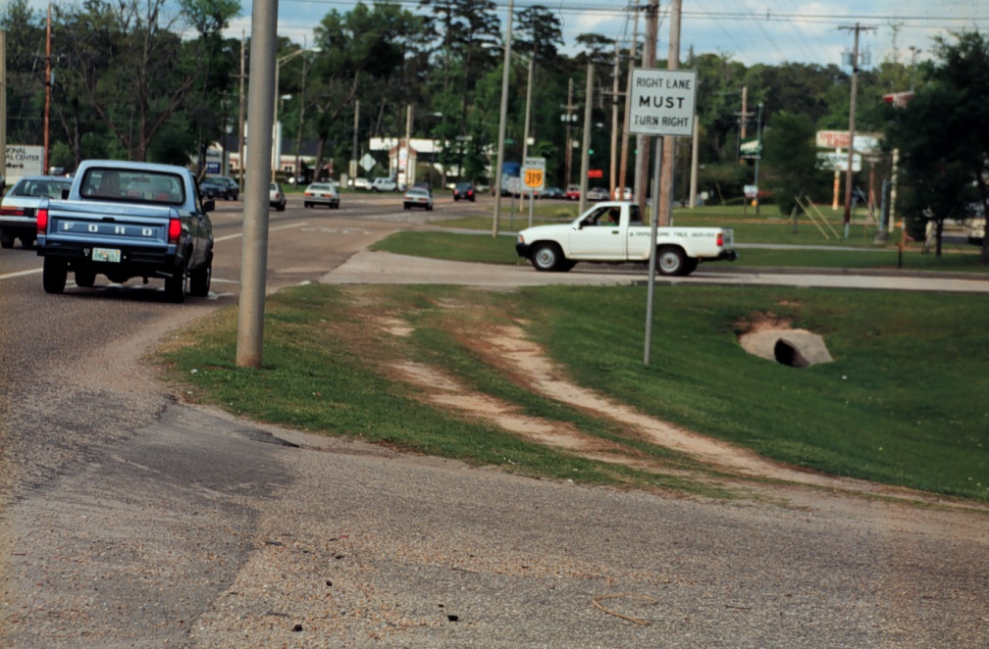
Typical Corridor Problems
Inadequate connections between land uses
Notes:
These are pictures from Tampa, Florida on Hillsborough Avenue illustrating typical corridor issues.

Slide 8
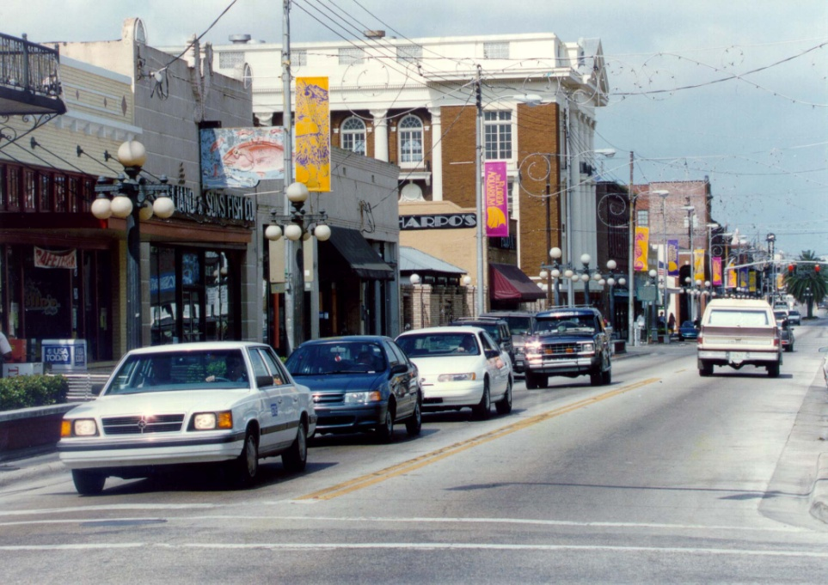
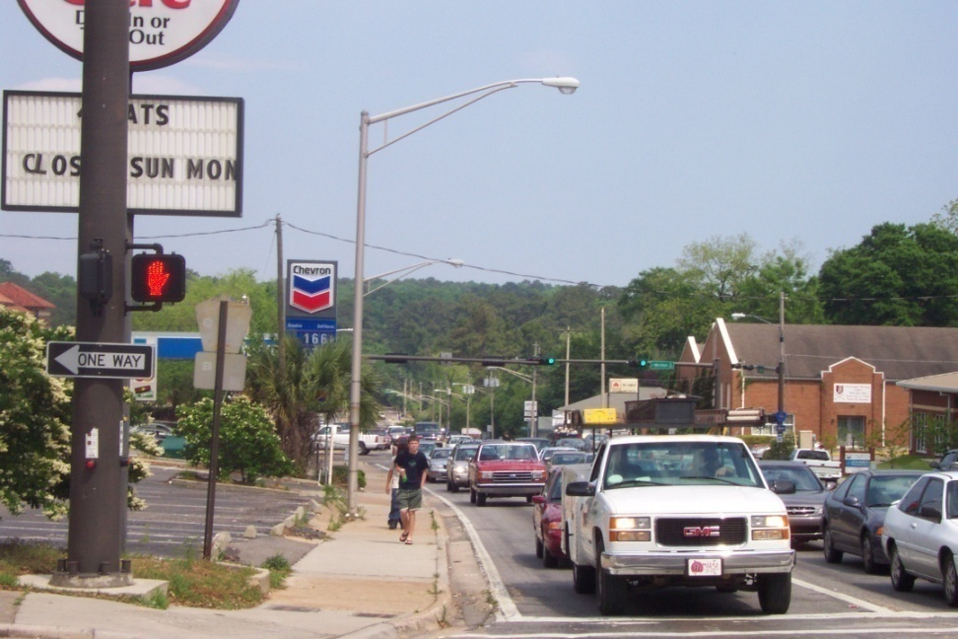
Typical Corridor Problems
Right-of-way constraints
Context issues (Main street vs suburban strip)
Notes:
These are pictures from Tampa, Florida on Hillsborough Avenue illustrating typical corridor issues.

Slide 9
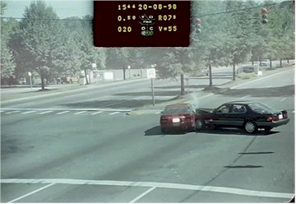
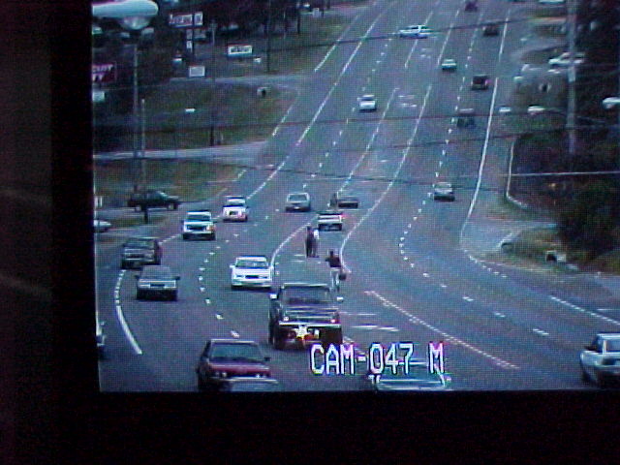
Typical Corridor Problems
Crashes, congestion, and poor aesthetics
Notes:
These are pictures from Tampa, Florida on Hillsborough Avenue illustrating typical corridor issues.

Slide 10
Getting Started – Data & Analysis
Traffic
Right-of-way
Land use/development
Site access and circulation
Policy
Notes:
Review the existing situation
Assess ROW constraints
Identify what you want the road to be
Determine how existing policies exacerbate the situation

Slide 11
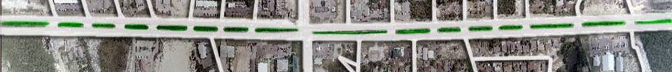
Key Components
Get “Lay of Land”
Collect Data
Analysis
Initial Recommendations
  Drive it
  Walk it
  Get photos
  Determine major intersections
  Determine major driveways
  Crash Data
  Traffic Counts
  Roadway Inventory
  Land Use
  Area Type
  Possible median closings/openings
  Signal locations
  Improved turn lanes
  Supporting network
Involve Businesses
Involve the Public
Notes:
ACCESS MANAGEMENT PLAN DEVELOPMENT
This section provides a detailed overview of the three component phases to be utilized for developing median opening locations.
Planning Phase
The components of this phase of plan development are illustrated in Figure 2. As shown in the process flow chart, the primary components of this phase are:
Determination of major cross streets and major driveway locations
Data requirements necessary for this phase of plan development
Analysis
Recommendations
Public Involvement
Note: This slide includes animation.

Slide 12
“Do I Really Need To See The Corridor?”
Field Reviews
  Existing/future signal locations
  Signal removals
  Median opening placement and type
  Design constraints – safety, queuing
  Local staff input
  Businesses/properties with special access needs
Yes!

Slide 13
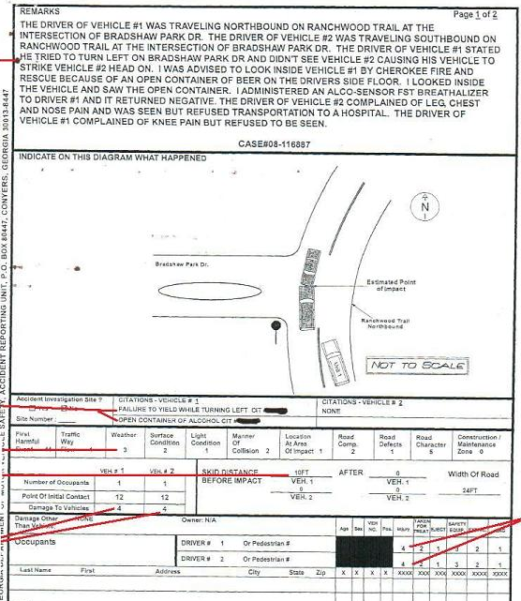
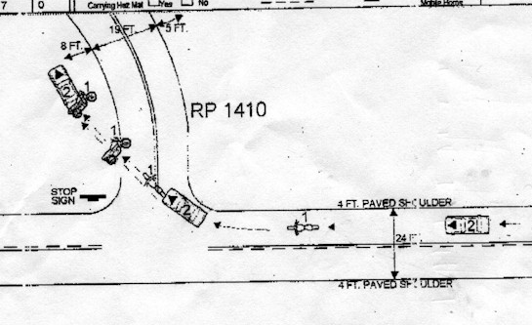
Use REAL
crash reports,
not simple safety factors for the corridor

Slide 14
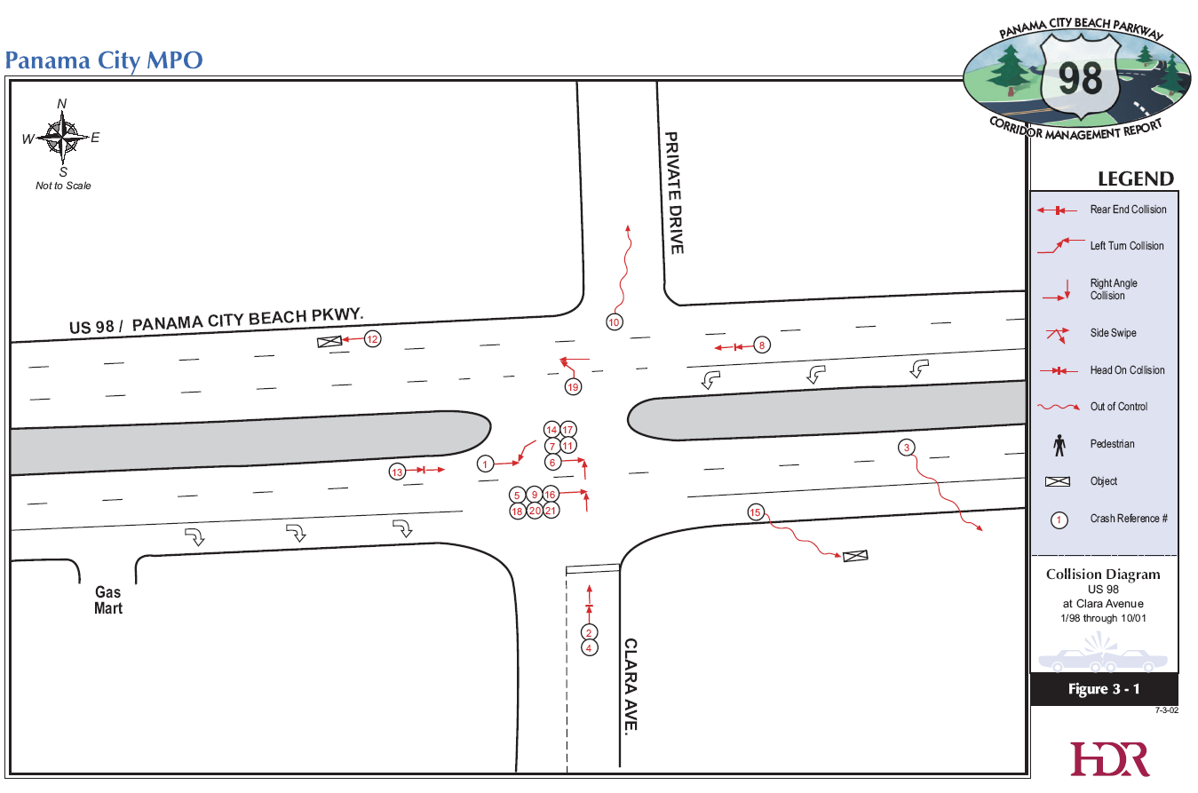
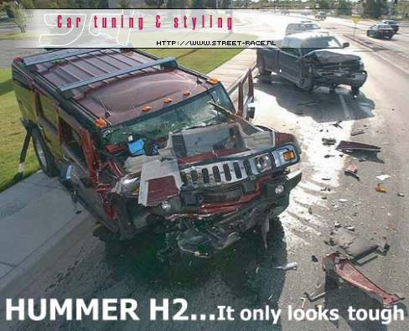
Crash Analysis
Notes:
Data Collection
Accident/Collision
Safety is the focal point in developing median opening strategies, therefore, in-depth analyses should be provided for any study type.
Based on the nature of the study, the following steps should be followed to analyze collision history:
1. All traffic accident reports for a minimum three-year period should be collected and summarized. The summaries should include a tabular listing of all accidents and include number of accidents, type of accident, number of injuries and fatalities, time and day of accident, contributing causes, lighting conditions, and weather. This may require research of short-form accidents from the FHP or local law enforcement agencies.
2. After collisions are summarized, the data should be plotted on collision diagram(s) of the entire roadway section and summarized in tabular format. The diagram should include enough information to indicate the type and location of the accident.
In the case of evaluating projects that have already been constructed for comparison to proposed projects, the following additional steps should occur:
1. The collision data for the period after construction should be collected, summarized, and plotted similarly to the before-construction data. This data will be used for comparison to the before data.
2. The "before" and "after" collision data must be converted to collisions per 100 million vehicle miles of travel or million entering vehicles to facilitate a meaningful comparison. The level of improvement can then be expressed in terms of property damage, injury, and fatality rate improvements.

Slide 15
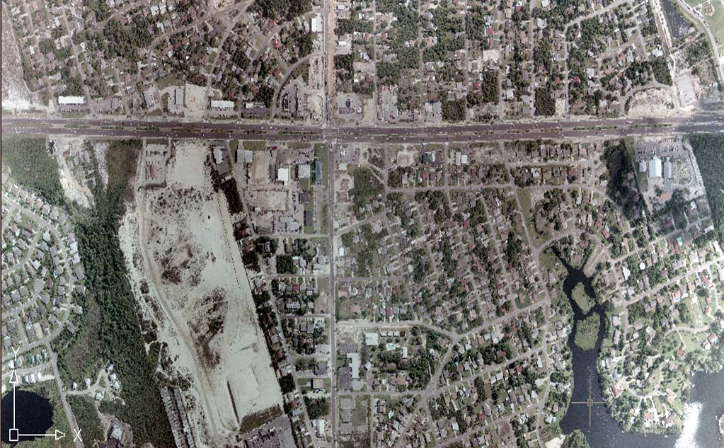
Land Use Information
Property roles from US98
PROPERTY LINES
Notes:
Land use data provides important information regarding the roadway’s function and context. Land use data collection can also extend to abutting areas that are serviced by the roadway under evaluation, thus the extent to which the area’s land use is inventoried should be determined early on within the study process.
Land uses along the corridor specifically can be inventoried in great detail by identifying:
Property Access
Signage
Internal Access and Circulation
Property Tax Parcel Id. No.?
Exact Business Type
Years in Operation?
Parking Facilities
Loading/Unloading Areas
Delivery Types and Frequencies
Vacant Parcels or Buildings
Parcels or Business for Sale?
Assessed property value history for a two to three-year period could also be obtained from the local tax collector’s office. Since much of this information is collected for other purposes as well, the additional effort required may be less than anticipated.
Land use information not directly adjacent to the corridor but served by it:
Residential areas (large sub-divisions) or large employment centers
Schools, Hospitals, and emergency facilities within a 2-mile radius
School boundaries encompassing the study area
Other government facilities such as parks, libraries, and other services
Other special facilities such as stadiums, civic or community centers
in the general area
All information should be summarized graphically. The magnitude of the information is again dependent upon the scope of each specific project but this information should be considered for all projects. It is noted that the majority of this information is collected and included in transportation project development.

Slide 16
Corridor Access Management and Complete Streets Concepts

Slide 17
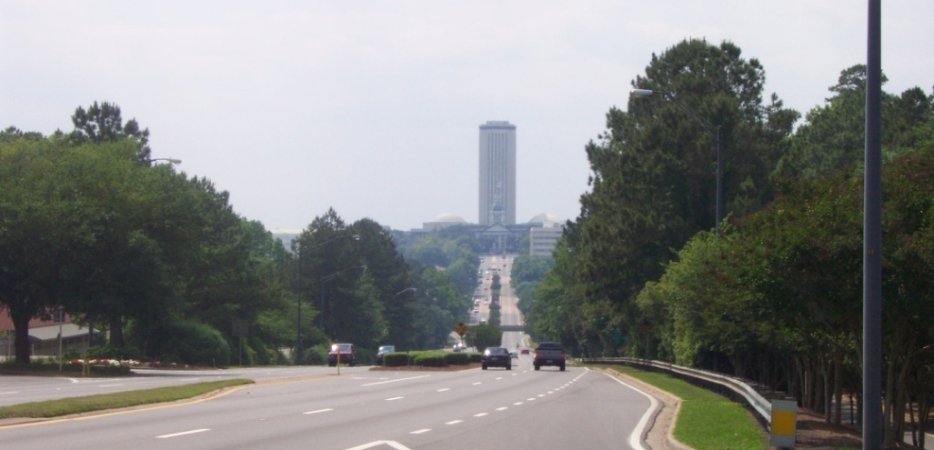
Typical Corridor Plan Objectives
Improve the safety and efficiency of the primary roadway(s) for all roadway users.
Notes:
Corridor management initiatives are as diverse as the areas involved and focus on any issues deemed important by the lead agencies.
ROW preservation is of growing interest and continues to be a challenge as agencies struggle to find to avoid development in the path of planned facilities that may be years away from construction.
Addressing access problems and establishing an effective access management plan. Also, traffic impact assessment and developer mitigation strategies.
Gated communities and poor depth and connectivity of streets and site circulation increase demand on major roadways for short local trips. Oregon’s corridor planning program is attempting to address this by pushing communities to increase the depth and connectivity of their streets.
Promote alternative modes of transportation through both transportation and community design measures.

Slide 18
Typical Corridor Plan Objectives
Promote a good supporting network of street, sidewalk, and site circulation systems
Provide multimodal opportunities
Sidewalk Cut-thru
Cul-de-sac
Transit stop
Notes:
Considering current and projected future traffic demand. Buildout analysis, site-generated trips, simulation, and analysis to assess impact on operations. Reconsideration of existing zoning, land use plans, etc.
Corridor beautification.
Economic development
Retrofitting older developed areas with improved access and circulation systems, landscaping, main street improvements, etc.

Slide 19
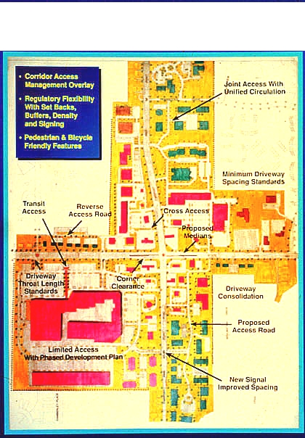
Typical Corridor Plan Objectives
Achieve the appropriate type and intensity of development for the corridor (economic vitality)
Preserve or enhance the appearance of corridors or entryways into communities

Slide 20

Typical Corridor Plan Objectives
Promote economic development and revitalize existing businesses
Fix problems in older developed areas

Slide 21
Developing the Corridor Plan
Right-of-way and complete streets cross-section(s)
Supporting street networks and site access and circulation system

Slide 22
Developing the Corridor Plan
Signal locations
Medians and median opening locations
Access spacing
Driveways and site circulation design
SPACING

Slide 23
Corridor Management Concepts
½ Mile
City blocks & connected streets create walkable places, transit destinations
Discontinuity & on-street parking on local streets reduce through traffic
Pedestrian cut-throughs on longer blocks or connecting to transit stops support non-motorized travel
Cross Road
Cross Road
Minor Arterial
Minor Collector
Service road
Major Arterial Roadway
500’
Bus stop
Ped cut-through
1000’
½ Mile +/-
Parallel Collector
The highway has a secondary road network
Network replaces driveway access to major arterial
Side street intersections are separated from the highway based on traffic.
“Place”
Parallel Reliever
Graphic concept courtesy of Gresham, Smith, and Partners, as adapted
Notes:
These corridor management concepts for major arterial roadways help maintain local and regional mobility. Connectivity is maintained while discouraging the use of local streets by through traffic through jogs or discontinuity, on-street parking, traffic calming measures, and bike/ped cut-throughs. The higher the density the closer the street spacing. Arterial 4-lane divided roadways will handle 3000 persons per square mile gross density. Minor arterials/major collectors ½ mile between them. Residential Arterial 6 lane 4500 persons per square mile with 1-mile spacing of arterials (six lanes). Beyond that arterials must be closer together. 2 six-lane arterials intersecting need to be grade-separated to avoid lengthy delays. For rural areas on the US land survey, you’ll have roads at 1-mile intervals. Some of these roads in the US are field drives and don’t exist. Rural areas won’t need many roads and don’t need parallel systems. Residential is based on lot depth.

Slide 24
Developing the Corridor Plan
Agency roles & responsibilities
Funding and time horizons
Cooperative Agreements

Slide 25
Implementation of Corridor Access Management Plans

Slide 26

Cooperative Agreements
Cooperation between internal divisions, government entities (and often private entities) is necessary to accomplish access management.
Documents
Resolutions
Memoranda of Understanding or Agreement
Intergovernmental Agreements
Partnering
Combination
Notes:
This cooperation may take any number of forms:
Resolutions - an expression of opinion or will of a governing body at a particular point in time; subject to change as members of the elected body change.
MOUs go a step further, signal the intent of the signatories to act, and this is where agencies may begin to define their roles and responsibilities in achieving a mutual set of objectives.
Intergovernmental agreements require more formal cooperation, essentially legal contracts between agencies, and work best when responsibilities, financial obligations, and procedures are clearly defined (e.g., maintenance agreements).
Partnering in planning or implementation,
Many agencies use a combination. It is not uncommon for a cooperative process to begin with a resolution whereby agencies establish a common understanding of the importance of a highway to regional mobility and the need to manage it. From there, they may enter a joint planning process and, finally, a more formalized agreement that establishes mutual commitments, agency roles, and specific standards or guidelines through reference to an adopted plan that each agrees to adopt and enforce.

Slide 27
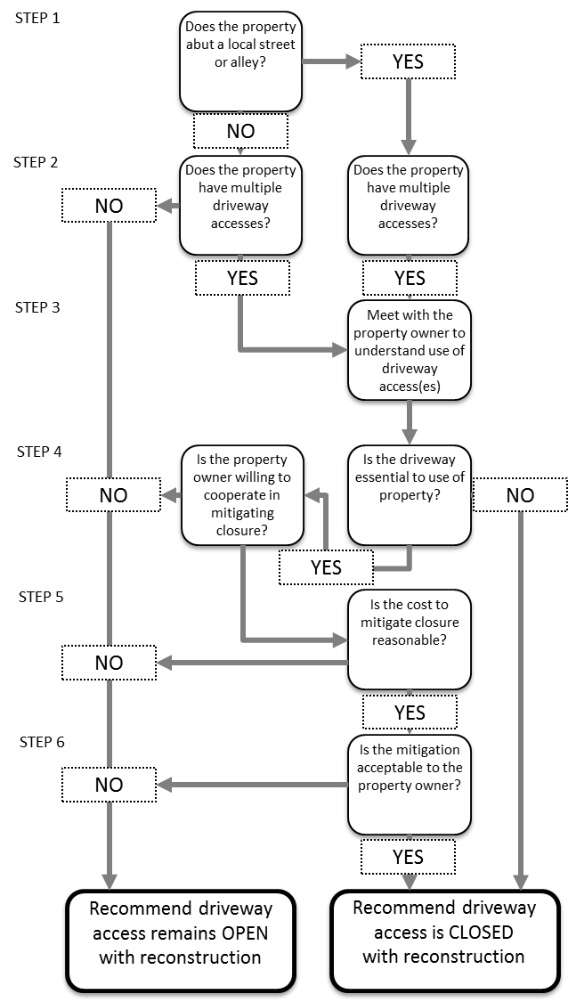
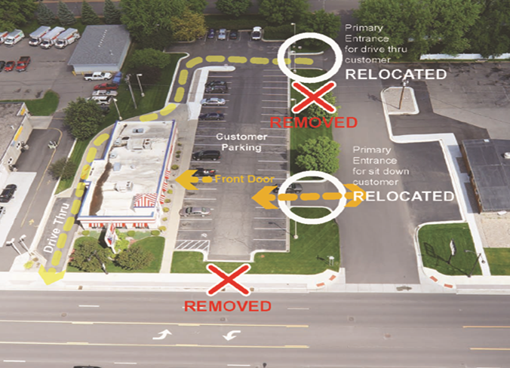
Negotiate driveway closures
Example: County Hwy 101, Scott County, MN
  41 entrances
  26 identified for closure
  voluntary agreements to close 20
Credits: Chris Chromy and M. Rasmussen
Notes:
Negotiate driveway closures during reconstruction. This decision tree provides a logical sequence for this purpose and can be used in the context of a roadway reconstruction project, sidewalk project, or resurfacings.

Slide 28
Plan Implementation
Adopted plan sometimes supersedes access management standards
Appropriate changes in policy, including local land development regulations
Funding for short-range improvements
Strategies for full implementation

Slide 29
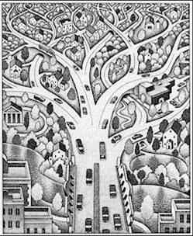
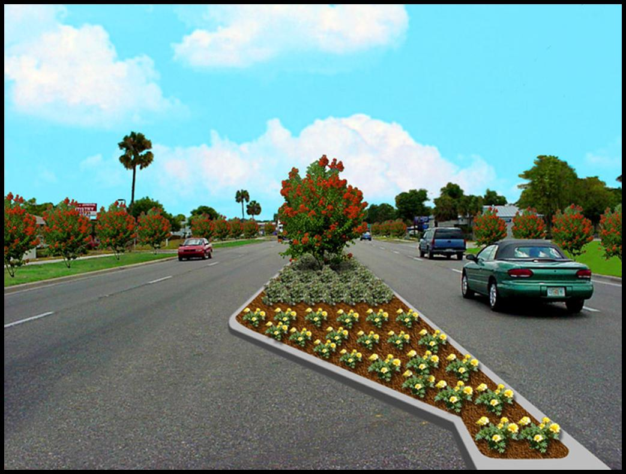
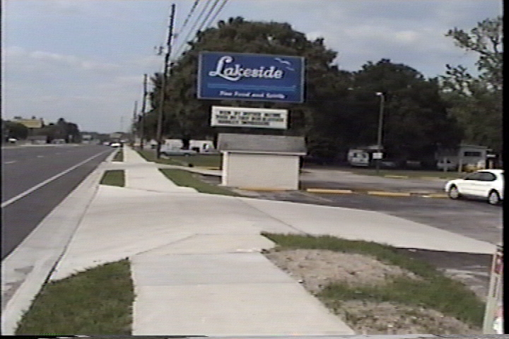
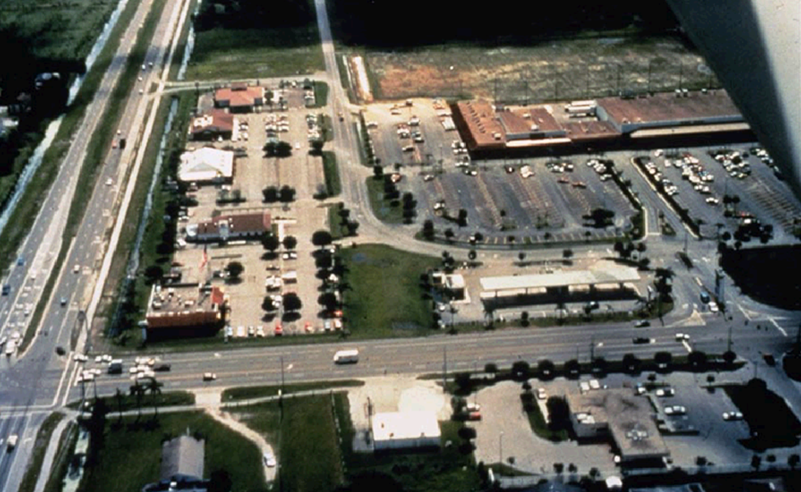
All decisions are made in context
MOBILITY
MEDIANS
Multimodal
Safety
Attractive Corridor
Safety Concerns
Property Rights
Economic Opportunity
Accessibility
Pedestrian
vs. Truck
DRIVEWAYS
ACCESS
The key is facing trade-offs
Notes:
Examples of trade-offs:
Multimodal access and safety vs. vehicular through movement
U-turns vs. direct left turns
Driveways in the right turn lane
Directional median opening vs. no left turn for a major development with no alternative access
Left turn queue not long enough for projected volumes
Attractive corridor landscaping vs. sight distance
State DOT vs. local government responsibility for maintaining landscaping
Driveway width and grade issues slow vehicles, and provides a better environment for pedestrians
Policy makers may push one of these issues more than the others

Slide 30
Corridor Evaluation Exercise
Notes:
Note: The slides for this exercise include animations to show responses.

Slide 31
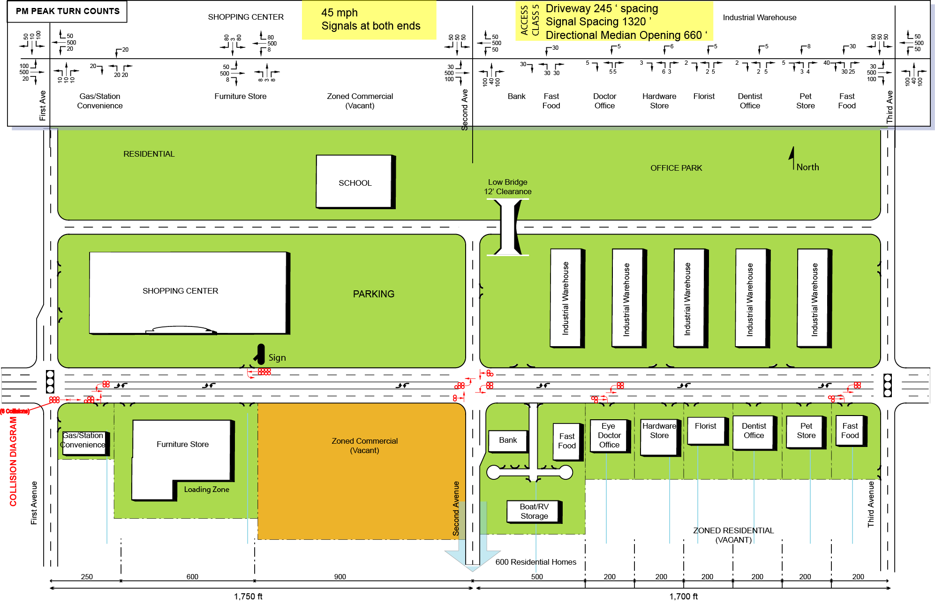
Example 1 Corridor Evaluation Exercise
PM PEAK TURN COUNTS
Notes:
Take a look at the study area on the slide
Your instructor will show you a series of slides with a magnified view of different parts of the study area.
Identify the problems and opportunities in each part of the study area.
Discuss your findings with the class.
The instructor will show the answers on the slides.

Slide 32
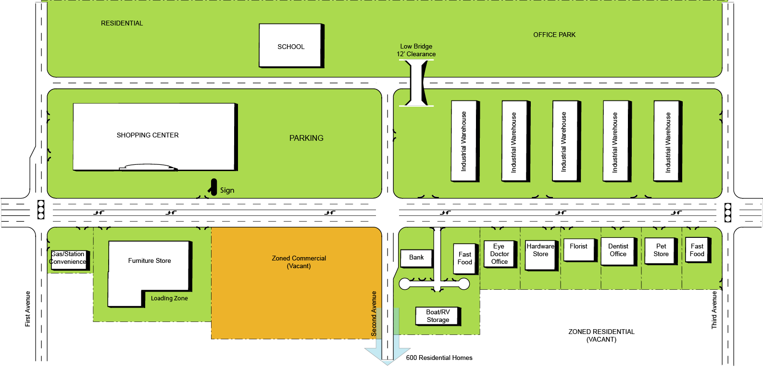
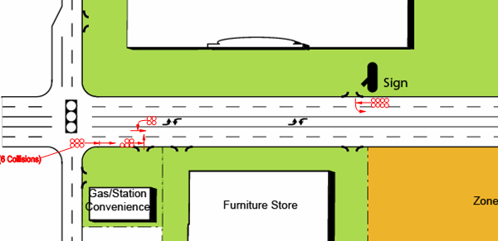
Collision Diagrams
Notes:
Take a look at the study area on the slide
Your instructor will show you a series of slides with a magnified view of different parts of the study area.
Identify the problems and opportunities in each part of the study area.
Discuss your findings with the class.
The instructor will show the answers on the slides.

Slide 33
Example 1
Take a few minutes and see how many problems
and opportunities you can find
Notes:
Take a look at the study area on the slide
The next few slides includes a series of slides with a magnified view of different parts of the study area.
Identify the problems and opportunities in each part of the study area.
Discuss your findings with the class.
The instructor will show the answers on the slides.

Slide 34
Answers 1
Notes:
Note: This slide includes animation to show the problems and opportunities in the study area.

Slide 35
Answers 1
Notes:
Note: This slide includes animation to show the problems and opportunities in the study area.

Slide 36
Answers 3
Notes:
Note: This slide includes animation to show the problems and opportunities in the study area.

Slide 37
Answers 1
Notes:
Note: This slide includes animation to show the problems and opportunities in the study area.

