Slide 1
Access Management Policy and Process
Module 6

Slide 2
Learning Objectives
List the components of systemwide access management regulations.
Explain the driveway permitting process.
Evaluate the adequacy of state and local access management programs.

Slide 3
Systemwide Programs – Key Points
The value of access management is best achieved when it is systematically applied to the transportation system through a comprehensive program of policies, procedures, and standards.
Some states, MPOs, and local agencies apply access management mainly on a corridor-by-corridor basis rather than systemwide. This is effective for the given corridor.
A majority of states and many local agencies practice some form of access management, but often, these standards and criteria have not been updated in many years.

Slide 4
Elements of a Comprehensive, Systemwide Access Management Program
An access classification system that builds upon functional classification and land use context
Permitted levels of access for each access class
Signalized and unsignalized access spacing
Means of enforcing policies and standards (e.g., permitting and review and approval process)
Provisions for variances and waivers

Slide 5
Need for Consistent AND Flexible Enforcement
Adopt clear written standards, rather than guidelines
Establish procedures and criteria for deviations from standards and appeals
Establish a Review Committee process to decide on major deviations (e.g., DRC, AMC)
Provide frequent staff training and/or communication opportunities

Slide 6
Corridor Programs
Corridor access management plans and projects address the unique needs of a roadway corridor or interchange area.
Bypasses are a costly solution to congested highways. Access management and land use controls (zoning, subdivision regulations) are needed to preserve this investment.
Notes:
Corridor access management plans are addressed in Module 7 of the Access Management Curriculum.

Slide 7
Access Classification Systems & Standards

Slide 8
Elements of Effective AM Programs: Access Categories & Standards
Access management categories based on function and land use context
Purpose and criteria for each access category
Standards for each category including:
signal spacing, unsignalized spacing, auxiliary lanes, medians
Assignment of a category to each roadway segment
Procedure for change in the category
Notes:
As in the first edition, the second edition of the Access Management Manual includes chapters on elements of effective state, local and regional programs, although more discussion of regional programs is provided by moving this into its own chapter. Here we see the core elements of effective programs from the state and local perspective. Regional agencies play different roles and extensive discussion of success factors and strategies (e.g., integrating AM policies into LRTP, AM criteria in project prioritization, etc.)
Suggestion:
Ask students to identify and discuss the effective elements of an Access Management program.

Slide 9
Example State Highway System Access Classification Framework
Notes:
Creating a state program with access management categories is long range planning policy in action.
Its an alignment with functional classifications and existing conditions with a vision of achieving long term functions identified here
This example is an 8-tier system.
Residential and other very local streets can be added for municipal access categories.

Slide 10
Example Access Category Application

Slide 11
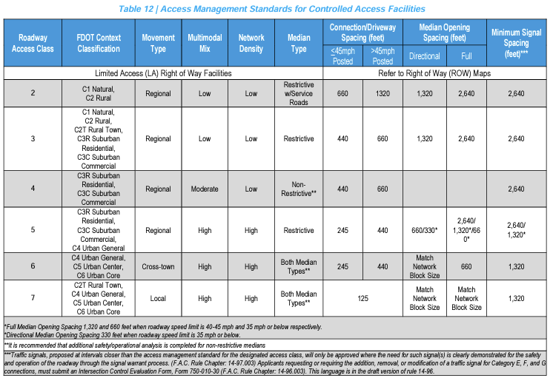
FDOT Access Classes
Florida DOT added Context Zones as a factor in access management
Source: Florida DOT, Multimodal Access Management Guidebook (2019)
https://fdotwww.blob.core.windows.net/sitefinity/docs/default-source/planning/systems/systems-management/document-repository/access-management/fdot-multimodal-access-management-guidebook_oct2023.pdf?sfvrsn=95abdf85_1
Notes:
Systemwide access management programs often include access classifications that are assigned to roadways to apply a set of spacing and design standards (driveways, medians, signals). More recently, FDOT added context class as well. As with zoning classifications that assign standards to land, these systems are regulatory and intended to prevent access problems. They are a supplement but not a replacement for good thoroughfare planning. A key coordination strategy is to enact requirements that are consistent with those of the state on the state highway system and coordinate with DOT on permitting access and development.

Slide 12
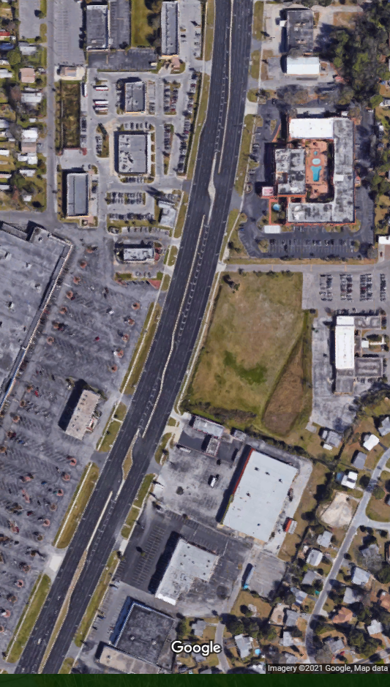
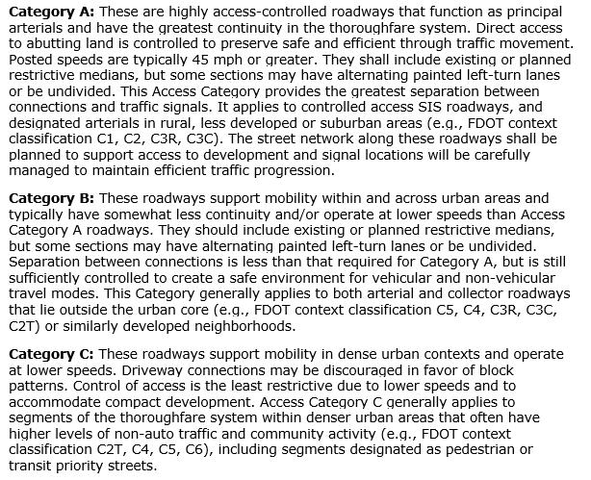
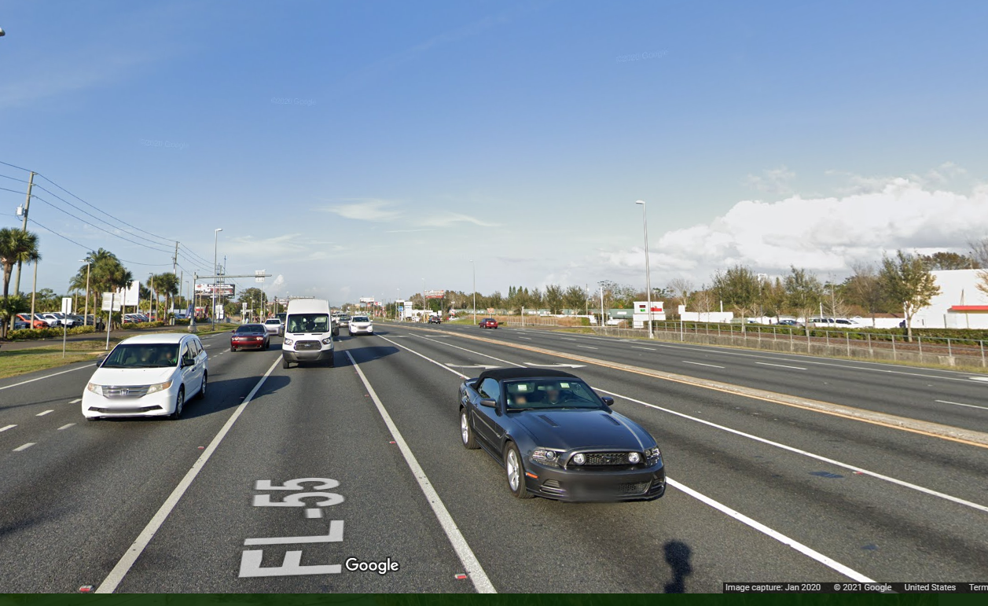
Florida Model Regulations, 2nd ed
Example descriptions for local thoroughfare plans
Notes:
This example from the Florida model access management regulations for local agencies takes this concept to the local throughfare plan. The descriptions address function, modal priority, and context – this description relates to principal arterials intended for the highest level of access control.

Slide 13
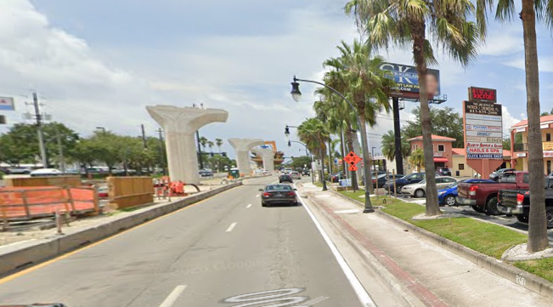
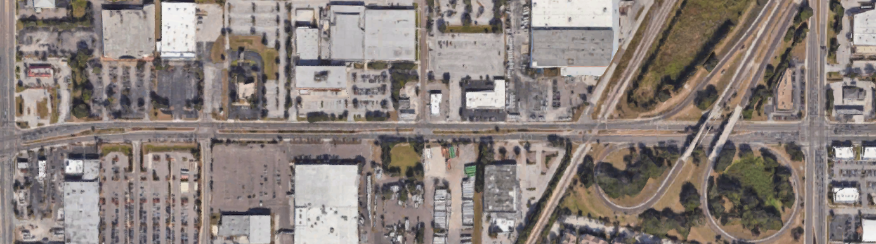
Florida Model Regulations, 2nd ed
Notes:
This relates to roadways that offer mobility within and across urban areas. Somewhat less continuous.

Slide 14
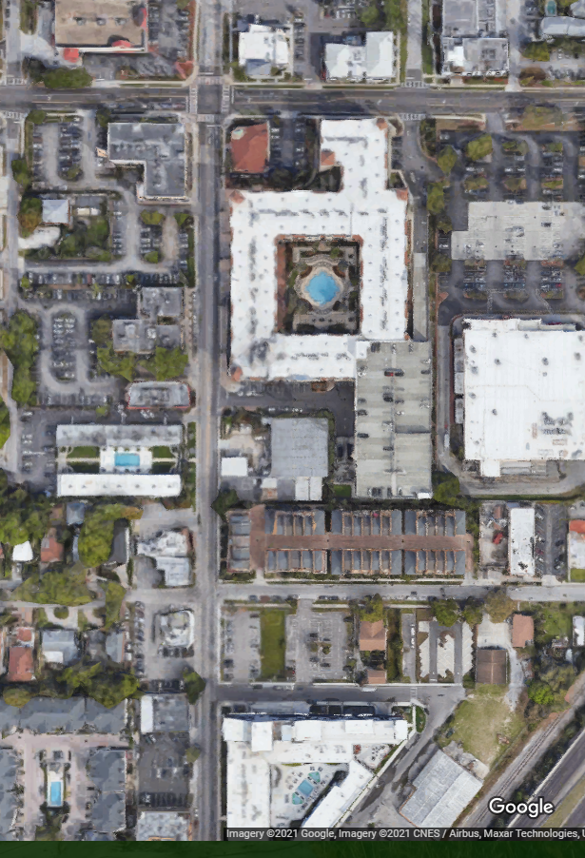
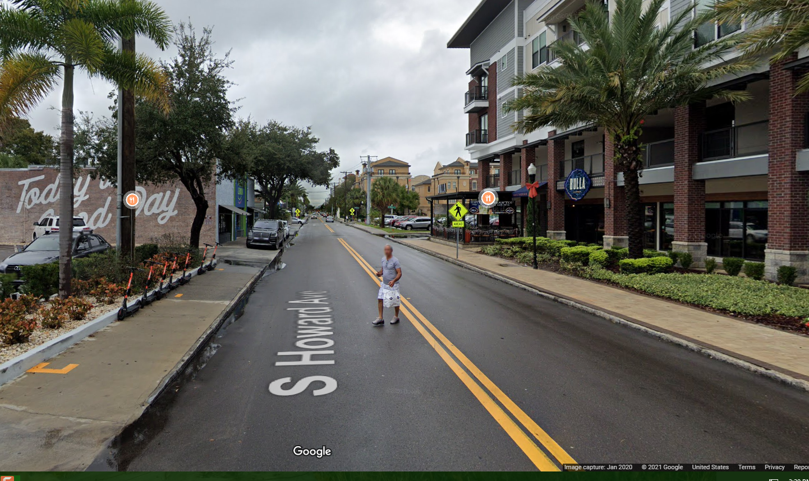
Florida Model Regulations, 2nd ed
Notes:
Here are roads in dense urban contexts, that may also include pedestrian or transit priority streets.

Slide 15
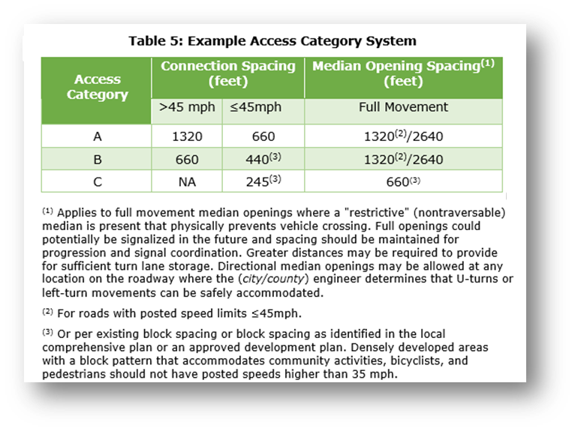
Florida Model Regulations
Example access category system and standards
Important Footnote
Notes:
Taking the FDOT access management criteria and applying it to these broader categories you get a chart like this. The posted speed moderates the distance and is a proxy for level of urbanization. In regulations, a lot of the good stuff is in the footnotes like here where it defers to city block spacing as the key guiding factor for access management, and discourages speeds greater than 35 mph.
Knowledge Probe Question #1
How do agencies handle existing developed areas that do not meet access management standards?
Answer: Existing developed areas are “grandfathered” and allowed to continue. However, new development and redevelopment must comply with the new access management standards to the extent feasible. This is similar to how development is handled in zoning when new regulations are adopted.

Slide 16
Land Development Regulations

Slide 17

How can local governments institute access management?
Comprehensive plans
Transportation plans & improvement programs
Corridor access management plans
Subarea or district plans
Land development and subdivision regulations
Roadway design
Site plan review
Traffic impact studies and developer mitigation
Internal & intergovernmental coordination
Notes:
So how can local governments effectively manage corridor development and access, and what are some of the best practices? Although states are rather limited in terms of the reach of their access management programs, the ability of local governments to influence how access is managed is broad reaching, addressing both land use and transportation.
The strategies we’ll be exploring in this webinar will help you to assess and update plans, policies, regulations and design standards to strengthen access management. Because access management crosses disciplines and agencies, it is also essential to Coordinate early and often with other divisions and agencies on AM opportunities in the planning and development process

Slide 18
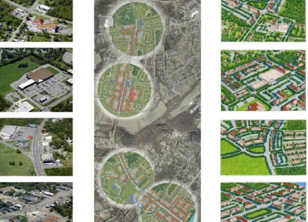
Access Management Comprehensive Plans
Access
Mobility
Vision
Goals, objectives, and policies
Land use plan
Transportation plan
Capital improvements
Source: Bluegrass Corridor Management Planning Handbook, 2000
Notes:
So how do plan for access comprehensively, that is, within the context of the community’s overall comprehensive plan and planning activities? We can begin by considering the vision of future growth and development and how this is integrated throughout the policies and various elements of the plan, including the CIP.

Slide 19
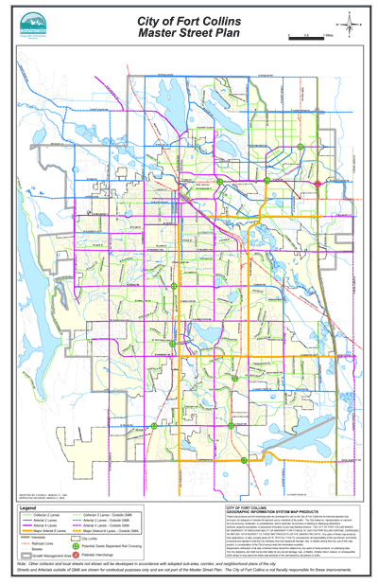
Roadway Network Planning Master Street or Thoroughfare Plans
Functional classification and layered networks
Signalized and unsignalized access spacing
Turn lanes and medians
Right-of-way needs and preservation
Improvement priorities and funding strategies
Source: City of Ft. Collins
Notes:
One way to establish an access management program is to prepare and adopt a master street or thoroughfare plan, as in this example from the City of Ft Collins. Here you can classify the network by function. Then you can define alternative cross sections, and appropriate spacing criteria, design elements like turn lanes and medians, and use that information to define ROW needs and set up a ROW preservation plan to lay the groundwork for future improvements. One way to refine the plan is to add layers that identify special segments of the network where you will emphasize specific issues such as express transit service, freight, and areas where you want to give bicycles and pedestrians more priority.

Slide 20
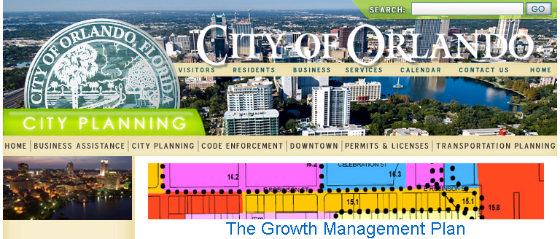
Access Management Policies in Plans
Policy 1.5.2 The City shall preserve the movement function of the major thoroughfare system by requiring development of parallel roads or cross access easements to connect developments as they are permitted along major roadways.
Notes:
Policies supporting access management should also be included the comprehensive plan or thoroughfare plan, like this one from Orlando stating the City’s commitment to preserving its thoroughfares by requiring development of parallel roads or cross access easements connecting developments along these roads.

Slide 21
Land Development Regulations
Allow smaller lots if access is internalized on a street network.
Local St.
660' minimum
660' minimum
Arterial
50'
50'
80'
60'
80'
60'
(property lines)
Stop the division of highway frontage into small lots
Notes:
Many different land development regulations can help implement access management. For example, minimum lot frontage in zoning can be used to discourage the division of highway frontage into small lots. Could tie these criteria to a desired spacing standard, while allowing smaller lots if an internal road network is provided. Lot split regulations can also be adopted to prevent the division of highway frontage into small lots. Module 3 Laned Development and Access reviews some of the more effective regulatory strategies.
Knowledge Probe Question #2
If you must permit access near a signalized intersection, what can you do to reduce the potential safety and operational impacts?
Answer: It is not uncommon for existing development patterns to preclude the ability to achieve corner clearance requirements. Options include:
Conditions in permit to restrict volumes of site
Median to restrict to right in/out only
Move access to edge of property
Share access with adjacent site
Note: This slide include animations.

Slide 22
Driveway Permitting

Slide 23
Access Management Regulations: Driveway Permitting
Application requirements
Fees
Review and processing of an application
Approval authority
Appeals when an application is denied

Slide 24
Access Management Regulations: Driveway Permitting (Cont’d)
Change in use
Non-conforming connections
Unpermitted (illegal) connections
Construction and maintenance
Delegation of authority

Slide 25
Access Management Regulations: Driveway Permitting (Cont’d)
Criteria for deviations
Processing and approval authority
Appeals when a requested deviation is denied

Slide 26
Driveway Permitting Considerations
Allow some variation from spacing standards at an administrative level
Distinguish between major and minor deviations from spacing standards
Increased review for major deviations
Include permit conditions
Type and volume of traffic
Temporary access until alternative access is obtained
Notes:
Establish clear sequence of actions for handling nonconforming situations

Slide 27
Improving Access During Redevelopment or Change in Use
Addresses when existing nonconforming access must be improved, such as:
When new driveway permits are requested
Substantial enlargements or improvements
Significant change in trip generation
If use is discontinued
Needs to be clearly defined

Slide 28

Other Driveway Permitting Best Practices
Specifying terms and conditions
for use and construction
provision of cross access
Expiration or revocation criteria
volume is exceeded
type of vehicle changes
alternative access becomes available
Interface with development permit
Certificate of occupancy
Building permit
Notes:
Best practices include:
Terms & conditions/ expiration or revocation criteria: In Colorado, for example, access permits are issued for the intended use of the access according to volume and vehicle type. An access must be upgraded to current standards when a change in the use of the property increases access volume above a certain percentage, as stated in the terms and conditions of the access permit. Site redevelopment that results in a change in the type or nature of access operation based on defined criteria is also subject to new driveway permit requirements. The Colorado DOT, at its own initiative and expense, can reconstruct or relocate an access when required by changes in roadway operations, design, and safety.
Strong interface with development permit
-Local government withholds Certificate of Occupancy and/or building permit until evidence of compliance with access permit
-Local agency notifies the DOT contact of all subdivision, rezoning and development proposals that impact state highway
-DOT review for access conformance and advice to applicant

Slide 29
Items to consider and evaluate when reviewing an access permit application
Classification of the roadway
Conforming/nonconforming parcel
Functional intersection area of proposed and nearby access connections
Presence/absence of a nontraversable median
Availability of reasonable alternative access
Conflicting through traffic volumes
Right-turn ingress/egress volume

Slide 30
Items to consider and evaluate when reviewing an access permit application
Left-turn ingress/egress volume
Percent of through vehicles impacted/influenced
Speed differential
Probability of a conflict between a turning vehicle and through traffic
Stopping sight distance
Intersection sight distance
Decision sight distance – the ability of approaching drivers to determine the location and geometrics of the access connection

Slide 31
Conditions and issues to consider and evaluate when reviewing an access connection application
Site plan and site layout features that may cause safety or operational problems to “spill back” onto the roadway
Throat width and return radii
Throat length
Profile of the access connection
Mix of vehicles expected to use the access connection
Flexibility of the site to respond to changed conditions on the abutting roadway

Slide 32
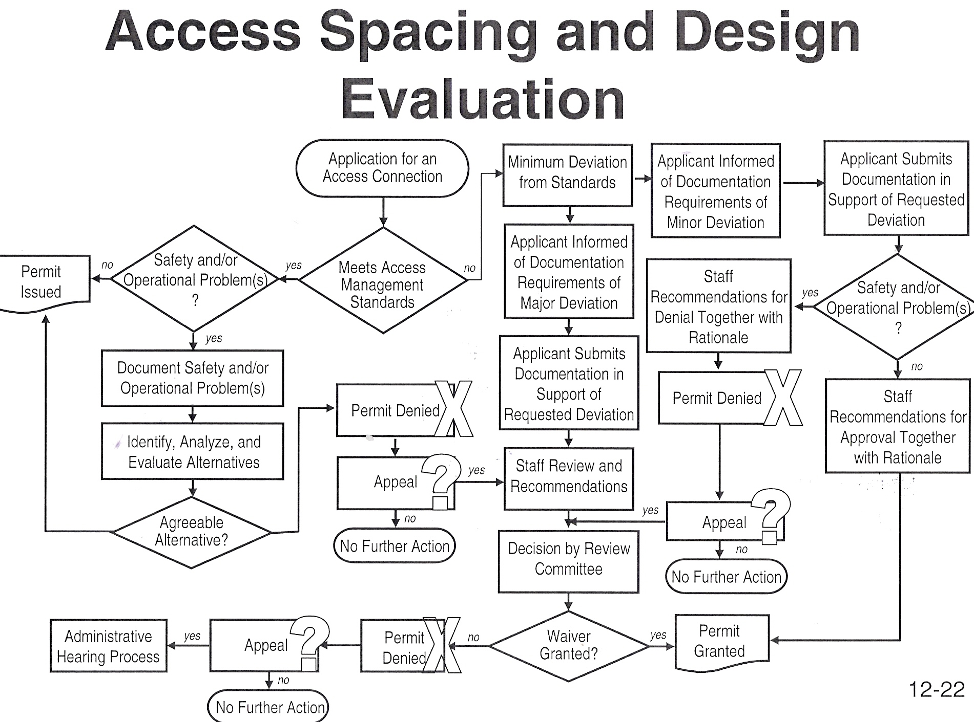
Access Spacing and Design Evaluation

Slide 33
Transportation Impact Analysis

Slide 34
Transportation Impact Analysis(TIA) Considerations
Depending on the size of the development, the TIA can range from a cursory review and letter to a comprehensive analysis and report
Four different levels or types of TIA are outlined including:
Access location and design review
Small-scale development: Traffic assessment
Medium-sized development: Traffic impact statement
Large-scale development: Regional traffic analysis

Slide 35
Type 1: Access Location and Design Review
Very small development (<100 peak hour trips)
Complete site access and circulation review of all approach-road connections – letter report
Principle elements to evaluate include:
Sight distance
Driveway geometrics and throat length
Potential for pedestrians and bicycles
Location of the proposed access with respect to left- or right-turn bays, median, grade separation, etc.

Slide 36
Type 2: Small-Scale Development: Traffic Assessment
Traffic expected to impact intersections and driveways in close proximity (not overall network)
Typical situations to consider traffic assessment:
Generation of at least 100, but <500 peak hour trips
Development <100 trips/hr abutting or within 660 feet of a high crash location
>20% or >100 trips per hour in peak period
>25% change in directional distribution
>2 vph increase in the number of large vehicles

Slide 37
Type 3: Medium-Sized: Traffic Impact Statement
Impact to an area some distance from the site (i.e., network impacts)
Typical situations to consider traffic assessment:
Generation of >500, but <1,000 peak hour trips
Development and a section of highway or intersection within 1,320 feet of a high crash location
>20% increase of trips per hour in peak period
>20% change in directional distribution
>3, but <10 vph increase in the number of large vehicles

Slide 38
Type 4: Large-Scale: Regional Traffic Analysis
Impact on roadway system over a wide area
Typical situations to consider traffic assessment:
Generation >1,000 peak hour trips (including pass-by)
Development expected to generate >500 vph in peak within ½ mile of a high crash location
Any site to be developed in two or more phases
10+ vph increase in number of large vehicles
Development to be located in an environmentally sensitive area

Slide 39
Study Area
The study area should include at least all site access points and major intersections adjacent to the site
It is suggested that the first signalized intersection on each street serving the site, if within a specific locally determined distance (i.e., ¼ or ½ mile), be included
Beyond this, the review agency should determine any additional area to be included based on local or site-specific issues, development size, or local policy
For multi-phase projects, the study area size may be based on cumulative traffic generated up through the phase being reviewed

Slide 40
Pre-Application Meeting
One of the most critical steps in the project is the pre-application meeting between the engineer and the jurisdictional agency
The following should be present at the meeting:
The applicant’s agent who will conduct the TIA
A representative of the local government agency
A representative of the DOT if the development abuts a state roadway

Slide 41
Pre-Application Meeting
The pre-application meeting should:
Be open
Be objective
Leave no assumptions undiscussed
Leave no expectations undiscussed
Conclude with a clear understanding of the TIA and site plan requirements and timeline

Slide 42
Background Data Collection
Pertinent transportation and land development information (short- and long-term) prepared in the past five years should be reviewed
High-crash locations within the study area should be identified (three years of data)
Other background data (see ITE Multimodal Transportation Impact Analysis for Site Development)

Slide 43
Review Process
The review process should be iterative and begin when the development’s planning is initiated, not after a development has been planned and a traffic study completed
This ensures that local guidelines and requirements are met and the objectives of both the land owner or developer and the local agency can be best met
The developer, study preparer, and reviewing agency should meet at the earliest possible point in the study process

Slide 44
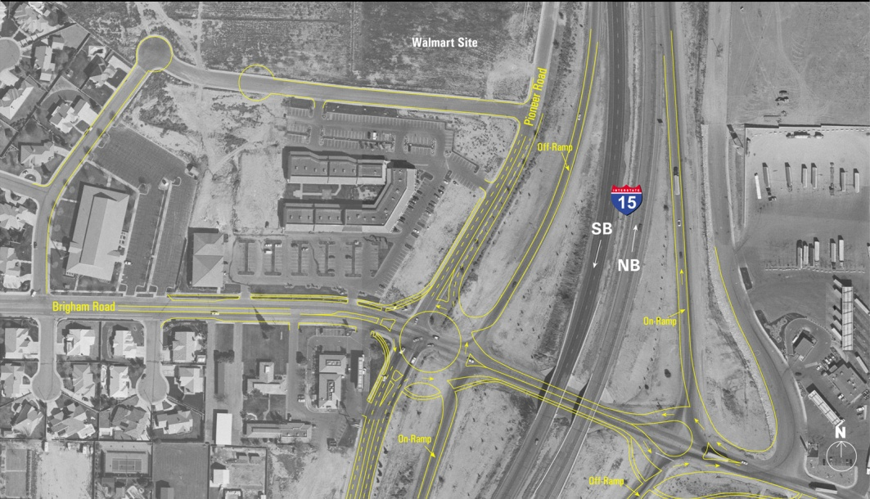
Review Process
Recommendations regarding the development of a comprehensive site access system, including complementary, effective, off-site improvements, or developer participation (if needed), to achieve an efficient and safe transportation system within and adjacent to the development
Fair and reasonable assessment of impacts and need for improvements

Slide 45
Ethics and Objectivity
“Although study preparers and reviewers will sometimes have different objectives and perspectives, all parties involved in the process should adhere to established engineering ethics, like the ITE Canons of Ethics for Members, and all analyses and reviews should be conducted in an objective and professional manner.”
Source: Multimodal Transportation Impact Analysis for Site Development, ITE

