Slide 1
Access Location and Spacing
Module 4

Slide 2
Learning Objectives
Describe the difference between upstream and downstream functional area.
Explain the different concepts that may be used to determine access spacing.
Calculate upstream and downstream functional intersection area.

Slide 3
Key Concepts: Sight Distance
Sight Distance: The distance visible to the driver of a passenger vehicle measured along the normal travel path of a roadway from a designated location and to a specified height above the roadway when the view is unobstructed by traffic.
Stopping sight distance: The distance required by a driver of a vehicle, traveling at a given speed to bring the vehicle to a stop after an object on the roadway becomes visible. It includes the distance traveled during driver perception and reaction times and the vehicle braking distance.
Notes:
Intersection sight distance: The length of crossing roadway that is visible to the driver of a vehicle approaching an intersection. The driver should have an unobstructed view of the entire intersection and sufficient view left and right on the crossing road to decide to cross or turn onto the crossing road.
Decision sight distance: The distance needed for a driver to detect an unexpected or otherwise difficult-to-perceive information source or condition in a roadway environment that may be visually cluttered, recognize the condition or potential threat, select an appropriate speed and task, and initiate and complete a complex maneuver.

Slide 4
Key Concepts: Speed Differential
The difference in vehicle speeds within the traffic stream. A large variation in these speeds complicates the driving task and leads to sudden braking, multiple lane changes, and other compensating driving maneuvers.
Notes:
Speed Differential: The speed differential is the difference in speed between a turning vehicle and through traffic.

Slide 5
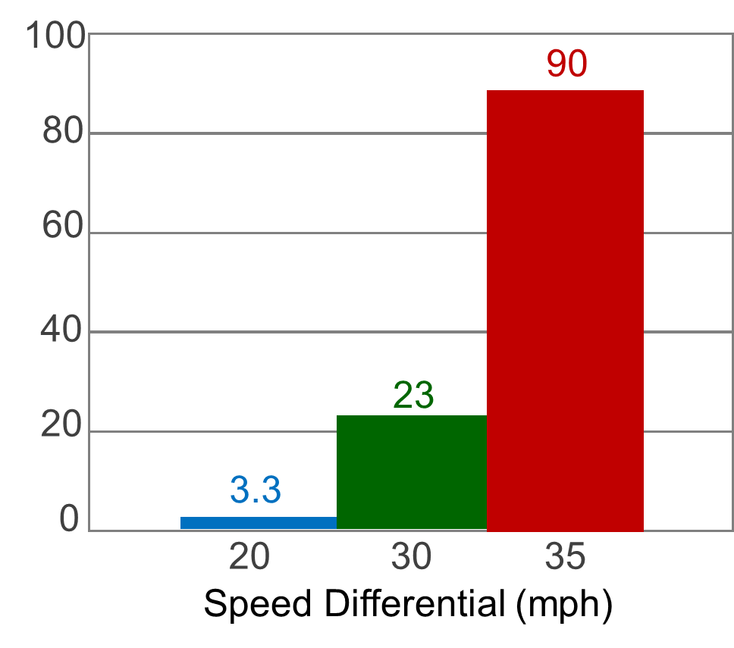
Effect of Speed Differential on Crash Potential
Relative crash involvement rate ratios in comparing speed differentials over 10 mph for arterial roads.
Source: TRB Access Management Manual, 2014
Notes:
When a turning vehicle is traveling 20 mph slower than other traffic, the crash potential is 3.3 times that if that vehicle was traveling 10 mph slower than the other vehicles.
A vehicle traveling 35 mph slower than other vehicles results in a crash potential that is 90 times that if the vehicle were traveling only 10 mph slower than the other vehicles.
Knowledge Probe Question #1
Explain the relationship between speed differential, access, and safety.

Slide 6
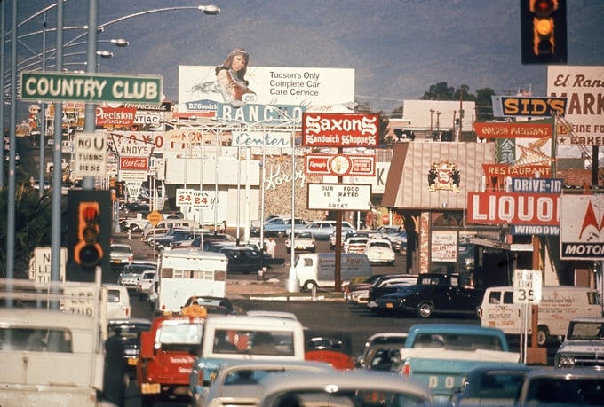
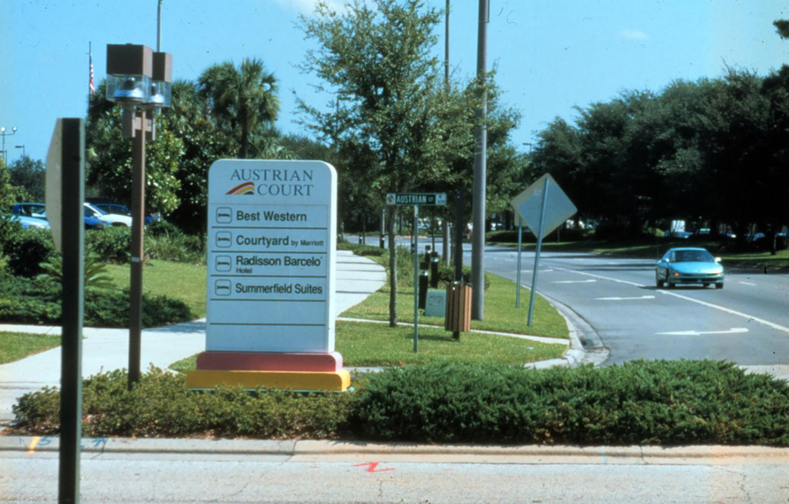
Key Concept: Driver Workload (Human Factors)
The mental demand placed on the vehicle operator, affecting the capacity to handle an additional task (e.g., the ratio of required to available mental resources).
Notes:
A key tenet of access management is that drivers are more likely to make mistakes and have more collisions when presented with complex driving situations. This is why an objective of access management programs is to limit and separate areas where traffic conflicts may occur (e.g., driveways, median openings, etc.).
Knowledge Probe Question #2
How might poorly managed access impact driver workload?

Slide 7
Access Location

Slide 8
Factors Considered for Access Location
Access locations (and density of access) affect safety and operations
Adequate sight distance
No connections in the function areas
Integrating roadways, driveways, and site layout
Roadway classification and characteristics
Site characteristics
User characteristics

Slide 9
Roadway Classification and Characteristics
Functional class
Operational characteristics
Speed
Volume and traffic flow
Driveways and other intersections
To avoid connecting a roadway of lower classification directly to a roadway of a much higher classification
Notes:
Access management ensures that access locations align with the designated roadway function (through movement versus access), operational characteristics, and other roadway elements such as number of traffic lanes, the presence or absence of a median and its width, on-street parking, and bicycle, pedestrian, and transit facilities. Key terms are defined as follows:
Speed: The distances needed to execute a maneuver, such as changing lanes or braking to stop, increase as speed increases.
Driver expectancy: Unfamiliar drivers need more time to react safely than those who use the roadway frequently. Drivers also need more time to react to complex situations.
Traffic flow: Signalization causes traffic to be organized in platoons. Disruptions in traffic flow increase as turn volumes and through volumes increase.
Number of conflict points: Numerous conflict points increase driver workload and the likelihood of collisions.

Slide 10
Site Characteristics
Size of a site
Flexibility in access location, building, on-site circulation
Traffic characteristics on adjacent roadways
Site layout
Structure near the right-of-way line with service area and parking behind the building;
Building near the rear property line with parking at the front
Notes:
Access is influenced by the size of the site. For example, good access and site design are described as being easier to develop on large sites. This is primarily attributed to the substantial street frontage, which allows space for amenities such as speed-change lanes and channelization for ingress and egress. Larger sites have more space for adequate driveway throat length and flexibility in the building location, which in turn, also influences the site layout and the on-site circulation. Smaller sites and corner sites have limited frontage for amenities such as speed-change lanes and channelization. Furthermore, multiple adjacent small sites with separate access introduce issues resulting from poor access spacing.

Slide 11
User Characteristics
Drivers’ perception –reaction time
Adequate intersection sight distance
Stopping sight distance
Intersection sight distance
Decision sight distance
Notes:
Intersection sight distance is from the perspective of the vehicle on the drive (or minor roadway) trying to enter the major roadway. Stopping sight distance provides a minimum distance based on perception–-reaction distance and braking distance to react to a hazard in the roadway. However, roadway and roadside conditions can be more complex, and a longer sight distance, such as decision sight distance, may be appropriate. The longer of the acceleration distance and the sight distance is used to determine the downstream functional distance.

Slide 12
Access Spacing

Slide 13
Factors Considered for Access Spacing
Factors:
Signal spacing
Driveway spacing
Median opening spacing
Corner clearance
Interchange spacing
Access to crossroads at interchange
Highway function and classification
Speed
Driver expectancy
Traffic flow
Number of conflict points
Separation of conflict areas
Notes:
Spacing at existing access locations is constrained, but where possible, the site should be evaluated to assess upgrading access at these sites to improve access and overall safety.

Slide 14
Signal Spacing
Effects of signal spacing
Speed
Crash and crash rates
Relationship between signal spacing, cycle length, and progression speed
Speed is a function of signal spacing and cycle length
Notes:
Signal spacing paired with appropriate median treatments can improve roadway efficiency. For example, ½ mile signal spacing was found to result in an approximately 60% reduction in vehicle hours of travel as compared to ¼ mile signal spacing.

Slide 15
Effects of Unsignalized Access Spacing
Safety
Stopping sight distance
Intersection sight distance
Functional area
Right-turn conflict overlap
Influence distance
Egress capacity
Notes:
The effects of unsignalized access are described in the following slides.

Slide 16
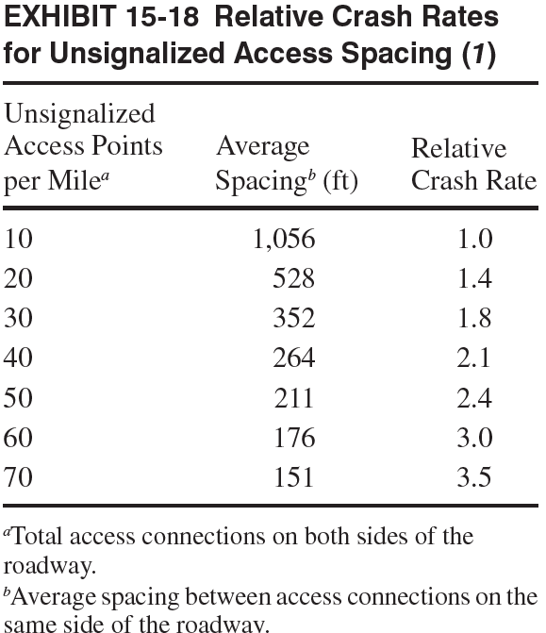
Safety
Crashes can be expected to increase as access spacing decreases.
Source: TRB Access Management Manual, 2014

Slide 17
Driveway Density and Safety
Every driveway introduces conflict points and potential crashes on an arterial
60 access points per mile
157 % increase in crashes
10 access points per mile
From 10 to 60 access points per mile
on urban 4 lane with TWLTL
Source: NCHRP Project 25-47 (2023)
Notes:
Note: The content of this slide was adapted from NCHRP Project 25-47

Slide 18
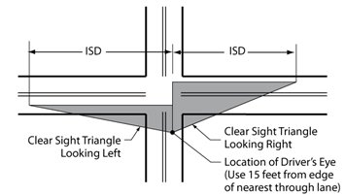
Stopping Sight Distance
Minimum stopping sight distance is the minimum distance needed to allow drivers to react to a potential conflict and come to a stop.
Source: FHWA
Notes:
Note: Exhibit 15-19 of the TRB Access Management Manual (2014) includes access connection spacing based on sight distances for passenger cars.

Slide 19
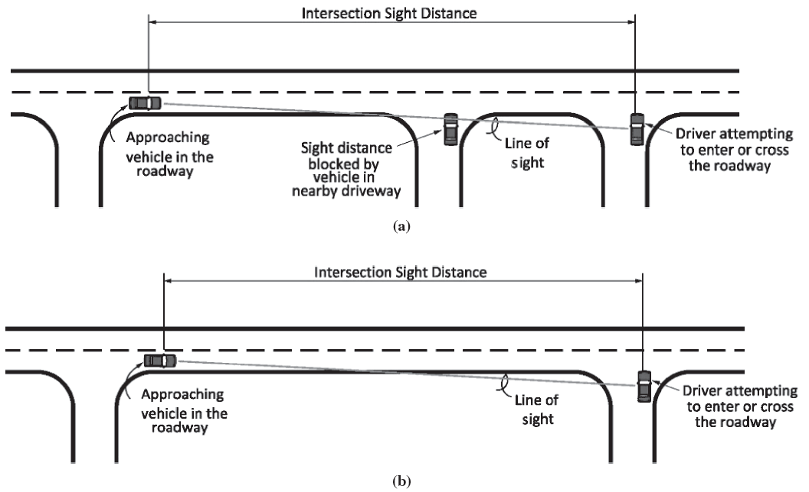
Intersection Sight Distance
Distance needed to provide a driver who is waiting in an access connection an opportunity to enter, or cross, the major roadway.
Source: TRB Access Management Manual, 2014
Notes:
Note: Exhibit 15-20 of the TRB Access Management Manual (2014) includes intersection sight distances for passenger cars.

Slide 20
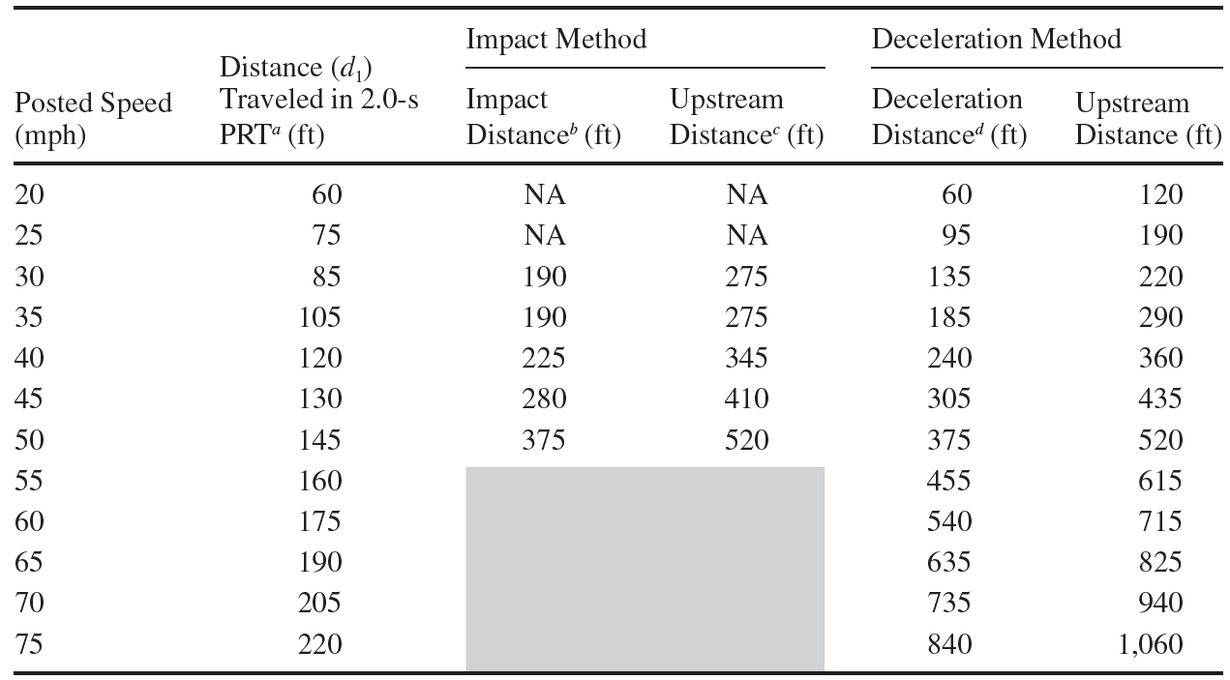
Functional Area
The access spacing should be no less than the upstream functional distance.
Source: TRB Access Management Manual, 2014
Notes:
Note: Exhibit 15-15 of the TRB Access Management Manual (2014) includes examples of unsignalized access connection spacing based on upstream functional intersection distance.

Slide 21
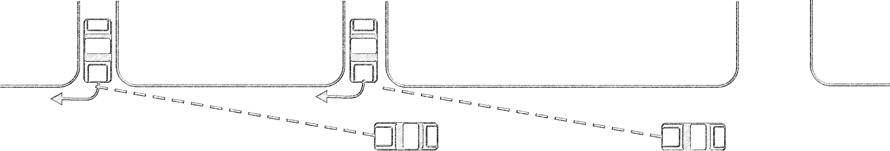
Right-Turn Conflict Overlap
It happens when a driver in a through-traffic lane must monitor more than one access connections at a time
Driveway #2
Driveway #1
Source: TRB Access Management Manual, 2014
Notes:
Note: Minimum distances needed to avoid right-turn conflict overlap are included in Exhibit 15-25 of the TRB Access Management Manual, 2014.

Slide 22
Influence Distance
The impact distance of right turns on following through traffic, plus the distance traveled during perception-reaction time.

Slide 23
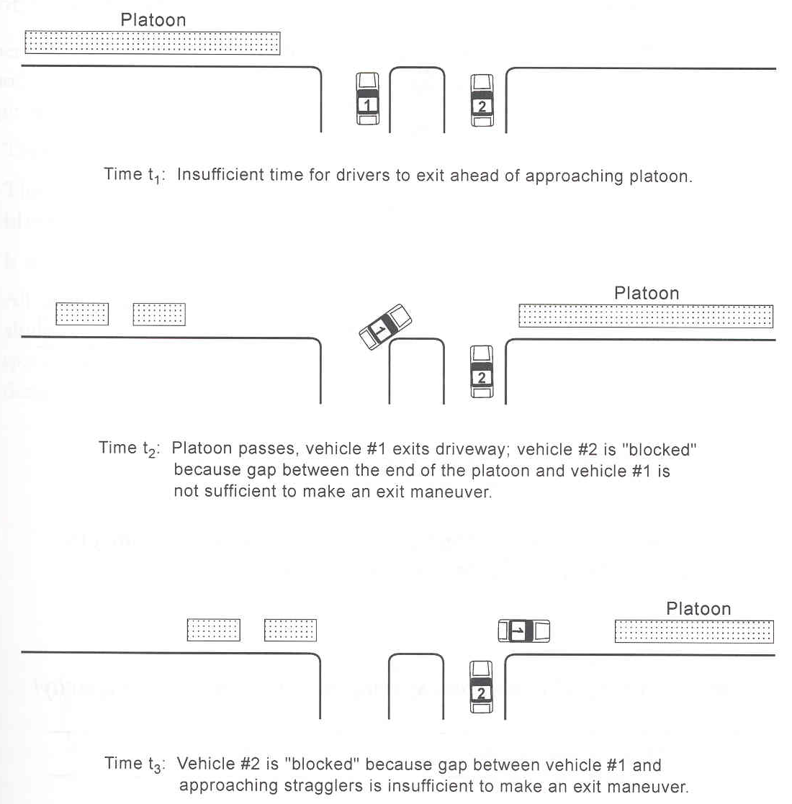
Egress Capacity
Closely spaced access interferes with each other and restricts egress capacity.
Egress capacity increases as access spacing increases.
Notes:
Note: The content of this slide was adapted from Brigham Young University CE664: Transportation Site Planning with permission from Grant Shultz.

Slide 24
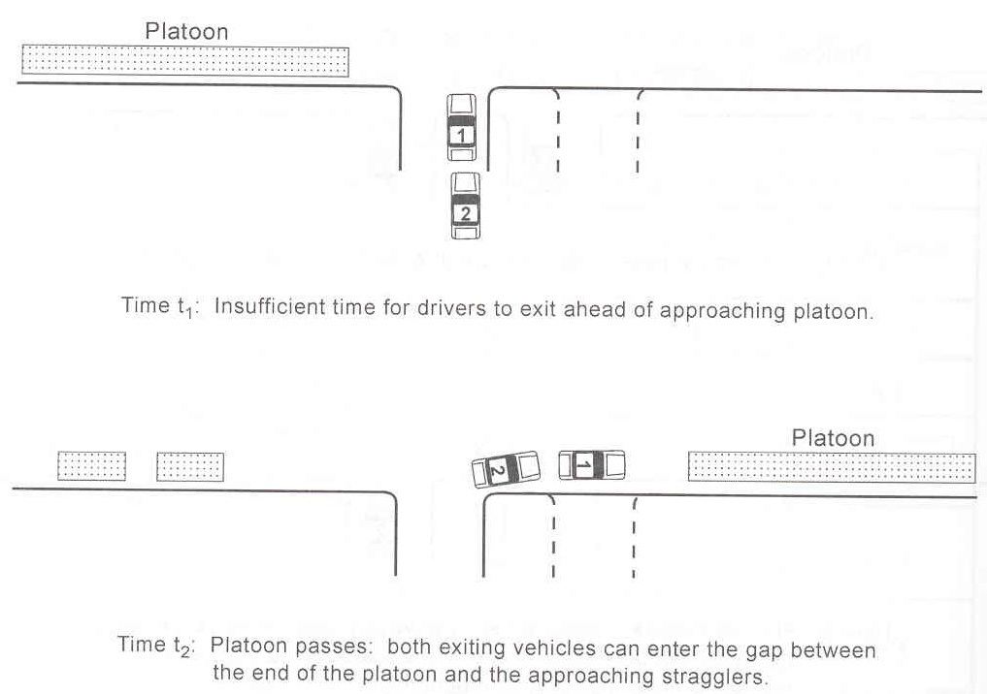
Egress Capacity
Speed (mph) | Spacing (feet)
30 | 315
35 | 450
45 | 625
45 | 850
50 | 1,125
Unsignalized access spacing to maximize egress capacity
Notes:
Note: The content of this slide was adapted from Brigham Young University CE664: Transportation Site Planning with permission from Grant Shultz.

Slide 25
Functional Intersection Area

Slide 26
Intersection Areas
Notes:
The functional area of an intersection includes the physical area and the functional area. The physical area is the space within the intersection. The functional area is larger than the physical area and extends upstream and downstream from the physical intersection area to include the longitudinal limits of auxiliary lanes.

Slide 27
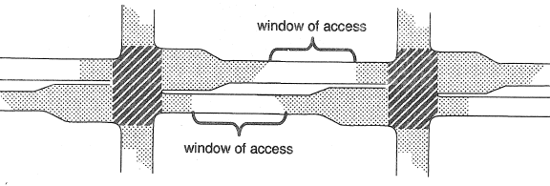
Importance of Functional Area
Driveways should not be located within the functional area of an intersection.
Notes:
Ideally, there should be no access in the functional intersection area. The access window is the location between the functional intersection area where access can be located with the most flexibility and the least amount of interference with the intersection.

Slide 28
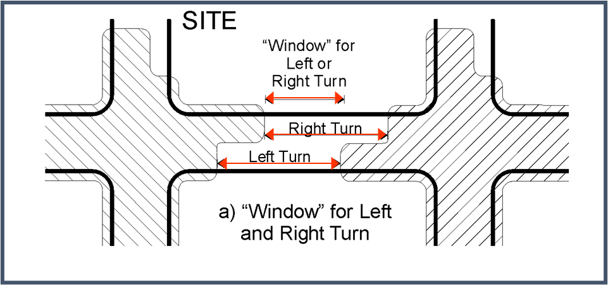
Access Window
Functional intersection area
Upstream functional distance
Distance traveled during a perception-reaction time, d1
Deceleration distance while the driver maneuvers to a stop, d2
Queue storage, d3
Notes:
When determining where to locate access, it is important to assess the functional distance upstream and downstream of an intersection and ascertain the ‘window’ in which the driveway may be located without adversely impacting the functional area of that intersection.

Slide 29
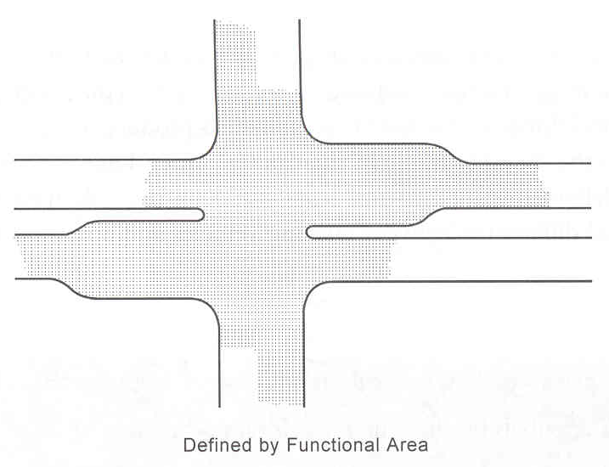
Identifying the “Access Window”
The space between the functional areas of two adjacent intersections is the region or “window” in which access might be provided.
The exact location of the access drives within this window will be determined by the layout of on-site circulation and parking.
Notes:
The steps to locate the access window are described in the following slides.

Slide 30
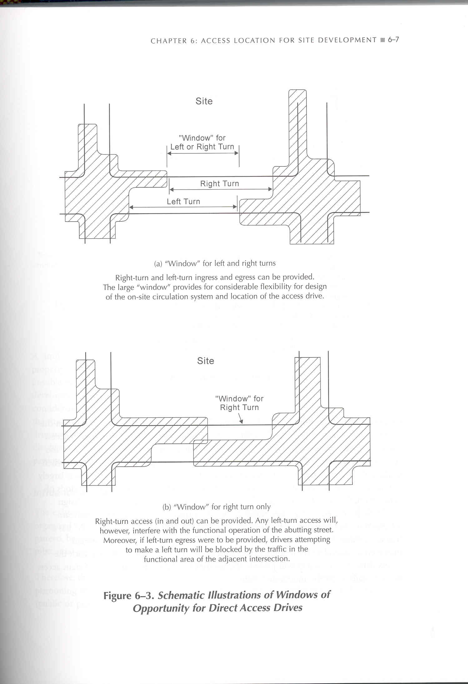
Identifying the “Access Window”
Notes:
The schematic shows the access window for left or right-turn access drives.

Slide 31
Identifying the “Access Window”
Notes:
The schematic shows the access window for right-turn access drives.

Slide 32
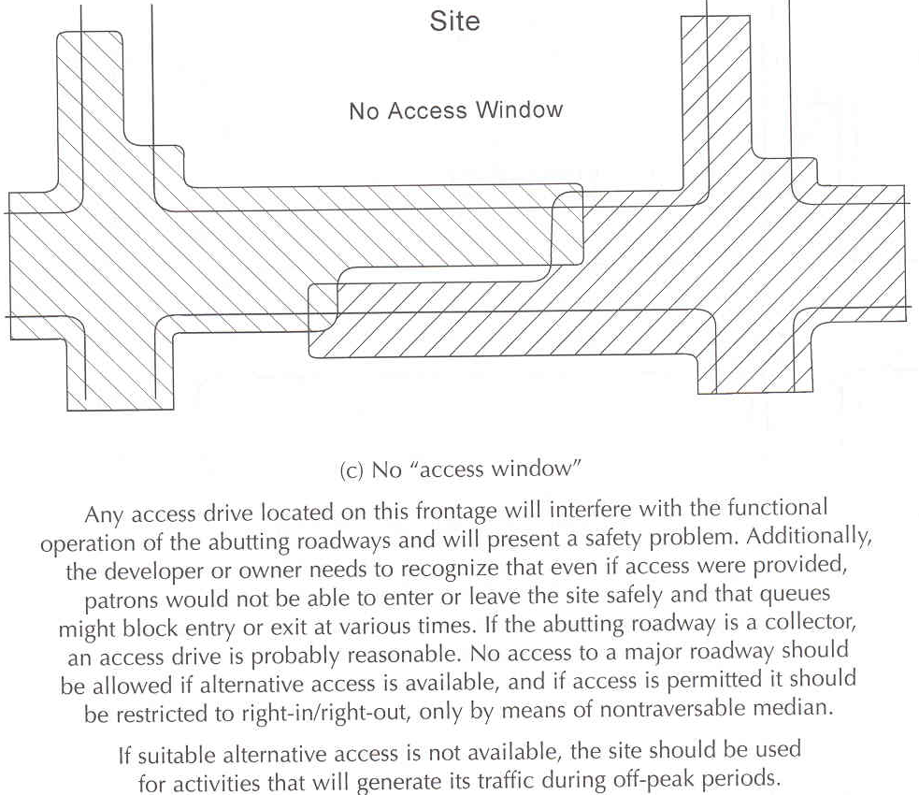
Identifying the “Access Window”
Notes:
The schematic shows a roadway with no access window.

Slide 33
Identifying the “Access Window”
When there is a large region in which access might be taken, the potential for changing conditions on the adjacent street should be considered.
The queue length on the upstream approach can be longer when traffic volumes increase in the future.
The downstream functional area, however, is largely a function of the intersection geometrics and is relatively stable over time.

Slide 34
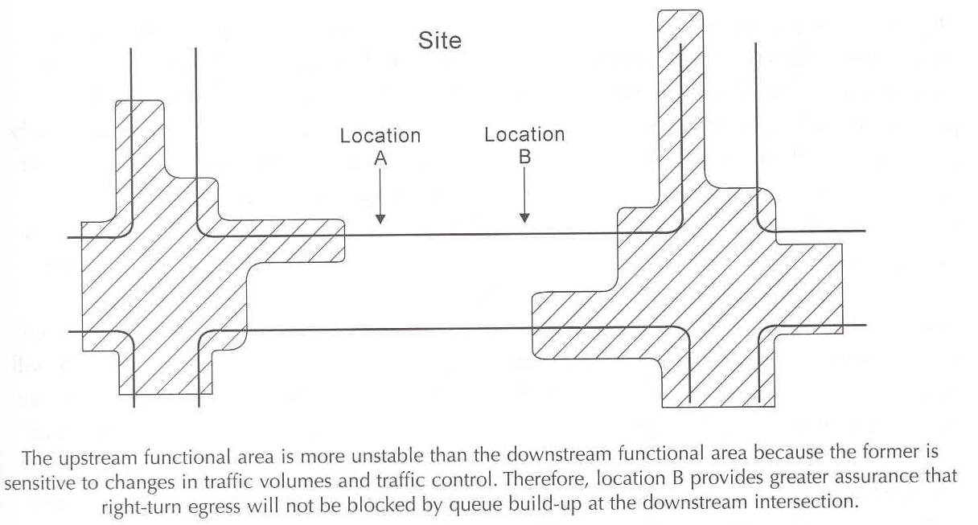
Identifying the “Access Window”
Location “A” has a higher likelihood of blockage.
Location “B” provides better flexibility in the future.

Slide 35
Identifying the “Access Window”
Traffic signals create traffic streams that are organized into platoons.
Platoon flow is substantially different from a random pattern, because intermittent groups (or platoons) of vehicles arrive, followed by gaps in the traffic flow.
Time-space diagrams on the arterial street should be analyzed for platooning when considering the location of signalized and unsignalized accesses.

Slide 36
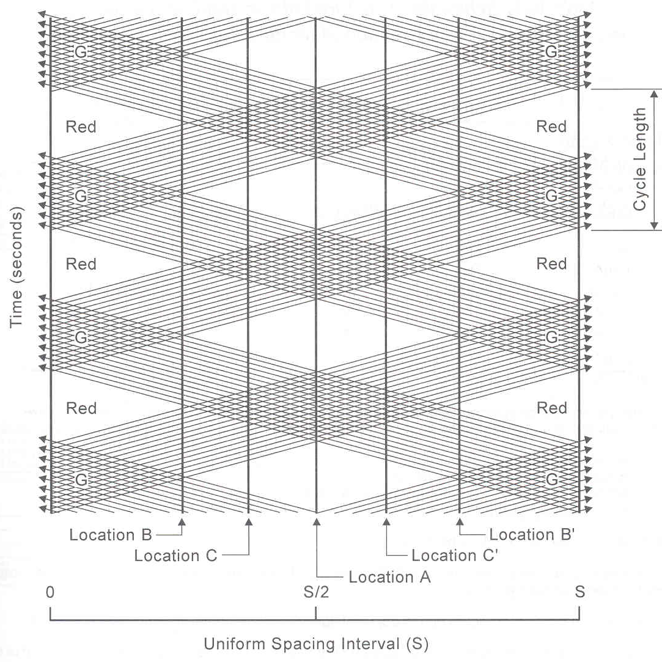
Identifying the “Access Window”
Location A:
Platoons on the major roadway simultaneously pass in front of the unsignalized access location.
Location B:
Platoons on the major roadway pass alternately in front of the unsignalized access location.
Location C:
Platoons on the major roadway do not alternately “block” left turns from an unsignalized access location all the time.

Slide 37
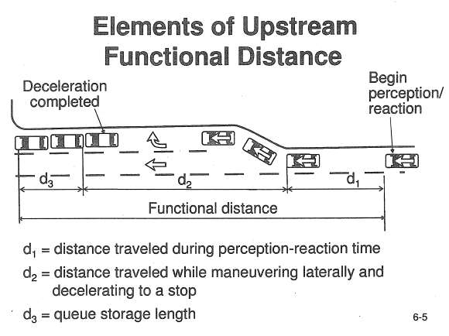
Elements of Upstream Functional Distance
Notes:
The minimum physical length consists of the perception–reaction distance (d₁), the deceleration–maneuver distance (d₂), and the queue storage (d₃).
Knowledge Probe Question #3
Which factors related to context (rural vs urban) and traffic conditions affect perception-reaction time? How can we account for these differences when calculating the upstream functional distance?

Slide 38
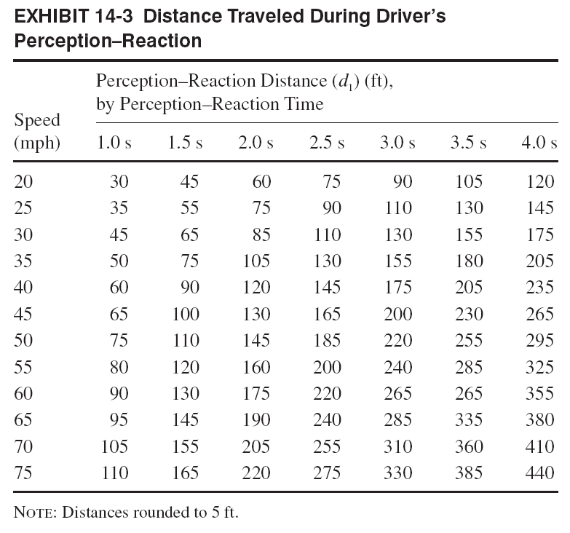
Perception Reaction Distance (d₁)
Source: TRB Access Management Manual, 2014

Slide 39
Methods to Determine Distance Traveled (d₂)
A) Deceleration/maneuver distance method
B) Impact distance method
Notes:
The deceleration distance method provides a value for all speeds based on the deceleration rate.
The impact distance method is applicable only for select speeds of 30, 40, 45, and 50 mph.

Slide 40
A) Deceleration/Maneuver Distance Method (d₂)
Speed (mph) | Deceleration/Maneuver Distance (ft.)
20 | 70
30 | 160
40 | 275
50 | 425
60 | 610
70 | 820

Slide 41
B) Impact Distance Method (d₂)
Speed (mph) | Percent of Through Vehicles Impacted
 | 5% | 10% | 15% | 20%
30 | 265 | 220 | 190 | 175
40 | 315 | 260 | 225 | 205
45 | 390 | 320 | 275 | 255
50 | 490 | 410 | 350 | 325
55 | 625 | 520 | 450 | 415
Notes:
These values are applicable to suburban and urban locations.

Slide 42
Queue Storage Length (d3)
where:
d₃ = queue length
V = turn volume, vehicles per hour
N = number of times, intervals per hour
= 3600 sec./time interval (cycle length), seconds
k = factor representing the likelihood that the storage length will accommodate the turning vehicles (a value of 2.0 is commonly used for major arterials); or: the design queue length divided by the average queue length
l = average length per stopped vehicle including the space between vehicles
Notes:
Queue storage varies by area context (rural vs urban). In urban areas, queue storage varies by time of day (peak vs non-peak). Determination of the upstream functional distance requires calculation for both the peak and off-peak, especially for urban roadways.

Slide 43
Example Problem
Conditions
Left-turn volume = 175 vph
Cycle length = 90 sec.
< 5% large vehicles

Slide 44
Example Problem
Solution

Slide 45
In-Class Activity A
Using the Deceleration Maneuver Method for distance d₂, what is the upstream functional distance for the following conditions?
Speed = 40 mph
Perception-reaction time = 2.0 sec.
Queue storage, d₃ = 175 ft.
Notes:
Answer: 570

Slide 46
In-Class Activity B: Overview
Functional Area Assessment
The purpose of this activity is to help you understand how to measure upstream and downstream functional intersection distance and identify access connections that are within the functional area.
Notes:
Instructor notes: Students will work alone to complete this in-class activity. Provide students with the handout in Appendix A of the Access Management Curriculum Guidance Document.
Procedure:
Time: 15 minutes
Individual Exercise
Source: NHI Course 133078 Access Management: Solutions for All Users

Slide 47
In-Class Activity B: Instructions
Measure the upstream and downstream functional areas of the intersection in the provided map and use the table provided by your instructor to complete the following:
Document the functional distance for D1 and D2 (assume 100’ for D3).
Identify access connections within the functional area.
Discuss your findings:
Describe the characteristics of the upstream and downstream functional areas.
How many access connections are within the functional area?
What are the safety and capacity implications of these characteristics and access connections?
Why is it important to protect the intersection functional area?
Notes:
Protection of functional area helps to:
Provide for the safe operation of each intersection
Identify acceptable locations for access connections
Identify and prioritize retrofit efforts
Note: The table can be found in Appendix A of the Access Management Curriculum Guidance Document.

Slide 48
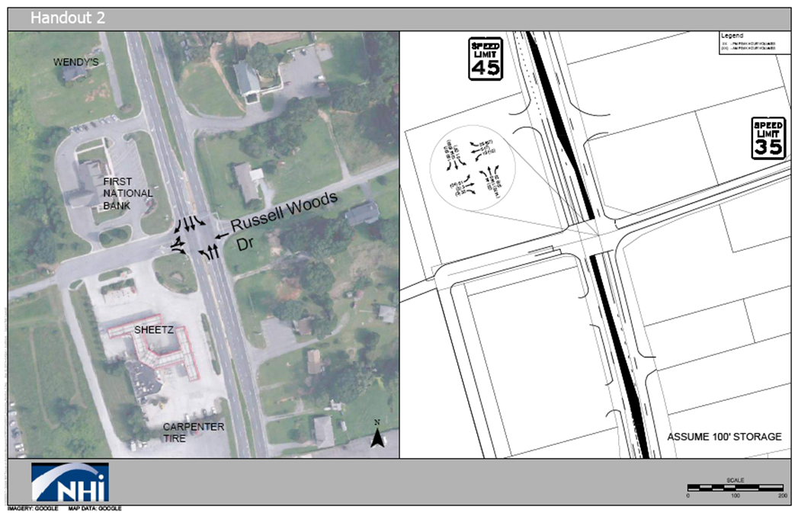

Slide 49
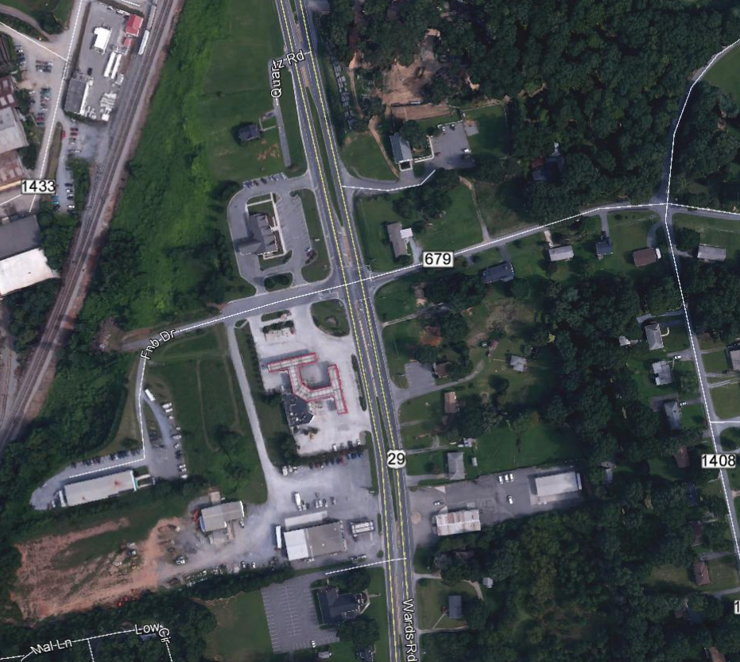
In-Class Activity B: Discussion
625 ft
365 ft
295 ft
160 ft
160 ft
295 ft
365 ft
625 ft
Imagery and Map Data: Google
Measurement: NHI Course 133078
Notes:
Note: The image on the slide includes animations to display the measurements.

Slide 50
Corner Clearance

Slide 51
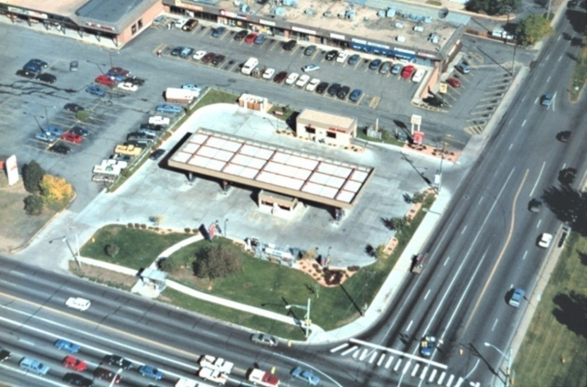
Access Spacing and Corner Clearance
Corner Clearance is the distance provided between a roadway intersection and the nearest access connection.
Corner Clearance is a special case of access connection spacing.
Notes:
It is typically measured from the inside edge of the driveway to the inside edge of the intersection.
Corner clearance is the distance between the roadway intersection and the nearest access connection (street or driveway). Ideally, corner clearance would not be less than intersection functional area as it could interfere with safety and operations at both the driveway and the intersection. Drivers may also be inconvenienced by delay and difficulties in entering and leaving such sites.
Corner clearance is a special case of access spacing. Some agencies apply the same spacing standards to corner clearance as to other access connections. For example, this is the practice in Colorado, Florida and a growing number of other states.

Slide 52
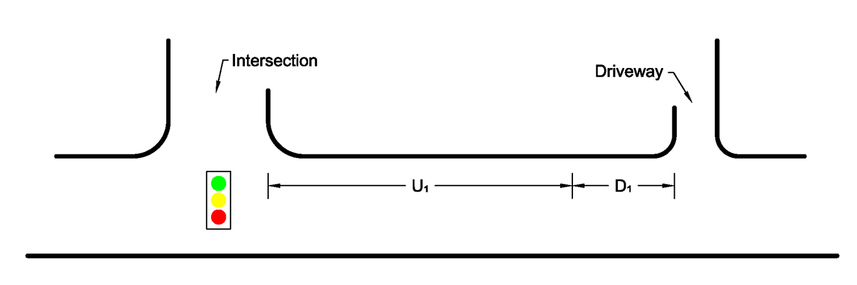
Ideal Upstream Corner Clearance
U₁ = upstream functional distance of the intersections
D₁ = downstream functional distance of the driveway
Notes:
The ideal corner clearance for an unsignalized access connection upstream from a signalized intersection is the sum of the downstream functional distance of the unsignalized access connection plus the upstream functional distance of the signalized intersection. These downstream and upstream distances were described in Part I last week.
The minimum length of a turn lane is the distance “U₁” shown on this slide.

Slide 53
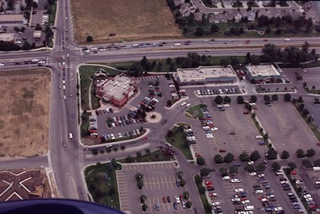
Upstream Corner Clearance
Notes:
The photo in this slide illustrates adequate upstream corner clearance on the minor street approach to a major intersection. No access is provided to the major street. Outparcels are provided access by an on-site circulation roadway.
Location: Fort Collins, Colorado

Slide 54
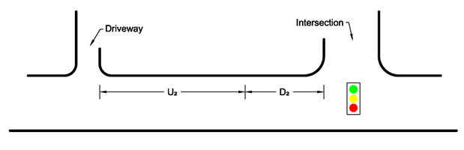
Ideal Downstream Corner Clearance
U₂ = upstream functional distance of the driveway
D₂ = downstream functional distance of the intersection
Notes:
The ideal downstream corner clearance is the sum of the downstream functional distance plus the upstream functional distance of the access connection.
An unsignalized access connection should not be located closer to a signalized intersection than the sum of D₂ and U₂ illustrated in this slide.

Slide 55
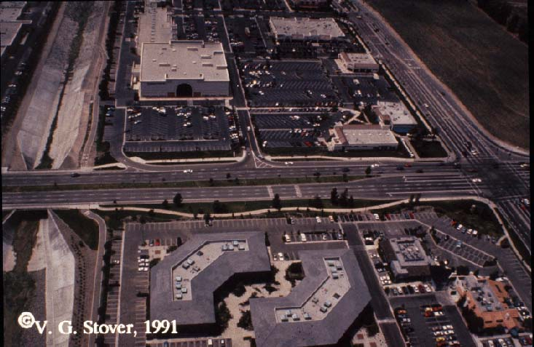
Distances Overlap
Notes:
This slide shows a development where the downstream functional distance of a major intersection overlaps with the upstream functional distance of an unsignalized access drive. (The upstream functional distance of the driveway extends through the signalized intersection.)
Spacing is much shorter than we want but observation indicates that the separation is adequate because:
A right-turn lane of adequate length is provided.
The driveway is right-in/right-out only. (Median provides positive control over left turns. Therefore, conflicts are limited to the overlapping functional distances of the driveway and intersection.)

Slide 56
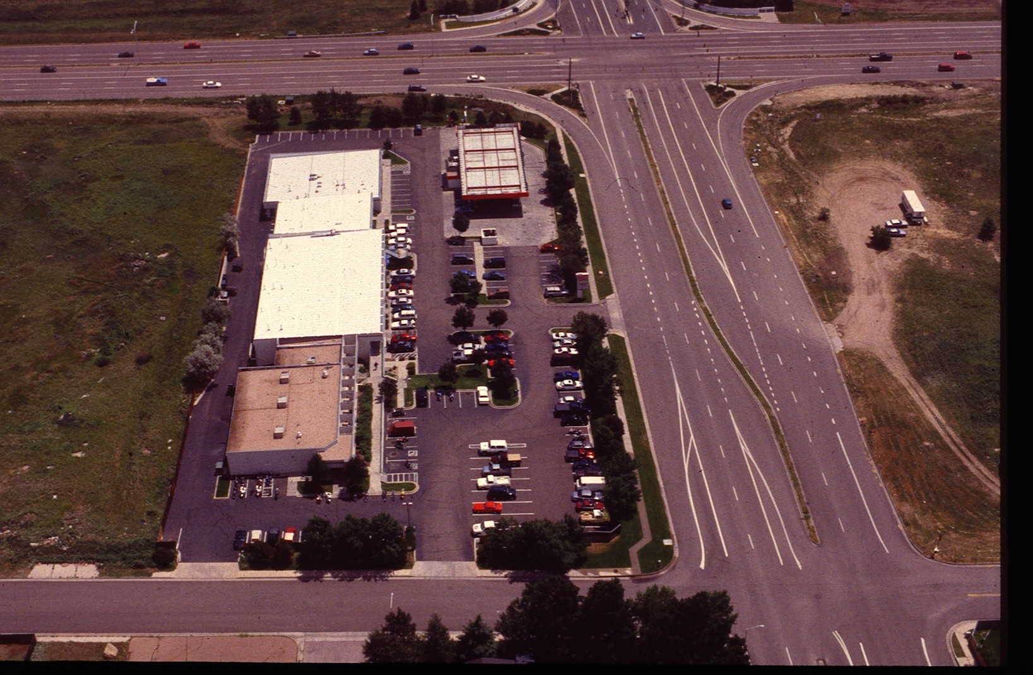
Orientation of Corner Parcel
Notes:
This “strip commercial” center was developed with its long dimension parallel to the minor street to provide adequate downstream corner clearance with access to the minor street only.
The building in the corner (circled in red) is a service station that has a high volume of business.
Note: The photo was taken about 8:30 a.m. This accounts for the small number of parked vehicles. After 10:00 a.m. when businesses open, nearly all parking spaces are continuously occupied.
Location: Colorado Springs, Colorado

Slide 57
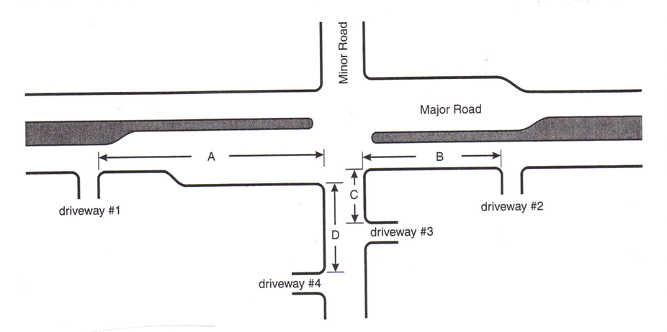
Corner Clearance Distance
Based on functional intersection area and probability of blockage on side streets.
Notes:
Minimum corner clearances should be based on functional intersection distance. A shorter distance might be appropriate when localized conditions make compliance with adopted standards – impractical.
“A” should be the sum of d₁ + d₂ + d₃ for the expected conditions that result in the longest distance.
At a minimum, “A” should exceed the sum of d₂ + d₃. An exception to this will be addressed under turn lanes.
“B” should also be the sum of d₁ + d₂ + d₃. However, d₃ will ordinarily be very short or even zero. Some queue storage may be needed where high pedestrian volumes require drivers to wait.
At a minimum “B” should be no shorter than SSD.
“C”, ideally would also be the sum of d₁ + d₂ + d₃. However, drivers on a minor roadway on the approach to a major roadway will expect to stop or make a slow speed right or left turn. Hence, d₁ will be short due to a short P-R time (1.0 sec.) and slow speed. d₂ will also be slow.
A minimum corner clearance for “C” should be queue length. An even shorter corner clearance may be acceptable when a barrier on the minor roadway restricts movements to right-in/right-out only – i.e., prevents left-turns in and out, especially in.
“D” will depend upon whether the intersection is channelized or not. We will address this in a later slide.

Slide 58
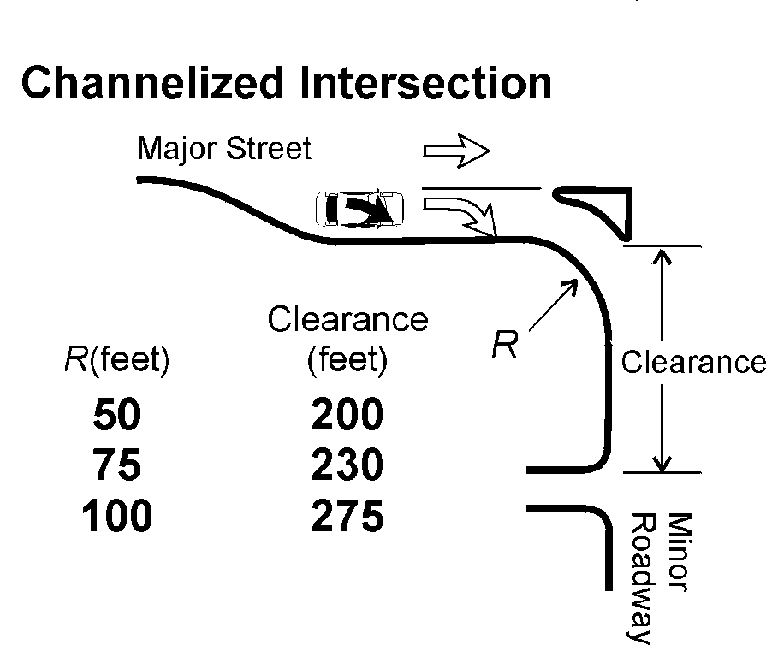

Minimum Downstream Corner Clearance
Source: Transportation and Land Development, ITE, 2002
Notes:
The downstream corner on the minor roadway (distance “D”) should exceed 120 ft. if the intersection is unchannelized. If channelized, the corner clearance depends upon the radius of the turning roadway.
It is suggested that intersections of major roadways with collectors not be channelized. This will increase the flexibility in developing the corner property.

Slide 59
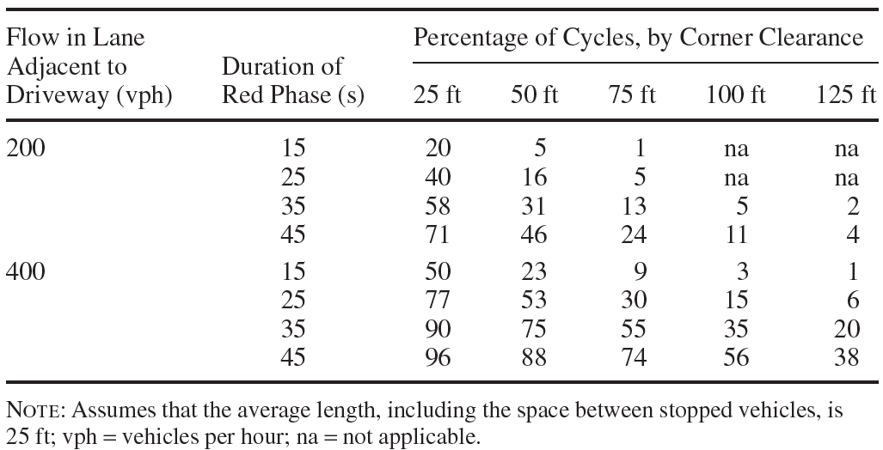
Example Problem
Calculate the probability of a queue extending past the driveway.
Conditions
Traffic flow in the lane adjacent to the driveway = 400 vph
Red phase = 35 seconds
Corner clearance = 100 ft.
Source: TRB Access Management Manual, 2014
Notes:
Note: The answer for this example problem is provided on the next slide.

Slide 60
Example Problem
Solution
On 35% of the cycles, the queue will extend past the driveway.
Source: TRB Access Management Manual, 2014
Notes:
Corner clearance “C” should not be less than the longest queue expected. This distance will depend on approach volume, volume on the major roadway, and traffic control.

