Slide 1
Land Development and Access
Module 3

Slide 2
Learning Objectives
Explain the land use and transportation cycle and why it is counterproductive
Describe how land division and subdivision activity impacts access design
Identify appropriate methods to manage access in the land development process.

Slide 3
Land Use and Transportation

Slide 4
Transportation & Land Use Cycle
Arterial
Projects
Deterioration
Increased
in Quality of
Accessibility
Traffic Flow
Increased
Increased
Traffic Conflict
Land Value
Increased
Land Use
Traffic Generation
Change
Notes:
Note: This slide includes animation.

Slide 5
NCHRP Report 121 (1971)
“The lack of access control along arterial highways has been the largest single factor contributing to the [loss of function] of ….an entire generation of new arterial facilities built only a short while ago.”
Notes:
A key mistake as noted in this NCHRP study published in 1971, was the lack of attention to access management, the report called lack of access control along arterial highways the largest single factor causing highways to lose their safety and efficiency almost as soon as they were built. Although some were fully access-controlled or designed as expressways, the majority (98%) of these routes had little control beyond basic driveway permits and access spacing and turn lanes as design elements received little attention.
(State standards for driveway spacing were commonly 10 to 50 feet - and remain so today.)
Auxiliary turn lanes were seldom required except at the largest volume access locations.

Slide 6
Land Division and Access

Slide 7
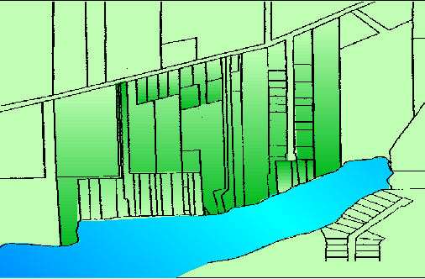
Land Division and Access Problems
Strip Development
Flag Lots
Cul-de-sac
Bowling alley lot
Notes:
Lot split activity on major corridors continues to create long-term access problems.
Solutions include lot split ordinances, flag lot restrictions in local codes, increased minimum lot frontages, and connectivity requirements.
Note: This slide includes animation.

Slide 8
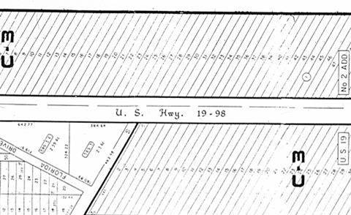
Narrow Lots on Strategic Highway
Notes:
Land division patterns along a handful of Florida’s Strategic Highways demonstrate frontage being stripped and one of the worst examples involves “bowling alley” lots of about 50 feet frontage and nearly 1000 feet deep. Although commercially zoned, these lots did not particularly function for commercial development so they were being consolidated to the extent someone wanted to build. Still, the implication was lots of individual closely spaced driveways and landowners were using the technique to obtain access without the cost of building a road.

Slide 9
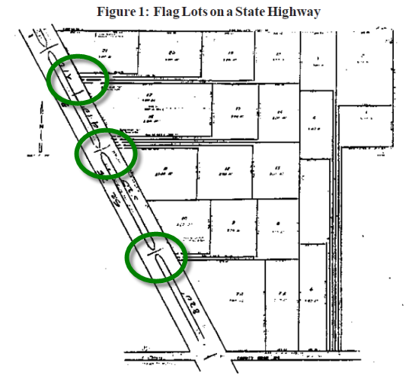
Flag lots on State Highway
This area was divided into 3-acre flag lots to avoid subdivision review. Staff worked with property owners to promote streets at median opening locations.
Notes:
“Flag” Lots
This is an example of a particularly poor land division practice called the “Flag” lot,
You can see, the land was divided into many individual lots stacked on each other.
3. All properties are given access to the state highway through a series of narrow 8 ft’ “Flag Poles”
4. Since all of these individual “flag poles” cannot really serve this property when fully developed
Therefore, the local government worked with the property owners to provide 3 public roads (rather than the “flag poles”) where you see the green circles
Again, in this case, the flag lots were stacked so each could obtain highway access and divided into 3 or more acres to avoid subdivision review and the associated cost of platting and providing roads. They could simply be recorded with the county of record.
Lot split regulations
Subdivision regulations
This area in northern Florida was divided into 3-acre lots to avoid subdivision review. The resulting flag lot "plat" creates long-term access problems on a state highway and county road. Problems such as this can be prevented with flag lot restrictions and a review process for minor subdivisions and lot splits.

Slide 10
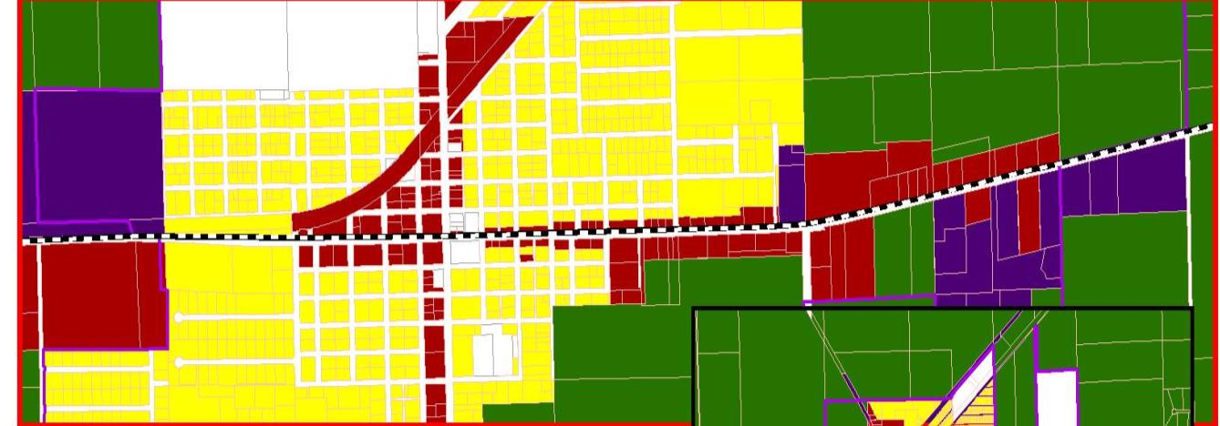
Land Use Plans and Zoning
Commercial strip zoning creates arterial access management challenges.
Notes:
This example from a small town in Florida illustrates what has occurred across the country. Whereas historically, towns were built on a platted system of streets and blocks, they now evolve largely through the development process. The elected officials are pressured to approve commercial rezonings along major roads and these small properties use the arterial for direct driveway access. This land use plan and the corresponding property ownership patterns clearly show this.

Slide 11
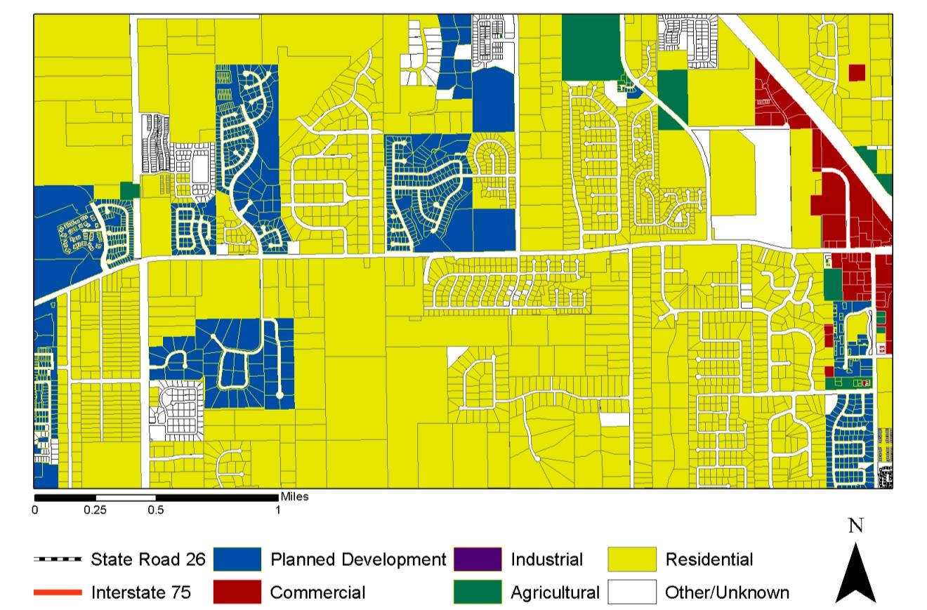
Discontinuous Local Networks
Notes:
Another issue is the lack of continuity and connectivity of the street networks that emerge.

Slide 12
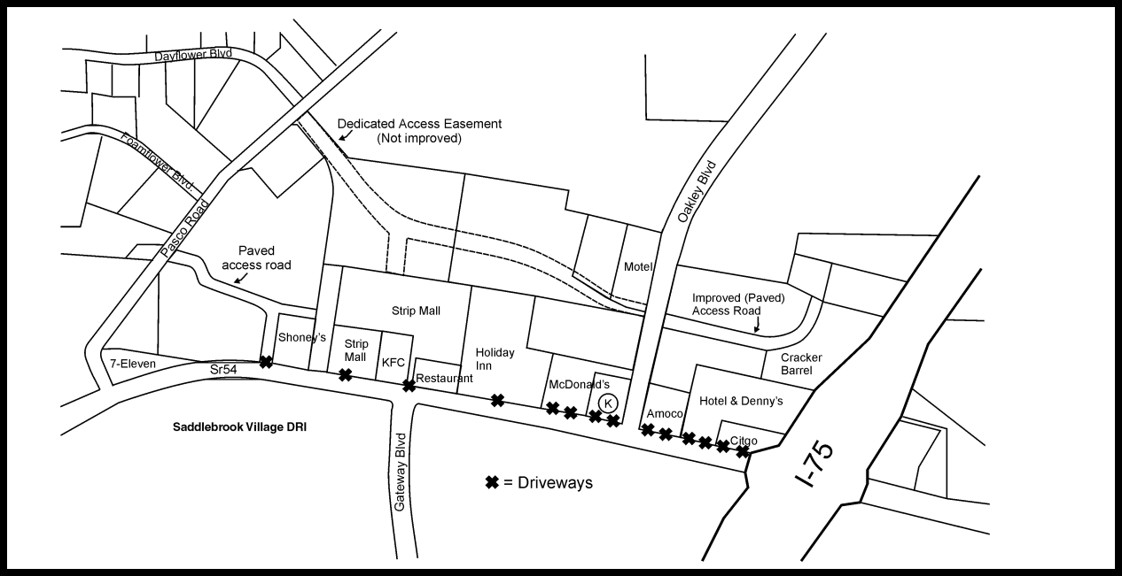
Interchange Areas
1999
Notes:
This is an example of interchange failure due to poor access management. In this northwest quadrant, there are ten driveways within 1100 feet of the taper; nearly every parcel has two driveways. The first driveway, to a gas station, was less than 25 feet from the end of the off-ramp taper creating serious conflicts. The first access road is located about 630 feet from the taper, currently serving a Cracker Barrel Restaurant and a hotel. A planned easement was not developed. Just ten years earlier, this interchange was nearly undeveloped.

Slide 13
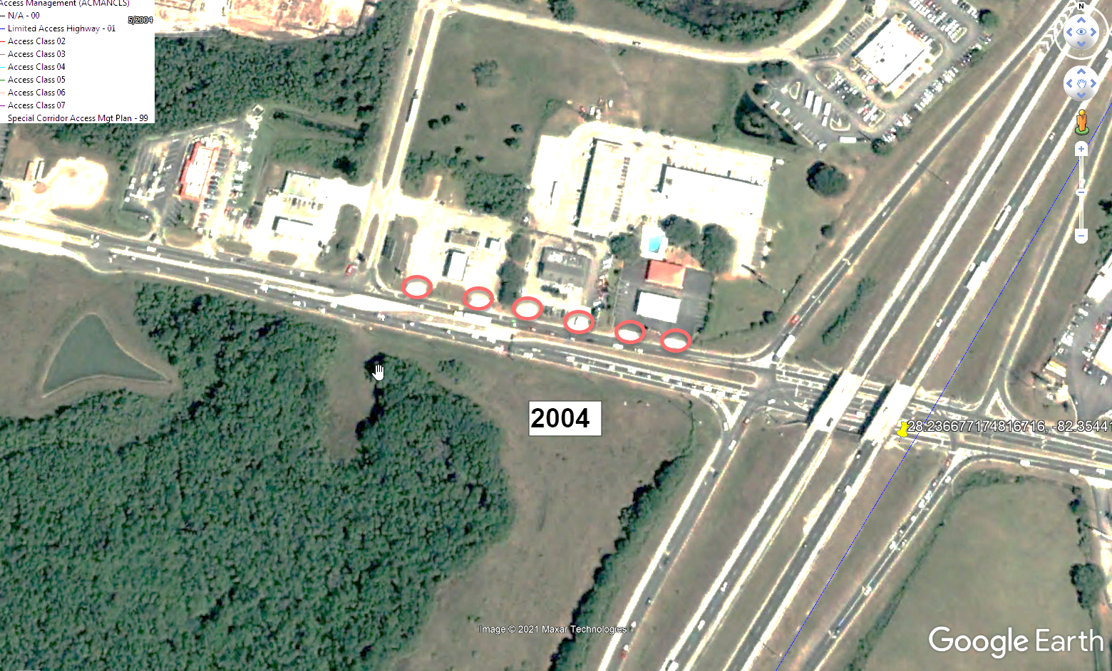
State DOTs have authority within the state roadway right-of-way
Local governments have authority over land use and development

Slide 14
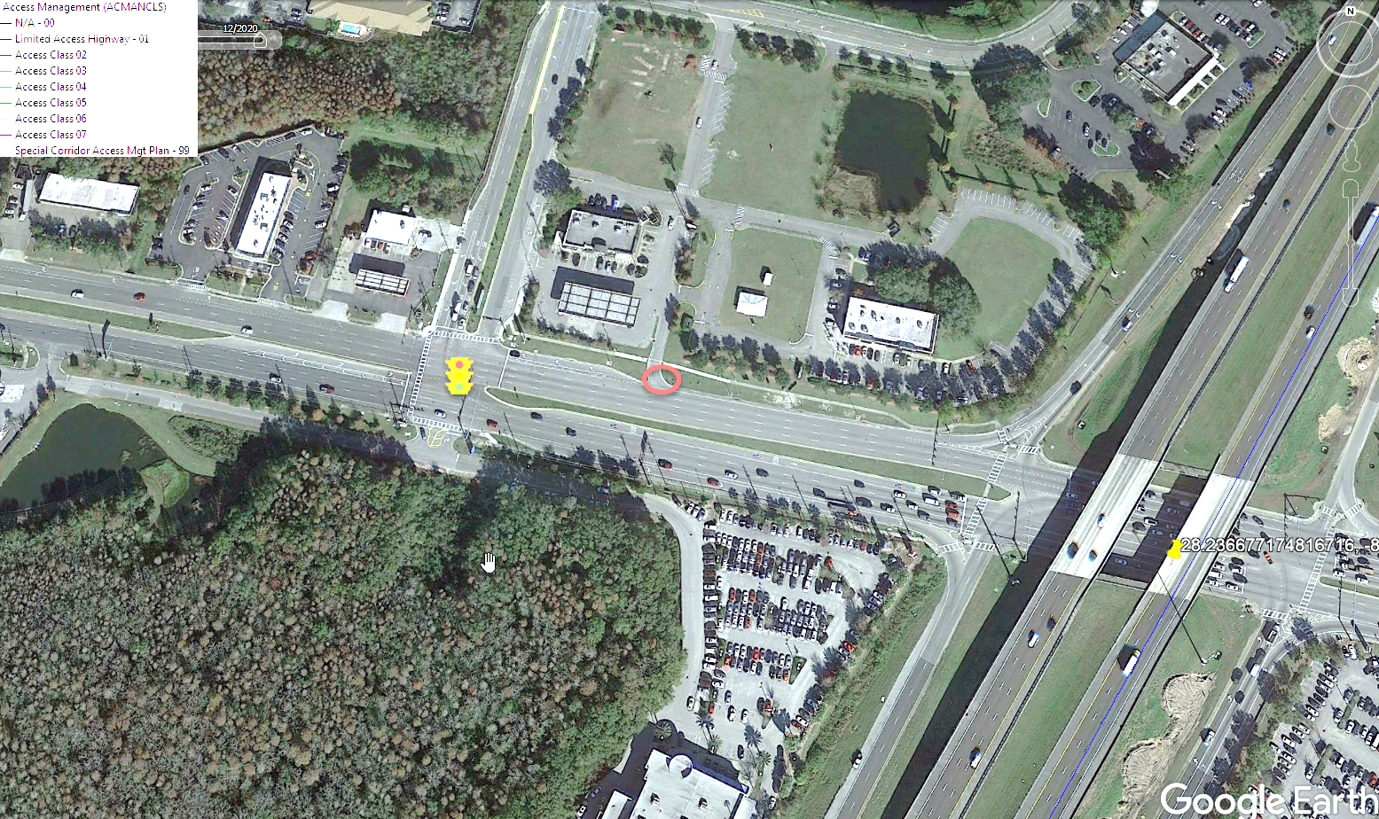
State DOTs have authority within the state roadway right-of-way
Local governments have authority over land use and development
Another Fact – Real access management success comes when we manage both sides of the right-of-way
2020
Notes:
The internal circulation network (area shown) and the easement serving interior land were improved to provide a supporting network. (read the facts of life. And in this case the potential for economic development by providing better circulation to internal properties.

Slide 15
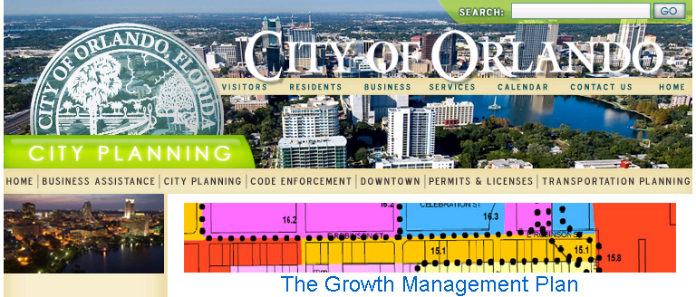
Access Management Policies
Policy 1.5.2 The City shall preserve the movement function of the major thoroughfare system by requiring development of parallel roads or cross access easements to connect developments as they are permitted along major roadways.
Notes:
Policies supporting access management should also be included in the comprehensive plan or thoroughfare plan, like this one from Orlando stating the City’s commitment to preserving its thoroughfares by requiring the development of parallel roads or cross-access easements connecting developments along these roads.

Slide 16
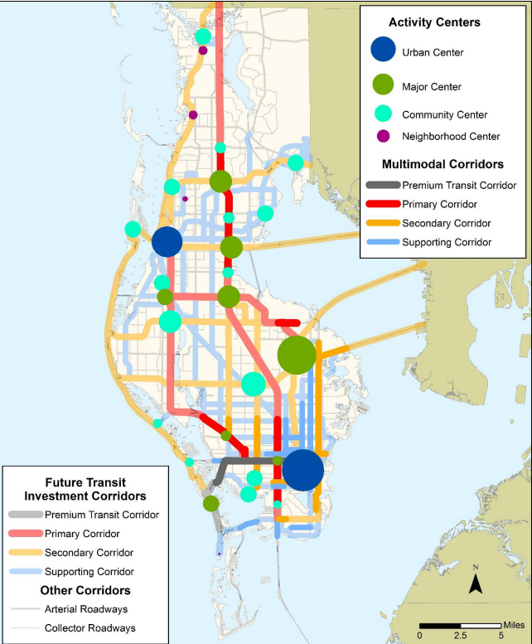
Activity Center Strategies
Support internal circulation and consolidate access
Help counter urban sprawl
Create multimodal destinations
Forward Pinellas, The Countywide Plan
Notes:
From a land use planning perspective, a key access management strategy is to discourage strip development and promote organization of land uses into activity centers with unified access and circulation systems. This creates destinations that can be served by transit, as well as the auto, and that can be designed for walkability. Activity centers are an antidote to the commercial strips caused by strip commercial zoning along major roadways, which is a defining characteristic of urban sprawl. Preserves the function of transit corridors. Here you can see the implicit hierarchy of primary and secondary multimodal corridors for transit investment and activity centers.

Slide 17
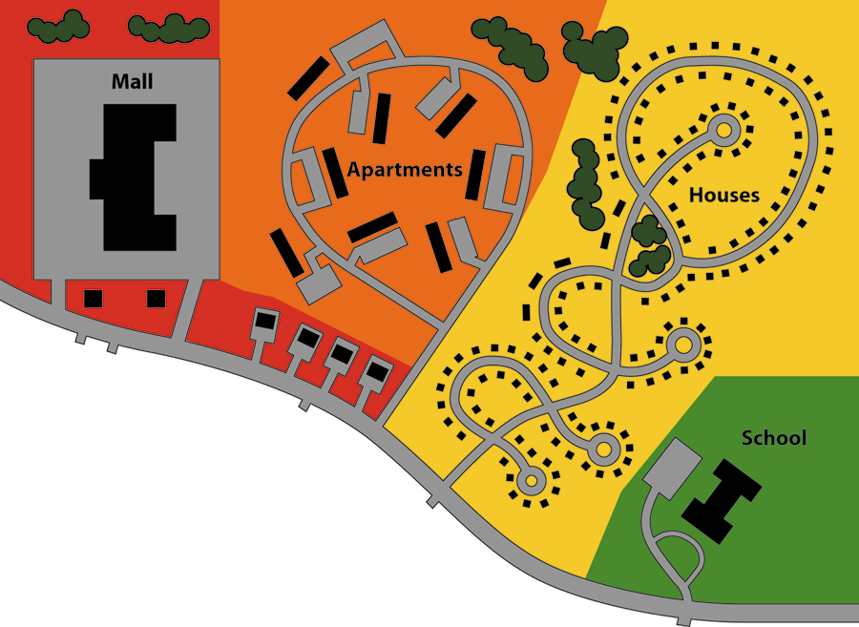
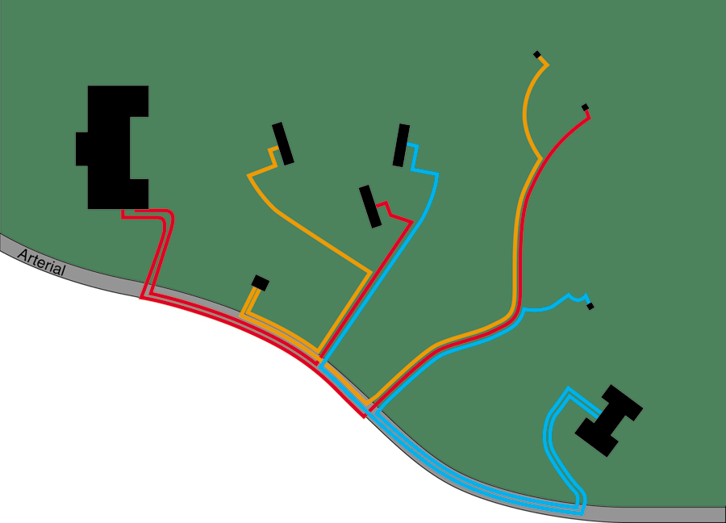
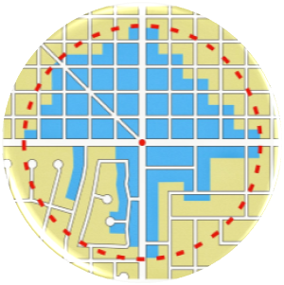
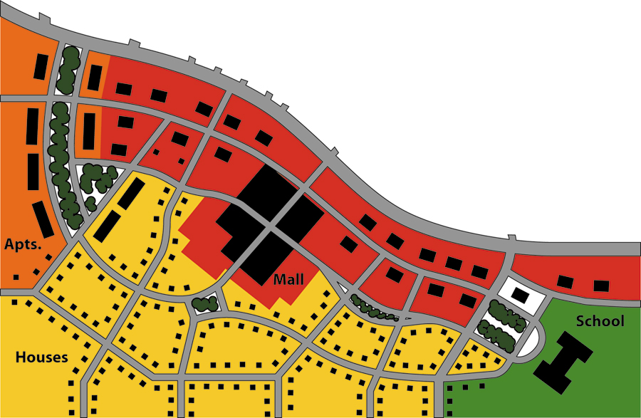
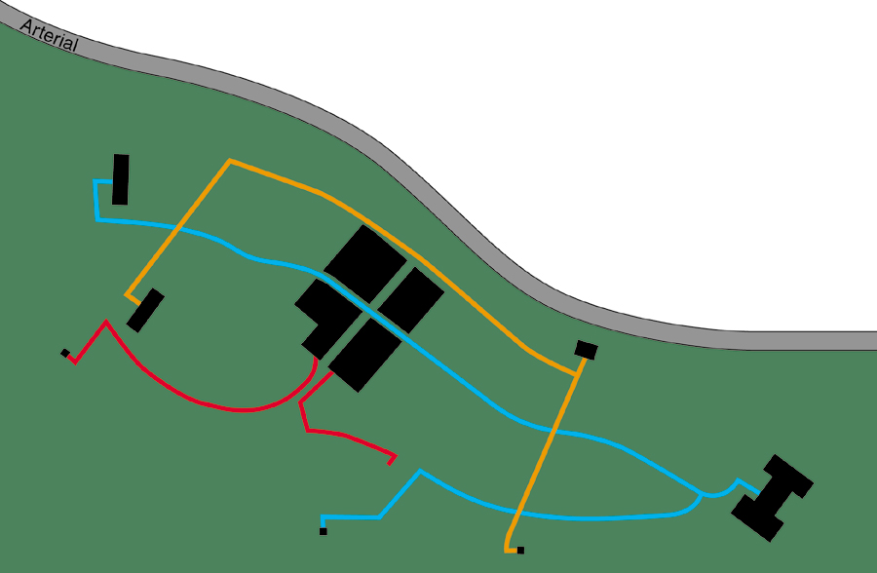
Access, Connectivity & Congestion
The blue area is where you can reach the center in a five-minute walk.
Source: Dan Zack/plannerdan.com
Notes:
Why activity centers? Let’s look at two scenarios – Segregated land use patterns force all automobile trips onto the same arterial roadway intended to accommodate through movement. Streets are often intentionally planned to not connect, to keep “incompatible” traffic out of the neighborhood. Trips from home to school or shopping can be very lengthy.
Integrating land uses on a network helps to remove short local trips from the arterial, reduce the need for direct arterial access, shorten trip lengths, and generally increase the potential for bicycle and pedestrian circulation. See for example the graphic comparing grid and disconnected networks. The blue area is where one can reach the center in a five-minute walk.
Closing gaps in sidewalks and bike lanes, and connecting sidewalks to developments and transit stops, provides a continuous network that improves bicycle and pedestrian mobility and access for persons with disabilities.
Safe arterial mid-block crossing opportunities, such as pedestrian islands and signalized crossings, support pedestrian access at logical locations, such as transit stops, schools, parks, and shopping centers.
Benefits of connectivity
Reduces the need for direct arterial access
Removes short, local trips from arterials
Increases sites having signalized access on major, high-volume roadways
More sensitive layout of streets and lots
Increases the convenience of alternative modes
Improves accessibility of neighborhoods to commercial goods and services
Note: This slide includes animation.

Slide 18
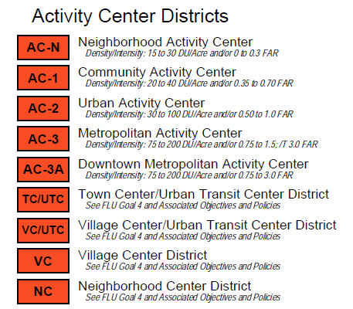
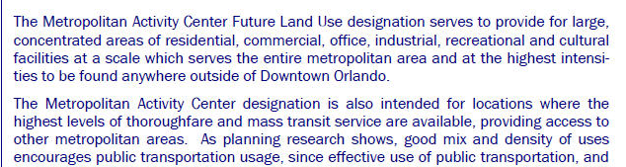

Activity Center Strategies
Notes:
From a land use perspective, activity center strategies can really benefit access management. This example from the City of Orlando is an effective approach, with varying levels and types of centers, ranging from metropolitan centers to those focused on transit, to smaller neighborhood centers.
Note: This slide includes animation.

Slide 19
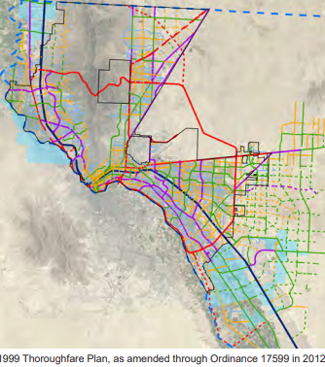
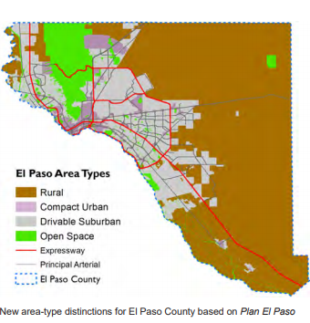
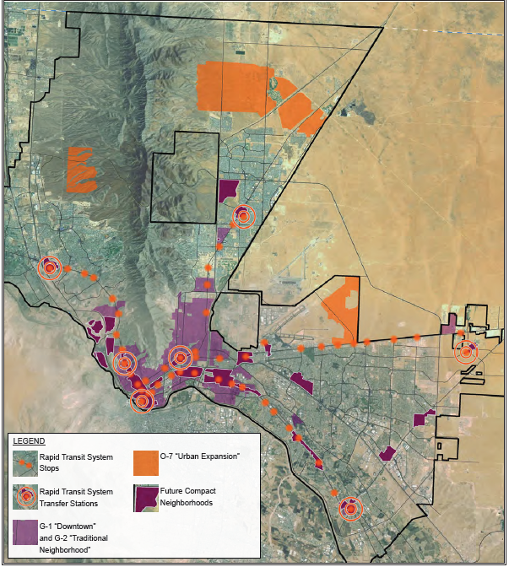
Linking Land use and Thoroughfare Plans
Defines place types and general land use vision
“Compact Urban” versus “Drivable Suburban”
Promotes regular spacing of continuous streets
Locates mixed-use “town centers” along major corridors & transit lines
Notes:
In sum, regular spacing of continuous streets and mixed-use activity centers supported by dense connected local street networks are important principles of access management planning. Other strategies to link land use and thoroughfare planning are to define the place types to give them context for street design and access. All of these ideas are contained in the El Paso plan for example. Developers of the plan note that the Texas Department of Transportation finds these designations helpful in clarifying local intentions and uses them in its roadway classification and design determinations for El Paso, rather than the broader FHWA urban/rural categories which offer little guidance to complete streets design.
The I-95 Corridor Mobility Planning Project in Broward County is a Florida example (large multi-agency collaboration with DOT, MPO, and local agency)

Slide 20
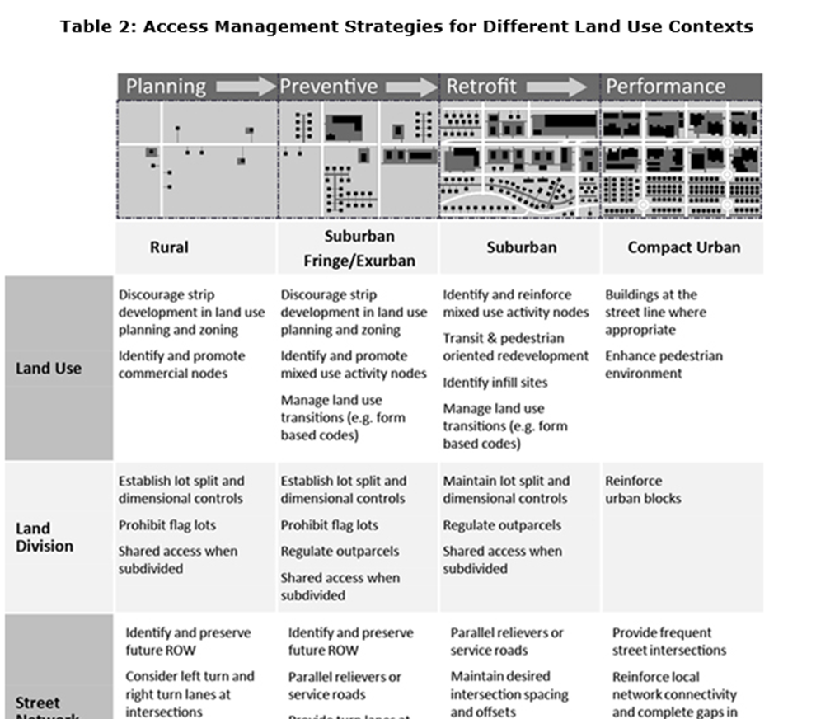
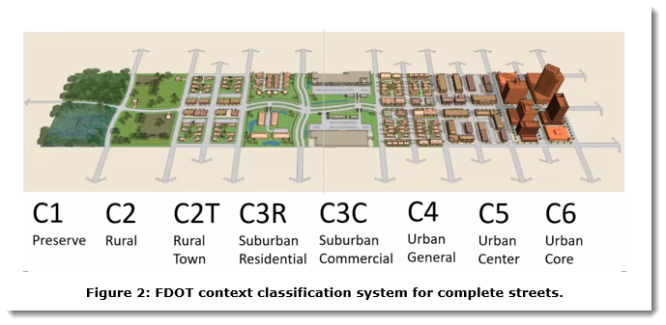
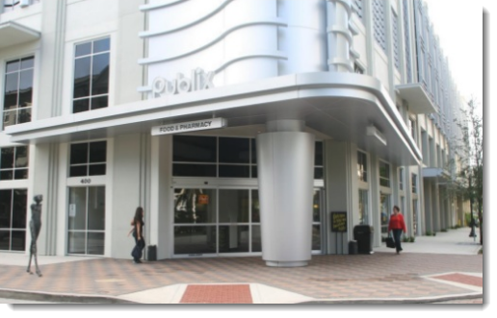
AM and Land Use Context
Notes:
Like street design, access management strategies differ by land use context. The TRB Access Management Manual includes a conceptual table identifying how the strategies might differ. For example, planning and preventive strategies are most critical to control the division of highway frontages in rural and developing suburban areas, whereas reinforcing urban blocks is and appropriate strategy for compact urban areas.
Note: This information is available in the TRB Access Management Manual (2014).

Slide 21
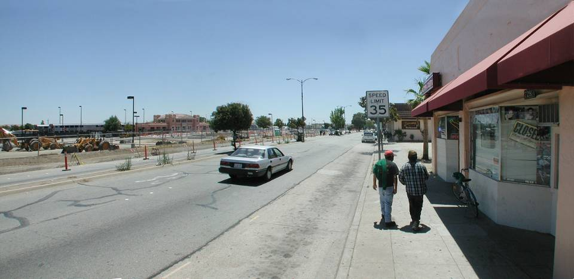
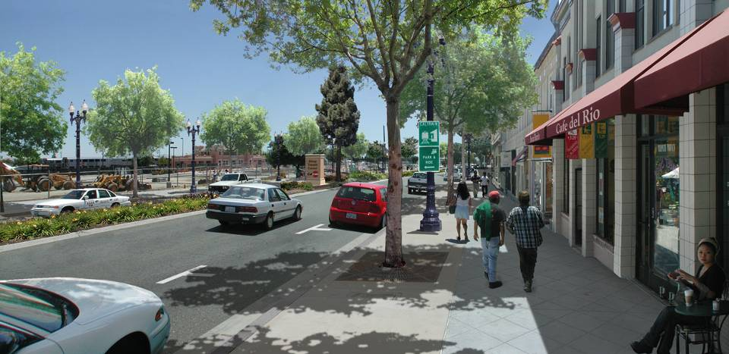
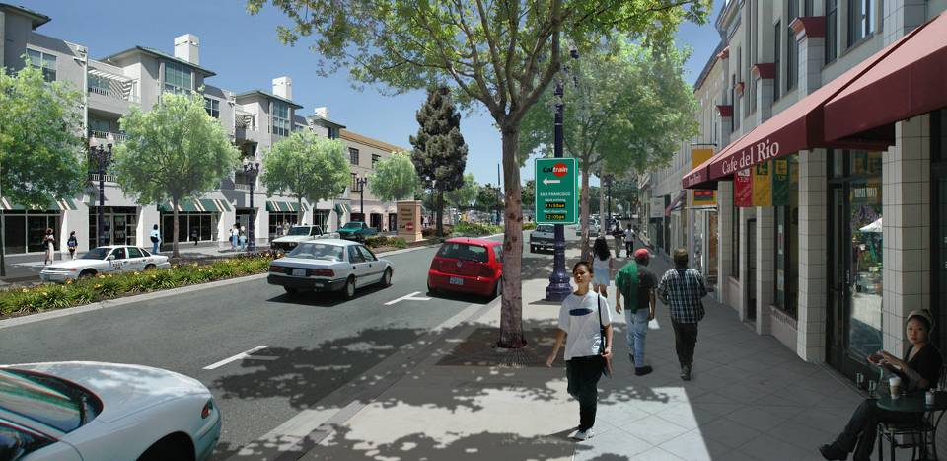

Access and the Multimodal Environment
Source: Urban-Advantage.com
Notes:
In compact urban centers and downtown, we also need to focus more on managing and improving access for pedestrians, cyclists, and transit users, as well as managing the curb for other uses, parking, TNCs, and delivery vehicles.

Slide 22
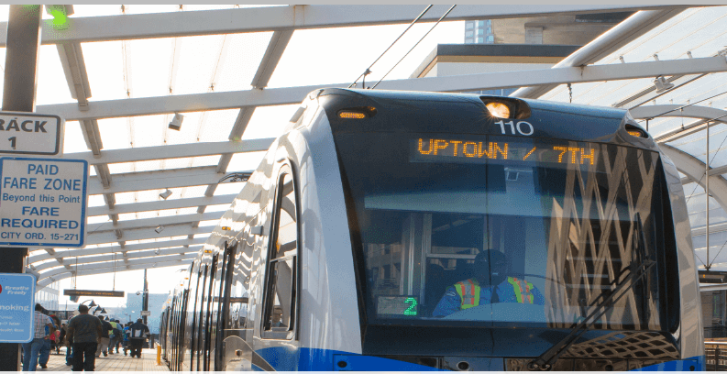
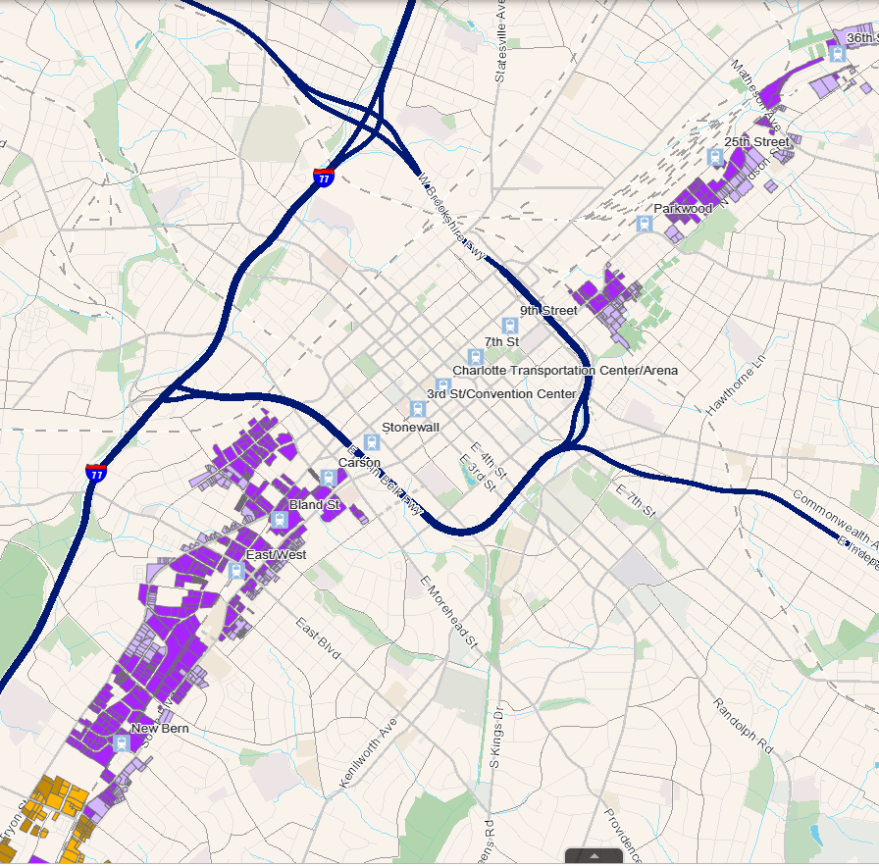
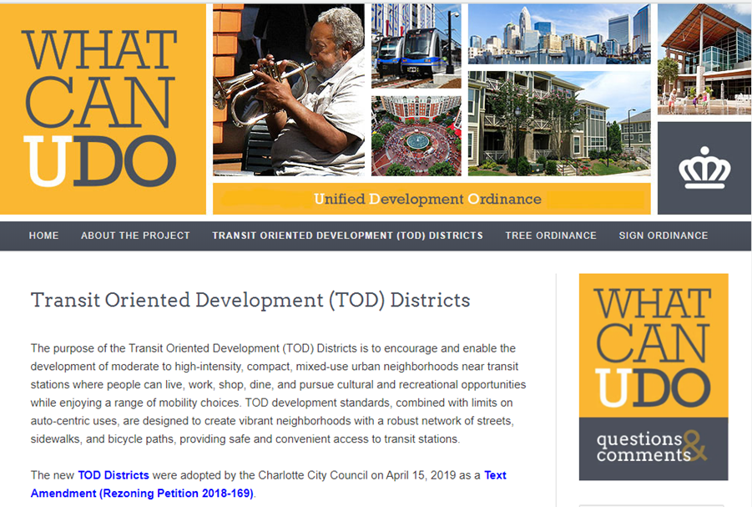
City of Charlotte, NC TOD Districts
Protects curb from driveway access
  All access to parking must be at the side or rear and from the secondary frontage, when available.
  No new curb cuts when alternative access is available.
  No surface parking and travel aisles in front of the building along the frontage.

Slide 23
Control Lot Splits
Regulate lot splits and promote network development.
Local St.
Arterial
50'
50'
80'
60'
80'
60'
(property lines)
Prohibit small lot frontages with no alternative access
Notes:
Good planning and policies and regulations that promote the organization of land uses on a street network can prevent this problem. Controlling lot splits through lot split ordinances, access management plans, and related methods is critical to corridor management.
Note: See the Guide for Analysis of Corridor Management Policies and Practices for regulatory language and ideas.

Slide 24
Lot Split Regulations
Lot Splits: No new or additional access rights will be permitted for properties created as the result of parcel or lot splits subsequent to enactment of this ordinance.
  Citrus County, FL US-19 Ordinance 2003
No additional access rights will accrue and no additional access will be provided upon the splitting or dividing of existing parcels of land or contiguous parcels under the same ownership or controlling interest. All access to the newly created properties shall be provided internally from the existing access or a new access determined by the permit application or subdivision procedures.
  Colorado Dept. of Transportation, Access Code
Notes:
How a state and local agency might approach this type of policy. This simple requirement on US Highway 19, for example, stopped the splitting of highway frontage. It was combined with a broader access management plan that required street network development and interparcel cross-access.

Slide 25
Joint and Cross Access
Good Separation
Rear Cross Access Drive
Good Separation
Front Cross Access Drive
Acceptable Separation
Zig-Zag Cross Access Drive
Notes:
Cross-access regulations require businesses to connect parking lots, share driveways, and provide side street access. They are sometimes assigned to a roadway through special corridor regulations or overlays.
Note: This slide includes animation.

Slide 26
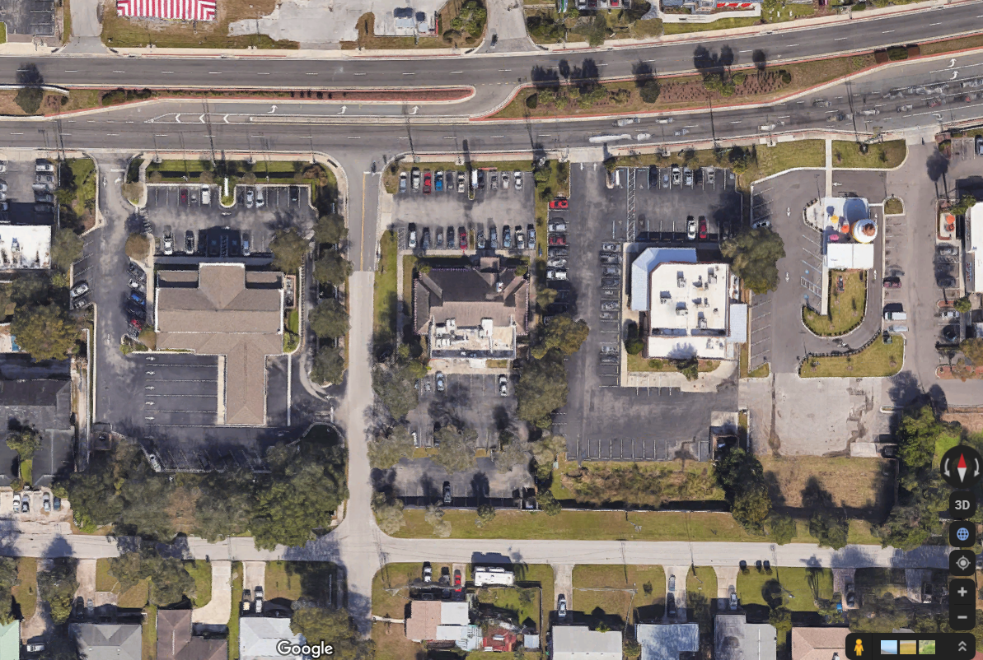
Require Side Street Access
Reduces local traffic circulation on major roadways.
Improves accessibility from the neighborhood.
Notes:
This example shows the addition of side street access at a bank, where previously none was present. Adding this provides improved accessibility to the abutting neighborhood and thereby helps reduce traffic circulation on the major road. Some cities prohibit side street access to businesses where residential development is nearby. Check local regulations for prohibitions on side street access and remove those regulations. They reduce accessibility to corridor businesses and are particularly inconvenient for the neighborhoods they seem to be designed to protect.

Slide 27
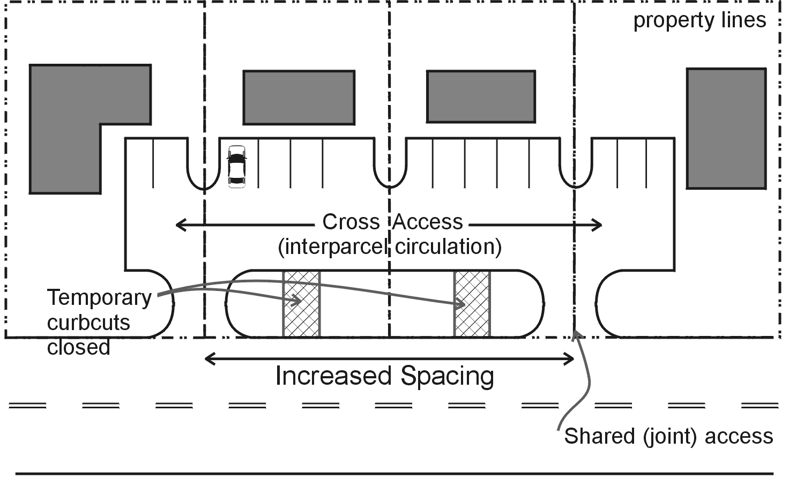
Cross Access Regulations
Apply to new development & redevelopment
Owner records cross access easement with deed
Agreement to close any temporary driveways
Joint maintenance agreement, can be prorated
Exceptions where impractical
Notes:
Variances and waivers are provided where cross-access is impractical. Existing sites cannot be required to connect, only encouraged, but if there is a change in use or the site is redeveloped, they can then be required to connect.

Slide 28
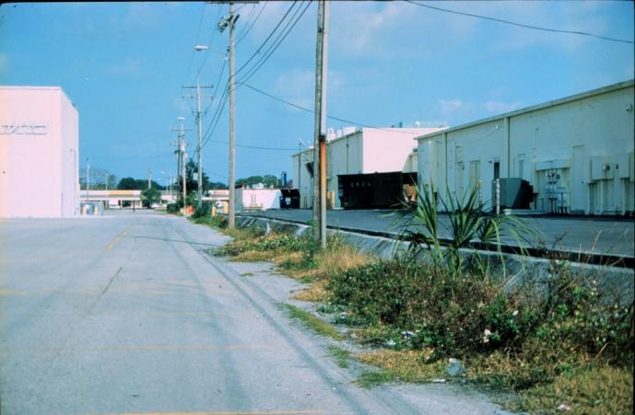
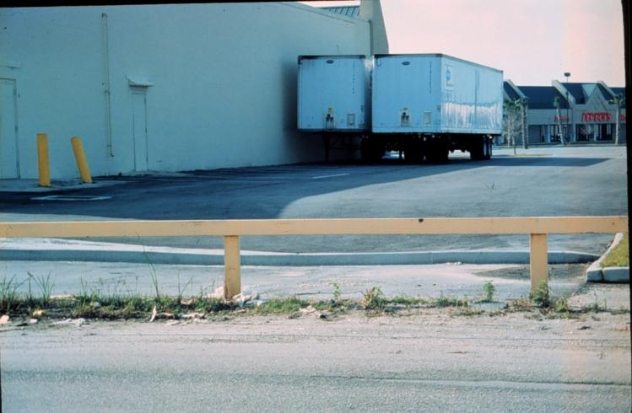
Two Adjacent Shopping Centers
Traffic between two shopping centers must circulate on a congested highway,
due to a lack of interparcel connection.

Slide 29
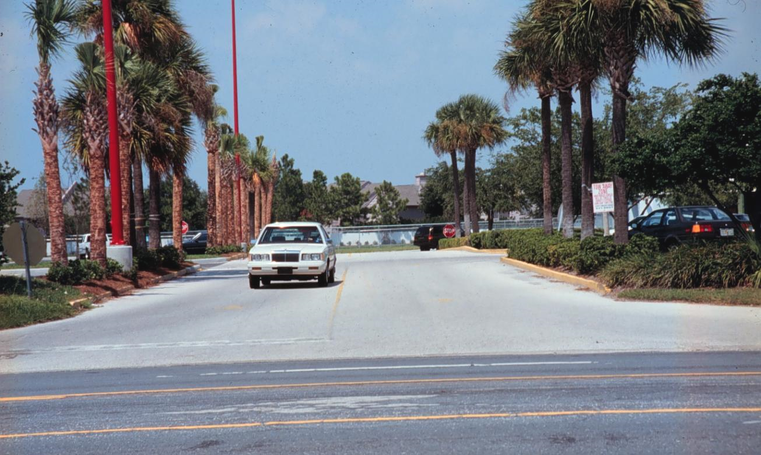
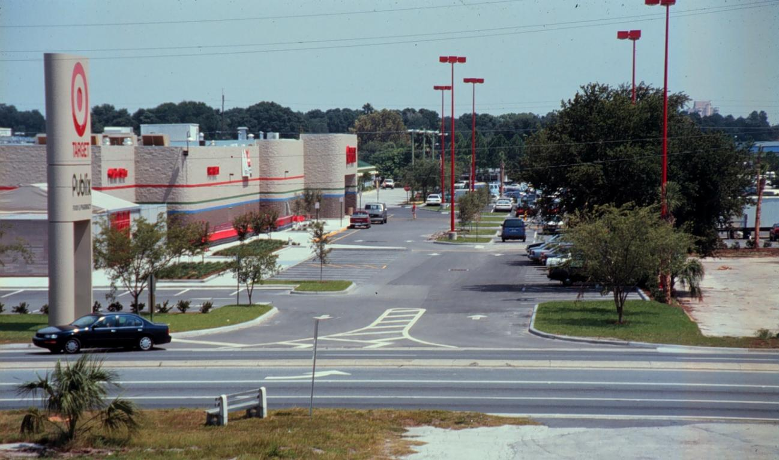
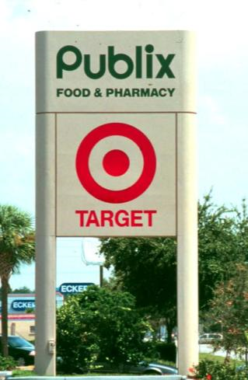
Shared Access and Signage

Slide 30
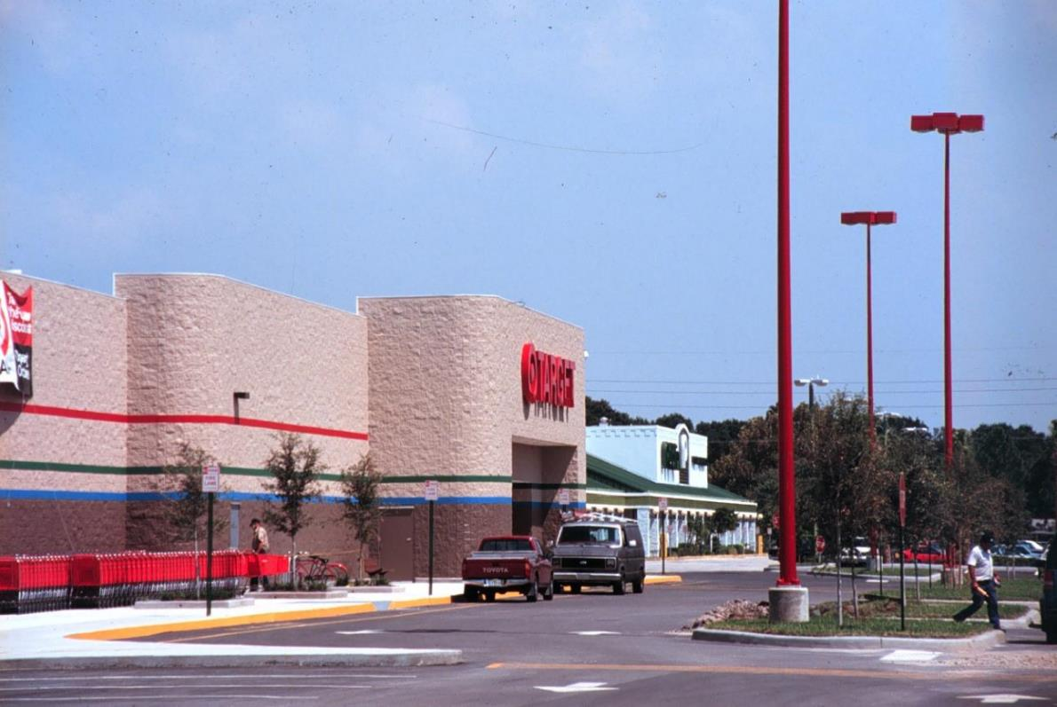
Interparcel Circulation

Slide 31
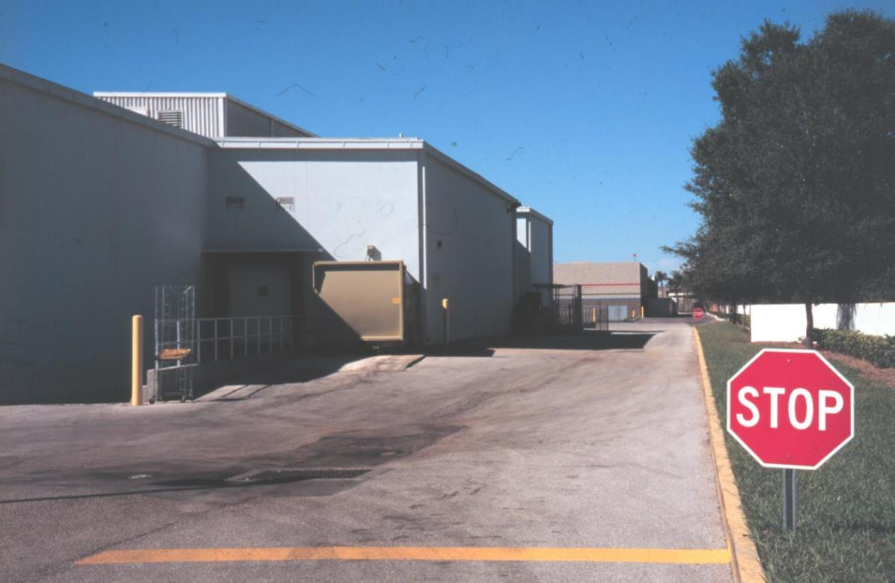
Shared Service Drive

Slide 32
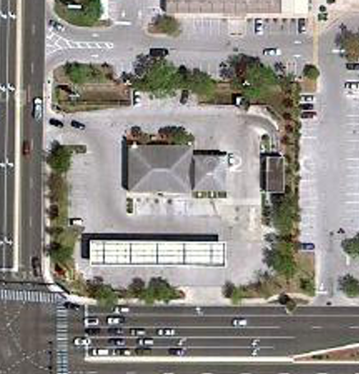
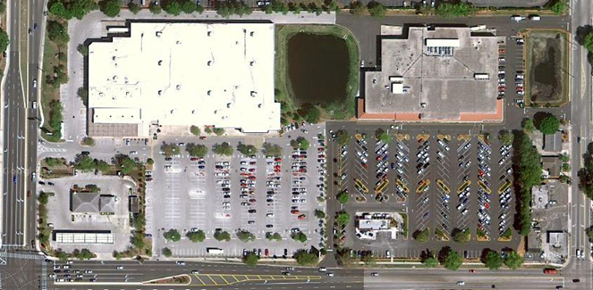
Unified Access and Circulation
Notes:
This example shows a Target and a grocery store that have a unified access and circulation plan. The site has joint-use driveways, shared signage, and truck delivery access to the rear of the sites. At the left of the slide is a gas station that was not connected.
Suggestion:
Ask your students the following questions and encourage them to discuss their responses:
How might you require unified access and circulation if the site redevelops? (Answer: Ask the shopping center site owner to sign an agreement to provide cross access into the site during the development process and when the site redevelops require the new owner to internalize access to the gas station with the shopping center. If the shopping center owner refuses it cannot be forced. However, it could be enforced if the cross-access provision to the gas station had been recorded with the original deed if regulations were in place when the site was first adopted.)
How might the cross-access and circulation be designed?
Note: This slide includes animations. The image on this slide is also used in Module 1 of the Access Management Curriculum.

Slide 33
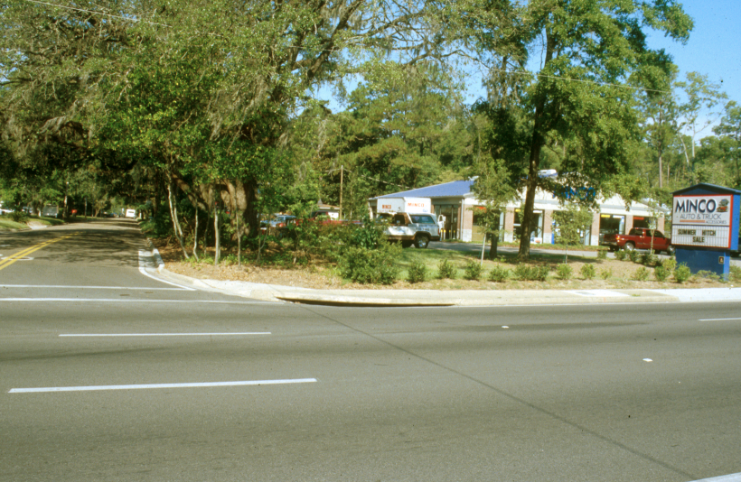
Side Street Access
Provide side street access to commercial uses abutting major roadways.
Business with no side street access
Notes:
Side street access improves accessibility from the neighborhoods and reduces local traffic circulation on major roadways. There is a tendency to prohibit side street access to businesses where residential development is nearby. Check local regulations for prohibitions on side street access and remove those regulations. They reduce accessibility to corridor businesses and are particularly inconvenient for the neighborhoods they seem to be designed to protect.
The example on the right shows a bank that was originally developed with no side street access. When the two-way left-turn lane was removed from the highway and replaced with a median, the bank owners provided the new side street access making it much more accessible to the neighborhood surrounding the site.

Slide 34
Pedestrian and Transit Access

Slide 35
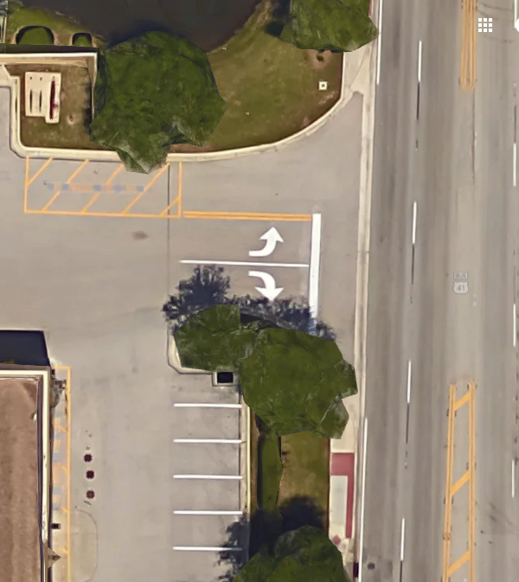
Driveways are for pedestrians too!
A grocery store adjacent to a mobile home park with no pedestrian access to enter the site.
Notes:
This driveway requires elderly residents of the adjacent mobile home park to walk in the driveway where they are exposed to vehicle traffic.

Slide 36
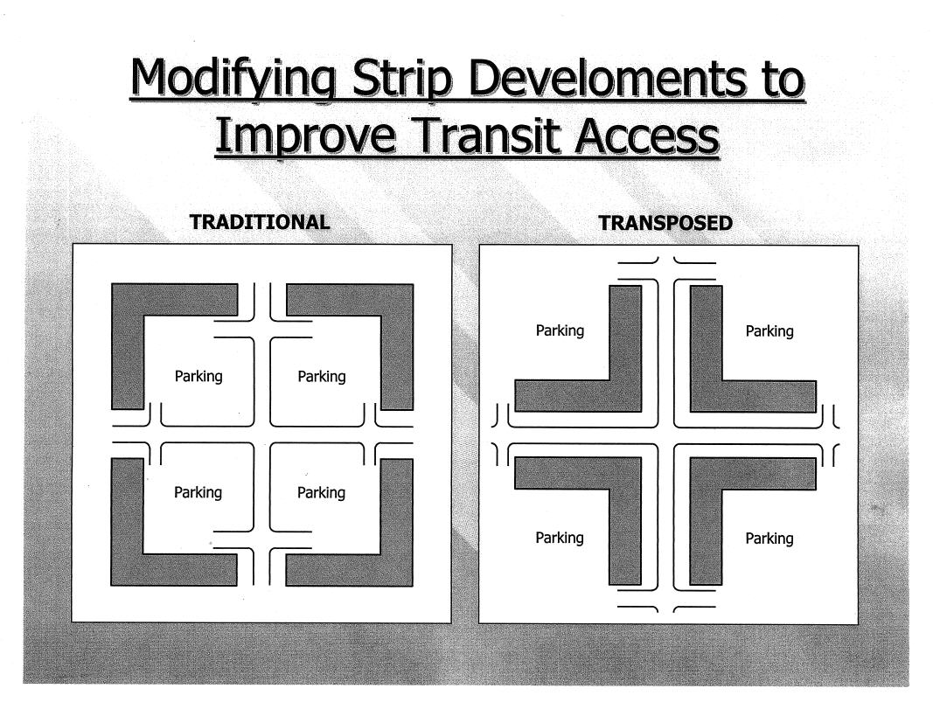
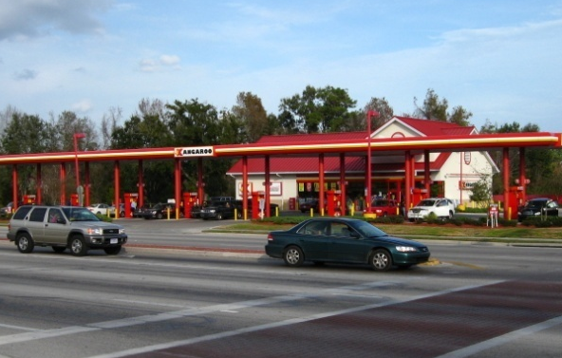
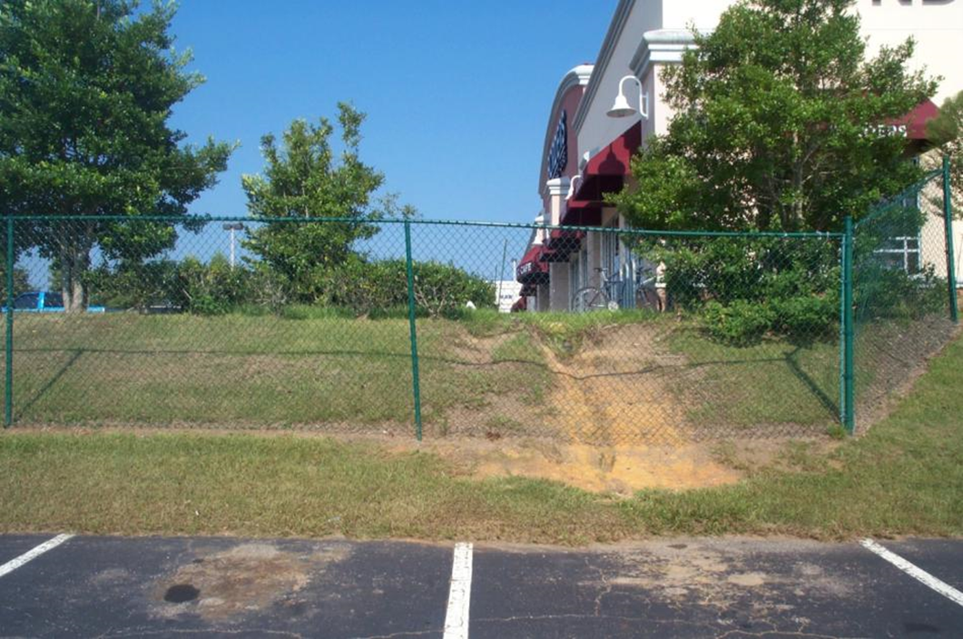
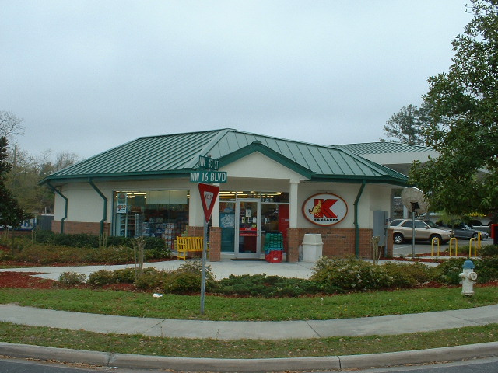
Pedestrian Access and Building Line
Connect paths between adjacent developments
Notes:
The design of access is in part a function of building location and setback. This arrangement makes pedestrian access to buildings and transit more convenient. It can be implemented with form-based zoning codes.
Note: The images on this slide are also included in modules 1 and 5 of the Access Management Curriculum.

Slide 37
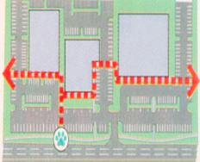
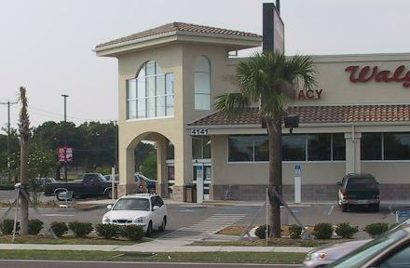
Pedestrian Connections
Pedestrian ways shall be provided between parking areas and from the building entrance to surrounding streets, external sidewalks, and outparcels.
Sample regulations
Pedestrian paths connecting adjacent buildings may be incorporated into the required landscape buffer.
Notes:
A walking tour on a corridor helps identify areas where people are unable to easily circulate. People prefer to take the shortest path and walk near buildings, through bushes, rather than walk some distance to the main sidewalk. Therefore, it is helpful to allow pedestrian paths closer to the buildings and space in the landscaped buffer between sites where people can cross.

Slide 38
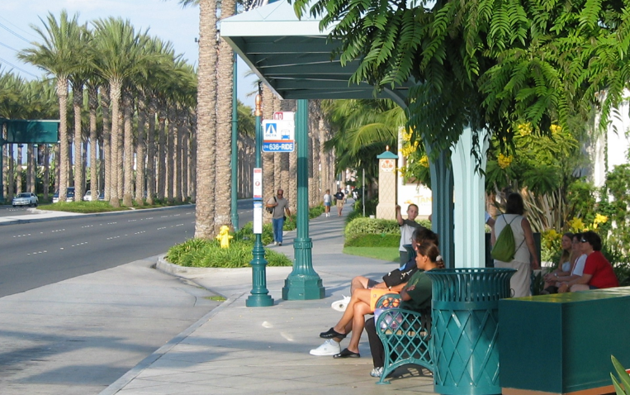
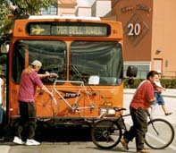

Bus Transit and Access Management
Pedestrian/bicycle connections with bus stops
Safe midblock crossings with medians
Internal transit access to shopping centers and other large developments
Notes:
Let’s consider bus transit, for example. Quality transit service requires speed, frequency, and reliability and therefore benefits from access management.
Measures that improve desired operating speeds and reliability for autos will also benefit buses except bus pullouts, which tend to delay buses but may be necessary for safety reasons on high-speed and high-volume roadways.
A traffic signal can be timed to reduce (eliminate) delay to a transit vehicle when the bus pullout is located downstream from the traffic signal.
Integrate pedestrians/bicycles with bus stops
Midblock median refuge can provide for safe crossings of pedestrians and bicyclists with minimum impact on vehicular delay and capacity. A midblock crossing can be signalized without interfering with traffic progression.

Slide 39
City of Charlotte, NC TOD Districts
Protects curb from driveway access
  All access to parking must be at the side or rear and from the secondary frontage, when available.
  No new curb cuts when alternative access is available.
  No surface parking and travel aisles in front of the building along the frontage.

Slide 40


Bike/Ped Access
Maintain continuity of non-vehicular pathways.
Provide direct connections to transit and midblock crossing locations.
Notes:
Even suburban areas can incorporate more direct pedestrian and cycle routes to transit or nearby destinations by connecting cul-de-sacs. Location: Irvine California; Culver Blvd.
Note continuity for pedestrian circulation leading to a bus stop (i.e., provides continuity for pedestrian movement but not for vehicles – this maintains low volume and very slow speed on streets providing direct access to homes.
A non-traversable median provides positive protection for pedestrians and bicycles
A median opening for pedestrians/bicyclists is needed wherever pedestrian generators – including bus stops – are located on opposite sides of the roadway
Pedestrian/bicyclist paths and street alignment should be coordinated to reduce the number of conflict areas (where paths and roadways cross)

Slide 41
Corridor Access
Management Strategies

Slide 42


Decision Tree for Driveway Closures
County Hwy 101 in Scott County, Minnesota
  41 entrances
  26 identified for closure
  voluntary agreements to close 20
Credits: Chris Chromy and M. Rasmussen
Notes:
Many locations are already developed, so we need strategies to clean up the access, usually in the context of roadway reconstruction projects. This decision tree was used to accomplish driveway closures on a highway in Minnesota, for example.

Slide 43


U.S. Highway 183, Vine Street
Corridor Master Plan
Reverse access roads
ROW dedicated by property owners
Funding 2/3 KDOT and 1/3 City
  City allowed to apply the value of dedicated ROW toward their 1/3 match
Notes:
The U.S. Highway 183/Vine Street System Enhancement Project. A corridor management plan established general standards and called for alternative access. It specified implementation parameters, including local code updates.

Slide 44
Corridor Access Management Concepts
City blocks & connected streets create walkable places, and transit destinations.
Pedestrian cut-throughs on longer blocks or connecting to transit stops.
Discontinuity & on-street parking on local streets reduce through traffic.
½ Mile
Cross Road
Cross Road
Minor Arterial
Minor Collector
Service road
Major Arterial Roadway
500’
Bus stop
Ped cut-through
The highway has a secondary road network of different sizes, capacities
  Crossroads
  Parallel routes
Side street intersections are separated from the highway based on traffic.
1000’
½ Mile +/-
Parallel Collector
“Place”
Parallel Reliever
Notes:
These corridor management concepts for major arterial roadways help maintain local and regional mobility. Connectivity is maintained while discouraging the use of local streets by through traffic through jogs or discontinuity, on-street parking, traffic calming measures, and bike/ped cut-throughs.
Note: This slide includes animation.

