Slide 1
Effects of Access Management
Module 2

Slide 2
Learning Objectives
Explain the benefits of access management to transportation systems, urban form, and the economy.
Describe how equity, sustainability, and resilience are impacted when access is not properly managed.
Apply basic methods to evaluate the impacts of access changes.

Slide 3
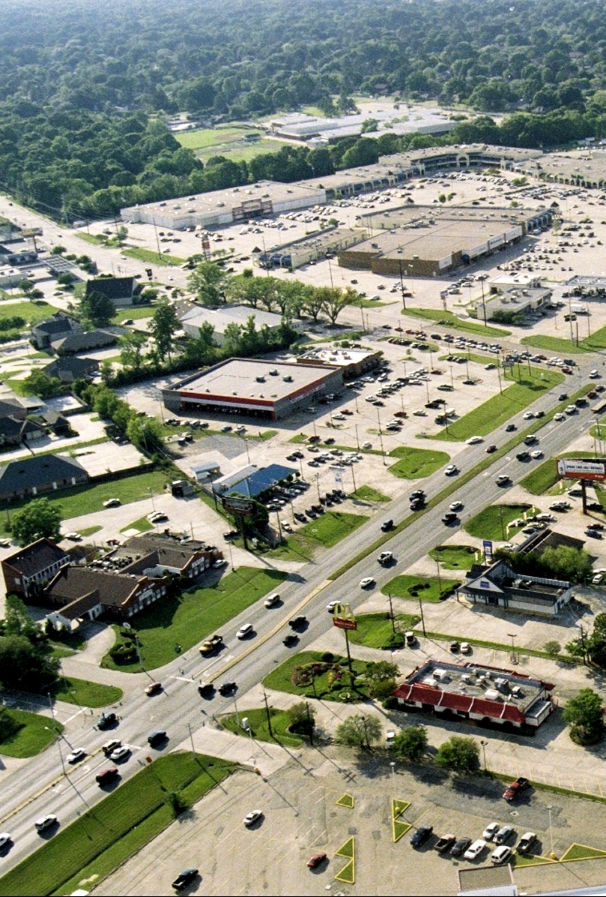
Typical Corridor Access Problems
Frequent and poorly designed driveways
Closely spaced signals and median openings
Inadequate street & site circulation networks
Lack of connections between adjacent land uses
Crashes, congestion, & poor aesthetics
Notes:
Poorly designed corridors create a hostile environment for pedestrians and bicyclists.

Slide 4
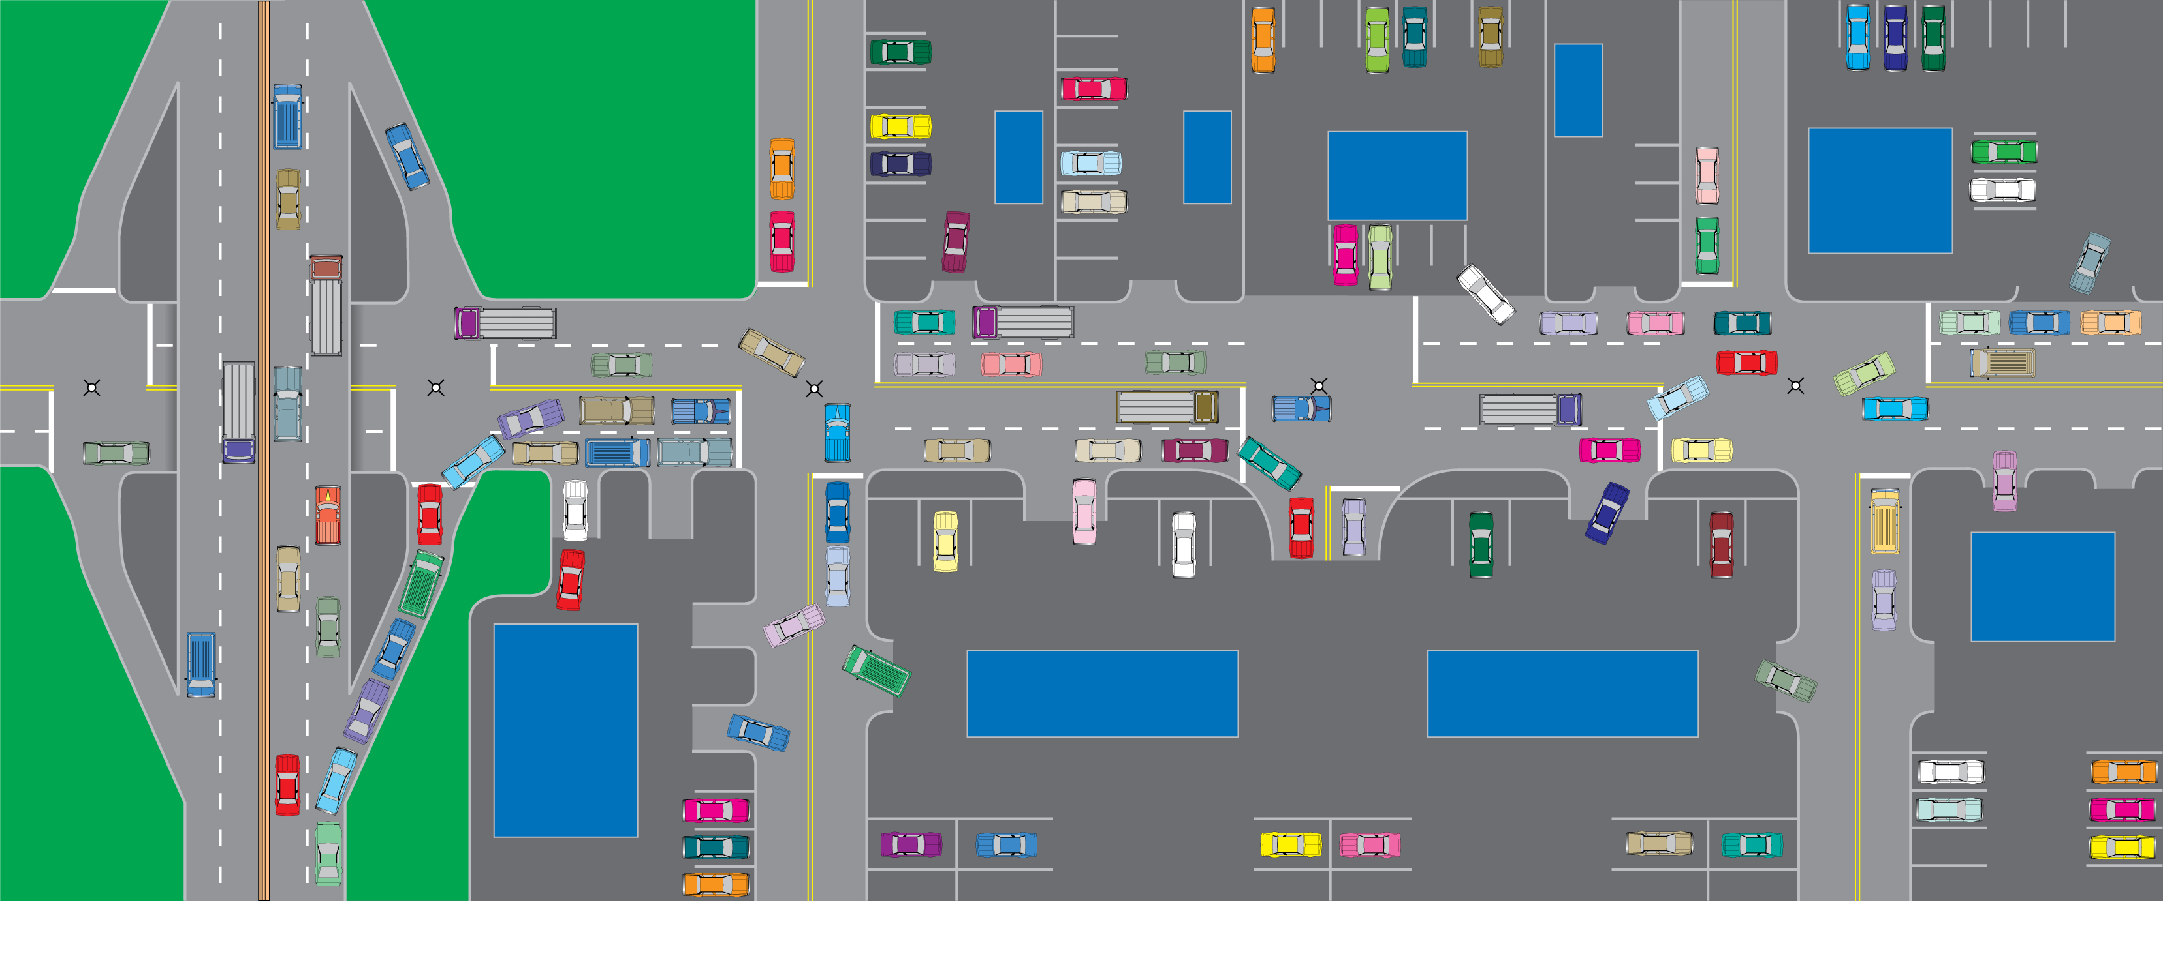
Results of Poor Access Management
Source: Urbitrans Associates, Inc.
Notes:
Poor access management creates safety and operational issues along corridors and for the entire roadway network.

Slide 5
Benefits of Access Management

Slide 6
Benefits of Access Management
Safety
Reduces crashes by up to 50%
Mobility
Increase roadway capacity 23% to 45%
Reduce travel time and delay 40% to 60%
Economic
Increased market area for businesses
Improved customer safety and convenience
Aesthetics
More area for landscaping
More attractive corridors

Slide 7
Benefits of Access Management
- Increases roadway capacity 23% to 45%
- Reduces travel time and delay 40% to 60%
- Increases market area for businesses
- Improves customer safety and convenience
- More area for landscaping
- More attractive corridors and gateways
- Reduces crashes up to 50%
- Improves predictability
Notes:
In general, studies show that an effective access management program can reduce crashes by as much as 50%, preserve roadway capacity, and reduce travel time and delay by as much as 40-60%. Doing so preserves the economic functions of our transportation system and the appearance of major roads that are often gateways into communities.

Slide 8
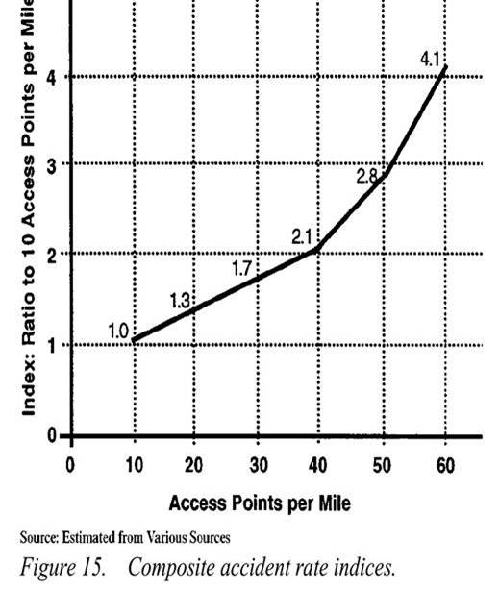
Crashes and Access Density
As access points increase, so does the frequency of highway crashes…
And the rate also increases
Source: NCHRP Report 420 1999 (estimated from various sources)
Notes:
The most comprehensive study, which looked at more than 37000 crashes and studies across the nation to develop crash rate indices, demonstrated the safety benefits. For example, this suggests that increasing access from 10 to 20 points per mile generally results in about a 30% increase in crashes. At 30, it would be a 70% increase, and then the crashes due to more access increase at an ever-increasing rate.

Slide 9
US 101 Study, Oregon
15
80
70
Number of
60
Access Points
10
Per Mile
50
Accidents Per Million Vehicle-Miles
Number of Access Points Per Mile
40
30
5
20
Accident
10
Rate
0
0
City Limit
Parkway
Source: Lall, et al, 1996
Comparison of Access Connections Per Mile with
Crashes per Mile on a segment of US 101 in Oregon
Notes:
This Oregon study shows it well, with crash rate in pink and the access density in purple. You can see the relationship. However, something happens in the parkway that moderates this effect. What do you think reduced the crash rate here in this location? (The presence of a median.)

Slide 10
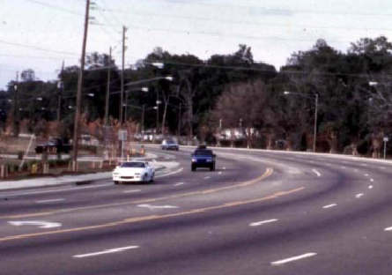
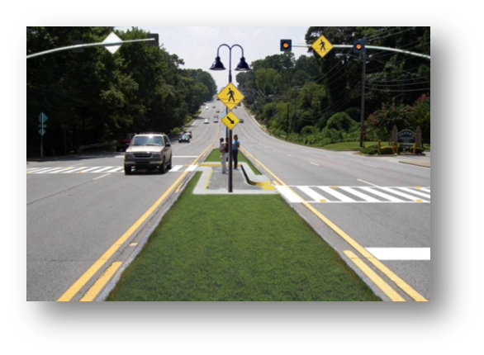
Medians vs. TWLTLS
Roadways with a median are about 30% safer than those with a TWLTL
Source: NCHRP Report 420
Notes:
NCHRP Report 420 includes extensive comparative evaluation and concluded the average crash rate on roadways with a median is about 30% less than on those with a TWLTL

Slide 11
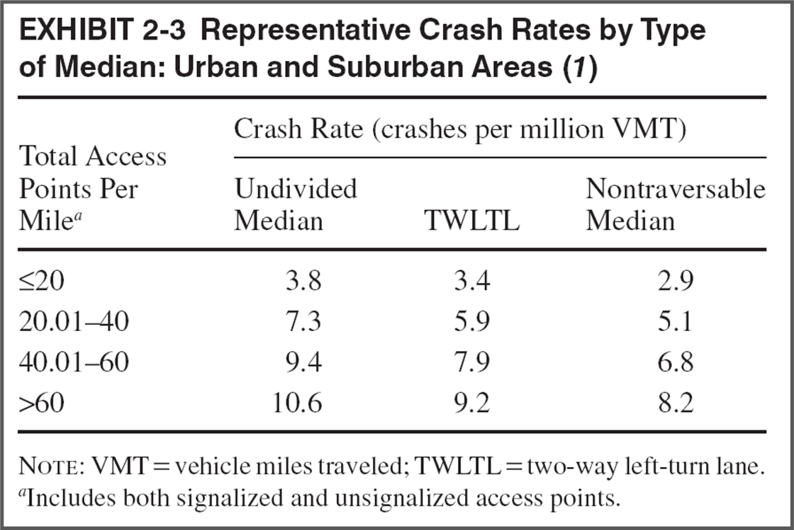
Median Type and Safety
Source: NCHRP Report 420: Impacts of Access Management Techniques (1999)

Slide 12
Effect of Left-Turn Bays on Crash Rates
Type of Crash | Crash Rates⁽¹⁾
 | Unsignalized |  | Signalized
 | No Left-Turn Lane | With Left-Turn Lane | No Left-Turn Lane | With Left-Turn Lane
Left-Turns | 1.20 | 0.12 | 0.65 | 0.37
All Other | 3.15 | 0.92 | 1.82 | 1.17
Total | 4.35 | 1.04 | 2.47 | 1.54
⁽¹⁾per million vehicle-miles

Slide 13
Operational Study – Right-Turn/U-Turn vs Direct Left-Turn
Over 300 hours of video
Actual analysis of evasive maneuvers (Conflicts)
Eight sites in Tampa Bay, FL area
Before and after available for one site where a full median opening was replaced with directional median opening
showed a 50% reduction in conflicts
Notes:
Source: Lu, J., S. Dissanayake, N. Castillo, and K. Williams. Methodology to Quantify the Effects of Access Management on Roadway Operations and Safety. (3 volumes). Florida Department of Transportation, 2001.

Slide 14
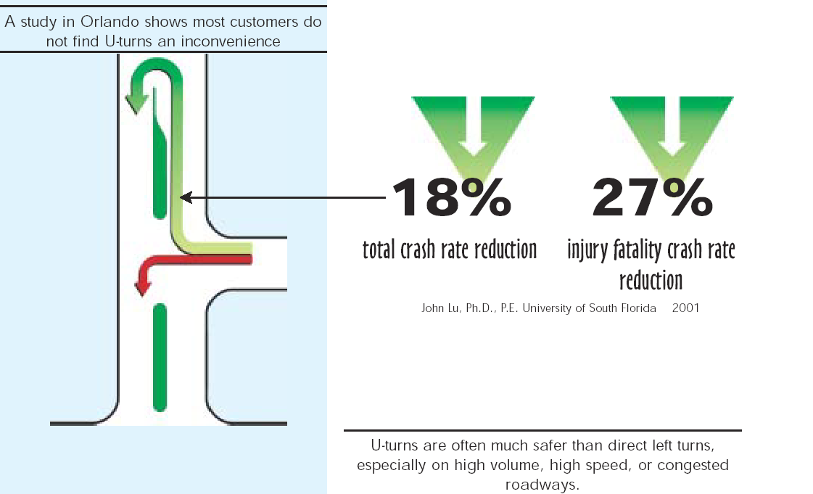
U-turns Are a Safe Alternative
Notes:
Source: Lu, J., S. Dissanayake, N. Castillo, and K. Williams. Methodology to Quantify the Effects of Access Management on Roadway Operations and Safety. (3 volumes). Florida Department of Transportation, 2001.

Slide 15
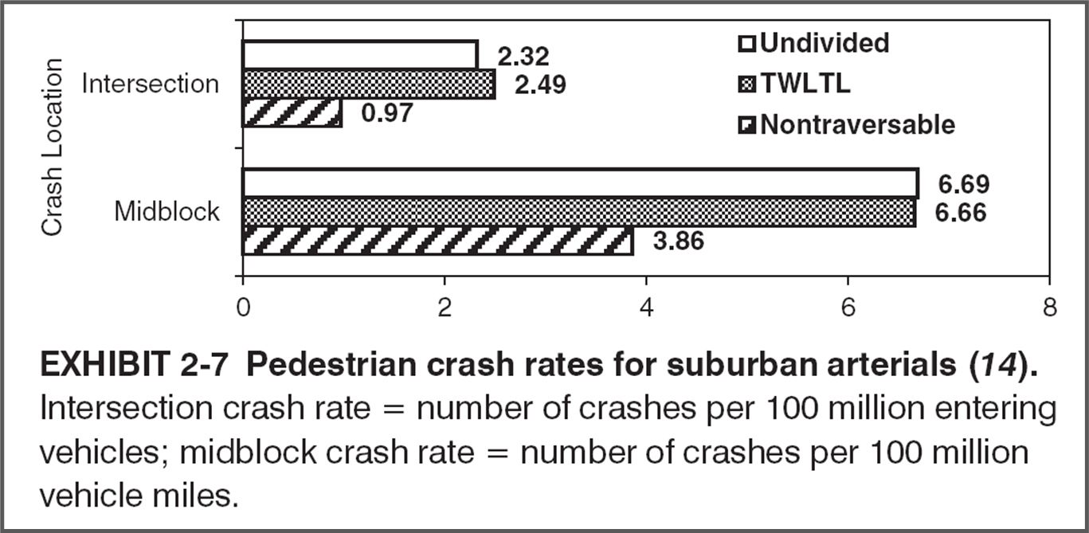
Pedestrian Safety
Source: TRB Access Management Manual, 2014
Notes:
Source: Bowman, B. L., and R. L. Vecellio. “Effect of Urban and Suburban Median Types on Both Vehicular and Pedestrian Safety.” Transportation Research Record 1455, TRB, National Research Council, Washington, D.C., 1994, pp. 169-179.

Slide 16
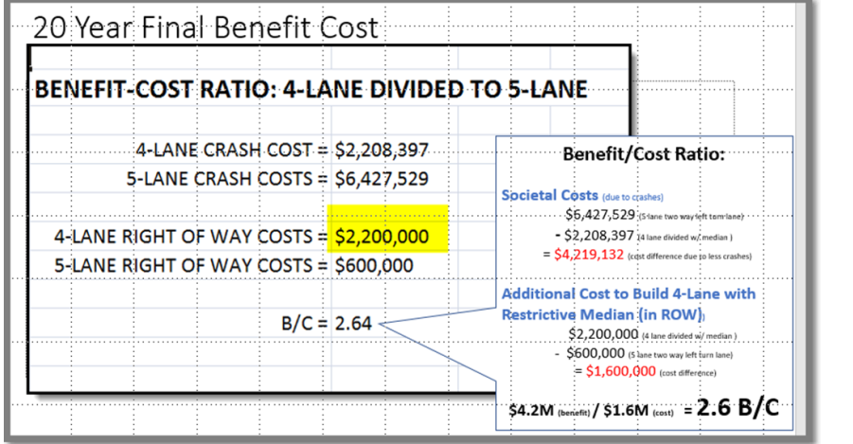
FDOT District 7 SR574 Case Study, Tampa
Benefit-cost ratio of median versus TWLTL
Notes:
(Before SPICE tool) Several years ago FDOT used B/C to communicate the benefits of providing a restrictive median to replace a two-way left-turn lane using predictive methods of the Highway Safety Manual (HSM) to determine the overall benefit. They estimated the benefit-cost ratio of the two alternatives and found that the societal benefit of reducing crashes of $4.2 million far surpasses the extra right-of-way cost of $1.6 million. They used the analysis to convince upper management to pay more for ROW to build the raised median.

Slide 17
Which of these has the least conflict points and potential for serious crashes?
A signalized intersection
A modern roundabout
A full median opening
Notes:
Note: This slide include animation to highlight the correct answer.

Slide 18
Signals and Travel Time
Signals per mile | Increase in travel time compared to two signals per mile
3 | 9%
4 | 16%
5 | 23%
6 | 29%
7 | 34%
8 | 39%
Source: NCHRP Report 420: Impacts of Access Management Techniques, 1999
Notes:
Minimizing the number of traffic signals and promoting uniform spacing significantly improves travel times. Each signal per mile added to a roadway reduces speeds by 2-3 mph. For example 4 per mile is about 16% greater travel time than a segment with two per mile.

Slide 19
Access Points and Delay
Access points per mile | Reduction in free-flow speed (mph)
0 | 0.0
10 | 2.5
20 | 5.0
30 | 7.5
>40 | 10.0
Source: Highway Capacity Manual, 2010
Notes:
Suggested access density adjustment factors for level of service determinations per 2010 HCM also indicate that roadways with lots of access will also have more traffic delay that can lead to congestion. The typical reduction in free flow speed for one direction is about .25 mph for each access point and .005 mph for each right movement per hour per mile.

Slide 20
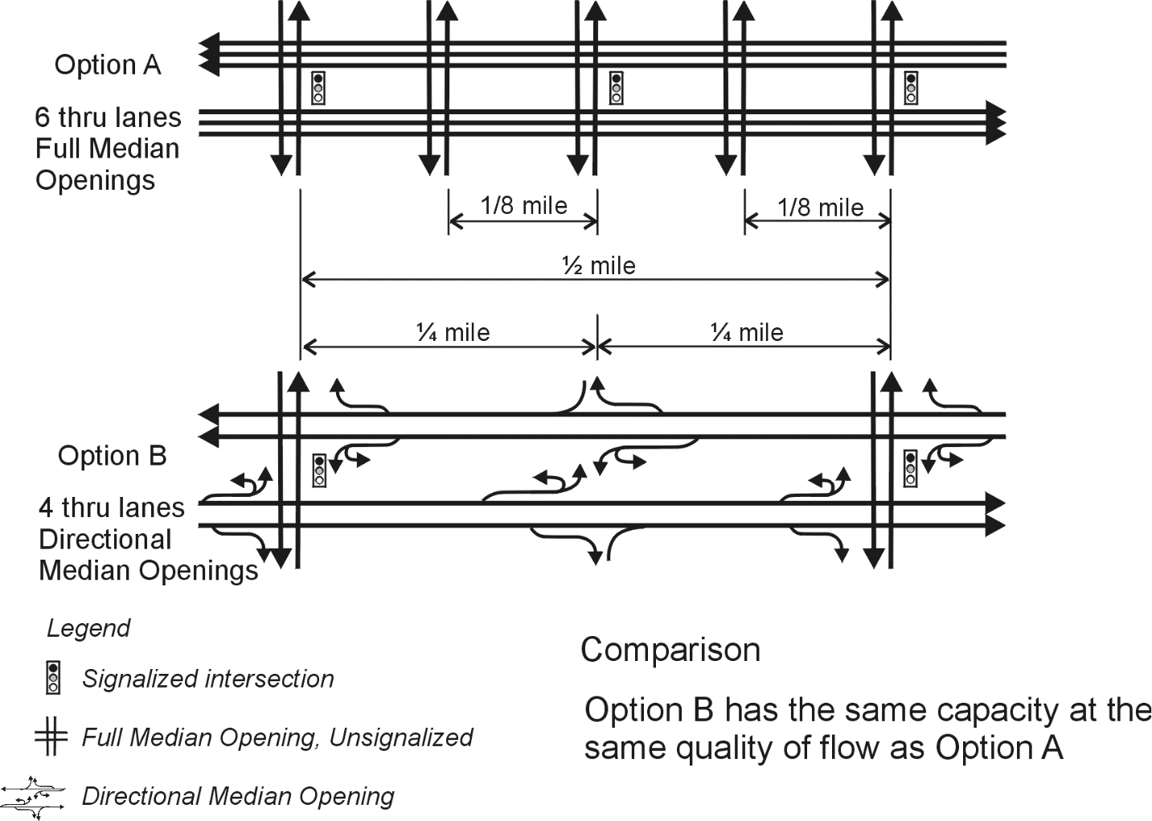
Quality of Service Benefits
Source: Access Management Manual, 2014
Notes:
Analysis by Stover concluded that ½ mile signal spacing and limited access can provide comparable service to that of a six-lane road with ¼ miles signal spacing and full movement between signals. this illustrates how effective access control reduces the need to continuously widen roadways. Of course, it is critical to have dense and connected supporting street networks to offset the need to circulate on the major roadways needed for vehicular through movement during peak hours.

Slide 21
Market Area Effects of Not Managing Access
Reduction in
Market Area
Original Trade Area
Avg. System
Relative to
Speed
Previous Size
0%
100%
45 mph
10%
81%
20%
65%
30%
45%
40%
36%
50%
25%
30 mph
Reduced Trade Area
Notes:
Reduced speed and delay reduce market area. For example, a 10% reduction in average speed reduces market area by about 20%. The point is not to promote speeding, but rather to avoid unnecessary delay at the posted speed. “93% of consumers say they typically travel NO MORE than 20 minutes to make everyday purchases.” https://blog.accessdevelopment.com/research-how-far-will-consumers-travel-to-make-routine-purchases.
Note: This slide includes animations.

Slide 22
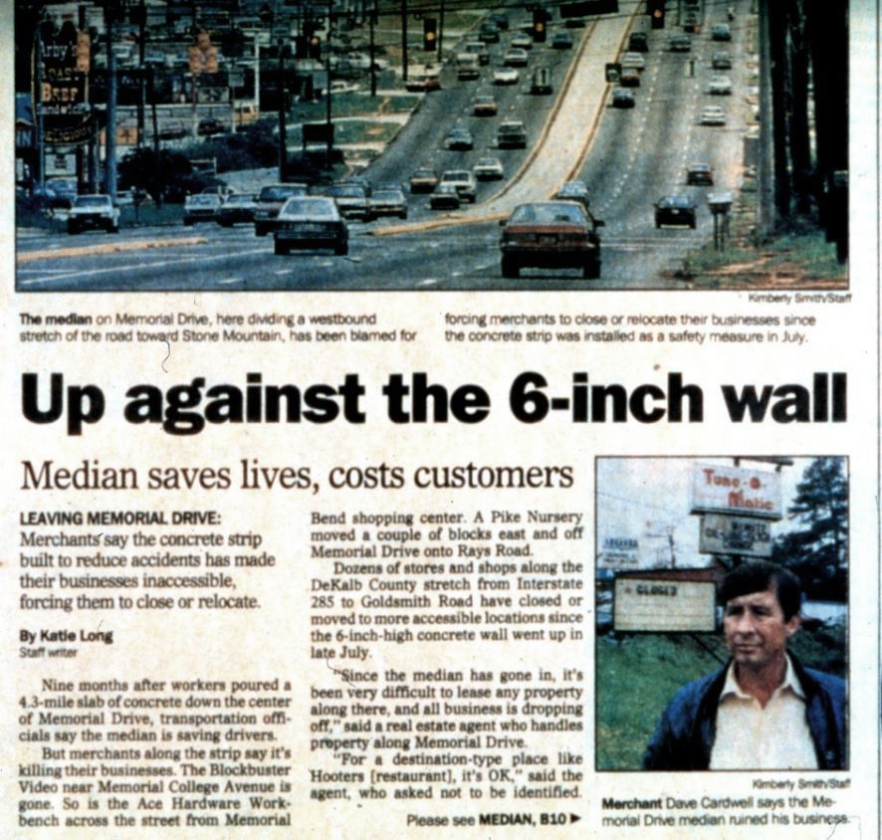

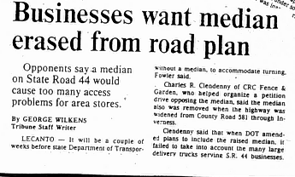
Economic concerns
Notes:
A common challenge in access management practice is the potential for intense opposition by business owners and in some cases neighborhood residents to median projects. We see these battles taking place across the country and therefore many studies have been done to determine if medians have an adverse effect on business activity. In fact, FHWA just began another project to develop a video and primer on this issue for businesses.

Slide 23
Economic Impacts
Studies to date show little or no adverse impact of AM on corridor business activity
Left turns already limited during peak hours, high volumes
Pass-by businesses more sensitive to access changes than destination businesses
Access changes that result in extreme circuity can have adverse impacts
particularly for auto-oriented businesses

Slide 24
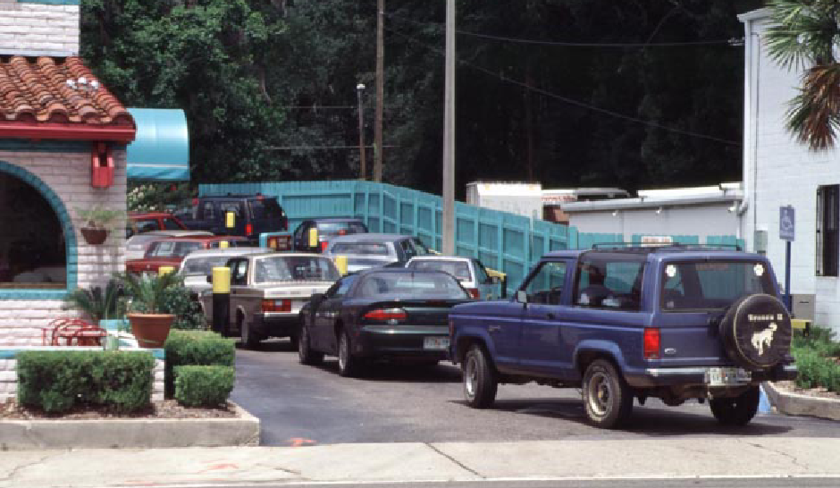
Poor internal design hurts traffic flow and deters customers
Photo credit Gary Sokolow, FDOT
Notes:
...deters customers and reduces the volume of sales at peak hours.

Slide 25
Iowa Statewide Business Survey
Corridors with completed access management projects had higher retail sales than the surrounding community
Majority of businesses reported the same/higher sales after the project was complete
72% of businesses reported no customer complaints about access
Notes:
The study corridors outperformed the surrounding community economically. The business reported increased sales and no customer complaints.
Source: CTRE, Iowa State University, Access Management Awareness Project

Slide 26
Iowa Business Study Conclusions
Business failure rates in study corridors were at or below the statewide average of 10% per year and generally were lower in corridors than their surrounding communities
Average project corridor outpaced its surrounding community in terms of retail sales growth by about 20%
About 65 percent of businesses reported stable or increased sales after project completion and 75 percent reported no customer complaints about access to their business
Some individual businesses (6%) did report sales declines and customer complaints about access (28%)
About half of customer complaints about access come from “auto-oriented” businesses
Access management projects are usually supported by a great majority of motorists; business support varies more.
Notes:
Source: Iowa State University and Iowa DOT, “The Impact of Access Management on Business Vitality Along Corridors, 38th Annual TRB Workshop on Transportation Law Seattle, Washington July 1999.

Slide 27
Effects of Access Management on Retail Sales Growth
Iowa opinion survey of business owners and managers after project completion
Source: Iowa State University and Iowa DOT, “The Impact of Access Management on Business Vitality Along Corridors, 38th Annual TRB Workshop on Transportation Law Seattle, Washington July 1999.
Notes:
Only 9 of 162 businesses surveyed reported sales losses.
5 were auto-oriented business.
5 involved median projects and four involved TWLTLs.

Slide 28
Florida Business Owner Surveys
Median reconstruction projects in the Orlando (FL) metropolitan area:
86% were in business before the changes
64% felt they were not impacted at all
59% had no problem with the changes
57% reported no decrease in business activity, similar to the economy as a whole
Notes:
5 corridors in District 5 (Orlando metro)
Median opening closures and conversions to directional openings
Personal surveys based on attitudes toward the changes
Source: TEI Engineers & Planners

Slide 29
Texas Business Owner Survey
Business owner perceptions before the project were more pessimistic than reality
Most business types reported increased customer activity and sales (including specialty retail and restaurants)
Gasoline stations and automotive repair shops reported decreased customer activity and sales
Notes:
Source: Texas Transportation institute

Slide 30
Equity, Sustainability, and Resilience in Access Management

Slide 31
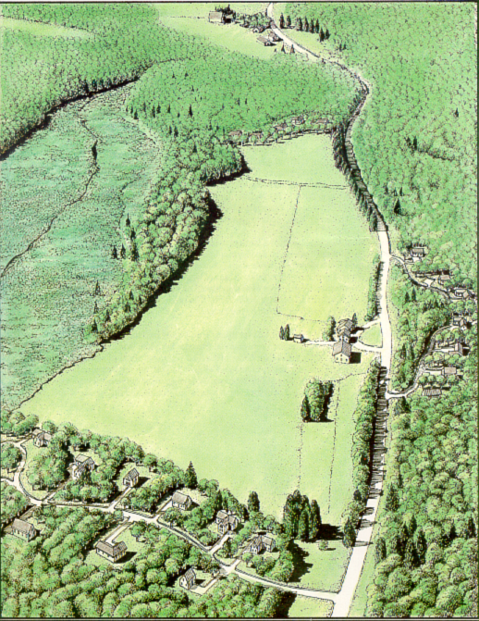
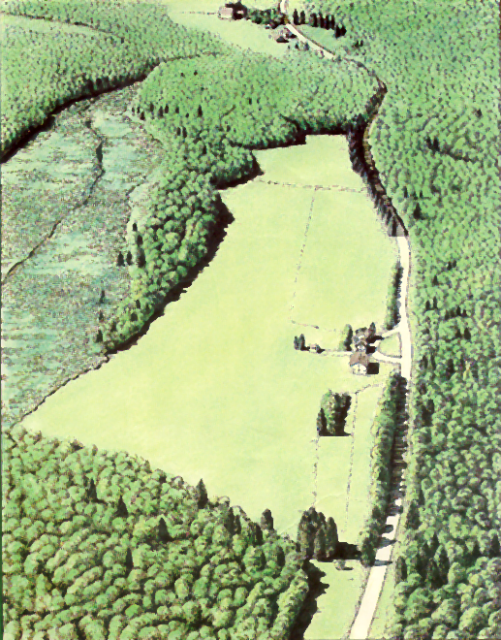
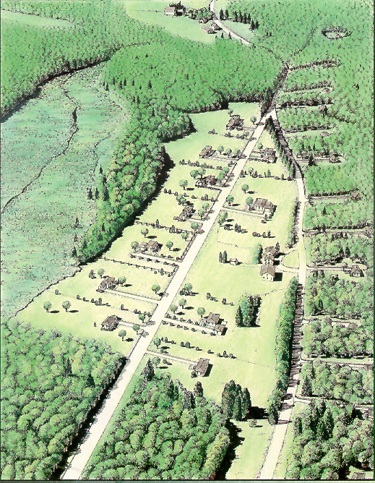
Conservation & Environmental Sustainability
Access management can help preserve scenic character, natural resources, and environmentally sensitive areas.
Source: R. Arendt, et. al, Dealing with Change
in the Connecticut River Valley
Notes:
This slide illustrates the different impacts of access on the scenic landscape. It shows how the use of conservation subdivision design with shared access helps to conserve natural resources and scenic beauty over conventional land division methods that provide direct individual access to lots.
Note: This slide includes animation.

Slide 32
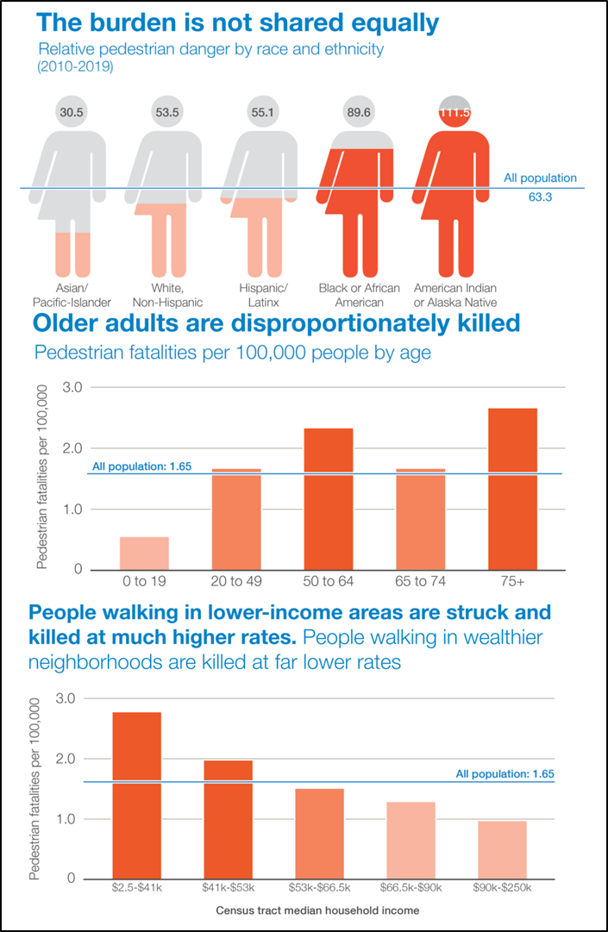
Equity and Safety
“Older adults, Black or African American and American Indian or Alaska Native people, and people walking in low-income communities continue to be disproportionately represented in fatal crashes involving people walking.”
-Dangerous by Design 2021, Smart Growth America
Source: Smart Growth America, 2021
Notes:
Vulnerable populations are likely to be those persons who rely more on active transportation (walking and cycling) and transit and therefore have greater exposure to transportation-related safety issues.
Additionally, as discussed in the previous slides, low-income neighborhoods are less likely to have adequate safety infrastructure and include elements (high volume traffic, high speed roadways, etc.) that increase risk.
Source: Smart Growth America. (2021). Dangerous by Design https://smartgrowthamerica.org/dangerous-by-design/

Slide 33
Equity and Access Management
Medians and driveway controls are proven to reduce crashes.
Medians provide safe mid-block crossing opportunities for pedestrians, a special need in underserved areas.
Network improvement strategies, like access management, help improve accessibility between underserved communities and nearby employment opportunities, community services, and shopping.

Slide 34
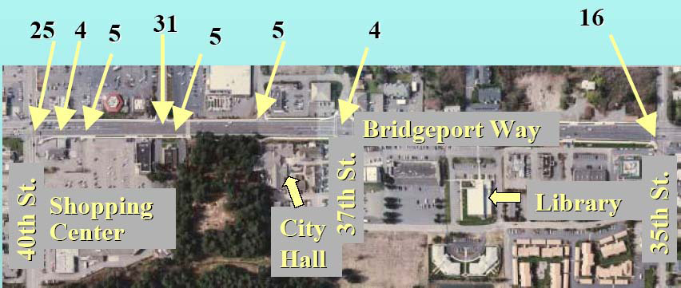
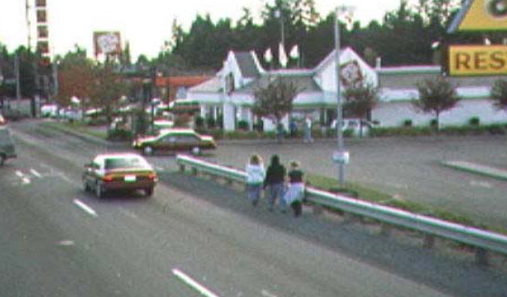
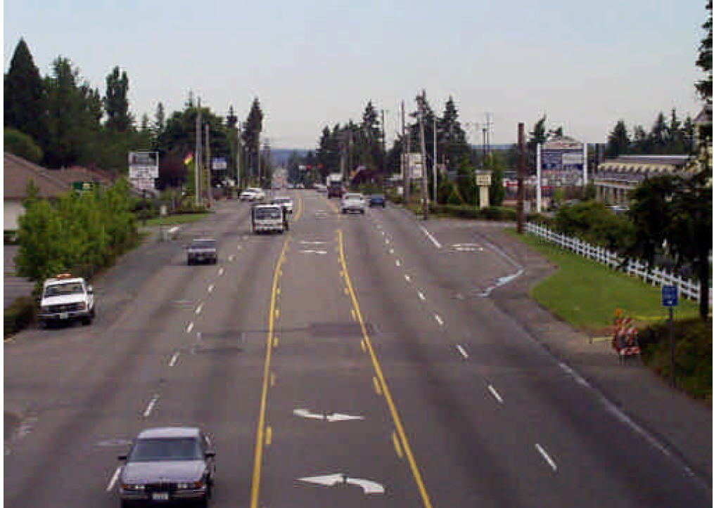
Retrofit example Bridgeport Way (Before)
300 crashes in 4.5 years
1/3 injury and ½ right angle
Several involving pedestrians
Source: contextsensitivesolutions.org
Notes:
This case example involves the retrofit of a typical suburban corridor with lots of commercial development and a low level of access management. University Place south of Seattle in Washington. Numbers in blue show the number of crashes on one small segment. The corridor experienced 300 crashes over a 4.5-year period, several involving pedestrians. The safety problems were due to the lack of sidewalks, a large number of access points, and a lack of median left turn controls.
The City council developed a vision statement to transform the corridor into a main street with a town center that would support a more walkable community. They sought to redesign the corridor to “improve safety, increase the mobility and cohesiveness of the community, improve the appearance of the corridor, and control traffic growth.” Extensive education and public involvement.

Slide 35
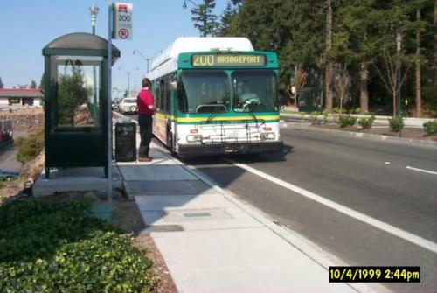
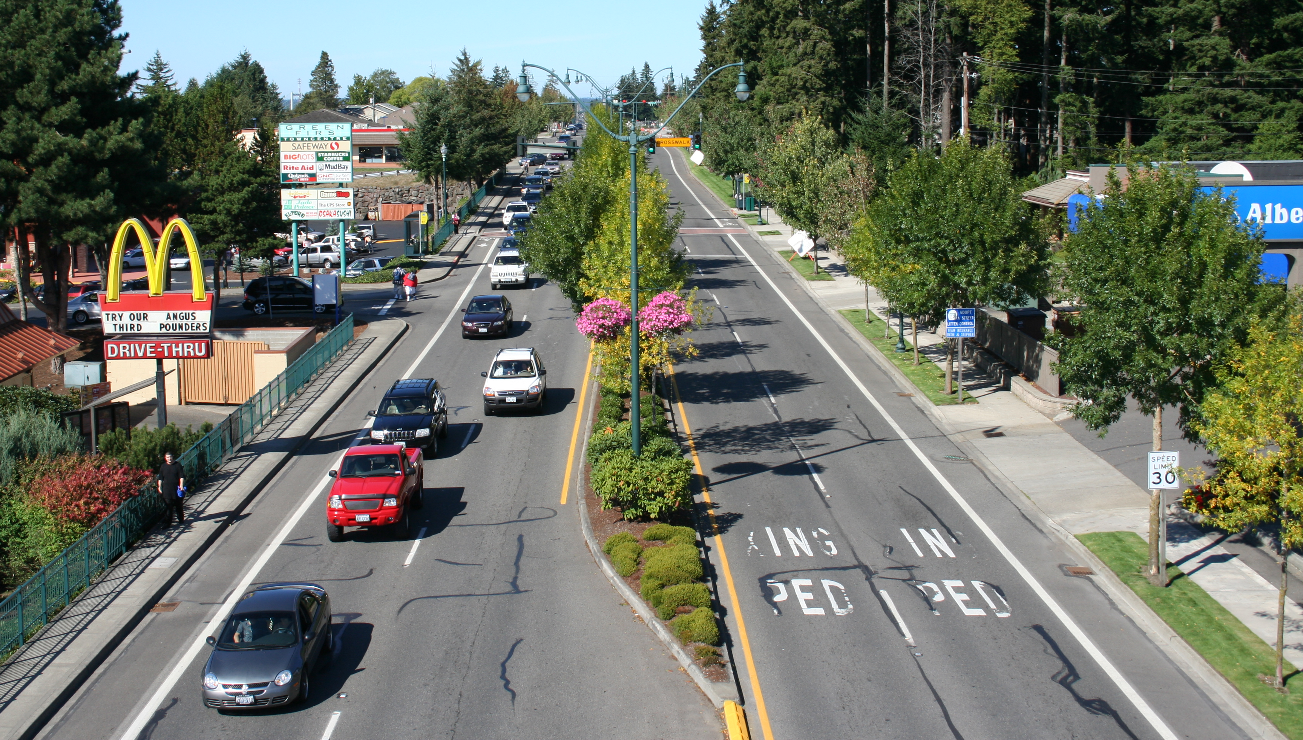
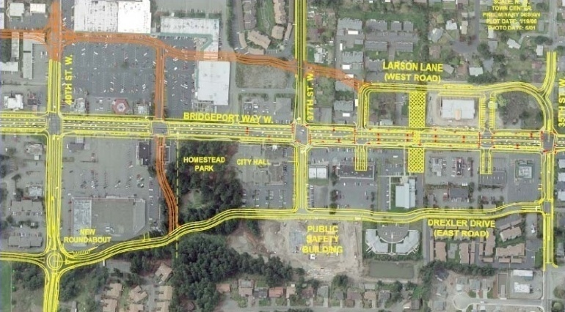
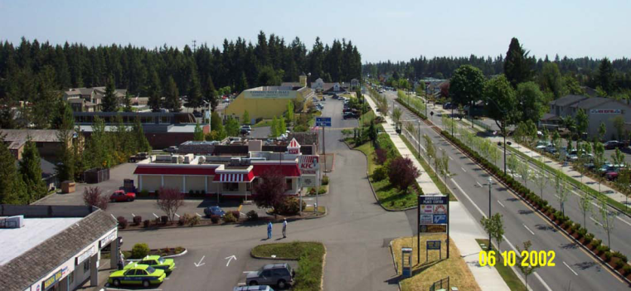
Bridgeport Way (After)
60% Crash Reduction
7% Speed Reduction
Increased sales & redevelopment
Notes:
They settled on a plan to establish a landscaped median (in place of TWLTL), bike lanes, left turn lanes with U-turns at signalized intersections, and two mid-block crossings at key transit stops. They also flared the intersections to accommodate U-Turns by longer vehicles. (Numerous studies show retrofits result in crash reduction and change in speed, but there is little before/after information on the impacts on sales and redevelopment.)
Despite early concerns by business owners regarding the median and its potential to deter customers and reduce revenues, they found an increase in sales of 8% following each construction phase (based on sales tax revenue collected) and an increase in redevelopment and relocation by businesses into the town center area.
7% speed reduction (35.3 -> 33.4 mph) (crash reduction 19 -> 8 in five blocks)

Slide 36
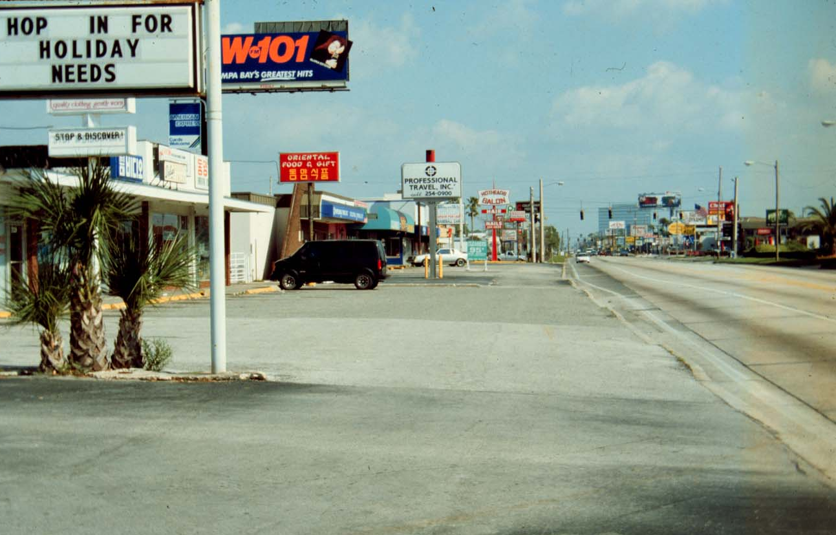
Example of a Poorly Managed Corridor
Notes:
Consider this corridor with no access management. It is ugly and unsafe for all users and these corridors are much more likely to suffer vacancies and economic decline.

Slide 37
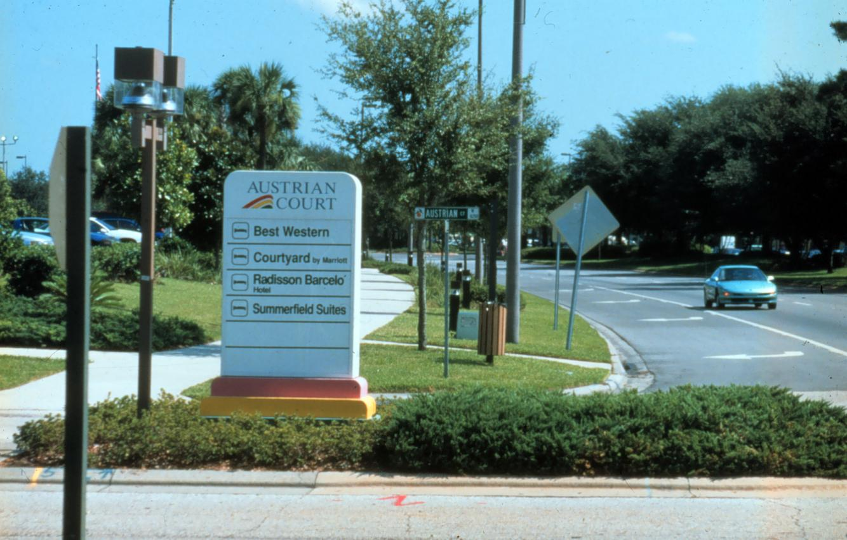
Example of a Well Managed Corridor
Notes:
A well-managed corridor is easier and safer to navigate, is visually appealing, and is more likely to attract investment.

Slide 38
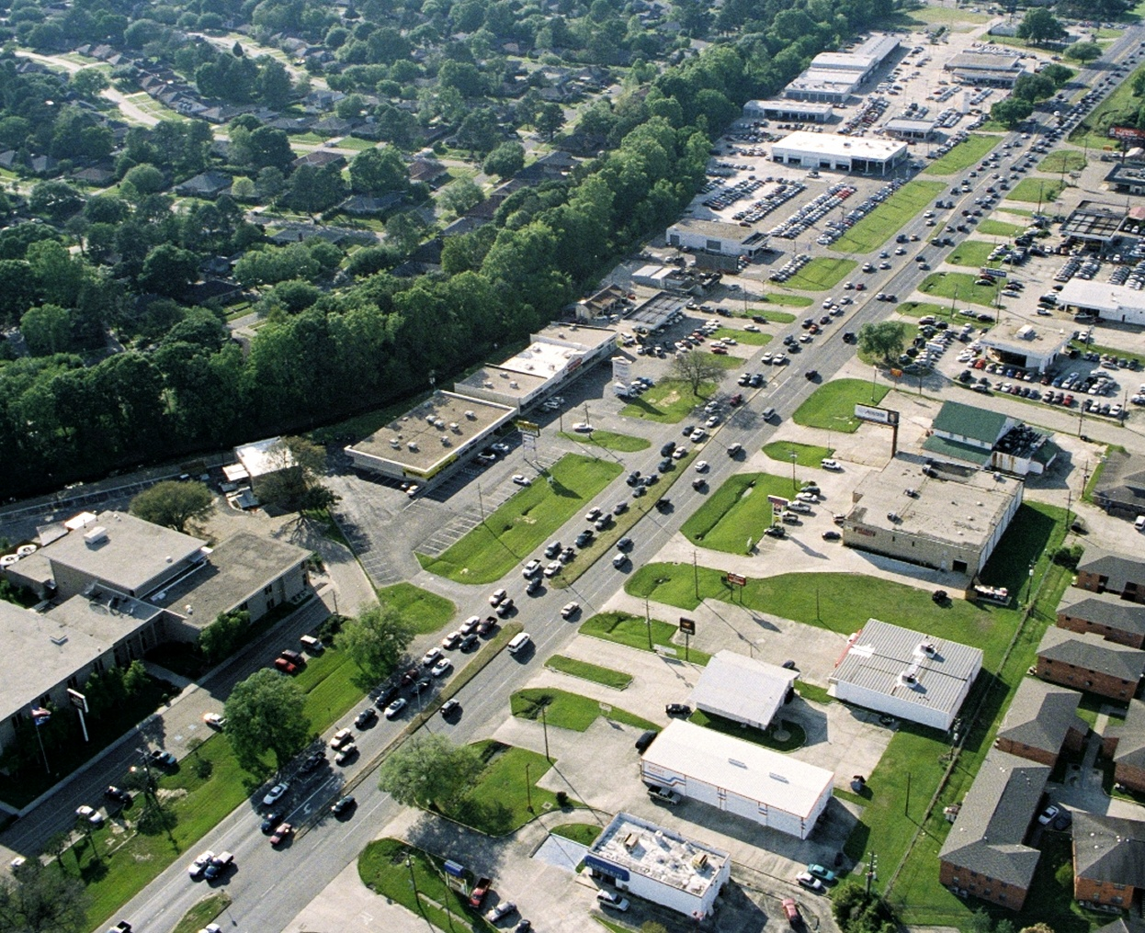
Without Access Management
Costs of failure to manage access include, but are not limited to:
Increase in vehicular crashes and collisions involving pedestrians and cyclists
Accelerated reduction in roadway efficiency
Need for continuous road widening or bypasses
Longer commute times
Smaller market area for businesses and economic development
Declining property values
Increased fuel consumption and emissions
This is NOT
Sustainable
Capable of being continued with minimal long-term effect on the environment
Notes:
In sum, without a concerted access management strategy, these are the impacts we are likely to experience.

Slide 39
Tools and Exercises

Slide 40
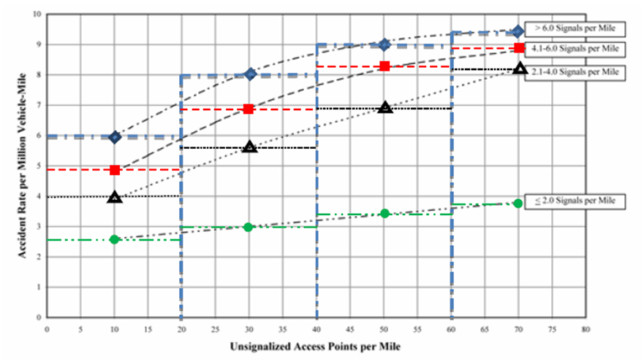
NCHRP Report 420: Impacts of Access Management Techniques
Effect of signals and access density on average crash rates
Source: NCHRP Report 420: Impacts of Access Management Techniques ,1999

Slide 41
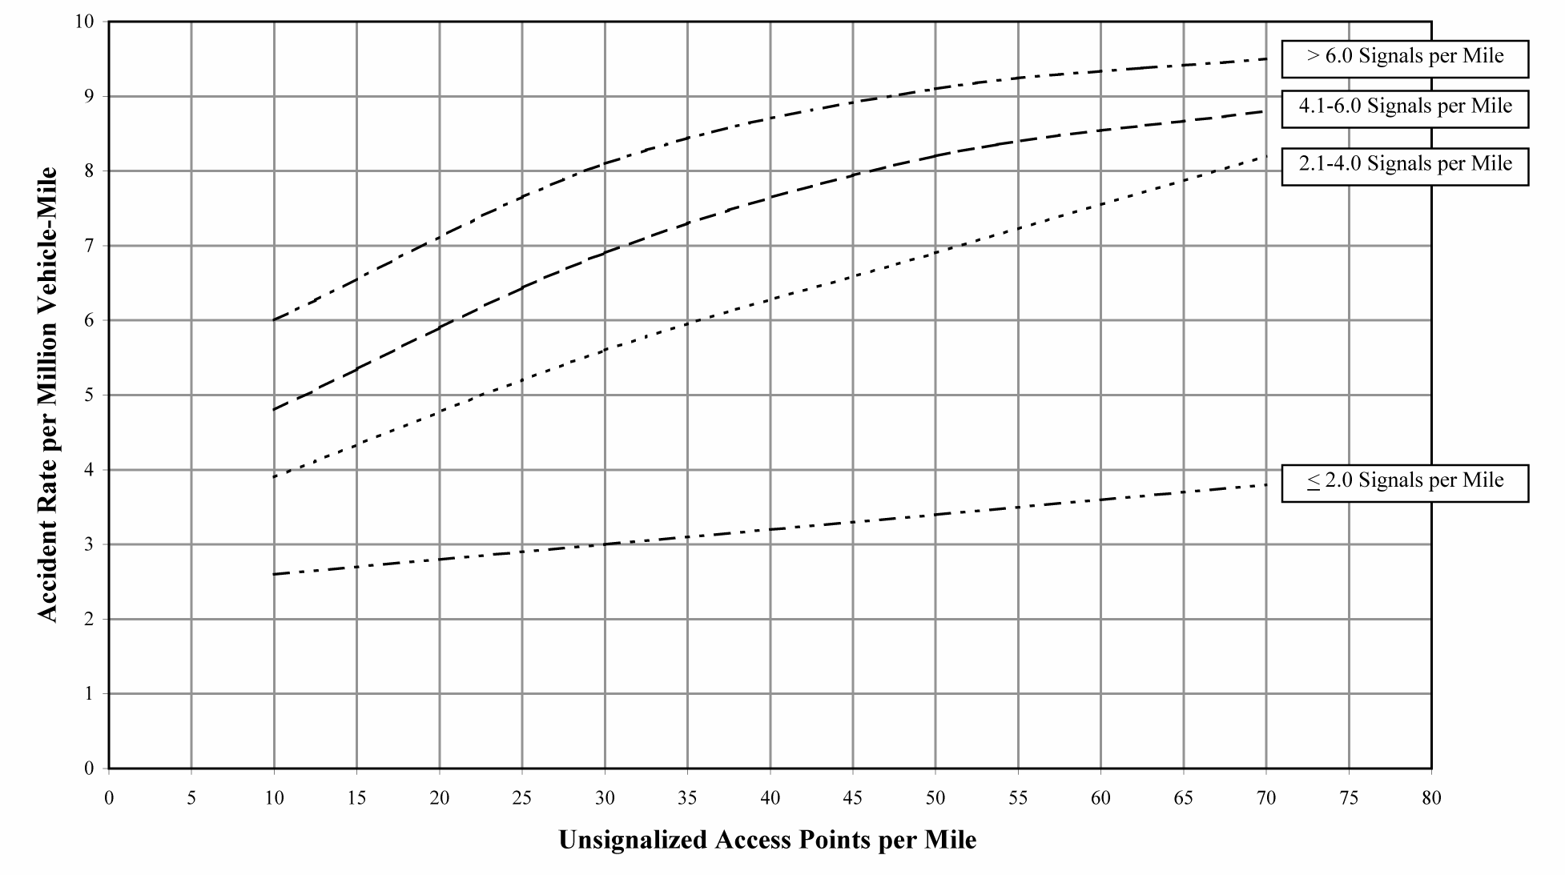
NCHRP Report 420: Impacts of Access Management Techniques
Effect of signal density and unsignalized access density on average crash rates in urban and suburban areas
Source: NCHRP Report 420: Impacts of Access Management Techniques ,1999
Notes:
For example, at a density of 20 unsignalized access points per mile, an increase in signal density from 2.0 or less to 2.1 to 4.0 signals per mile can result in a 70% increase in the average crash rate – from about 2.8 to 4.8 crashes per million vehicle miles. At 60 unsignalized access points per mile, the average crash rate more than doubles – from 3.6 to 7.6 crashes per million vehicle miles. The increased number of signals per mile also results in poor fuel efficiency and excessive vehicular emissions.

Slide 42
Effect of Access Density on Crash Rates
(1.5 mile segment) | Existing | Proposed
Number of signals | 3 | 6
Number of unsignalized access connections | 21 | 66
Crash rate, per million vehicle miles
?
3.1
7.6
(1 mile segment) | Existing | Proposed
Signalized, per mile | 3/1.5=2 | 6/1.5=4
Unsignalized, per mile | 21/1.5=14 | 66/1.5=44
Crash rate, ‘per mile’
Look-up chart
2.7
6.6
To Solve:
Find increase in expected crash rate:
Expected future crash rate:
6.6
=
2.44
2.7
2.44
x
3.1
7.6
=
Notes:
To solve this problem, you must first divide the existing and proposed data given for the 1.5-mile segment by 1.5. This then allows you to use the look-up table provided.
To find the increase in the expected crash rate, take 6.6 (the proposed crash rate for a 1-mile segment) and divide by 2.7 (the existing crash rate for a 1-mile segment). Your total is 2.44, which is how many times larger the future crash rate is over the existing for the 1-mile segment.
To find the future crash rate for the 1.5-mile segment, you must multiply the future crash rate multiplier of 2.44 by the existing crash rate for a 1.5-mile segment (3.1)

Slide 43
NCHRP 1032 Access Management Communication Toolkit Spreadsheet Tools
Median Type
Estimated crash reduction of providing a median versus undivided or TWLTL
Right-turn Lanes
Estimated crash reduction of providing right turn lanes at three-leg and four-leg intersections
Left-turn Lanes
Estimated crash reduction from providing left-turn lanes at three-leg and four-leg intersections
Unsignalized Intersection and Driveway Density
Estimated number of crashes for different access densities on: (a) urban/suburban 4-lane roadways with TWLTL or (b) by median type (two tools)
Signalized Intersection Density
Estimated number of crashes by changing density of four-leg and three-leg intersections per mile
Median Opening near Signalized Intersection
Estimated number of crashes from providing a median opening near a signalized intersection.
Notes:
The suite of safety spreadsheet tools developed for NCHRP 1032 How to Measure and Communicate the Value of Access Management employs crash modification factors (CMFs) or the latest predictive methods from the Highway Safety Manual (HSM) to estimate the potential crash reduction associated with the access management treatments or techniques you see here.
Median Type: Predicted crashes (per HSM) based on median type (does not include localized calibration).
Right-turn Lanes: Estimated crash reduction while providing a right-turn lane(s) at three-leg intersections and estimated crash reduction while providing a right-turn lane(s) at four-leg intersections.
Left-turn Lanes: Estimated crash reduction while providing a left-turn lane(s) at three-leg intersections and estimated crash reduction while providing a left-turn lane(s) at four-leg intersections.
Unsignalized Intersection Density: Estimated crash reduction by changing the unsignalized intersection density on an urban/suburban four-lane roadway where a two-way left-turn lane (TWLTL) is present.
Signalized Intersection Density: Estimated number of crashes for various traffic signal spacing (presented as the density of signalized intersections per mile).
Note: NCHRP 1032 How to Measure and Communicate the Value of Access Management can be accessed using this link: https://onlinepubs.trb.org/onlinepubs/nchrp/nchrp_rpt_1032Toolkit.pdf

Slide 44
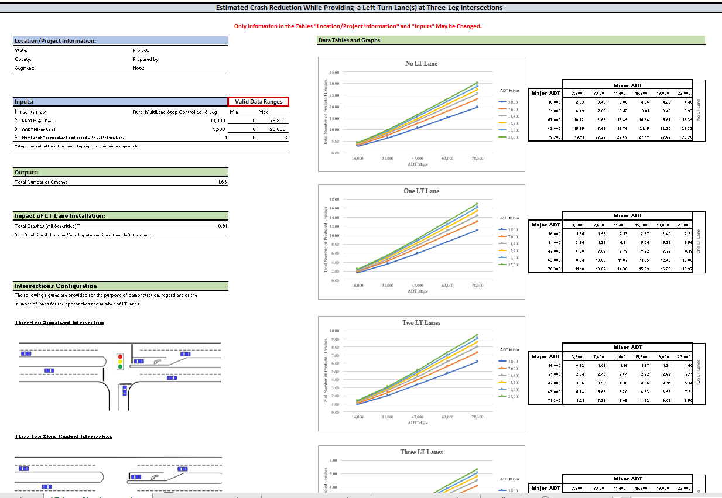
Left Turn Lanes Module - Safety
Notes:
By removing stopped or slower-turning vehicles from the through lanes, turn lanes reduce the potential for high-speed rear-end collisions.
Inputs include facility type, number of approaches facilitated by turn lane, and AADT of the major and minor roads. Begin by selecting facility type (urban-suburban signalized, urban-suburban stop controlled, rural two-lane stop controlled, or rural multi-lane stop controlled). Next input the number of approaches facilitated by the turn lane. Note that stop-controlled approaches are not considered in the number of approaches with right-turn lanes. Next input the AADT of the major road and the AADT of the minor road.
Outputs include the total number of crashes without installation of the turn lane (Total Number of Crashes) and the total crashes for all severities with installation of the turn lane (Safety Effect of LT Lane Installation). The relative change in safety performance can be determined by comparing the estimate of total number of crashes prior to installing the turn lane with the total crashes after installation. The guidance document includes several sample applications.
facility type (rural multilane stop controlled 3 leg intersection) and varies based on AADT on major (10,000) and minor (3500) road and number of approaches (1 approach) facilitated with left turn lanes. Total number of crashes with no LT lane is 1.63. With LT Lane =.91
Note: NCHRP 1032 How to Measure and Communicate the Value of Access Management can be accessed using this link: https://onlinepubs.trb.org/onlinepubs/nchrp/nchrp_rpt_1032Toolkit.pdf

Slide 45
Mobility Assessment Tools
Signal Spacing
Estimated increase in travel time based on adding new signals
Signal Progression
Estimated progression speed based on signal spacing and cycle length
Right-turn Lanes and Left-turn lanes (two tools)
Estimated delay reduction from providing right-turn deceleration lane or left-turn deceleration lane at unsignalized intersection
Unsignalized Access Spacing
Estimated impact of driveway spacing on right-lane, through-vehicle mobility
Corner Clearance
Estimated % of cycles during which a driveway near a signalized intersection will be blocked
Notes:
The suite of mobility spreadsheet tools adapts findings from a variety of NCHRP research projects to enable the user to estimate the potential implications of access management techniques relative to delay. They include modules for each of the following applications:
Signal Spacing: the estimated increase in travel time based on adding new signals;
Right-turn Lanes: the reduction in delay to through traffic associated with adding a right-turn lane on four-lane and two-lane arterial roadways;
Left-turn Lanes: the reduction in delay from adding a left-turn lane at an unsignalized intersection at an existing site and at a new development site on four-lane and two-lane arterial roadways;
Signal Progression: the estimated progression speed based on signal spacing and cycle length;
Driveway Spacing: the mobility impacts of unsignalized access spacing on traffic in the curb lane (percent of vehicles impacted – brake and/or evasive maneuvers); and
Corner Clearance: the percentage of signal cycles during which a driveway near a signalized intersection will be blocked.
Note: NCHRP 1032 How to Measure and Communicate the Value of Access Management can be accessed using this link: https://onlinepubs.trb.org/onlinepubs/nchrp/nchrp_rpt_1032Toolkit.pdf

Slide 46
Signal Spacing Module
Estimated increase in travel time based on adding new traffic signals |  |  |  |  |  |  |  |  |  | Signal Spacing
 | Inputs: |  |  |  |  |  |  |  |  | Valid Data Ranges
 |  |  |  |  |  | Units |  |  |  |  | Min | Max
1 | Current signal density |  |  |  | 2 | Signals per Mile |  |  |  | --> | 2 | 2
2 | Potential signal density |  |  |  | 4 | Signals per Mile |  |  |  | --> | 0 | 8
 | Outputs: |  |  |  |  |  |  |  |  | Calculations/Data
 |  |  |  |  |  | Units |  |  |  |  | % Increase in Signal Density
1 | Estimated percent change in travel time |  |  |  | 16% |  |  |  |  | --> | 100.0%
Notes:
Here is an example of the signal spacing module that estimates the increase in travel time based on signal density, here going from 2 to 4 signals per mile for an estimated 16% increase in travel time.
Note: NCHRP 1032 How to Measure and Communicate the Value of Access Management can be accessed using this link: https://onlinepubs.trb.org/onlinepubs/nchrp/nchrp_rpt_1032Toolkit.pdf

Slide 47
Economic Value Assessment Tools
Safety Economic Value
monetized value of crash reduction in 2020 dollars
benefit-cost ratio: the monetary value of the reduction in number of crashes and expenditures to construct and maintain the facility
Mobility Economic Value
applies a value of time for a daily and annual cost of increase in travel times due to changes in signal spacing
Notes:
The spreadsheet tools work in tandem with the outputs of the safety and mobility tools to calculate the economic value of the reduction in crashes or delay to society. The tools are demonstrated in the example applications, as well as the case study applications.
Note: NCHRP 1032 How to Measure and Communicate the Value of Access Management can be accessed using this link: https://onlinepubs.trb.org/onlinepubs/nchrp/nchrp_rpt_1032Toolkit.pdf

Slide 48
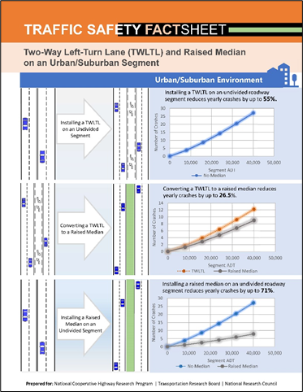
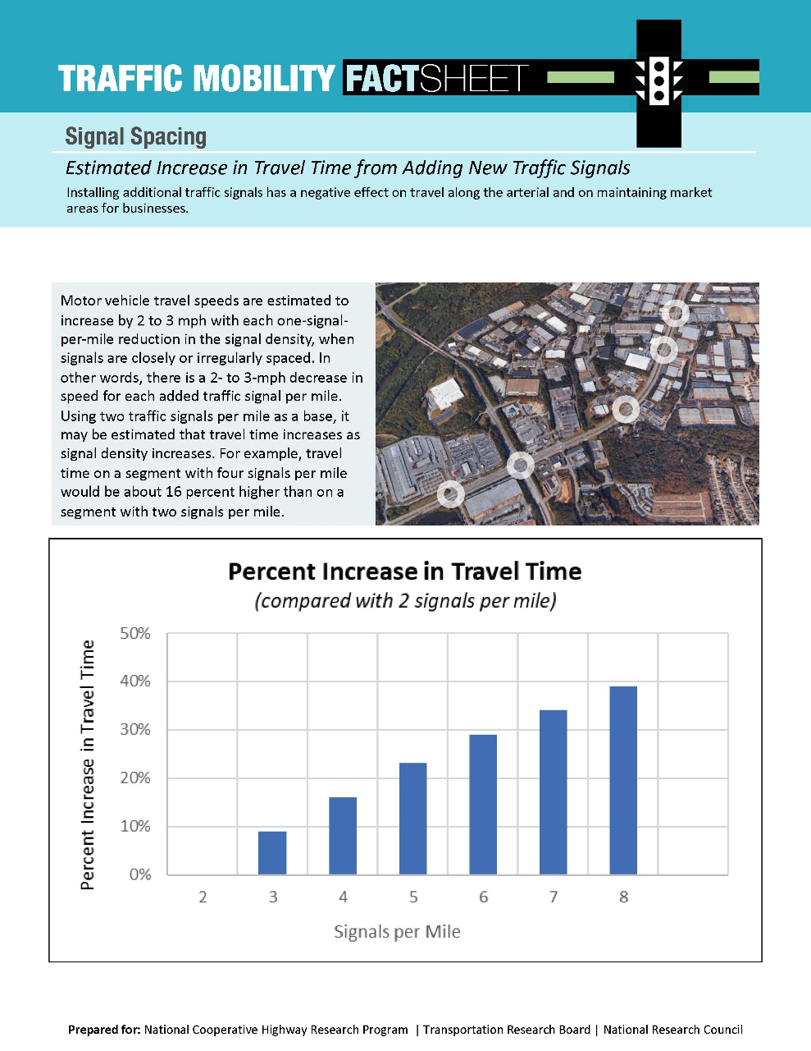
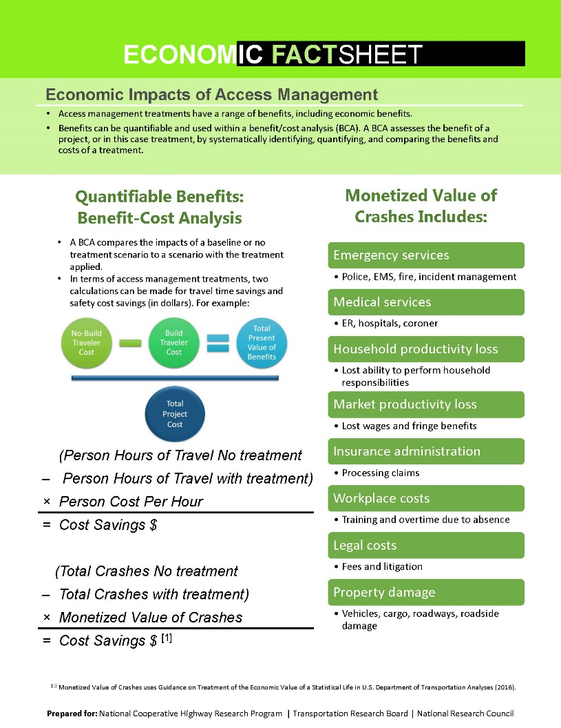
Fact Sheets Demonstrate Outputs or Methods
Notes:
Each tool is accompanied by a Fact Sheet illustrating the outputs. The Economic Fact Sheet also describes methods such as benefit/cost studies and before/after studies of sales tax receipts for estimating the economic value of access management projects.
Note: NCHRP 1032 How to Measure and Communicate the Value of Access Management can be accessed using this link: https://onlinepubs.trb.org/onlinepubs/nchrp/nchrp_rpt_1032Toolkit.pdf

