Slide 1
Public Involvement
In Access Management

Slide 2
Learning Objectives
Explain the do’s and don’ts of effective public involvement.
Choose an appropriate level of public outreach for a specific project or decision.
Identify appropriate involvement techniques.
Apply communication strategies to address common stakeholder concerns.

Slide 3
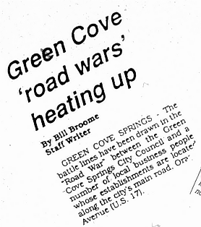
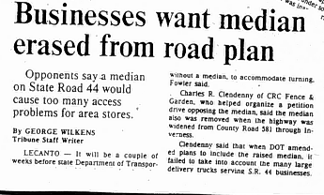
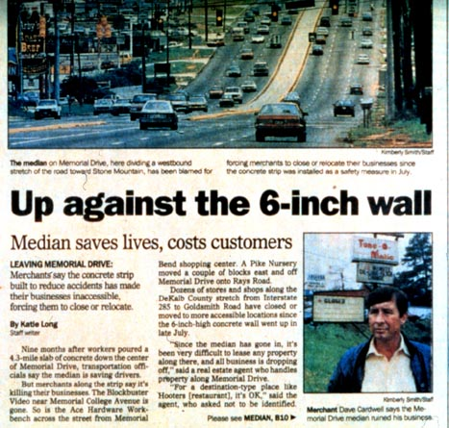
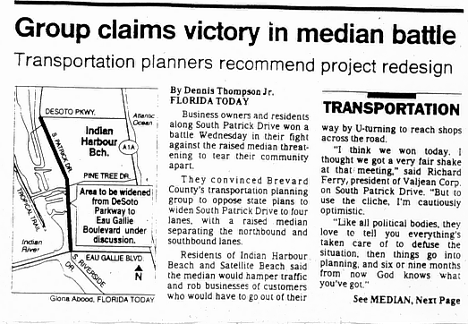
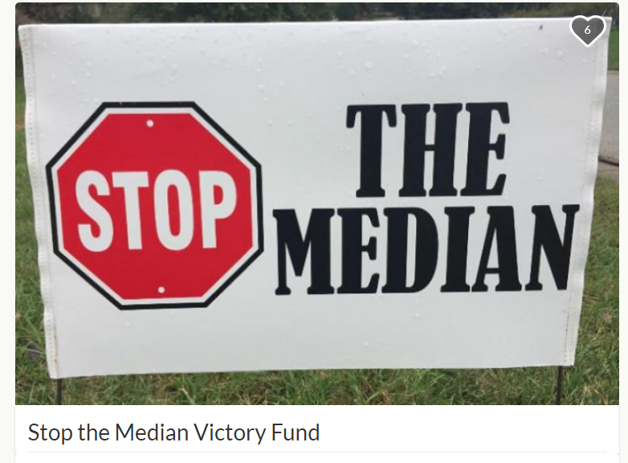
Access Management Can be Controversial
Notes:
Government actions that affect property access tend to be controversial.
Typical concerns include:
economic impacts on businesses
access for delivery vehicles
safety of U-turns
circuity of access
neighborhood accessibility
through traffic and speeding
People will get involved in these decisions, whether or not they are offered a formal opportunity. The challenge is to involve the public in a way that is productive and meaningful for them and your agency.

Slide 4
Choosing the Appropriate Level of Public Outreach

Slide 5
Tug-of-War
Local
State
?
Property owner or developer
General Public

Slide 6
Potential Sources of Tension
Process Issues
Uncertainty of Outcomes
Competing
Interests
Rules and
Regulations
Interdependence of
Solutions
Notes:
Uncertainty: Specific examples include technical disputes over access design or contention over perceived risk versus potential gain. Uncertainty requires objective analysis of potential outcomes, open discussion of pros and cons, and contingency measures to reduce concern over negative impacts. Unless it is effectively addressed, opponents may play up uncertainty to generate political opposition or win variance approval.
Interdependence: Access management decisions across divisions, agencies, and jurisdictions. Differences in procedures, standards, or objectives across these groups can lead to conflict. Coordination mechanisms and communication reduce misunderstandings and administrative problems.
Rules and Regulations: Lack of clarity, inconsistent or heavy-handed administration, and inadequate administrative flexibility can all lead to conflict.
Competing interests: Adding to the potential for internal or interagency conflict is the push and pull of competing interests. This tension between public and private interests raises the importance of clear public policy and consistent administration.
Process issues: Conflicts may also revolve around the way decisions are made. Without a fair and open process for responding to public concerns, planners and engineers may face intense pressure to concede to demands for unrestricted access.

Slide 7

Typical Process Issues
The agency did not follow its own procedures
The public was not involved early enough
Affected parties were not adequately notified
Inadequate response times
Notes:
Several issues may arise when agencies attempt to involve the public

Slide 8
Identifying Involvement Strategies

Slide 9
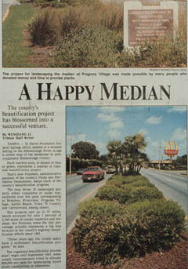
We need strategies to:
Foster trust
Minimize conflict
Create positive outcomes
Notes:
Knowledge Probe Question #1
What are some common mistakes agencies make when they attempt to involve the public?

Slide 10
Adhere to the Principles of Public Involvement
Communicate clearly
Listen
Satisfy process values
Be inclusive
Tell the truth
Notes:
Adherence to certain principles of public involvement and techniques can help minimize conflict, foster public trust, and achieve broad-based support from the public and policymakers.

Slide 11
Understanding Opposition
Opposition becomes active when:
People feel the decision-making process is unfair
People feel the outcome will be much worse than doing nothing
Notes:
Ultimately, the success or failure of an agency program or project often lies more with its ability to prevent vetoes than its ability to generate support.
Consensus may be unrealistic on controversial projects. When working with opponents, sometimes the best outcome that can be expected is “a grudging willingness to go along.”
Process issues
Or
The perception that the action will damage them in some way, their livelihood, their community, their safety, etc.

Slide 12
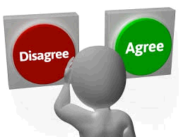
Gaining Public Acceptance
People are more likely to oppose a project or action they feel is being imposed on them.
People are more likely to accept a decision if they have been fully informed, treated fairly, and involved in decision-making.
Notes:
What can we do to reduce the likelihood that people will exercise their veto power?
First, never try to slip a controversial project or decision past the public. Even if you can get away with it, your project, and perhaps your entire access management program, will be living on borrowed time.
This is because you have created resentment and a desire for future retaliation. Those who have been treated unfairly may do more than oppose future projects.
People are much more likely to accept the project or action if they have been fully informed and feel that their concerns have been considered. Appeals can also be managed more effectively if you can demonstrate that there is a process for responding to public concerns and that these concerns have been carefully weighed.

Slide 13
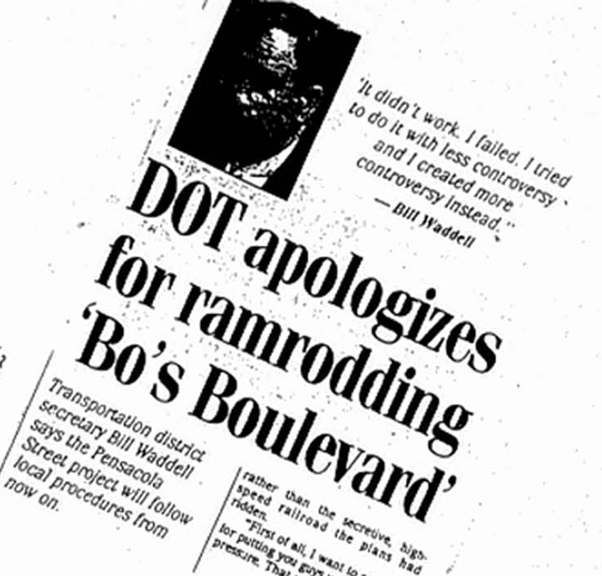
Satisfying Process Values
Begin early and parallel decision process
Prove to the public their concerns will be considered
Achieve clear resolution and provide prompt feedback

Slide 14
Maintain Continuity
Establish linkages with past decisions and commitments
“The public” may change
More people get involved as a project progresses
Notes:
The issue of continuity is particularly difficult for state DOTs in relation to roadway projects as it may be years from concept to construction and the transition is not always smooth from project planning and public involvement to design and construction.
Issues arise in each phase of a project and it is critical that the agency follows through on past commitments or informs affected parties if a change occurs during design. Otherwise, there is a direct and serious violation of the public trust and the principles of public involvement.

Slide 15

Use Networks
Get to know the key players
Build relationships
Keep the lines of communication open
Don’t forget to brief
elected officials.
Notes:
It is often hard for large agencies to interact effectively with the public. Networking is one way to overcome this problem. Develop a network of key players from various interest groups, neighborhood associations, community leaders, elected officials, and so on, or use stakeholder interviews to identify the network.
This helps solidify relationships and keep information flowing.
Keep elected officials in the know and brief them early about the project and your program for addressing public concerns. Then if they are contacted by concerned citizens, they will already have some knowledge of the project and how you are working with the public.
Knowledge Probe #2
What are some common public concerns that might arise when an agency proposes to install a median or close median openings?

Slide 16
Example: Florida’s History with Median Projects
Problems
Solutions
Involvement again early in Design
Meaningful involvement and open house format
Median Opening Procedure
Median issues “fall through the cracks”
Reliance on public hearings
Inconsistent decisions
Notes:
Research on public involvement in median projects in Florida indicated that conflict over median decisions was highest in Districts that lacked a clear public involvement process for medians. Median issues would often “fall through the cracks” until it was too late to provide the public with a reasonable opportunity for involvement. Specific changes were often not identified until the design phases of production and affected parties sometimes were not aware of median changes until the public hearing. This problem was exacerbated by project changes and a lack of continuity and public follow-up as the project proceeded from PD&E to design, right-of-way, and construction.
Districts with a public involvement process for median decisions reported greater success in achieving their objectives and fewer appeals to management or requests for administrative hearings on access management issues than those who relied on public hearings.
An open house meeting format was reported to be less contentious and more conducive to constructive dialogue than the public hearing format.
Median Opening Procedure
3.3 Median opening analysis, consisting of decisions to close, relocate, or modify existing median opening locations, should be done on all projects.
3.4 On major improvement projects, the median opening analysis should be done early in the process, preferably no later than the Phase I plan.
7.1 Any time there is an access change proposed, regardless of when the change is proposed in the process, local governments, property owners, and occupants in the affected area will be notified in a clear and easy-to-understand way.
Section 335.199, F.S., applies to any proposed Department work program project beginning design on or after November 17, 2010. This statute does not apply to permit applications. However, for permit applications that affect medians and median openings, potentially affected people and businesses should be informed and involved by the permittee as soon as possible.
Section 335.199, F.S., directs the Department to notify all affected property owners, municipalities, and counties of a Department-proposed project on the SHS that will divide a state highway, erect median barriers, or close/modify existing access to an abutting property owner at least 180 days before the design is finalized.
The Department’s notice shall provide a written explanation regarding the need for the project and indicate that affected parties will be given an opportunity to provide comments to the Department regarding the potential impacts of the change.
If the project is within the boundaries of a municipality, the notification shall be issued in writing to the chief elected official of the municipality. If the project is in the unincorporated area of a county, the notification shall be issued in writing to the chief elected official of the county.
The Department shall hold at least one public hearing in the jurisdiction where the project is located and receive public input to determine how the project will affect access to businesses and the potential economic impact of the project on the local business community.
Note: This public hearing may be satisfied in conjunction with hearings required by other state and federal process requirements.
The Department must consult with the applicable local government on its final design proposal. The local government may present the Department with alternatives.
Recently reactivated projects (on-the-shelf projects) where public hearings have already been held should be evaluated. This evaluation should consider how the corridor businesses and residents have changed. If there have been significant changes in businesses or residences, Department staff will work with these people to fully inform them about the project. This will not necessarily cause the need for a new public hearing.

Slide 17
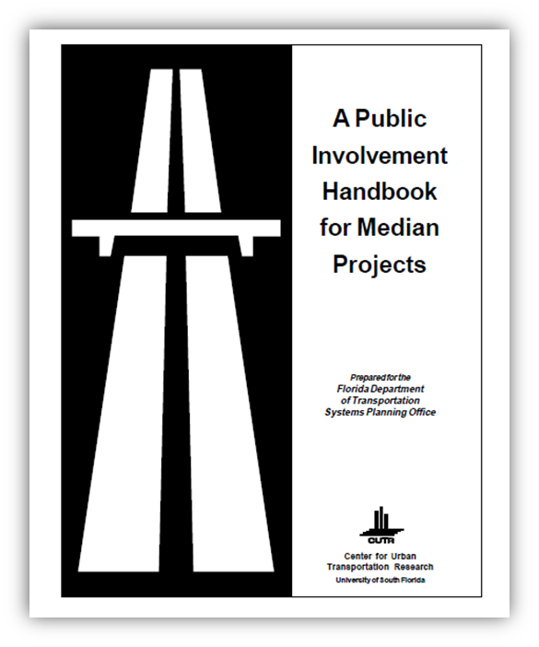
Example DOT Process
FDOT District IV CAP Process
Controversial project?
  Contact the FDOT press office
More than 30 property owners?
  Brief elected officials
  Public meetings
  Analyze comments
Plan changes needed?
  Notify property owners
Notes:
Be prepared for controversy and have a process to keep the lines of communication open.
Example – FDOT D4 community awareness process (modeled in other areas of the state. The guidelines prescribe a tiered approach for informing and involving the public. Projects are categorized as levels 1-3 according to the complexity or anticipated level of controversy, and greater public involvement is required for more controversial “level 3” projects. For these, the process acknowledges a need to prepare for media inquiries, early briefing of elected officials so they aren’t blindsided by their constituencies and open house public meetings where maps could be shown and individuals could speak one-on-one with District personnel about the project. Concerns are then analyzed, changes made as appropriate, and affected parties are notified in writing of the changes made to accommodate their concerns. The District will even look at area traffic patterns, how drivers in a particular neighborhood are circulating, and how many would truly be affected by a median change down the road.
Another issue not shown here is the need for a clear and fair process for handling requests for variances from FDOT access management standards or appeals of FDOT decisions.

Slide 18
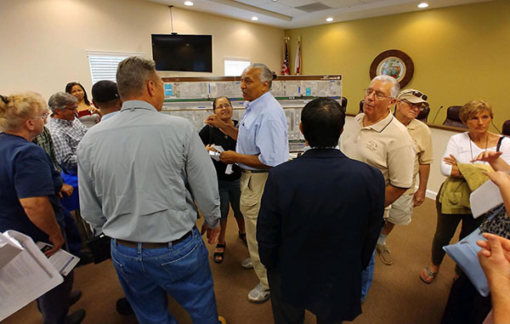
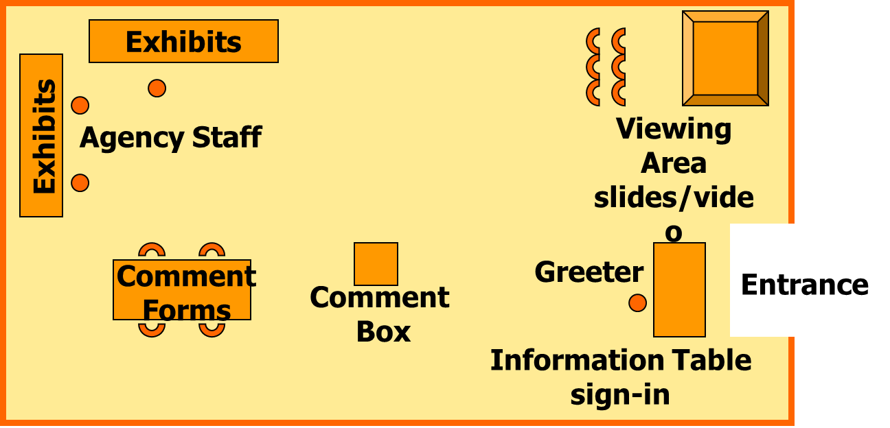
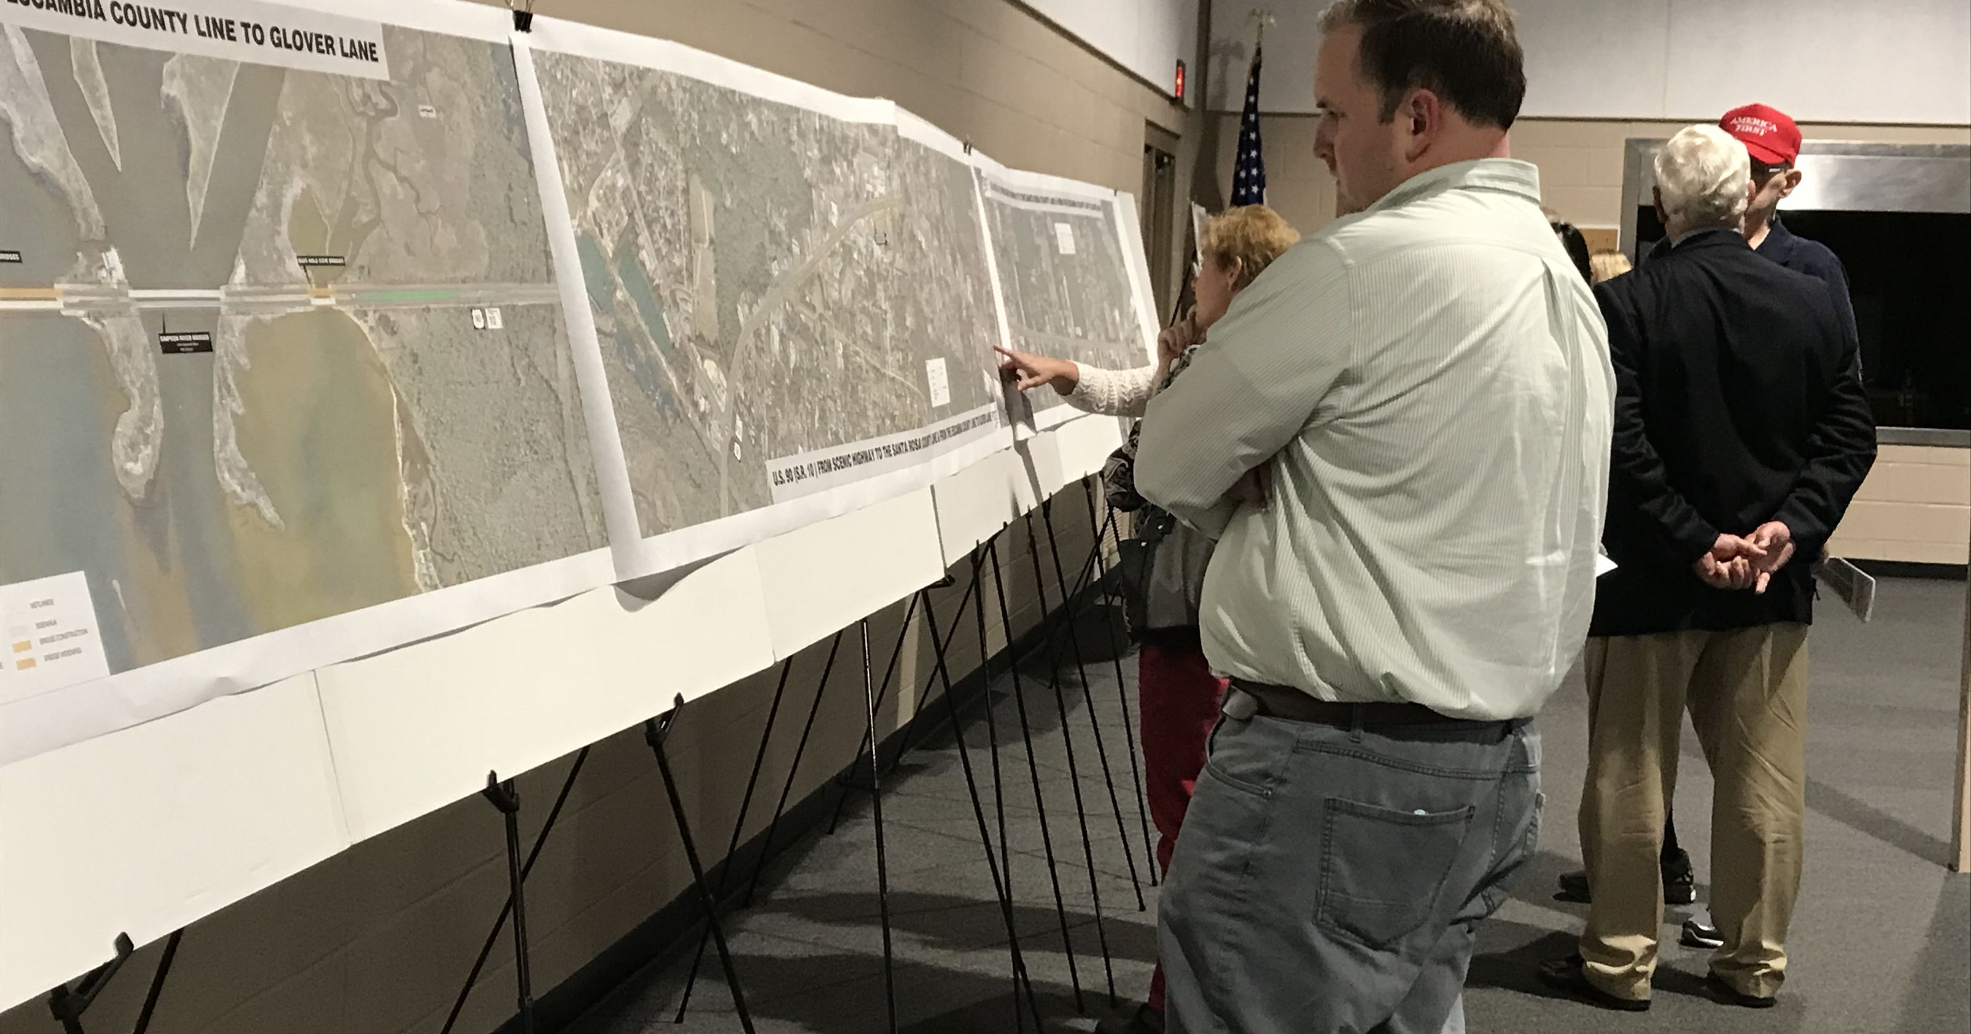
Example Open House Format

Slide 19
Involving Minority and Low-Income Populations
Barriers include:
  Cultural and language barriers
  Low literacy levels
Standard approaches are often inadequate
Determine how various groups receive information and target those forums
Notes:
Environmental justice can be achieved by providing ACCESS TO DECISION MAKING!
Inadequate access to project information combined with a low understanding of the decision-making process for transportation projects can result in a perception of discrimination by minority and low-income populations.
Standard public involvement and outreach programs may be inadequate.
“Reach people where they live.” Determine how different groups receive information and use that medium to reach out. Example locations may include:
The local Spanish-language newspaper for households in a predominately Hispanic neighborhood.
Churches
Community centers or non-profit organizations
Shopping centers

Slide 20
Communication Strategies

Slide 21

Effective Communication
Know your audience
Focus on their interests when conveying your message
Anticipate the questions or concerns
Use their words
Notes:
How do you get a handle on community issues?
Review secondary sources
Talk to knowledgeable people
Visit the community
Stakeholder interviews

Slide 22
Active Listening
Summarize, don’t judge or editorialize
Acknowledge, don’t agree or disagree
Be aware of body language
Listening is the most important skill in conflict management.
Notes:
Active listening, careful communication, and attention to body language all help to reduce the potential for conflict to develop.
Effective listening is harder than you might think. It is important to avoid judging or filtering what is being said based on one’s biases or preconceptions.
The experts recommend that we:
summarize and restate what is being said to ensure accuracy. “Let me clarify – there is a driveway at the north end of the intersection that you feel is necessary for delivery vehicles to get in and out of your business.”
acknowledge what is being said, but avoid agreeing or disagreeing. “ I understand your concern and I will look into it and get back to you. Where can I reach you during the day?”
Body language conveys emotions and feelings, rather than facts or ideas. Be aware of your facial expressions, gestures, and posture. Are you frowning? Arms folded? What are they doing? Can you put them at ease?

Slide 23

Public Comment
You are going to put me out of business!
People shop for value and price, even businesses considered “convenience”
People avoid places where left turns are risky
Share research on economic impacts
Source: Public Information Meetings For Access Management Projects
David W. Gwynn, Jr., P.E., as adapted for FDOT by Kittelson & Associates
Notes:
You are going to put me out of business!
Motorists avoid unsafe locations (such as locations where they cannot safely turn left out of the business)
Along busy multilane corridors, it is advantageous to have a way to get customers to a traffic signal for left turns – one of the main principles of a successful access management program is the support of street network and connectivity
People do cross the street for a better price and product (always have, and it should be the same after a median is put in.
This is by far the most common and passionate complaint. Most small business owners pour their life savings into their businesses. It is their source of income and security for the future. Therefore, they are very protective of their businesses and are afraid of anything that they view as a threat to the viability of their business. Although it is very difficult to persuade these folks that closing a median opening will not significantly impact their business, the following points could be used to try and calm their fears:
< Our surveys have shown that median opening modifications had little or no effect on the selections drivers make when doing business. Most drivers are willing to make U-turns to access a business that they have used in the past.
< The most heavily affected businesses are convenience-type stores (gas stations, fast food, etc..). However, the median changes do not impact the demand for these items. Some businesses may be positively impacted in these cases. While the store may become slightly less attractive to some motorists, it will likely be more attractive to others.
< Many motorists avoid businesses where the access is perceived as unsafe. This often occurs along roadways with poor access management and numerous conflicts. Motorists may be more attracted to a sight with fewer conflicts at its access points.
< Our before and after surveys of business owners found that most business owners were not negatively impacted, and in fact, most said that it was not nearly as bad as they had thought it would be.
< Most motorists surveyed stated that they liked the median changes and that the changes did not change their shopping habits.
< Service industry offices (Doctors, Lawyers, Accountants, etc..) and specialty stores are not generally impacted as their patrons tend to have an allegiance with the owner or service provider.

Slide 24
Public Comment
No one can show me how you came to your final decision.
Do not say “because it doesn’t meet our standards”
Show the benefits of access management
Show detailed documentation and studies
Know your backup data and rationale
Offer to send data and resources to the person
Show re-routing patterns
Source: Public Information Meetings For Access Management Projects
David W. Gwynn, Jr., P.E
Notes:
No one can show me how you came to your final decision.
This is a common complaint. Many times, a member of the public will want to see what analysis was
done to justify recommending a median opening for closure of modification. This includes traffic
volumes, collision data, alternate routes, etc. It is very important to have a clear understanding of the rationale for why the changes are proposed. Because it doesn’t meet our standards is an instant credibility killer. Go to the area, drive the route, and understand the need for the change.
The following items have proven invaluable in such
situations:
Ensure that someone has copies of all documentation prepared for the project. Additionally, a summary of the rationale behind how each median opening was analyzed should be readily available.
Be prepared to show existing traffic volumes and collision data. Also, be prepared to show how the traffic will be rerouted after construction.
Offer to send the person copies of the traffic volume and collision data if they would like.

Slide 25
Public Comment
I wasn’t notified of the meeting.
Use the media for advertisements and articles
Land owners and tenants may not be the same
Send out newsletters to property owners; hand deliver flyers to tenants
Notify the Chamber of Commerce and homeowner groups
Keep a comprehensive mailing list
Source: Public Information Meetings For Access Management Projects
David W. Gwynn, Jr., P.E
Notes:
I wasn't notified of the meetings.
This is a common complaint, although not always a valid complaint. However, there are many things we can and need to do that will help provide notice to as many people as possible. Many people fear that the government is trying to "sneak something past them" by not notifying everyone.
The media can be useful. Most newspapers are receptive to running articles announcing the meetings. The articles for our meetings have ranged from one paragraph in the local section to front-page articles, depending on the level of controversy associated with the project.
Fliers for the meeting should be distributed in several ways. For very small projects, the fliers can be distributed to homes and businesses along the road and affected side streets. The fliers should clearly describe the time, date, location, and purpose of the meeting. This will ensure that all of the directly affected properties are notified.
For larger projects, fliers should be mailed out in addition to handed out. The mail-out should be to the entire affected area, while the hand-delivered fliers should be distributed along the frontage of the road. This will help ensure that both property owners and tenants are notified. Many times, especially with commercial property, the property owner is not located at the site.
Radio stations and television stations generally do not announce the meetings, but for highly controversial or very large projects they may be receptive to announcing or even covering the meeting.
By a combination of field visits, review of aerials, and discussions with local agencies, try and determine any neighborhoods, major employers, or others who may be interested and/or impacted by the project. Sometimes these groups are not immediately identified. Then ensure that these groups are notified.
Keep a list of the people who were mailed fliers. Check the name of anyone who states that they were not notified against the list and add their name if it is not on the list. Apologize to the person if they were overlooked and ensure them that they are now on the list.

Slide 26

Public Comment
You don’t care what I have to say!
Let people have their “say”
Reassure the person that we need their input
Listen well, do not interrupt
Do not argue
Send a personalized letter to each person making comments
Source: Public Information Meetings For Access Management Projects
David W. Gwynn, Jr., P.E.,
Notes:
You really don't care what I have to say!
This is a very common complaint and can be credited to a combination of people's general distrust for the government, and perhaps past experience with FDOT and other agencies before the current emphasis on public involvement was established. Although many of these people will not believe anything you say, some things can be used to help convince these people that we indeed do care what they have to say.
The most important thing you can do is to let the person know that the project or strategy is not final. Encourage them to make comments, both verbally and preferably in writing, for consideration by the Department staff.
Listen well. Do not interrupt people. If someone becomes long-winded, try and convince them to restate the problem and then let you respond. We want to avoid the impression that we already have our minds made up -- which is what many of them think.
After the meeting, carefully review the input from the public and make changes as necessary. Make sure that each comment is thoroughly discussed and resolved.
Send a personalized letter to each person who submitted a written comment. The letter should thank them for their input and also explain the resolution of their comments. Although this is time-consuming, it is received much better than a form letter.
Do not argue with people. Explain the Department's position and guidelines, but don't allow yourself to get pulled into an argument. If the person is aggressive or offensive, thank him for his comments and tell them you must go help other people.
Under no circumstances give the Median Opening Spacing distances included in 14-97 as the reason a median opening was placed where it was. These spacings should be portrayed as guidelines that are modified as necessary for specific site conditions. Strict adherence to the formal spacing will tend to reinforce some people's belief that the FDOT is either inflexible or already has their mind made up and is at the meeting merely as a formality.

Slide 27
Public Comment
What about the trucks?
Talk to business owners
Understand how trucks circulate and identify reroutes
Drive the new routes and look for problems
Source: Public Information Meetings For Access Management Projects
David W. Gwynn, Jr., P.E.,
Notes:
What about Trucks?
One of the legitimate concerns of local businesses is the ability of delivery vehicles to access their property. Many buildings are designed specifically to accommodate trucks entering from a specific access point. Others may require unusually large or wide vehicle access, sometimes only once a month or so. Rerouting trucks due to the modification of a median opening requires special analysis to ensure that you do not unreasonably restrict trucks from accessing a business.
One of the most important things to do in this regard is to talk to the business owners along the road. This includes both businesses along the frontage of the road as well as those on the side streets. You must think about how trucks would access the site for any proposed median plan.
Then you must drive that route and look for any problems that a truck might have in maneuvering that route.
Determine any internal circulation problems that may occur. Some may be easily addressed while others may require structural or other expensive modifications to the site.
The objective is to try and accommodate the land owners existing business operations as much as possible.
Be prepared to discuss how trucks will access all affected sites.
In discussions with affected property owners, talk them through how the median will affect traffic operations in their area.
Demonstrate how they will get in and out of their property or neighborhood and how the project will improve safety.
If additional questions arise that require further analysis, do the analysis and follow up with them on the results. If changes are warranted then indicate the changes. If no changes are warranted, clearly explain why.
FDOT District 4 –A few businesses are concerned about trucks getting in and out. FDOT took traffic counts of truck traffic. Also, neighborhood concerns about cut-through traffic south of Powerline Rd. due to a median improvement project. Petition to FDOT. FDOT said they would look into it, but people didn’t believe them and called their Representative. FDOT met with her to go over how they were addressing the concerns and this went a long way toward diffusing the issue and assuring the Rep that they were considering the concerns.
The District looked at residences that signed the petition in relation to the median opening changes. Over half would be accommodated by the proposed changes. One variance was given for a directional median opening to avoid putting U-turns at a hazardous signalized intersection. FDOT sent a letter to all petitioners and others summarizing the results of their assessment and the variance that was approved and copied to the Representative. Opposition was diffused.

Slide 28
Public Comment
The U-turns will cause a safety problem.
Show number of left-turn and angle crashes
Show research on the benefits of U-turn movements and reduction in crashes/conflicts
Make sure the receiving pavement width is adequate
Will U-turns cause right-turn conflicts?
Use local law enforcement to back up your case
Source: Public Information Meetings For Access Management Projects
David W. Gwynn, Jr., P.E.,
Notes:
The U-turns will cause a safety problem.
Many people, especially the elderly, believe that increasing the number of U-turns will increase collision frequency. In general, this is not true, however, the following items may help to address this complaint:
Studies have shown that reducing the number of conflicts along a roadway results in a decrease in angle and left-turn collisions. In general, the increase in U-turns will not increase the number of accidents at the location the U-turns will be rerouted through, and will significantly reduce the collision frequency at the openings being closed.
Ensure there are no problems associated with U-turns(e.g., conflicts between U-turns and right turns from side streets, provisions for commercial and oversized vehicles, etc.
Review the existing collision data with the person. Often the median opening strategy is designed, at least in part, to eliminate high collision locations.
Talk to local law enforcement agencies about any known safety problems. These folks work the accidents and oftentimes are the most knowledgeable persons regarding safety conditions. They may also be able to help you determine if you have all the accident data or if you are missing some.

Slide 29
Do Access Management Projects Harm Business?
Most businesses see no loss in business due to access management projects.
Notes:
Several studies were conducted in the past few decades to help fill the need for more information on the potential economic effects of access management. These studies have focused largely on the potential impacts of left-turn restrictions (median projects) on business activity, although some have also addressed changes to driveway access. Due to the proprietary nature of sales information and the variety of factors that affect business activity, analysis of this issue has been difficult. Most studies have focused on business owner perceptions of impacts, before and after case examples, or generalized comparisons of business activity across corridors.

Slide 30
Example: Florida Business Owner Surveys
Median reconstruction projects in the Orlando metro area:
  64% felt they were not impacted at all
  59% had no problem with the changes
  57% reported no decrease in business activity, similar to the economy as a whole
Source: FDOT District 5 Study – Ivey, Harris, and Walls; TEI, 1995
Notes:
Conclusions
These results generally indicate that median projects have little overall adverse impact on business activity. Although some businesses report increases in sales and some report decreases, the majority of businesses report no change in business
Business Owner Surveys
500 mail-back surveys distributed. 46% returned.
86% had been in business at the same location before the change in median treatments.
64% had no impacts from the changes.
91% made no changes to the way they did business.
59% had no problems with the changes.
57% reported an increase or stability in their business volumes.

Slide 31
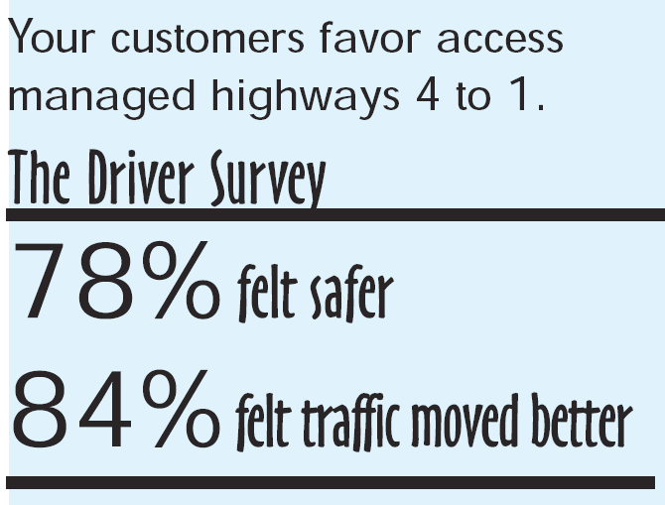
How Do Customers Respond to Access Management?
Drivers surveyed along 5 improved corridors
in Central Florida FDOT District 5 (Ivey Harris & Walls – 1995)
Notes:
TEI Study
Usually, the people who show up at public information meetings are not a good representation of the general public. For the most part, people will not attend the meeting unless they are worried that they will be adversely impacted and will not make public comments or fill out a comment card unless they are very concerned that they will be negatively impacted. Unfortunately, the general road users and non-affected business owners and residents are not willing to give up their limited time to attend these meetings. TEI attempted to solicit these people’s input and opinions by using mail-out surveys, handouts along the roadways, and general discussions with business owners, law enforcement agencies, and local residents. The general results of the surveys are as follows:
Driver Surveys
800 mail back surveys were distributed and 23% were returned.
73% noted an origin or destination adjacent to the roadway section which was modified.
88% were familiar with the changes.
78% believed the roadway was safer as a result of the changes.
82% favored the changes.
57% did not feel inconvenienced having to make U-turns.
U-turns were overwhelmingly not a major decision in selecting a business patron

Slide 32
Overall Objectives
Legitimacy
Responsiveness
Effectiveness
….of Agency
Know the interests
Protect your
credibility
Ability to see from
their point of view
Maintain 2-way
…of Process
communication
…of Assumptions
Identify problems
Find the basis
and solutions
for agreement
…of Decisions
Clarify key issues
Mediate
Notes:
Knowledge Probe #3
Explain how the level of involvement might differ between a project to install a new median and a project to close an existing median opening.

