Slide 1
October 25, 2018
Accessibility for Document Creators and Providers
Kevyn Barnes, Manager of Library Services, TxDOT Research Library
https://transportation.libguides.com/TLR
Audio call-in number: 877-336-1274; Access code: 5759713
Notes:
Welcome to the October 25, 2018, Transportation Librarians Roundtable: Accessibility for Document Creators and Providers, with our speaker Kevyn Barnes, Manager of Library Services, TxDOT Research Library.
The webinar link is: https://transportation.libguides.com/TLR
For participant audio: please call in at phone number 877-336-1274; when prompted enter access code: 5759713

Slide 2
Accessibility for Document Creators & Providers
TLR Presentation October 2018
Presented by:
Kevyn Barnes, Manager/Webmaster
TxDOT Research Library,
Operated by Center for Transportation Research Library
The University of Texas at Austin
Notes:
For the librarians on the line, I hope this presentation will help you become an accessibility influencer or specialist for your organization.
************** POLL ****************
How Many of You…
Create documents to post online?
Create documents to share within your organization? (via intranet, email, or saved to a network folder.)
Provide electronic documents to your customers?
Post documents online, whether or not you are the creator?
************** POLL ****************
Who around you has an impairment to consider?
Myself, my spouse/partner, child, or other close relative.
My supervisor, co-worker, employee.
A friend or close acquaintance.
Somebody who has not told me.

Slide 3
POLL #1
Notes:
************** POLL ****************
How Many of You…
Create documents to post online?
Create documents to share within your organization? (via intranet, email, or saved to a network folder.)
Provide electronic documents to your customers?
Post documents online, whether or not you are the creator?

Slide 4
POLL #2
Notes:
************** POLL ****************
Who around you has an impairment to consider?
Myself, my spouse/partner, child, or other close relative.
My supervisor, co-worker, employee.
A friend or close acquaintance.
Somebody who has not told me.

Slide 5
Documents to Consider
Public Internet Access *
Behind a Login or Paywall **
Intranet Access **
Shared Folders
Email
Filed for Your Successors
Notes:
Not just technical reports but also handouts, presentations, flyers. PDFs, Word documents, PowerPoints.
* Gets the most attention, particularly due to laws that cover public facilities/accommodations and the wider visibility and impact.
** After the revised Section 508 of the Rehabilitation Act rules, aka “Section 508 Refresh” (effective 2018), “agency official communication” must conform even when not public-facing https://www.access-board.gov/guidelines-and-standards/communications-and-it/about-the-ict-refresh/final-rule/text-of-the-standards-and-guidelines#E205-content
“For Section 508-covered ICT, all covered Web and non-Web content and software – including, for example, Web sites, intranets, word processing documents, portable document format documents, and project management software – is required, with a few specific exceptions, to conform to WCAG 2.0’s Level A and Level AA Success Criteria and Conformance Requirements. By applying a single set of requirements to Web sites, electronic documents, and software, the revised requirements adapt the existing 508 Standards to reflect the newer multifunction technologies (e.g., smartphones that have telecommunications functions, video cameras, and computer-like data processing capabilities) and address the accessibility challenges that these technologies pose for individuals with disabilities. “ --https://www.access-board.gov/guidelines-and-standards/communications-and-it/about-the-ict-refresh/final-rule/i-executive-summary

Slide 6
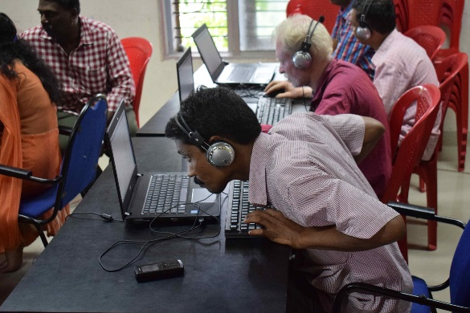
What needs to be considered?
Photo illustration by Senior Airman Kristin High,
U.S. Air Force
CC-BY-SA-4.0L “ICT training for blind teachers by It@School
Kollam” / Ivanjoseplavila
Photo by Kemberly Groue, U.S. Air Force
Colorblindness
Vision Impairment
Physical Limitations
Perceivable
Operable
Notes:
(Auditory issues are not covered in my talk, but are important when dealing with videos and audio recordings.)
“It is estimated that, while 15-20% of all individuals would benefit from receiving communications in an accessible format, only 3-4% of all documents are currently accessible. With an increasingly aging population, and an explosion in the growth of conditions such as diabetes and macular degeneration, the need for accessible documents will continue to increase dramatically.” --https://www.crawfordtech.com/blog/document-accessibility-for-print-service-providers
Perceivable: Can a person with colorblindness tell there is a link to more content? Is their eye drawn to it like a person who can distinguish colors? Can a sight impaired person see and tell what that important flowchart is on the page?
If you are ignoring color, then you may be leaving people like Zuckerberg, Clinton, and Marco Rubio unable to interpret your supposedly high-impact graphics.
Operable: Can they quickly scan and flip straight to the content they want? (own story about hovering over a small one letter link.)
A 2008 “ study put together by Google based on data from the World Bank (WDI, 2008) and CDC.gov (NHI Survey, 2008), …[states there are] more users who are blind / low-vision than the population of Canada.” [around 30-32 million at the time] ~http://www.interactiveaccessibility.com/accessibility-statistics (Source includes a graphic)
Motor Limitations = traumatic injures, diseases, conditions (temporary broken hand, Parkinson’s, loss of limb, etc). Think of veterans.
You’ve all heard the stats from other accessibility overviews, unfortunately this does not yet seem to resonate with a large majority of document creators. I was there once, too, so this is not a shaming but hopefully will be an eye opener.

Slide 7
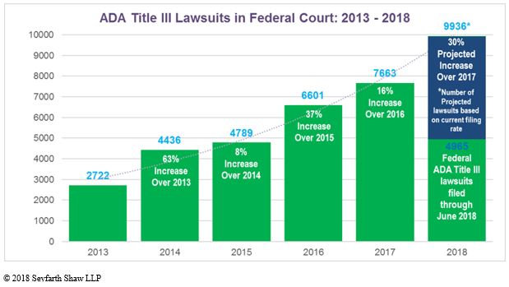
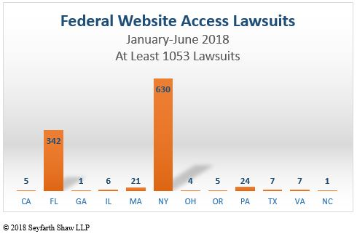
Why Else Should We Care?
“Plaintiffs filed 4965 federal ADA Title III lawsuits in just the first six months of 2018… If the filings continue at the same rate, there will be close to 10,000 ADA Title III lawsuits for all of 2018—a 30% increase over 2017.”
Source: Vu, M. N. (2018, July 19). Website Access and Other ADA Title III Lawsuits Hit Record Numbers. Retrieved August 16, 2018, from https://www.adatitleiii.com/2018/07/website-access-and-other-ada-title-iii-lawsuits-hit-record-numbers/
Notes:
There are many examples of ADA lawsuits and although only a modest number are based on electronic documents, they do occur. Commercial website content is most affected but=➔
Janie Lin states in her recent article in July/August 2018 Information Outlook: “Comply or Be Punished” (Lin, Jaime, “Four Ways to Talk about Accessibility,” Information Outlook, vol.22 no.4, 2018.) Also, “it makes sense to spend money on web accessibility, not on court cases.”
Title II: State and local government: One landmark university case: In March 2017 UC Berkeley Removed More Than 20,000 classroom lectures and podcasts Online Videos From Public Access In Response To DOJ Captioning Demand.. “DOJ concluded in the findings that a covered entity subject to Title II has a duty to ensure content that it makes available to the public free of charge is accessible” https://www.adatitleiii.com/2017/03/uc-berkley-to-remove-more-than-20000-online-videos-from-public-access-in-response-to-doj-captioning-demand.
Title III: Public / commercial facilities Considering Title III, lawsuits filed due to accessibility complaints have risen. In only 6 months, over one thousand of those have been about accessibility of web content. (see graphic.)
AT THE END OF SEPTEMBER 2019, “In a letter to members of Congress, the DOJ reaffirmed its longstanding policy that Title III of the Americans with Disabilities Act applies to website, though it declined to issue specific regulations on what websites need to do to comply with the law…. Key Takeaways: The DOJ still believes the ADA applies to websites, even if it is not acting to issue regulations. The lack of regulations doesn’t mean organizations don’t need to make their websites accessible. Organizations have a little flexibility in deciding how to make their websites accessible, but in most cases, working to meet WCAG 2.1 AA success criteria will be the best strategy. Litigation will likely continue to increase in the absence of specific regulations.” --

Slide 8
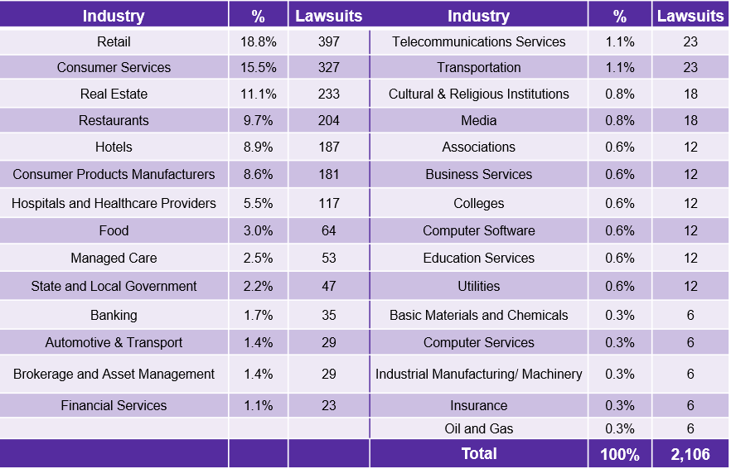
Why Else Should You Care?
Level Access presentation, September 13, 2018
Notes:
State and local governments do get hit.
According to a December 2017 article from adPharos “Since 2011, at least 142 local governments in the US have been sued due to website accessibility issues.”
According to Level Access, under ADA Title II, the US DOJ reached 18 settlements from 2015-2018 and 12 agreements in 2017 (mostly polling places and detention centers). Current DOJ is not pursuing much with current admin.
Laws are highly individual between states, so lawsuits are usually brought by private parties, not lawyers conducting mass fishing expeditions. “Expect minimal federal enforcement in current administration. Expect increasing private enforcement at state level.”

Slide 9
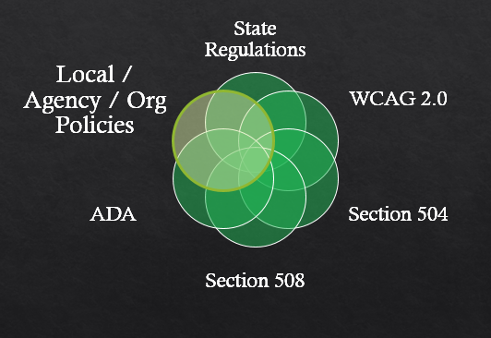
Regulations & Best Practices
Notes:
U.S. factors—internationally there are other standards and regulations (but think about UN committee treaty on disabilities).
*So here is my story* : university policies. UT strengthened its policy in 2013/14. We had just developed on new online catalog and a contractor had just finished redesigning our Center’s website=➔
===========
People often say “ADA” to refer to any accessibility issue, but that is not always correct. At one time, judges had ruled that ADA only referred to physical spaces, but recent trends have ruled in favor of websites being included. =➔ At the end of September 2018, in a letter to Congress, the DOJ reconfirmed it’s stance that ADA does apply to websites. Because they have not issued exact guidelines as to what that means, lawsuits are expected to continue – Level Access https://learn.levelaccess.com/webmail/487581/223995521/fc5795ef67ff07e4f5b6d0de4fb47bb549bd14b408ceb59766934dfc670766d6
See https://www.w3.org/TR/WCAG20/
Web Content Accessibility Guidelines 2.0
W3C recommendations from the Accessibility Guidelines Working Group (AGWG): Perceivable, Operable, Understandable, and Robust
Section 508 refresh “… rule references Level A and Level AA Success Criteria and Conformance Requirements in WCAG 2.0 and applies them not only to websites, but also to electronic documents and software."
Section 504: “No otherwise qualified individual with a disability in the United States, [shall] be denied the benefits of, or be subjected to discrimination under any program or activity receiving Federal financial assistance…”
Most states now have web accessibility requirements codified in some way, which their state agencies must follow.
“508, ADA, WCAG: What’s the difference?”
https://www.logicsolutions.com/508-ada-wcag-accessibility-difference/

Slide 10
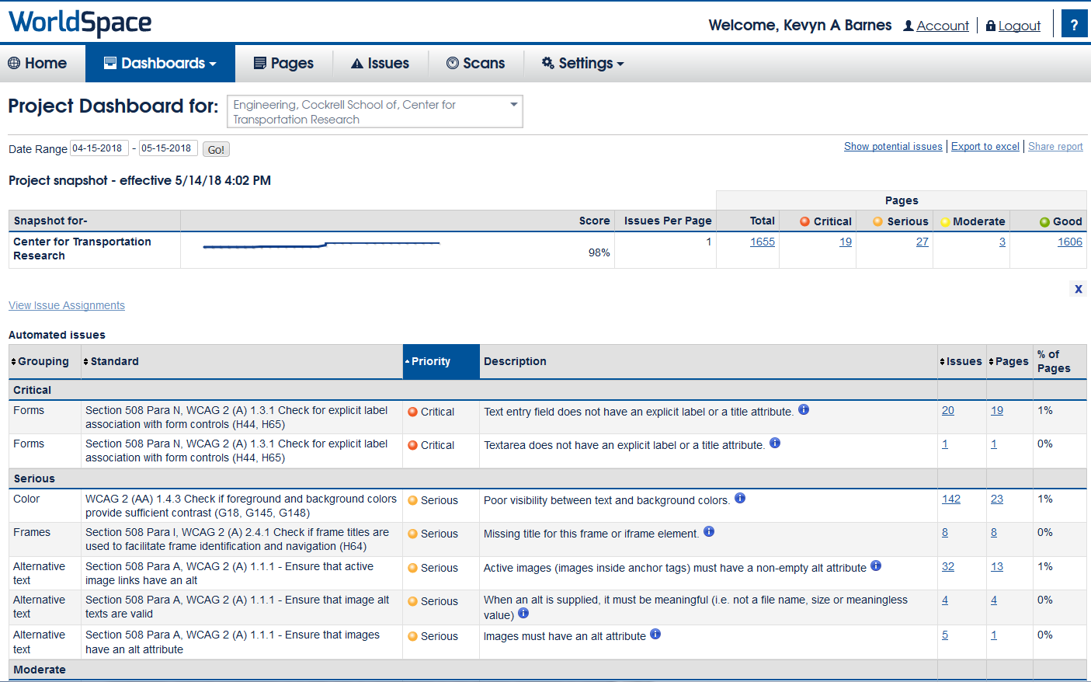
Regulation Compliance
Notes:
➔ Our web pages have been required to meet a minimum of 90% compliance with the Website Content Accessibility Guidelines 2.0 Level AA (WCAG 2.0 AA) standard, We were below 50%. I watch our accessibility scans monthly now. I suspect that in the next few years, the scans will apply to document attachments including PDFs so wanted to be ahead of the game.
In February 2018, we received notice that no documents will be accepted into our university’s digital repository (Texas ScholarWorks) unless it is WCAG 2.0 compliant. This affects all theses/dissertations and faculty-submitted reports. .

Slide 11
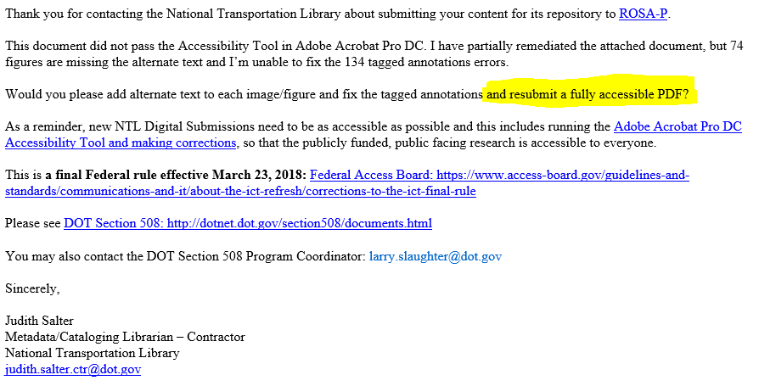
Regulation Compliance
Notes:
In addition, many webmasters our now rejecting documents and other attachments that do not meet guidelines. Our library regularly submits TxDOT to TRID and requests duplicative archiving of the electronic documents with NTL. We received this rejection from NTL on Monday. Expect this to be a rising trend.
Provide compliant documents and information to your IT when submitting information to add to website. With thousands of pages and other media files received, it would be impossible for webmasters to remediate each one even if we had the subject knowledge to do so. We depend on the creators to provide files with accessibility in mind.

Slide 12
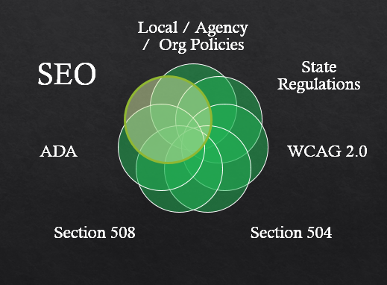
Regulations & Best Practice Sources
Notes:
Another argument to persuade document creators may be that accessibility provides SEO benefits. Higher ranking in online search results and increased exposure which could lead to more citations of the work.
“Almost without exception, Google ranks websites with accessibility techniques included in metadata, content, visual design, and development better in organic search. Why? Search engine crawlers can’t see or hear, and they only use a keyboard, similar to many people with disabilities.” --https://blogs.perficientdigital.com/2018/01/12/website-accessibility-benefit-seo/ (Lisa Michael of Perficient Digital “Does Website Accessibility Benefit SEO?, January 2018)

Slide 13
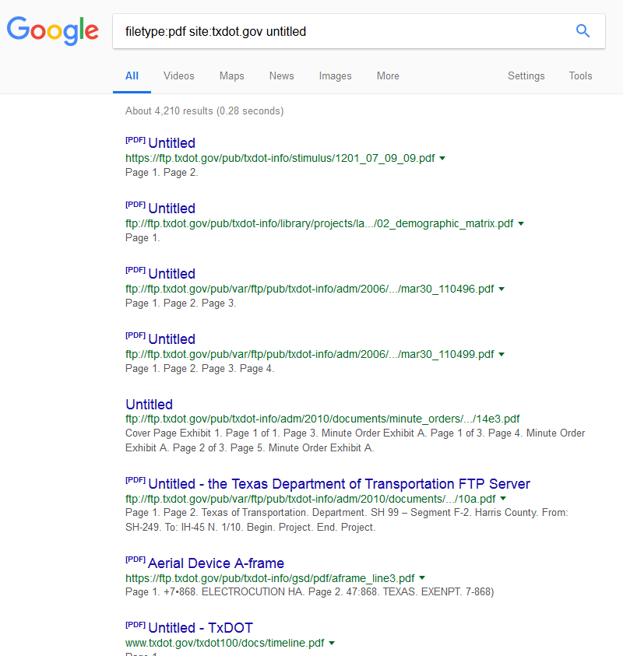
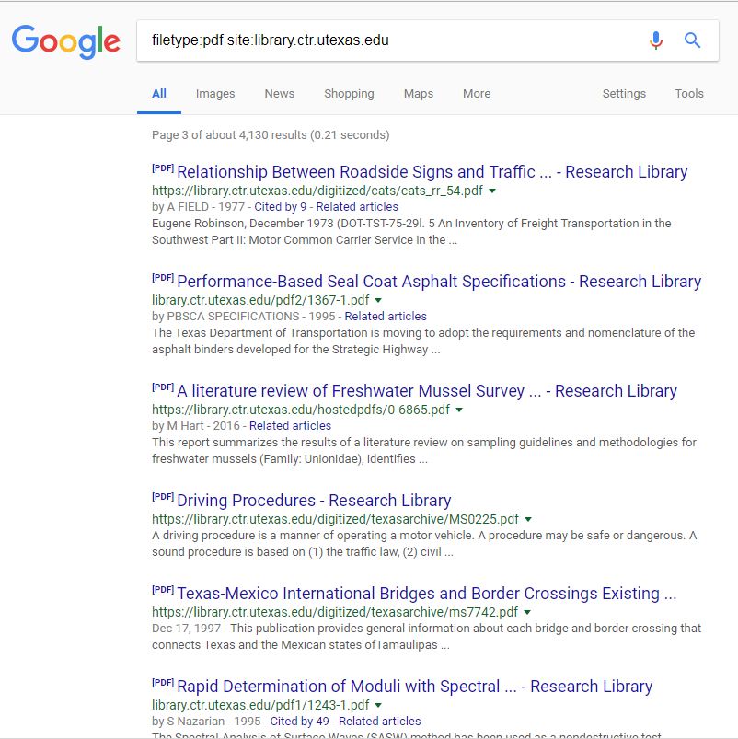
The SEO Factor
Notes:
On the left, an example of documents without metadata: I doubt these documents come up in many search results unless the search is extremely specific.
To the right, an example of documents that our library remediated for accessibility.
Which results would you rather see? If a screen reader can read it, then search engines will be able to read it better also.
Google and other search engine algorithms may purposely rank accessible documents above inaccessible files.
https://acrobatusers.com/tutorials/make-your-pdfs-work-well-google-and-other-search-engines

Slide 14
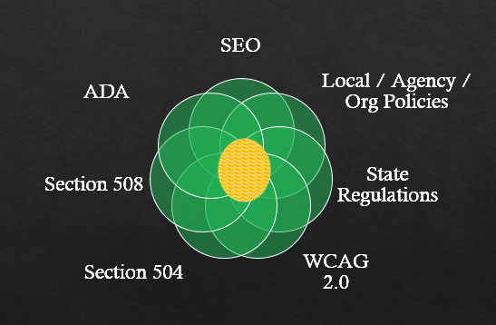
Regulations & Best Practice Sources
Your knowledge of a document consumer’s needs.
Notes:
Not covering all requirements of any component in depth, but I’ll provide tips for several accessibility factors that you can start practicing on all your documents to show a good-faith effort.
Also consider any special needs of people you know will use the document.

Slide 15
Basic Checklist
Use filenames that are descriptive but use web-safe punctuation only.
Describe hyperlinks correctly.
Use built-in tools to check for accessibility errors.
Set metadata properties for the document.
Add bookmarks to PDFs.
Images: Add Alt Text descriptions, including all text that is part of image.
Check reading order—especially after inserting images, tables, etc.
Graphs: Check for color contrast & convey information by means other than color.
Ensure an acceptable color contrast between text and background.
Tables: Include column headers that repeat across pages.
Formatting: Avoid using tables & extra paragraph breaks solely for formatting.
Formatting: Use built-in tools for bullet lists.
Formatting: Use headers and properly nest tag elements.
Notes:
See presentation slide Works Cited for more thorough checklists for complying with regulations.
U.S. Department of Education ED Accessibility Checklists for Word, PowerPoint, Excel, and PDFs: https://www2.ed.gov/web-guidance/accessibility-requirements.html.

Slide 16
Filenames: Pitfalls
2013&Improvement in Pavement Ride, Distress, and Condition Based on Different Pavement Types (Summary).pdf
1. Sharing in email / documents / web pages / library catalogs:
http://[...domain name…]/reports/1314/2013&Improvement in Pavement Ride, Distress, and Condition Based on Different Pavement Types (Summary).pdf
2. Encoded for web browsers:
http://[...domain name…]/reports/1314/2013%20Improvement%20in%20Pavement%20Ride%2C%20Distress%2C%20and%20Condition%20Based%20on%20Different%20Pavement%20Types%20(Summary).pdf
Notes:
Consider filenames for ease of sharing (i.e., once it is web-based, people with mobility problems or on cell phones may need to copy & paste links that break due to spaces and unsafe punctuation. The longer the filename, the harder this is. If this link is pasted as-is on a website (e.g., in a bibliographic database/catalog), we often get calls from our web visitors who say a link is not working but this is almost always the cause.
So I encode the URL before the screen reader will read the individual characters of the encoded portions (“ride-percent-two-C-percent-two-zero-distress-percent-two-c…”).
http://next.fordham.edu/?p=230
SEO and Google indexing factors of upper vs. lowercase (counted as separate files for analytics) & underscores (does not read words before and after as separate words).
Safe characters: [0-9a-zA-Z-.,_] "weird characters and spaces can cause other problems, most notably when trying to send a link to a particular file to download.
“Unsafe: Characters can be unsafe for a number of reasons. The space character is unsafe because significant spaces may disappear and insignificant spaces may be introduced when URLs are transcribed or typeset or subjected to the treatment of word-processing programs.” -- Uniform Resource Locators (URL), IETG Network Working Group, 1994. http://www.rfc-base.org/rfc-1738.html https://www.ietf.org/rfc/rfc1738.txt
Patent office requirements, NIH submission requirements include limit on filename characters, but note that that includes the entire file path so filenames should not contain maximum. Entire threads and programs devoted to solving the problem of files that become inaccessible when filename is too long or has unsafe characters.

Slide 17
Filenames: Better Practice
2013-rr-0-6673-s.pdf
http://[domain name]/reports/1314/2013-rr-0-6673-s.pdf
2013-summary-improvements-different-pavement-types.pdf
http://[domain name]/reports/1314/2013-summary-improvements-different-pavement-types.pdf
Notes:
Instead, connect all parts of the filename with a dash to eliminate spaces.
Descriptive is good and helps SEO, too: https://accessibility.iu.edu/creating-content/documents/general-guidelines/descriptive.html
➔ Notice that if you do that, once it is placed on the web, its URL will not break and a screen reader will recognize each part as a word.

Slide 18
Hyperlinks
Links:
here.
Here.
Here.
Click here
Find the report here.
Versus
Download the summary report Improvement in Pavement Ride, Distress, and Condition Based on Different Pavement Types.
Find more information on the NCHRP 20-07(132) project page.
Notes:
When including links in your report, consider both screen readers and colorblind factors. Problems in this example: link not underlined, color not what people expect and may not have enough contrast, and the link text is not descriptive.
DO WHAT PEOPLE EXPECT=> underline links and do not underline things that are not hyperlinks.
The text that is hyperlinked is what is used by screen readers to list all of the links on a page. This is what blind users will hear if trying to flip through links on the page.
It is better to place the link on descriptive text. I probably should actually place the link over “summary report” as well.

Slide 19
PDF Accessibility
Remediating after the Fact

Slide 20
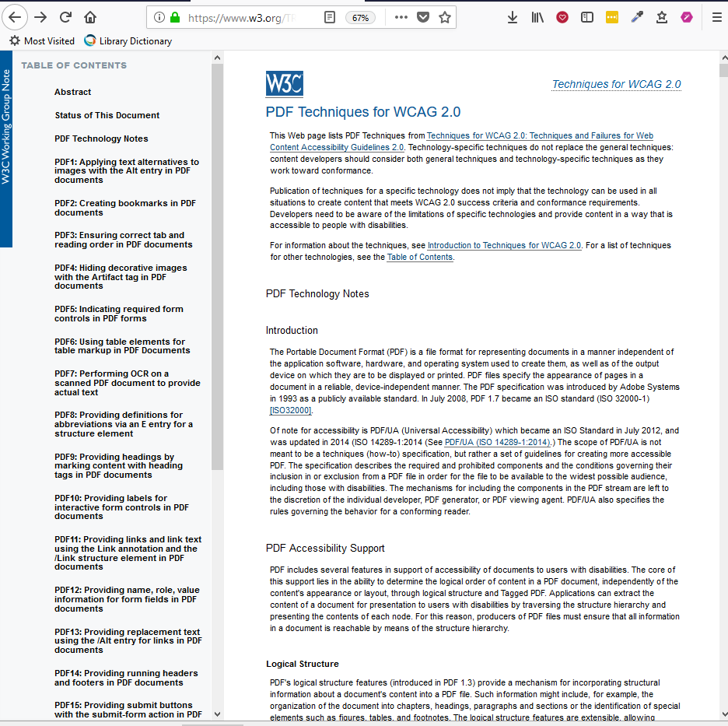
PDF Accessibility
PDF Techniques for WCAG 2.0: https://www.w3.org/TR/WCAG-TECHS/pdf.html
Notes:
PDF Techniques for WCAG 2.0 : list of 23 accessibility items and techniques for remediating a PDF to comply with guidelines.

Slide 21
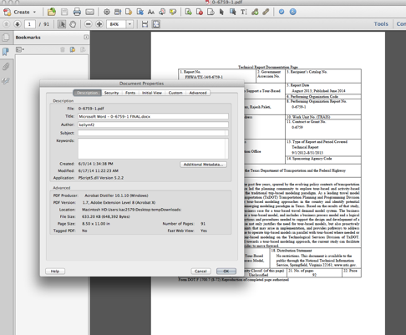
Basic PDF Metadata
Notes:
PDF properties generally just import the information from the Word document or other file that it was converted from. This usually means that there isn’t much information or it is not descriptive.

Slide 22
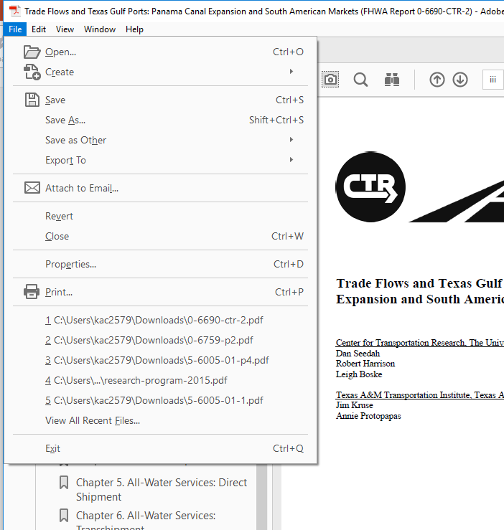
Basic PDF Metadata
Notes:
Next the properties settings

Slide 23
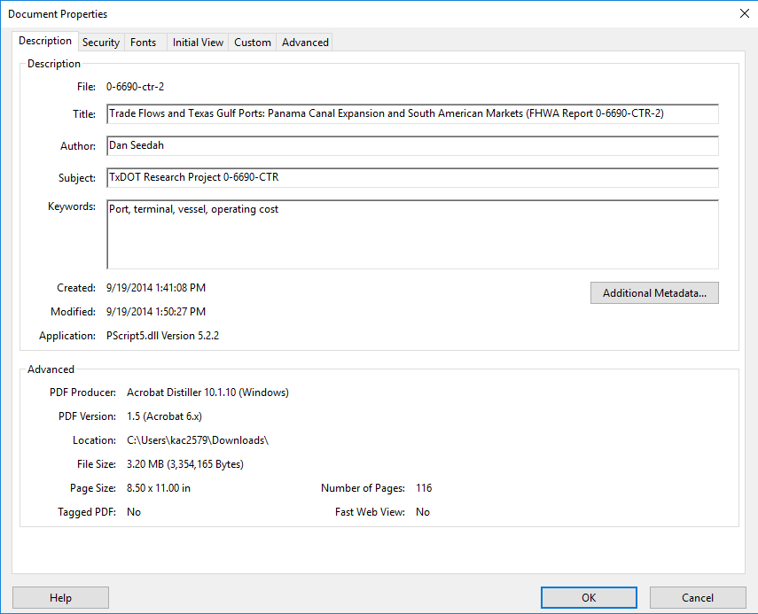
Basic PDF Metadata
Notes:
Within the Description area of PDF Properties. Solid red arrows mean required. Dashed green arrows mean recommended but not required.

Slide 24
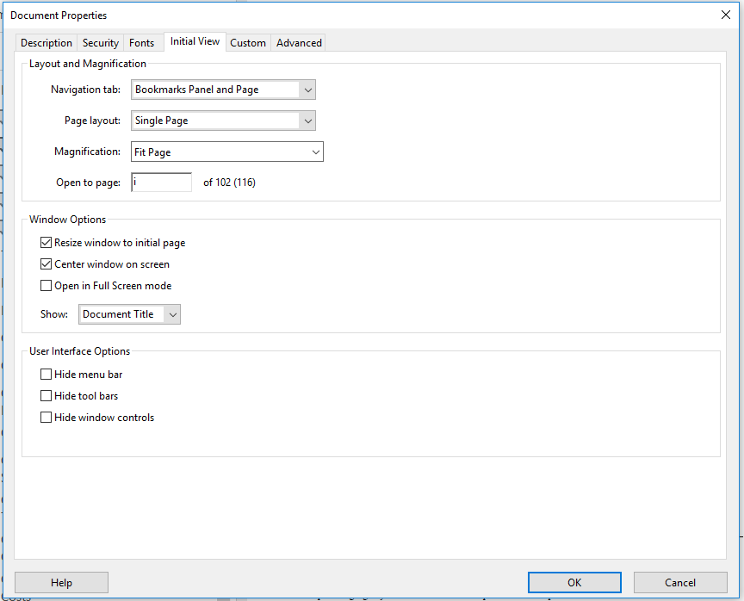
Basic PDF Metadata
Notes:
Initial view tab of PDF Properties

Slide 25
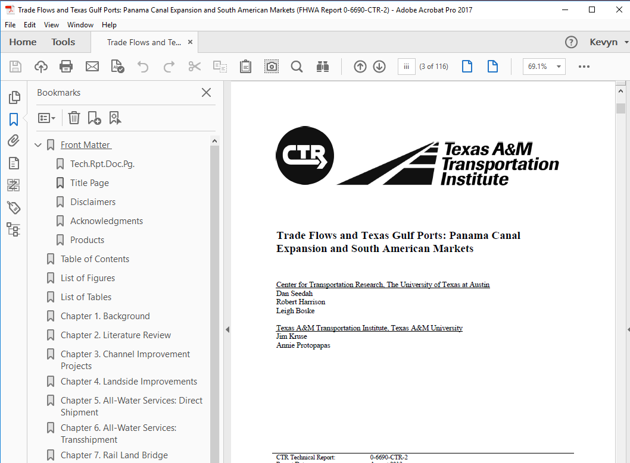
Basic PDF Metadata
Notes:
Show title instead of filename on the title bar.

Slide 26
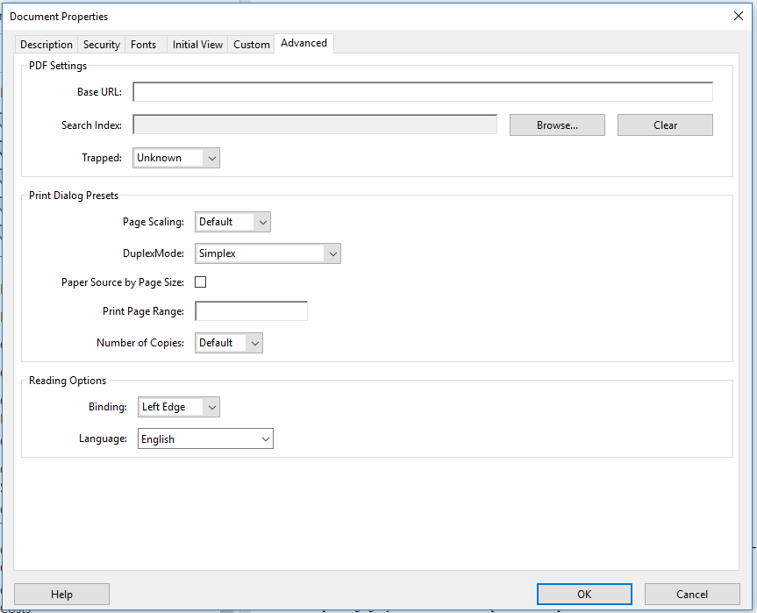
Basic PDF Metadata
Notes:
Within the Advanced tab area of PDF Properties. Setting the language is a requirement.

Slide 27
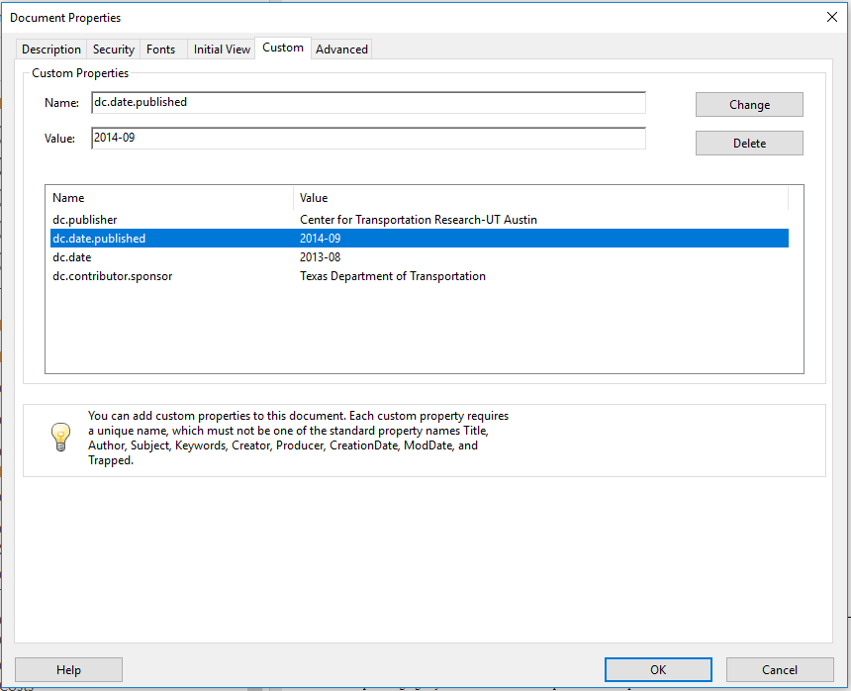
Basic PDF Metadata
Notes:
Within the Description area of PDF Properties. If you have suggestions for adding additional properties, please share.

Slide 28
Basic PDF Metadata
Notes:
Bookmarks for all major sections. These may import if you use proper headings in your Word document.

Slide 29
PDF Accessibility, pt. 2
Built-in Accessibility Checker

Slide 30
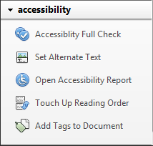
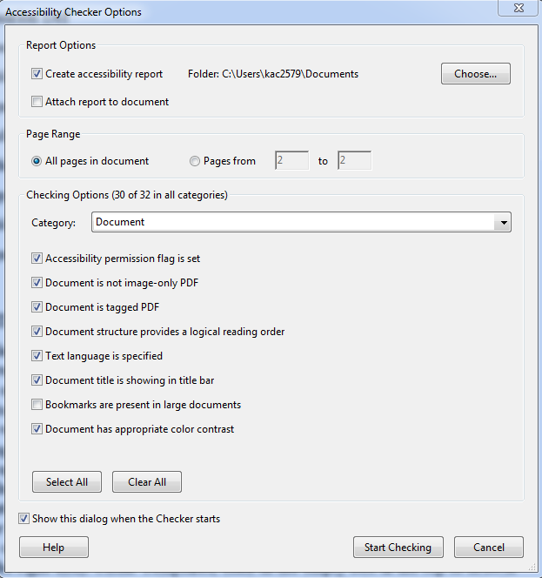
PDF Accessibility Checker
Notes:
Built in Accessibility checker in Adobe Pro

Slide 31
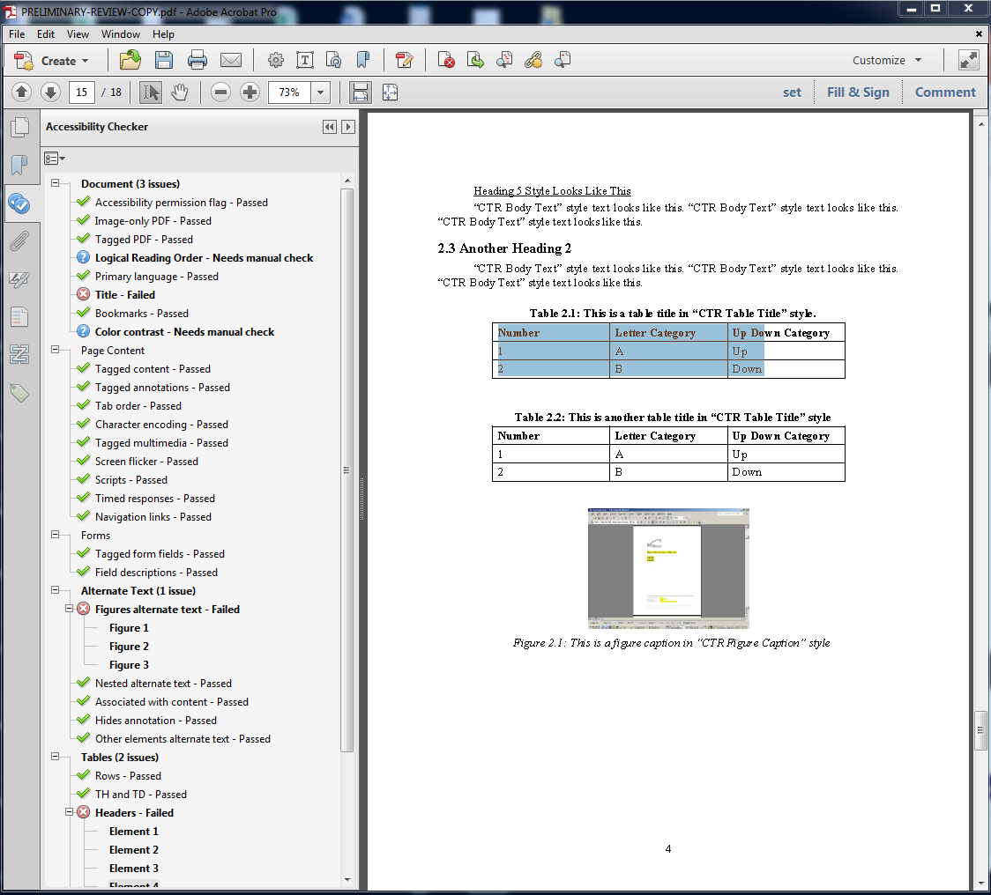
PDF Accessibility Checker
Notes:
Here I’m going to pick on one of our old internal research report templates.
The Adobe internal accessibility checker doesn’t necessarily cover all requirements of 508, etc., but gets you started.
** CLICK**
Here, most items pass, but there are several that fail.
Also, many things will have to be manually checked--color contrast, whether or not the alt text is meaningful, whether the headings are properly set (checker only makes sure heading tags are properly nested), and whether the reading order is correct.

Slide 32
PDF Accessibility, pt. 3
Reading Order

Slide 33
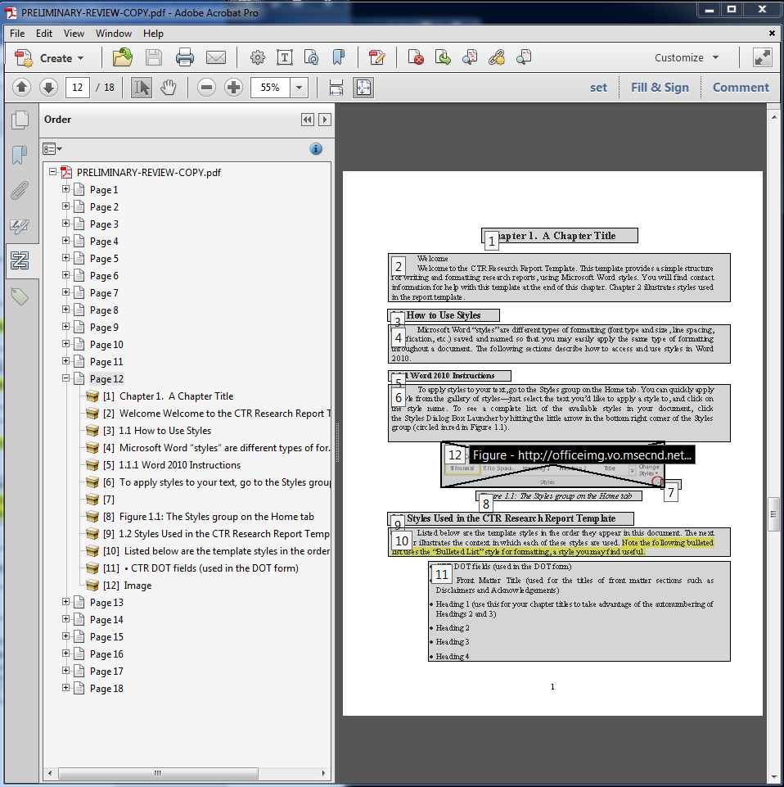
PDF Reading Order
6 (paragraph)
12 (image)
7 (blank spacing)
8 (image caption)
9 (heading)
10 (paragraph)
11 (list)
Notes:
Reading Order has to be manually checked.
Here there are a few things out of whack. #7 is an empty space where space/paragraph break was used for formatting purposes and the Image is the very last thing to to be read (#12).

Slide 34
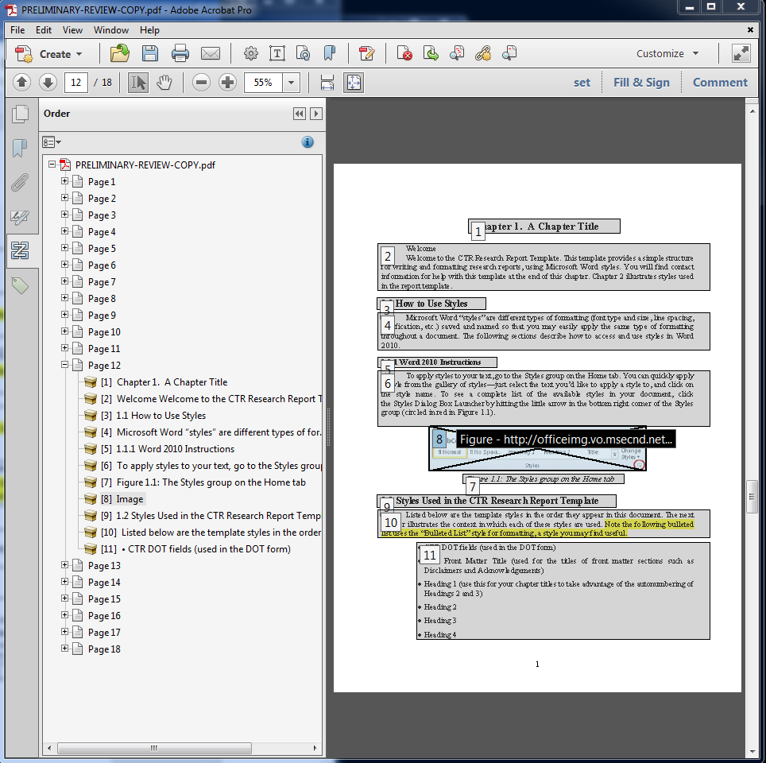
PDF Reading Order
Notes:
Here, I deleted the Empty line (under the image for formatting) and used drag/drop to move the reading order of the image (I moved it under the Figure description).
*** Note: moving the reading order only affects the screen reader’s order, however, deleting a tag will also delete it entirely from the page.***
Doing this on a few pages may be no problem, but a 200-page document with a high number of illustrations would be very time-consuming.

Slide 35
PDF Accessibility, pt. 4
Tags – Advanced Remediation

Slide 36
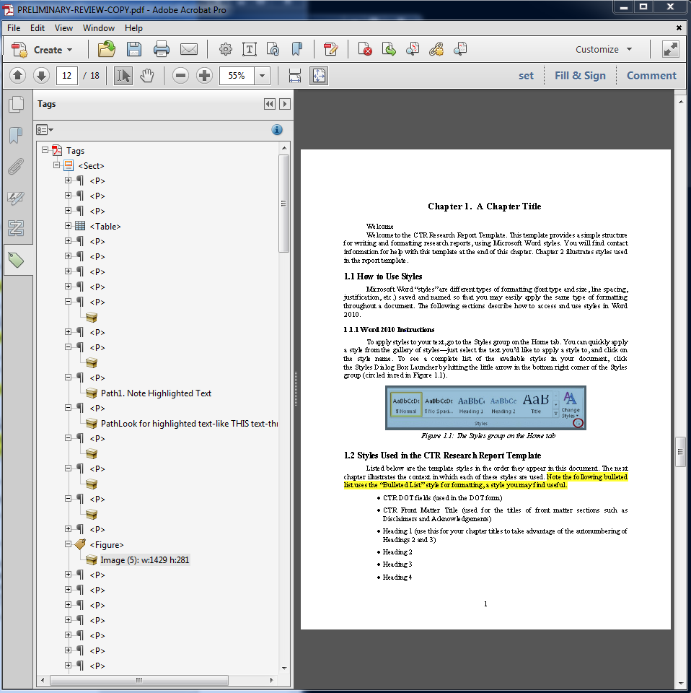
PDF Tags
Manual check shows that none of the subheadings (section 1.1, subsection 1.1.1, etc.) are marked as nested headings.
Notes:
ADVANCED---Checking tags and containers to make sure headings are marked as headings, paragraphs as paragraphs, etc. Also removing empty paragraphs that were used for spacing/formatting. This takes much care because if you delete the wrong tag element, it will also delete the text from the page. You may not just affect ADA accessibility but could end up inadvertently changing the content.

Slide 37
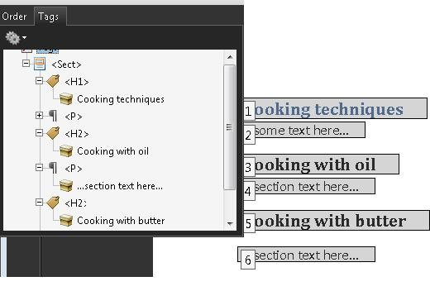
PDF Tags
Notes:
I will not touch this.
See https://www.w3.org/TR/WCAG20-TECHS/PDF9.html for instructions.
So what I want to show you is how to create these accessible features before the document is ever converted to a PDF

Slide 38
MS Office Accessibility
Built-in Accessibility Checker

Slide 39
MS Office Accessibility Check
Notes:
I’ll be using my own presentation to illustrate some of these points.
In PowerPoint, switch to "File" on menu bar

Slide 40
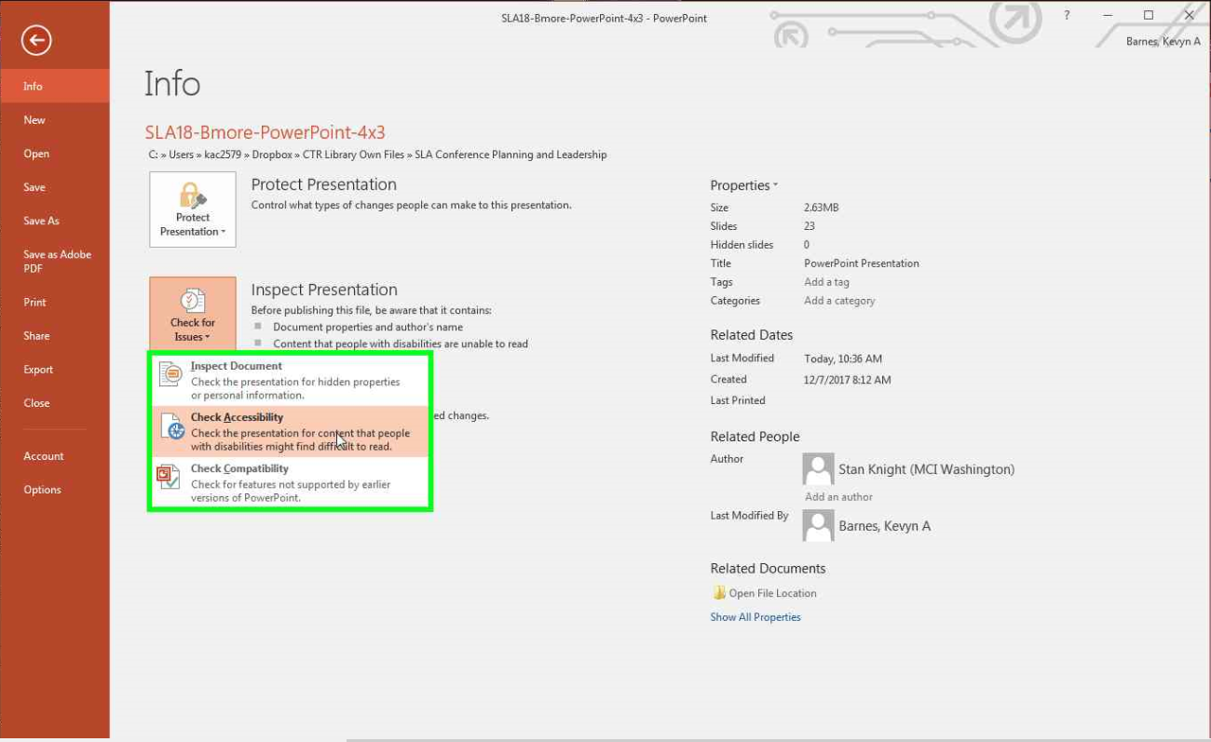
MS Office Accessibility Check
Notes:
File Options include "Check for Issues" then "Check Accessibility"

Slide 41
Accessibility Check Results: PPTX
Notes:
Now you have a Window that show definite accessibility errors as well as things you might need to check manually

Slide 42
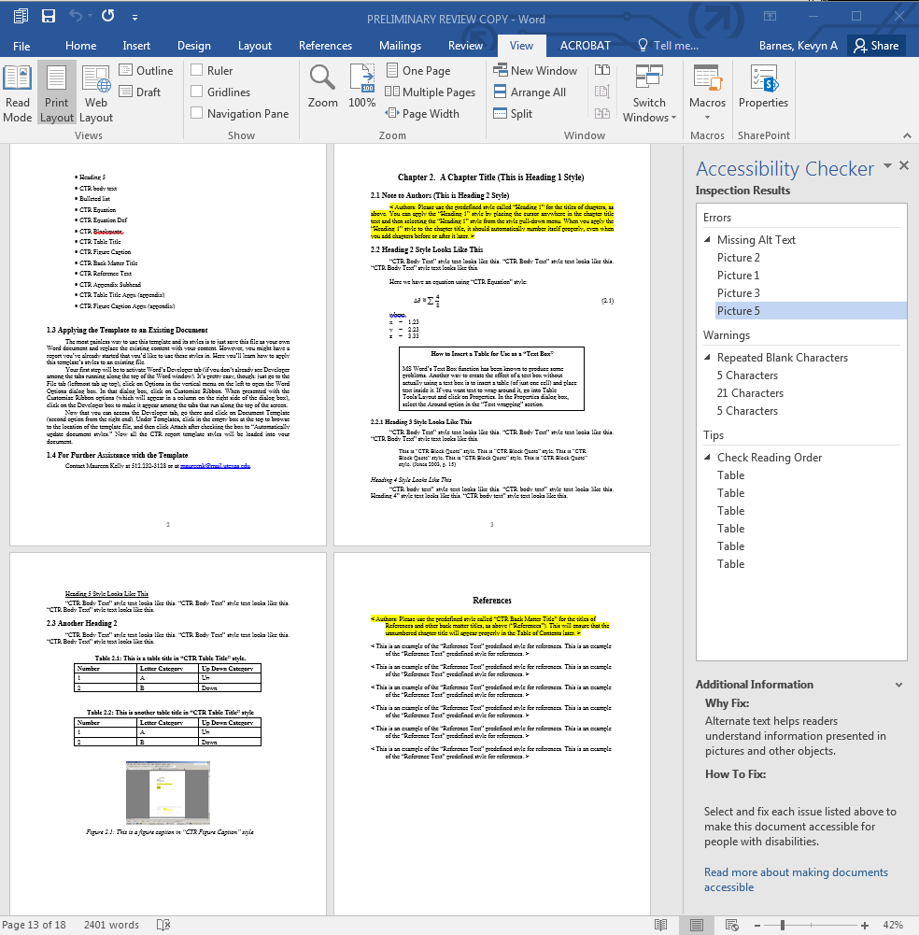
Accessibility Check Results: DOC
Notes:
Same process for MS Word documents

Slide 43
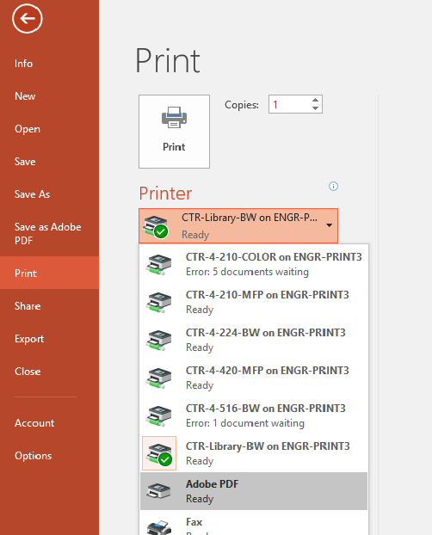
Warning
Here is How to Waste All Your Good Efforts
Notes:
Before we go any further: if nothing else is remembered, remember this one warning to avoid wasted time. =>

Slide 44
“Print” ≠ Accessible
Notes:
“PRINT to PDF” strips all tags and other accessibility features from your Word, PowerPoint, and other documents, just like a document printed on paper.

Slide 45
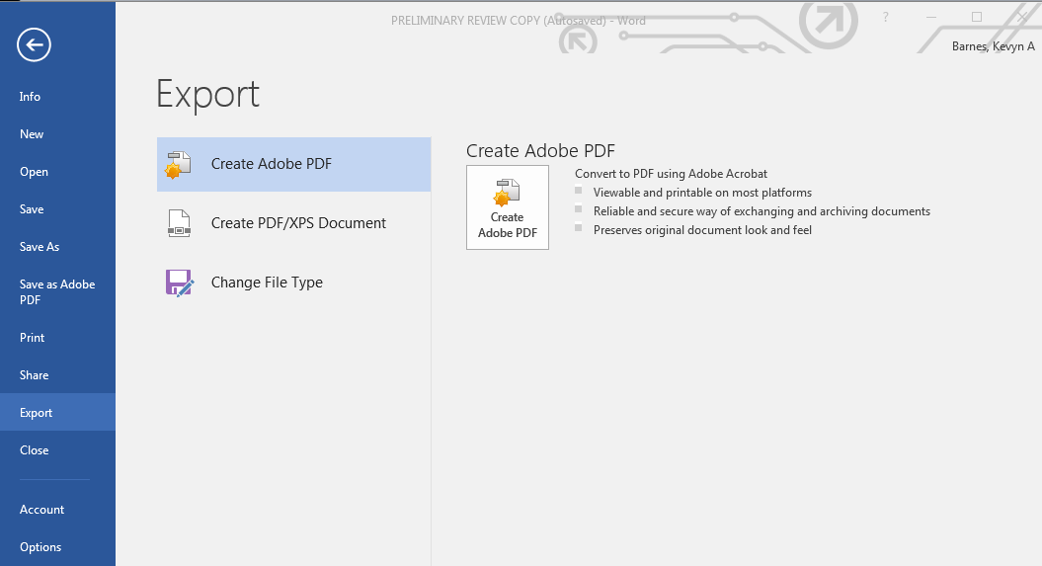
Converting to PDF
Notes:
Use “Export” or “Save As…” instead. Options may depend on if you have Adobe Acrobat Pro or not.

Slide 46
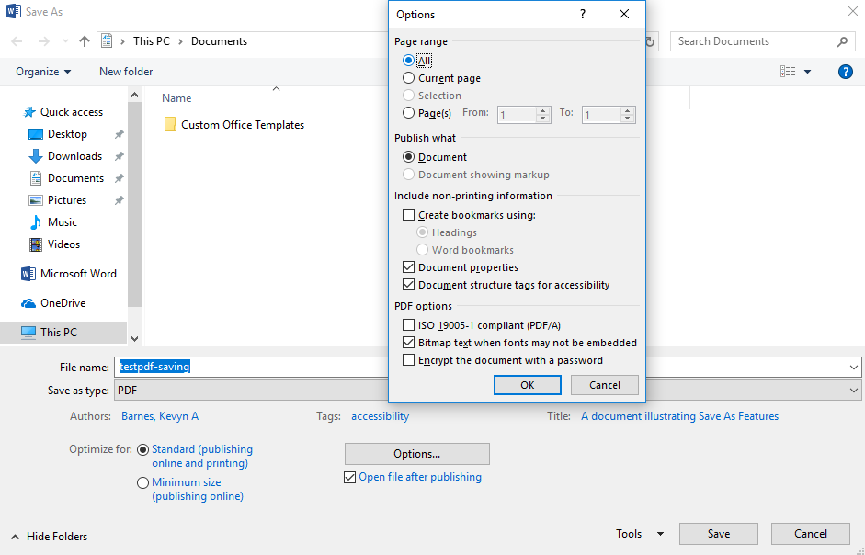
Converting to PDF
Notes:
Use “Export” or “Save As…” instead. Options may depend on if you have Adobe Acrobat Pro or not.

Slide 47
MS Office Accessibility
Making Images Perceivable

Slide 48
Making Images Perceivable
Notes:
When you click on the item in the Accessibility checker results, you are taken to the slide with the error.

Slide 49
Making Images Perceivable
Notes:
Right click image to get “Format Picture” option

Slide 50
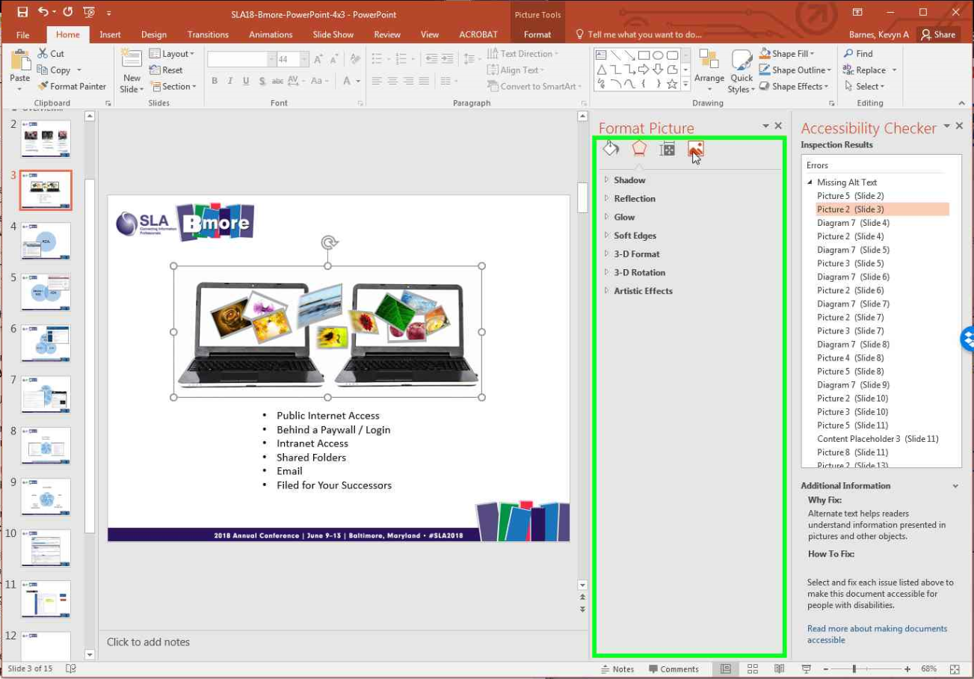
Making Images Perceivable

Slide 51
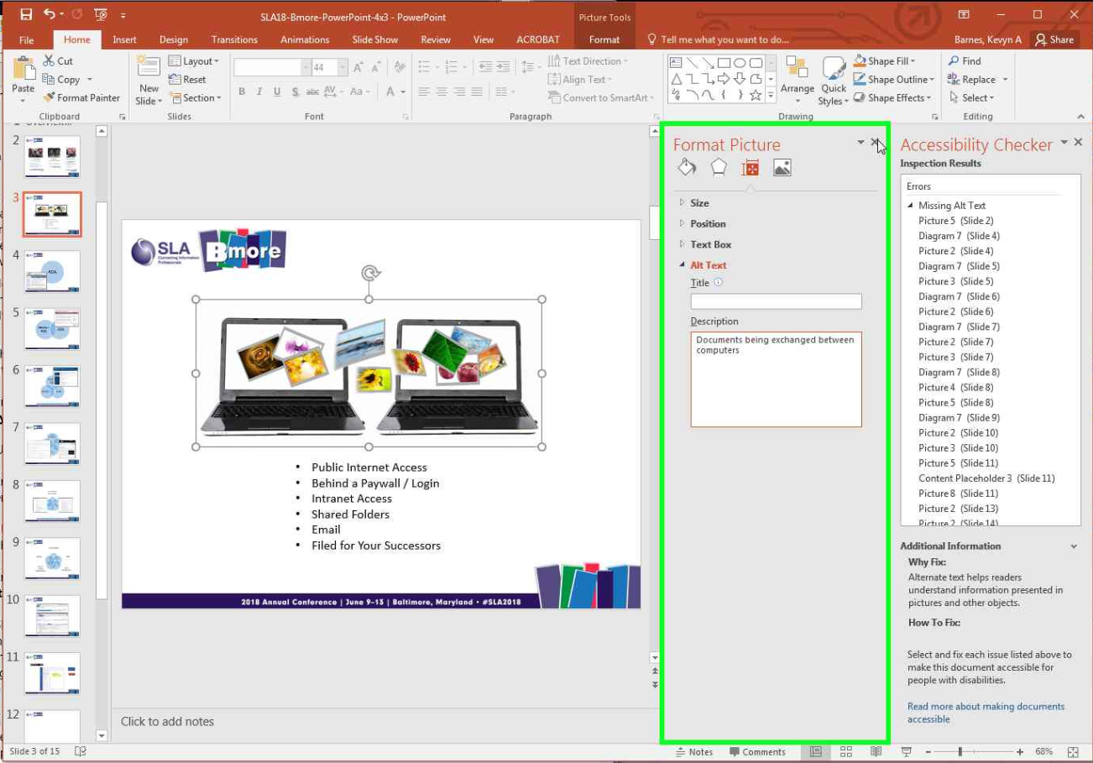
Making Images Perceivable
Notes:
Screen reader already notes it as an image, so just describe what the image conveys. Use punctuation. Position image in line with text, not with text wrapping.

Slide 52
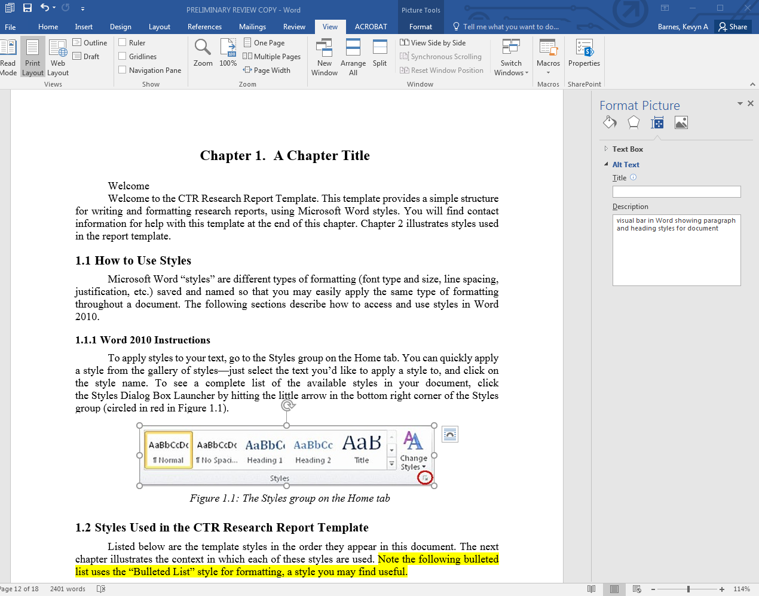
Making Images Perceivable
Notes:
Same exact steps in MS Word, same icon in the Format Picture display.

Slide 53
MS Office Accessibility
Making SmartArt Perceivable

Slide 54
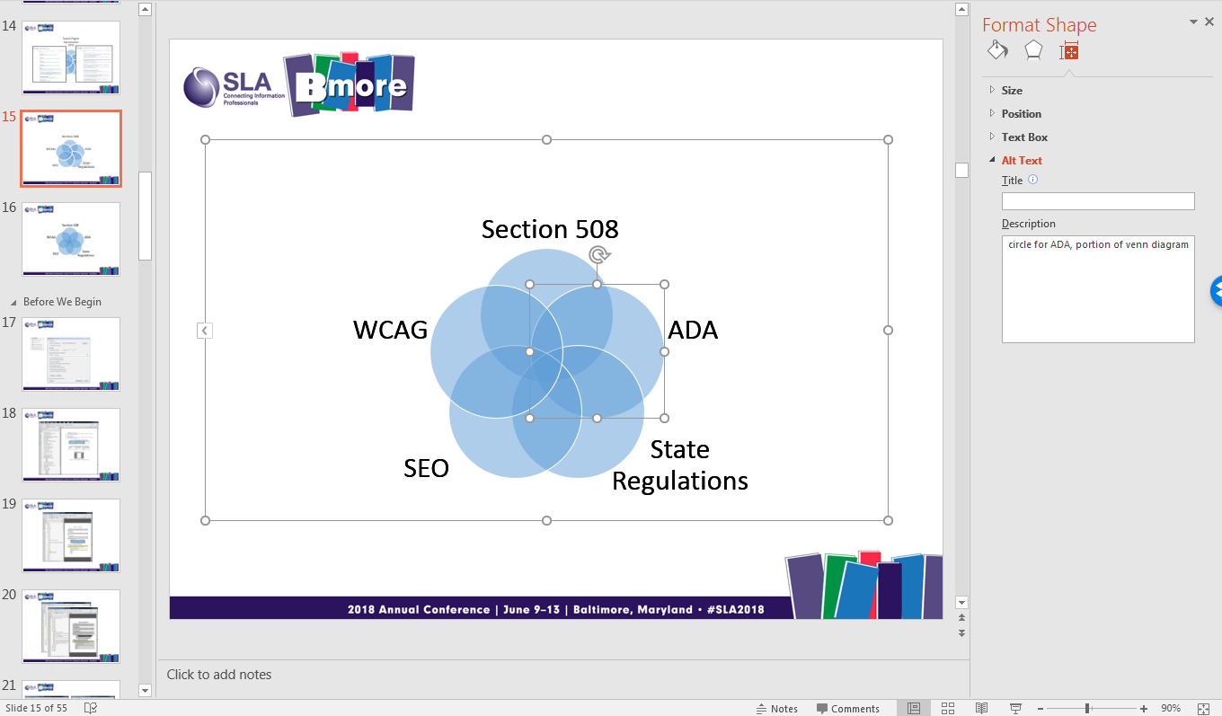
Making Smart Art Perceivable
Notes:
Screen readers can not interpret smart art and Alt Text can only be added for individual pieces of the graphic. Grouping does not change this.

Slide 55
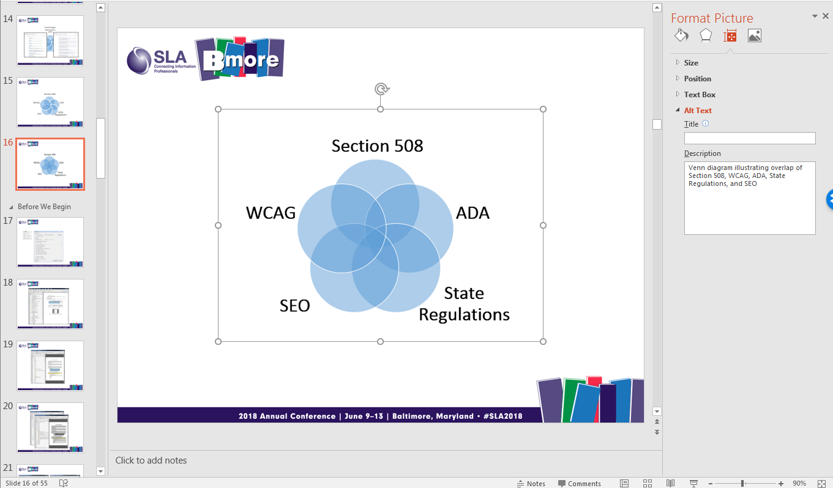
Making Smart Art Perceivable
Notes:
Better to screenshot / snip the graphic and then apply a description to the entire image. Save the version that can be modified as an extra slide or page at the end of a document.

Slide 56
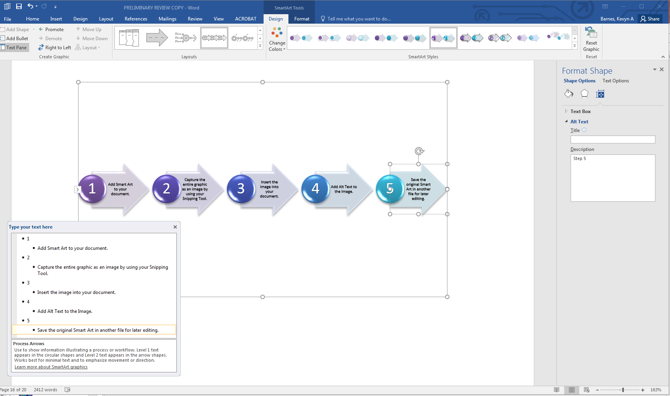
Making Smart Art Perceivable
Notes:
Same issue in MS Word… Note that each section of text is also seen as an image by the computer.

Slide 57
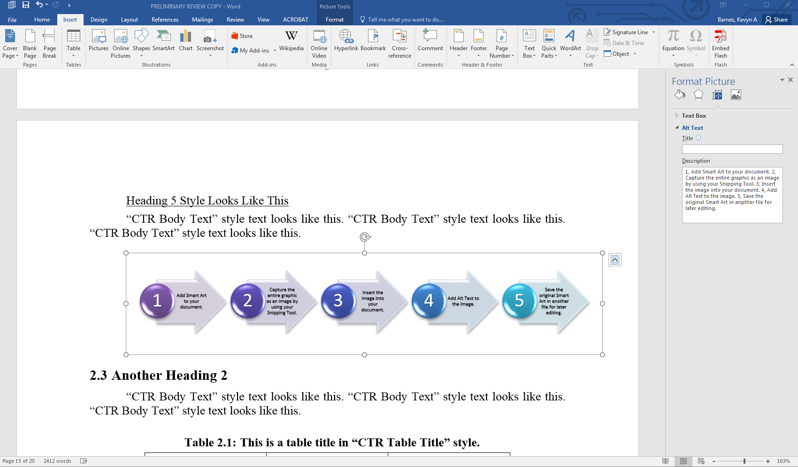
Making Smart Art Perceivable
Notes:
With same solution in MS Word.

Slide 58
MS Office Accessibility
Making Tables Perceivable

Slide 59
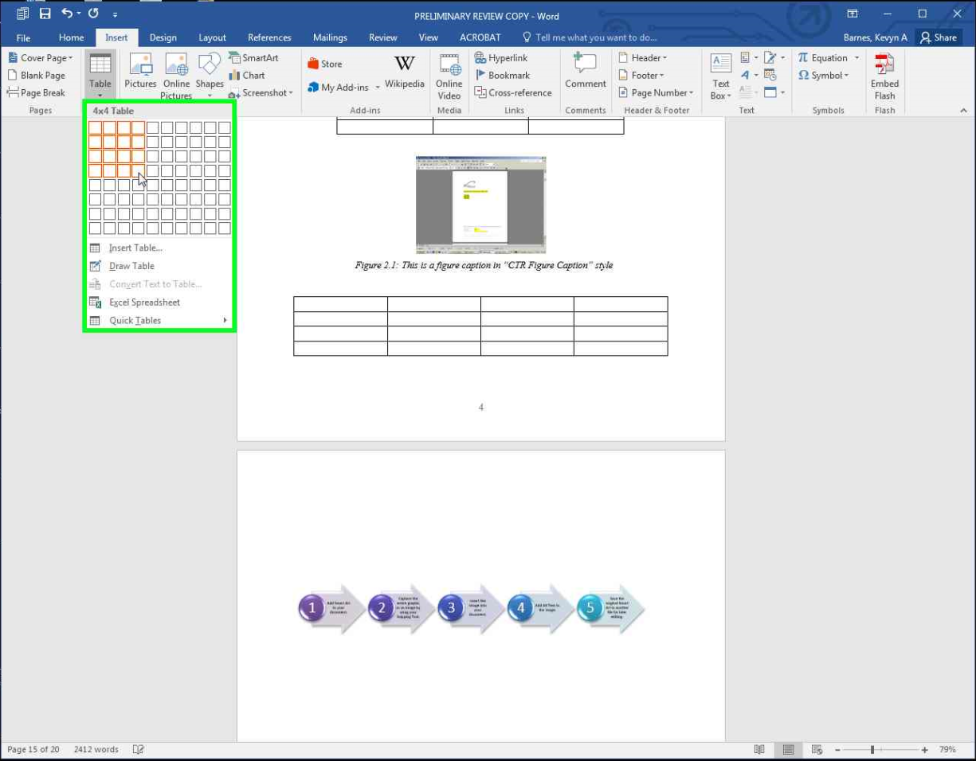
Making Tables Perceivable: Caption
Notes:
Use the built-in Insert Table method.

Slide 60
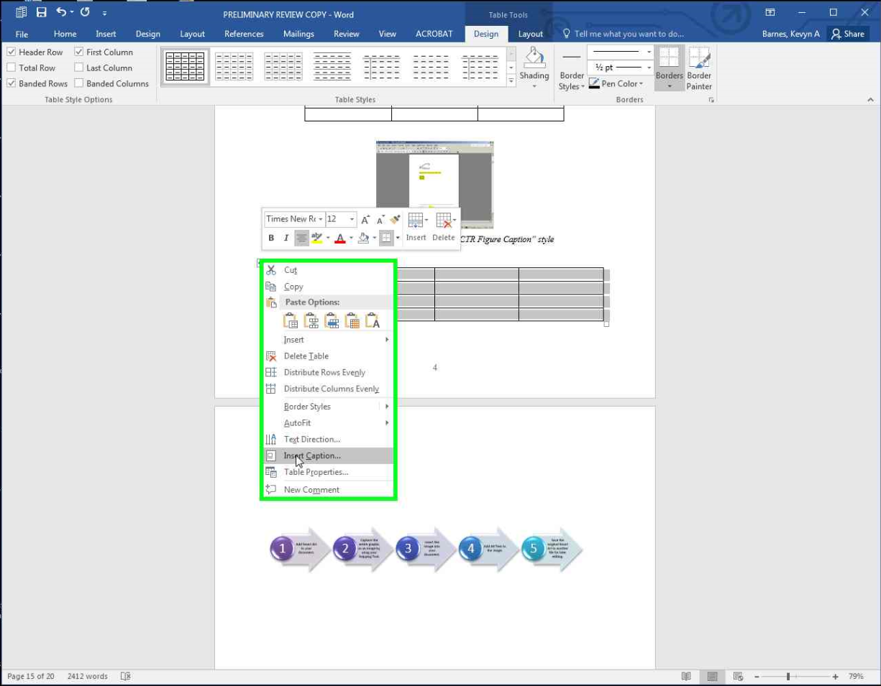
Making Tables Perceivable: Caption
Notes:
Right click on the table to get to “Insert captions” option

Slide 61
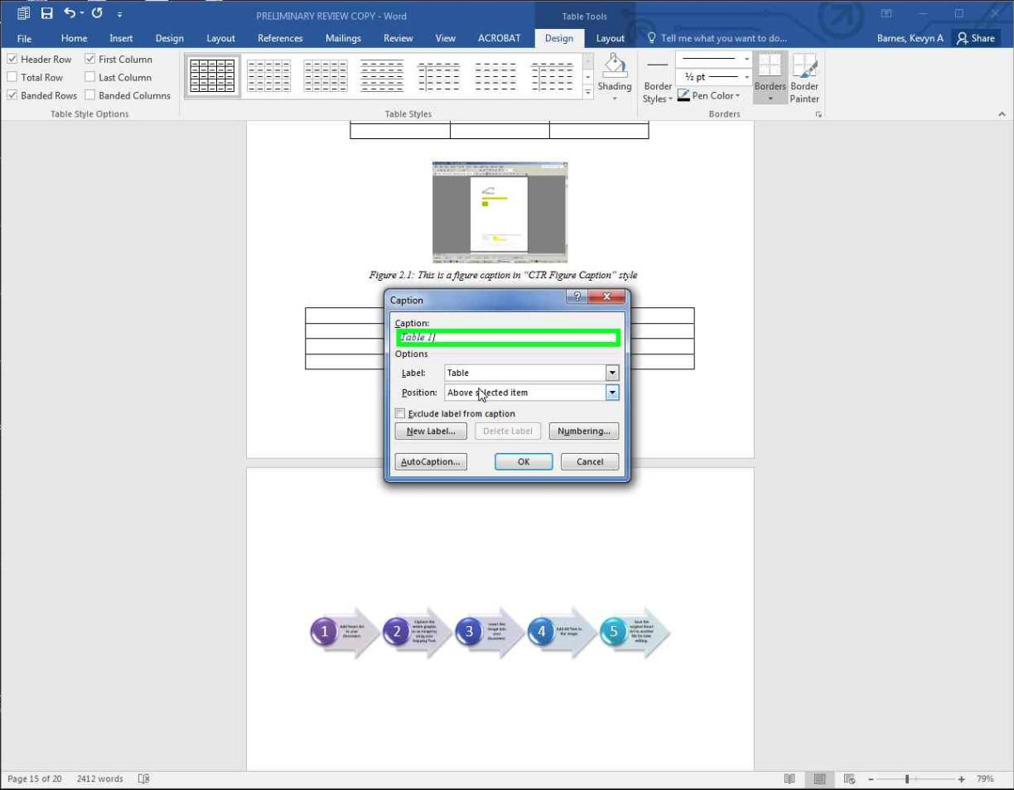
Making Tables Perceivable: Caption

Slide 62
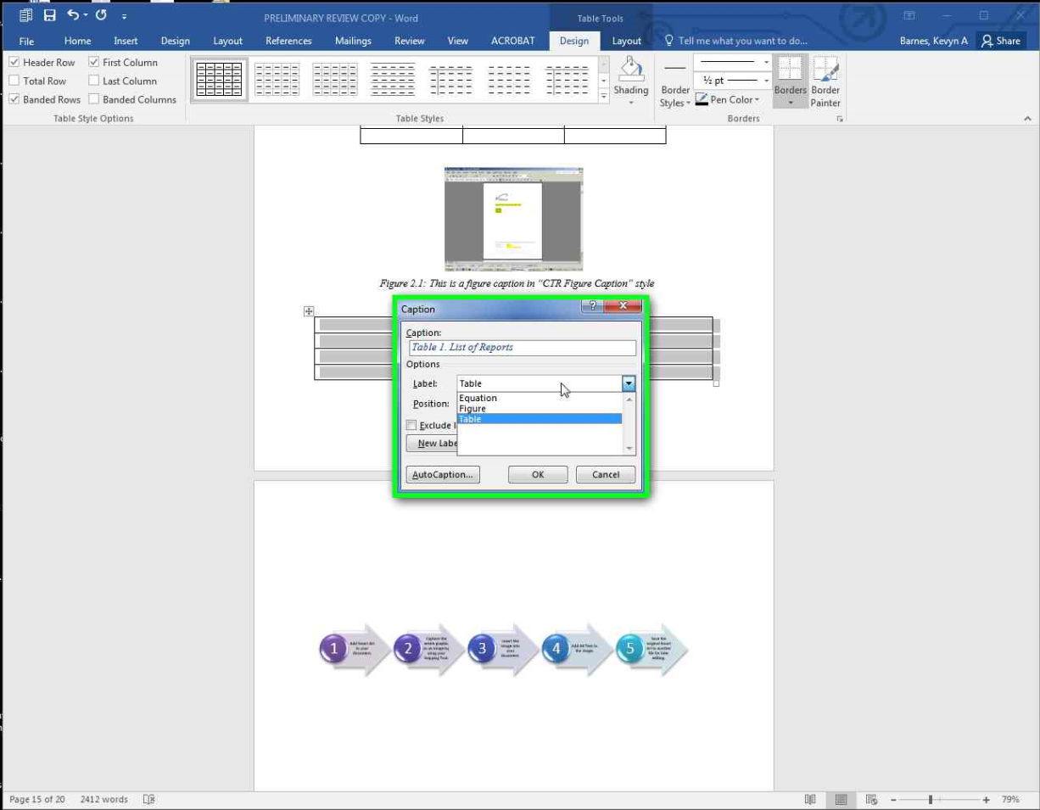
Making Tables Perceivable: Caption
Notes:
Add caption.

Slide 63
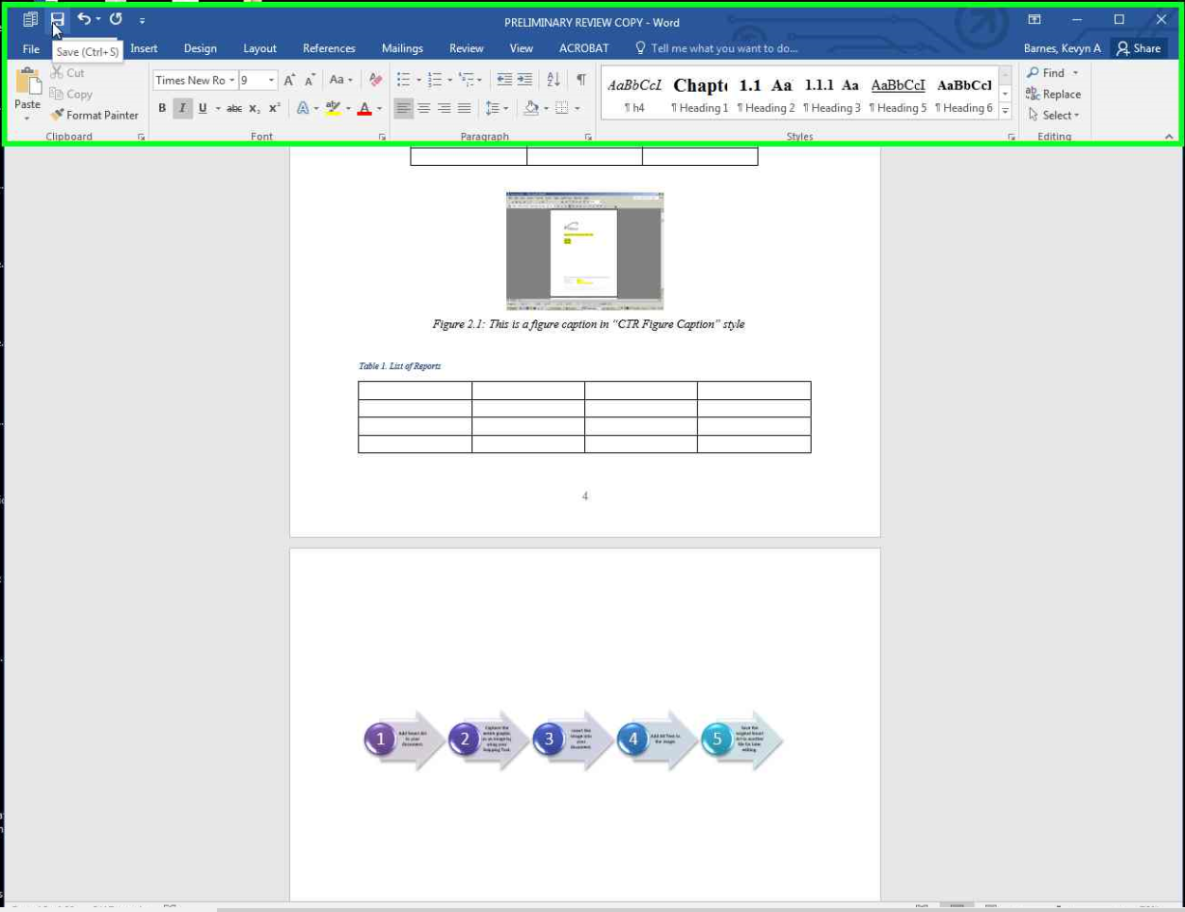
Making Tables Perceivable: Caption
Notes:
Caption is now added above the table.

Slide 64
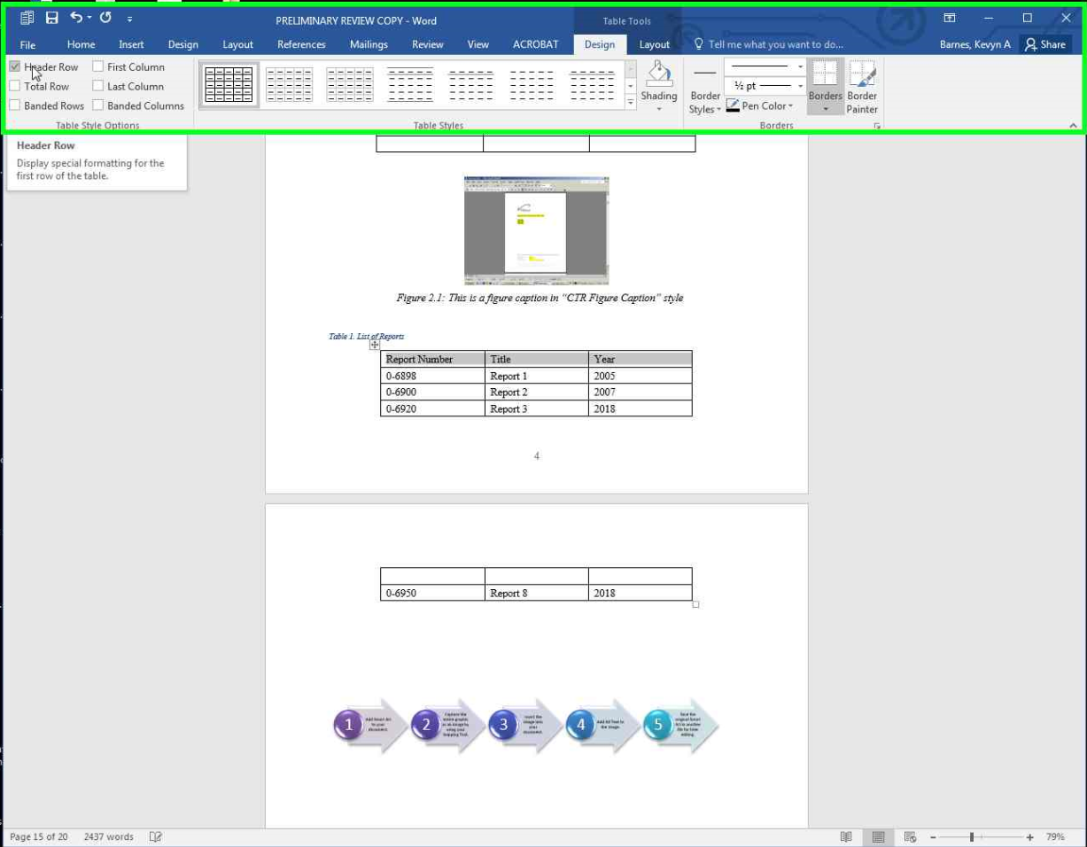
Making Tables Perceivable: Headers
Notes:
Here I have filled out some information. Select the header row, then go to “Table Tools > Design > Header Row.”
Notice that on the next page, there is no way to know what the column headings are.

Slide 65
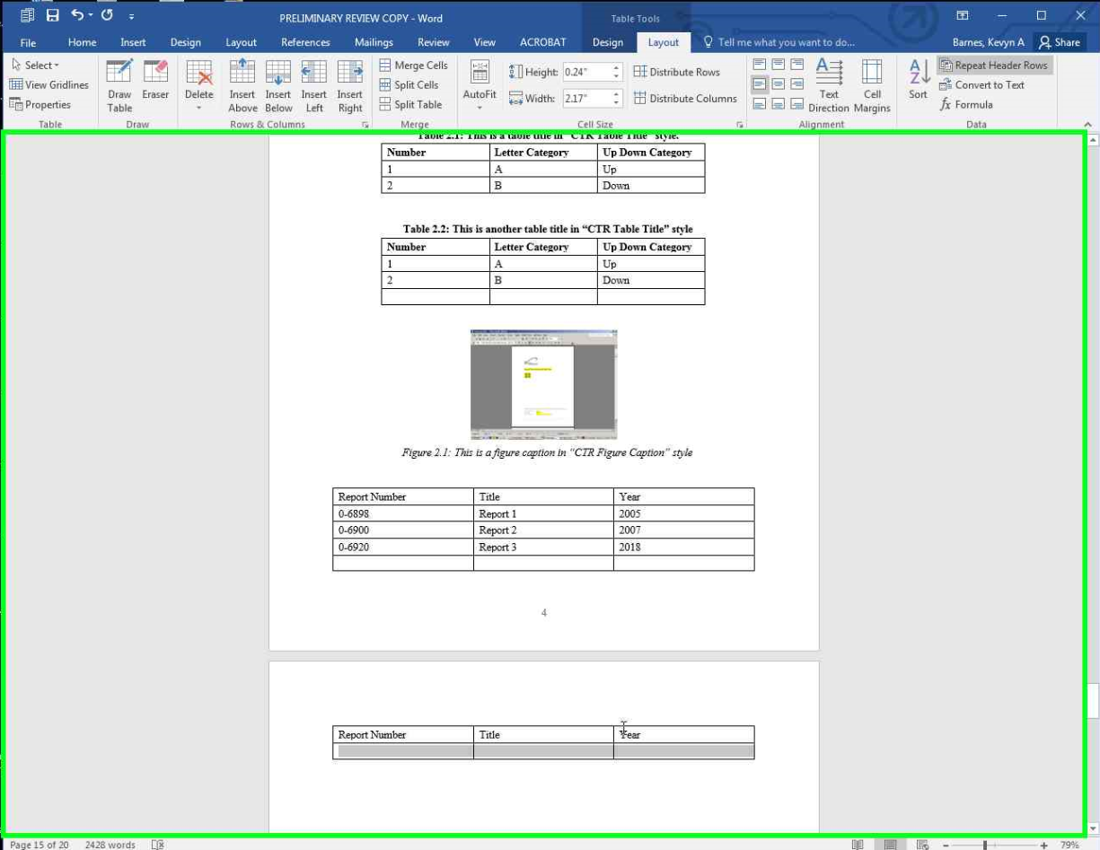
Making Tables Perceivable: Headers
Notes:
Go to “Table Tools > Layout > Repeat Header Rows” so the headings are repeated.

Slide 66
MS Office Accessibility
Reading Order

Slide 67
Reading Order
Notes:
Next, let’s check reading order issues.

Slide 68
Reading Order
Notes:
Home > Arrange > Selection Pane

Slide 69
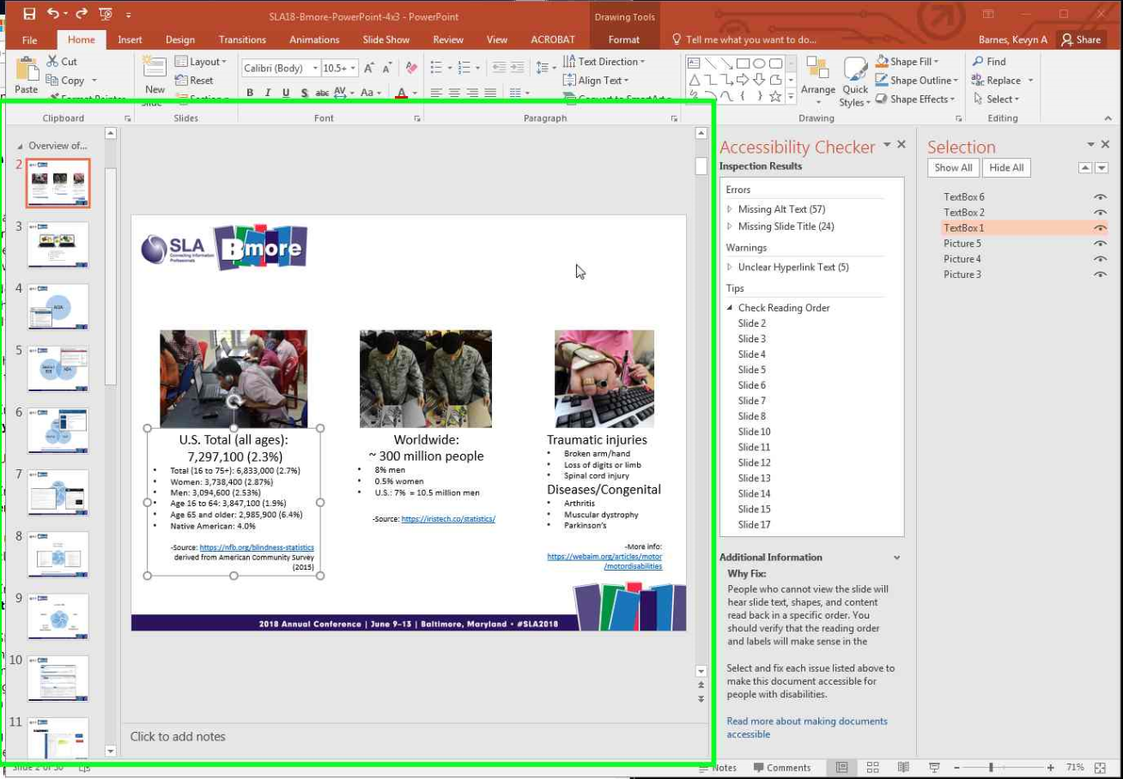
Reading Order
REVERSE order!
Notes:
The first column of text will be the 4th section read.
IMPORTANT: “Use the Selection pane to set the order in which the screen readers read the slide contents. The Selection pane lists the objects on the slide in reverse order. When the screen reader reads this slide, it reads the objects in the reverse order listed in the Selection pane.”

Slide 70
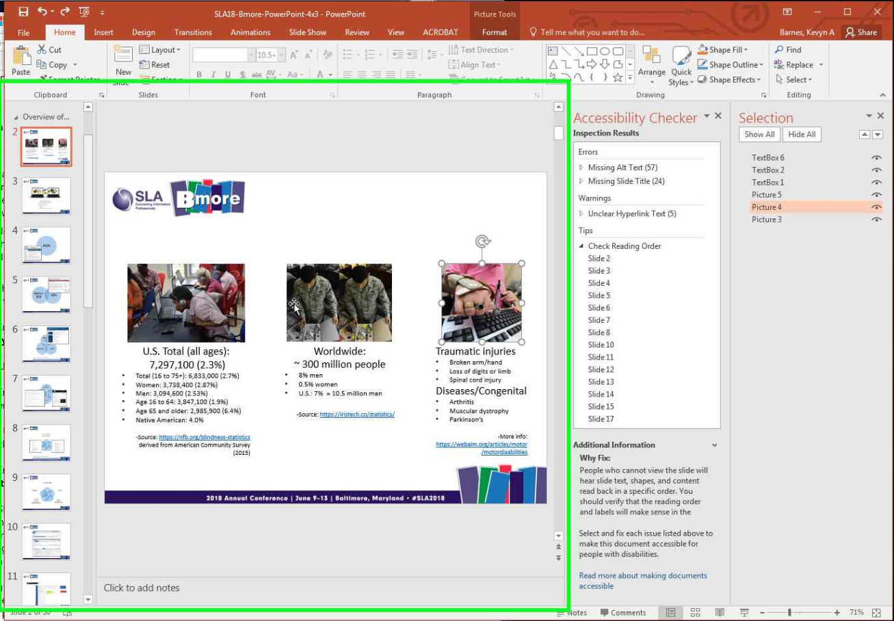
Reading Order
Notes:
The 3rd picture is the 2nd item that will be read.

Slide 71
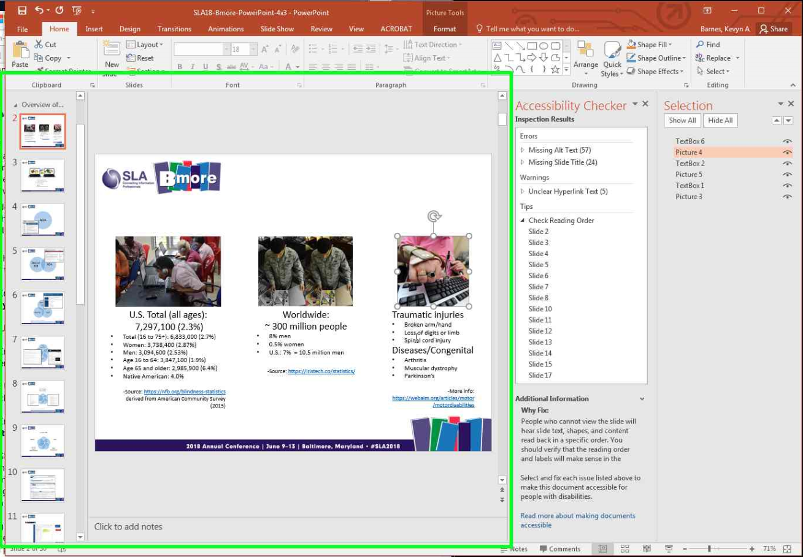
Reading Order
Notes:
Here, I have reordered the text and pictures so that text is read after the image that it is associated with. Simple drag and drop in the Selection pane.

Slide 72
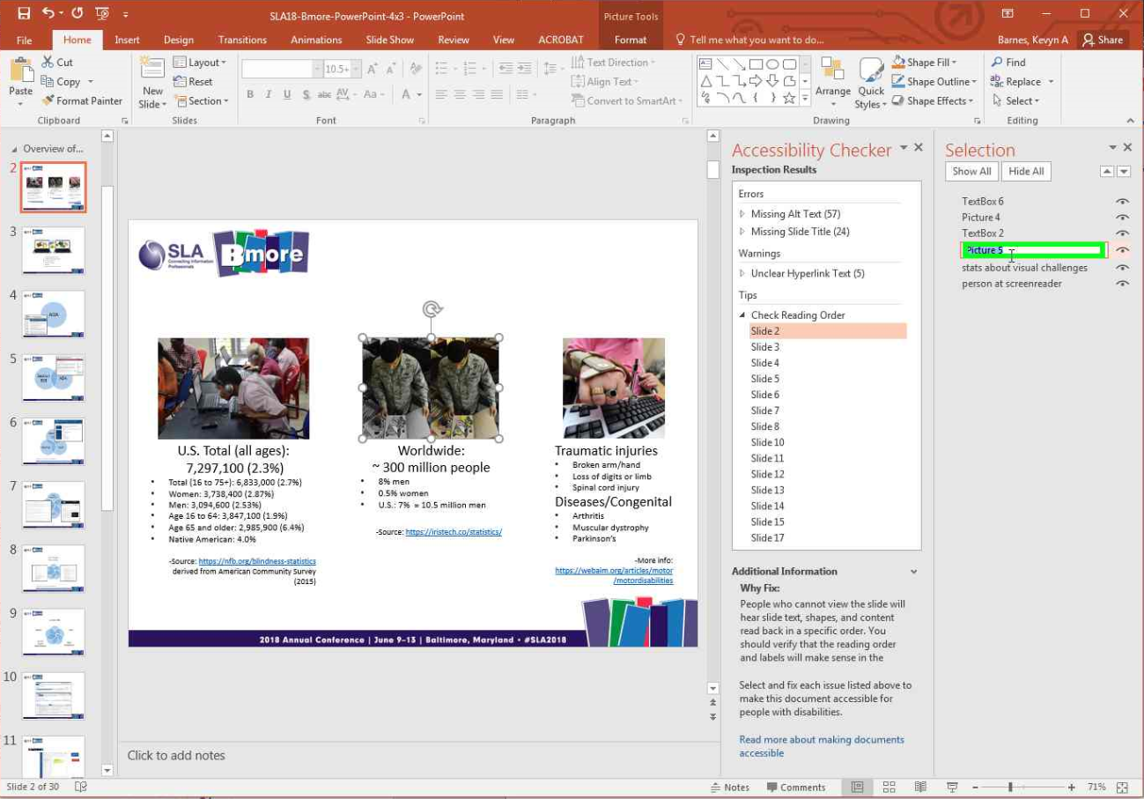
Reading Order
Notes:
In this case, it might have been easier to rename each element before dragging and dropping. Makes it easier if you still plan on reordering itmes.

Slide 73
MS Office Accessibility
Headings / Tags

Slide 74
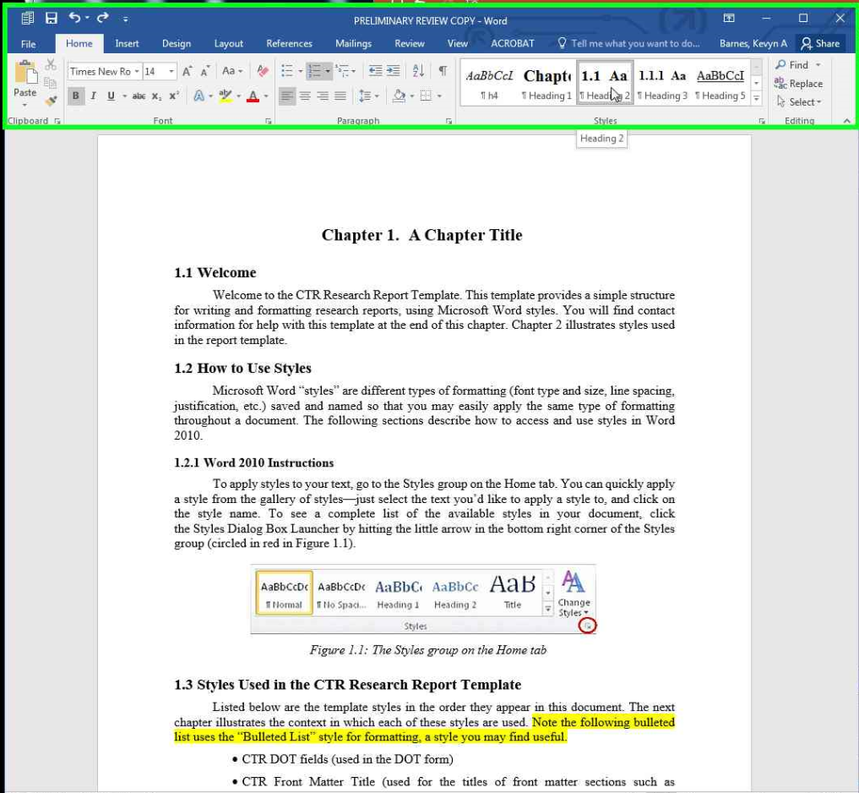
Headings / Tags
Notes:
Heading structure must be properly structured. In Word, if you will be converting to PDF, use only one “heading 1” <h1> in the document (instead of “title”).
In this case, our template needs to be changed so chapter titles are <H2> and so forth.
Here, you’ll see how to change the overall styles in your document so that you don’t have to rely on empty paragraphs for spacing and headings are automatically recognized.

Slide 75
Headings / Tags
Notes:
Dropdown to view list of style categories and to customize your styles

Slide 76
Headings / Tags
Notes:
Modify an individual style item here

Slide 77
Headings / Tags
Notes:
This is where you adjust formatting options for consistency

Slide 78
MS Office Accessibility
Color

Slide 79
Graphs
Graph 1 cannot be interpreted in grayscale nor by a person with Monochromacy or Achromatopsia colorblindness.
Graph 2 uses shapes in addition to color to convey the information. It can be interpreted in grayscale and by somebody with Monochromacy / Achromatopsia.
Notes:
Authors may be excluding the Bill Clintons, Mark Zuckerbergs, and Marco Rubios of the world from understanding your visualizations

Slide 80
Colour Contrast Analyser Tool
Notes:
Free Colour Contrast Analyser allows you to check color-blind accessibility directly within MS Word or other office application.

Slide 81
Color Contrast
Notes:
Lets say we want to check whether this SmartArt can be read be a colorblind person.

Slide 82
Color Contrast
Notes:
Open up Colour contrast Analyser and use the color picker.

Slide 83
Color Contrast
Notes:
Open up Colour contrast Analyser and use the color picker to pick up the foreground and background colors.

Slide 84
Color Contrast
Notes:
Open Colour Contrast Analyser and use the color picker to pick up the foreground and background colors.

Slide 85
Color Contrast
Notes:
Colour Contrast Analyser tells you immediately if it passes or fails. This one passes most guidelines.

Slide 86
Color Contrast
Notes:
This one fails.

Slide 87
Color Contrast
Notes:
A neat option in the tool is the ability to see results for different types of colorblindness.

Slide 88
Color Contrast
Notes:
The point is that you would want to use a darker background color or different color them altogether. There are some resources in the works cited handout to help with color themes.

Slide 89
Changing Colors in Entire Doc
Notes:
In the Design tab, you can change preset color themes or customize.
https://venngage.com/blog/color-blind-friendly-palette/
COLOR PALETTES FOR COLOR BLINDNESS --http://mkweb.bcgsc.ca/colorblind/

Slide 90
Changing Colors in Entire Doc
Notes:
Sometimes you have to be careful about your themes… the built in themes are not necessarily accessible. When I changed this presentation’s theme, the hyperlinks did not have enough contrast with the slide’s black background.
In that case, you need to customize your color scheme. WebAIM has a Link Contrast Checker at https://webaim.org/resources/linkcontrastchecker/

Slide 91
Changing Colors in Entire Doc
Notes:
You can play around with different colors and every slide will be automatically updated with that color.

Slide 92
Suggest Tools and Works Cited
https://tinyurl.com/accessibility-ref

Slide 93
Video Captioning
Notes:
Caption files with proper punctuation don’t just happen automatically. The computer-generated files can also have embarrassing misinterpretations of what the person said.

Slide 94
Video Captioning
Notes:
Very easy to review the video on YouTube and create a new or edited transcript / caption file for shorter videos. Can also upload a file created outside of YouTube.

Slide 95
Thank you for attending
Join us Twice in November!
November 8, 2018
TLR Listening Session: Tools for Impacting Research
Roberto Sarmiento and Rachel Cole,
Northwestern University Transportation
November 15, 2018
Tribal Libraries and Transportation Resources
George Franchois, Director of the U.S. Department of Interior Library
For Past Episodes, Visit the TLR Archive at:
https://rosap.ntl.bts.gov/browse/collections
Notes:
Thank you for attending
Join us Twice in November!
First: November 8, 2018, TLR Listening Session: Tools for Impacting Research; featuring speakers Roberto Sarmiento and Rachel Cole, Northwestern University Transportation
Second: November 15, 2018; Tribal Libraries and Transportation Resources, with George Franchois, Director of the U.S. Department of Interior Library
For Past Episodes, Visit the TLR Archive at: https://rosap.ntl.bts.gov/browse/collections

