Slide 1

Demographic Trends and Future Impacts on Freight Transportation
Freight 2055 Roundtable
Michael E. Cline, Ph.D.
Associate Director,
Hobby Center for the Study of Texas
Rice University
July 8, 2015
Slides Available at: http://hobbycenter.rice.edu
Go to “Presentations”

Slide 2
Meeting the Texas Challenge
Slides Available at http://hobbycenter.rice.edu/
  Go to: “Presentations”
See also, “Data”
  Current (2014) Estimates for Incorporated Places and Counties
  Selected 2010 Census Data (Including 2000-2010 Change and 2000 Comparisons) for Counties and Places
For background on Changing Texas, see: http://thetexaschallenge.com

Slide 3
Major Categories of Impacts
Impacts on Demand
  Freight transportation is a demand driven activity
Impacts to Industry
  Factors that inhibit or enhance delivery of freight from one point to another

Slide 4
Major Demographic Trends
Population Growth
Urbanization/
Regional Concentration
Population Aging
Racial/Ethnic Diversification

Slide 5
population growth
Notes:
So were is the growth?

Slide 6
Ten Largest States in the United States
Ranked by Population Size in 2014
State | April 1, 2000 | April 1, 2010 | July 1, 2014 |  | Change 2000-10 |  |  | Change 2010-14
 |  |  |  |  | Numeric | % |  | Numeric | %
United States | 281,421,906 | 308,745,538 | 318,857,056 |  | 27,323,632 | 9.7 |  | 10,111,518 | 3.3
California | 33,871,648 | 37,253,956 | 38,802,500 |  | 3,382,308 | 10 |  | 1,548,544 | 4.2
Texas | 20,851,820 | 25,145,561 | 26,956,958 |  | 4,293,741 | 20.6 |  | 1,811,397 | 7.2
Florida | 15,982,378 | 18,801,310 | 19,893,297 |  | 2,818,932 | 17.6 |  | 1,091,987 | 5.8
New York | 18,976,457 | 19,378,102 | 19,746,227 |  | 401,645 | 2.1 |  | 368,125 | 1.9
Illinois | 12,419,293 | 12,830,632 | 12,880,580 |  | 411,339 | 3.3 |  | 49,948 | 0.4
Pennsylvania | 12,281,054 | 12,702,379 | 12,787,209 |  | 421,325 | 3.4 |  | 84,830 | 0.7
Ohio | 11,353,140 | 11,536,504 | 11,594,163 |  | 183,364 | 1.6 |  | 57,659 | 0.5
Georgia | 8,186,453 | 9,687,653 | 10,097,343 |  | 1,501,200 | 18.3 |  | 409,690 | 4.2
North Carolina | 8,049,313 | 9,535,483 | 9,943,964 |  | 1,486,170 | 18.5 |  | 408,481 | 4.3
Michigan | 9,938,444 | 9,883,640 | 9,909,877 |  | -54,804 | -0.6 |  | 26,237 | 0.3
Source: U.S. Census Bureau.
Notes:
Texas annualized change = 1.6% vs. US: 0.74%
Assuming same annualized change for decade: Texas: 16% and US: 7.4%

Slide 7
Ten States in the United States with the
Largest Numeric Population Increase, 2010-2014
State | April 1, 2000 | April 1, 2010 | July 1, 2014 |  | Change 2000-10 |  |  | Change 2010-14
 |  |  |  |  | Numeric | % |  | Numeric | %
United States | 281,421,906 | 308,745,538 | 318,857,056 |  | 27,323,632 | 9.7 |  | 10,111,518 | 3.3
Texas | 20,851,820 | 25,145,561 | 26,956,958 |  | 4,293,741 | 20.6 |  | 1,811,397 | 7.2
California | 33,871,648 | 37,253,956 | 38,802,500 |  | 3,382,308 | 10.0 |  | 1,548,544 | 4.2
Florida | 15,982,378 | 18,801,310 | 19,893,297 |  | 2,818,932 | 17.6 |  | 1,091,987 | 5.8
Georgia | 8,186,453 | 9,687,653 | 10,097,343 |  | 1,501,200 | 18.3 |  | 409,690 | 4.2
North Carolina | 8,049,313 | 9,535,483 | 9,943,964 |  | 1,486,170 | 18.5 |  | 408,481 | 4.3
New York | 18,976,457 | 19,378,102 | 19,746,227 |  | 401,645 | 2.1 |  | 368,125 | 1.9
Arizona | 5,130,632 | 6,392,017 | 6,731,484 |  | 1,261,385 | 24.6 |  | 339,467 | 5.3
Washington | 5,894,121 | 6,724,540 | 7,061,530 |  | 830,419 | 14.1 |  | 336,990 | 5.0
Colorado | 4,301,261 | 5,029,196 | 5,355,866 |  | 727,935 | 16.9 |  | 326,670 | 6.5
Virginia | 7,078,515 | 8,001,024 | 8,326,289 |  | 922,509 | 13.0 |  | 325,265 | 4.1
Source: U.S. Census Bureau.

Slide 8
Ten States in the United States with the
Largest Percentage Population Increase, 2010-2014
State | April 1, 2000 | April 1, 2010 | July 1, 2014 |  | Change 2000-10 |  |  | Change 2010-14
 |  |  |  |  | Numeric | % |  | Numeric | %
United States | 281,421,906 | 308,745,538 | 318,857,056 |  | 27,323,632 | 9.7 |  | 10,111,518 | 3.3
North Dakota | 642,200 | 672,591 | 739,482 |  | 30,391 | 4.7 |  | 66,891 | 9.9
Texas | 20,851,820 | 25,145,561 | 26,956,958 |  | 4,293,741 | 20.6 |  | 1,811,397 | 7.2
Colorado | 4,301,261 | 5,029,196 | 5,355,866 |  | 727,935 | 16.9 |  | 326,670 | 6.5
Utah | 2,233,169 | 2,763,885 | 2,942,902 |  | 530,716 | 23.8 |  | 179,017 | 6.5
Florida | 15,982,378 | 18,801,310 | 19,893,297 |  | 2,818,932 | 17.6 |  | 1,091,987 | 5.8
Arizona | 5,130,632 | 6,392,017 | 6,731,484 |  | 1,261,385 | 24.6 |  | 339,467 | 5.3
Nevada | 1,998,257 | 2,700,551 | 2,839,099 |  | 702,294 | 35.1 |  | 138,548 | 5.1
Washington | 5,894,121 | 6,724,540 | 7,061,530 |  | 830,419 | 14.1 |  | 336,990 | 5.0
South Dakota | 754,844 | 814,180 | 853,175 |  | 59,336 | 7.9 |  | 38,995 | 4.8
South Carolina | 4,012,012 | 4,625,364 | 4,832,482 |  | 613,352 | 15.3 |  | 207,118 | 4.5
Source: U.S. Census

Slide 9
Population in Texas, 1970-2010 and Projected to 2050
Zero Migration assumes no migration into or out of Texas during projection period. This scenario is shown for illustrative purposes only.
Notes:
We have more than doubled since 1970 and expect to more than double by 2050
We will be the size of CA of today by 2030.
Even if we shut our doors, we will be at least 32.1 million in 2050

Slide 10
Population, Licenses Drivers, Yearly Vehicle Miles of Travel, and Road Miles Needed, 2010-2050
 |  |  |  |  | Drivers Per 1,000 Population |  | Yearly Vehicle Miles of Travel |  |  | Additional Road Miles Needed*
Year | Population |  | Drivers |  |  |  | Per Driver | Total (in Billions)
2010 | 25,145,561 |  | 15,157,650 |  | 602.8 |  | 13,475 | 204.2 |  | -
2020 | 30,583,311 |  | 18,625,949 |  | 609.0 |  | 13,075 | 243.5 |  | 71,218
2030 | 37,282,785 |  | 22,708,486 |  | 609.1 |  | 12,688 | 288.1 |  | 155,050
2040 | 45,316,711 |  | 27,403,007 |  | 604.7 |  | 12,446 | 341.1 |  | 251,448
2050 | 55,205,530 |  | 33,261,797 |  | 602.5 |  | 12,276 | 408.3 |  | 371,753
Source: Projections by the authors; and 2010 driver estimates and rates derived from U.S. Department of Transportation, Federal Highway Administration, Highway Statistics Series, 2009, 2010, and 2011; and U.S. Department of Transportation, Federal Highway Administration, National Household Travel Survey 2009; U.S. Department of Transportation, Federal Highway Administration, Office of Highway Policy Information, Highway Statistics Series, Highway Statistics 2011.
*Includes all street, freeway, and highway miles.
From: Changing Texas: Implications of Addressing or Ignoring the Texas Challenge

Slide 11
Urbanization/ regional concentration
Notes:
So were is the growth?

Slide 12
Population Growth and Urbanization in Texas, 1850 - 2010
Urban = Area of concentrated
population equaling 2,500 or more
Source: U.S. Census
* Urban = Area of concentrated population equaling 2,500 or more. The Census Bureau began defining urban areas using new criteria beginning with the 2000 Census.
Notes:
Urban areas continue to see growth.
19 Million in Urbanized areas of 50K or more
Total: 25,145,561 100.0%
Urban: 21,298,039 84.7%
Inside urbanized areas 18,947,957 75.4%
Inside urban clusters 2,350,082 9.3%
Rural 3,847,522 15.3%

Slide 13
Change in Urban/Rural Population in Texas, 1900-2010
Source: U.S. Census
* The Census Bureau began defining urban areas using new criteria beginning with the 2000 Census.
Notes:
100 Years ago – mostly farm and rancch dwellers by 2010 86% urban (75% in Urbanized areas of 50k or more)
Total: 25,145,561 100.0%
Urban: 21,298,039 84.7%
Inside urbanized areas 18,947,957 75.4%
Inside urban clusters 2,350,082 9.3%
Rural 3,847,522 15.3%

Slide 14
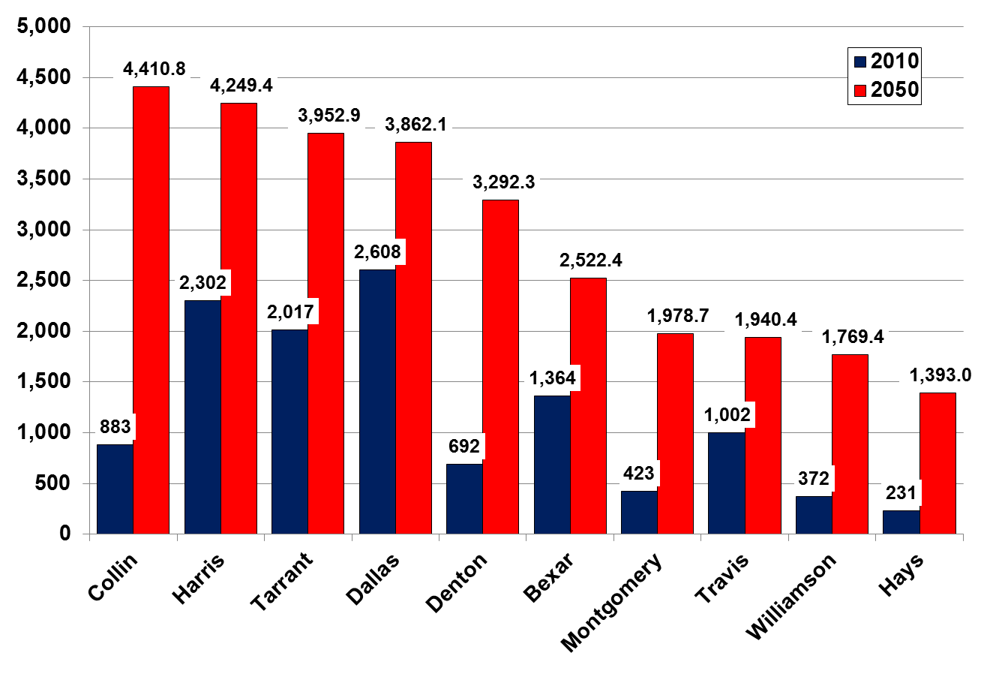
Population Density of Selected Counties,
2010 and Projected to 2050
Source: Texas State Data Center
Notes:
Emerging urban counties will ccontinue to put pressire on services, transportation, and change the character of many of our counties.

Slide 15
Population Change in
Texas Counties
April 1, 2000 – April 1, 2010
Source: U.S. Census Bureau.

Slide 16
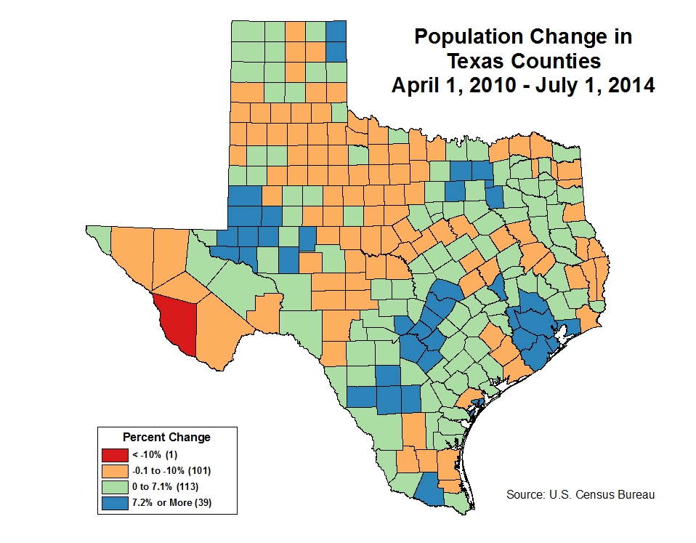

Slide 17
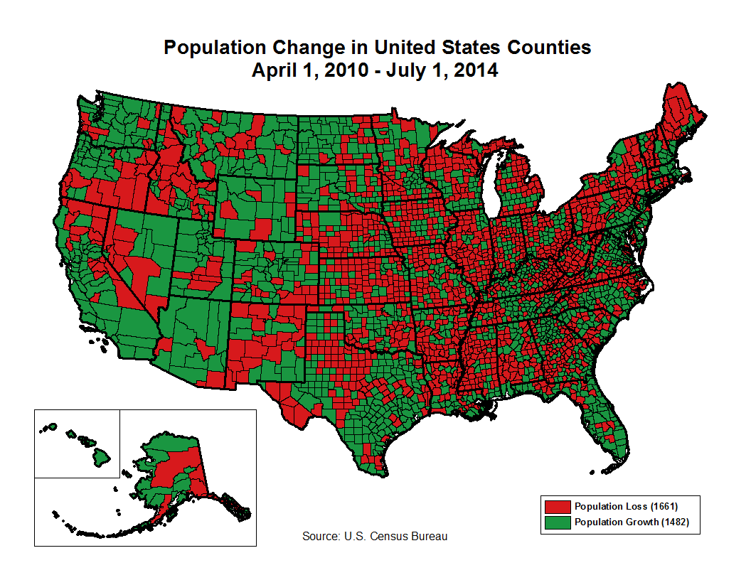

Slide 18

Notes:
U.S. House Appropriations Chair – George Mahon from Loraine, Texas (Living in Colorado City) – longest serving from 1964-1979.
Now Subcommittee Members for Transportation: John Culberson (Born in Houston – Serves Houston)
Henry Cuellar: Democrat from Laredo
Speakers of Texas House since 1960s:
Waggoner Carr (Lubbock – worked as farm hand)
Ben Barnes (Gorman – Eastland County)
Gus Mutscher (Brenham)
Billy Clayton – Lamb County
Gib Lewis – Mexia/Cleveland
Pete Laney – Hale Center
Tom Craddick (from Midland but originally from Belloit, Wisconsin
Joe Strauss – San Antonio

Slide 19
Population aging
Notes:
So were is the growth?

Slide 20
Median Age in the United States and Texas,
1900-2010
Notes:
20
In addition to population change, distribution, diversification, we are experience growth in the population in older ages
“Aging of the population”
Note decline in average age during 1960s and 1970s

Slide 21
Texas Crude Birth and Crude Death Rates, 1942 - 2010
Average Birth Rates, 1946-1964: 26.1
Births and deaths per 1,000 Texas residents
Source: 2010 Texas Vital Statistics Annual Report, Texas Department of State Health Services

Slide 22
Youth, Old-Age, and Total Dependency
Ratios for Texas, 2000-2050
71.1
75.3
75.7
74.5
70.5
68.5
Total Dependency: (((Population 65 and Older + Population < 20) / (Population 20-64)) * 100
Old Age Dependency: (((Population 65 and Older) / (Population 20-64 )) * 100
Youth Dependency: (((Population < 20) / (Population 20-64)) * 100

Slide 23
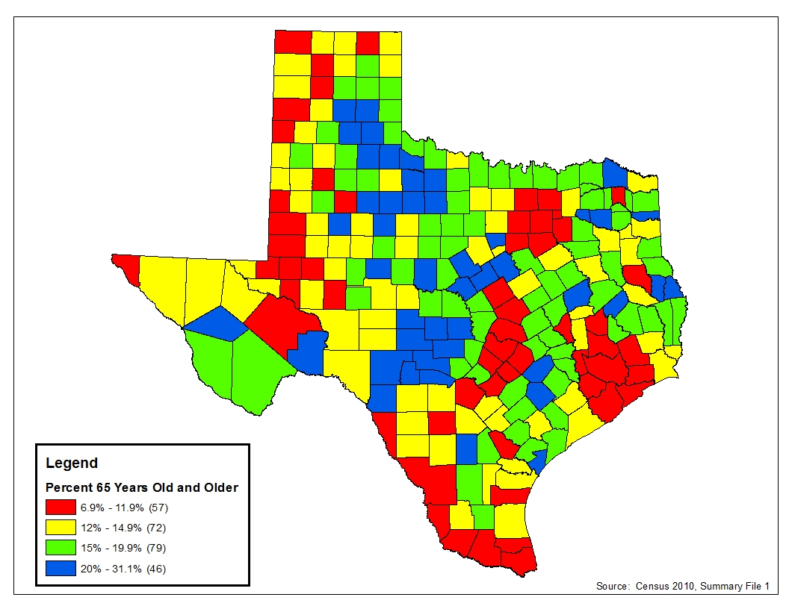
Percent of Persons 65 Years of Age and Older in Texas Counties, 2010

Slide 24
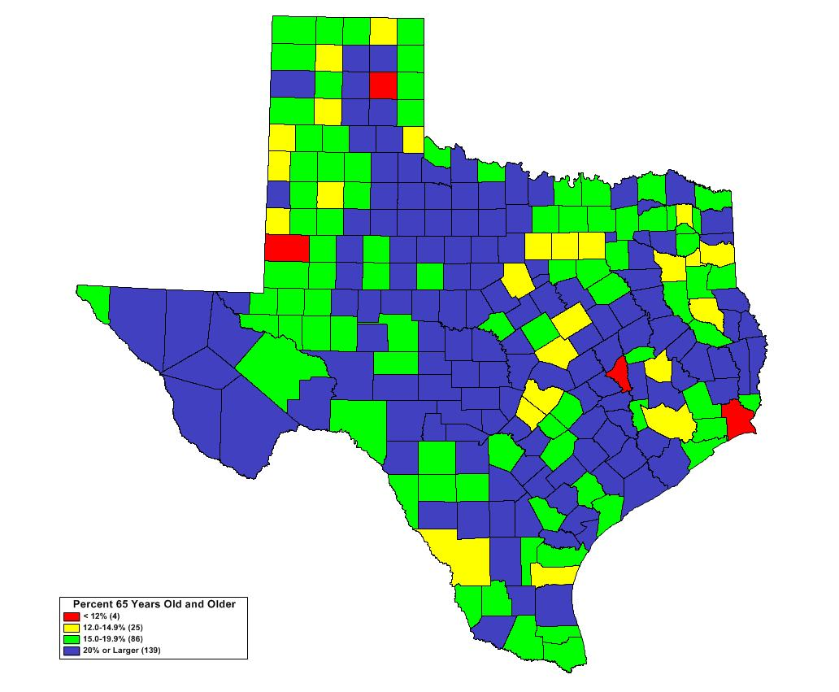
Percent of Persons 65 Years of Age and Older in Texas Counties, 2050*
* Assuming rates of net migration equal to 2000-2010

Slide 25
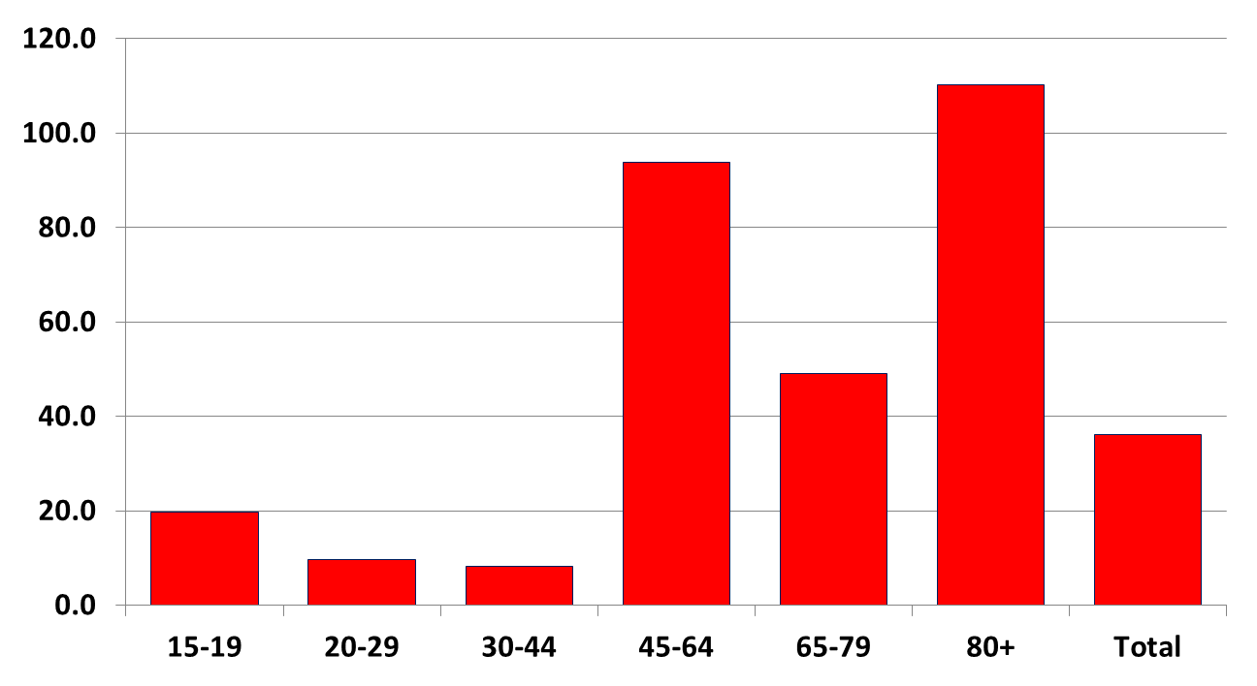
Percentage Change in Licensed Drivers in Texas by Age, 1990-2010

Slide 26
Racial/ethnic diversification
Notes:
So were is the growth?

Slide 27
Race/Ethnicity as a Percent of the
Total Population in Texas, 2000 and 2010
Source: U.S. Census Bureau, 2000 and 2010 Census

Slide 28
NH White and Hispanic Populations as a Percent of the Total Population in 2000, 2010, and Projected in 2050
Note: 2000 and 2010 Census counts derived from U.S. Census PL 94-171 Data for respective year. Anglo includes non-Hispanic White alone (not in combination with any other race). Hispanic include all persons identifying themselves as Hispanic or Latino. The proportions in 2040 are derived from the Hobby Center for the Study of Texas 1.0 Migration Projection Scenario.

Slide 29
Percent of the Population Age 25 and Older in the
United States and Texas with Less Than High School Diploma/GED by Race/Ethnicity, 2010

Slide 30
Percent of the Population Age 25 and Older in the
United States and Texas with Bachelor, Professional, or Graduate Degree by Race/Ethnicity, 2010

Slide 31
Median Household Income, Family Income, and
Per Capita Income by Race/Ethnicity for Texas, 2010
Source: U.S. Census Bureau, American Community Survey, 2006-2010

Slide 32
Mean Household Income in 2010 and Projected for 2050 Under Alternative Assumptions of Socioeconomic Closure Between Minority and NonHispanic White Households

Slide 33
Mean Consumer Expenditures in 2010 and Projected for 2050 Under Alternative Assumptions of Socioeconomic Closure Between Minority and NonHispanic White Households

Slide 34
Aggregate Consumer Expenditures (in $Billions) in 2010 and Projected for 2050 Under Alternative Assumptions of Socioeconomic Closure Between Minority and
NonHispanic White Households
Billions

Slide 35
Components of Population Change for Texas, April 1, 2010 – July 1, 2014
Total Change: 1,811,397

Slide 36
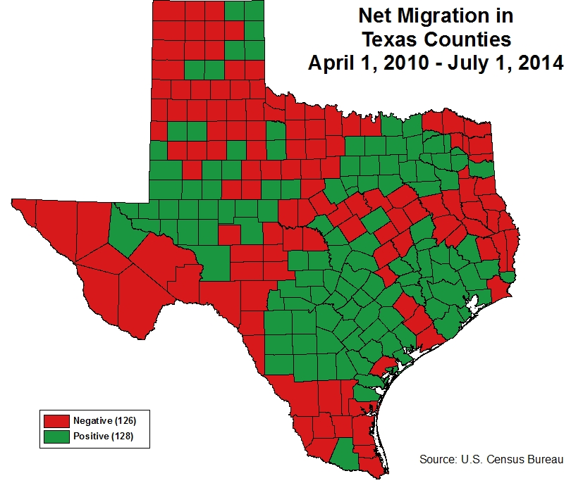

Slide 37
Twenty MSAs with the Largest Numeric Change, 2010 - 2014
 | Population |  |  |  | Change 2013-2014 |  |  | Change 2010-2014
Place | 2010 | 2013 | 2014 |  | Numeric | % |  | Numeric | %
Houston-The Woodlands-Sugar Land, TX | 5,920,416 | 6,333,809 | 6,490,180 |  | 156,371 | 2.5 |  | 569,764 | 9.6
Dallas-Fort Worth-Arlington, TX | 6,426,214 | 6,823,113 | 6,954,330 |  | 131,217 | 1.9 |  | 528,116 | 8.2
New York-Newark-Jersey City, NY-NJ-PA | 19,567,410 | 20,002,086 | 20,092,883 |  | 90,797 | 0.5 |  | 525,473 | 2.7
Los Angeles-Long Beach-Anaheim, CA | 12,828,837 | 13,175,849 | 13,262,220 |  | 86,371 | 0.7 |  | 433,383 | 3.4
Washington-Arlington-Alexandria, DC-VA-MD-WV | 5,636,232 | 5,967,176 | 6,033,737 |  | 66,561 | 1.1 |  | 397,505 | 7.1
Miami-Fort Lauderdale-West Palm Beach, FL | 5,564,635 | 5,863,458 | 5,929,819 |  | 66,361 | 1.1 |  | 365,184 | 6.6
Atlanta-Sandy Springs-Roswell, GA | 5,286,728 | 5,525,432 | 5,614,323 |  | 88,891 | 1.6 |  | 327,595 | 6.2
Phoenix-Mesa-Scottsdale, AZ | 4,192,887 | 4,404,129 | 4,489,109 |  | 84,980 | 1.9 |  | 296,222 | 7.1
San Francisco-Oakland-Hayward, CA | 4,335,391 | 4,529,654 | 4,594,060 |  | 64,406 | 1.4 |  | 258,669 | 6.0
Seattle-Tacoma-Bellevue, WA | 3,439,809 | 3,613,621 | 3,671,478 |  | 57,857 | 1.6 |  | 231,669 | 6.7
Austin-Round Rock, TX | 1,716,289 | 1,885,803 | 1,943,299 |  | 57,496 | 3.0 |  | 227,010 | 13.2
Riverside-San Bernardino-Ontario, CA | 4,224,851 | 4,390,262 | 4,441,890 |  | 51,628 | 1.2 |  | 217,039 | 5.1
Denver-Aurora-Lakewood, CO | 2,543,482 | 2,699,750 | 2,754,258 |  | 54,508 | 2.0 |  | 210,776 | 8.3
Orlando-Kissimmee-Sanford, FL | 2,134,411 | 2,271,083 | 2,321,418 |  | 50,335 | 2.2 |  | 187,007 | 8.8
San Antonio-New Braunfels, TX | 2,142,508 | 2,282,201 | 2,328,652 |  | 46,451 | 2.0 |  | 186,144 | 8.7
Boston-Cambridge-Newton, MA-NH | 4,552,402 | 4,698,049 | 4,732,161 |  | 34,112 | 0.7 |  | 179,759 | 3.9
San Diego-Carlsbad, CA | 3,095,313 | 3,222,558 | 3,263,431 |  | 40,873 | 1.3 |  | 168,118 | 5.4
Charlotte-Concord-Gastonia, NC-SC | 2,217,012 | 2,337,339 | 2,380,314 |  | 42,975 | 1.8 |  | 163,302 | 7.4
Minneapolis-St. Paul-Bloomington, MN-WI | 3,348,859 | 3,461,434 | 3,495,176 |  | 33,742 | 1.0 |  | 146,317 | 4.0
Tampa-St. Petersburg-Clearwater, FL | 2,783,243 | 2,874,154 | 2,915,582 |  | 41,428 | 1.4 |  | 132,339 | 4.8

Slide 38
Twenty MSAs with the Largest Percentage Change, 2010 - 2014
 | Population |  |  |  | Change 2013-2014 |  |  | Change 2010-2014
Place | 2010 | 2013 | 2014 |  | Numeric | % |  | Numeric | %
The Villages, FL | 93,420 | 108,483 | 114,350 |  | 5,867 | 5.4 |  | 20,930 | 22.4
Midland, TX | 141,671 | 157,240 | 161,290 |  | 4,050 | 2.6 |  | 19,619 | 13.8
Austin-Round Rock, TX | 1,716,289 | 1,885,803 | 1,943,299 |  | 57,496 | 3.0 |  | 227,010 | 13.2
Odessa, TX | 137,130 | 149,522 | 153,904 |  | 4,382 | 2.9 |  | 16,774 | 12.2
Myrtle Beach-Conway-North Myrtle Beach, SC-NC | 376,722 | 404,789 | 417,668 |  | 12,879 | 3.2 |  | 40,946 | 10.9
Bismarck, ND | 114,778 | 123,993 | 126,597 |  | 2,604 | 2.1 |  | 11,819 | 10.3
Raleigh, NC | 1,130,490 | 1,215,299 | 1,242,974 |  | 27,675 | 2.3 |  | 112,484 | 10.0
Auburn-Opelika, AL | 140,247 | 151,708 | 154,255 |  | 2,547 | 1.7 |  | 14,008 | 10.0
St. George, UT | 138,115 | 147,719 | 151,948 |  | 4,229 | 2.9 |  | 13,833 | 10.0
Cape Coral-Fort Myers, FL | 618,754 | 661,336 | 679,513 |  | 18,177 | 2.7 |  | 60,759 | 9.8
Greeley, CO | 252,825 | 270,560 | 277,670 |  | 7,110 | 2.6 |  | 24,845 | 9.8
Daphne-Fairhope-Foley, AL | 182,265 | 195,443 | 200,111 |  | 4,668 | 2.4 |  | 17,846 | 9.8
Houston-The Woodlands-Sugar Land, TX | 5,920,416 | 6,333,809 | 6,490,180 |  | 156,371 | 2.5 |  | 569,764 | 9.6
Charleston-North Charleston, SC | 664,607 | 712,081 | 727,689 |  | 15,608 | 2.2 |  | 63,082 | 9.5
Crestview-Fort Walton Beach-Destin, FL | 235,865 | 253,309 | 258,042 |  | 4,733 | 1.9 |  | 22,177 | 9.4
Fargo, ND-MN | 208,777 | 223,853 | 228,291 |  | 4,438 | 2.0 |  | 19,514 | 9.3
Orlando-Kissimmee-Sanford, FL | 2,134,411 | 2,271,083 | 2,321,418 |  | 50,335 | 2.2 |  | 187,007 | 8.8
Sioux Falls, SD | 228,261 | 243,622 | 248,351 |  | 4,729 | 1.9 |  | 20,090 | 8.8
San Antonio-New Braunfels, TX | 2,142,508 | 2,282,201 | 2,328,652 |  | 46,451 | 2.0 |  | 186,144 | 8.7
Hilton Head Island-Bluffton-Beaufort, SC | 187,010 | 198,279 | 203,022 |  | 4,743 | 2.4 |  | 16,012 | 8.6

Slide 39
Twenty Places with the Largest Numeric Change, 2010 - 2014
 | Population |  |  |  | Change 2013-2014 |  |  | Change 2010-2014
Place | 2010 | 2013 | 2014 |  | Numeric | % |  | Numeric | %
New York, NY | 8,175,133 | 8,438,379 | 8,491,079 |  | 52,700 | 0.6 |  | 315,946 | 3.9
Houston, TX | 2,099,451 | 2,203,806 | 2,239,558 |  | 35,752 | 1.6 |  | 140,107 | 6.7
Los Angeles, CA | 3,792,621 | 3,897,940 | 3,928,864 |  | 30,924 | 0.8 |  | 136,243 | 3.6
Austin, TX | 790,390 | 887,124 | 912,791 |  | 25,667 | 2.9 |  | 122,401 | 15.5
San Antonio, TX | 1,327,407 | 1,411,766 | 1,436,697 |  | 24,931 | 1.8 |  | 109,290 | 8.2
Phoenix, AZ | 1,445,632 | 1,512,442 | 1,537,058 |  | 24,616 | 1.6 |  | 91,426 | 6.3
Dallas, TX | 1,197,816 | 1,260,725 | 1,281,047 |  | 20,322 | 1.6 |  | 83,231 | 6.9
Charlotte, NC | 731,424 | 793,951 | 809,958 |  | 16,007 | 2.0 |  | 78,534 | 10.7
San Diego, CA | 1,307,402 | 1,359,844 | 1,381,069 |  | 21,225 | 1.6 |  | 73,667 | 5.6
Fort Worth, TX | 741,206 | 794,055 | 812,238 |  | 18,183 | 2.3 |  | 71,032 | 9.6
San Jose, CA | 945,942 | 1,003,821 | 1,015,785 |  | 11,964 | 1.2 |  | 69,843 | 7.4
Denver, CO | 600,158 | 648,401 | 663,862 |  | 15,461 | 2.4 |  | 63,704 | 10.6
Seattle, WA | 608,660 | 653,404 | 668,342 |  | 14,938 | 2.3 |  | 59,682 | 9.8
Washington, DC | 601,723 | 649,111 | 658,893 |  | 9,782 | 1.5 |  | 57,170 | 9.5
Columbus, Ohio | 787,033 | 823,536 | 835,957 |  | 12,421 | 1.5 |  | 48,924 | 6.2
San Francisco, CA | 805,235 | 841,138 | 852,469 |  | 11,331 | 1.3 |  | 47,234 | 5.9
Nashville-Davidson, TN | 601,222 | 634,870 | 644,014 |  | 9,144 | 1.4 |  | 42,792 | 7.1
Oklahoma City, OK | 579,999 | 611,030 | 620,602 |  | 9,572 | 1.6 |  | 40,603 | 7.0
New Orleans, LA | 343,829 | 379,006 | 384,320 |  | 5,314 | 1.4 |  | 40,491 | 11.8

Slide 40
Education Pays
Unemployment Rate
Median Weekly Earnings
Overall Unemployment Rate: 7.6%
Median: $827
Source: U.S. Department of Labor, Bureau of Labor Statistics, June 2013/first quarter 2013

Slide 41
Educational Attainment for the Texas Population
Age 25 and Older by Race/Ethnicity, 2010
Race Ethnicity | Population Age 25 and Older | Less than high school | High school diploma | Some college or associates degree | Bachelor or more
Non-Hispanic White | 8,099,053 | 8.0 | 25.3 | 32.6 | 34.1
Black | 1,788,223 | 13.9 | 30.3 | 36.2 | 19.6
Hispanic* | 5,063,779 | 40.4 | 25.8 | 22.2 | 11.6
Asian | 639,967 | 14.4 | 15.2 | 18.6 | 51.8
Total Population | 15,772,122 | 19.3 | 25.6 | 29.2 | 25.9
________ Source: U.S. Census, American Community Survey, 2010. Note: Due to size, some groups are excluded. *Includes Hispanic persons of all races.

Slide 42
Population, Population Change, and Proportion of the Total Population by Race/Ethnicity for Texas, 2000 and 2010
 |  | Population |  | Population Change |  |  | Percent of Total Population
Race/Ethnicity* |  | 2000 | 2010 | Numeric | Percent | Percent of Total Change | 2000 | 2010
NH White |  | 10,933,313 | 11,397,345 | 464,032 | 4.2 | 10.8 | 52.4 | 45.3
Hispanic (All Races) |  | 6,669,666 | 9,460,921 | 2,791,255 | 41.8 | 65.0 | 32.0 | 37.6
NH Black |  | 2,364,255 | 2,886,825 | 522,570 | 22.1 | 12.2 | 11.3 | 11.5
NH Asian |  | 554,445 | 948,426 | 393,981 | 71.1 | 9.2 | 2.7 | 3.8
NH Other |  | 330,141 | 452,044 | 121,903 | 36.9 | 2.8 | 1.6 | 1.8
Total |  | 20,851,820 | 25,145,561 | 4,293,741 | 20.6 | 100.0 | 100.0 | 100.0
*Hispanic includes persons of all races. All other race/ethnicity categories shown here are Non-Hispanic. Non-Hispanic Other includes persons identifying themselves as Non-Hispanic American Indian or Alaska Native, Non-Hispanic Native Hawaiian or Pacific Islander, Non-Hispanic Some Other Race, or Non-Hispanic and a combination of two or more races.
Source: U.S. Census 2000 and 2010, P.L. 94-171.
Prepared by the Hobby Center for the Study of Texas at Rice University http://HobbyCenter.Rice.edu

Slide 43
Population, Population Change, and Proportion of the Population Under 18 Years by Race/Ethnicity for Texas, 2000 and 2010
 |  | Population |  | Population Change |  |  | Percent of Total Population
Race/Ethnicity* |  | 2000 | 2010 | Numeric | Percent | Percent of Total Change | 2000 | 2010
NH White |  | 2,507,147 | 2,322,661 | -184,486 | -7.4 | -18.8 | 42.6 | 33.8
Hispanic (All Races) |  | 2,386,765 | 3,317,777 | 931,012 | 39.0 | 95.1 | 40.5 | 48.3
NH Black |  | 732,807 | 810,543 | 77,736 | 10.6 | 7.9 | 12.4 | 11.8
NH Asian |  | 139,226 | 231,458 | 92,232 | 66.2 | 9.4 | 2.4 | 3.4
NH Other |  | 120,814 | 183,385 | 62,571 | 51.8 | 6.4 | 2.1 | 2.7
Total |  | 5,886,759 | 6,865,824 | 979,065 | 16.6 | 100.0 | 100.0 | 100.0
*Hispanic includes persons of all races. All other race/ethnicity categories shown here are Non-Hispanic. Non-Hispanic Other includes persons identifying themselves as Non-Hispanic American Indian or Alaska Native, Non-Hispanic Native Hawaiian or Pacific Islander, Non-Hispanic Some Other Race, or Non-Hispanic and a combination of two or more races.
Source: U.S. Census 2000 and 2010, P.L. 94-171.
Prepared by the Hobby Center for the Study of Texas at Rice University http://HobbyCenter.Rice.edu

Slide 44
Numeric Change in Population (in Thousands) by Race/Ethnicity for Texas, 2000-2010

Slide 45
Proportion of Total Population Change in Texas by Race/Ethnicity, 2000-2010

Slide 46
Numeric Change in Texas Child (<18) Population
(in Thousands) by Race/Ethnicity, 2000-2010

Slide 47
Proportion of Change in Texas Child (<18) Population by Race/Ethnicity, 2000-2010

Slide 48
Population, Population Change, and Proportion of the Total Population by Race/Ethnicity for State of Texas, 2010-2013
 | Population |  |  | Change 2010 - 2013¹ |  |  |  | Percent of Total Population
Race/Ethnicity² | 2010 | 2013 |  | Numeric | Percent | Percent of Total Change |  | 2010 | 2013
NH White | 11,428,638 | 11,648,258 |  | 219,620 | 1.9 | 16.9 |  | 45.4 | 44.0
NH Black | 2,899,884 | 3,089,995 |  | 190,111 | 6.6 | 14.6 |  | 11.5 | 11.7
Hispanic | 9,460,921 | 10,153,145 |  | 692,224 | 7.3 | 53.1 |  | 37.6 | 38.4
NH Asian | 960,543 | 1,105,009 |  | 144,466 | 15.0 | 11.1 |  | 3.8 | 4.2
NH Other³ | 395,575 | 451,786 |  | 56,211 | 14.2 | 4.3 |  | 1.7 | 1.7
Total | 25,145,561 | 26,448,193 |  | 1,302,632 | 5.2 | 100.0 |  | 100.0 | 100.0
Source: U.S. Census Bureau, Population Estimates, Vintage 2013. ¹39 months change from April 1, 2010 to July 1, 2013. ²Hispanic includes persons of all races who identify as Hispanic. All other race/ethnic categories shown here are NonHispanic. ³NonHispanic Other includes persons identifying themselves as NonHispanic Native Hawaiian or Pacific Islander, NonHispanic American Indian or Alaska Native, NonHispanic Some Other Race, or NonHispanic and a combination of two or more races.

Slide 49
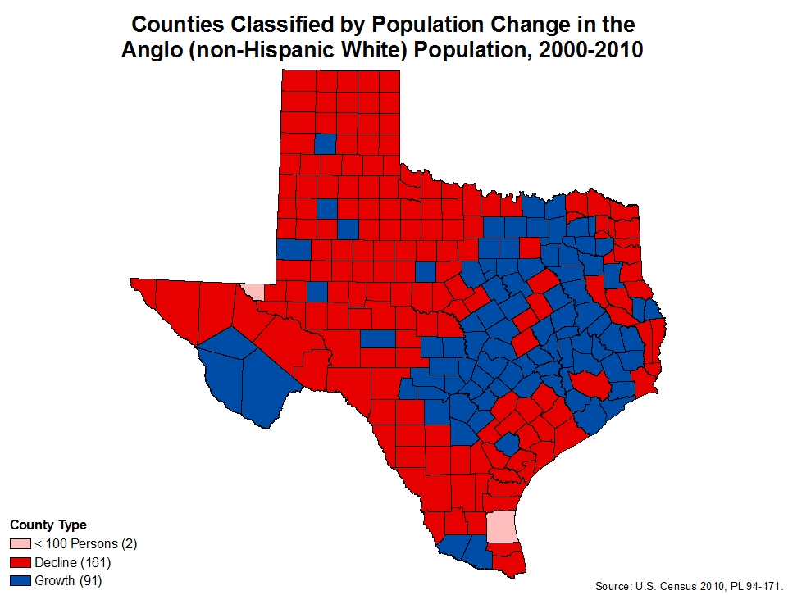

Slide 50
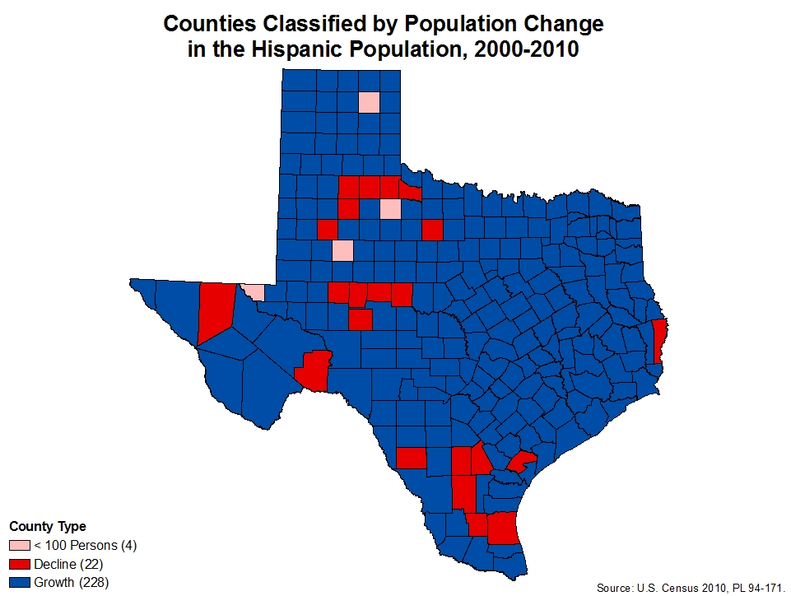

Slide 51
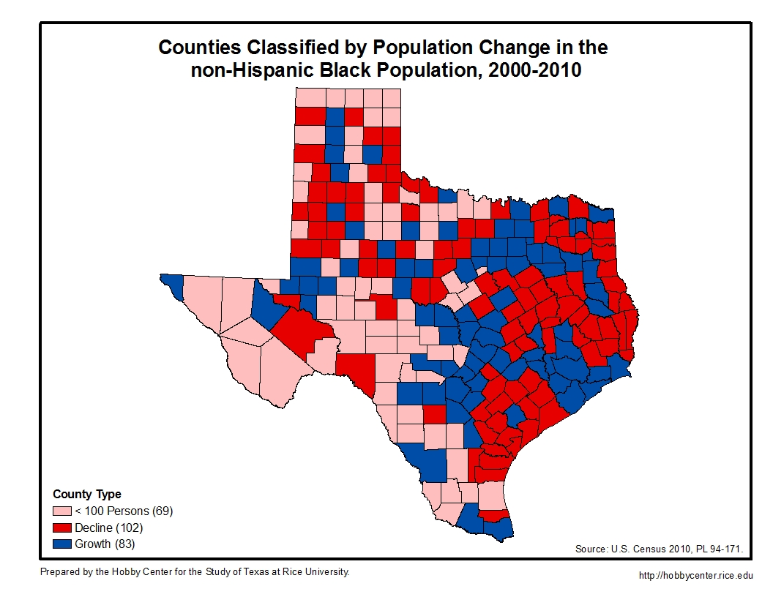

Slide 52
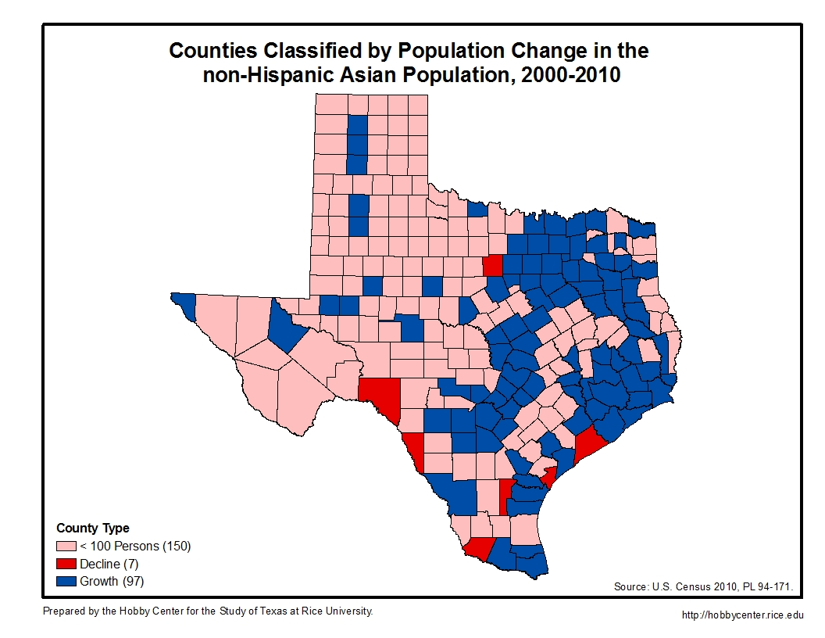

Slide 53
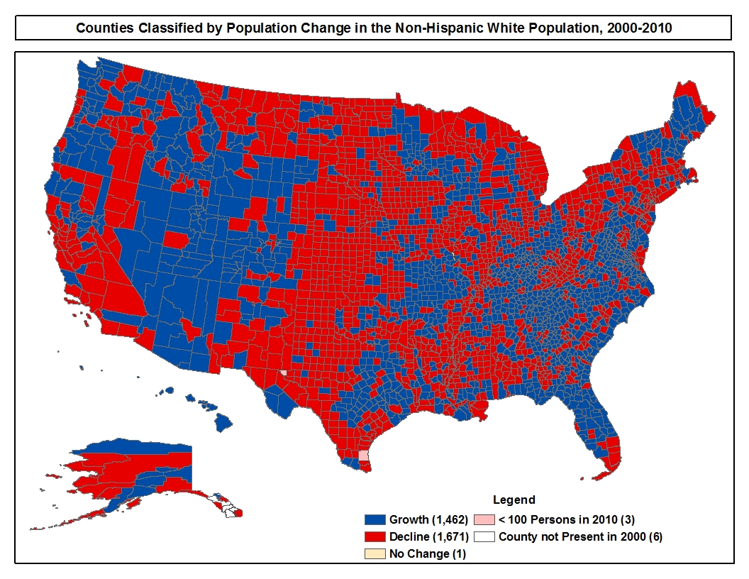

Slide 54
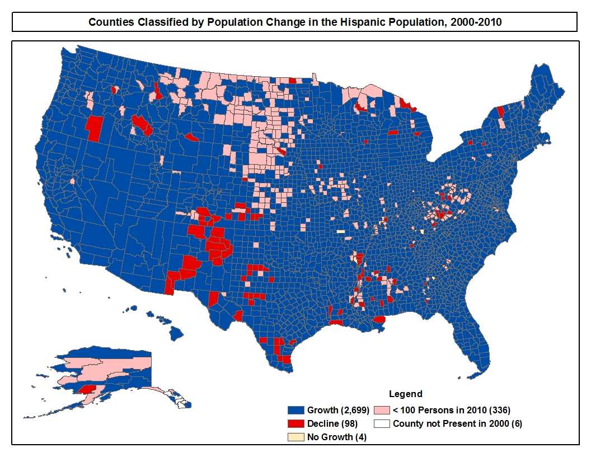

Slide 55
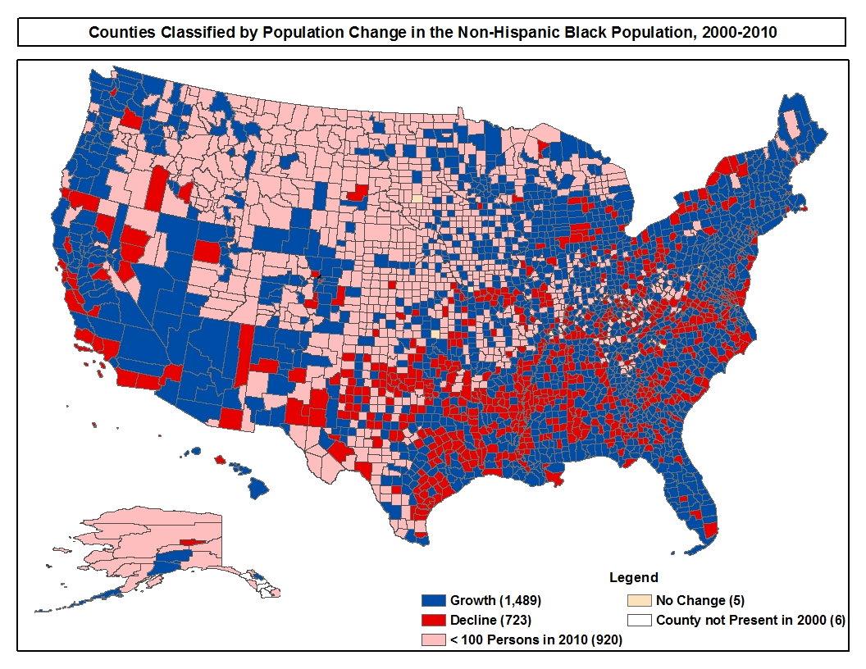

Slide 56
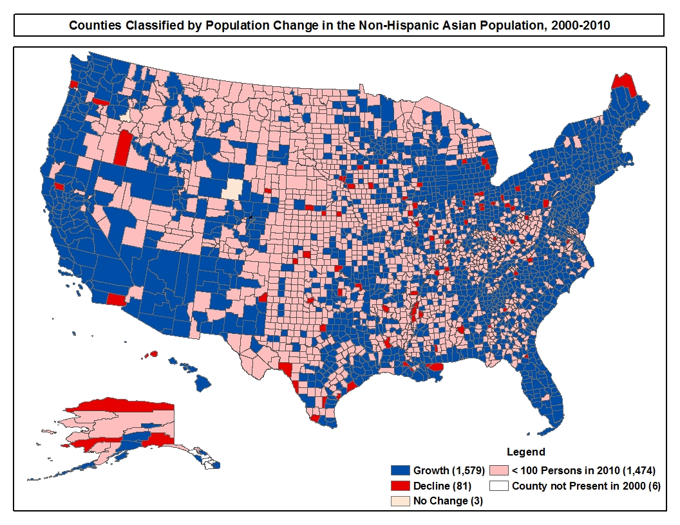

Slide 57
NonHispanic White Population as a Percent of the
Total Population in Selected Metropolitan Statistical Areas in Texas in 2000 and 2010

Slide 58
NonHispanic White Child (<18) Population as a Percent of the Total Childhood Population in Selected Metropolitan Statistical Areas in Texas in 2000 and 2010

Slide 59
Hispanic Population as a Percent of the
Total Population in Selected Metropolitan Statistical Areas in Texas in 2000 and 2010

Slide 60
Hispanic Child (<18) Population as a Percent of the
Total Child Population in Selected Metropolitan Statistical Areas in Texas in 2000 and 2010

Slide 61
Population in Texas by Race/Ethnicity in 2010 and Projections of the Population in Texas by Race/Ethnicity from 2020 to 2050 Under Alternative Assumptions of Age and Race/Ethnicity-Specific Rates of Net Migration
Year | NH¹ White | NH Black | Hispanic | NH Asian & Other² | Total
Assuming Zero Net Migration
2010 | 11,397,345 | 2,886,825 | 9,460,921 | 1,400,470 | 25,145,561
2020 | 11,576,595 | 3,122,637 | 11,137,672 | 1,536,693 | 27,373,597
2030 | 11,501,020 | 3,280,941 | 12,869,753 | 1,638,249 | 29,289,963
2040 | 11,182,576 | 3,355,500 | 14,570,851 | 1,714,232 | 30,823,159
2050 | 10,766,622 | 3,366,528 | 16,191,150 | 1,728,206 | 32,052,506
Assuming Net Migration Equal to One-Half of 2000-2010
2010 | 11,397,345 | 2,886,825 | 9,460,921 | 1,400,470 | 25,145,561
2020 | 11,752,530 | 3,295,198 | 12,031,059 | 1,825,130 | 28,903,917
2030 | 11,850,180 | 3,658,997 | 15,082,058 | 2,309,763 | 32,900,998
2040 | 11,676,157 | 3,951,909 | 18,489,803 | 2,881,525 | 36,999,394
2050 | 11,376,576 | 4,182,155 | 22,268,390 | 3,483,178 | 41,310,299
Assuming Net Migration Equal to 2000-2010
2010 | 11,397,345 | 2,886,825 | 9,460,921 | 1,400,470 | 25,145,561
2020 | 11,931,815 | 3,477,928 | 13,003,159 | 2,170,409 | 30,583,311
2030 | 12,211,664 | 4,080,453 | 17,702,132 | 3,288,536 | 37,282,785
2040 | 12,194,151 | 4,653,725 | 23,514,974 | 4,953,861 | 45,316,711
2050 | 12,024,913 | 5,195,861 | 30,701,208 | 7,283,548 | 55,205,530
¹NH refers to Non-Hispanic; values shown are only for the non-Hispanic persons in each race category. Hispanic includes Hispanics of all races.
²NH Asian & Other category includes non-Hispanic persons who identify themselves as belonging to two or more race groups.

Slide 62
Percent of the Population by Race/Ethnicity in 2010 and Projected Through 2050 Under Alternative Assumptions of Age and Race/Ethnicity-Specific Rates of Net Migration for the State of Texas
Year | NH¹ White | NH Black | Hispanic | NH Asian & Other² | Total
Assuming Zero Net Migration (Scenario 0.0)
2010 | 45.3 | 11.5 | 37.6 | 5.6 | 100.0
2020 | 42.3 | 11.4 | 40.7 | 5.6 | 100.0
2030 | 39.3 | 11.2 | 43.9 | 5.6 | 100.0
2040 | 36.3 | 10.9 | 47.2 | 5.6 | 100.0
2050 | 33.6 | 10.5 | 50.5 | 5.4 | 100.0
Assuming Net Migration Equal to One-Half of 2000-2010 (Scenario 0.5)
2010 | 45.3 | 11.5 | 37.6 | 5.6 | 100.0
2020 | 40.7 | 11.4 | 41.6 | 6.3 | 100.0
2030 | 36.0 | 11.1 | 45.8 | 7.1 | 100.0
2040 | 31.6 | 10.7 | 50.0 | 7.7 | 100.0
2050 | 27.5 | 10.2 | 53.9 | 8.4 | 100.0
Assuming Net Migration Equal to 2000-2010 (Scenario 1.0)
2010 | 45.3 | 11.5 | 37.6 | 5.6 | 100.0
2020 | 39.0 | 11.4 | 42.5 | 7.1 | 100.0
2030 | 32.8 | 10.9 | 47.5 | 8.8 | 100.0
2040 | 26.9 | 10.3 | 51.9 | 10.9 | 100.0
2050 | 21.8 | 9.4 | 55.6 | 13.2 | 100.0
¹NH refers to Non-Hispanic; values shown are only for the non-Hispanic persons in each race category. Hispanic includes Hispanics of all races.
²NH Asian & Other category includes non-Hispanic persons who identify themselves as belonging to two or more race groups.

Slide 63
Percent Change for Selected Time Periods Under Alternative Scenarios of Age and Race/Ethnicity-Specific Net Migration for the State of Texas
Period | NH¹ White | NH Black | Hispanic | NH Asian & Other² | Total
Assuming Zero Net Migration (Scenario 0.0)
2010-2020 | 1.6 | 8.2 | 17.7 | 9.7 | 8.9
2020-2030 | -0.7 | 5.1 | 15.6 | 6.6 | 7.0
2030-2040 | -2.8 | 2.3 | 13.2 | 4.6 | 5.2
2040-2050 | -3.7 | 0.3 | 11.1 | 0.8 | 4.0
2010-2050 | -5.5 | 16.6 | 71.1 | 23.4 | 27.5
Assuming Net Migration Equal to One-Half of 2000-2010 (Scenario 0.5)
2010-2020 | 3.1 | 14.1 | 27.2 | 30.3 | 14.9
2020-2030 | 0.8 | 11.0 | 25.4 | 26.6 | 13.8
2030-2040 | -1.5 | 8.0 | 22.6 | 24.8 | 12.5
2040-2050 | -2.6 | 5.8 | 20.4 | 20.9 | 11.7
2010-2050 | -0.2 | 44.9 | 135.4 | 148.7 | 64.3
Assuming Net Migration Equal to 2000-2010 (Scenario 1.0)
2010-2020 | 4.7 | 20.5 | 37.4 | 55.0 | 21.6
2020-2030 | 2.3 | 17.3 | 36.1 | 51.5 | 21.9
2030-2040 | -0.1 | 14.0 | 32.8 | 50.6 | 21.5
2040-2050 | -1.4 | 11.6 | 30.6 | 47.0 | 21.8
2010-2050 | 5.5 | 80.0 | 224.5 | 420.1 | 119.5
¹NH refers to Non-Hispanic; values shown are only for the non-Hispanic persons in each race category. Hispanic includes Hispanics of all races.
²NH Asian & Other category includes non-Hispanic persons who identify themselves as belonging to two or more race groups.

Slide 64
Percent of Net Change in Population from 2010 to 2050 Due to
Each Race/Ethnicity Group Under Alternative Scenarios of Age and Race/Ethnicity-Specific Net Migration for State of Texas
Race/Ethnicity | Number | Percent
Assuming Zero Net Migration (Scenario 0.0)
NH¹ White | -630,723 | -9.1
NH Black | 479,703 | 6.9
Hispanic | 6,730,229 | 97.4
NH Asian & Other² | 327,736 | 4.8
Total | 6,906,945 | 100.0
Assuming Net Migration Equal to One-Half of 2000-2010 (Scenario 0.5)
NH White | -20,769 | -0.1
NH Black | 1,295,330 | 8.0
Hispanic | 12,807,469 | 79.2
NH Asian & Other | 2,082,708 | 12.9
Total | 16,164,738 | 100.0
Assuming Net Migration Equal to 2000-2010 (Scenario 1.0)
NH White | 627,568 | 2.1
NH Black | 2,309,036 | 7.7
Hispanic | 21,240,287 | 70.7
NH Asian & Other | 5,883,078 | 19.5
Total | 30,059,969 | 100.0
¹NH refers to Non-Hispanic; values shown are only for the non-Hispanic persons in each race category. Hispanic includes Hispanics of all races.
²NH Asian & Other category includes non-Hispanic persons who identify themselves as belonging to two or more race groups.

Slide 65
Total Public School Students by Race/Ethnicity in the 10 Largest School Districts in Texas, 2000-2001 and 2014-2015
Source: Data compiled from Texas Education Agency, Academic Excellence Indicator System (AEIS) District Profiles

Slide 66
A note on Hispanic growth

Slide 67
Hispanic Population in Texas by Origin and Citizenship Status
Hispanic Population: 9.9 Million
Source: U.S. Census, 2012 American Community Survey
Notes:
There were an estimated 2.8 million foreign born (Hispanic plus all other groups). Of that group, an estimated 1.8 or 64% were undocumented.

Slide 68
Hispanic Population Aged 18 and Older in Texas by Origin and Citizenship Status

Slide 69
Hispanic Population Under Age 18 in Texas by Origin and Citizenship Status

Slide 70
Mexican-American Population Growth in the United States, 1980-2010
Millions
Note: Deaths in are not included in the figure.
Source: Pew Hispanic Center, 2011 (based upon tabulations of Current Population Survey and U.S. Census Integrated Public Use Microdata Samples).

Slide 71
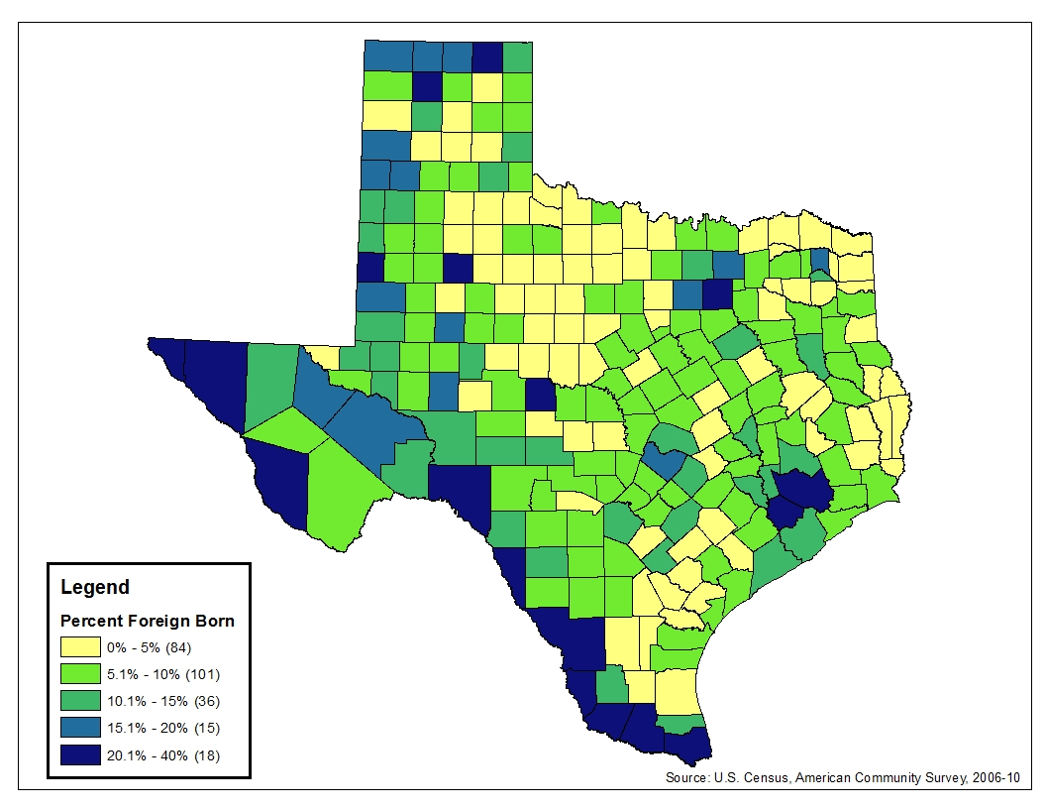
Foreign Born as a Percent of the Total Population, 2006-2010
Notes:
33 Counties 15% or more Foreign born

Slide 72
Country of Birth of the Unauthorized Immigrant Population in the United States: January 2000 and 2011
Total: 8.5 million
Source: Homeland Security

Slide 73
Estimates of the Unauthorized Immigrant Population
in the United States, 2000-2012
Source: Passel, Jeffrey, D’Vera Cohn, and Anna Gonzalez-Barrera, “Population Decline of Unauthorized Immigrants Stalls, May Have Reversed,” Pew Hispanic Center, September 23, 2013

Slide 74
Estimates of the Unauthorized Immigrant Population
in Texas, 2000-2012
Source: Passel, Jeffrey, D’Vera Cohn, and Anna Gonzalez-Barrera, “Population Decline of Unauthorized Immigrants Stalls, May Have Reversed,” Pew Hispanic Center, September 23, 2013

Slide 75
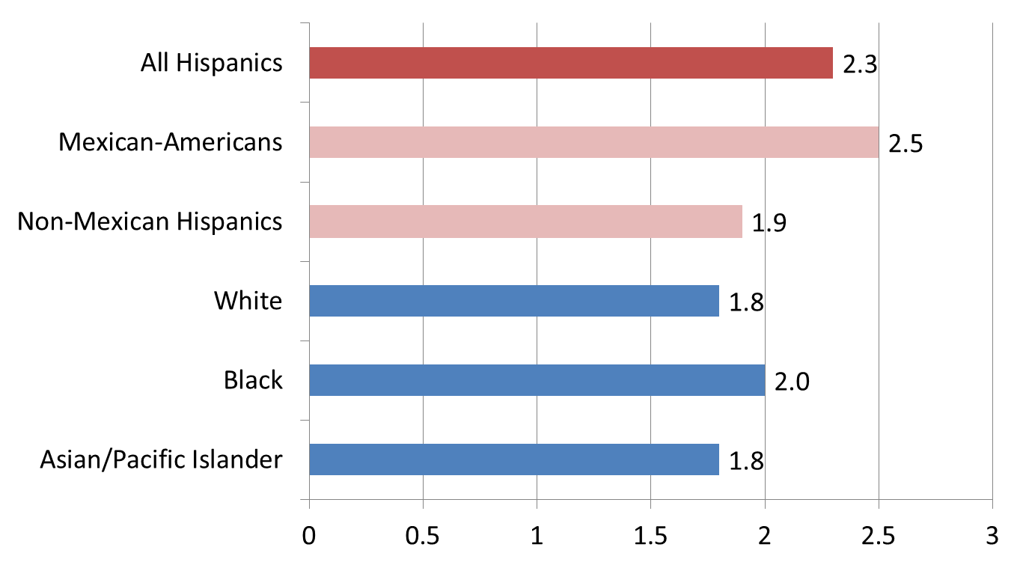
Children Ever Born by Race/Ethnicity
Among Women Ages 40 to 44, 2008
Source: Pew Hispanic Center tabulations of the 2006 and 2010 Current Population Survey June Supplements.

Slide 76
Texas Age Distribution by
Race/Ethnicity and Sex

Slide 77
Households Most Likely to Have School Aged Children

Slide 78
NH White and Hispanic Births in 2010 Compared to Alternative Scenarios Assuming Hispanic Births or Hispanic Age Characteristics for Both Groups
Birth data and rates from Texas Dept. of State Health Services and National Center for Health Statistics.

Slide 79
Difference Between Reported Births in 2010 and Alternative Scenarios Assuming Hispanic Births or Hispanic Age Characteristics for All Race/Ethnic Groups
Birth data and rates from Texas Dept. of State Health Services and National Center for Health Statistics.
Estimates for other groups, including race/ethnicity not identified, are not reported here but are included in the total.
Notes:
NH White: +45,623 and +91,127
NH Black: +13,049 and +14,990
Asian: +3,832 and +4,669
Other: +6,191 and +7,043
Total: +68,695 and +117,828

Slide 80
agE Structure and demographic diversity

Slide 81
Percent of Texas Population by Age Group and Ethnicity, 2000
Notes:
Combination of ethnic diversity and aging will be felt in the next few decades
In about 2003, Texas became a non-majority state and by 2035, Texas is predicted to become Hispanic majority state
What is seen here is to the right – the Texas of old and to the left – the Texas of the future
81

Slide 82
Percent of Texas Population by Age Group and Ethnicity, 2010
Notes:
Non-anglo populations primarily in younger ages
Largest proportion of anglos in oldest ages
82

Slide 83
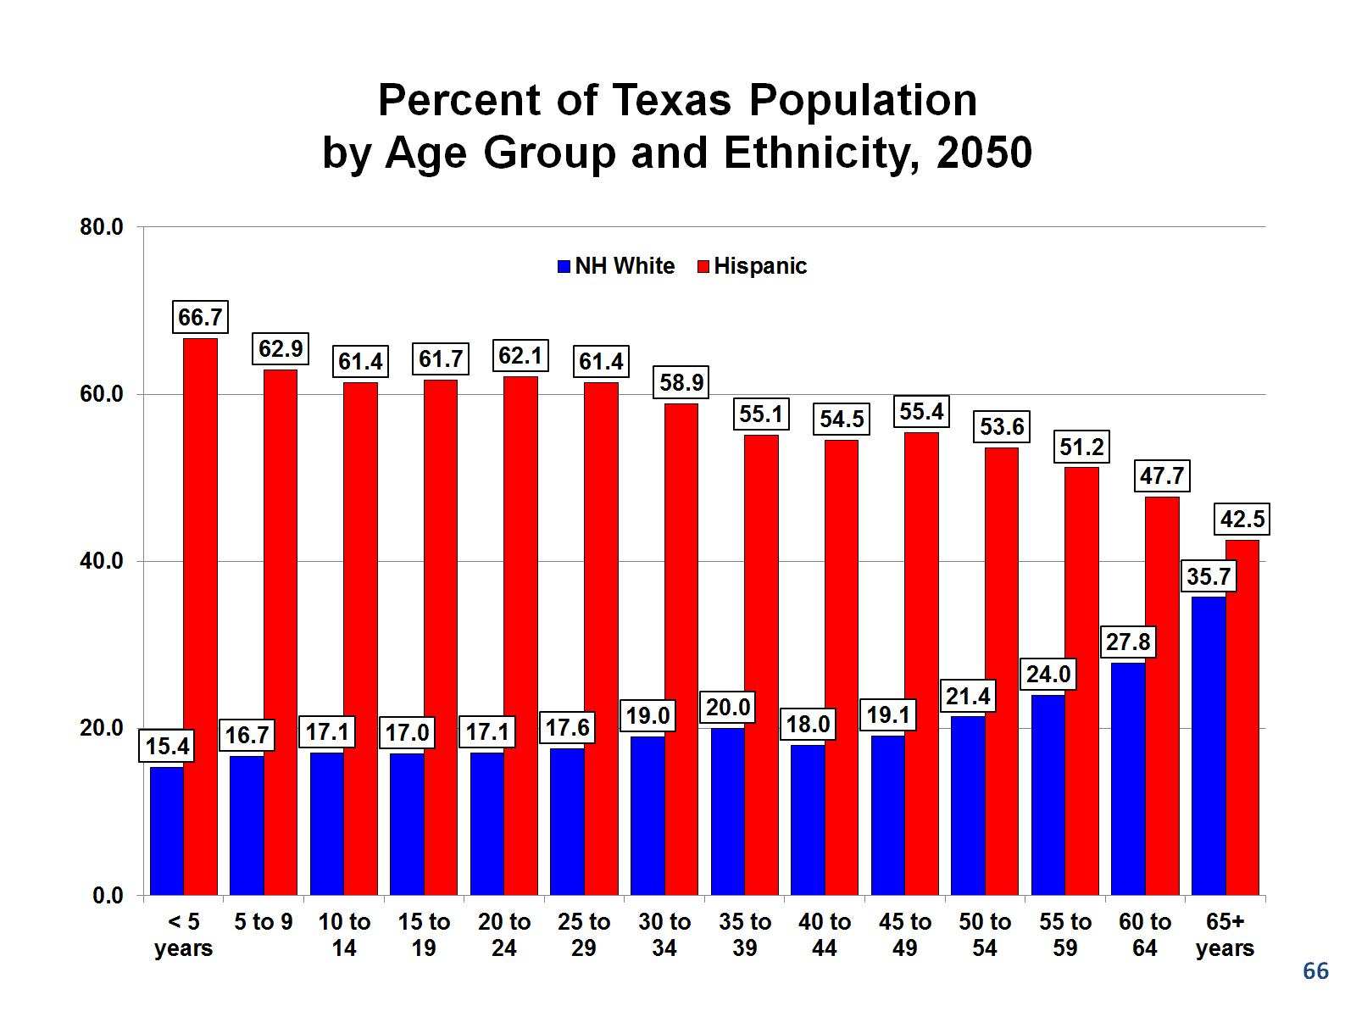
Percent of Texas Population by Age Group and Ethnicity, 2050

Slide 84
The challenge

Slide 85
Education Pays
Unemployment Rate
Median Weekly Earnings
Overall Unemployment Rate: 7.6%
Median: $827
Source: U.S. Department of Labor, Bureau of Labor Statistics, June 2013/first quarter 2013

Slide 86
Educational Attainment for the Texas Population
Age 25 and Older by Race/Ethnicity, 2010
Race Ethnicity | Population Age 25 and Older | Less than high school | High school diploma | Some college or associates degree | Bachelor or more
Non-Hispanic White | 8,099,053 | 8.0 | 25.3 | 32.6 | 34.1
Black | 1,788,223 | 13.9 | 30.3 | 36.2 | 19.6
Hispanic* | 5,063,779 | 40.4 | 25.8 | 22.2 | 11.6
Asian | 639,967 | 14.4 | 15.2 | 18.6 | 51.8
Total Population | 15,772,122 | 19.3 | 25.6 | 29.2 | 25.9
________ Source: U.S. Census, American Community Survey, 2010. Note: Due to size, some groups are excluded. *Includes Hispanic persons of all races.

Slide 87
Mean Household Income by Race/Ethnicity, Educational Attainment, and Occupation In Texas in 2010
Occupations | Less Than High School | High School /GED | Bachelor's Degree | Graduate/ Prof Degree
NH White
Managerial & Professional | $ 72,446 | $ 84,504 | $ 120,792 | $ 149,819
Technical, Sales, & Admin. | 52,930 | 64,179 | 112,843 | 130,471
Precision Prod., Craft, & Repairers | 55,079 | 68,247 | 94,875 | 119,057
Operatives and Laborers | 48,819 | 61,211 | 77,581 | 89,720
Total | 50,533 | 64,975 | 114,698 | 144,714
NH Black
Managerial & Professional | $ 47,483 | $ 52,186 | $ 84,758 | $ 99,073
Technical, Sales, & Admin. | 33,980 | 43,933 | 75,416 | 80,852
Precision Prod., Craft, & Repairers | 42,767 | 53,192 | 82,885 | 69,805
Operatives and Laborers | 37,811 | 46,296 | 66,181 | 63,707
Total | 31,072 | 42,465 | 78,933 | 94,490
Hispanic
Managerial & Professional | $ 52,178 | $ 61,992 | $ 88,036 | $ 116,400
Technical, Sales, & Admin. | 40,131 | 50,127 | 81,005 | 91,155
Precision Prod., Craft, & Repairers | 42,302 | 51,527 | 63,695 | 63,345
Operatives and Laborers | 41,273 | 47,455 | 54,282 | 57,806
Total | 38,221 | 47,760 | 81,548 | 108,473
NH Asian & Other
Managerial & Professional | $ 84,172 | $ 73,016 | $ 103,737 | $ 130,603
Technical, Sales, & Admin. | 52,764 | 60,719 | 86,039 | 105,469
Precision Prod., Craft, & Repairers | 54,594 | 63,451 | 70,778 | 92,041
Operatives and Laborers | 47,939 | 49,015 | 60,895 | 65,074
Total | 50,815 | 55,496 | 93,474 | 123,035
Source: Ruggles et al. 2010; U.S. Census Bureau, American Community Survey 2010 Public Use Microdata Sample, 2011.

Slide 88
Percent of Population 25 Years of Age and Older in Texas Who Are High School Graduates and Higher or College Graduates and Higher by Race/Ethnicity, 1990-2010
 | Educational Attainment Level
 |  | NH White* | NH Black | Hispanic | NH Asian & Other | Total
 | 1990
 | High School and Higher | 81.5 | 66.2 | 44.6 | 79.1 | 72.1
 | College and Higher | 25.2 | 12.0 | 7.3 | 41.3 | 20.3
 | 2000
 | High School and Higher | 87.2 | 75.8 | 49.3 | 80.7 | 75.7
 | College and Higher | 30.0 | 15.3 | 8.9 | 47.8 | 23.2
 | 2010
 | High School and Higher | 92.0 | 86.4 | 59.6 | 87.1 | 80.7
 | College and Higher | 34.1 | 19.7 | 11.6 | 46.0 | 25.9
* NH refers to Non-Hispanic; values for categories labeled NH are only for the Non-Hispanic persons in each race category. Hispanic includes Hispanics of all races. Source: U.S. Census Bureau, 2010 American Community Survey, Census 2000, Summary File 3, Census of Population and Housing, 1990: Summary Tape File 3, 2012, 2002, 1990, 1991.

Slide 89
Comparisons of Educational Attainment by Selected
Race/Ethnic Characteristics and Foreign Born Status for the Population Age 25 and Over in Texas, 2010
Source: American Community Survey, 2010

Slide 90
Percent of All Households in Poverty in 2010 and Projected for 2050 Under Alternative Assumptions of Socioeconomic Closure Between Minority and NonHispanic White Households

Slide 91
Percent Change in Socioeconomic Resources Compared to Percent Change in Households, 2010 - 2050
Household Change: 127.6%

Slide 92
Per Capita Income in 2010 and Projected for 2050 Under Alternative Assumptions of Socioeconomic Closure Between Minority and NonHispanic White Households

Slide 93
Aggregate State Tax Revenues (in $Billions) in 2010 and Projected for 2050 Under Alternative Assumptions of Socioeconomic Closure Between Minority and NonHispanic White Households
Billions

Slide 94
Advice to new legislators:
Spend every nickel you can on education. Every nickel you don't spend now will cost dollars in the future for welfare and prisons. Then go home. Please don't pass any more laws.
--Former Lt. Governor William P. Hobby, Jr.

Slide 95
Recommended Links/Readings
U.S. Census Bureau (www.census.gov):
  The American Community Survey
  Decennial Censuses (primarily 2000 and 2010)
  Population Estimates
  Population Projections
Texas State Data Center: (http://txsdc.utsa.edu)
  Population Estimates
  Population Projections
Hobby Center for the Study of Texas (http://hobbycenter.rice.edu)
NCES School District Demographic System (http://nces.ed.gov/surveys/sdds/index.aspx)
  Texas Workforce Commission (http://www.twc.state.tx.us/)
  Texas Real Estate Center (http://recenter.tamu.edu/)
  Texas Almanac (http://www.texasalmanac.com )
  Annie E. Casey Foundation – Kids Count (http://datacenter.kidscount.org/ ) See Data by State
  - Selected Data Indicators by State, County, Place
Hobby, Bill 2010. How Things Really Work: Lessons from a Life in Politics. Austin, Texas: The Briscoe Center for American History, The University of Texas at Austin.
Murdock, Steve H., M. Cline and M. Zey. 2013. The History of Texas’ Population in Major Problems in Texas History (2nd Edition). Sam W. Haynes, ed. Arlington: University of Texas-Arlington Press.
Murdock, Steve H., M. Cline, et al. 2014. Changing Texas: Implications of Addressing or Ignoring the Texas Challenge
College Station, Texas: Texas A&M University Press.
Notes:
95

Slide 96

Mike Cline
Associate Director,
Hobby Center for the Study of Texas
Changing Texas: Implications of
Addressing or Ignoring the Texas Challenge
http://thetexaschallenge.com/
For copies of the presentation and
additional data for your area go to:
http://hobbycenter.rice.edu
Phone: 713-348-5396
E-mail: mec6@rice.edu

