Slide 1
JCP Distresses in PMIS
Sources
PMIS Rater’s Manual 2010
TxDOT Research Report 1989-1: PMIS Concepts, Equations and Analysis Models
PMIS data tables from 1993 to 2010:
  PMIS JCP Ratings
  PMIS Data Collection Section
  PMIS Scores Summaries

Slide 2
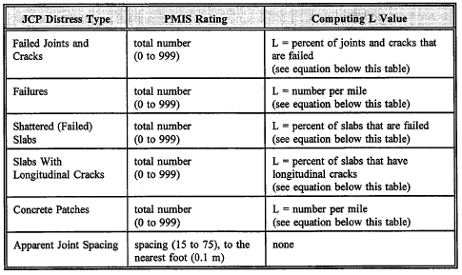
JCP Distresses in PMIS
Overview

Slide 3

JCP Distresses in PMIS
Apparent Joint Spacing (ft)
Joint spacing
Utilization in PMIS:
In calculations of distress levels L measured per slab

Slide 4
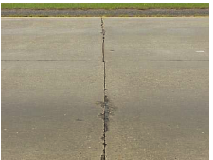
JCP Distresses in PMIS
Failed Joints and Cracks (FJC)
Field rating (Rat)=# occurrences
Distress level calculated as
Spalling = yes
Load transfer loss = no

Slide 5
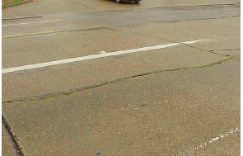
JCP Distresses in PMIS
Longitudinal Cracks (LC)
Field rating (Rat)=# occurrences
Distress level calculated as

Slide 6
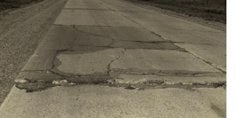
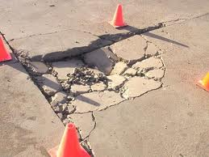
JCP Distresses in PMIS
Shattered Slabs (S, SS)
Failures ≥ 5
or
failure larger than ½ slab
Shattered slab
Field rating (Rat)=# occurrences
Distress level calculated as
Failure

Slide 7
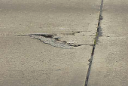
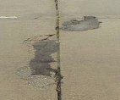
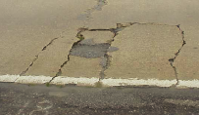

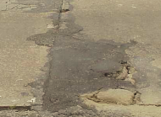
JCP Distresses in PMIS
Failures (F, FL)
Field rating (Rat)=#occurrences
Distress level calculated as: Rat/Len

Slide 8



JCP Distresses in PMIS
Concrete Patches (P, Pat)
Field rating (Rat)=#occurrences
Distress level calculated as: Rat/ Len

Slide 9


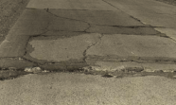

JCP Distresses Progression
Failed Js&Cs
Failure
PCC patch
other cracks
Shattered slab
Long. crack

Slide 10
Example of Non-Adherence to Order of Performance
Zone 3 Data

Slide 11
Example of Non-Adherence to Order of Performance
Zone 1 LR Data

