Slide 1

Webinar
Texas Department of Transportation
0-6677: Costs Associated with Conversion of Surfaced to Un-Surfaced Roads
Is Conversion of a Roadway from Surfaced to Un-Surfaced for Agency Cost Savings Realistic?
August 30, 2012

Slide 2
Agenda
Overview of the Project
  Purpose
  Process
Results
Application to Road Management Strategy
Additional Questions

Slide 3
Project Overview - Background
Can you find agency cost savings in converting surfaced low-volume roads into un-surfaced roads?
  Specifically in maintenance savings
Studies in South Dakota and Minnesota addressed this question
  Both found that the threshold average daily traffic (ADT) for cost savings on gravel roads was around 150

Slide 4
Project Overview - Purpose
To determine if there was an agency cost savings benefit associated with conversion of low-volume roads in Texas from surfaced to un-surfaced
To determine what the threshold would be for converting a surfaced road to an un-surfaced road

Slide 5
Project Overview - Process
Determine the number of lane miles under consideration for conversion
Determine the methods and costs associated with:
  Conversion from surfaced to un-surfaced
  Maintenance of un-surfaced roads
  Conversion from un-surfaced to surfaced
  Maintenance of surfaced roads

Slide 6
Project Overview – Process Outline
Survey
Data Collection
HDM-III Simulations
  Sensitivity Analysis
  Simulations
Establish Conversion Cost
Analysis of Results

Slide 7
Project Overview - Survey
TxDOT has no un-surfaced roads maintained officially as such, so there was an initial survey of county maintenance engineers and managers for un-surfaced maintenance cost data
What we learned:
  County maintenance records are insufficient for data extraction
  The public is very opposed to the idea of “un-paving” a road
Notes:
Explain how temporary conversion is on the table for certain roads, such as how Paul explained conversion associated with natural gas extraction and wind farm construction.

Slide 8
Project Overview – Data Collection
Data from TxDOT
  Material costs
  ADT data
  Schedule and process confirmation from Project Director
Data from RS Means Heavy Civil 2012
  Labor
  Equipment
  Area modifiers

Slide 9
Project Overview – HDM-III Sensitivity Analysis
Sensitivity Analysis
  To establish variables (inputs) within the program with the most impact on the results
Sensitivity Analysis Results:
  Cost (inputs for material cost, equipment, labor, etc.) have an obvious and measured impact on the overall cost
  Average Daily Traffic (ADT) is the main contributing factor to deterioration of a road surface and also had a substantial measured impact

Slide 10
Project Overview – HDM-III, Simulations
Goal of the HDM-III simulations was evaluation on the long-term maintenance cost of:
  Environmental conditions
  Soil conditions
  Effects of ADT on the cost of maintaining a given section of roadway
There were 187 simulations run:
  Each of the twenty-five (25) TxDOT districts
  Five (5) climate regions
  One (1) for Texas as a whole
    For unsurfaced, each was run six (6) times: at ADTs of 100, 200, 300, 400, 500, and once for a surfaced road
  A simulation at 0 ADT was run as a control
Notes:
Define roadway section: one mile long by 24 feet wide
The impact to the surfaced pavement at such a low traffic volume was nil. There was no change in the effect from 100 to 500 ADT on a surfaced road.

Slide 11
Results – HDM-III, Simulations
HDM-III projected an average yearly maintenance cost for each district and climatic zone for unsurfaced roads
The results produced by HDM-III were for a 25-year analysis of the maintenance costs
Surfaced/Un-surfaced break-even points were calculated for each district, climatic zone, and Texas as a whole
Most relevant general finding from HDM-III simulations:
  The cost of the materials and the level of ADT has the most crucial impact on the cost of maintenance (as well as conversion)

Slide 12
Results – ADT Analysis
Purpose of the ADT Analysis:
  To estimate eligible miles for potential conversion
  To determine the maintenance cost break-even point for surfaced and un-surfaced roads per district
ADT data per district were pulled from data extracted from PMIS by TxDOT
Notes:
All should have table 4-1 to reference the break-even ADT for their own district

Slide 13
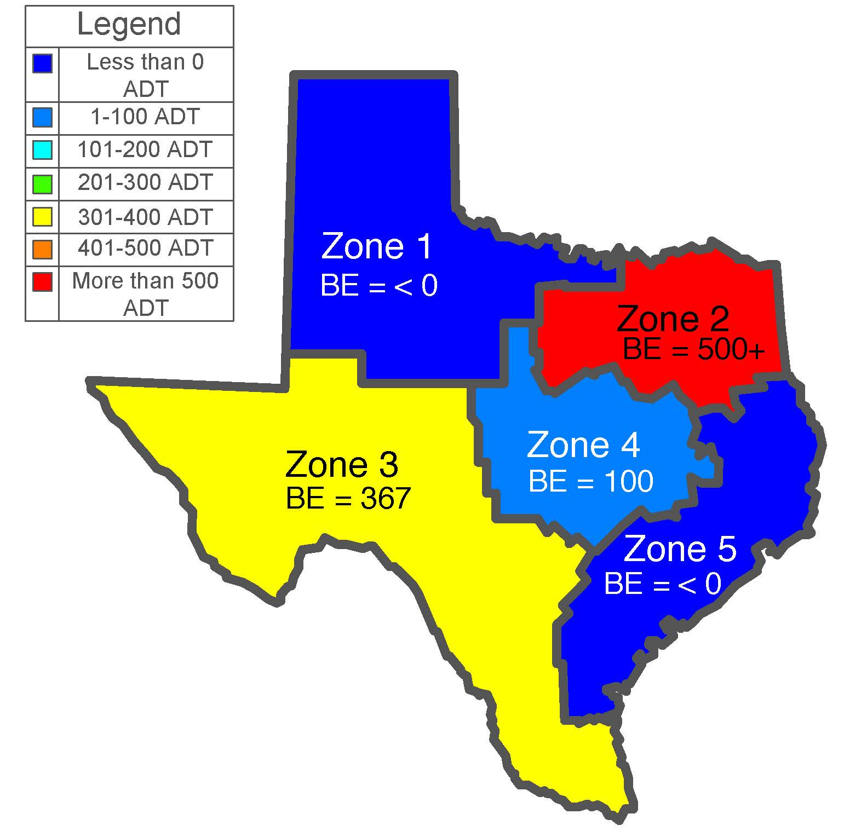
Results – Break-Even ADT by Zone
This map shows the
average break-even
ADT per zone.

Slide 14
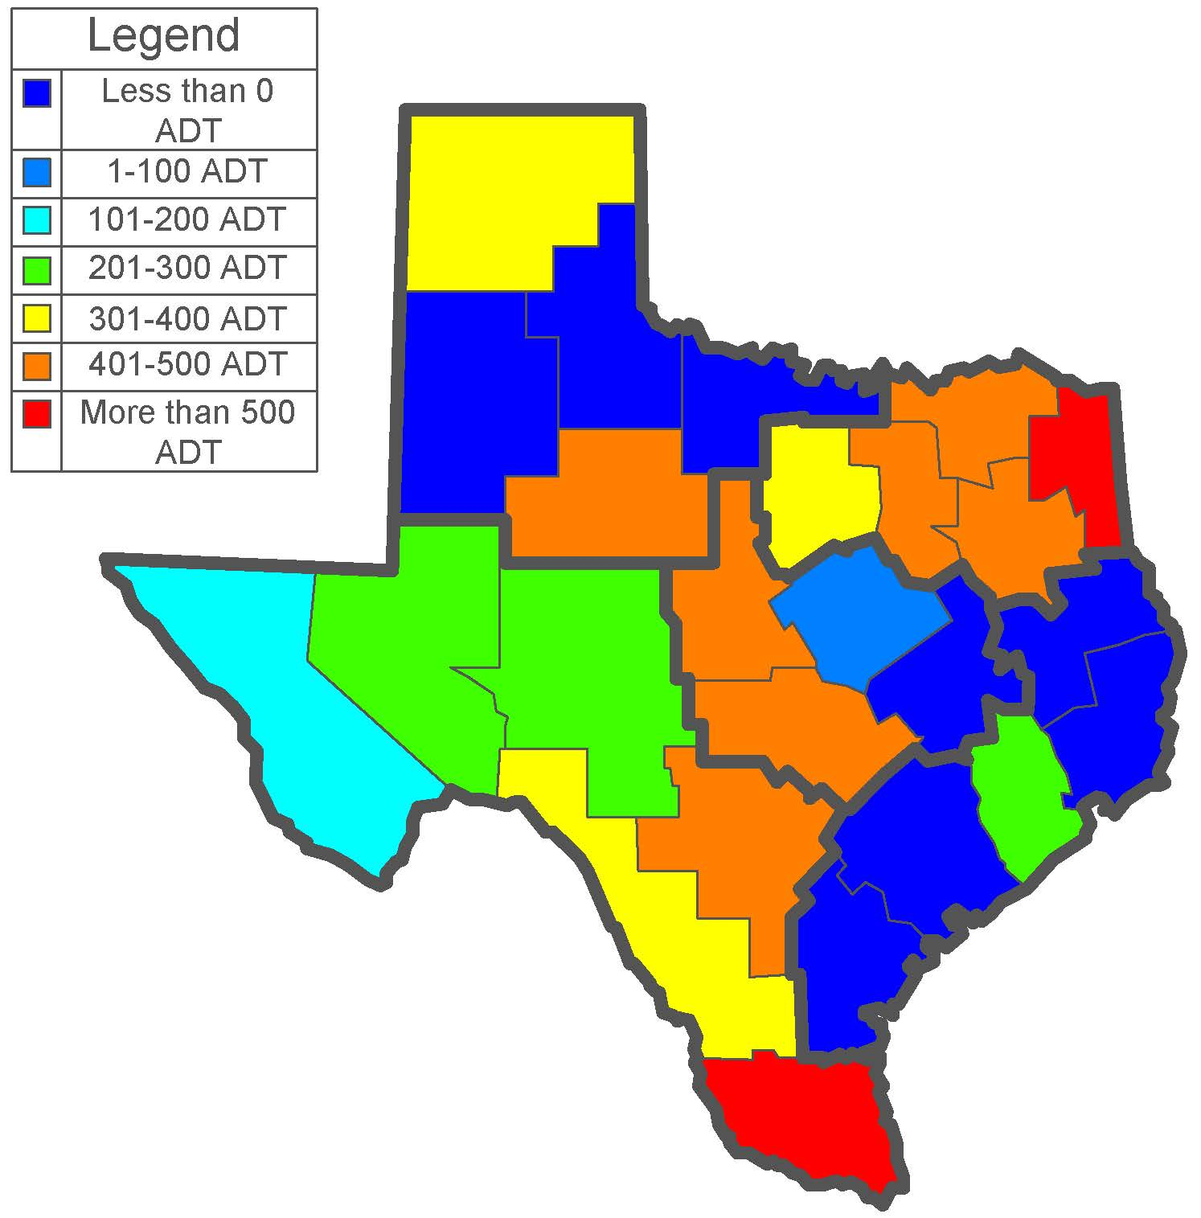
Results – Break-Even ADT by District
Overall, the break-even
for the state as a whole is
~150 ADT.
This varies greatly by
district, and could depend
on the material choice,
cost, and frequency of
maintenance.

Slide 15
Application to Road Management Strategy
The process of converting a roadway from surfaced to un-surfaced could be an economical decision from the agency perspective in terms of maintenance cost savings
Each road under consideration must be evaluated independently, it is not possible to make judgments based on state or zone averages
Notes:
It is possible to save money by converting from surfaced to un-surfaced, in some cases. That is heavily dependent on the cost of materials, labor, equipment, and expected rise in ADT.

Slide 16
Application to Road Management Strategy - Your District
Establish engineered gravel/aggregate material
Find all material costs
  Gravel/Aggregate
  Seal Oil
  Chip Rock
  Prime Oil
Enter cost into HDM-III
  Get effects of ADT
  Get annual economic impact
  Simulate surfaced versus un-surfaced

Slide 17
Application to Road Management Strategy - Your District
Compare costs generated to find the break-even point
  Evaluate roadways in the specific district relative to that ADT
Establish conversion cost
Compare entire process of conversion
  How many years to break-even on the process?
  Consider population trends in the area and if/when growth is anticipated

Slide 18
Application, Impact – Example
The Situation: One surfaced lane mile in Texas, at ADT 100 (below the break even ADT 150), is under consideration for conversion to unsurfaced roadway
  Unit costs used to calculate inputs for HDM-III came from unit bid prices and Maintenance Management Information System
  All maintenance costs used were generated through the HDM-III simulations
  All costs are relative to the ADT being examined and specific to the Texas statewide average

Slide 19
Application, Impact– Scenario 1
The roadway is converted
  Cost to convert surfaced to unsurfaced: $7,649
  Annual cost to maintain un-surfaced roadway: $6,116
  Annual cost to maintain surfaced roadway: $6,276
  Savings per year per mile in maintenance with un-surfaced roadways: $161
  Number of years it would take for the conversion to pay for itself (cost to convert divided by the savings per year): 48
  * Conversion cost was calculated by research team and includes materials, equipment, and labor
  ** Annual maintenance costs were generated by HDM-III

Slide 20
Application, Impact – Scenario 2
The roadway is converted, then needs reconversion at some point
  Cost to convert from surfaced to unsurfaced: $7,649
  Cost to reconvert from un-surfaced to surfaced: $106,771
  Total conversion cost: $114,420
  Difference of the two annual maintenance costs: $161
  Number of years to break-even on the un-surfacing then reconversion of a roadway: 711
  * Conversion cost was calculated by research team and includes materials, equipment, and labor
  ** Annual maintenance costs were generated by HDM-III

Slide 21
Application, Impact – Scenario 3
The roadway is left as is. No conversion takes place
  Annual cost to maintain surfaced roadway: $6,276
  The savings in this scenario is in the money not spent on conversion, especially reconversion (a total of $114,420)
  * Conversion cost was calculated by research team and includes materials, equipment, and labor
  ** Annual maintenance costs were generated by HDM-III

Slide 22
Conclusions
Conversion is a potential cost savings tool, but is very risky due to unpredictable growth, as the cost to convert from un-surfaced to surfaced is 14x more than to convert from surfaced to un-surfaced.
Material cost was the main factor in driving overall cost. Regions with cheaper overall materials have higher break-even ADT.

Slide 23

Additional Questions?

