Slide 1

MODULE 2b
Operational Functionality
Notes:
This module continues Operational Functionality

Slide 2
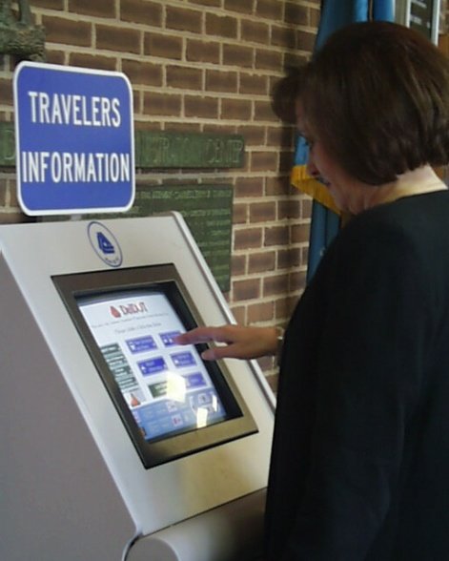

Developing Your Operational Functionality Program
Assemble collaborating agencies, stakeholders
Establish objectives
Develop corridor concept of operation
Agree on concept
Develop operating plan
Identify improvements, resources
Develop implementation strategy
  Responsibilities
  Priorities
  Public information program
Notes:
Bullets: show the 7 steps to develop an operational functionality program using the tools described in this module
Photos – both illustrate dissemination of travel conditions:
top – a traveler information kiosk to provide advanced traveler information to aid in trip planning
bottom – feed travel conditions to the media so they can be broadcast and help viewers plan their travel

Slide 3
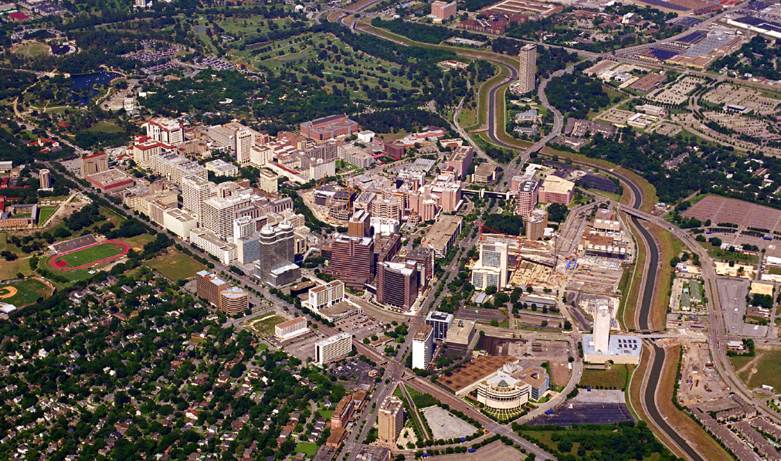
Sample Operations Concepts
Time managed operation
Area or corridor signal coordination
Through traffic priority
Long distance travel priority
Person movement priority
Maintain travel times/speeds on selected facilities
Evacuate high intensity trip generator
How might you accomplish these?
Notes:
Bullets: list of some operational concepts to preserve operational functionality
Photo: Texas Medical Center (Houston), the world’s largest, operates 24/7 and has very demanding access and internal circulation needs and issues. TMC operates its own traffic management center (integrated with emergency management center) which has an extensive operations plan to cover a myriad of normal and abnormal conditions (e.g., fires, crashes, street maintenance, congestion, etc.). TMC and City of Houston frequently review street system operations and changing TMC needs and make adjustments as needed.

Slide 4
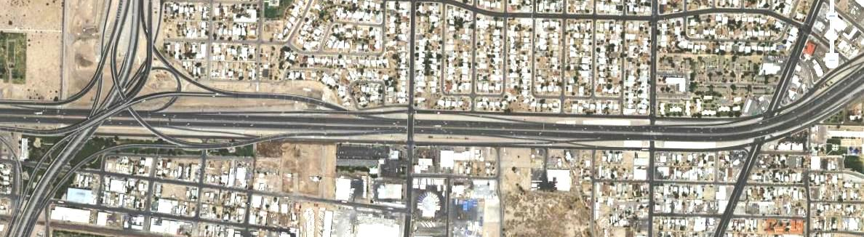
Examples
I-10 – US 54 interchange, El Paso
US 54
North
I-10
Paisano
Raynolds
Chelsea
Congestion
  Southbound to Eastbound ramp
  Eastbound I-10
Auxiliary lane improperly used to bypass queue
Notes:
(This slide was not covered in the pilot due to time constraints.)
This slide starts a series of examples showing actions taken to preserve operational functionality.
First example: eastbound I-10 in in vicinity of the US 54 interchange
Bullets list problems that caused congestion.

Slide 5
Examples
I-10 – US 54 interchange, El Paso
←Deficiency
Congestion
  Southbound to Eastbound ramp
  Eastbound I-10
Auxiliary lane improperly used to bypass queue
Solution →
Restripe US 54 entrance ramp for (original) 2 lanes
Extend added lane as auxiliary lane to drop at Paisano exit
Stripe out inside lane between US 54 exit and Copia entrance ramps
Notes:
(This slide was not covered in the pilot due to time constraints.)
This slide shows the problems/causes identified on the left and solution on the right. Yellow identifies the improvement areas. The following slides show aerial photography of this section of I-10 after improvement.

Slide 6
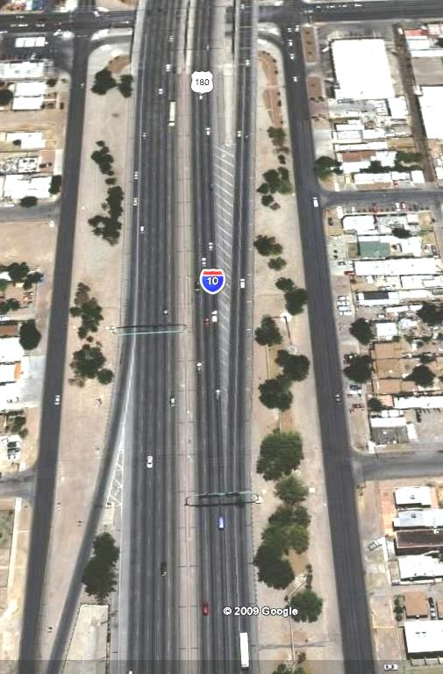
Examples
I-10 – US 54 interchange, El Paso
Exit to US 54 northbound
North
Notes:
(This slide was not covered in the pilot due to time constraints.)
This photo starts on the west end. Subsequent photos proceed east. Orange and yellow designate improved conditions. This segment shows the auxiliary lane that was removed (orange highlight).

Slide 7
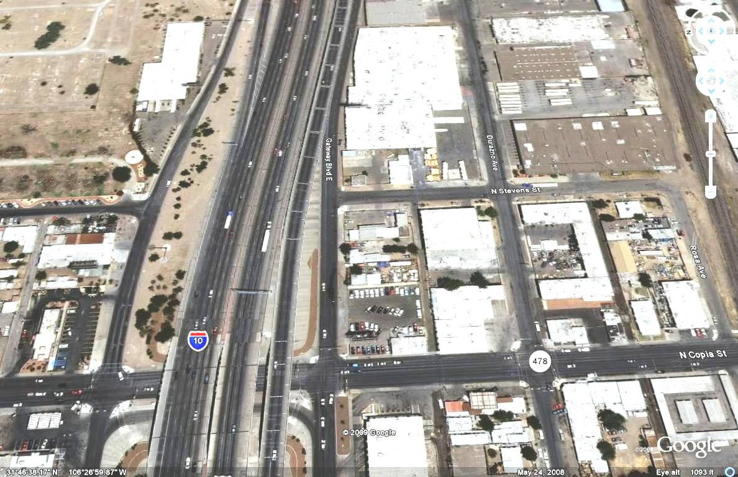
Examples
I-10 – US 54 interchange, El Paso
North
Exit to US 54 northbound
Notes:
(This slide was not covered in the pilot due to time constraints.)
Auxiliary lane striped out.

Slide 8
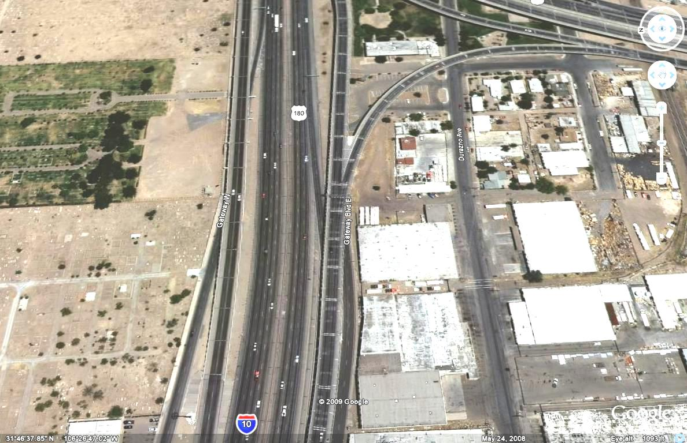
Examples
I-10 – US 54 interchange, El Paso
North
Exit to US 54 northbound
Entrance from Copia
Notes:
(This slide was not covered in the pilot due to time constraints.)
End of former auxiliary lane.

Slide 9
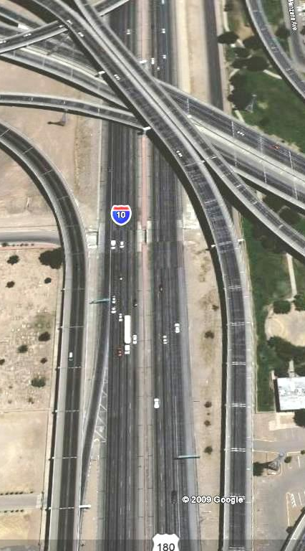
Examples
I-10 – US 54 interchange, El Paso
Entrance from Copia
Exit to US 54 northbound
North
Notes:
(This slide was not covered in the pilot due to time constraints.)
Proceeding through US 54 interchange

Slide 10
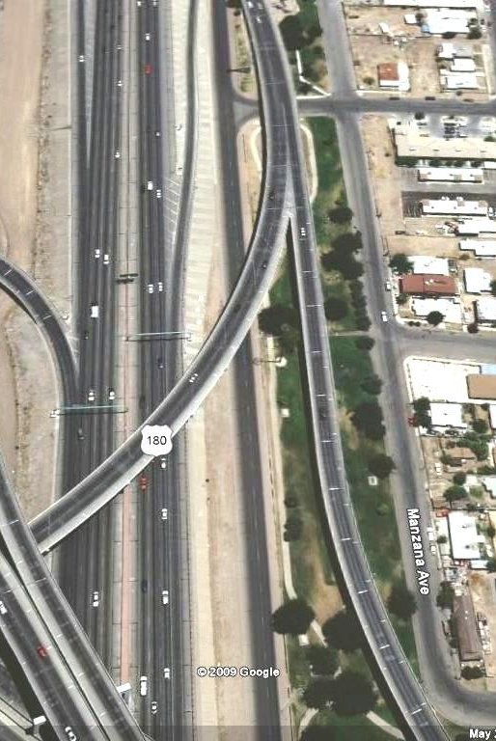
Examples
North
I-10 – US 54 interchange, El Paso
Exit to Raynolds
Eastbound entrance from US 54
Notes:
(This slide was not covered in the pilot due to time constraints.)
East side of US 54 interchange

Slide 11
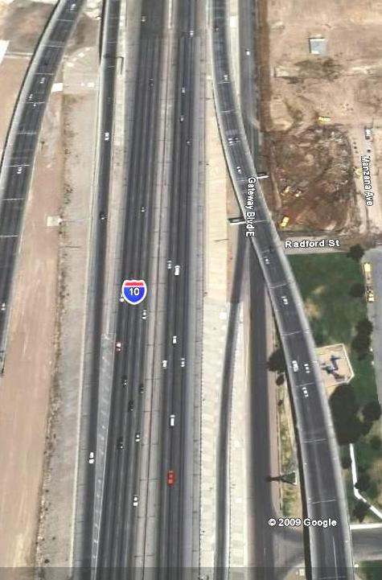
Examples
North
I-10 – US 54 interchange, El Paso
Eastbound entrance from US 54
Exit to Raynolds
Notes:
(This slide was not covered in the pilot due to time constraints.)
East end of US 54 interchange. Start striping to add lane (yellow highlight) to on-ramp (originally constructed for two lanes).

Slide 12
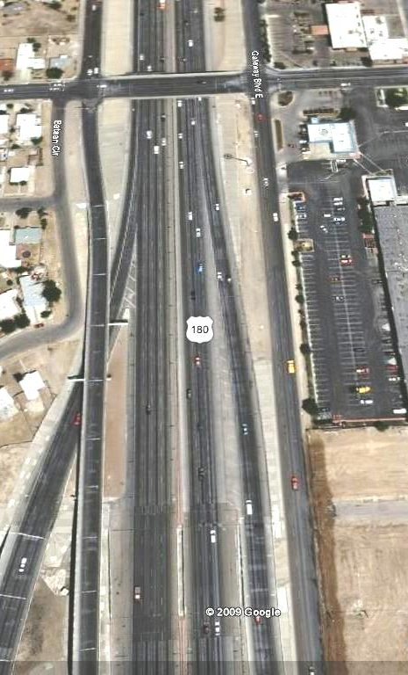
Examples
North
Raynolds
I-10 – US 54 interchange, El Paso
Eastbound entrance from US 54
Notes:
(This slide was not covered in the pilot due to time constraints.)
Additional lane continues, becoming an auxiliary lane.

Slide 13
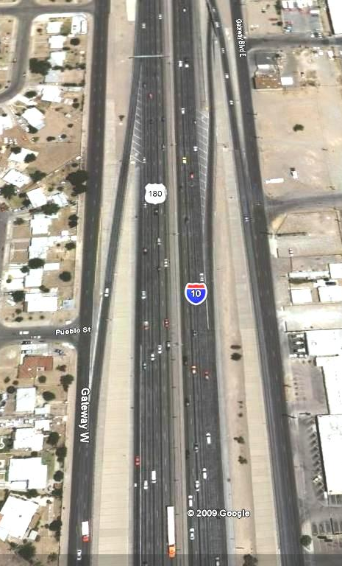
Examples
I-10 – US 54 interchange, El Paso
Exit to Paisano
North
Notes:
(This slide was not covered in the pilot due to time constraints.)
Auxiliary lane ends at exit ramp (lane drop).

Slide 14
Examples
I-10 – US 54 interchange, El Paso
Cost - $530,000
Benefits - $1.3 million annually
  Delay reduction
  Decreased injury crashes
Notes:
(This slide was not covered in the pilot due to time constraints.)
Minor improvement cost only $530K. Travel time and crash reduction benefits about $1.3M annually.

Slide 15
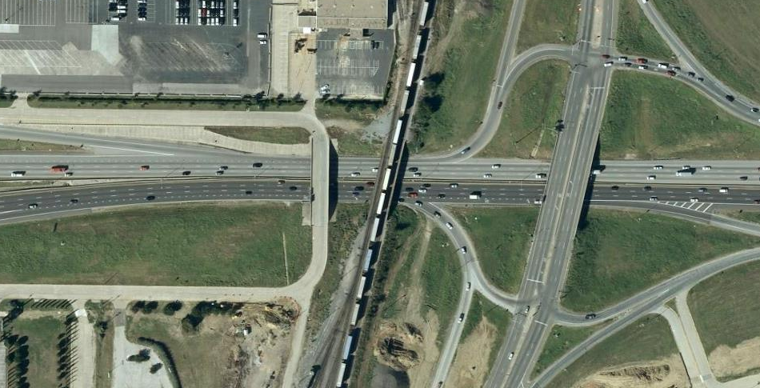
Examples
SH 360, Arlington
Congestion in short weave between Abrams on ramp and Division exit ramp
Lane drop at Division exit
Second exit ramp to Randol Mill
SH 360
Abrams on-ramp
Randol Mill exit ramp
Division exit ramp
North
Notes:
Next example: freeway weaving-related congestion on SH 360 in Arlington
Conditions as explained on slide

Slide 16
Examples
SH 360, Arlington
Deficiency
Congestion in short weave between Abrams on ramp and Division exit ramp
Lane drop at Division exit
Second exit ramp to Randol Mill
Solution
Extend auxiliary lane to Randol Mill exit
Notes:
Description of problems and solution.

Slide 17
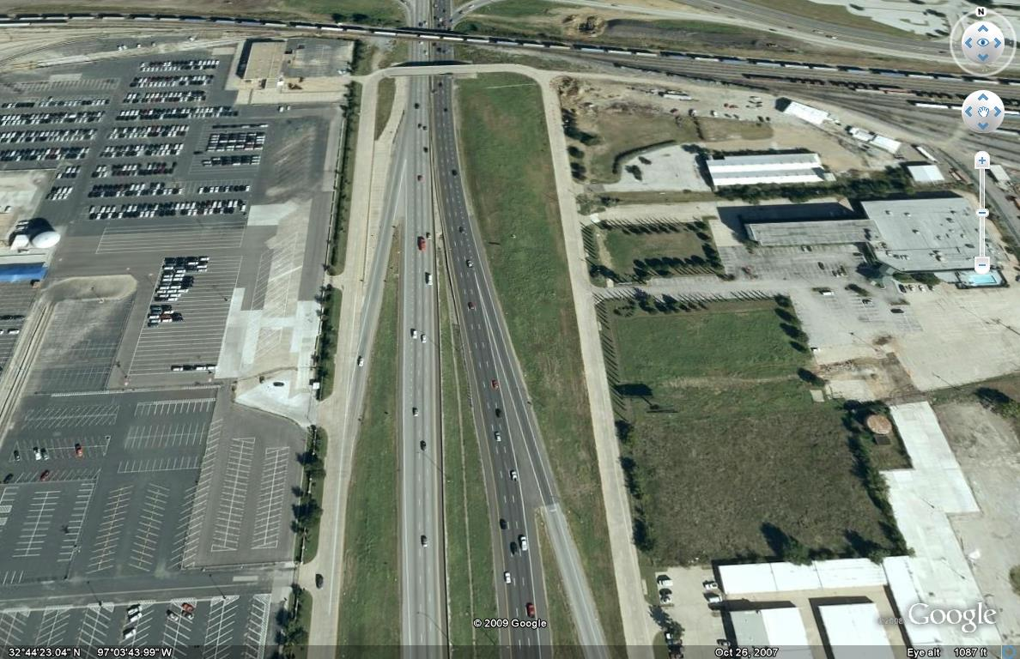
Examples
SH 360, Arlington
(after)
Abrams entrance ramp
SH 360
North
Notes:
Aerial photos of freeway after improvement

Slide 18
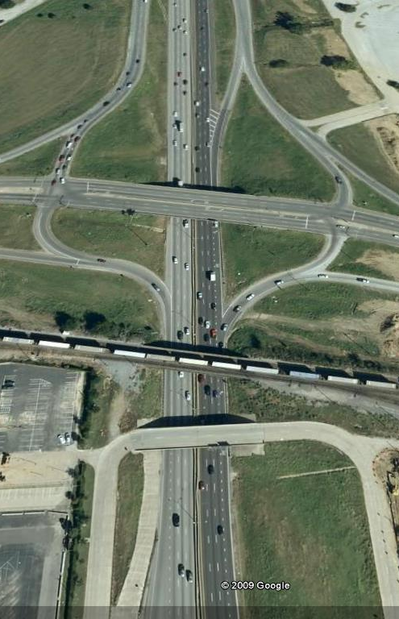
Examples
SH 360, Arlington
(after)
Randol Mill exit ramp
Abrams exit ramp
North
SH 360
Notes:
Auxiliary lane added as shown in yellow.

Slide 19
Examples
SH 360, Arlington
Cost - $150,000 (contract change)
Benefits
  $200,000 annual delay reduction
  76% fewer injury crashes
Notes:
Change order added to contract for unrelated work ongoing at time. Cost only $150K , but resulted in annual travel time and crash reduction benefits of $200k.

Slide 20
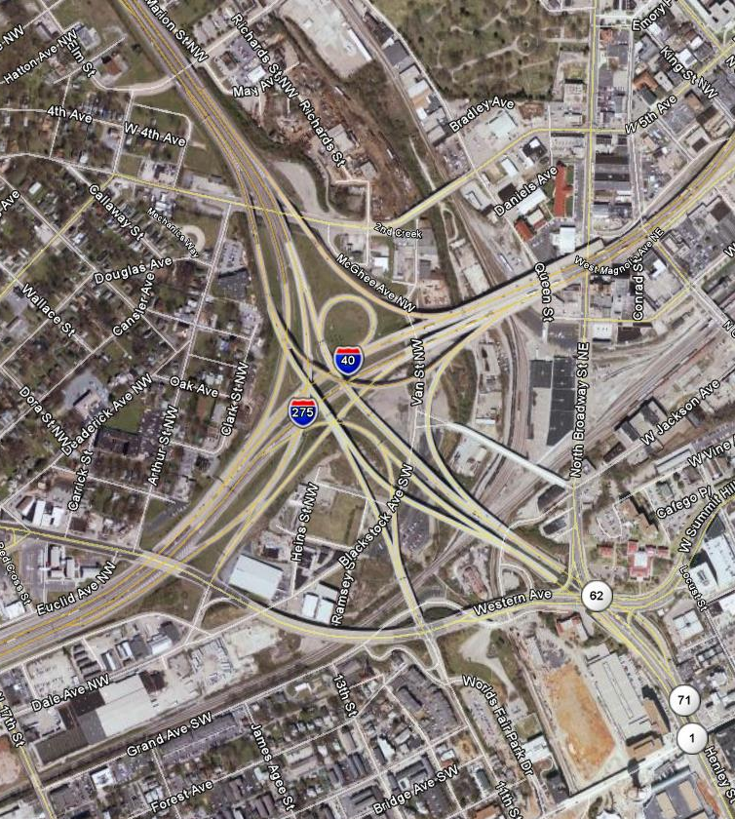
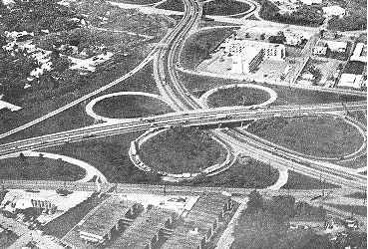
Examples
I-40 – I-275 Interchange, Knoxville, TN
Notes:
Third example – bigger improvement: Former “Malfunction Junction.” State DOT planned to upgrade a 30+ year old system interchange that had originally been built as an urban at-grade highway grade separation. Tentative design was going to retain most existing ramps but add flyovers between north and west legs because designers could not figure out how to maintain traffic during construction if existing ramps were to be replaced.
City took a broader look at interchange and area access needs and determined retention of most existing ramps would not suffice. City proposed interchange similar to one at right together with a traffic maintenance plan. State DOT agreed and built interchange to meet the longer range needs.

Slide 21
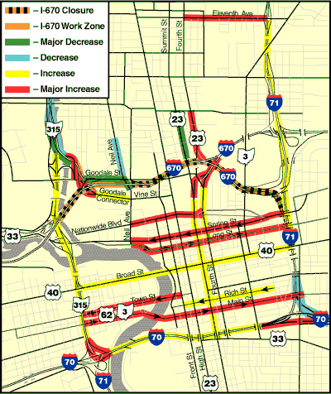
Examples
I-670 reconstruction, Columbus, OH
Traffic changes
Notes:
Traffic detour/diversion plan to facilitate major reconstruction - Full closure of sections of I-670 for reconstruction made possible by using network of well connected street system.

Slide 22
Internet Sources
FHWA freeway management website
  http://ops.fhwa.dot.gov/freewaymgmt/index.htm
FHWA arterial management website
  http://ops.fhwa.dot.gov/arterial_mgmt/index.htm
FHWA incident management website
  http://www.ite.org/M&O/resources.asp
ITE management and operations website
  http://www.ite.org/M&O/resources.asp
FHWA travel demand management website
  http://ops.fhwa.dot.gov/tdm/
FHWA real time traveler information website
  http://ops.fhwa.dot.gov/travelinfo/index.htm
FHWA work zone mobility and safety program website
  http://ops.fhwa.dot.gov/travelinfo/index.htm
FHWA emergency transportation operations website
  http://ops.fhwa.dot.gov/eto_tim_pse/index.htm
FHWA operations performance measurement website
  http://ops.fhwa.dot.gov/perf_measurement/index.htm
Notes:
Sources for more information to help preserve and enhance operational functionality

Slide 23
Preserving and Recapturing Operational Functionality
Questions?
Exercise
Notes:
Questions and discussion

Slide 24
EXERCISE
Notes:
Exercise to help participants practice and apply concepts discussed up to now.
Participants should be split into groups of ideally 2-4 people; larger groups will get bogged down (too many groups will take too much time to report back).
Challenge is described on next slides. Hand out the exercise if it is not already inserted in the workshop binder.

Slide 25
Develop A Functionality Preservation Strategy
Recommend strategy to preserve the functionality of this highway for at least the next 50 years.
  Short term: 0-5 years
  Medium term: 5-20 years
  Long term: 20-50 years
Details on handout
Notes:
For the existing east-west highway shown on the attachment, recommend a short, medium, and long range strategy to preserve the functionality of the highway for the next 50 years and beyond. (cont. next slide)

Slide 26
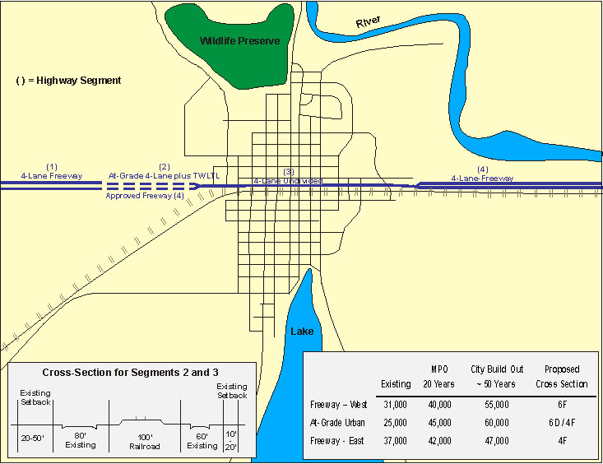
Develop A Functionality Preservation Strategy
Notes:
You will see that the highway segment shown has four different cross-sections:
Segment 1 (westernmost): 4 lane freeway
Segment 2: at-grade 4 lanes plus TWLTL; the DOT has approved an upgrade to a 4-lane freeway when needed
Segment 3: at-grade 4 lanes TWLTL
Segment 4: 4 lane freeway
The cross-section for segments 2 and 3 are as shown on the cross-section on the map sheet of the attachment.
Your assignment is to create a strategy to preserve as well as you can and enhance as needed the highway’s functionality. Consider three periods:
Short-term – 0-5 years
Medium term – 5-20 years
Long term – 20-50 years
Notice that both 20 and 50 year traffic projections have been provided on the attachment. So have ultimate cross-sections that have been proposed by the city and/or MPO.
Please use the “Strategy Sheet” to show your strategy. (cont. next slide)

Slide 27
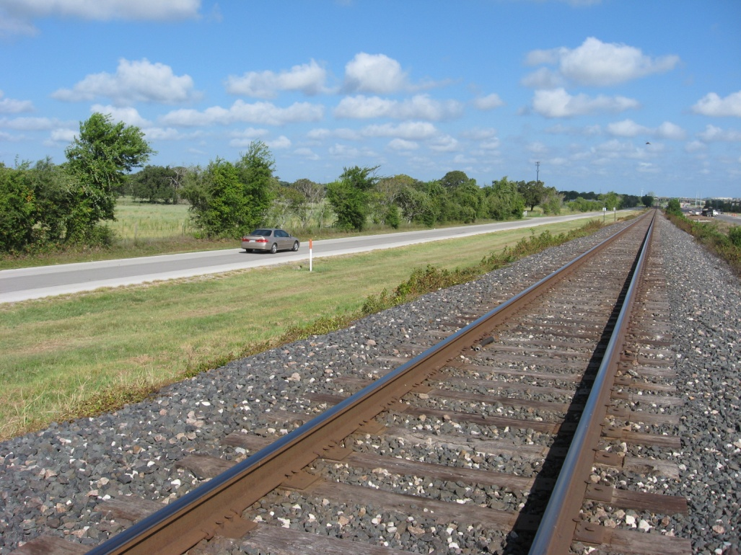
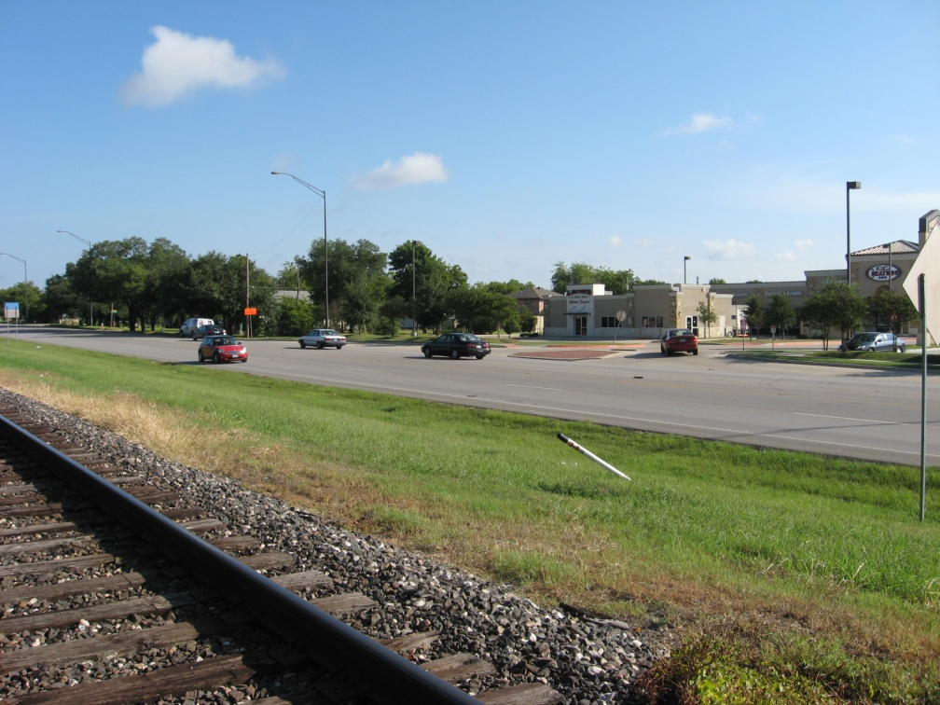
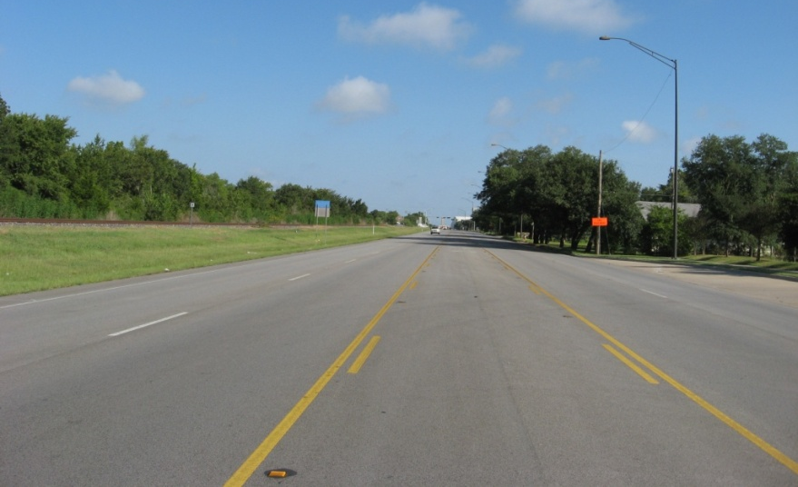
Develop A Functionality Preservation Strategy
Looking west with highway on right and local street on left of rail line
Existing state highway
Notes:
Photos: Existing Segment 3 – state highway on north side of rail track is at-grade 4 lanes with TWLTL; local street on south side of track has two lanes

Slide 28
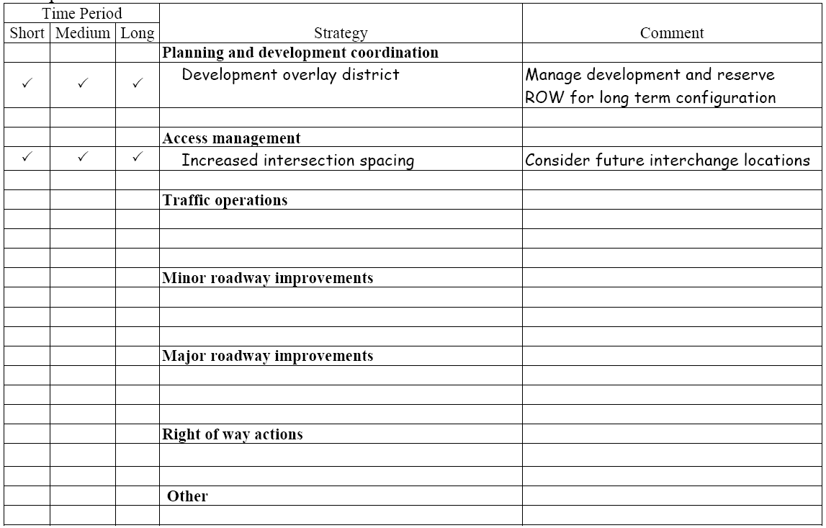
Develop A Functionality Preservation Strategy
Example
Notes:
Here is an example of what a couple of strategies could look like when entered. Your corresponding handout sheet provides more room to write. It is organized into the same categories as shown here.
Once you decide on a preservation or enhancement strategy, write a brief description in the “strategy column.”
Decide which period(s) the strategy should be implemented and check the applicable boxes in the first three columns.
Enter any clarifying or supplemental comments in the right column.

Slide 29
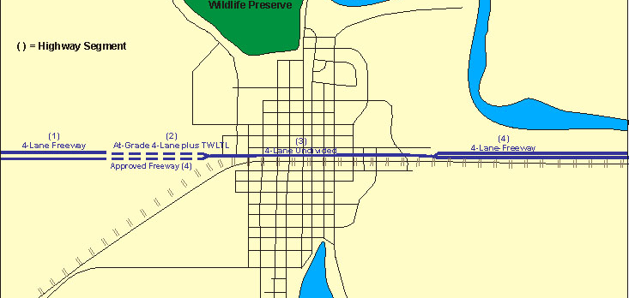
Develop A Functionality Preservation Strategy
Group reports and discussion
3 minutes: your team’s recommendations
Discussion after last report
Notes:
Ask each group to report its recommendations in no more than 3 minutes each.
After last group, ask participants for reactions to the recommendations made. If a stimulus is needed to get discussion moving, select a strategy recommended by only one group and ask other groups why they did not make such a recommendation. Another possibility is to ask the participants to help rank the recommendations in order of priority.

Slide 30
Break
Notes:
Afternoon break. Scheduled for 15 minutes.

Slide 31
MODULE 3
Right of Way and Functionality
Notes:
In previous modules covered functionality as it relates to Planning and Land Development and Traffic Operations.
This third module addresses how right-of-way and utilities can impact highway functionality.

Slide 32
Factors Affecting ROW Functionality
Acquisition
Protection
Utility Accommodation
Notes:
Highways are built and improved on highway right of way. Effectively acquiring, preserving, and protecting the right of way is critical for maintaining the functionality of the state highway system.
Right-of-way acquisition, right-of-way protection/preservation and accommodating utilities are three important areas that affect functionality.

Slide 33
Right-of-Way Acquisition
Notes:
Right-of-way acquisition is a critical stage is TxDOT’s project development process. It can have major implications to preserving or enhancing highway functionality.

Slide 34
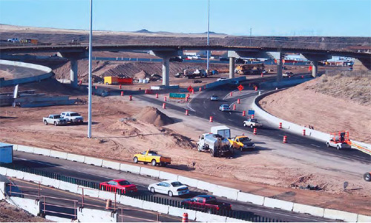
Right-of-Way Acquisition
ROW planning and acquisition are critical to:
  Functionality
  Project development
Planning affects function and acquisition
Acquisition can be:
  Time consuming
  Socially sensitive
Notes:
ROW planning and acquisition are critical to functionality and project development because they can be time consuming, socially sensitive, and the source of increased project costs and delays.
Delays in projects results in longer periods of time for congestion. Increased project costs could also impact project design and the inability to properly address all needed improvements.

Slide 35
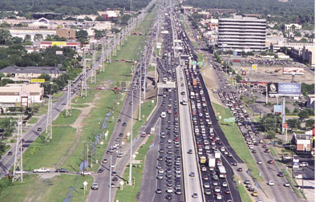
Potential Functionality Loss
Right-of-way acquisition delays
  Construction delays
  Increased right-of-way cost
Insufficient right of way
  Insufficient for desired improvement
  Cannot accommodate utilities or other features
Resulting functionality shortfalls
  Congestion
  Safety
  Other project objectives
Notes:
This slide shows the functionality losses in relation to ROW acquisition delays and insufficient ROW and the resulting functionality shortfalls.
Five major factors driving ROW acquisition durations:
The processes to be followed
Total number of parcels
Location type
District ROW staff size
District Annual ROW budget

Slide 36
ROW Best Practices or Countermeasures
Right-of-way plan
  Provide adequate ROW for ultimate needs
  Consider alignment that shifts ROW to parcels with willing sellers
  Avoid ROW alignments causing environmental impacts
Notes:
One best practice to help prevent ROW from negatively impacting functionality is to develop a right-of-way plan that not only addresses the current improvement, but also accommodates ultimate design and needs for facility. It should not just rely on a 20-year traffic forecast.
Develop a multi-disciplinary and multi-jurisdictional partnered approach that brings engineering, transportation planning, and land use decision-making together to develop ultimate roadway design and right-of-way needs

Slide 37
ROW Best Practices or Countermeasures
Improve acquisition methods
  Obtain more ROW through local planning/platting process
  Use land consolidation strategies to reduce number of parcels to be acquired
  One-agent concept: use same agent in area to ensure consistency, efficiency, and accountability
  Coordinate and communicate early and frequently
    With property owners
    Between ROW staff
    With other agencies
Notes:
This slide shows four best practice methods to improve ROW acquisition. An important component required in them all is good coordination with local agencies and property owners.
Regarding land consolidation strategies, one example would be to develop programs to consolidate parcels into larger tracts on a voluntary basis. Some European countries have successfully used land consolidation strategies to pool individual and fragmented parcels into more contiguous tracts to simplify right-of-way acquisition.
Florida uses a one agent concept where the same agent handles the acquisition, relocation, property management, and clearing of the improvements for construction. This practice helps to ensure information, process, and policy consistency so that right-of-way acquisition can be carried out more effectively.

Slide 38
Sample Performance Measures ROW Acquisition
  Average parcel acquisition duration
  Overall duration of ROW acquisition
  Parcel condemnation rate
  Percent of parcels acquired within a specified period
  ROW costs saved for land dedicated or donated
  Number or percent of parcels acquired by early acquisition
  Percent of highway miles with inadequate ROW for desired improvements
Notes:
This slide was included in the pilot, but it is recommended that it be removed due to time constraints.

Slide 39
Right-of-Way Protection
Notes:
The next subsection in the area of ROW is ROW Protection
Inadequate or non-existing policies or practices in various activities impacting ROW protection can result in loss to highway functionality

Slide 40
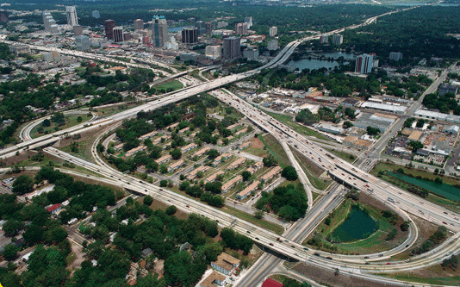
Right-of-Way Protection
Important for future new and improved facilities
General topics for ROW protection
  Early or advance acquisition
  Coordination in local planning and development
  Roadside management
Interstate 4 at SR 408, Orlando, Florida
Notes:
This slide sets forth three general topics for ROW protection.
Early/advanced acquisition refers to acquisition of ROW in advance of full NEPA environmental clearance. TxDOT’s ROW Manual allows for four such methods: hardship buys, protective purchases, donations, and options to purchase. The use of these methods is limited to parcel by parcel protection. They can not be used on a project-wide scale.
Roadside management activities include precluding ROW encroachments such as unauthorized structures, vehicles, or vendors. TxDOT does not permit encroachment into state ROW. It also includes regulating outdoor advertisements along state ROW through the Texas Administrative Code and TxDOT’s ROW Manual.
It includes Interstate 4 at SR 408 in Florida as an example.

Slide 41
Early Acquisition and Protection
Method | TxDOT Authority | Local Authority | Purchase/ Possession | Obtain Rights
Acquisition
Fee simple/negotiated purchase | ● | ● | ●
Condemnation | ● | ● | ●
Early acquisition – hardship purchase | ● | ● | ●
Early acquisition – protective purchase | ○ | ● | ●
Early acquisition – donations | ◉ | ● | ●
Dedication through platting |  | ● | ●
Preservation | ●
Option to purchase | ◉ | ● |  | ●
Right of first refusal | ● | ● |  | ●
Reservation through platting |  | ● |  | ●
Purchase development rights | ● | ● |  | ●
Development agreement | ● | ● |  | ●
○ - More limited than local authority in some cases.  - More limited but also requires Commission approval.
Notes:
This slide shows an overview of early ROW acquisition and preservation methods available by TxDOT and local authority.
The use of an early acquisition strategy involving the full use of allowable methods could be used by TxDOT to acquire and protect critical parcels identified early in TxDOT’s project development process. TxDOT’s ROW Manual includes provisions for the three following methods of early acquisition.
hardship acquisition – an acquisition undertaken at the owner’s written request to alleviate the hardship of the inability to sell his/her property. This method allows TxDOT to relieve a distressed property owner when a property cannot be sold on the private market due to public knowledge of a pending highway project.
protective buying – an advanced method commonly used to prevent imminent development or increased cost.
donation – a voluntary donation of property to TxDOT (or its local partner) typically done by the owner due to some economic benefit such as an exit ramp or an overpass.
In addition to these techniques, TxDOT may also use the advance acquisition option as permitted in the Texas Transportation Code Section 202.111 through 202.114 to acquire property in advance. An advance acquisition, or options to purchase, is a contract to buy the right to purchase property. To do this, TxDOT pays the property owner a fee, and the owner takes the property off of the market for a specified term.
Other methods are also available through partnerships with local agencies.
Reference 0-5606 report and separate available workshop regarding ROW acquisition and protection methods.
All these methods are available; some can only be used by local agencies; some are only available on a parcel-by-parcel basis; some can only be used under limited circumstances.
Chart shows value and need to approach ROW acquisition and preservation in a cooperative partnership with local agencies.

Slide 42
Protection via Coordination with Local Agencies
TxDOT authority ends at the ROW line
Activities most requiring coordination:
  Subdivision
  Zoning
  Site plan review
  Short /long-range planning
  Roadway design plans and schematics (during project development)
  Corridor/access management planning
  Local major thoroughfare design standards and policies
Notes:
Since TxDOT’s authority ends at the right of way line, partnerships with local jurisdictions are important to ensure that the impact on TxDOT right of way and infrastructure are considered in local development decisions.
The principal activities that TxDOT and local agencies most frequently need to coordinate are:
the local subdivision, site review, and development processes;
short- and long-range planning (through MPO, regional, and local planning; continually through coordination and involvement in municipal and county land use and thoroughfare planning);
TxDOT roadway design plans and schematics (as part of project development); and
Local and MPO corridor/access management planning activities.
TxDOT should also coordinate with local jurisdictions on their major thoroughfare design standards and policies as these may be applied in the local development process as a means of acquiring or preserving right of way along a TxDOT facility. Since local thoroughfare plans commonly include state roads—cities and in some cases, counties—can require that right of way be dedicated (or reserved) for TxDOT facilities when abutting properties are platted or subdivided if:
additional right of way is needed in order to gain compliance with an adopted municipal or county thoroughfare plan; or
the amount of right of way dedication is roughly proportional to the impact of the development.
Right of way dedication and reservation through local platting is a good tool for protecting and acquiring right of way along existing TxDOT facilities. It is common practice by most cities in Texas to require right of way dedication and/or reservation of right of way along state facilities as part of their platting process.

Slide 43
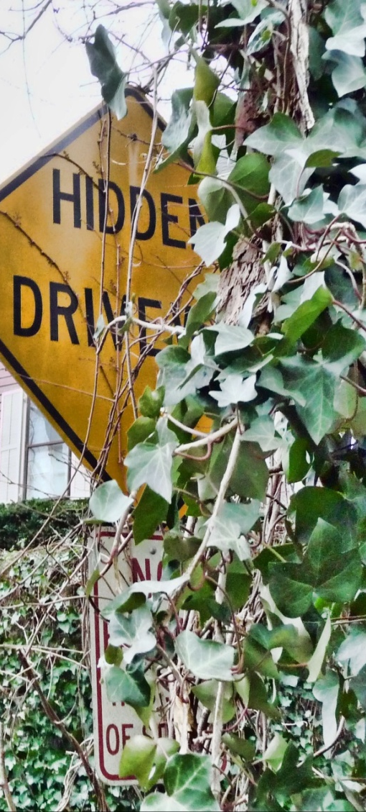
Protection via Roadside Management
ROW encroachment prevention
  Encroachment identification
    Development review, permits, monitoring, maintenance
  Policies and regulations for roadside encroachment management
Outdoor advertisement management
  ROW Manual Vol.7 - Beautification
  Local billboard ordinances
Notes:
Encroachment on highway right of way may by unauthorized structures or vehicles and by roadside vendors cause damage to the infrastructure and create unsafe conditions to roadway users.
Examples of roadside encroachment are:
Vegetation grows in ROW
Vegetation from off-ROW plants extends into ROW
Signs built or placed partly or wholly in ROW
Buildings, parking lots, driveways built partially or wholly in ROW
Private drainage facilities extending into ROW
unauthorized private runoff, traffic or other operation across ROW
TxDOT generally does not allow right-of-way encroachment, unless proper authorization is obtained . Encroachments within state right-of-way property lines are identified during right-of-way survey and are subject to disposition . TxDOT also initiated efforts to control right-of-way encroachment caused by grasses and trees that impairs sight distance and result in road deterioration .
Outdoor advertisement along state right of way is primarily regulated through the Texas Administrative Code (TAC) and the Right-of-Way Manual. TxDOT has developed outdoor advertisement licensing and permitting processes to manage outdoor advertisement signs. In addition, it is in the midst of a major initiative to privatize aspects of its outdoor advertising control program . For example, TxDOT had funded the research project 0-4609 (Options for Outsourcing Outdoor Advertising Control in Texas) to explore feasible strategies for outsourcing outdoor advertising.
Cities in Texas can assist TxDOT in managing and controlling outdoor advertising through local ordinances that regulate the amount, size and placement of signs and billboard along TxDOT right of way.
Development and outdoor advertising activities along roadways and right-of-way encroachments may affect traffic operations, safety, and asset value, and can cause functionality loss over time

Slide 44
Potential ROW-Related Functionality Loss
ROW factors causing functionality loss
  Lack of coordination with local planning
  Insufficient ROW requirements for major local thoroughfares
  Lack of ROW reservation
  Delay in ROW acquisition
  Limitations on early acquisition
  Failure to protect existing corridors
Forms of functionality loss
  Delayed construction/improvements
  Inability to implement planned improvements
  Deterioration in mobility and safety
Notes:
This slide lists ROW-related factors that cause functionality loss and in what form the functionality loss can occur.
Lack of coordination and involvement with local jurisdictions in local planning, subdivision plats, and site development plans result in local decisions being made that have detrimental impacts on TxDOT right of way.
Insufficient minimum right-of-way requirements for major local thoroughfares that prevent opportunities for right-of-way dedication or reservations along TxDOT roadways as part of the local platting process.
The inability to begin right-of-way acquisition earlier in the project development process. This delay, perhaps several years, results in paying higher costs for right of way and reduces funds that can be used on measures to improve functionality.
Restrictions on the use of advanced acquisition methods and the increases resources and advanced level of experience needed to undertake them.
Poor roadside vegetation cause infrastructural deterioration and environment impact in the right of way and abutting areas. For example, improper vegetation management causes vegetation encroachment to pavements and shoulders causing increased pavement deterioration and traffic safety problems. Invasive vegetation species brought in right of way may cause significant damages to sensitive native species and change the local environment.
Improperly installed outdoor advertising signs can reduce sight distances of motorists and cause safety concerns.
Failure in protecting existing transportation corridors limits expansions and enhancements of highways to improve functionality and mobility. Acquiring lands with costly developments may require significant financial and enforcement efforts.

Slide 45
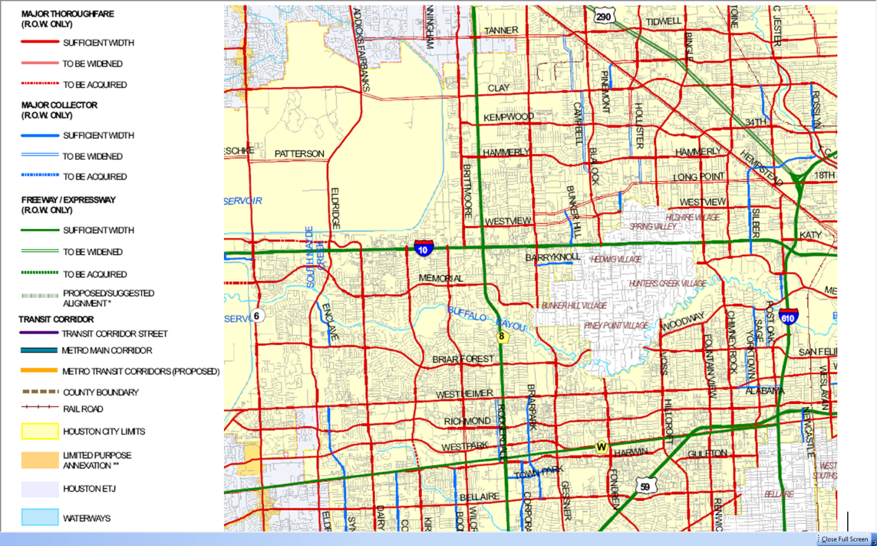
Best Practices or Countermeasures
Local agency coordination
  Use multi-jurisdictional partnering to preserve, protect, or acquire ROW for long-term facility needs
Early acquisition methods
  Seek funds and authority for use in protective ROW purchases
  Seek donations
ROW protection via local thoroughfare plans and authority
  Protect needed ROW via in local planning/platting process
  Incorporate TxDOT (or other agreed) ROW and/or design requirements into local development regulations
Notes:
This slide lists best practices and countermeasures to protect ROW. It is a recap of methods/practices discussed in previous slides in this section.

Slide 46
Best Practices or Countermeasures
ROW protection and roadside management
  Utilize computer technology such as GIS, database, and Internet to facilitate outdoor advertising permitting and management
  Pursue the use and enforcement of local building and parking setbacks and sign ordinances to prevent encroachment in TxDOT ROW
Notes:
This slide lists best practices and countermeasures to protect ROW. It is a recap of methods/practices discussed in previous slides in this section.

Slide 47
Selected Performance Measures
Extent of pavement or shoulder cracks caused by vegetation encroachment
Number of noncompliant outdoor advertising signs
Percent of all plats and development proposals adjacent TxDOT facilities that are reviewed by TxDOT and coordinated with local agencies
ROW acquisition unit cost
Notes:
This slide was included in the pilot, but it is recommended that it be removed due to time constraints.

Slide 48
Utility Accommodation
Notes:
The final subsection in the area of ROW is Utility Accommodation. Protection

Slide 49
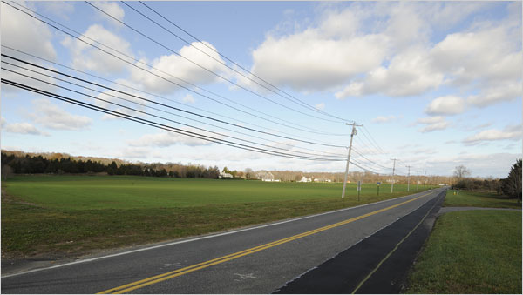
Utility Accommodation and Relocation
Utility accommodation and relocation are major concerns for highway engineers
  Joint use of ROW is in public interest and can avoid additional cost for exclusive utility ROW
  Utility facilities are not owned or controlled by highway agencies
  Joint use requires extensive collaboration
Notes:
This slide speaks to why accommodating and planning for utilities in or adjacent to ROW is important.
Coordinating with public and franchise utilities will help to avoid utility-related project delays.
Public utilities could include water, sewer, and electric lines. Private or franchise utilities could include telephone, cable, and natural gas lines.

Slide 50
Preparing For Utility Coordination
Assess highway and utility needs early in project development
Identify alignments that minimize conflict
  Ultimate
  Design life
If adjustments needed, do it just once
Critical steps in the utility adjustment process:
  Identify utility facilities and their ownership
  Determine utility conflicts
  Develop utility plans
  Obtain, review, and approve agreements
  Relocate utilities
Notes:
Keys to preparing for utilities are to assess their needs early in project planning and development and to identify alignments that minimize their conflict with existing or anticipated utility infrastructure.
Discuss the critical steps in the final bullet point and ask the participants to discuss challenges or experiences in accommodating utilities in local projects.
Interstate with Federal Funds in Right of Way
Transportation Code, §203.092, provides that the adjustment of any utility facilities necessitated by the improvement of any highway on the interstate highway system will be made by the utility at the expense of TxDOT, provided such adjustment is eligible for Federal participation. The intent of this article is to relieve utility owners of the financial burden of adjustments necessitated by improvements to interstate highways. The Federal Utility Procedure (FUP) flowchart in PDF format, showing steps of this procedure, is available.
Characteristics
TxDOT is directly responsible for all utility adjustments and payments.
Utility adjustments are eligible for reimbursement at any location, regardless of prior property rights held.
Benefits
TxDOT maintains full control.
Utility adjustments and payments are accomplished in a timely manner.
State Utility Procedure
Under the State Utility Procedure (SUP), TxDOT assumes a right of way acquisition function that may include eligible utility adjustments. Use of the State Procedure allows the LPA to escrow its estimated contribution percentage up front, and relieves the LPA of the burden or duty of acquiring the necessary right of way. A(flowchart in PDF format, showing steps of this procedure, is available.
Eligibility is based on compensable property interests held by the utility. TxDOT cost participation is based on totally or partially eligible adjustments.
The LPA coordinator will request an estimate of utility costs in order for the LPA to be able to escrow their percentage of the costs.
The primary advantage of the State procedure is that the LPA is relieved of the burden of right of way acquisition and utility adjustment. This procedure also allows the LPA to escrow its cost contribution up front with no future reimbursement.
The LPA should thoughtfully consider these options before executing a right of way contractual agreement on any project.

Slide 51

TxDOT-Utility Cooperative Management Process
Major activities:
  Preliminary information: annual meetings
  Project specific information: initial project notification, preliminary design meetings, and field verification
  Design and utility construction phase: design conference, intermediate design meetings, final design and initial construction coordination meeting, and pre-letting utility meeting
  Construction phase: utility meeting after award and utility coordination meeting during project construction
Notes:
To enable efficient accommodation of utilities and minimize delays both before letting and during the construction phase, TxDOT uses the Utility Cooperative Management Process (UCMP), a partnership between TxDOT, LPAs when applicable, and the utility industry. The process encourages the inclusion of the utility accommodation considerations in project planning, right of way, design, and construction functions at the district level. Through the process, TxDOT also promotes early involvement of and sufficient coordination with utility owners during the project development process.

Slide 52
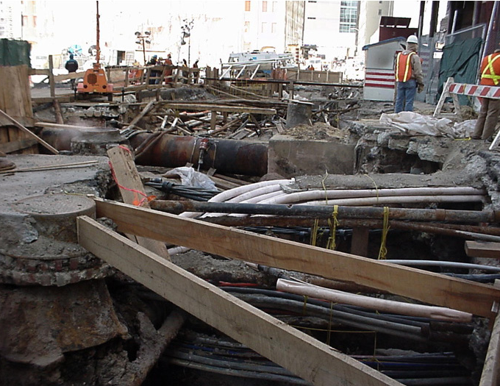
Potential Functionality Loss
Factors leading to utility-related project delays:
  Failure of utility conflict identification
  Late project notification to utility owners
  Limited staffing and fiscal resources
  Unresponsive or uncooperative utility owners
  Lengthy process to obtain required agreements for reimbursable utility relocations
Forms of functionality loss
  Increased construction costs
  Delayed construction/improvements
  Deterioration in mobility and safety
Notes:
This slide lists utility-related factors that cause functionality loss and in what form the functionality loss can occur. Go over the factors and ask if any of these have been experience in their area. If so, discuss.

Slide 53
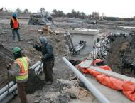
Best Practices or Countermeasures
Utility coordination
  Involve utilities early and frequently
  Maintain good working relationships with utilities
Utility relocation
  Avoid relocating utilities where possible
Utility conflict detection and management
  Detect utility conflicts early and accurately
  Use advanced utility conflict management systems to effectively inventory and track utility conflicts
Notes:
Utility Coordination:
Well established coordination with utility owners is important
supporting utility accommodation and relocation and helps to avoid
utility-related project delays.
Involve public utility companies and franchises early to ensure for adequate involvement. This may include involving utilities during the project planning and programming stage, effectively and frequently coordinating with utilities throughout PDP, and establishing fast and efficient channels for utility information acquiring.
Develop good working relationships with utilities to reduce communication hurdles and improve the willingness of utilities for early and frequent involvements
Utility relocation:
Avoiding unnecessary utility relocations can help save time and project cost.
Avoid need for utility relocation through mechanisms such as minor modifications to highway designs.
Use automated utility installation permitting process such as the Utility Installation Review (UIR) system developed by TxDOT that has been used in several districts.

Slide 54
Best Practices or Countermeasures
Utility Accommodation
  Consider protecting certain urban arterial highways from new utility installations
  Consider innovative utility accommodation practices such as utility corridors or joint
  Acquire ROW for utility accommodation
Notes:
Utility Accommodation.
Consider protecting certain urban arterial highways from new utility installations to improve safety and operations, mitigate the competition for ROW, reduce work zones.
Consider innovative utility accommodation practices such as utility corridors or joint trenching to simplify accommodation and ease congestion caused by utilities
Acquire ROW for utilities to simplify the utility accommodation and reduce utility-related interruptions to roadway construction and operations
Utility accommodation restriction for roadway protection
Restricting certain utilities in congested right-of-way or use innovative strategies for utility accommodation simplify utility accommodation and ease right-of-way congestion caused by utilities.
Consider protecting certain urban arterial highways from new utility installations to improve safety and operations of existing highways, mitigate the competition from utility facilities for right-of-way needed for highway enhancement or expansion, and reduce maintenance activities and work zones.
Consider innovative utility accommodation practices such as utility corridors or joint trenching to simplify utility accommodation and ease right-of-way congestion caused by utilities.
Acquire right-of-way for utility accommodation to simplify the utility accommodation process and reduce utility-related interruptions to roadway construction and operations.

Slide 55
Performance Measures
Number or length of utility relocations per mile or per project
Utility conflict points per mile
Percent of project budget for utility relocation
Utility relocation cost per project mile
Length of project duration for utility relocations, and
Percent of utility-delayed projects
Notes:
This slide was included in the pilot, but it is recommended that it be
removed due to time constraints.

Slide 56
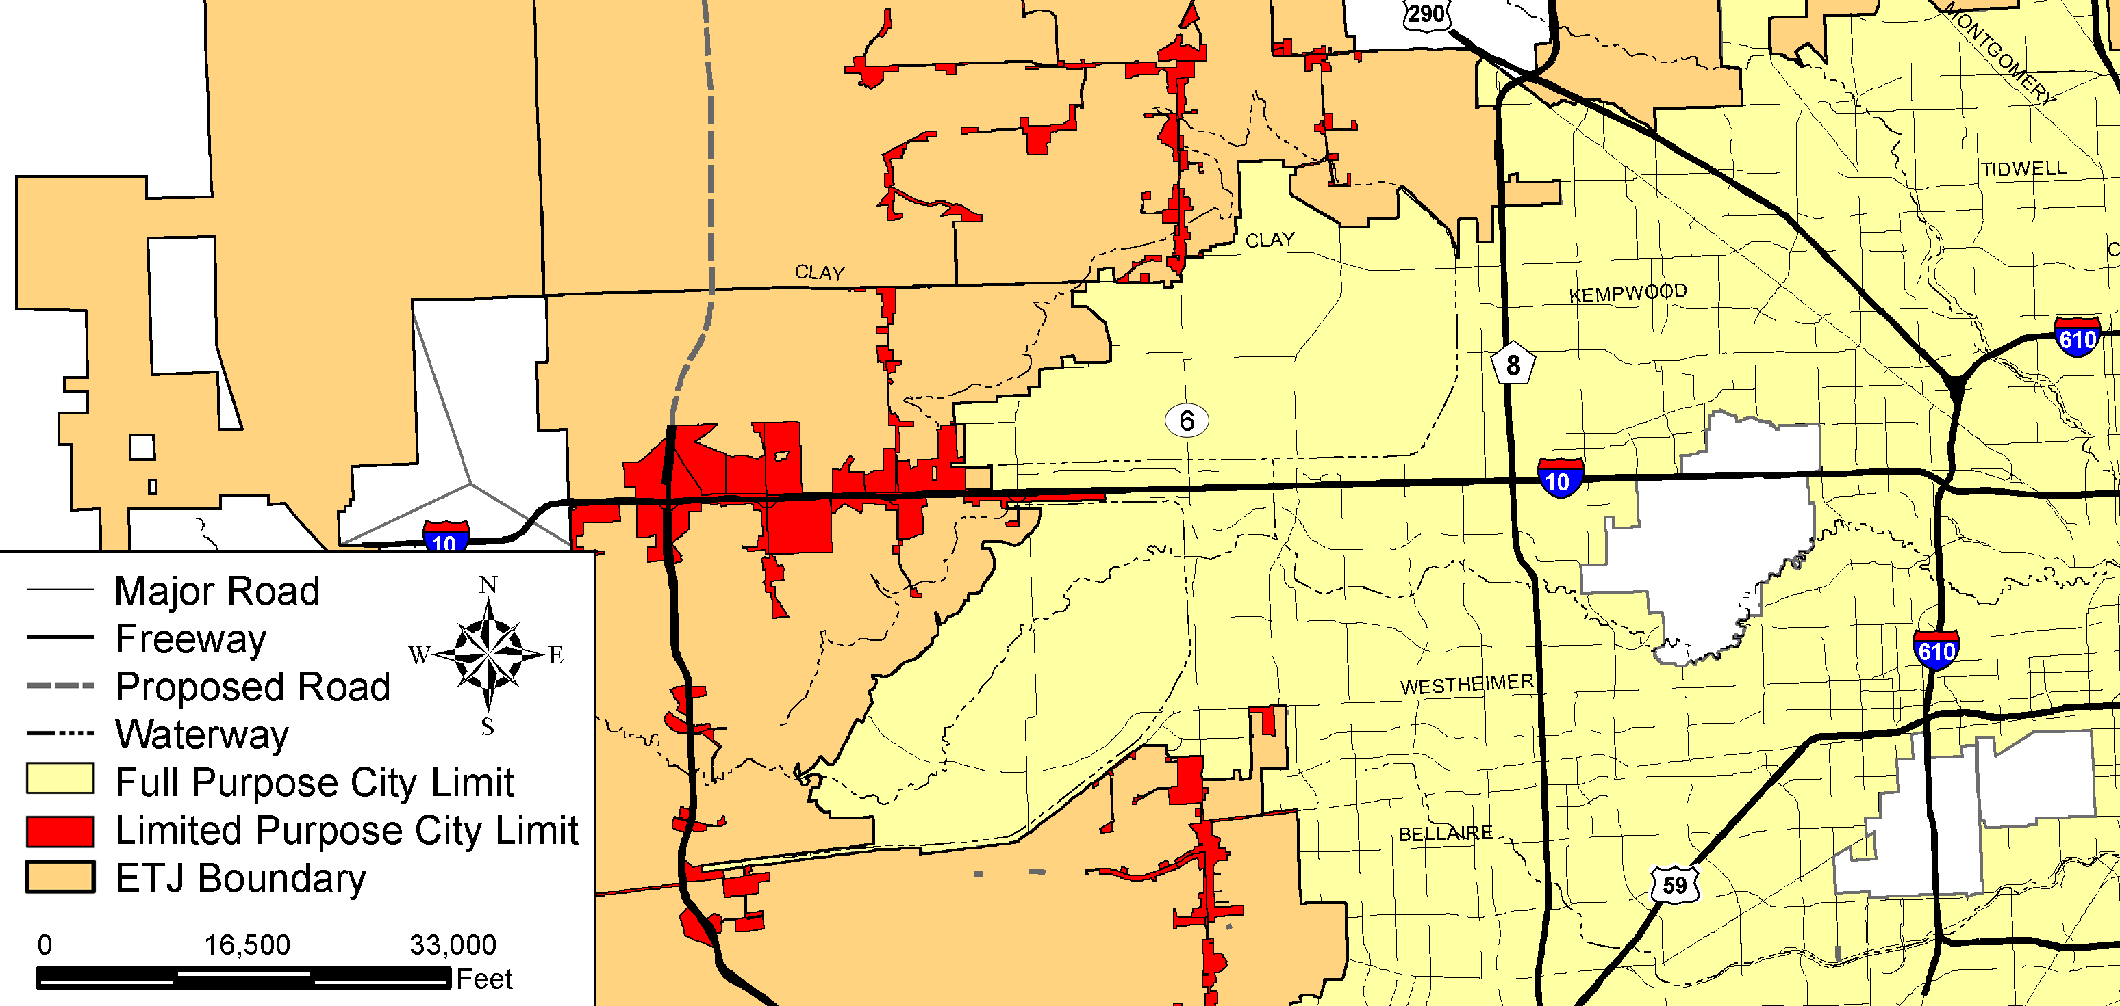
Functionality Case Study:
IH-10 Katy Freeway, Houston TX
Source: City of Houston
Limits: Between SH 6 and Loop 610
Length: 11.5 miles
Notes:
Like the SH 105 case study covered this morning, we now have case study of the IH 10 Katy Freeway in west Houston.
This case study examines the complex evolution and development of Houston’s Katy Freeway to identify how its functionality developed, deteriorated, and enhanced overtime from various aspects including planning, operations, and right of way. To ensure depth, the study was limited to the 11.5-mile Katy Freeway section from west IH 610 west to SH 6.
The entire section is within Houston city limit.
The IH 10 Katy Freeway was the last of the 1960s era major radial freeways in Houston to undergo a comprehensive expansion and rehabilitation. With its latest expansion completed in late 2008, it is now one of the nation’s premier super-freeways with at least four general purpose lanes, two managed lanes, and three frontage road lanes in each direction.

Slide 57
Historic Review
Year | Event
1930s | Originally SH 73 (generally located along the route of today’s IH 10)
1941 | West Houston portion of SH 73 designated as US 90
1953 | US 90 between Katy and Loop 610 designated as full freeway
1954-1968 | US 90 between Katy and Loop 610 upgraded to freeway
1980s | Katy Freeway Transitway between Loop 610 and SH 6
1992 | 100 ft. railroad right of way along Katy Freeway acquired from Union Pacific Railroad
2000s | Katy Freeway reconstruction
Notes:
This slide lists major events and milestones over the past 80 years to help explain how how the IH 10 Katy Freeway has evolved.
The beginnings of the modern Katy Freeway can be traced back to the original SH 73 in the 1930’s that was generally located along the route of today’s IH 10 . In 1941, the west Houston portion of the SH 73 was designated as US 90. The section between the current location of Loop 610 and Katy was later authorized as a full freeway by the Texas Transportation Commission in 1953 and then officially designated as IH 10 in 1959. The corresponding upgrade of the highway section began in 1954 by constructing several interchanges and grade separations at intersecting local roads. In 1968, the IH 10 section between Loop 610 and the City of Katy was fully upgraded to a freeway.

Slide 58
Key Areas Affecting Functionality
Right of way and ROW constraints
Mainlane, frontage, and interchange design
Travel demand/systems management
Planning and development
Coordination and partnerships
Notes:
Many areas have affected the functionality of Houston’s Katy Freeway.
Planning and development in an area with few land use controls have affected functionality along this corridor
Aspects of main lane, frontage, and interchange design have affected functionality.
Right of way and right-of-way constraints have affected facility design and functionality throughout its history and life cycle.
Importantly, state-of-the-practice programs and measures in travel demand management (TDM) involving HOV lanes, mass transit, and tolling have played/will play a role in maintaining functionality on this mega-freeway.

Slide 59
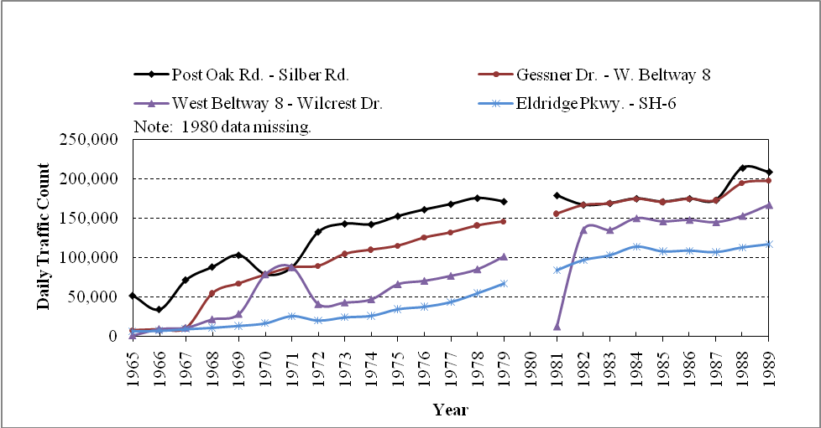
Early Development in West Houston
Notes:
This slide shows the growth in daily traffic volumes at four locations along the Freeway from 1965 through 1989. As shown in the figure, the daily traffic on the highway section dramatically increased from less than 50,000 in the mid 1960s to more than 200,000 in the late 1980s at several locations between Beltway 8 and IH 610, while Katy Freeway remained most of its original lane configuration without substantial improvements.
Starting from the 1970s with the early Houston’s energy boom, the area between SH 6 and Beltway 8 along Katy Freeway quickly developed to the well-known energy corridor by housing a large number of major national and international energy-related companies. Along with the adjacent local residential developments, the corridor generated a significant traffic demand on the Katy Freeway.

Slide 60
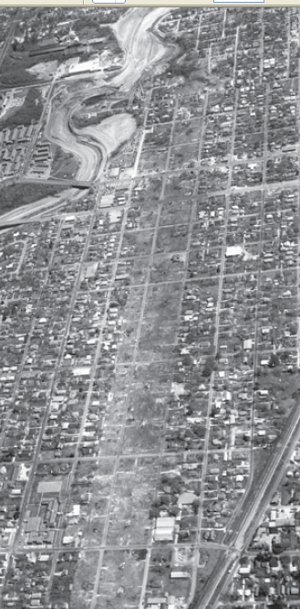
IH-10: Early Planning
Inside vs. Outside Loop 610
Different engineers in charge of planning/design
Disagreed on ultimate ROW needs
Inside – ample ROW acquired, designed for future
Outside – under-designed in existing ROW
  Major constraint, source of delay for future expansion
Notes:
In the early days of planning the Katy Freeway, there were different highway engineers in charge of planning and design for the sections inside and outside of Loop 610 and the two engineers vastly disagreed on what the ultimate right-of-way width of the freeway corridor should be . Outside of Loop 610 west, IH 10 was planned and constructed as a 6-lane freeway with 2-lane frontage roads in order that the facility could fit, where possible, within the available 175-foot right-of-way of US 90. However, IH 10 from inside the Loop to downtown was planned and developed as a significantly larger section with 10 freeway lanes and frontage roads within 300 feet of right of way. While the inner loop section was well designed in the early days to handle traffic far into the future, the outer loop section (the section included in this case study) was under-designed in a narrow right-of-way section that created a major constraint and source of delay for future freeway expansion.

Slide 61
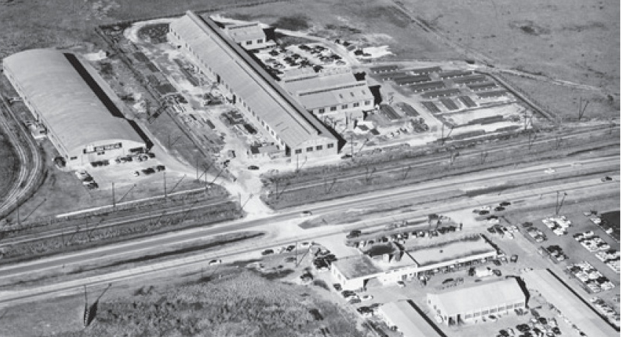
IH-10 West: Early Planning
1954 view of US 90 as a 4-lane divided highway
just west of today’s Loop 610
Notes:
Picture: An early look at U.S. 90 in 1954. The predecessor to the current day I-10 through this area.

Slide 62
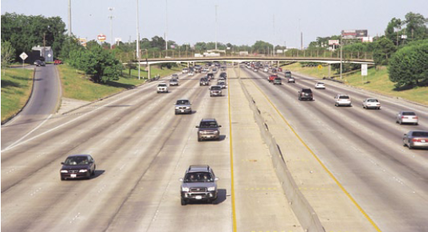
Katy Freeway Upgrade in 1960s
IH-10 outside of Loop 610:
Built on existing ROW
3 main + 2 frontage lanes
ROW limit prevented further improvement
IH-10 inside of Loop 610:
10 main lanes minimum
Currently still in service
Notes:
Upper left pic: The original U.S. 90 was a gradually expanded to six main lanes with a two-lane frontage road on each side during the IH 10 freeway upgrade. The original corridor had a 175-foot right-of-way that was designed according to the early plans. The IH 10 freeway upgrade kept its typical rural settings and was squeezed in a narrow corridor mostly less than 300 ft without considerable right-of-way expansion despite disputes.
The later freeway improvements to accommodate the growing traffic demand were delayed for many years due to much more costly and difficult acquisition of new right-of-way because of adjacent development.
Lower right pic: In contrast, a freeway section with a minimum of 10 general purpose lanes was built for the IH 10 section inside IH 610 during the 1960s, which better accommodated the growing traffic demand along the corridor.

Slide 63
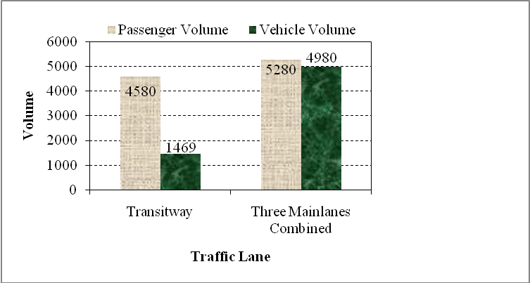
Katy Freeway Transitway (1980s)
SH 6 to IH 610: 15 min. on transitway vs. 45 min. on general lanes
Served 23% of vehicle volume but 46% of passenger volume during morning peak hour
Notes:
To improve mobility in Houston area, TxDOT and the Metropolitan Transit Authority of Harris County (METRO) jointly started the development of a transitway network on five radial freeways in the region, including Katy Freeway, north IH 45, south IH 45, US 290, and south US 59. The Katy Freeway Transitway was built and operated in several phases. Phase 1 added a 4.75-mile transitway on the freeway between IH 610 and Gessner Road, which opened to traffic October 29, 1984. Phases 2 and 3 extended the transitway further west to Beltway 8 (opened to traffic May 2, 1985) then to SH 6 (opened to traffic June 29, 1987), respectively, resulting in a total of about 11.5-mile HOV facility. A later phase extended the transitway eastbound by 1.5 miles from North Post Oak Road to east of IH 610.
The figure shows passenger and vehicle volumes on IH 10 for the morning peak in 1987.
As shown in the figure, the single-lane facility served just 23 percent of the vehicle volume but over 46 percent of the total passenger volume on the roadway during the morning peak hour (7:00 a.m. – 8:00 a.m.)

Slide 64
Katy Freeway Reconstruction (2000s)
Study for expansion started in mid-1980s
1992: 100 ft. railroad ROW along Katy Freeway acquired from UP Railroad
1995: Katy Freeway MIS - preferred alternative selected
  Later involvement of HCTRA - HOV lanes converted to HOT lanes
  August 2002: FHWA issued Record of Decision
  March 2003: FHWA, TxDOT, and HCTRA signed agreement finalizing operational/financial arrangements
  October 2008: grand opening of the new freeway
Notes:
The Katy Freeway transitway resulted in a slight relief to the busy highway section. However, a majority of the vehicles had to stay on the crowded main lanes and frontage roads. During the 1990s, the corridor continued developing and as the major gateway to downtown Houston on the city’s west side, Katy Freeway became severely congested. As a result, the freeway finally went through a substantial expansion in the 2000s.
The first studies to develop a feasible Katy Freeway expansion plan started in the mid-1980’s. In 1986, TxDOT launched a study to evaluate 3 proposed options. In 1995, the selected alternative included 2 special use lanes and four general purpose lanes in each direction, with auxiliary lanes to provide lane balance at interchanges.

Slide 65
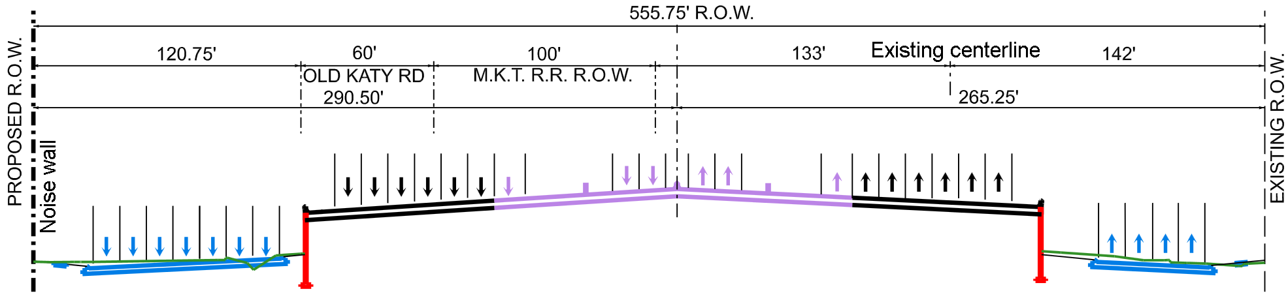
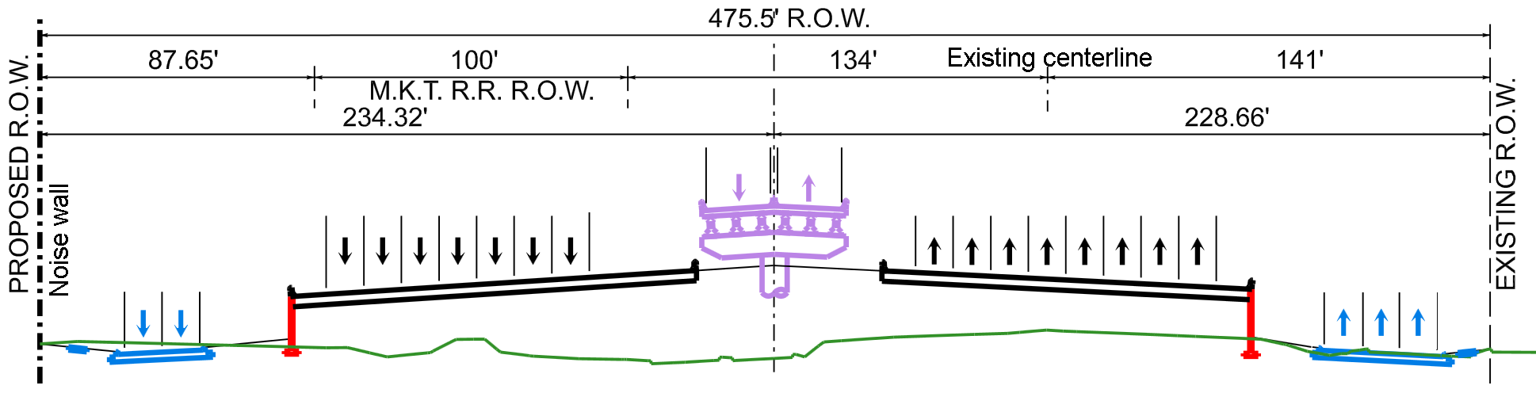
Katy Freeway Reconstruction – Final Design
Katy Freeway Cross Section at East of Bunker Hill Road (Looking East)
Katy Freeway Cross Section East of Silber Road (Looking East)
Notes:
The final design of the study section included four nominal general purpose lanes, two managed lanes, and a frontage road with three mandated through lanes in each direction. However, most sections on the Katy Freeway between SH 6 and IH 610 had additional auxiliary lanes for entering and exiting the freeway, seldom leaving only four general purpose lanes. The continuous frontage road in each direction was also designed with auxiliary lanes for turning movements so that their impact on traffic of the three through lanes was minimized. At key connector, entrance and exit ramp locations, the freeway had as many as eight general purpose lanes in each direction. In addition, TxDOT used stronger pavement and bridges and corrosion protection mechanisms for the managed lanes to allow timely and cost-efficient transition to a light rail in future

Slide 66
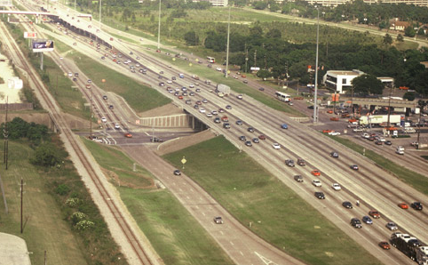
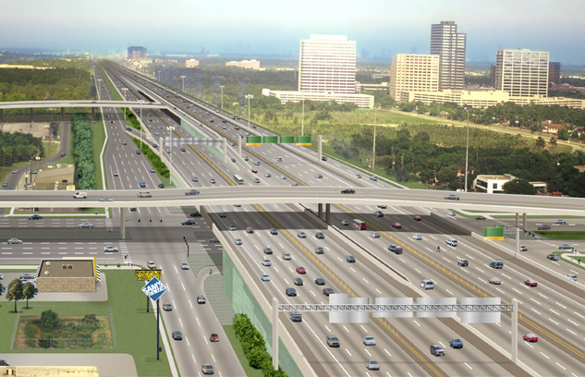
The New Katy Freeway
IH10 at SH 6
IH10 at SH 6, Before Construction
IH10 at SH 6, After Construction
Notes:
This slide shows before and after construction pictures at the SH 6/ I-10 interchange.
The SH 6 intersection was reconstructed to a three-level separation where SH 6 main lanes fly over Katy Freeway while the main lanes of the latter overpass the frontage roads of SH 6. In addition, at Beltway 8, Katy Freeway was significantly widened by adding several additional lanes.
The four managed lanes between SH 6 and IH 610 are separated by concrete barriers and delineators with multiple access points to major freeway exits. According to the Houston TranStar traffic information system, the managed lanes currently provide a free flow speed higher than 60 mph at all times except at certain on/off ramps.

Slide 67
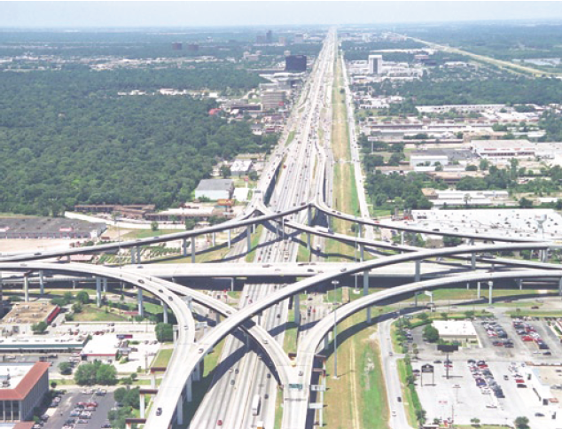
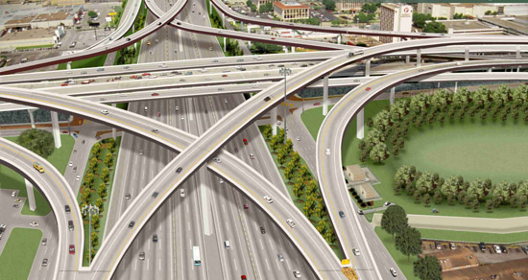
I-10 at Beltway 8
Before Construction
After Construction
Notes:
This slide shows before and after construction pictures of the IH-10/Beltway 8 interchange
At Beltway 8, the Katy Freeway was significantly widened by adding several additional lanes.
The four managed lanes between SH 6 and IH 610 are separated by concrete barriers and delineators with multiple access points to major freeway exits. According to the Houston TranStar traffic information system, the managed lanes currently provide a free flow speed higher than 60 mph at all times except at certain on/off ramps.

Slide 68
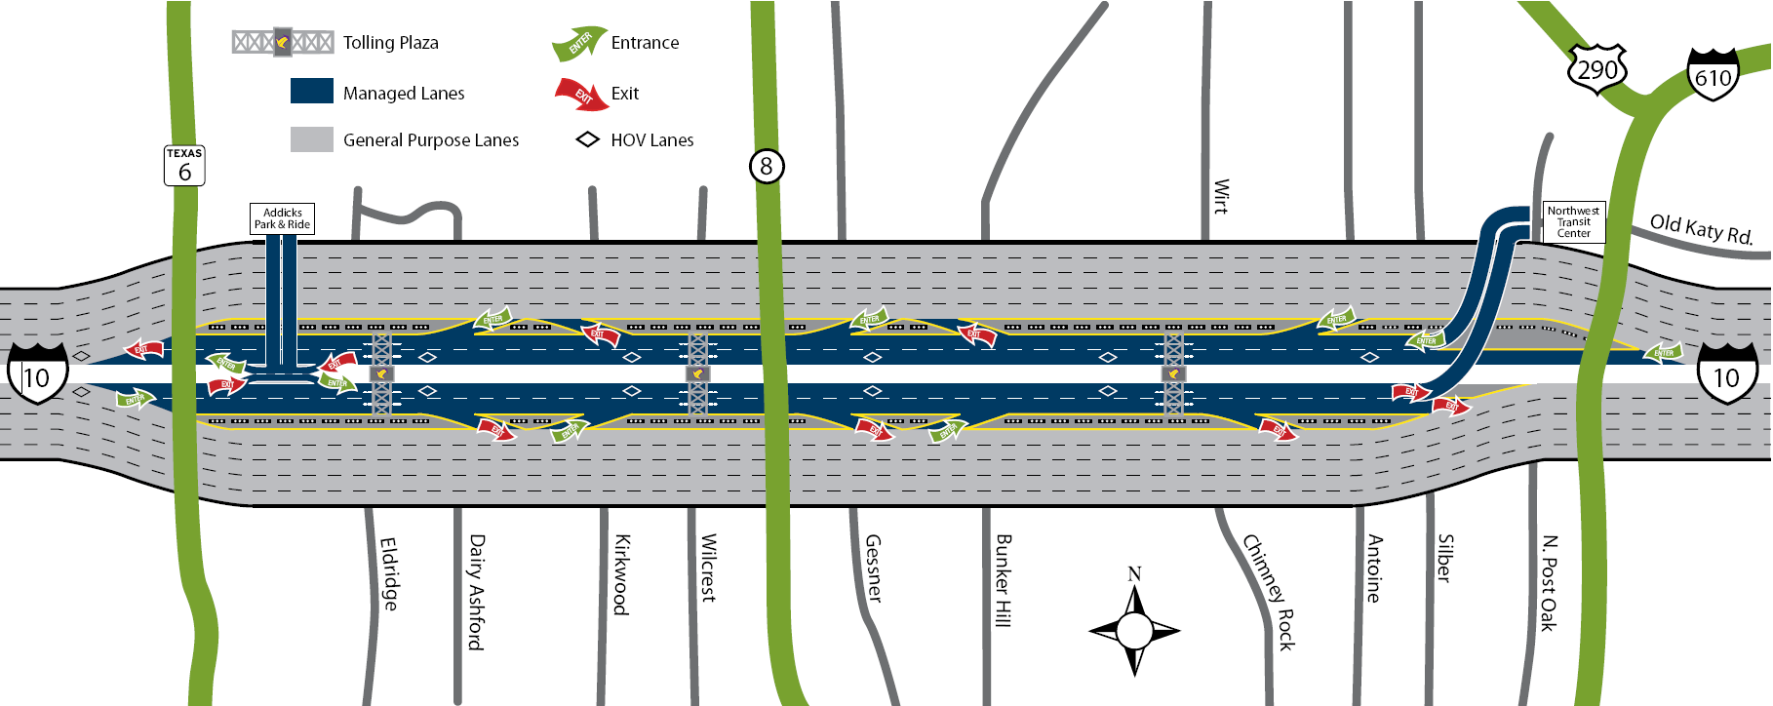
Katy Freeway Managed Lanes
Notes:
This slide shows an illustration of the managed lanes on the Katy Freeway. There are two in each direction
The managed lanes were officially opened to commuters on April 18, 2009 . These facilities combine several transportation options including HOV lanes, transit, and toll roads and are first of their kind in Texas.

Slide 69
Katy Freeway Managed Lanes
Opened April 2009
4 managed lanes between SH 6 and Loop 610, separated by barrier
Combine HOV lanes, transit, and toll roads; first in Texas
METRO and school buses use for free
Dynamic tolling method used
Provides faster option and funding source for maintenance
Notes:
METRO buses and school buses can use the lanes free of charge any time. HOV vehicles use the lanes free of charge during HOV hours but pay a toll at other times. Other vehicles can only use the facility by paying a toll at all times. The facility provides a faster option for Katy Freeway users and a funding source for highway maintenance in Harris County. More importantly, they promote ride-sharing and the use of transit and therefore mitigate congestion in a long run.
HCTRA uses a dynamic tolling method to manage the tolled vehicles on the facility. The toll rate changes dynamically according to variables including traffic volume and time of day to leverage the traffic volume on the lanes for reasonable speed. HCTRA initially follows a predetermined rate schedule that changes at designated times during peak periods. A more sophisticated system that can determine the appropriate toll rate at a real-time basis has been explored.

Slide 70

Katy Freeway Managed Lanes Video
Notes:
This media clip is an in-car video of a vehicle travelling westbound on IH 10 that enters and exits the managed lanes.

Slide 71

Local Thoroughfare Planning
Houston’s adopted in MTFP 1942
General 1 mile thoroughfare grid system
Houston’s adopted in MTFP 1942
Plan amendments considered once per year via public hearing
I-10 functionality supported through local street connectivity
City of Houston 2008 Major Thoroughfare and Freeway Plan
Notes:
Local thoroughfare planning efforts have also supported the functionality of Houston’s Katy Freeway.
In addition to managing the traffic signals along the Katy Freeway frontage roads, the City of Houston has been supporting the functionality enhancement of the corridor by increasing local arterials in the vicinity to improve system-wide connectivity and mobility.
A grid of major thoroughfares has been developed along Katy Freeway thanks in large part to the City of Houston’s Major Thoroughfare and Freeway Plan . In addition to serving local traffic, these roadway connections adjacent to the freeway provide mobility and draw local travelers off the freeway and its frontage roads to ultimately improve functionality of the freeway.
The city uses MTFP as a guideline to develop a general one-mile thoroughfare grid system in addition to radial and circumferential highways to enable system-wide mobility.
Since the adoption of MTFP in 1942 , the plan has facilitated the planning and development of the local highway system that helped to relieve the traffic burden on congested freeways. To maintain the original integrity of the plan and to ensure its implementation, the city requires that all proposals of major changes to the plan to be only approved through the public hearing process held once per year. In addition, the city planning department also discourages property owners to dedicate major thoroughfare right of way through their property by separate instrument (in lieu of dedication by plat) inconsistent with approved subdivision plans.

Slide 72
Katy Freeway Case Study Discussions
Importance of ROW preservation
Use of minor improvements
Use of managed lanes
Interagency collaboration (FHWA, TxDOT, HCTRA, and METRO)
Local thoroughfare planning support
Notes:
This slide includes discussion items in 5 key areas that have contributed to the enhanced functionality of the Katy freeway. The instructor should facilitate discussion or comments on these items.
Right-of-way preservation: Due to limited right-of-way and the lack of corridor preservation strategies historically, the latest Katy Freeway expansion was delayed for many years, resulting in extensive travel delays, maintenance costs, and safety problems. The Katy Freeway upgrade in the 1960’s was an opportunity for constructing a more ambitious facility to better respond to the rapid urbanization in west Houston area. However, instead of preserving sufficient right-of-way along the much less developed corridor, the upgrade was carried out in a narrow strip with little right-of-way expansion. At the same time, the Katy Freeway section within the IH 610 loop was constructed to a modern freeway with five lanes in each direction, which has met traffic demand and lasted to today. Other major freeways in the west Houston area, such as Beltway 8 that intersects with the study freeway, were expanded much earlier partly due to their better preserved right-of-way.
Use of minor improvements: Minor improvements demand less funding resources and implementation efforts and can be quick relieves for many congestion problems. In the case of Katy Freeway, the reversible transitway in the 1980’s was implemented promptly without changing the highway cross section significantly. Although it shared a relatively small proportion of the traffic, it was able to provide approximately half of the person volume on the freeway with much improved travel speeds while having minimum impact on capacity of the other lanes.
Interagency collaboration: The Katy Freeway Transitway in the 1980’s was a collaborative improvement by TxDOT and METRO, which benefited almost half of the person volume on the freeway. The latest Katy Freeway expansion project was another example of interagency collaboration involving FHWA, TxDOT, HCTRA, and METRO. The funds due to HCTRA’s participation reduced the construction schedule from ten years to six while releasing resources for use on other Texas roadways. The National Partnership for Highway Quality (NPHQ), a collaboration of Federal and State highway officials and highway industry leaders, awarded the project a silver “Making a Difference” prize for partnering. Currently, HCTRA operates, maintains and provides enforcement on the managed lanes; TxDOT operates and maintains the general purpose and frontage lanes; and METRO continues to operate the buses on the Katy Freeway Managed Lanes. H-GAC is also involved in the freeway by overseeing long-term transportation planning along the corridor.
Managed lanes: A noteworthy feature of Katy Freeway after the latest improvement is the four managed lanes that innovatively combine the concepts of toll, HOV, and transit. These managed lanes reduce travel delays for METRO buses and HOVs and provide an option for regular travelers to drive at a higher speed at a cost. As the traffic continuously increases over time, it is foreseeable that these facilities will play a more important role in the near future in relieving traffic congestion on the freeway.
Local planning support: A well-established local highway network can support the functionality of major freeways by providing system-wide accessibility, connectivity, and mobility. Such a network attracts shorter trips and share traffic burden from the major freeways.

Slide 73
MODULE 4
Safety and Functionality
Notes:
This module covers ways to preserve safety to maintain functionality.

Slide 74
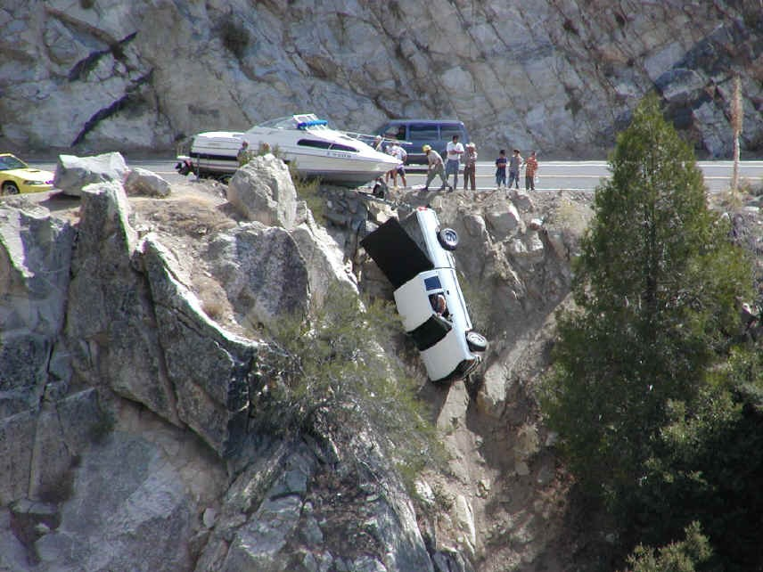
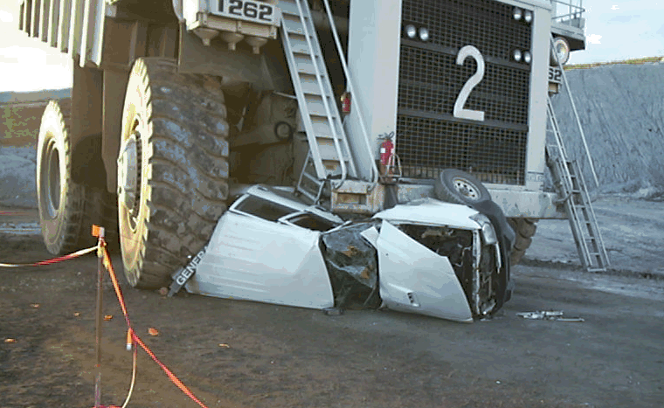
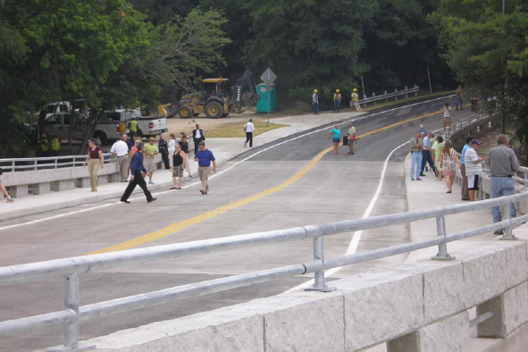
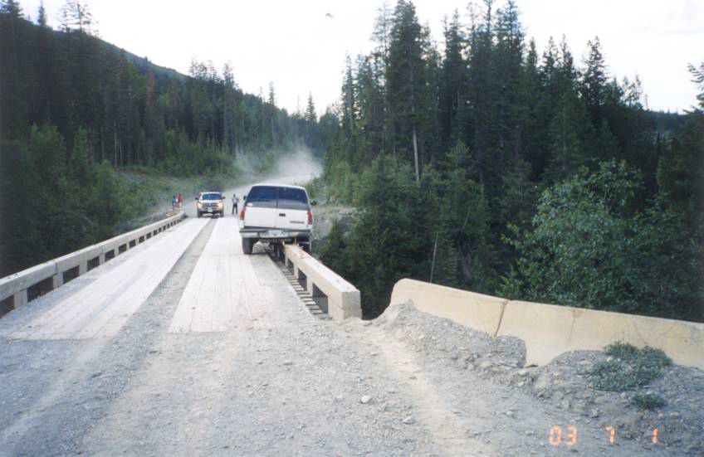
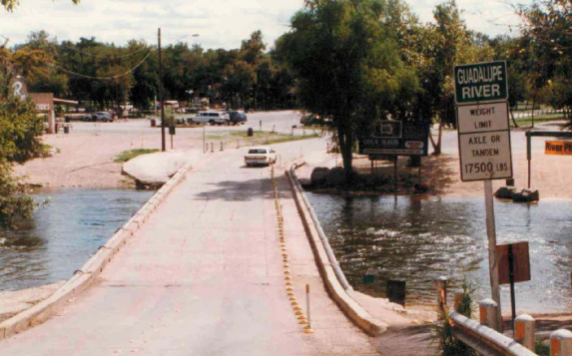
Notes:
America kills nearly 40,000 people a year in traffic crashes. While something like 90% of the crashes are due to human error, the roadway still contributes its share to causing crashes, injuries and fatalities. Some of that is due to declining functionality as the “ideal” conditions available after the road opens are subjected to more traffic, more access, and eventually the possibility of a decline in operations and safety characteristics.
None of us wants to have one of our roads look like this (Photo 1), and we sure hope not to get caught with a design that results in this (Photo 2) after a change in use of the road (wait; Photo 3 shows that we actually had a Texas road (Gruene Road in Gruene) that was subject of a recent off-system TxDOT improvement (Photo 4)). Getting back to sample safety problems, how about Photo 5 which seems to be lacking an outer guard barrier or rail. Fortunately we have very few situations where this could happen (Photo 6) but there are a few places where special purpose roads do intersect state highways (e.g., logging and oil field construction and service roads).

Slide 75
Safety Functionality Cycle
Decision, Funds to Improve/Add Facility
New or Improved facility
Monitor Operations
Need For Major Improvement
Additional Development, Access, Intrusions
Increased Crashes, Hazards
Increased Traffic
Retain best of photos
Increased Congestion, Operational Deficiencies
Operations Adjustments
Increased Traffic
Additional Development, Access, Intrusions
Additional Development, Access, Intrusions
Increased Traffic
Spot Hazard Elimination, Minor or Operational Changes
Congestion, Operational Deficiencies
Crashes, Hazards Increase
Notes:
This slide was included in the pilot, but it is recommended that it be removed due to time constraints.
This diagram is similar to others shown previously except that it addresses safety. Notice that as congestion gains a foothold, safety can also decline. HOWEVER, safety is not tied only to volumes approaching or exceeding capacity. It can be affected by a number of changing conditions including pavement deterioration, poor signing, decreased sight distance, changes in use of the road, lighting deficiencies and many more.

Slide 76
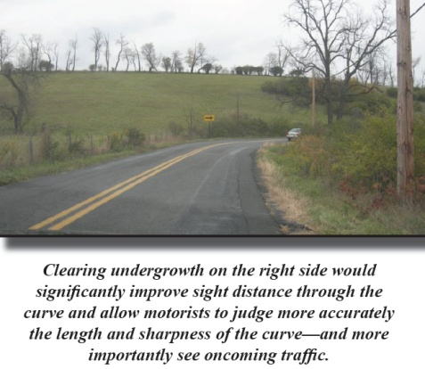
Keeping Up with Safety Changes
Complaints
Requests
Performance measures
Notes:
Bullets: show some ways of how agencies learn about safety deficiencies
Photo: shows an example of deterioration of sight distance

Slide 77

Safety Performance Measures
Crash rates
  Segments
    Crashes/100 MVM
    Serious injuries + fatalities/100 MVM
    Fatalities/100 MVM
  Intersections
    Crashes/million entering vehicles
    Fatalities/million entering vehicles (rarely used)
Crash severity (segments and intersections)
  Percent fatal or serious injury crashes
  Severity index (weighted severity)
Notes:
Safety performance measures are a good way to monitor safety of segments or intersections along highways. Bullets list some commonly used measures.

Slide 78

Data Sources for Performance Measures
Crash report information (TxDOT)
  Crash record information system (CRIS)
  Accident history database
Safety performance analysis
  Highway Safety Information System (HSIS)
Notes:
Bullets: examples of sources of data for safety performance
Photo: Example of an installation of a minimum 6 foot wide raised splitter island on the stop approach (no pavement widening required)

Slide 79

Causes of Safety Deterioration
Design deficiencies
Changed conditions, such as:
  Pavement
  Roadside objects
  Sight obstructions
    Development
    Plants
    Signs
  Development access
  Traffic volume or composition
    Vehicle types
    Modes
  Sign, marking deterioration or loss
  Shoulder, roadside erosion
Example of blue bike lane between right turn lane and shared right-through lane (Portland, OR)
Notes:
This plus next 2 slides list causes of highway safety deterioration.

Slide 80


Causes of Safety Deterioration
Changed conditions (cont.)
  Increased volumes
    Total
    Merge
    Weave
    Turns
  Warrants for improvement are exceeded
    Access management/medians
    Lanes, ramps
    Lighting
    Signals
Notes:
Continued list of causes

Slide 81



Causes of Safety Deterioration
Changed conditions (cont.)
  Signals not retimed periodically
  Increased pedestrian, bicycle activity
  Speed limit not commensurate with conditions
  Hazards installed over time
    Poles and boxes
      Utility
      Signals
      Lighting
    Signs
    Drainage structures
Notes:
End of list of causes.
Photos (bottom, upper left): Milled and rolled rumble strips.
A 1985 before-and-after study (California Effectiveness Report) indicated a 49 percent reduction in run-off-road crashes after shoulder rumble strips were installed along sections of Interstate 15 and 40 in San Bernardino County. Recent follow-up evaluation for freeway segments where shoulder rumble strips have been in-place for 3 or more years indicated an average reduction of 33 percent statewide.
Photo (upper right) : milled rumble strips in center line. Also used in Texas – center line rumble strips with buttons

Slide 82


Factors Related to Safety Deterioration
Access management
Horizontal, vertical curves
Cross-sections
Clear zone
  Width
  Obstructions
Sight distances
Interchange spacing, merge, weave sections
Drainage
Pedestrian, bicycle facilities
Drainage
Grades
Intersection design
Lighting
Roadway delineation
Traffic control
Design consistency
Maintenance conditions
Pavement friction
Notes:
This list includes actions and characteristics that can contribute to safety deterioration…and conversely be used to preserve or enhance safety.

Slide 83



Countermeasures
Multiple sources
  ITE Traffic Engineering Handbook, chapter 5
  NCHRP Report 500 (several volumes)
  NCHRP Synthesis 321
Notes:
There are many sources that provide information on countermeasures that can improve safety in specific kinds of situations. These three sources cover a broad range and are an excellent place to start.

Slide 84
Countermeasures
Example – Rural Run-Off-Road
Potential Causal Factor | Some Possible Countermeasures
Excessive speed | Reduce speed limit; enforce
Slippery pavement | Reduce speed limit; enforce Overlay pavement Provide adequate drainage Groove pavement Provide SLIPPERY WHEN WET signs
Inadequate roadway lighting | Improve lighting
Poor visibility of curve warning sign | Increase sign size
Inadequate roadway design | Widen lanes Re-align curve Install guardrail
Inadequate delineation | Install/improve warning signs Install/improve Pavement markings Install/improve delineation
Inadequate shoulder | Upgrade shoulder
Inadequate pavement maintenance | Repair road surface
Source: Traffic Engineering Handbook, 6th edition, Institute of Transportation Engineers
Notes:
Sample crash causes and corresponding potentially effective countermeasures to increase safety.

Slide 85

Countermeasures
Example – Rural Roadside Safety
~50% of all crashes run-off-road
Fatalities usually involve fixed objects
  Trees, shrubs
  Culverts, ditches, curbs
  Utility poles
Improvement options
  Remove obstacle
  Relocate or redesign obstacle to be less likely struck
  Use breakaway base
  Shield obstacle with barrier or other device
  Delineate obstacle (only if other methods not viable)
Notes:
Here is an example:
rural highway
50% of all crashes run off the road
numerous fatalities; most involve fixed objects (see list)
Cause of fatalities: obstacles in what should be clear zone
Improvement countermeasures – candidates as listed
Photo: Guardrails and proper, highly visible road markings are important aspects of a hazard elimination program.

Slide 86





Countermeasures – Geometrics Examples
Geometric design
  Improve access control
    Close/consolidate access points
    Relocate access to side road
    Add turn/speed change lanes
    Increase distance to ramps
    Redesign access for higher speed
  Improve curve features
    Widen lanes or shoulders through curve
    Realign to increase radius
    Increase sight distance
  Increase roadside recovery distance
Diverging Diamond Interchange, I-40 at Hwy 13, Springfield, MO
Bend, OR
Michigan U-Turns
“Michigan Loon”
Notes:
Another example (exhibits) – reduce left turn conflicts
THREE WAYS TO REMOVE LEFT TURNS FROM INTERSECTIONS
Photo – at-grade intersection in Bend, OR with jug-handle ramps in 2 quadrants to remove all left turns and right turns from two of four legs of the intersection (safety, capacity)
Left sketch – Michigan “Loon” intersection to remove main road left turns from intersection
Right Sketch – Michigan U-turns to remove left turns from intersections and convert them to right turns.
(after click) covering photo – a new interchange configuration that reduces vehicle conflicts and simplifies traffic signal operation (all 2-phase), thereby reducing crash potential. Notice this one is the first one in USA (opened 2009); used previously in France.
-------------------------------------------------------------------------------------------------------------------------------------------------------------------------------
A diverging diamond interchange is a rare form of diamond interchange in which the two directions of traffic on the non-freeway road cross to the opposite side on both sides of the bridge at the freeway. It is unusual in that it requires traffic on the freeway overpass (or underpass) to briefly drive on the opposite side of the road from what they are accustomed.
Like the continuous flow intersection, the diverging diamond interchange allows for two-phase operation at all signalized intersections within the interchange. This is a significant improvement in safety, since no left turns must clear opposing traffic and all movements are discrete, with most controlled by traffic signals.^{[1]} Additionally, the design can improve the efficiency of an interchange, as the lost time for various phases in the cycle can be redistributed as green time; there are only two clearance intervals (the time for traffic signals to change from green to yellow to red) instead of the six or more found in other interchange designs. Some of the intersections in the design can be unsignalized. The left turn from the freeway off-ramp, for example, can form an auxiliary lane that then becomes an exit-only lane for the entrance ramp to the freeway in the opposite direction. Omitting the traffic signals for the left turn movements off the freeway only works well with single left turns and when short queues exist within the interchange on the arterial street.

Slide 87




Tools, Sources
Low Cost Treatments for Horizontal Curve Safety (FHWA)
Interactive Highway Safety Design Model (IHSDM) (FHWA)
Highway Safety Manual (FHWA)
NCHRP Report 500 – several volumes (TRB)
Traffic Engineering Handbook (ITE)
Desktop Reference For Crash Reduction Factors (FHWA) and Highway Safety Improvement Program Manual (TxDOT)
SafetyAnalyst software (FHWA)
Highway/Utility Guide (FHWA)
Notes:
These are some good resources for evaluating safety and identifying candidate countermeasures.
SafetyAnalyst Scope
SafetyAnalyst addresses site-specific safety improvements that involve physical modifications to the highway system. SafetyAnalyst is not intended for direct application to non-site-specific highway safety programs that can improve safety for all highway travel such as vehicle design improvements, graduated licensing, occupant restraints, or alcohol/drug use programs. However, SafetyAnalyst has the capability not only to identify accident patterns at specific locations and determine whether those accident types are overrepresented, but also to determine the frequency and percentage of particular accident types systemwide or for specified portions of the system (particular highway segment or intersection types). This capability can be used to investigate the need for systemwide engineering improvements (e.g., shoulder rumble strips on freeways) and for enforcement and public education efforts that may be effective in situations where engineering countermeasures are not.
IHSDM: Modules
The IHSDM suite of software analysis tools for includes six evaluation modules:
Crash Prediction Module: estimates the expected frequency crashes on a highway using geometric design and traffic characteristics.
Design Consistency Module: estimates the magnitude of potential speed inconsistencies to help identify and diagnose safety concerns at horizontal curves
Intersection Review Module: performs a diagnostic review to systematically evaluate an intersection design for typical safety concerns.
Policy Review Module: checks highway segment design elements relative to design policy.
Traffic Analysis Module: estimates operational quality-of-service measures for a highway under current or projected future traffic flows.
Driver/Vehicle Module: estimates a driver’s speed and path along a highway and corresponding measures of vehicle dynamics.
The 2009 Crash Prediction Module Beta Release includes capabilities to evaluate two-lane rural highways, multilane rural highways and urban/suburban arterials. The 2008 Public Release – which includes all six evaluation modules – is only applicable to two-lane rural highways.

Slide 88
Assessing Safety in Design
Starting Point |  | Work Stage
Existing |  | 1. Use performance measures to identify problems
 |  | 2. Analyze crash records and existing conditions
 |  | 3. Identify effective countermeasures
 |  | 4. Select best countermeasure
New design |  | 1. Project feasibility/initial schematic design
 |  | 2. Preliminary design
 |  | 3. Final design
 |  | 4. Pre-opening
Road Safety Audit
Review Each stage
Notes:
“Existing” - These are steps to use to evaluate existing conditions and find an effective safety countermeasure.
“New design” – steps in the development process when safety should be evaluated. Discussed more under road safety audits which comes next.

Slide 89







Road Safety Audit (RSA)
Proactive low cost effort to prevent crashes before they happen
Performed by specially trained personnel
  RSAs and crash prevention
  Independent of design team
  Not unlike value engineering
Notes:
Road safety audit is an effective way to systematically review and improve safety of a design as it goes through the project development process.
Bullets:
RSAs are low cost, preventative approaches
Should be performed by personnel who have been specifically trained
RSA should be done by people NOT part of the design team
Process has a similar to that of value engineering done properly (helpful; not a “gotcha” approach)
Exhibits:
Lower left – sample summary of RSA findings of potentially hazardous conditions that could result from the design; would be accompanied by suggested changes to improve safety
Others – resource documents:
NCHRP Synthesis 336 – Road Safety Audits
Transportation Association of Canada (TAC – Canadian equivalent of AASHTO) Canadian Guide to In-service Road Safety Reviews
TAC Canadian Road Safety Audit Guide

Slide 90
RSA Benefits
Can
  Help produce designs that result in fewer and less severe crashes
  Reduce costs by identifying safety issues and correcting them before projects are built
Considers human factors in all facets of design
Raises profile of safety
Promotes awareness of safe design practices
Integrates multimodal safety concerns
Notes:
Bullets: as listed

Slide 91

RSA Checklist (partial)
MnDOT Road Safety Assessment
Design criteria and application
Design speed
Design volumes and vehicle and mode types
Alignment and continuity
Cross-sections
Intersections, interchanges
Sight distances
Shoulder and edge treatments
Access management
Lighting
Traffic control devices
Drainage
Landscaping
Construction staging
Traffic operations, incident management
(differs by type of facility)
Conditions (partial)
Numerous unreported minor crashes
Considerable curb damage
Skid marks and curb jumping at ramp approach to west roundabout
11 inch curb on medians and roundabouts
Faded markings
Sight distance limited by plants
Recommendations (partial)
Install YIELD and ONE-WAY signs on ramps
Trim vegetation
Refresh pavement markings
Check geometrics for turn radii for vehicles using interchange
Notes:
This slide was included in the pilot, but it is recommended that it be removed due to time constraints.
Bullets: This is a partial list of characteristics and design features that an RSA examines. The checklist varies by project type.
Photo: Abridged summary of findings of an interchange in-service road safety review showing conditions and recommendations

Slide 92


RSA Finding Examples
Sight line obstructions resulting from proposed improvements
Insufficient merge or weave section length
Transition problems
Temporary pavement marking still clearly visible
Improper sign sizes used
Missing traffic control devices
Proposed pole unconstructable; utility beneath
Potential for wrong way turns
Drainage headwall creates clear zone obstruction
Water ponds in curb lanes
Combination horizontal and vertical curves create condition well below design speed
View of signal heads will be obstructed from one approach when trucks present
Guardrail lacks end treatments
Traffic signal timing insufficient for pedestrians
Insufficient night visibility
CCTV camera view blocked by overhead sign
Near right traffic signal has insufficient target value
Sidewalks to or at bus stops badly cracked/broken
Notes:
Bullets: Sample of RSA safety concern findings.
Photos:
Top: Poor maintenance cause water to pond, obscures lane markings, causes pedestrians to cross away from designated locations, may encourage aggressive driving during/after rains
Bottom: Improperly located bus stop blocks driveway, not enough patron queuing space, deteriorated or missing sidewalk.

Slide 93

RSA Applicability
New facilities
Existing facilities (“roadway safety assessment”)
  During project development/design
  In operation
Any size project
Example - 12-inch heads, one signal head per lane, back plates
Notes:
This slide was included in the pilot, but it is recommended that it be removed due to time constraints.
Bullets:
Lists what RSAs are applicable for (purpose of the RSA is preventative actions)
“In-Service Road Safety Reviews” (ISRSR) provide similar benefits for existing facilities (emphasis of the ISRSR is corrective actions)
Photo - Example of 12-inch heads, one signal head per lane, and back plates plus individual lane use control signs facing each lane to make controls/directions as clear as possible to drivers.

Slide 94


RSA Example
Improvements include:
Replacement of left-side ramps with conventional right-side ramps
Lengthening or elimination of existing short weaving sections
Increased curve radii on ramps
Lane continuity and consistency for through traffic
Increased capacity on system ramps
Increased barrier height
Notes:
This slide was included in the pilot, but it is recommended that it be removed due to time constraints.
Another example of an RSA – for reconstruction of an existing interchange (Milwaukee)
Bullets: Desired improvements
Table: Some of the deficiencies and recommended changes found in the design

Slide 95
TxDOT Programs
Highway Safety Improvement Program
  90% federal, 10% state/local
  Hazard elimination (non-Interstate)
High Risk Rural Roads
  Major and minor collectors
  Fatal/incapacitating injury rate above statewide average
  Excludes Interstates, bridges, general maintenance
Administered by TxDOT Traffic Operations Division
Notes:
Bullets: Specific TxDOT safety programs related to highway functionality (as listed)
Photo – extension of edge line across intersection to keep vehicles in lane. Also offset left turn lane to permit opposing left turning driver (behind camera) to see approaching vehicles

Slide 96

Crash Data
Obtain from Traffic Operations Division
Crash Records Information System (CRIS)
Use 3 (or more) years of data
Notes:
This slide was included in the pilot, but it is recommended that it be removed due to time constraints.
Bullets: sources for crash data and how much should be used for analysis of existing conditions
Sketch: intersection collision diagram. Should do one of these for any (high) crash location to be analyzed.

Slide 97
Internet Sources
http://www.safety.fhwa.dot.gov
http://www.ite.org/safety/default.asp
http://www.nhtsa.dot.gov
http://www.fars.nhtsa.dot.gov
http://www.transportation.org
http://www.atssa.com
http://www.ihsdm.org
http://safety.fhwa.dot.gov/rsa/guidelines/
http://www.safetyanalyst.org
http://www.highwaysafetymanual.org
Notes:
Some good information sources on safety:
FHWA traffic safety site
Institute of Transportation Engineers traffic safety site
National Highway Transportation Safety Administration site
Fatality Analysis Reporting System site – contains summaries of national crash data.
AASHTO website
American Traffic Safety Services Association site – primarily oriented to work zone safety
Site for the IHSDM
SafetyAnalyst software site
Site for the Highway Safety Manual

Slide 98
Preserving and Recapturing Safety Functionality
Questions?
Notes:
Questions and discussion

Slide 99

Participant Feedback on Workshop
How can we improve this workshop?
  Content?
  Organization?
  Time on each topic?
  Instructor delivery?
  Other?
Please complete evaluation form
Give
Notes:
Pass out workshop evaluation forms and ask for honest feedback. Any helpful suggestions that would make this workshop more valuablewould be welcomed. Please leave forms before you leave.

Slide 100


Preserving and Enhancing the Functionality of Highways in Texas
….for attending!
Notes:
Thank participants for attending and participating, etc.

Slide 101
Questions Later?
Ed Hard
  (979) 845-8539
  e-hard@tamu.edu
Brian Bochner
  (979) 458-3516
  b-bochner@tamu.edu
To download presentation files, click on: https://tti-sharepoint.tamu.edu/dropbox
Gain access using:
Username: TTI-SERVERS\Extern_Guest
Password: el7phantb9nd
Click on: System Planning, Policy…
Click on: Preserving Highway Functionality
Select desired files
Notes:
Contact presenters if any questions as you try to use this information. Presenters would be glad to clarify or even give advice to help you use these tools.
Box: The presentation slides will be posted at this download site for about 30 days. Feel free to download the slides.

