Slide 1
TxACOL Workshop
Texas Asphalt Concrete Overlay
Design and Analysis System
5-5123-03-P1
Project Director: Dr. Dar-Hao Chen
TTI Research Team:
Sheng Hu, Fujie Zhou, and Tom Scullion

Slide 2
General Information
Two workshops were held respectively on Aug. 25 at Paris, Tx and on Oct. 6 at Austin, Tx
More than 30 representatives from TxDOT attended
Introduction of TxACOL software, key input parameters, and related lab and field tests were presented
Attendees practiced the software step by step

Slide 3
Presentation Outline
Introduction
Program training and exercises
Key inputs for existing pavement and field testing
Key inputs for asphalt overlay and lab testing

Slide 4
Expected Learning Outcomes
Be able to perform program installation and un-installation
Be familiar with creating, editing, saving, and running a project file
Know how to design an asphalt overlay using the TxACOL program
Understand Key input parameters and the requested lab or field test

Slide 5
Presentation Outline
Introduction
Program training and exercises
Key inputs for existing pavement and field testing
Key inputs for asphalt overlay and lab testing

Slide 6
TxACOL Flowchart
Crack propagation and reflection cracking analysis
Daily crack propagation:
Input
AC Overlay
+
Traffic
Existing
Pavement Condition
Environment
Models
Reflection Cracking
Model
Rutting Model
Output
Cracking Data and Chart
Rutting Data and Chart

Slide 7
TxACOL Features
M-E program
User-friendly interface
Short running time
Default values provided in the software
Traffic input is compatible to the current pavement design software FPS19W

Slide 8
TxACOL Features (Continued)
Pavement temperature is automatically predicted from EICM model
Rutting and cracking are analyzed simultaneously
Output is in Excel format and can be easily incorporated into electronic documents and reports

Slide 9
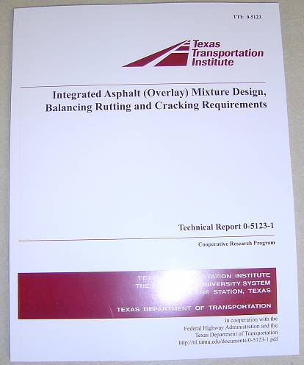

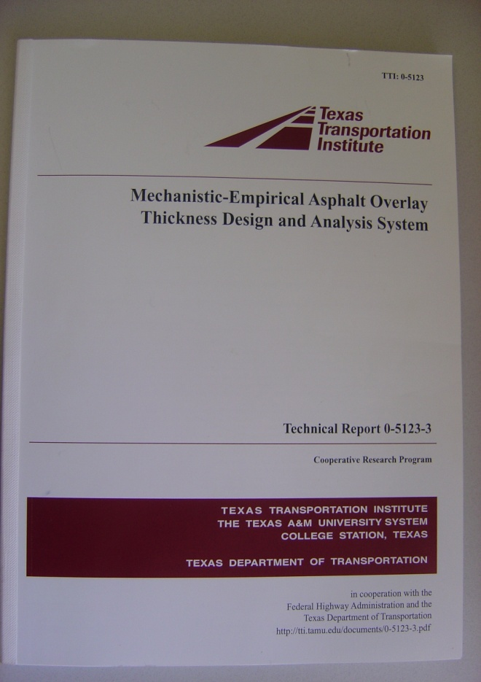
TxACOL Technical Background

Slide 10
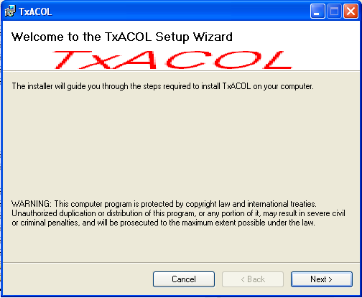
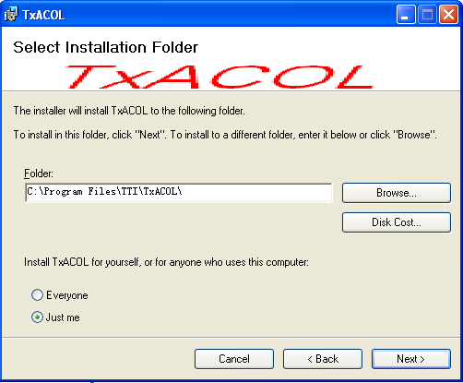
How to Install
Double click “Setup.exe” file
If this is the first installation, the following screens will appear:
Choose your favorite installation folder here

Slide 11
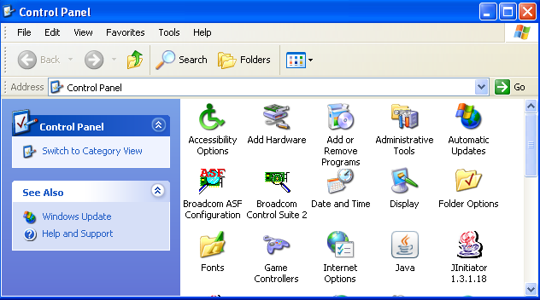
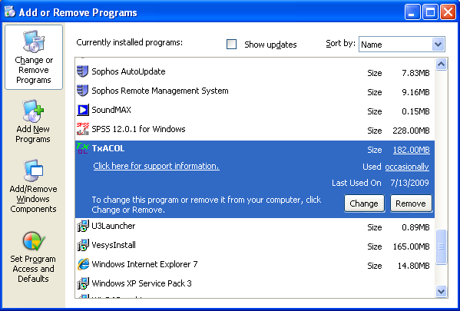
How to Uninstall

Slide 12

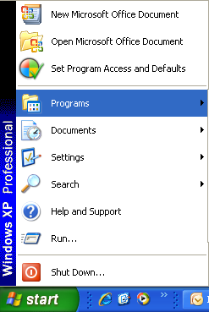
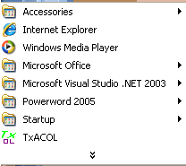
Launch the Program
Double click the icon
or

Slide 13
Presentation Outline
Introduction
Program training and exercises
Key inputs for existing pavement and field testing
Key inputs for asphalt overlay and lab testing

Slide 14
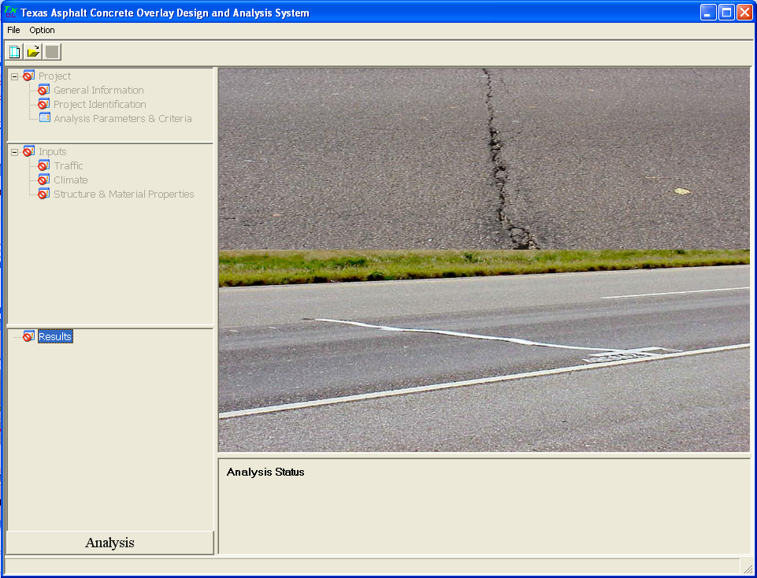
Step 1: Create a New Project File
Click this button or select the menu “File” -> “New”

Slide 15
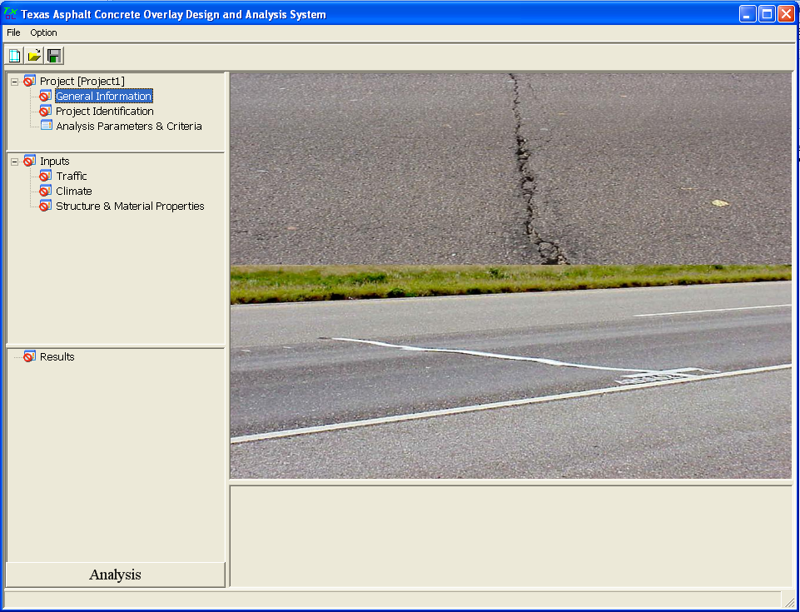
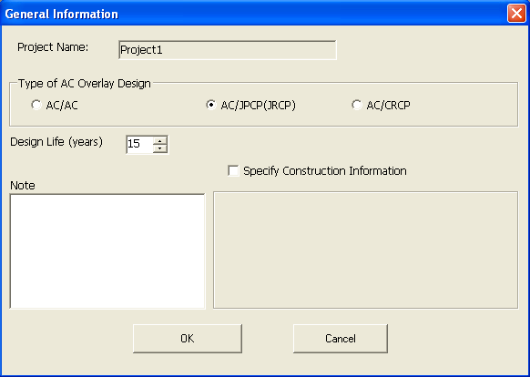
Step 2: General Information Input
Double Click

Slide 16

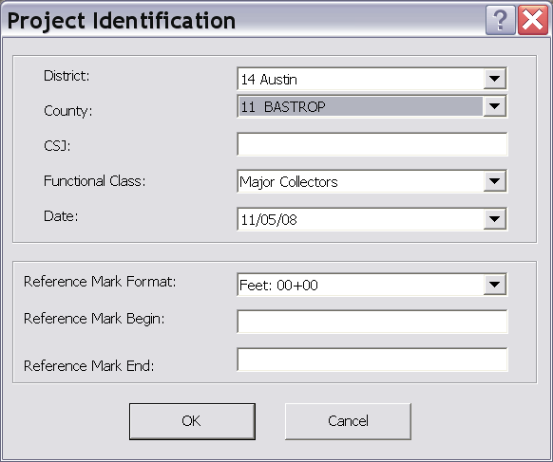
Step 3: Project Identification Input
Double Click
Similar to FPS19W

Slide 17
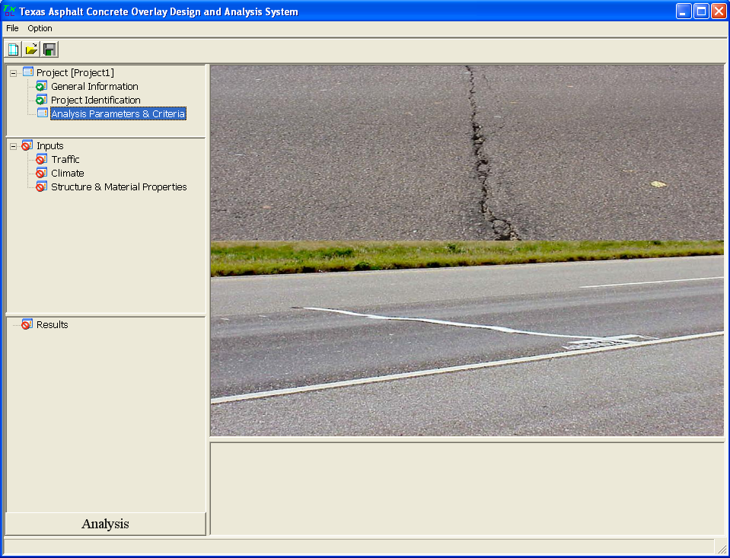
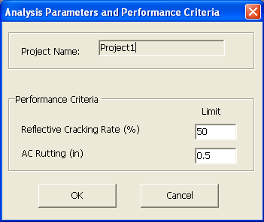
Step 4: Analysis Parameters & Criteria Input
Double Click
Defined by crack amount reflected to surface divided by total existing crack amount
Only rutting in the new AC overlay is considered

Slide 18
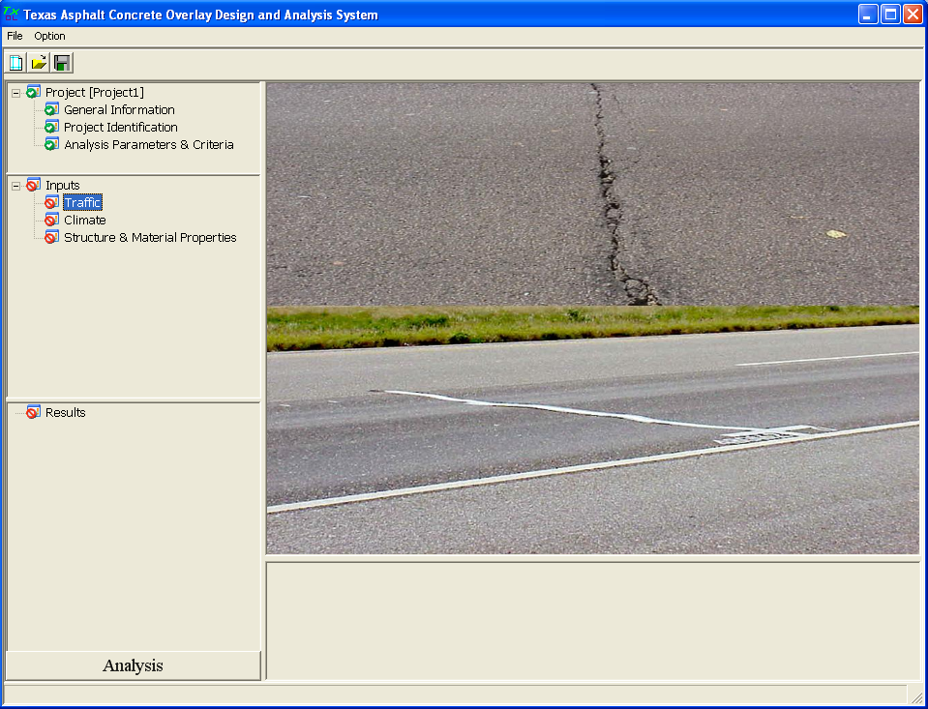
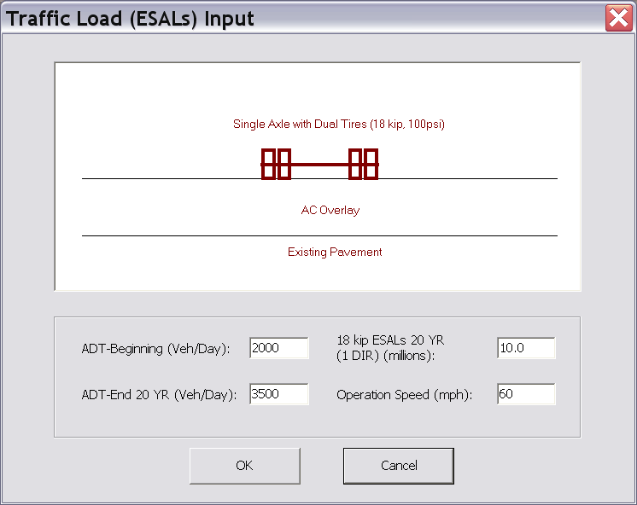
Step 5: Traffic Input
Double Click
Same as FPS19W

Slide 19
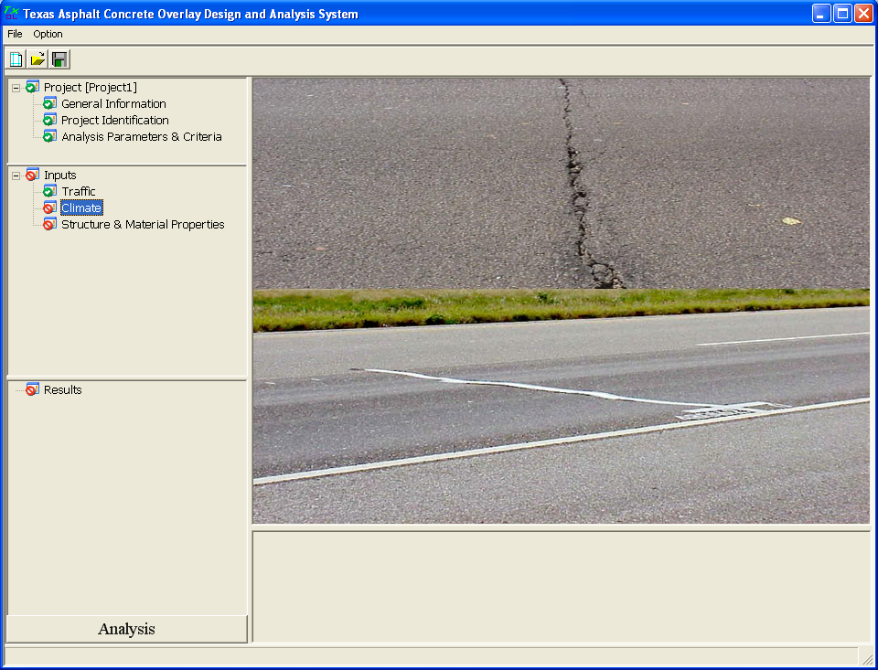
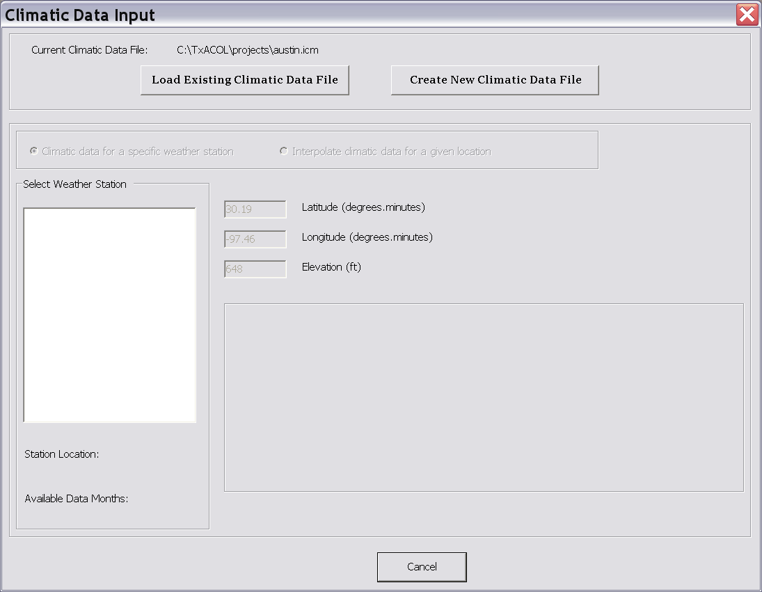
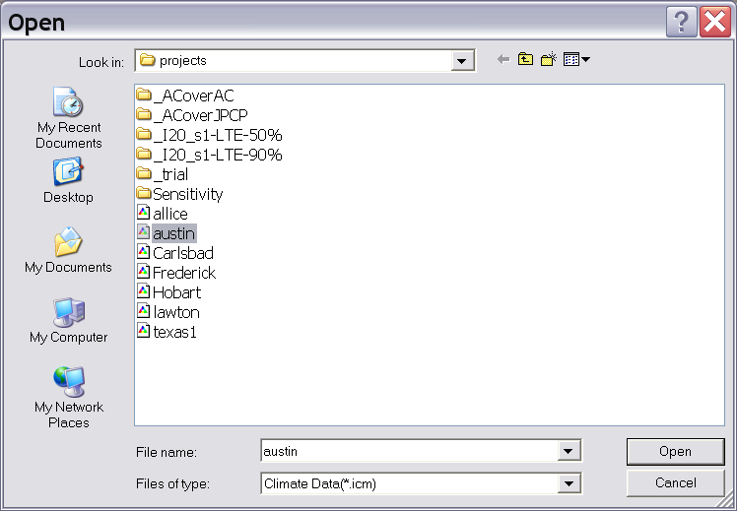
Step 6: Climate Input
Double Click

Slide 20
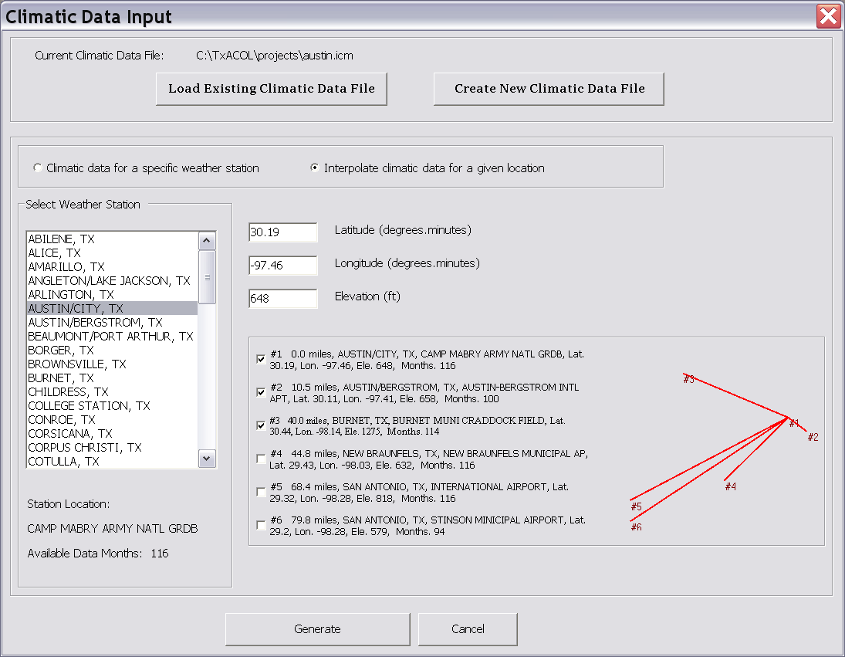
Step 7: Climate Input (Continued)
Double Click

Slide 21
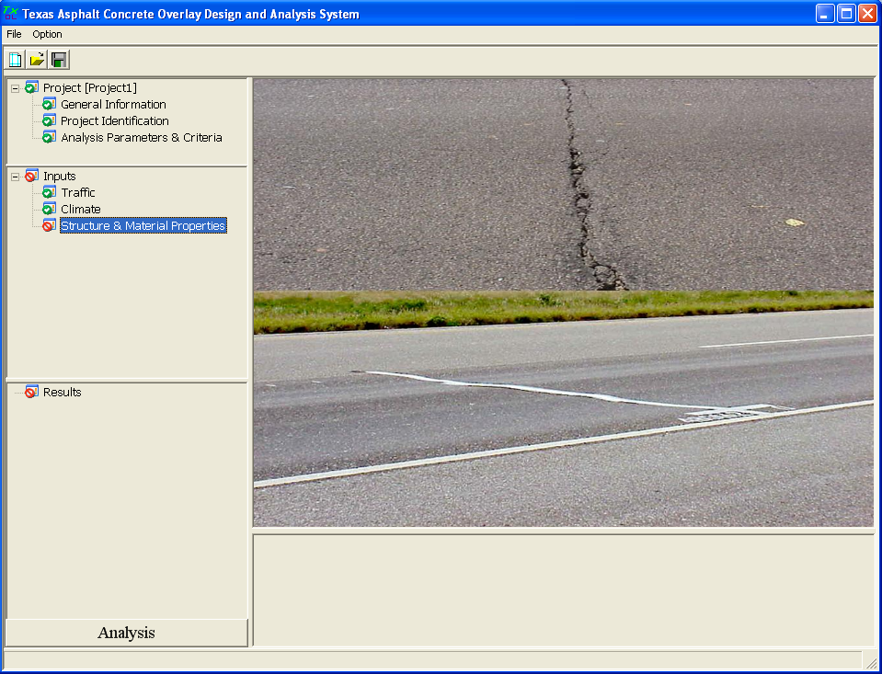
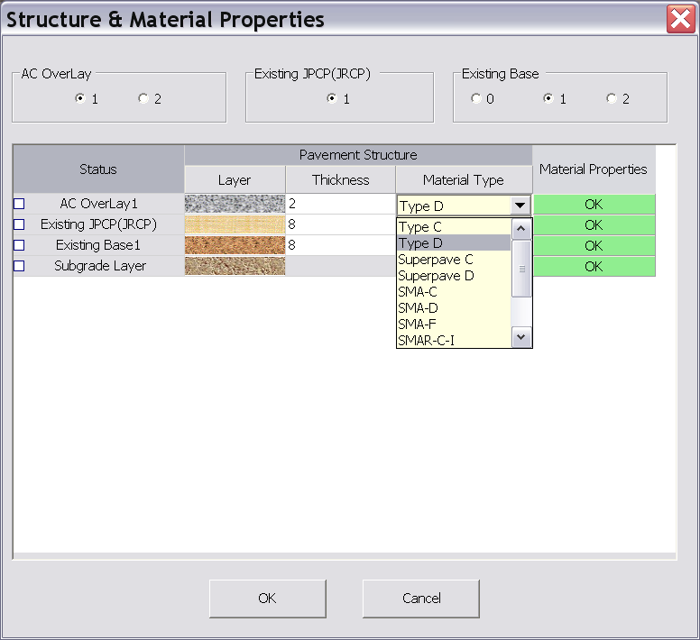
Step 8: Structure Input
Double Click
All commonly used overlay mix types in Texas are included

Slide 22
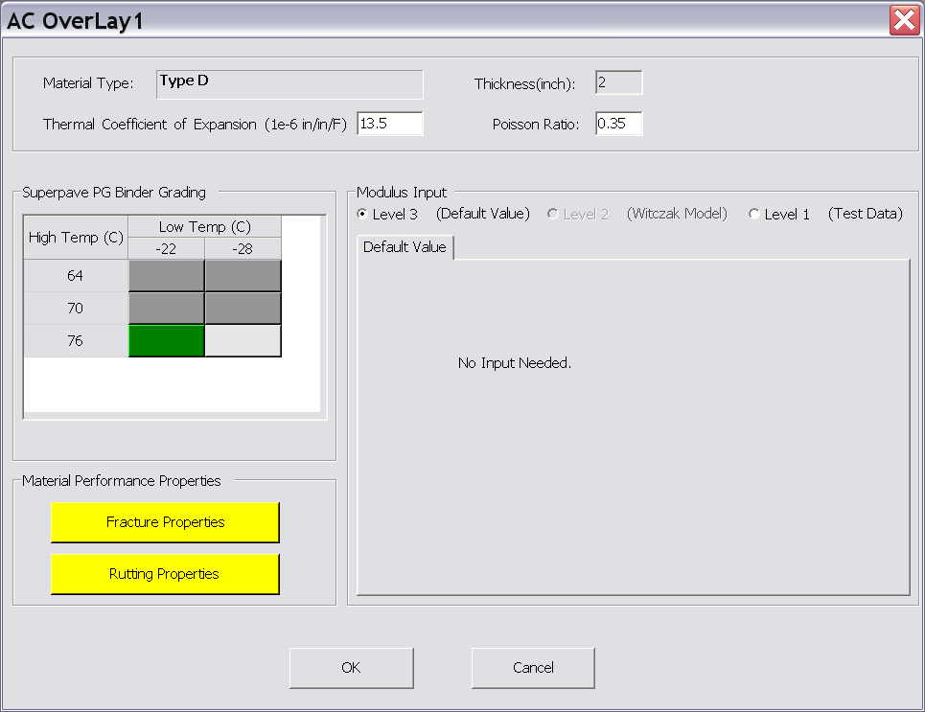
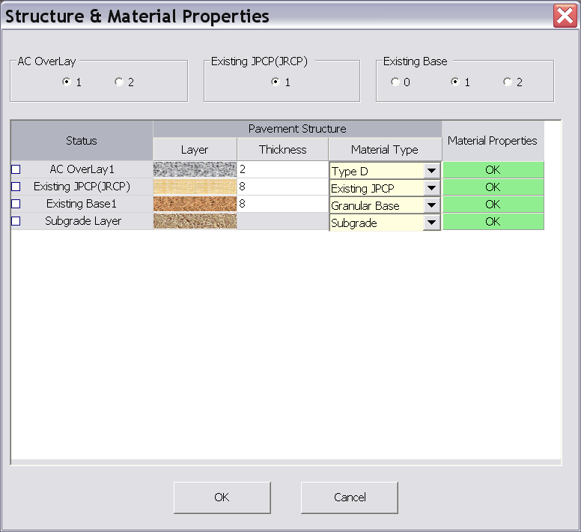
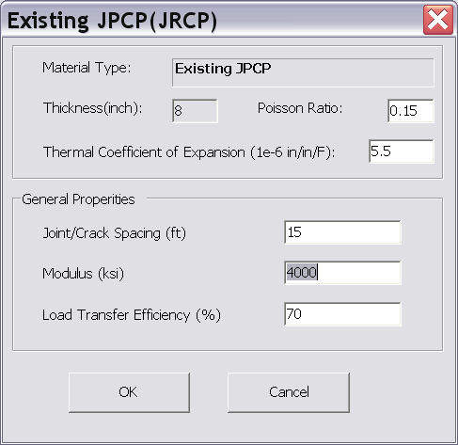
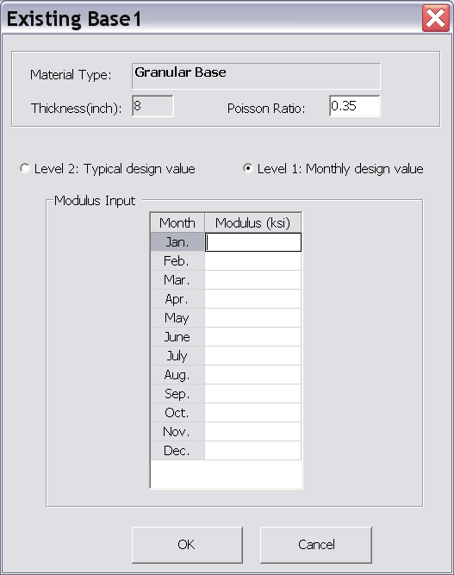
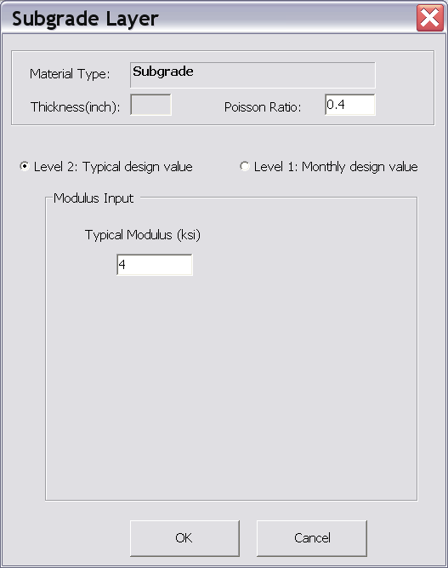
Step 9: Structure Input
(Continued)

Slide 23
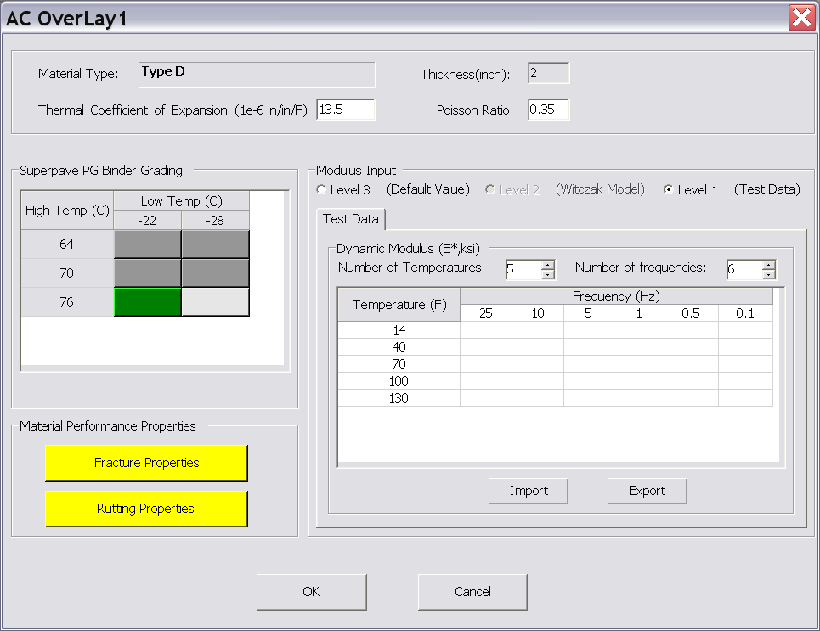
Step 10: AC Material Properties Input
Level 3 Input Level 1 Input
You can import or export dynamic modulus here

Slide 24
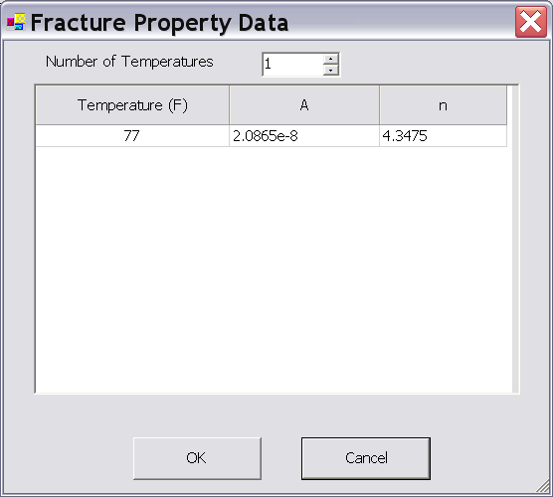
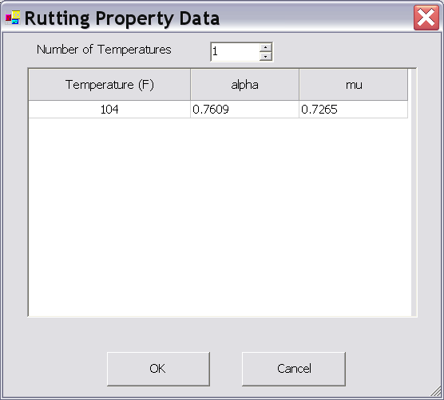
Step 11: Fracture and Rutting Properties Input
Fracture Properties Rutting Properties

Slide 25
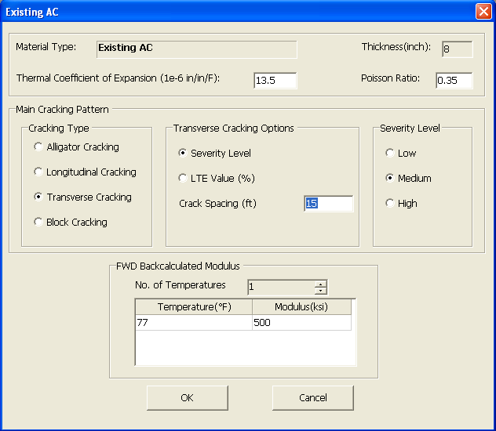
Step 12: Existing Layer Properties Input
Existing AC Existing PCC
The default values are different between JPCP and CRCP

Slide 26
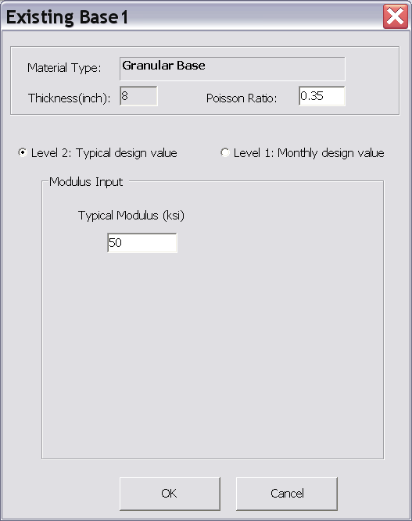
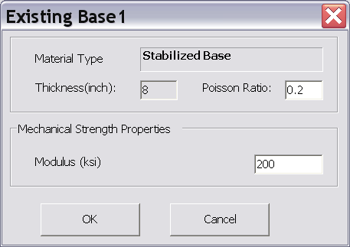
Step 13: Base Layer Properties Input
Granular Base Stabilized Base

Slide 27

Step 14: Subgrade Properties Input
Level 2 Level 1

Slide 28
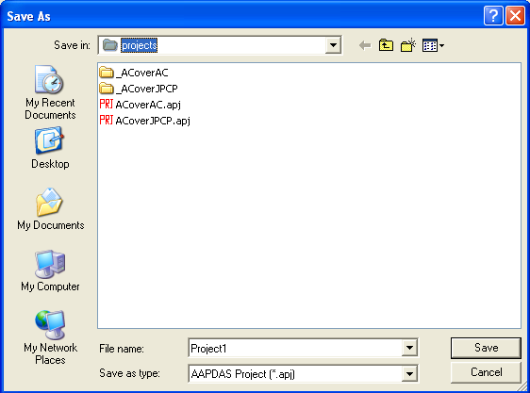
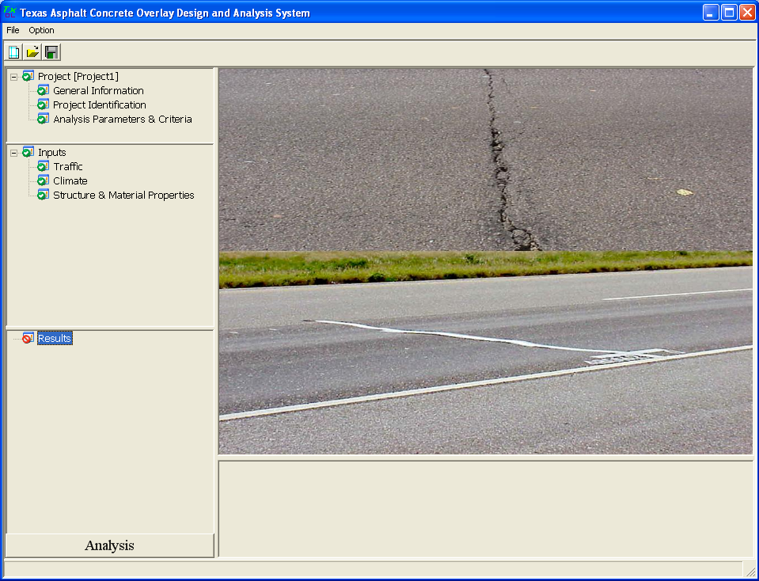
Step 15: Save the Project File
Click the “save” icon to save all these inputs before running analysis
If it is the first time to save the project, this window will pop up and users can input project name here

Slide 29
Step 16: Run Analysis
Click this button

Slide 30
Example 1 (Paris Workshop)
AC over AC
Design life: 10 years
District: Paris, Lamar
Traffic: 5 million ESALs for 20 years
Location: latitude 33°39’, longitude -95°33’, and elevation 600 ft

Slide 31
Example 1 (Paris Workshop) (Continued)
Layer thickness
  AC overlay: 2 inches; Existing AC: 3 inches; Base: 6 inches
AC overlay property
  Mix type: Type D; Binder type: PG 76-22
  Modulus Input Level: Level 3-default values
  Fracture properties and Rutting properties: default values
Existing AC layer property
  Transverse cracking, medium severity, cracking space: 15 ft
  FWD modulus @ 77 °F: 500 ksi
Base
  Type: CTB, Modulus: 200 ksi
Subgrade
  Modulus: By default

Slide 32
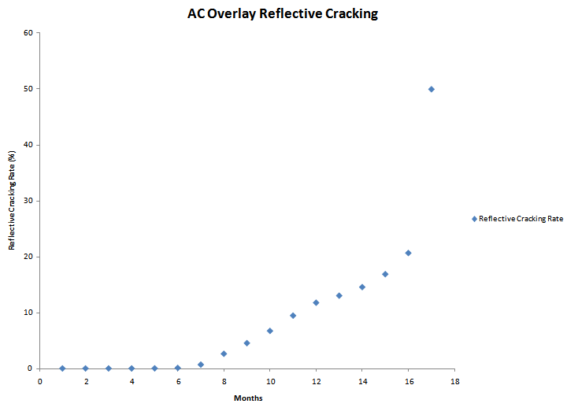
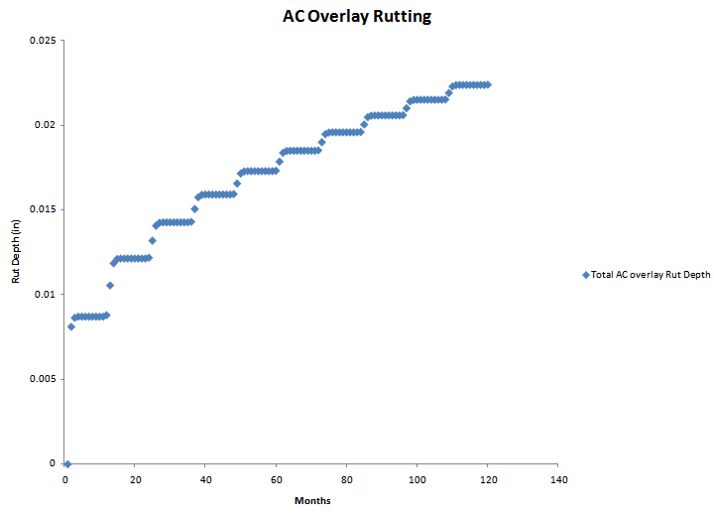
Example 1 (Paris Workshop) Result
Cracking Rutting

Slide 33
Example 1 (Austin Workshop)
Overlay Type: AC over JPCP
Design or Analysis Life: 15 years
District: Austin; County: Travis
Analysis Parameters & Criteria:
Reflective Cracking Rate Limit: 50%
AC Rutting: 0.5 inch
Traffic: ADT-Beginning: 20000; ADT-End: 35000; ESALs: 5.0 million; Speed: 60 mph
Weather Station: Austin/City, Tx

Slide 34
Example 1 (Austin Workshop ) (Continued)
Layer thickness
  AC overlay: 2.5 inches; Existing JPCP: 9 inches; Base: 4 inches
AC overlay property
  Mix type: Type D; Binder type: PG 76-22
  Modulus Input Level: Level 3-default values
  Fracture properties and Rutting properties: default values
Existing JPCP property
  Modulus: 4000 ksi, cracking space: 15 ft, LTE: 70%
Base
  Type: Granular base, Modulus: 50 ksi
Subgrade
  Modulus: By default

Slide 35
Exercise 1
Use “New” function
Change the previous example to 2-lift overlays
The top overlay is the same Type D mix, but its thickness reduces to 1.5 inches
The bottom overlay is 1 inch CAM mix with a PG76-22 binder
All the other inputs are kept the same as Example 1

Slide 36
Exercise 2
Use “Save as” function
Change the previous exercise back to one lift overlay
Select overlay mix: SMA-D with a PG76-22 binder
Keep all the other inputs the same as Example 1

Slide 37
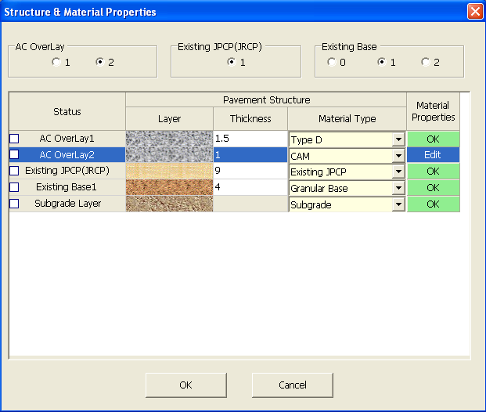
Exercise 2_Hint
Use “save as” function
Click radio button “1” to remove an overlay (Remember: choose/highlight one overlay first)

Slide 38
Summary for Different Overlay Mixes
2.5 inches Type D
After 52 months, Reflective Cracking Rate reaches 50%.
Rut depth reaches 0.084 inches after 15 years (180 months).
1.5 inches Type D +1 inch CAM
After 129 months, Reflective Cracking Rate reaches 50%.
Rut depth reaches 0.3 inches after 15 years (180 months).
2.5 inches SMA
After 129 months, Reflective Cracking Rate reaches 50%.
Rut depth reaches 0.08 inches after 15 years (180 months).

Slide 39
Example 2 – Overlay Thickness Design
Overlay Type: AC over JPCP
Design Life: 10 years
District: Wichita Falls; County: Cooke
Analysis Parameters & Criteria:
Reflective Cracking Rate Limit: 50%
AC Rutting: 0.5 inch
Traffic: ADT-Beginning: 19350; ADT-End: 28800; ESALs: 4.5 million; Speed: 60 mph
Weather Station: Wichita Falls, Tx

Slide 40
Example 2 – Overlay Thickness Design (Continued)
Layer thickness
  AC overlay: Unknown; Existing JPCP: 8 inches; Base: 4 inches
AC overlay property
  Mix type: Type D; Binder type: PG 76-22
  Modulus Input Level: Level 3-default values
  Fracture properties and Rutting properties: default values
Existing JPCP property
  Modulus: 4000 ksi, joint space: 15 ft, LTE: 70%
Base
  Type: Granular base, Modulus: 30 ksi
Subgrade
  Modulus: By default

Slide 41
Trial Thicknesses During Design
Overlay thickness trial 1: 2 inches
Overlay thickness trial 2: 4 inches
After 15 months, Reflective Cracking Rate reaches 50%.
Rut depth reaches 0.05 inches after 15 years (180 months).
After 162 months, Reflective Cracking Rate reaches 50%.
Rut depth reaches 0.077 inches after 15 years (180 months).

Slide 42
Trial Thicknesses During Design (Continued)
Overlay thickness trial 3: 3.5 inches
Obviously for all these cases, the rutting problem is not significant. To meet the 10 years design life requirement, a 4 inches overlay is recommended
After 100 months, Reflective Cracking Rate reaches 50%.
Rut depth reaches 0.07 inches after 15 years (180 months).

Slide 43
Exercise 3
Change the existing JPCP’s LTE to 50%
Keep the other inputs the same as Example 2
The recommended overlay thickness=?

Slide 44
Answer to Exercise 3
5 inches
Trial 1: 4 inches, 69 months
Trial 2: 5 inches, 148 months
Trial 3: 4.5 inches, 105 months

Slide 45
Tips and Reminders
Accept default values if you don’t have specific test results
Use climatic interpolation function when there is no existing weather station available in this area
Use “save as” to reduce some input work
Save the project file before clicking “Analysis” button
Do not move or rename the project file manually

Slide 46
Presentation Outline
Introduction
Program training and exercises
Key inputs for existing pavement and field testing
Key inputs for overlays and lab test

Slide 47
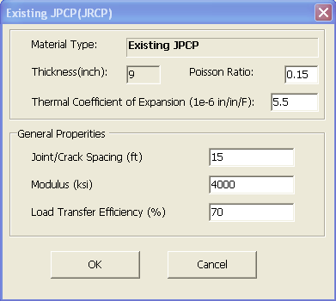
Key Input Parameters for Existing Pavements
Existing pavements
  1) Layer modulus and 2) Joints/cracks LTE
Field testing
  FWD
  RDD

Slide 48
JPCP Pavement Evaluation
For Layer modulus backcalculation
  center slab
  30 drops per section (max spacing: 0.1 mile)
For LTE
  joint measurements
    FWD
    RDD

Slide 49
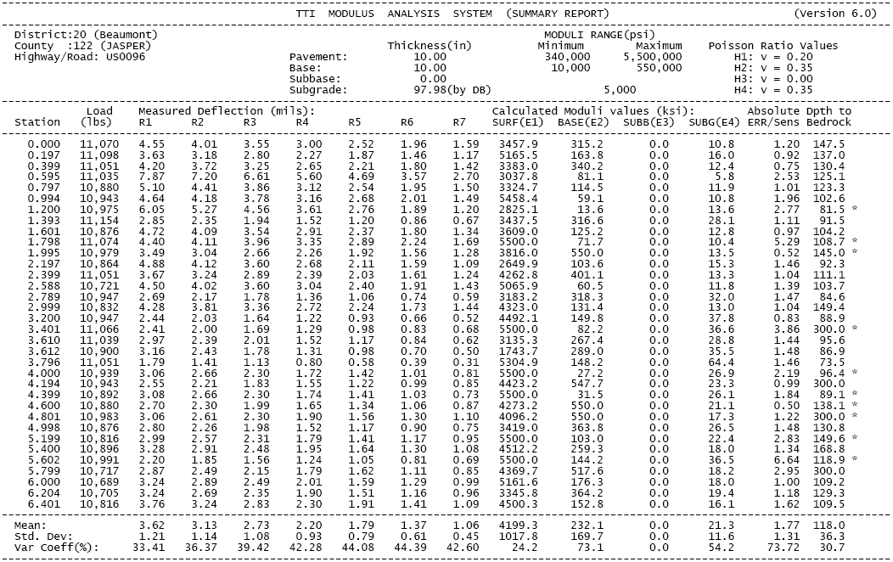
FWD Backcalculated Modulus
In Texas, “MODULUS 6.0” is commonly used for modulus backcalculation

Slide 50
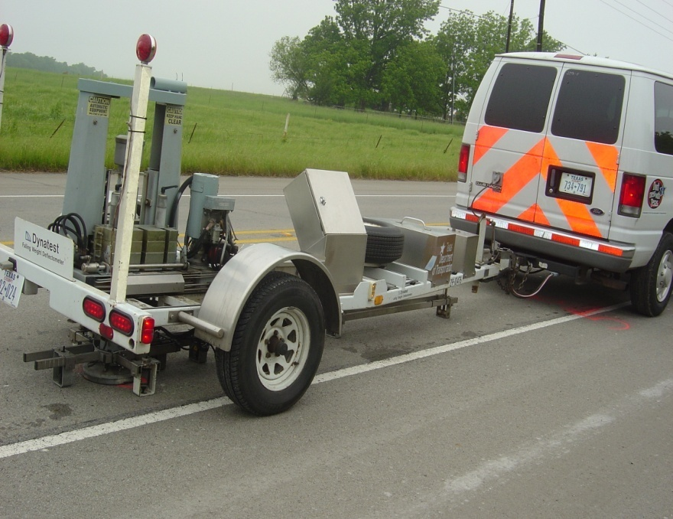
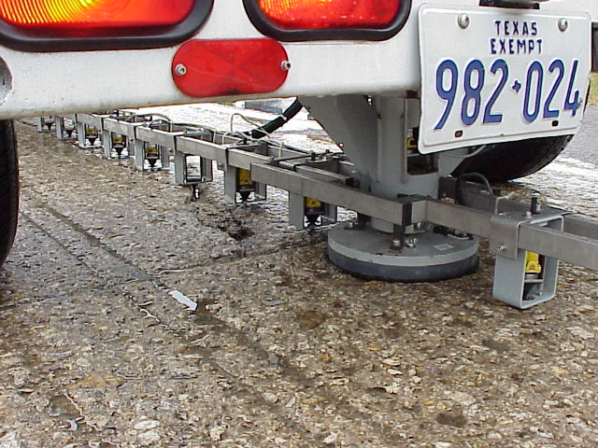
FWD Based LTE at Joints/Cracks
FWD
Load
FWD
Load
W_{1c}
W_{2c}
W_{1j}
W_{2j}
LTE = (W_{2j}/W_{1j})/ (W_{2c}/W_{1c})
Near the slab center
Near the joint/crack

Slide 51
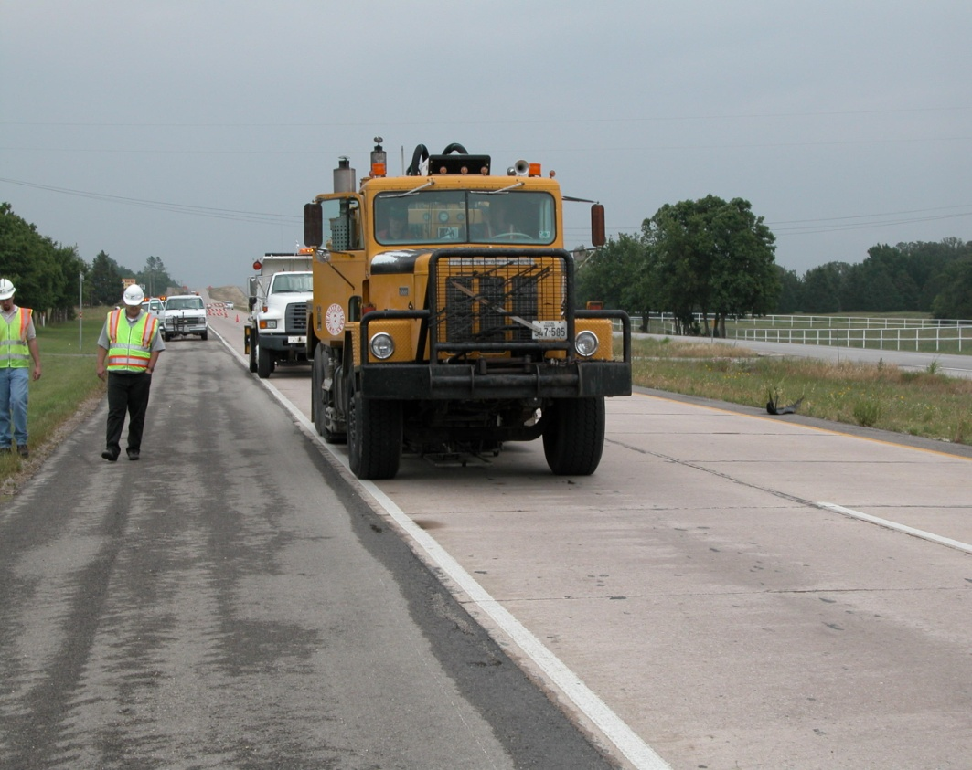
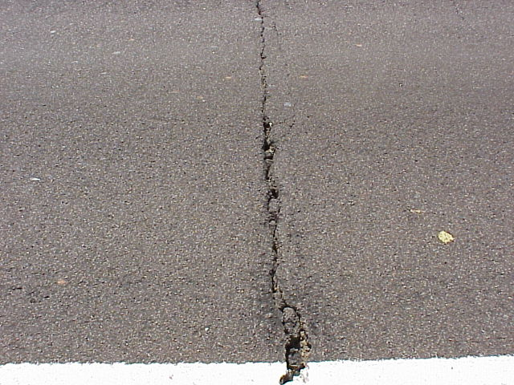
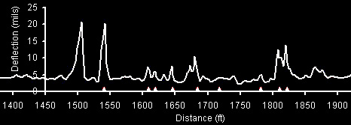
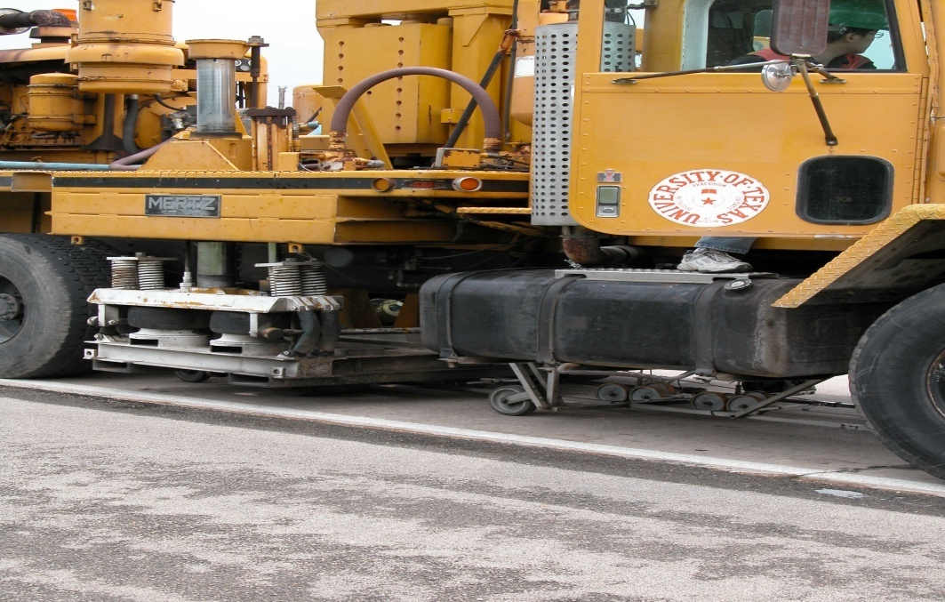
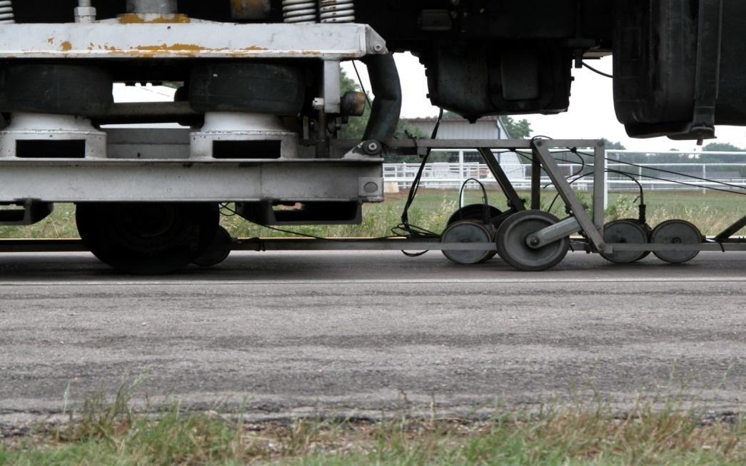
RDD Based LTE Evaluation

Slide 52
RDD Raw Data
Joints
Joint
Quality
Base
Quality

Slide 53
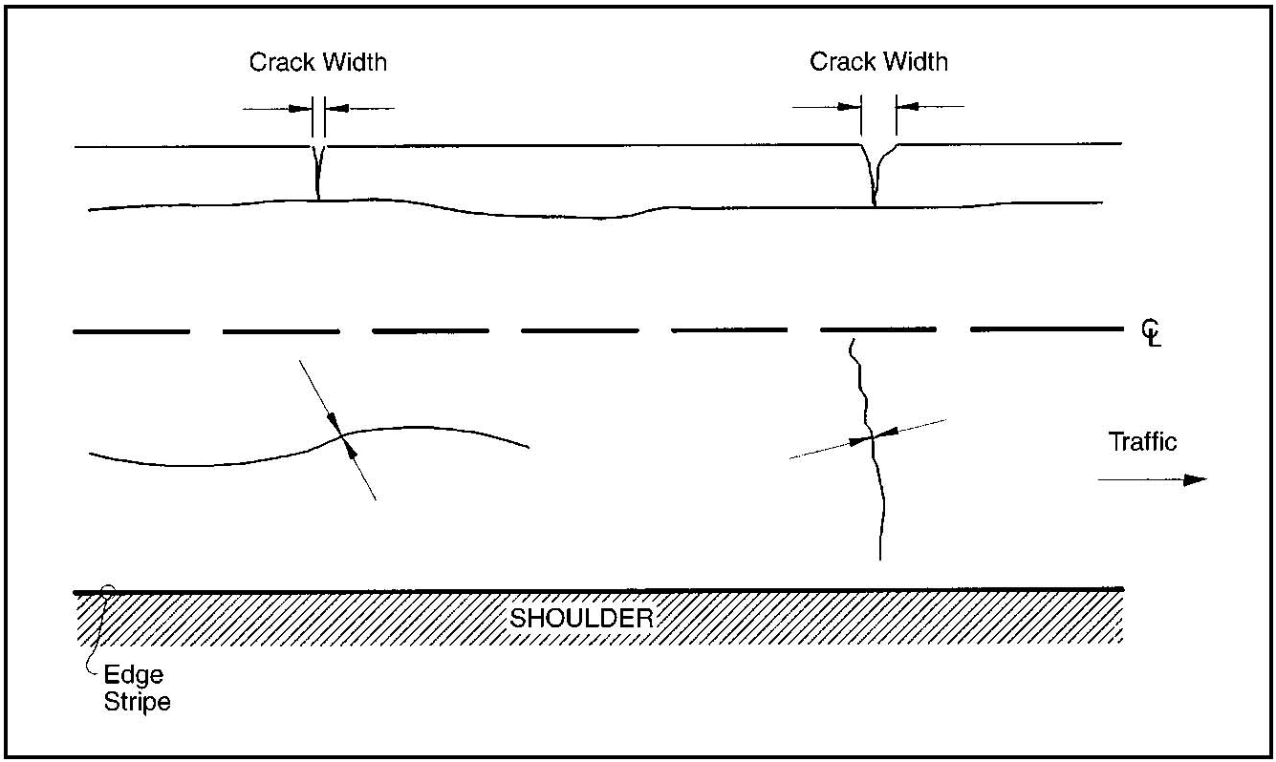
Flexible Pavement Evaluation
For layer modulus backcalculation
  30 drops per section (max spacing 0.1 mile)
For LTE evaluation
  FWD based, similar to JPCP
  Crack severity level base

Slide 54
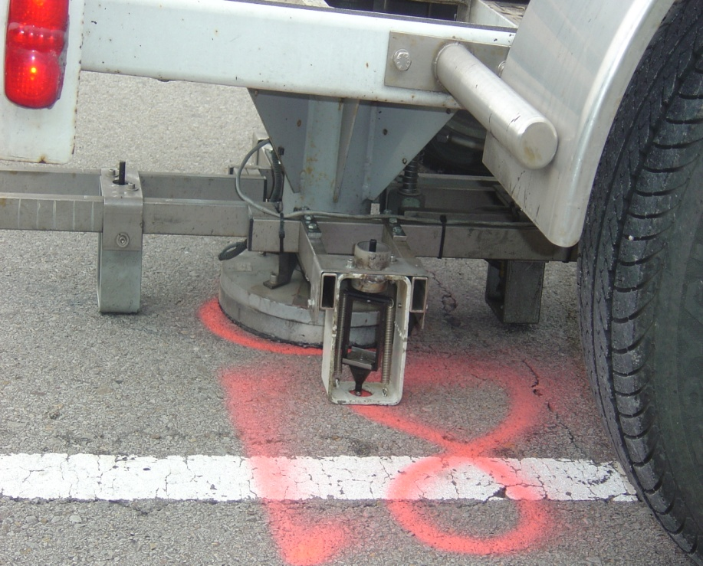
FWD Based LTE Measurement
 |  | Load | Measured | Deflection | (mils):
 |  | Station | (lbs) | R1 | R2 | R1/R2 | LTE (%)
----------------------------------------------------------------------------------------------------------------------------------------
 | Center | 0 | 10,359 | 9.45 | 4.15 | 0.439153
1/2 | Crack | 21 | 10,284 | 10.03 | 3.79 | 0.377866 | 86
 | Center | 67 | 10,355 | 7.31 | 3.55 | 0.485636
3 | Crack | 84 | 10,312 | 10.31 | 3.68 | 0.356935 | 73
 | Center | 99 | 10,244 | 6.56 | 3.34 | 0.509146
4 | Crack | 112 | 10,189 | 10.49 | 4.34 | 0.413727 | 81
 | Center | 136 | 9,795 | 9.04 | 5.14 | 0.568584
5 | Crack | 153 | 10,288 | 11.52 | 4.41 | 0.382813 | 67
 | Center | 169 | 10,300 | 8.48 | 4.07 | 0.479953
6 | Crack | 182 | 10,395 | 6.36 | 3.77 | 0.592767 | 124
 | Center | 196 | 10,153 | 10.19 | 5.63 | 0.552502
7 | Crack | 207 | 10,343 | 8.87 | 4.35 | 0.490417 | 89
 | Center | 222 | 10,228 | 9.73 | 5.33 | 0.54779
8 | Crack | 231 | 10,113 | 11.72 | 4.2 | 0.358362 | 65
 | Center | 248 | 10,077 | 11.04 | 5.7 | 0.516304
9 | Crack | 262 | 10,153 | 10.57 | 4.39 | 0.415326 | 80
 | Center | 290 | 10,145 | 7.09 | 3.41 | 0.480959
10 | Crack | 304 | 10,161 | 8.3 | 3.78 | 0.455422 | 95
 | Center | 325 | 10,252 | 6.8 | 3.82 | 0.561765
11 | Crack | 338 | 10,220 | 10.49 | 4.42 | 0.421354 | 75
 | Center | 351 | 10,276 | 3.81 | 3.01 | 0.790026
12 | Crack | 361 | 10,125 | 13.41 | 4.67 | 0.348248 | 44
 | Center | 373 | 10,220 | 4.08 | 2.91 | 0.713235
13 | Crack | 383 | 10,101 | 10.63 | 4.5 | 0.42333 | 59
 | Center | 405 | 10,010 | 10.61 | 4.92 | 0.463713
14 | Crack | 420 | 10,069 | 12.74 | 5.07 | 0.397959 | 86
 | Center | 440 | 10,220 | 3.33 | 2.72 | 0.816817
15 | Crack | 451 | 10,165 | 4.68 | 2.94 | 0.628205 | 77

Slide 55
FWD Based LTE Measurement

Slide 56
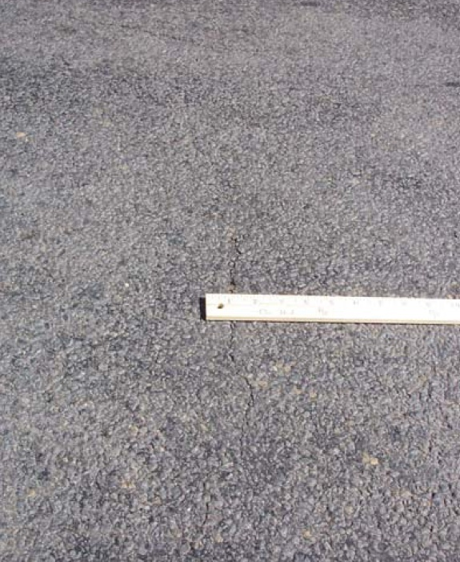


Flexible Pavement-
Severity Level Based LTE
Low
Low severity crack: LTE=85%
  Crack width<1/8"
Medium severity crack: LTE=70%
  1/8"<Crack width<1/4" or any crack (<1/4") with adjacent random low severity cracking
High severity crack: LTE=55%
  Crack width>1/4" or any crack (<1/4") with adjacent random medium to high severity cracking
Medium
High

Slide 57
Presentation Outline
Introduction
Program training and exercises
Key inputs for existing pavement and field testing
Key inputs for asphalt overlays and lab testing

Slide 58
Key Inputs for Asphalt Overlays
Level 1
Dynamic modulus |E*|
Fracture properties (A and n)
Rutting properties (α and µ)

Slide 59

Dynamic Modulus |E*|
Test equipment
Sample size:
4" diameter by 6" high
Replicates: 3

Slide 60
Dynamic Modulus |E*| (Continued)
5 test temperatures:
14, 40, 70, 100, and 130°F
6 loading frequencies:
25, 10, 5, 1, 0.5, and 0.1Hz
Sample |E*| values (ksi)
 | 25Hz | 10Hz | 5Hz | 1Hz | 0.5Hz | 0.1Hz
14°F | 2346.7 | 2307.4 | 2175 | 1810 | 1682 | 1378
40°F | 1843 | 1687 | 1498 | 1080 | 916 | 619
70°F | 820 | 597 | 467 | 280 | 223 | 139
100°F | 161 | 118 | 96 | 64 | 54 | 40
130°F | 61 | 50 | 43 | 32 | 29 | 23

Slide 61

Dynamic Modulus |E*|
Input interface in the program

Slide 62

Fracture Properties: A & n
Fracture model

Slide 63

Fracture Properties A & n (Continued)
Test equipment: Overlay Tester
  Step 1: Modulus Test
  Step 2: Cracking test to obtain A, n
  Three replicates required

Slide 64


Fracture Properties A & n (Continued)
Modulus test –preparing samples
Sample glue gig

Slide 65


Fracture Properties A & n (Continued)
Modulus test – installing new base plates
Regular
OT
Machine
OT-E*
System

Slide 66


Fracture Properties A & n (Continued)
Modulus test – mounting
No glue on the bottom.

Slide 67

Fracture Properties A & n (Continued)
Cracking test
Same as regular OT test except with a
smaller opening displacement: 0.017”

Slide 68


Fracture Properties A & n (Continued)
Excel macro to determine A & n
Input
Output

Slide 69
Fracture Properties: A & n
Input interface in the program

Slide 70

Rutting Properties α & μ
Rutting model

Slide 71


Rutting property α & μ (Continued)
Test equipment: same as |E*| test
Test conditions
10,000 load repetitions
0.1s loading+0.9s rest
2 replicates required

Slide 72


Rutting Properties: α & μ (Continued)
α & μ determination method

Slide 73
Rutting Properties: α & μ (Continued)
Input interface in the program

Slide 74


Lab Test Summary
Dynamic modulus |E*|test 3 replicates
Rutting properties (α & μ) test 2 replicates
Cracking properties (A & n) test 3 replicates

Slide 75
Questions?

Slide 76
Assistance needed?
Contact TTI research team:
  by email
    Sheng Hu: S-hu@ttimail.tamu.edu
    Fujie Zhou: F-zhou@ttimail.tamu.edu
    Tom Scullion: T-scullion@tamu.edu
  by phone
    Sheng Hu: 979-845-9767
    Fujie Zhou: 979-458-3965
    Tom Scullion: 979-845-9913

Slide 77
Thank you!

Slide 78


Slide 79


Slide 80


Slide 81


Slide 82


Slide 83


