Slide 1
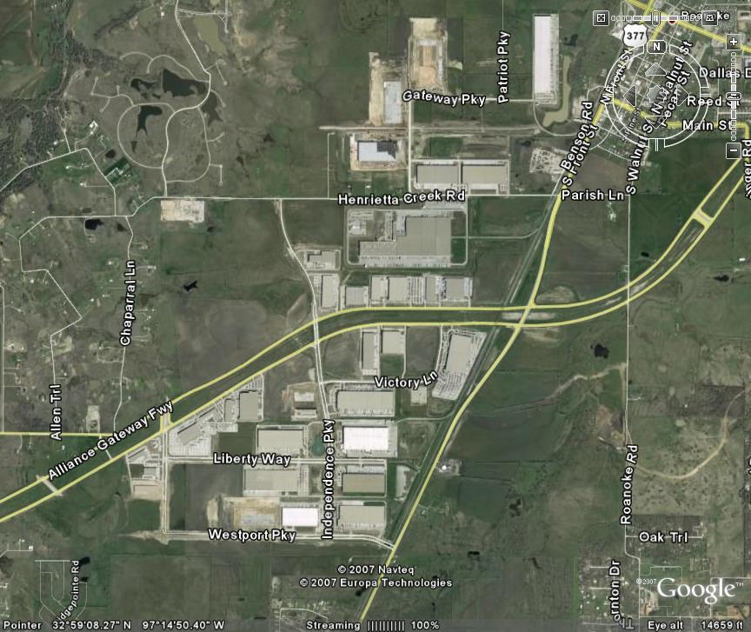
TEAMING FOR SUCCESS “TxDOT is here to help”
Site Selection and Access For Large Distribution Centers
Several DCs in industrial park near Alliance Airport
Notes:
Note to Presenters:
These slides are intended to be used as a free-standing brief presentation or within larger presentations to describe and promote the advantages of involving TxDOT early in the distribution center site selection process. The purpose is to involve TxDOT early so TxDOT can help site selectors find sites that do not need major highway improvements to become suitably accessible. Where improvements would be needed, these slides describe how TxDOT can help and how. These presentations would usually be made by:
The Governor’s Office of Economic Development and Tourism in its briefings of site selectors;
TxDOT’s Government and Public Affairs Division when it receives inquiries from site selectors or others;
TxDOT district engineers in briefings of local leaders, economic development agencies, or others within their districts; and/or
Local economic development agencies in their own briefings to site selectors.
The presenter notes at the bottom of each slide explain the main message of each slide. They are talking points and not intended for use as a verbatim script. For most effective use, review both slide contents and presenter notes in advance and select points to be made based on both the audience and objectives of your presentation.
Please be sure to fill in the appropriate contact information on the final slide.
=======================================================================================
Slide 1
Over the past 20 years many large distribution centers have been built in Texas.
Large distribution centers are highly sought after as economic generators
Jobs: often 300-1000
tax base: often $100m or more
Distribution center site selectors usually seek low cost rural or peripheral urban locations without congestion; they often consider costs before access.
Small communities seek these distribution centers as major economic development opportunities and often offer large financial incentives to attract the them to their communities.

Slide 2
Texas Economic Development
A TxDOT goal
TxDOT is here to help
Notes:
Slide 2
One of TxDOT’s strategic agency goals is to support economic development efforts throughout Texas
Assisting site selectors to identify accessible locations for new distribution centers in Texas is consistent with that goal.
TxDOT can help most if involved early – during site selection.

Slide 3
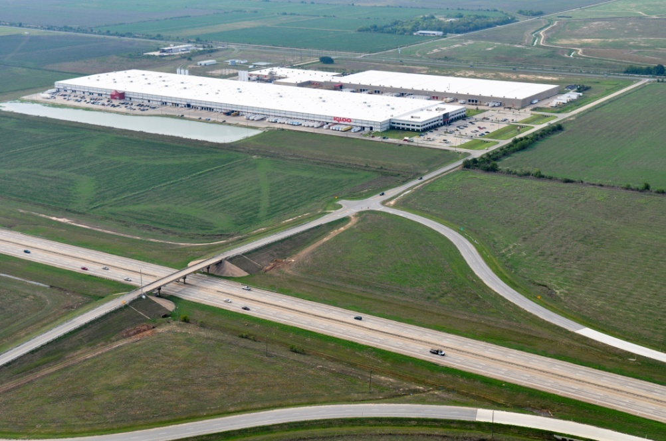
Common Site Selection Criteria
Central to outlets served
Low cost site
Interstate Highway access
Existing or provided infrastructure
Qualified available local workforce
Financial incentives
Igloo distribution center, Katy
Notes:
Slide 3
Distribution center owners, site selectors, and developers employ site selection criteria.
Three of these criteria relate to access:
Interstate Highway access
Existing/available infrastructure
Financial incentives/subsidies
Distribution center owners want access to Interstate Highway interchanges that are “truck ready.”
Low cost rural sites often do not have:
Interstate Highway truck ready interchanges, and
Sufficient highway connections to proposed sites

Slide 4
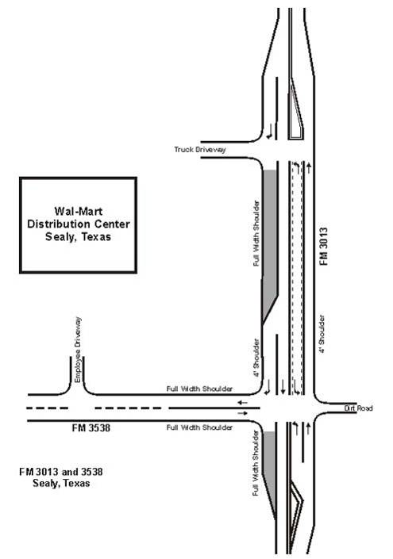
Example – Site Needing Extensive Improvements
New interchange ramps, new FM road, widen existing FM road, intersection improvement & signal
NEW
DC
(now) FM 3538
Notes:
Slide 4
Here is one Texas example:
Existing Interstate Highway interchange has short radius ramps; not sufficient for high volumes of trucks.
Existing truck volumes were high along connecting state highways
Intersection along access route needed signalization and turn lane.
FM road (3013) on which site is located needed left turn, right turn deceleration lanes added (highlighted in green and shown in sketchet).
Additional solution (also highlighted in green):
“New” interchange (2 ramps) and new FM road to connect interchange to distribution center site
Challenges:
TxDOT was not brought into the site selection process; was only approached when access improvements and access permits were about to be requested.
There was not enough lead time to develop designs, find and secure funding, and complete construction before the distribution center was to open.
Result – access improvements were not ready when distribution center opened.

Slide 5
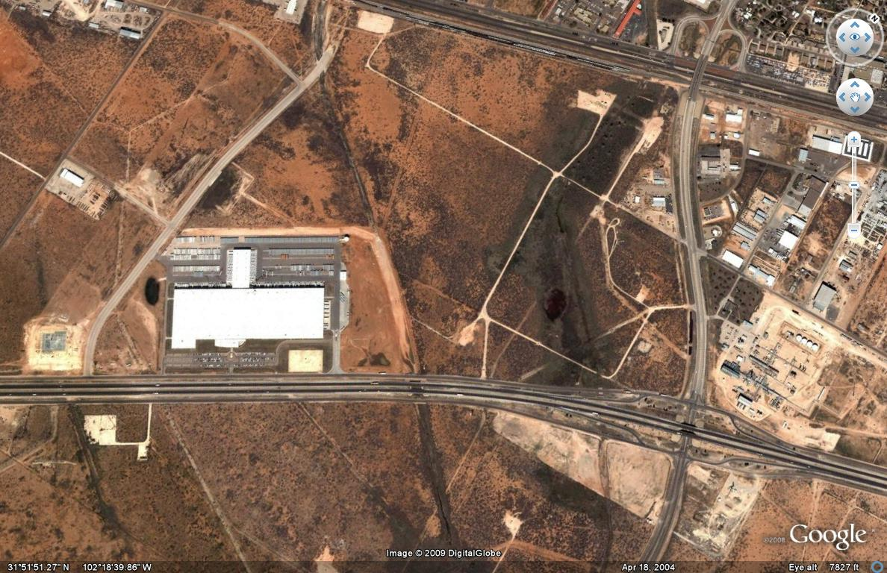
Other Examples
Additional access to Interstate highway
Notes:
Slide 5
Two other examples with similar requests:
TxDOT brought in after sites selected.
Each distribution center owner asked for additional interchange closer to distribution center site.
Each interchange was planned for future construction (5-10 years in future)
Distribution center owner requested TxDOT to advance construction to current program
No TxDOT funding was available
For the distribution center at left, a signal was requested to facilitate use of existing interchange to the east (right) and the road at the top of photo to reach the site
For the distribution center on the upper right, interchanges 1 mile to east (right) and 2 miles to west were used until new interchange could be completed.
Interchanges were not completed until several years after opening (not shown in these photos)
One was funded with reprogrammed funds
One was funded by distribution center owner and adjacent property owners

Slide 6
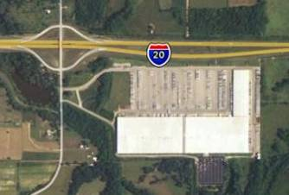
TxDOT Can Help
You can help TxDOT help you
Target distribution center, Tyler
Notes:
Slide 6
TxDOT can help distribution center site selectors and developers.
TxDOT wants to help.
TxDOT can provide benefits if brought in early in the site selection process.
Here’s how… (next slide)

Slide 7
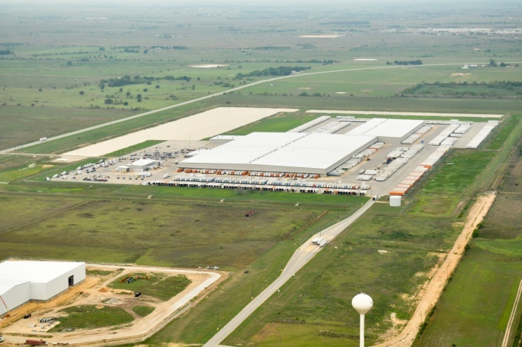
Available From TxDOT
Site selection criteria
Save time and money
Access
Road improvements
Information about highway improvements
Steps to obtain state highway improvements
Improvements
Funding
Schedules/lead time
Access permits to state highways
Best practices for site selectors
Wal-Mart distribution center, Sealy
Notes:
Slide 7
TxDOT can assist early site selection
This information is available through:
Texas Governor’s Office of Economic Development
TxDOT Government and Public Affairs Office
TxDOT district offices

Slide 8
TxDOT Suggestions Distribution Center Site Location
Served by existing Interstate/regional freeway interchange
“Truck ready”
Underutilized
On highway without congestion
Existing site connection to interchange
4 lane or “Super 2” lane road
No congested locations
Pavement designed for heavy truck traffic
Assess access needs before committing to site
Notes:
Slide 8
TxDOT suggests these access-related criteria as starters when seeking a site for a large distribution center.
Needs for site access and any road improvements can be determined or confirmed through a traffic impact analysis (TIA). Traffic engineering consultants with experience preparing these analyses can usually complete a study within six weeks.

Slide 9
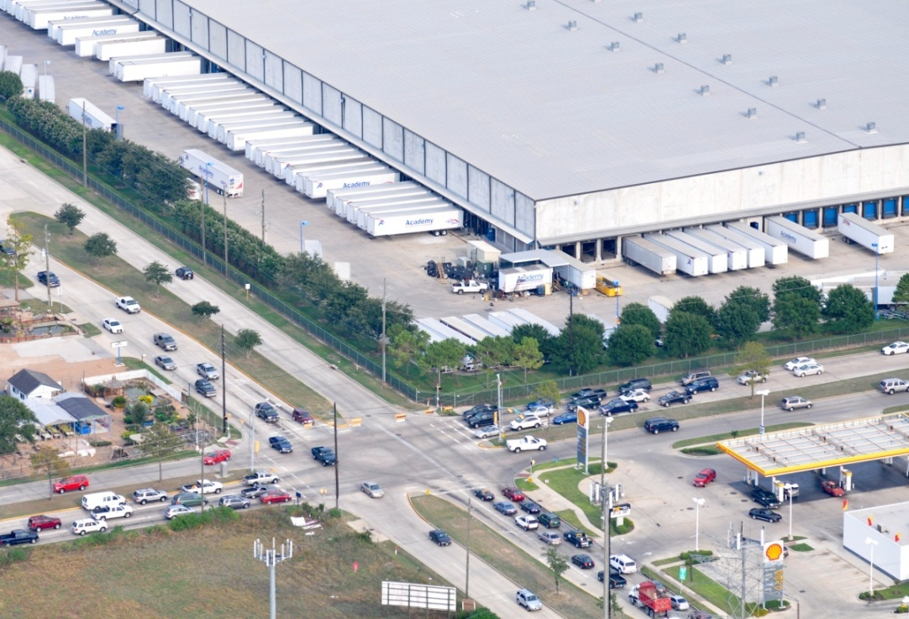
Other Helpful Tools from TxDOT
Traffic impact analysis checklist
Site plan review checklist
Site access permit application
Notes:
Slide 9
TxDOT recommends that a traffic impact analysis be complete for any large distribution center (over 500,000 square feet) to:
Determine access needs;
Assess impact on nearby traffic conditions;
Assess safety considerations; and
Identify any roadway improvements that are needed.
TxDOT district offices can work with distribution center developers to outline a scope of work appropriate to a site under consideration.
TxDOT can also provide a site plan review checklist they use when reviewing site access permit applications.

Slide 10
TxDOT is here to help
Contact:
(Presenter of TxDOT District Office)
Or
Alicia Taliaferro
TxDOT Government and Public Affairs
512-475-1395
ataliaf@dot.state.tx.us
Notes:
Slide 10
TxDOT is ready and willing to help.
For assistance contact… (see slide – add a local contact if appropriate for this presentation’s audience)

