Slide 1
A Simple Approach for the Auralization of Moving Sources
Aaron Hastings
Inter-Noise 2015
The National Transportation Systems Center
U.S. Department of Transportation
Office of the Secretary of Transportation
John A. Volpe National Transportation Systems Center
Advancing transportation innovation for the public good

Slide 2
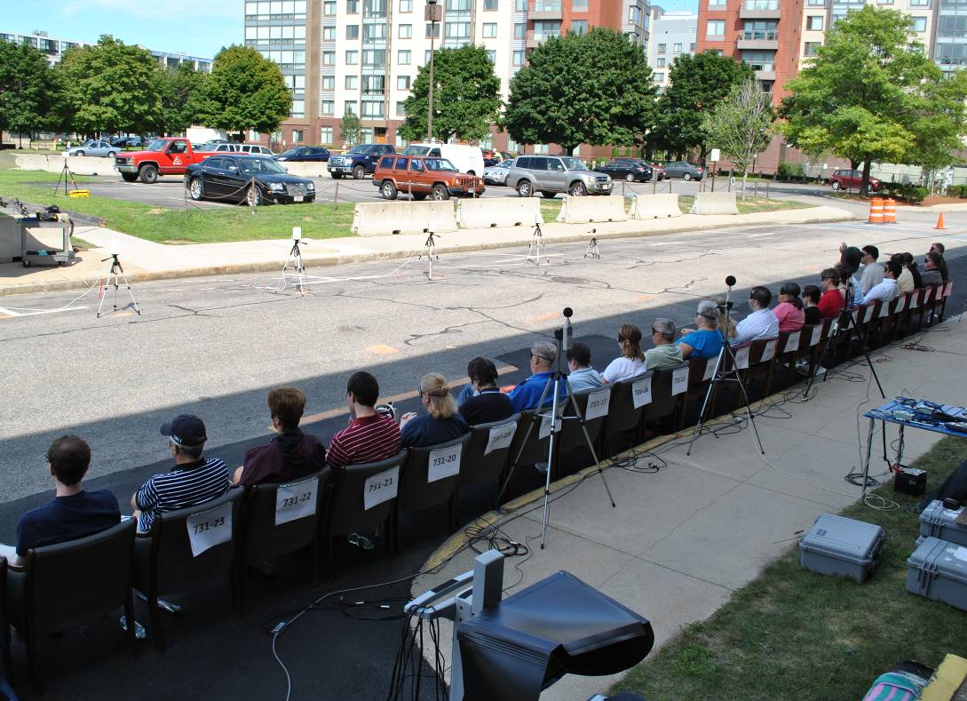
Background
Needs
Sound Signal Development – Human Response Testing
Soundscape Simulation – Community Outreach
Software to Auralize Moving Sources
Commercial / Proprietary
Source / Environment Specific
Optimized for Speed
Method Requirements
Signal and Processing Agnostic
Modifiable / Extensible
Open / Transparent Implementation
Near Real-time
Batch Processing
In Situ Testing: Time, Expense, Accuracy
Notes:
Needs
Sound Signal Development – Human Response Testing (performance, annoyance, etc.)
Soundscape Simulation – Community Outreach
Software to Auralize Moving Sources
Commercial / Proprietary ( Research: DIVA at the Helsinki University of Technology, RAVEN at Aachen University. Commercial: B&K. Gaming: Unity, Blender)
Application Specific (Game Development, Architectural, Research Tools for Specific Sound Environments)
Approach Requirements
Signal and Processing Agnostic
Modifiable / Extensible
Open / Transparent Implementation
Near Realtime
Batch Processing

Slide 3
Assumptions
Point Source in Far Field
Ray Acoustics
Homogeneous Atmosphere
Free Field Propagation
No reflections, edge diffractions, etc
Add hard ground using image sources
Receiver & Source:
Translate in X, Y, Z
Rotate horizontally (azimuth) & vertically (elevation)
Receiver
Translation removed after source defined
source
receiver
Image source
Notes:
Current focus is handling moving sources
Future focus on advancing propagation modeling

Slide 4
Implementation
Matlab Main Function
Sub-routines
Allow Switching Methodologies
May Require Additional Assumptions
Sub-routines:
Define Receiver
Define Source
Define Signal at Source
Determine Time Delay for Propagation
Determine Attenuation (Divergence, Atmospheric Absorption)
Adjust for Signal Directivity
Adjust for Receiver Head Related Transfer Functions (HRTFs)
Output Signal
Notes:
Modular implementation

Slide 5
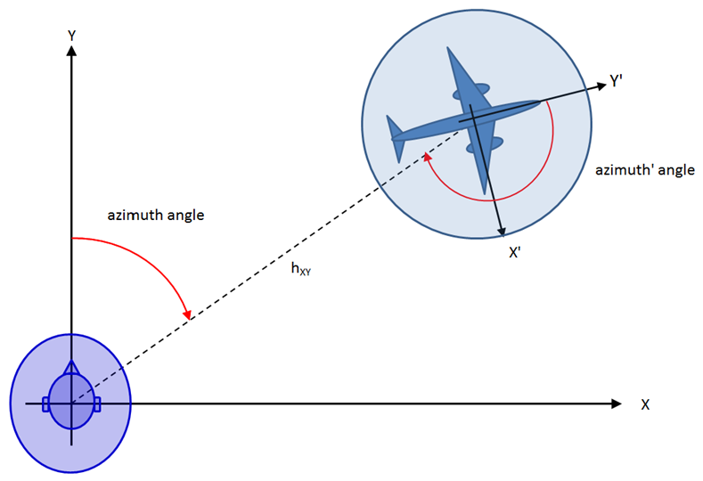
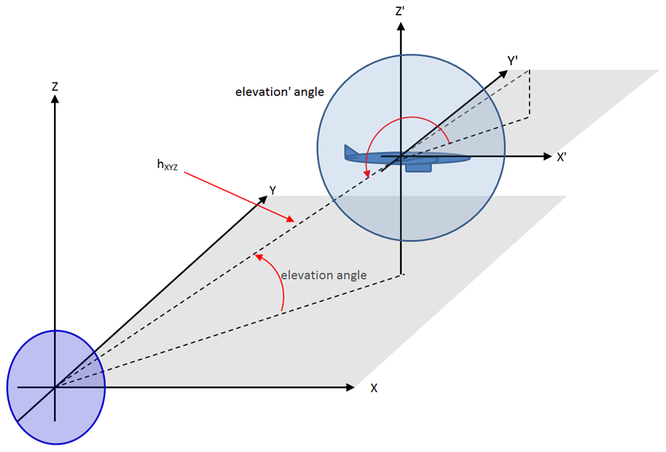
Defining Receiver and Source
Flat Earth X, Y, Z (RHR)
Horizontal (Azimuth) Angle
Vertical (Elevation) Angle
Receiver Defined First
Receiver Translation Removed during Source Definition
Subtract Receiver Translation Vector from Source Translation Vector
Receiver and Source Angles Computed after Receiver Translation Removed
Final Distances and Angles Defined for Fix Reference Frame Centered on Receiver

Slide 6
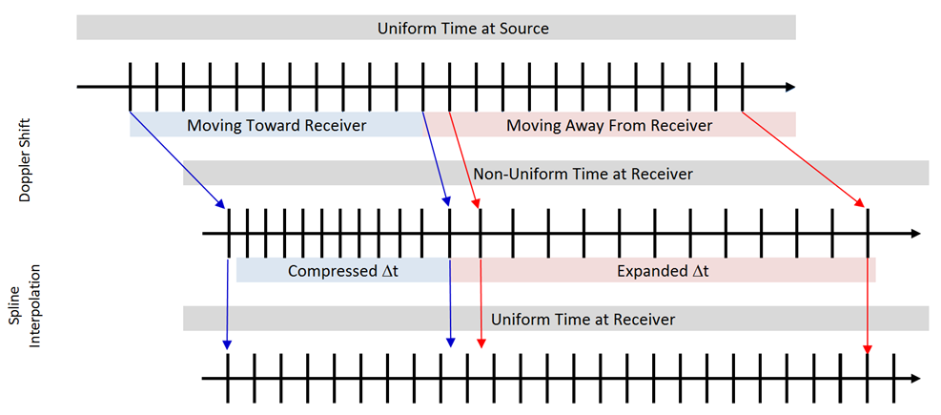
Defining Signal
Signal can be Defined Using:
Stationary time signal
Parametric formulae
Sinusoids and band-limited noise
Propagation from Source to Receiver:
Time Delay → Produces Doppler Shift
Non-uniform time intervals at receiver
Interpolation used to generate uniform time at receiver
Interpolation:
Nearest Neighbor
Linear
Spline
Lagrange
Whittaker-Shannon
Lanczos
Doppler Shift Obtained Here
Uniform Time Sample
Recovered, Preserving
Doppler Shift
Notes:
Reference: Non-Uniform Sampling in Statistical Signal Processing -- Frida Eng
Assuming low speeds relative to C
Interpolation: Uniform or non-uniform, periodic or aperiodic
Lantsohsh

Slide 7
Free-field Attenuation
Divergence – 6 dB / doubling
Atmospheric Absorption: ISO 9613-1
Function of Frequency and Distance
Frequency Associated w/. Time Interval
Distance Associated w/. Single Sample
Approach:
Develop Filters for Each 3 dB of Overall Attenuation
Linear Interpolation: Weighted average of two nearest distances for each sample
Frequency (Hz) | Attenuation (dB/m) | Frequency (Hz) | Attenuation (dB/m)
50 | 7.81E-05 | 800 | 3.91E-03
63 | 1.22E-04 | 1000 | 4.66E-03
80 | 1.94E-04 | 1250 | 5.71E-03
100 | 2.94E-04 | 1600 | 7.45E-03
125 | 4.40E-04 | 2000 | 9.89E-03
160 | 6.71E-04 | 2500 | 1.36E-02
200 | 9.54E-04 | 3150 | 1.97E-02
250 | 1.31E-03 | 4000 | 2.97E-02
315 | 1.74E-03 | 5000 | 4.42E-02
400 | 2.24E-03 | 6300 | 6.76E-02
500 | 2.73E-03 | 8000 | 1.05E-01
630 | 3.27E-03 | 10000 | 1.59E-01
$$p\left(d_{i}\right)=\frac{1}{2}p\left(d_{i},h_{nearer}\right)\frac{d_{farther}−d_{i}}{d_{farther}−d_{nearer}}+\frac{1}{2}p\left(d_{i},h_{farther}\right)\frac{d_{i}−d_{nearer}}{d_{farther}−d_{nearer}}$$
$$p\left(d_{i},h_{nearer}\right)=\left(p∗h_{nearer}\right)\left(t\right)|_{t→d_{i}}$$
Notes:
Sums to 1 if hnear = hfar

Slide 8
Adjusting for Directivity and HRTFs
Measured HRTFs
Center for Image Processing and Integrated Computing (CIPIC) at U.C. Davis
Azimuth Angles: +/- 80, 65, 55, 45, 40, 35, 30, 25, 20, 15, 10, 5, 0 deg
Elevation Angles: : -45 to 230.625 deg (5.625 degree increments)
Angles Relative to Head Orientation
Directivity
Uses Monopole unless directivity provided
Same format as for HRTFs
Angles based on Fixed Reference Frame (Independent of Head Rotation)
Interpolation
Similar to that used for Atmospheric Absorption
Except nearest neighbors determined for azimuth and elevation: Bilinear Interpolation
Notes:
Note in paper just used a linear interpolation weighting applied to both, simpler, but a rougher estimate. Bilinear is better.

Slide 9
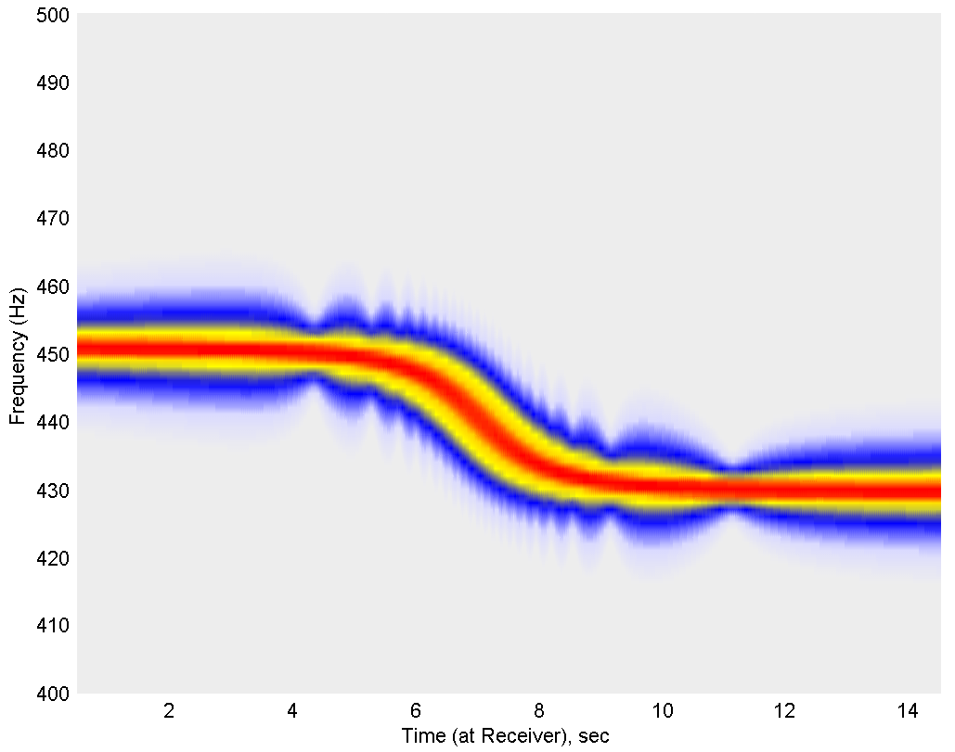
Sample Results
Spectrogram of 440 Hz pure tone source signal passing by receiver at 8.33 m/s with perpendicular distance of 10 m. No head-related transfer function or source directivity is applied.
Notes:
Bigger fonts, () for sec

Slide 10
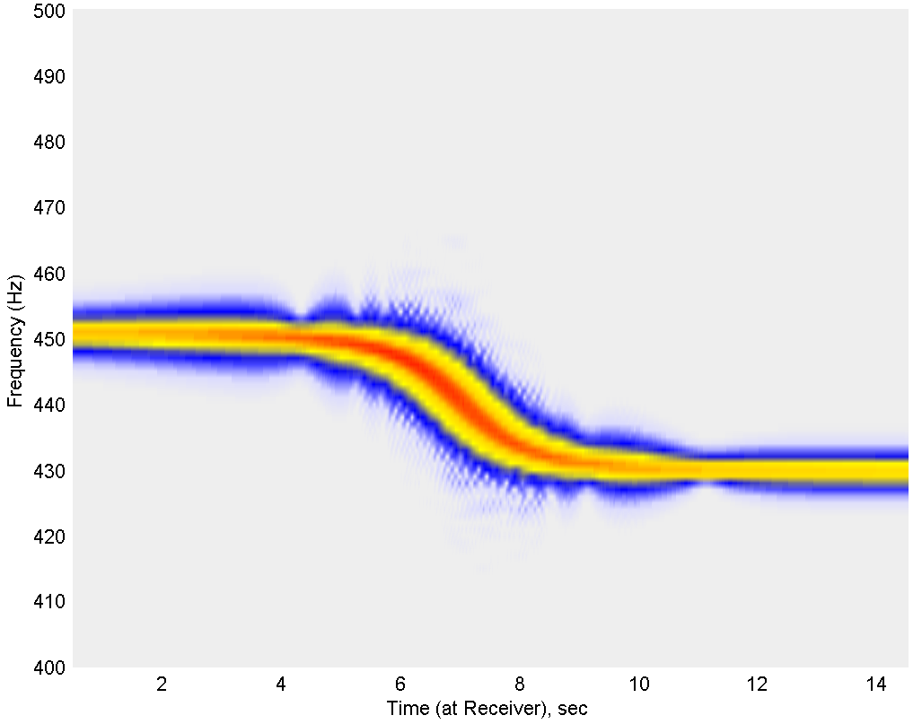
Sample Results
Spectrogram of 440 Hz pure tone source signal passing by receiver at 8.33 m/s with a perpendicular distance of 10 m. Head-related transfer function applied by using a weighted interpolation.

Slide 11
Next Steps
Extend Functionality to Include Reflections (e.g. Ground Effects) and Edge Diffractions (e.g. Shielding)
Improve Interpolation Functions
Add HRTFs with Higher Spatial Resolution
Add Dipole, Cardioid, etc. Directivity Patterns
Add other Atmospheric Absorption Standards
Develop Library of Standard Sound Sources
Develop Library of Standard Source Trajectories
Add Metric Computations and Calibrations for Signal at Source and at Receiver

Slide 12
Questions / Comments?
Aaron.Hastings@dot.gov

