Slide 1
Utilizing Traffic Simulation Tools with MOVES and AERMOD
Extended Abstract 2011-A-717-AWMA
Presented by George Noel, Dr. Roger Wayson, and Adam Klauber

Slide 2
Overview
Quantify the emissions and fuel consumption associated with traffic congestion from Commercial Motor Vehicle (CMV) crashes
Project Description
Traffic Simulation
Emissions Analysis
Future Use with Dispersion Analysis

Slide 3
Field CMV Crash Delay Data
All States contacted for crash data – Kentucky and Pennsylvania contributed statewide CMV crash closure duration and location data
Attribute | Kentucky | Pennsylvania
Location | Road mile marker | Latitude/longitude
Duration | Discreet value of lane closure | 7 range values for incident (e.g. 0-30 min.)
Severity | Fatal, Injury, Property Damage Only (PDO) | Fatal, Injury, PDO
Truck type | No data | Yes
Urban/rural distinction | As defined by Kentucky State Highway Patrol | As defined by PennDOT
Vehicle configuration | 4 truck types, 2 bus types | 7 truck types, 2 bus types
Other relevant data | Hazmat presence, other involved vehicles | # injuries/fatalities, Hazmat presence

Slide 4
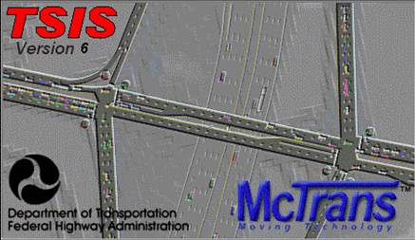
CMV Crash Delay TSIS-CORSIM Tool
TSIS (Traffic Software Integrated System) CORSIM (CORridor-microscopic SIMulation program) version 6.2 (Feb. 2010)
Components
NETSIM for urban streets (or rural non-freeway)
FREESIM for freeways
Investigation Sequence
Simulation Design → Translation → Processing → Outputs
TRAVU (Animation)
NETSIM
CORSIM
TSIS-CORSIM TOOL
TRAFED or
Coding
FRESIM
Text Editor (Code)

Slide 5
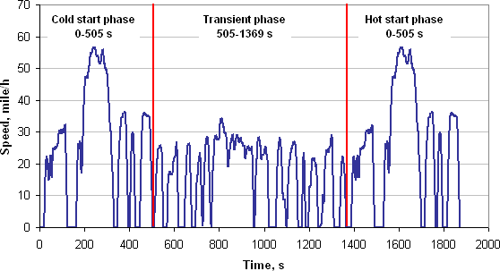
Problem: Emissions Traffic Modeling Did Not Directly Align with Emissions Modeling
Emissions estimations relied on simplistic vehicle performance (MOBILE)
Constant velocities
Non-validated idling times
Limited set of pre-defined drive cycles
What happened with emissions values?
Non-alignment with traffic simulations
Low fuel burn estimates (paradoxical results)
Low nitrous oxides (NOx) estimates
Vehicle Drive Cycle Example
From: http://www.daham.org/basil/leedswww/emissions/drivecycles.htm

Slide 6
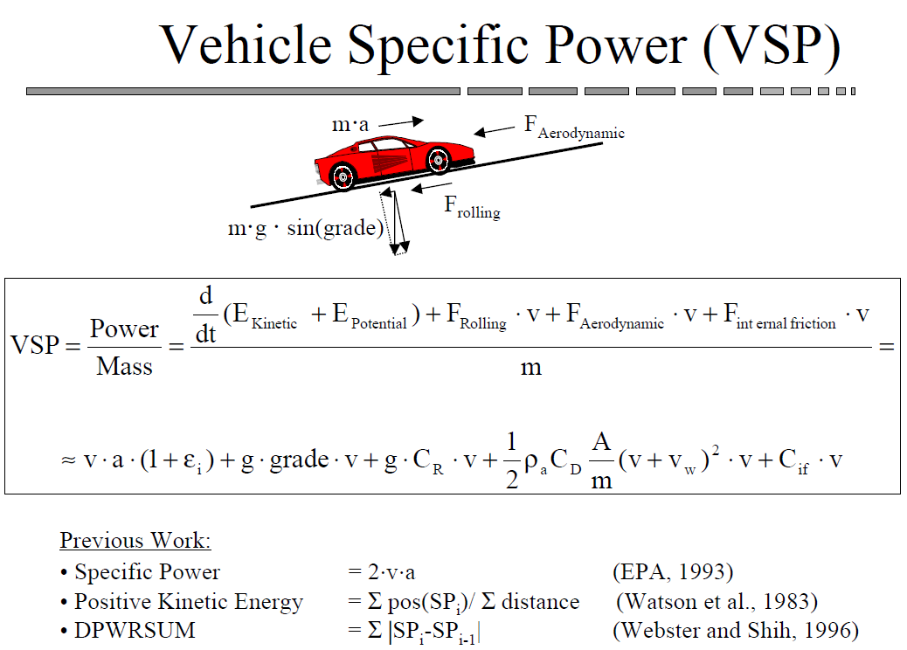
Solution: Traffic Simulation Animation Files to Provide Vehicle Specific Power
Inquiries to subject matter experts revealed possible solution
Obtain animation file vehicle time-step data from traffic simulation
Translate vehicle performance (in binary code) to database via Volpe Center developed parser tool. Actual performance factors:
Vehicle aerodynamic drag
Road surface friction
Inertia forces
Utilize vehicle specific power equation to calculate more accurate engine performance
Run US EPA MOVES model on project level to obtain associated emissions estimates
From: Jimenez, J et .al. “Vehicle Specific Power: A Useful Parameter
for Remote Sensing and Emission Studies” 1999

Slide 7
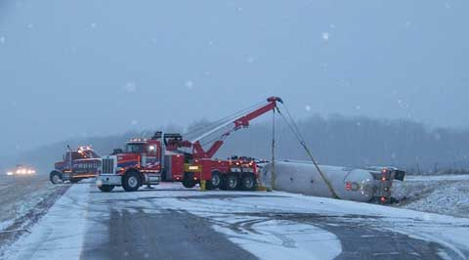
Traffic Simulations Overview
Traffic Simulation runs (TSIS CORSIM tool – version 6.2)
Baseline cases (without crashes) Monte Carlo 10 runs each
Crash scenarios, Monte Carlo 40 runs each
Full closures (15 minutes; 1½ hour; 4 hr) diversions for longer 2 runs
Partial closures (same durations as full closure)
Network configurations
Expressway, urban & rural (without surface network)
Arterial, urban only (with connected expressway)
Other, urban & rural local/collector/minor arterial (with connected expressways)

Slide 8
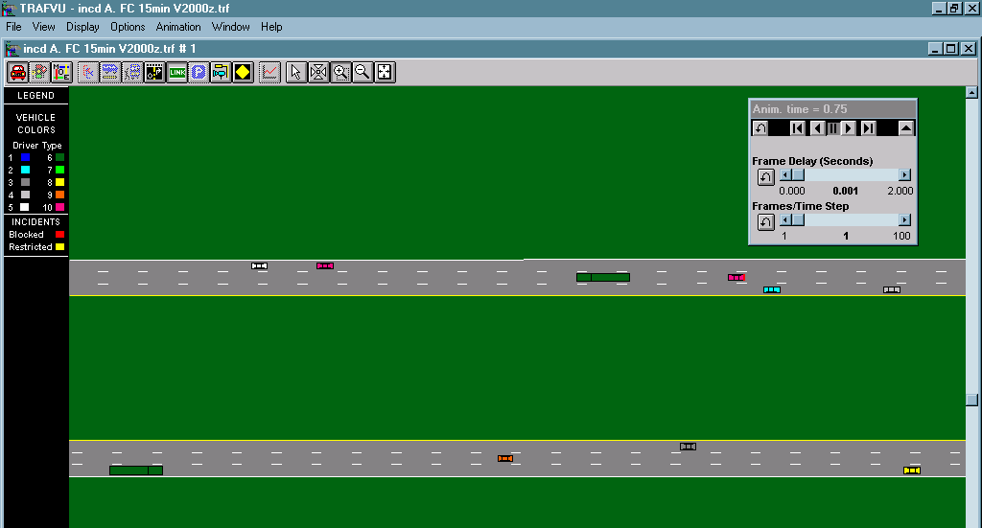
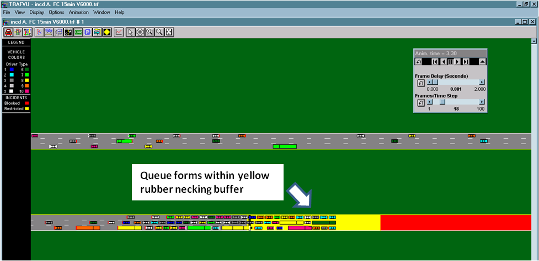
Traffic Simulation Details
Baseline Scenario Runs
Facilities 5 representational categories
Volumes (50-6,000 vehicles per hour)
Lane Number range (2-6 bi-directional) HPMS data
Fleet Composition
Speeds Freeflow (HPMS data)
Crash Scenario Runs
Baseline Facility, Volume, Freeflow, Volumes, Fleets, and Speeds
Land closure durations (Kentucky and Pennsylvania Field Data)
Partial and Full Closures
Rubber-necking Factor (ORNL research)
Baseline Scenario
Crash Scenario

Slide 9
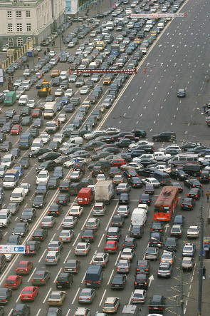
Traffic Simulation Details
Scenario Observed Requirements
Roadway length sufficient to contain traffic queues
Extended duration road and lane closures
Freeway utilizes TSIS-CORSIM incident feature
Non-freeway necessitated alternative introduced measures (e.g. dummy traffic controls, etc.)
Deterministic vehicle/driver performance for diverted traffic
Traffic Simulations Output
Delay distributions (median value selected) baseline delay subtracted
Animation files for translation to time-step data (TSD)

Slide 10
Emissions Analysis
Emissions Analysis Methodology
Parsing of TSIS-CORSIM Binary Files
Utilize Parser Application developed by Volpe
Parser reads second by second CORSIM animation file data and calculates VSP
VSP is calculated for each Link and separated by vehicle type
Motor Vehicle Emission Simulator (MOVES) 2010a
Parser Application creates an output table that utilizes MOVES Operating Mode Distribution feature
Operating Mode Distribution determines drive cycle across each link for each vehicle type by hour
Emissions Analysis
Incident minus Baseline to estimate the emissions impacts

Slide 11
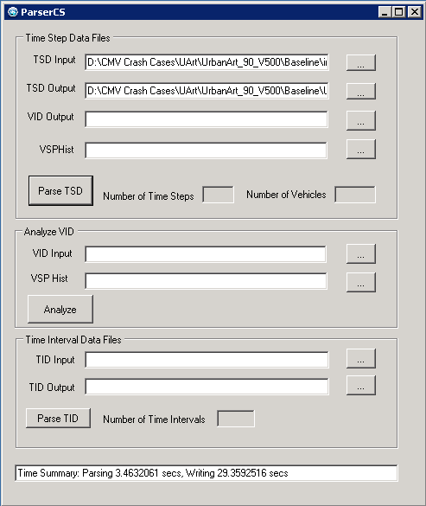
Parsing of TSIS-CORSIM Binary Files
TSIS-CORSIM Binary Files
Utilized for the TRAFVU component for visualizing the simulation
Contains information for each vehicle at a 1 second resolution
Contains aggregated information for each time interval assigned by the user
Parsing Application Developed to Translate Binary Output
Time Step Data Files (TSD) - Individual Vehicle data

Slide 12
CORSIM to MOVES Mapping
CORSIM | MOVES
Vehcile_Type | sourcetypeID | rollingTermA | rotatingTermB | dragTermC | sourceMass | fixedMassFactor | sourceTypeName
1 | 21 | 0.156461 | 0.00200193 | 0.000492646 | 1.4788 | 1.4788 | Passenger Car
2 | 21 | 0.156461 | 0.00200193 | 0.000492646 | 1.4788 | 1.4788 | Passenger Car
3 | 52 | 0.561933 | 0 | 0.00160302 | 7.64159 | 17.1 | Single Unit Short-haul Truck
4 | 52 | 0.561933 | 0 | 0.00160302 | 7.64159 | 17.1 | Single Unit Short-haul Truck
5 | 52 | 0.561933 | 0 | 0.00160302 | 7.64159 | 17.1 | Single Unit Short-haul Truck
6 | 62 | 2.08126 | 0 | 0.00418844 | 31.4038 | 17.1 | Combination Long-haul Truck
8 | 21 | 0.156461 | 0.00200193 | 0.000492646 | 1.4788 | 1.4788 | Passenger Car
9 | 21 | 0.156461 | 0.00200193 | 0.000492646 | 1.4788 | 1.4788 | Passenger Car

Slide 13
VSP Parameters
Link | SourceType | OpMode | Desc | Count
810082 | 21 | 0 | Braking | 0.00
810082 | 21 | 1 | Idling | 0.00
810082 | 21 | 11 | Low Speed Coasting; VSP< 0;1<=Speed<25 | 0.00
810082 | 21 | 12 | Cruise/Acceleration; 0<=VSP< 3; 1<=Speed<25 | 0.00
810082 | 21 | 13 | Cruise/Acceleration; 3<=VSP< 6; 1<=Speed<25 | 0.00
810082 | 21 | 14 | Cruise/Acceleration; 6<=VSP< 9; 1<=Speed<25 | 0.00
810082 | 21 | 15 | Cruise/Acceleration; 9<=VSP<12; 1<=Speed<25 | 0.00
810082 | 21 | 16 | Cruise/Acceleration; 12<=VSP;1<=Speed<25 | 0.00
810082 | 21 | 21 | Moderate Speed Coasting; VSP< 0; 25<=Speed<50 | 0.00
810082 | 21 | 22 | Cruise/Acceleration; 0<=VSP< 3; 25<=Speed<50 | 0.00
810082 | 21 | 23 | Cruise/Acceleration; 3<=VSP< 6; 25<=Speed<50 | 0.00
810082 | 21 | 24 | Cruise/Acceleration; 6<=VSP< 9; 25<=Speed<50 | 0.00
810082 | 21 | 25 | Cruise/Acceleration; 9<=VSP<12; 25<=Speed<50 | 0.00
810082 | 21 | 27 | Cruise/Acceleration; 12<=VSP; 25<=Speed<50 | 0.00
810082 | 21 | 28 | Cruise/Acceleration; 18<=VSP<24; 25<=Speed<50 | 0.00
810082 | 21 | 29 | Cruise/Acceleration; 24<=VSP<30; 25<=Speed<50 | 0.00
810082 | 21 | 30 | Cruise/Acceleration; 30<=VSP; 25<=Speed<50 | 0.00
810082 | 21 | 33 | Cruise/Acceleration; VSP< 6; 50<=Speed | 0.04
810082 | 21 | 35 | Cruise/Acceleration; 6<=VSP<12; 50<=Speed | 0.49
810082 | 21 | 37 | Cruise/Acceleration; 12<=VSP<18; 50<=Speed | 0.43
810082 | 21 | 38 | Cruise/Acceleration; 18<=VSP<24; 50<=Speed | 0.03
810082 | 21 | 39 | Cruise/Acceleration; 24<=VSP<30; 50<=Speed | 0.01
810082 | 21 | 40 | Cruise/Acceleration; 30<=VSP; 50<=Speed | 0.00

Slide 14
Operating Mode Distribution – Free Flow

Slide 15
Operating Mode Distribution – Congestion

Slide 16
Emissions Results
Urban Interstate
Duration = 90 min Partial and Full Closure
Closure | Volume | CO2 (grams) | CO (grams) | NOx (grams) | Energy (MMBtu) | PM10 (grams) | PM25 (grams) | SO2 (grams) | HC (grams) | VOC (grams)
Partial | 1000 | 43296 | 1452 | -19 | 0 | 8 | 7 | 2 | 29 | 27
Full | 1000 | 2555818 | 15339 | 4877 | 30 | 305 | 293 | 46 | 1691 | 1657
Partial | 2000 | 6631950 | 49575 | 17125 | 83 | 911 | 876 | 114 | 3163 | 3090
Full | 2000 | 18126560 | 121890 | 38918 | 225 | 2360 | 2270 | 320 | 11087 | 10846
Partial | 3000 | 21131530 | 150437 | 54987 | 265 | 2862 | 2753 | 361 | 10016 | 9790
Full | 3000 | 38901130 | 266171 | 84789 | 488 | 5175 | 4973 | 689 | 23796 | 23272

Slide 17
Dispersion Considerations
Nomenclature problem
Traffic links
Emission links
Dispersion links
Emission allocation into AERMOD is not as straight forward as the MOBILE to CAL3QHCR input

Slide 18
Dispersion Considerations (cont)
Specific Emission Problems
When area sources are used, there is not a direct connect with MOVES and AERMOD (units of mass/time-area vs. mass/time)
Determination of traffic link output to emission link input/output and dispersion link input requires considerable pre-planning by analyst (e.g., idle contribution at an intersection; where, how much, vehicle mode)

Slide 19
Dispersion Considerations (cont)
Dispersion Specific Issues
Best way to approximate the line source using either volume or area sources
Methodologies for input of initial plume parameters into AERMOD needs to be improved
Chemistry (e.g., NO₂/NO_{X} ratio, HAPS)
Consistent input between among users to meet the needs of reviewers
Inconsistencies at near field receptor locations
Need for verification

Slide 20
Acknowledgments
Project Sponsor
Federal Motor Carriers Safety Administration (FMCSA) – Michael Johnsen
Technical Support
Federal Highway Administration (FHWA) – Joon Byun
University of Florida McTrans Center

