Slide 1



MOVES Project Level Sensitivity Analysis
George Noel
Southern Transportation and Air Quality Summit (STAQS)
Atlanta, GA
August 13th, 2015
The National Transportation Systems Center
U.S. Department of Transportation
Office of the Secretary of Transportation
John A. Volpe National Transportation Systems Center
Advancing transportation innovation for the public good

Slide 2
Overview
Background
Sensitivity Analyses
  MOVES2010a – Regional Level
  MOVES2010b – Project Level
  MOVES2014 – Comparison with MOVES2010b National Level and Project Level
Results
Questions

Slide 3
Background
Sensitivity analyses sponsored by Federal Highway Administration (FHWA)
MOVES2010a Regional Level Sensitivity Analysis
  Report released in December of 2012
MOVES2010b Project Level Sensitivity Analysis
  Was a follow up analysis to MOVES2010a Regional Level Sensitivity Analysis
  Completed March 2014
MOVES 2014 Comparison with MOVES2010b
  Conducted summer/fall of 2014
  National Level and Project Level comparison
Notes:
Highlight the Regional level analysis and how it was presented at A&WMA in 2012 in San Antonio.
Also the Regional level was used to determine the input parameters we analyzed for the project level analysis

Slide 4
Regional Level Sensitivity Analysis
MOVES2010a was utilized
Parameters analyzed
  Temperature
    Running Emissions and Starts
  Humidity
  Year
  Age Distribution
  Average Speed Distribution

Slide 5
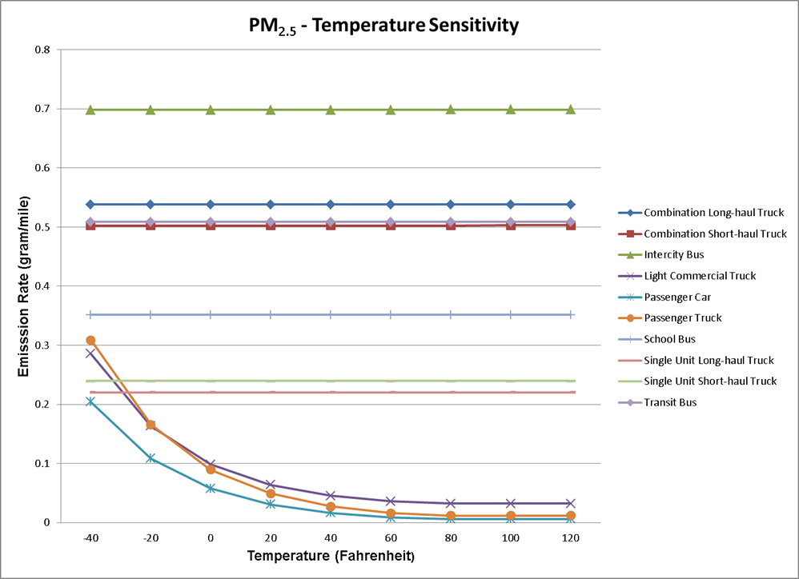
PM2.5 Temperature Sensitivity

Slide 6
Project Level Sensitivity Analysis
MOVES2010b was utilized
Parameters analyzed
  Age Distribution
  Fleet Mixture
  Average Speed and Operating Mode Distribution Comparison

Slide 7
Age Distribution
Age Distribution was analyzed for the Regional Level Sensitivity Analysis
The Project Level Analysis applied more meaningful variations
  Reached out to the Metropolitan Washington Council of Governments (MWCOG) to obtain data.
Analyzed multiple vehicle types
  Passenger Cars
  Transit Buses
  Single Unit Trucks
  Combination Trucks
Notes:
When Age Distribution was analyzed in the Regional Sensitivity we used arbitrary values to test the senstivity. For the project level we wanted to be more realistic.
We reached out to an MPO to get real world data. We used that real world data to obtain more realistic vairaions

Slide 8
Age Distribution
MWCOG provided data for 2005, 2008, and 2011
The data showed the fleet aging throughout the years

Slide 9
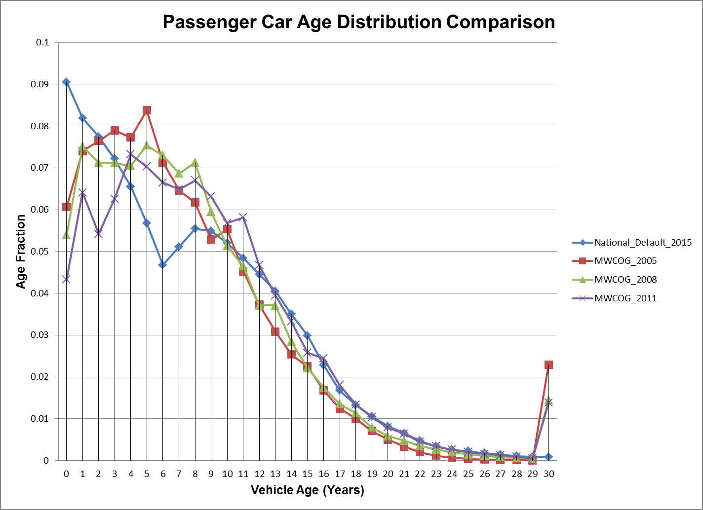
Passenger Car Age Distribution Trends
More variable for newer model years
Less variable for latter years
Age Groupings were based on these observed trends
Notes:
Point out the blue line being the national default

Slide 10
Passenger Car Age Distribution Groupings
Passenger Cars were put into five age groups
Five Scenarios were analyzed
Scenario 1 has the least amount of variation based upon the observed data
Scenario 5 has the highest amount of variation base upon the observed data
Vehicle Age Range | Baseline Age Fractions | Scenario 1 | Scenario 2 | Scenario 3 | Scenario 4 | Scenario 5
0-3 years | 0.32 | -5% | -10% | -20% | -30% | -45%
4-7 years | 0.22 | -2% | -5% | -7.50% | -10% | -20%
8-12 years | 0.26 | +5% | +10% | +20% | +30% | +50%
13-17 years | 0.14 | +4% | +8% | +15% | +20% | +30%
18-30 years | 0.06 | +2.5% | +5% | +7.5% | +10% | +25%
Average Vehicle Age | 7.48 | 7.68 | 7.86 | 8.21 | 8.53 | 9.24
Notes:
Also mention that we are aging the fleet in each scenario.
Also highlight that these ranges are realistic. Even in scenario 5 we did observed some model years have that much variation at the high end.

Slide 11
Passenger Car Age Distribution Results
Source Type | Pollutant | Case | Average Age | Emission Rate (gram/vehicle-mile) | Percent Change
Passenger Car | CO | Baseline | 7.48 | 1.484 | -
 |  | Scenario 1 | 7.68 | 1.516 | 2.15%
 |  | Scenario 2 | 7.86 | 1.548 | 4.14%
 |  | Scenario 3 | 8.21 | 1.604 | 7.49%
 |  | Scenario 4 | 8.53 | 1.653 | 10.24%
 |  | Scenario 5 | 9.24 | 1.776 | 16.47%
 | NO_{X} | Baseline | 7.48 | 0.2929 | -
 |  | Scenario 1 | 7.68 | 0.3017 | 2.91%
 |  | Scenario 2 | 7.86 | 0.3104 | 5.63%
 |  | Scenario 3 | 8.21 | 0.3246 | 9.76%
 |  | Scenario 4 | 8.53 | 0.3367 | 12.99%
 |  | Scenario 5 | 9.24 | 0.3700 | 20.84%
 | VOC | Baseline | 7.48 | 0.0398 | -
 |  | Scenario 1 | 7.68 | 0.0409 | 2.88%
 |  | Scenario 2 | 7.86 | 0.0421 | 5.56%
 |  | Scenario 3 | 8.21 | 0.0439 | 9.51%
 |  | Scenario 4 | 8.53 | 0.0455 | 12.62%
 |  | Scenario 5 | 9.24 | 0.0502 | 20.78%
 | PM_{2.5} | Baseline | 7.48 | 0.0067 | -
 |  | Scenario 1 | 7.68 | 0.0068 | 1.16%
 |  | Scenario 2 | 7.86 | 0.0069 | 2.27%
 |  | Scenario 3 | 8.21 | 0.0070 | 4.01%
 |  | Scenario 4 | 8.53 | 0.0071 | 5.56%
 |  | Scenario 5 | 9.24 | 0.0075 | 9.94%
Notes:
Shows that the emissions rates increase as the fleet gets older and more vairable.
Once again highlight that these ranges are observed from an actual MPO. Shows how much the fleet can change for the same area in just a few years.
Also, highlight that is shows how important it is to get the most recent age distribution. For certain analyses it may be important to forecast possible aging of the fleet.

Slide 12
Fleet Mix
Analyzed five cases to determine how sensitive fleet can be a specific MOVES link
The five cases include
  Geographic area comparisons of fleet mix(Georgia Tech provided data)
  Passenger Car to Passenger Truck ratio
  Percent Truck Mix
  Truck Type Mix
  Transit Bus Mix
Notes:
We will only show the passenger Car to Passenger Truck Ratio Case.
Mentioned Ga. Tech for the Geographic area case.

Slide 13
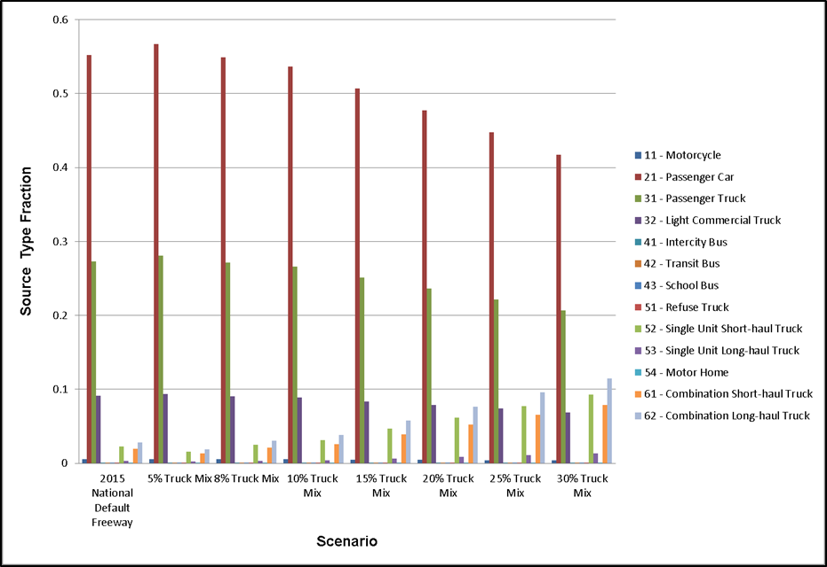
Percent Truck Mix Sensitivity
Varied the truck mix while proportionally adjusting the other MOVES source types
Notes:
First Bullet: Passenger Trucks are much higher than passenger cars in MOVES.
Truck Mix focused on Single Unit and Combination Truck Types. MOVES Sources Types 52, 53,61, and 62

Slide 14
Percent Truck Mix Results
Pollutant | Description | Emission Rate (gram/vehicle-mile) | Percent Change
NO_{X} | Baseline_Highway | 1.2006 | -
 | 5% Truck Mix | 1.0046 | -16.33%
 | 8% Truck Mix | 1.2464 | 3.82%
 | 10% Truck Mix | 1.4077 | 17.25%
 | 15% Truck Mix | 1.8108 | 50.83%
 | 20% Truck Mix | 2.214 | 84.41%
 | 25% Truck Mix | 2.6172 | 117.99%
 | 30% Truck Mix | 3.0204 | 151.57%
PM_{2.5} | Baseline_Highway | 0.0342 | -
 | 5% Truck Mix | 0.0268 | -21.55%
 | 8% Truck Mix | 0.0359 | 5.04%
 | 10% Truck Mix | 0.042 | 22.77%
 | 15% Truck Mix | 0.0571 | 67.08%
 | 20% Truck Mix | 0.0722 | 111.41%
 | 25% Truck Mix | 0.0874 | 155.73%
 | 30% Truck Mix | 0.1025 | 200.06%
Notes:
The closer you are to a 50/50 split the higher the CO and NOX rates will be.
The main take away is that if you can increase your proportion of passenger trucks your CO and NOX rates can go up by a significant amount.
It will be important to classify these vehicles appropriately.

Slide 15
Average Speed and Operating Mode Distribution Comparison
Compared utilizing average speed for a link to a user defined operating mode distribution
  When using average speed with MOVES, default drive schedules are applied
Highway Capacity Manual (HCM) based drive schedules
Georgia Tech provided operating mode distributions
Notes:
During the first main and sub bullet explain the how the average speed works and the different options that can be used.
Average Speed
Drive Schedule
Operating Mode Distribution. Remind everyone that everything turns into an operating mode distribution.
Mention Ga. Tech here again and how important they were for this portion of the analysis.

Slide 16
Intersection Analysis
Intersection
  25 mph, 35 mph, 45 mph approach speeds
  LOS B,D, and E
  Consisted of approach, queue, and departure (acceleration) links
45 mph Scenario Intersection Data
Approach Speed (mph) | LOS | Signal Cycle Length | Yellow Time (seconds) | Green Time (seconds) | Red Time (seconds) | Vehicle Headway (seconds) | Deceleration Rate (mph/s) | Acceleration Rate (mph/s) | Volume per Cycle
 |  | (Seconds)
45 | B | 55 | 4 | 10 | 41 | 14 | -5 | 3 | 4
 | D | 95 | 4 | 23 | 68 | 10 |  |  | 9
 | E | 100 | 4 | 24 | 72 | 9 |  |  | 11
Notes:
This is an example of the detail we come up with to develop these scenarios.
We used this information in conjunction with the kinematic equations.
We developed our own drive schedules and using the VSP calculation converted them into Operating Mode Distributions.

Slide 17
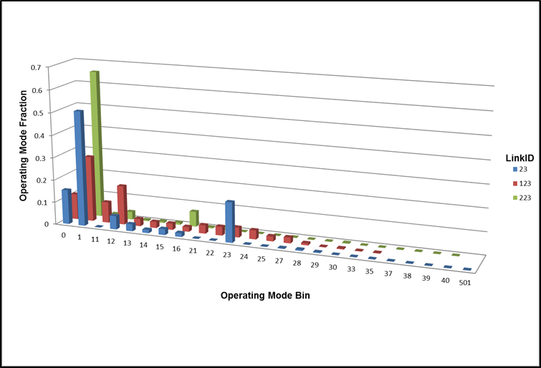
Operating Mode Distributions
45 mph Intersection Scenario – Queue Links LOS D Operating Mode Distributions
Notes:
For the Queue link LOS D in the 35 mph scenario
Blue is MOVES average speed
Red is HCM generated
Green is Georgia Tech provided.

Slide 18
Intersection Results
Link Description | LinkID | Modeled Average Speed (mph) | Level of Service | CO Emission Rate (gram/veh-mile) | CO % Difference Compared to Average Speed | PM_{2.5} Emission Rate (gram/veh-mile) | PM_{2.5} % Difference Compared to Average Speed
Intersection Queue Link Average Speed | 120 | 14.84 | LOS B | 3.135 | - | 0.0214 | -
Intersection Queue Link HCM | 20 |  |  | 1.555 | -50.40% | 0.01506 | -29.62%
Intersection Queue Link GATech | 220 |  |  | 1.644 | -47.57% | 0.0189 | -11.72%
Intersection Queue Link Average Speed | 123 | 13.24 | LOS D | 3.256 | - | 0.02276 | -
Intersection Queue Link HCM | 23 |  |  | 2.028 | -37.71% | 0.01679 | -26.25%
Intersection Queue Link GATech | 223 |  |  | 1.842 | -43.41% | 0.02118 | -6.95%
Intersection Queue Link Average Speed | 126 | 11.8 | LOS E | 3.393 | - | 0.02356 | -
Intersection Queue Link HCM | 26 |  |  | 2.345 | -30.89% | 0.01877 | -20.32%
Intersection Queue Link GATech | 226 |  |  | 2.067 | -39.07% | 0.02302 | -2.27%
Notes:
Large variations compared to average speed for the queue segment.
CO and NOX results.
Very important finding for getting a good representative operating mode distribution for the segment being modeled.

Slide 19
MOVES2014 Comparison
MOVES2014 compared with MOVES2010b
National Scale
  Composite Emission Rates
  Source Type Emission Rates
Project Scale
  Composite Emission Rates
  Source Type Emission Rates

Slide 20
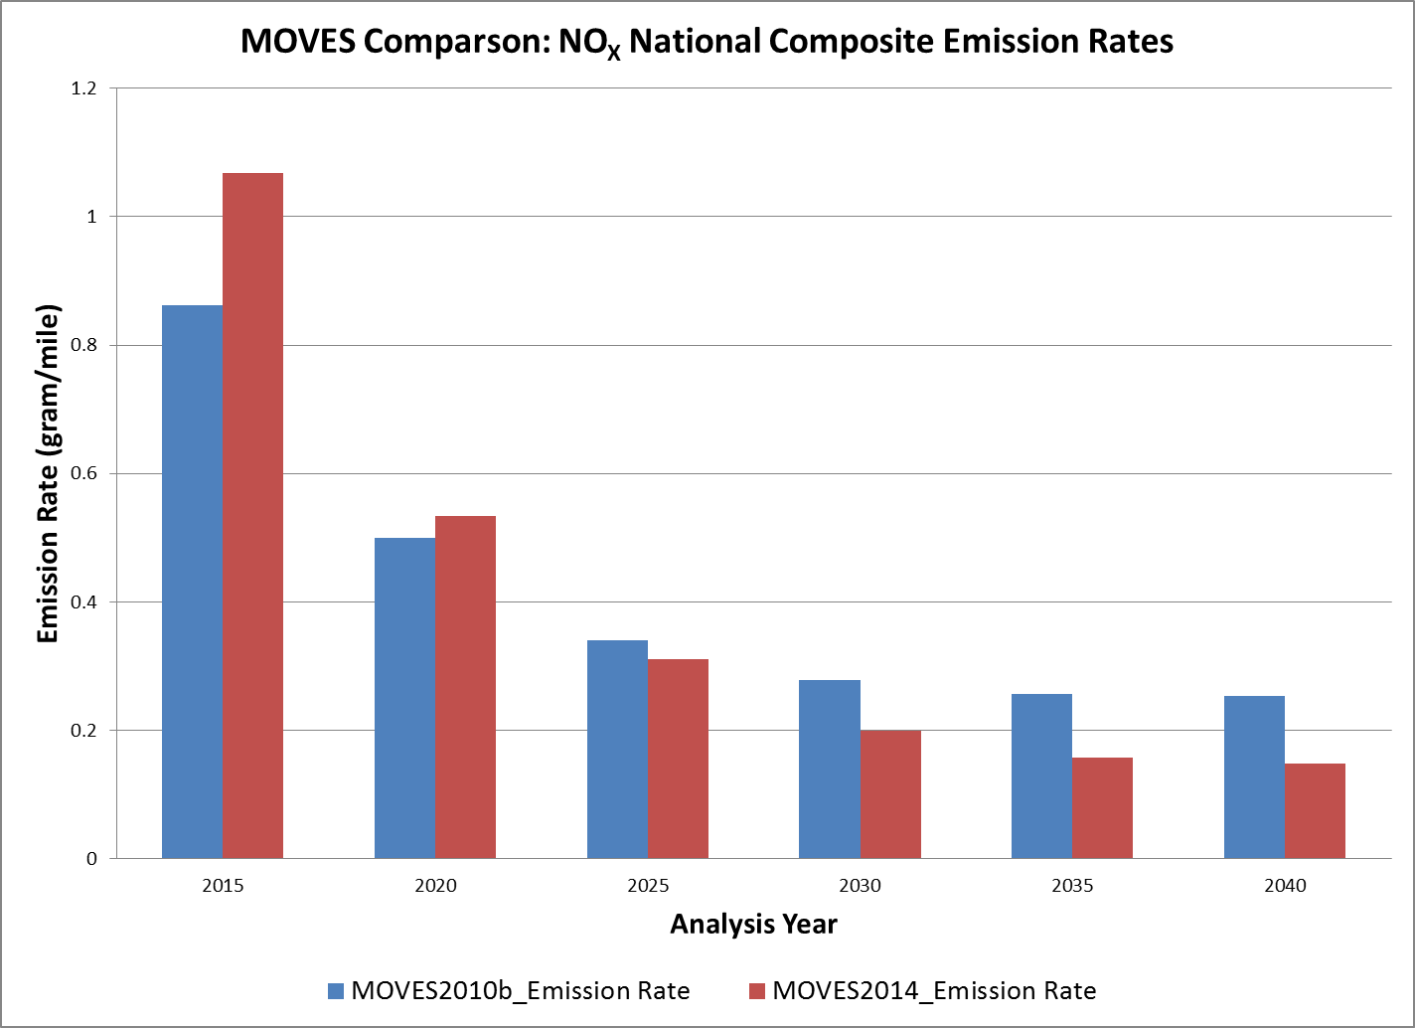
MOVES2014 NOx National Scale
pollutantName | yearId | MOVES2010b Emission Rate (gram/mile) | MOVES 2014 Emission Rate (gram/mile) | MOVES2014 Percent Difference to MOVES2010b
Oxides of Nitrogen (NOx) | 2015 | 0.862 | 1.068 | 23.92%
 | 2020 | 0.500 | 0.533 | 6.58%
 | 2025 | 0.340 | 0.311 | -8.56%
 | 2030 | 0.278 | 0.200 | -28.10%
 | 2035 | 0.256 | 0.157 | -38.59%
 | 2040 | 0.253 | 0.148 | -41.52%

Slide 21
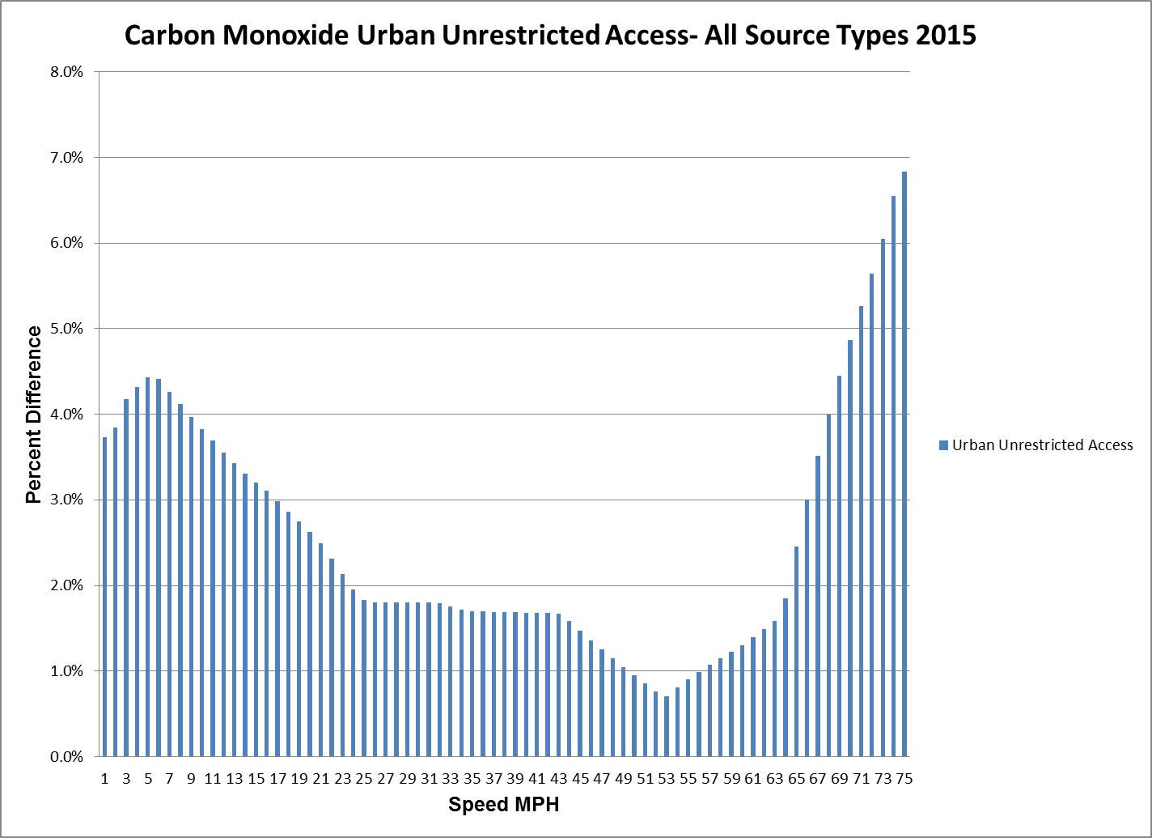
MOVES2014 Comparison to MOVES2010b Project Level

Slide 22
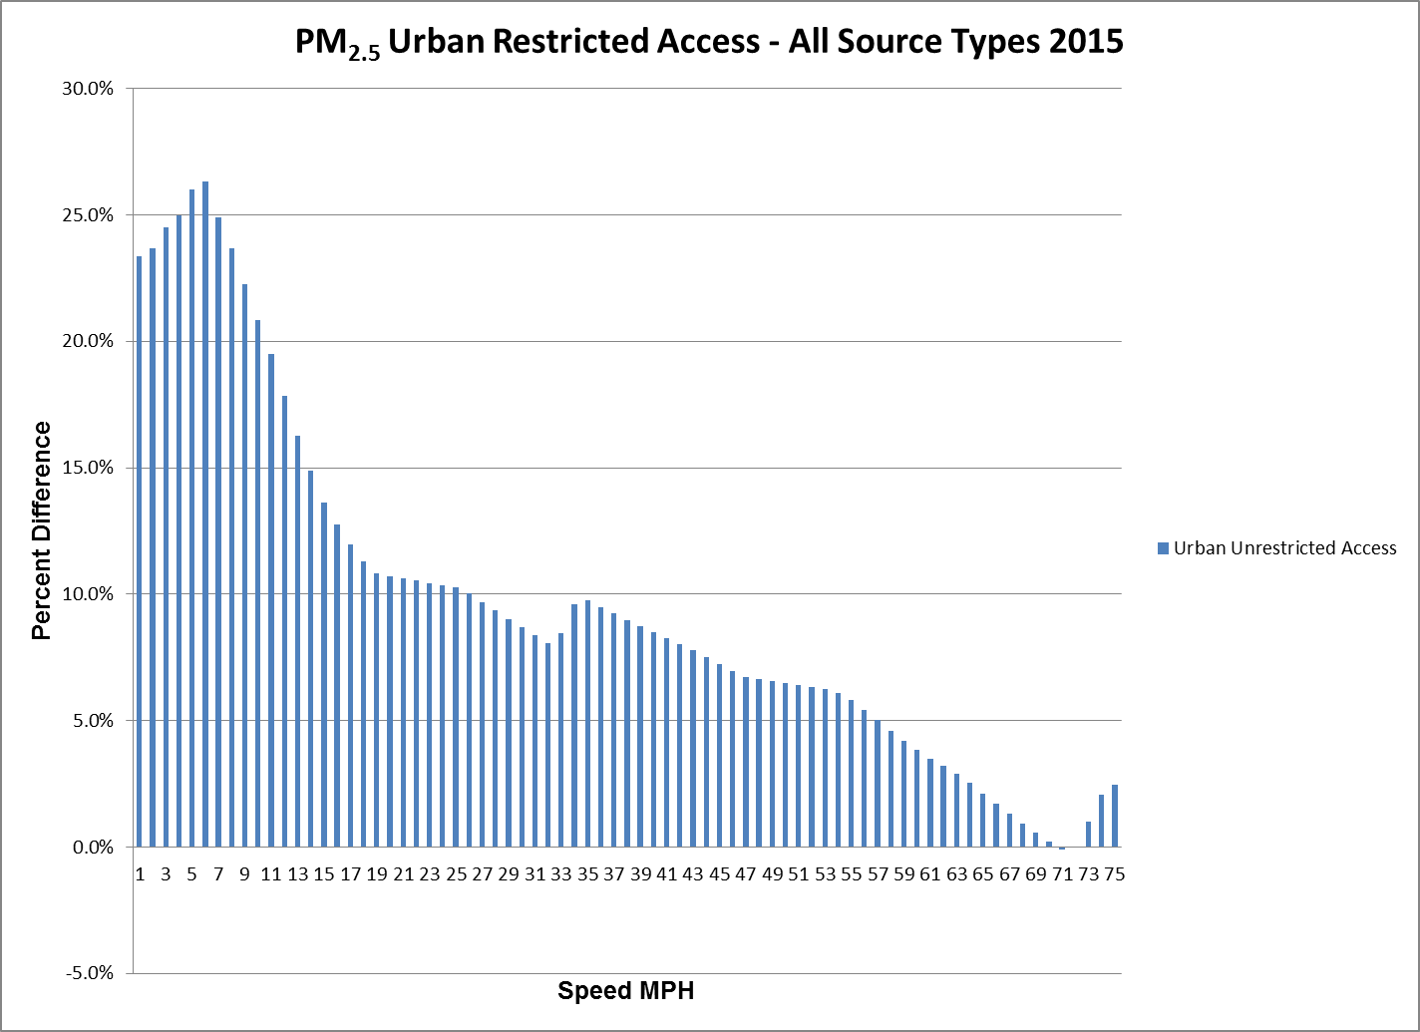
MOVES2014 Comparison to MOVES2010b Project Level

Slide 23
Questions?
Email: george.noel@dot.gov

