Slide 1
Methodology for Using AEDT and MOVES for Airport Air Quality Analyses
George Noel
108th Air & Waste Management Association Annual Conference and Exhibition
Paper # 81
June 24th, 2015
The National Transportation Systems Center
U.S. Department of Transportation
Office of the Secretary of Transportation
John A. Volpe National Transportation Systems Center
Advancing transportation innovation for the public good

Slide 2
Background - AEDT
Aviation Environmental Design Tool (AEDT) version 2b released May 29th, 2015
Replaces Emissions and Dispersion Modeling System (EDMS) 5.1.4.1 (August 2013) as the preferred model for airport air quality analyses
Replaces the Integrated Noise Model (INM)
EPA’s MOtor Vehicle Emission Simulator (MOVES) is not embedded within AEDT 2b or EDMS 5.1.4.1
EDMS: The Usage of the U.S. Environmental Protection Agency's (USEPA) Motor Vehicle Emission Simulator (MOVES) with the Federal Aviation Administration's (FAA) Emissions and Dispersion Modeling System (EDMS) (February 28th, 2014)
AEDT 2b: Using MOVES with AEDT 2b Version 1.0
Available on AEDT website: https://aedt.faa.gov/

Slide 3
Background - MOVES
MOVES is required model for estimating emissions from on-road mobile sources
Required as of March 2013
Replaces MOBILE6.2
MOVES2014 is the current version
Released October 7th, 2014
Replaces MOVES2010b
2 year grace period with exceptions
NONROAD2008 embedded

Slide 4
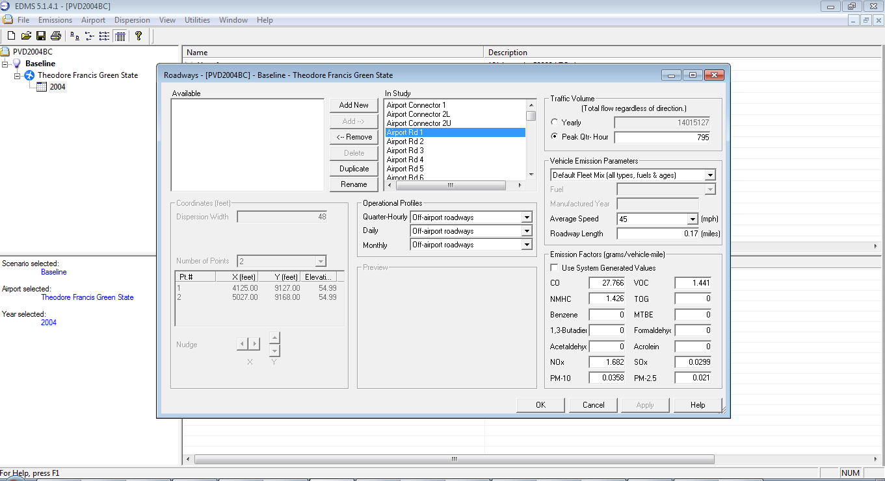
Background - EDMS
EDMS – Roadway Input Interface

Slide 5
Using AEDT with MOVES
Emissions Inventories
Analysts will generate emissions inventories for on-road and off-road (e.g. construction equipment) mobile sources independently of AEDT 2b
Emissions Inventory results may be imported in AEDT 2b
The following Emissions Inventory categories can be imported
Roadways
Parking Facilities
Construction

Slide 6
Using AEDT with MOVES
Dispersion Modeling
Analysts will generate AERMOD input files for on-road and off-road (e.g. construction equipment) mobile sources independently of AEDT 2b
Analyst generated AERMOD input file (.inp)
Analyst generated AERMOD hourly emission rate file (.hre)
AERMOD .inp and .hre files may be imported into AEDT 2b
Merged with aircraft and other airport sources

Slide 7
Methodology – MOVES
MOVES executed at Project Level Domain
Allows for Link (roadway segment) level emissions estimates
Each MOVES run models a single hour
Single hour, month, and year for each MOVES run
Number of MOVES runs required may vary
Use Case
Emission Inventory may require less runs
Dispersion modeling may require more runs
Meteorological variation
Traffic Variation

Slide 8
Methodology – MOVES
Number of MOVES Runs
Determined by interagency coordination
Meteorological and traffic variation
An example of a detailed set of runs is 16 MOVES runs
Quarterly seasonal variation (Table 1)
Daily traffic variation (Table 2)
Table 1. Quarters of the year for MOVES runs
Code | Name | Months
Q1 | First Quarter | January - March
Q2 | Second Quarter | April – June
Q3 | Third Quarter | July - September
Q4 | Fourth Quarter | October - December
Table 2. Traffic volume times of day for MOVES runs
Code | Name | Time of Day
AM | Morning Peak | 0600 – 0900 (3 hours)
MD | Midday | 0900 – 1600 (7 hours)
PM | Evening Peak | 1600 – 1900 (3 hours)
ON | Overnight | 1900 – 0600 (11 hours)

Slide 9
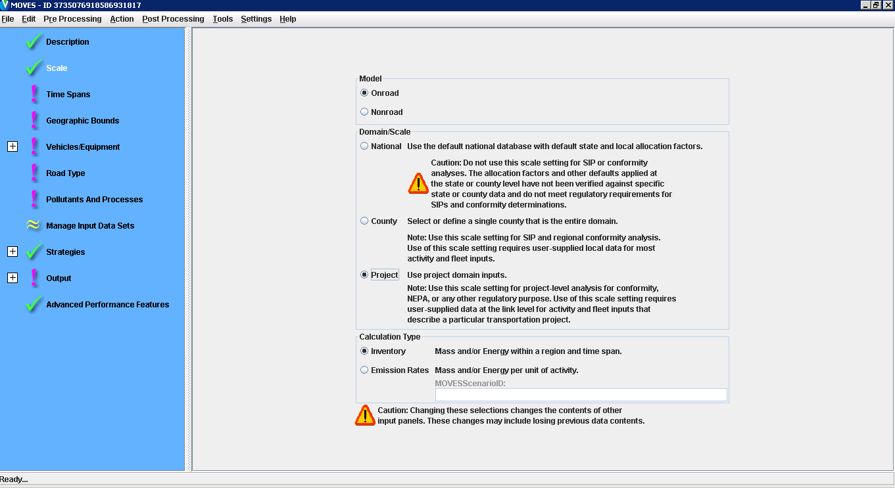
Methodology – MOVES
Scale

Slide 10
Methodology – MOVES
Pollutants and Processes for Roadway Links
These Pollutants and processes must be selected so results appropriately map to AEDT
Pollutant | Emissions Process
Total Gaseous Hydrocarbons | Running Exhaust and Crankcase Running Exhaust
Non-Methane Hydrocarbons
Non-Methane Organic Gases
Volatile Organic Compounds
Total Organic Gases
Carbon Monoxide (CO)
Oxides of Nitrogen (NOX)
Sulfur Dioxide (SO2)
Total Energy Consumption
Atmospheric CO2
Primary Exhaust PM10 - Total
Primary Exhaust PM2.5 - Total
Primary PM10 - Organic Carbon
Primary PM2.5- Organic Carbon
Primary PM10 - Elemental Carbon
Primary PM2.5 - Elemental Carbon
Primary PM10 - Sulfate Particulate
Primary PM2.5 - Sulfate Particulate
Primary PM10 - Brakewear Particulate | Running Exhaust, Crankcase Running Exhaust, and Brakewear
Primary PM2.5 - Brakewear Particulate
Primary PM10 - Tirewear Particulate | Running Exhaust, Crankcase Running Exhaust, and Tirewear
Primary PM2.5 - Tirewear Particulate

Slide 11
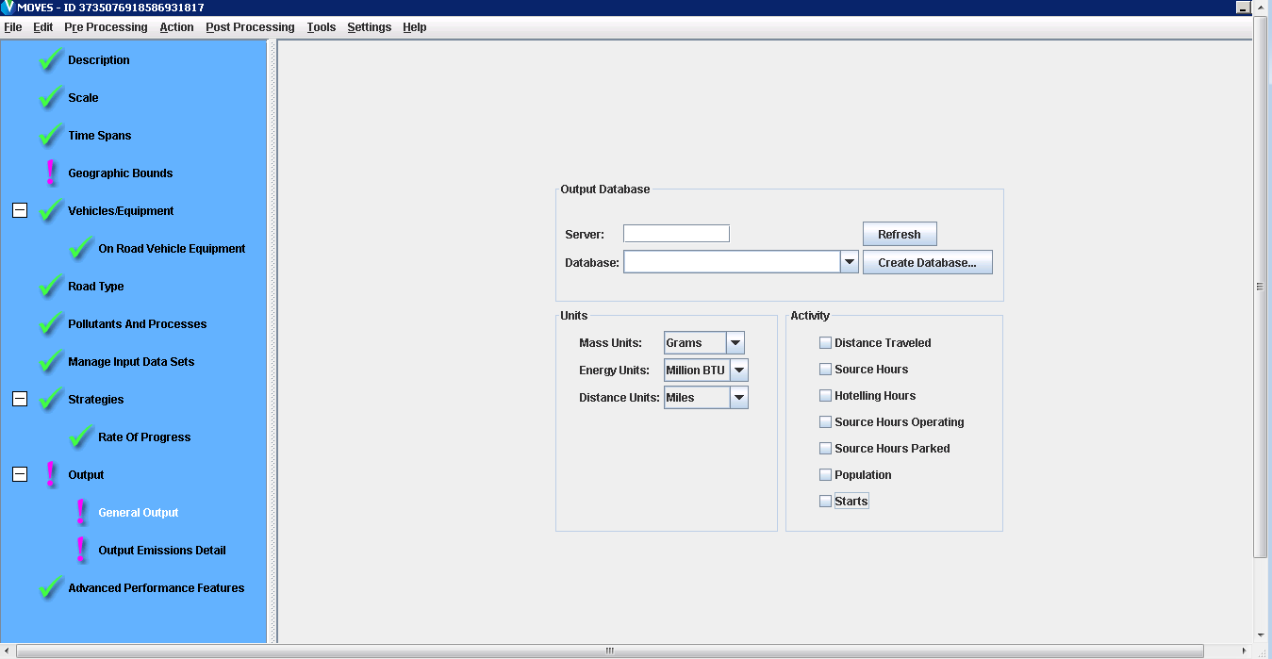
Methodology – MOVES
Output – General Output
Notes:
This table shows the emissions and fuel consumption rates association with each event that occurs during the inspection process.
The “Event Type” is one emissions component of the entire inspection process.

Slide 12
Methodology – MOVES
Links
Roadway Links
Unique Link for each Roadway Segment
Road Type
Average Speed (mph)
Length (miles)
Grade (%)
Parking Facility Links
Three Links for each Parking Facility/Level
Parking Facility Movement Link
Idle Link
Off-Network Link (starts and soak)
Only a single off-network link can modeled with each MOVES run

Slide 13
Methodology – MOVES Output
After all MOVES runs have been completed, the analyst will have generated output by each link represented in total grams of each pollutant for the hour modeled.
The MOVES output for all links is located in the “movesoutput” table within the output database.
The analyst must conduct post processing on the MOVES output so that pollutants match those generated by the other sources modeled with AEDT
Pollutant | MOVES Pollutant ID
THC | 1
CO | 2
VOC | 87
NMHC | 79
TOG | 86
NOx | 3
SOx | 31
PM10 | 100 (100 + 106 + 107)
PM2.5 | 110 (110 + 116 + 117)
CO2 Atmospheric | 90
H2O | 119

Slide 14
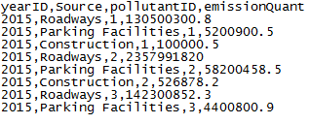
Methodology – MOVES Output
AEDT accepts a comma separated file (.csv) for importing an emission inventory
A single emission inventory for each analysis year can be imported in AEDT
Four columns of information are to be included in the .csv import file
YearID – Analysis Year
Source – Roadway, Parking Facilities, and Construction
PollutantID – MOVES Pollutant ID
emissionQuant – total mass in grams
Example of Emissions Inventory Input File

Slide 15
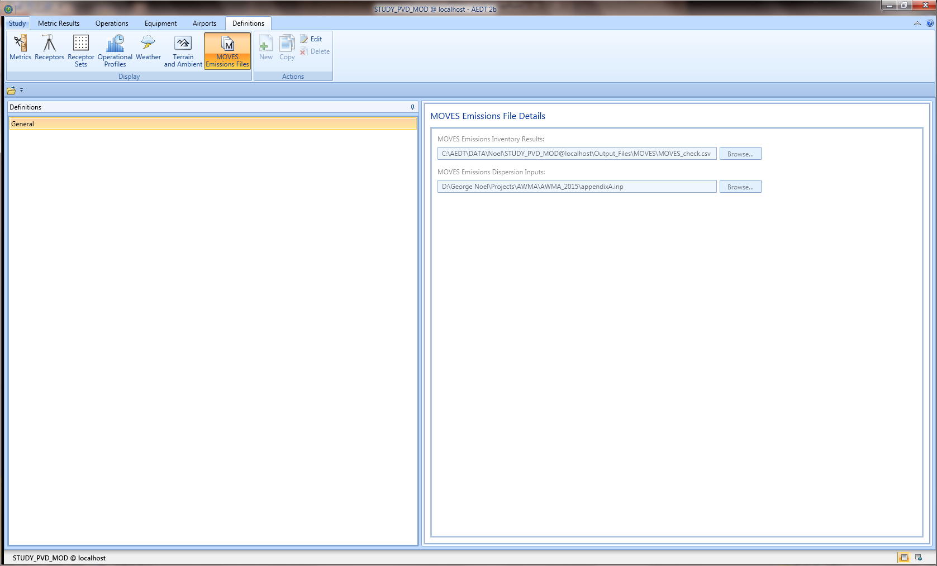
Methodology – AEDT Import
Emission Inventory and AERMOD input files Import

Slide 16
Methodology – AERMOD Input Files
AEDT does not manage or utilize geospatial data associated with roadway links or parking facility links
The analyst can import a GIS shape file (.shp) to display roadways on the AEDT map viewer.
Shape file data is not used for any other purpose (e.g., AERMOD)
Analyst is responsible for managing geospatial coordinates of roadway and parking facility sources
All AERMOD source coordinates are based on a local coordinate system with the origin based on the airport reference point
UTM Coordinates are not utilized

Slide 17
Methodology – AERMOD .inp File
Roadway Sources
Modeled using AREA sources
Parking Sources
Modeled using AERAPOLY sources
Each level of a parking garage is to be modeled as an individual source
Construction Sources
Can be modeled as AREA, AREAPOLY, POINT, or VOLUME sources

Slide 18
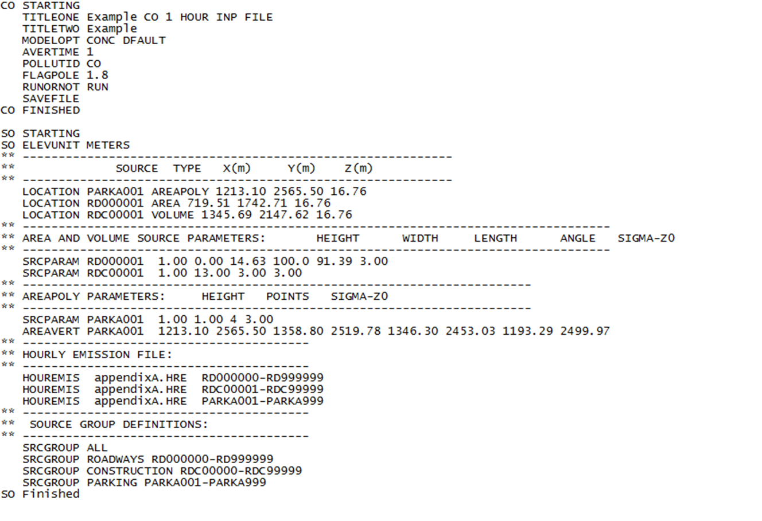
Methodology – AERMOD .inp File
The analyst needs to only specify the CO and SO Pathways

Slide 19
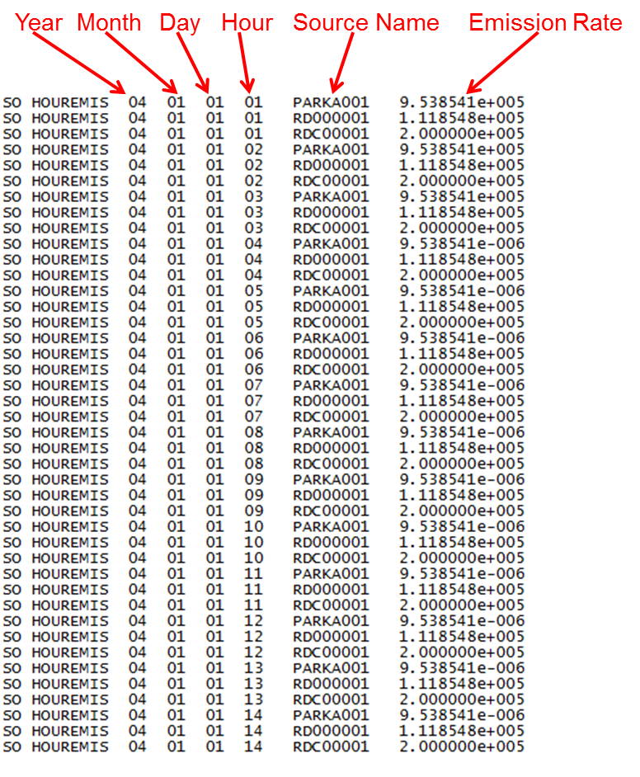
Methodology – AERMOD .hre File

Slide 20
Methodology – AERMOD .inp and .hre Requirements
A minimum of one parking facility must be included in the .inp and corresponding .hre file. If the analyst does not want to model a parking facility then the emission rates can be set to zero in the .hre file.
The following naming conventions must be used in order for the AERMOD .inp to import correctly into AEDT.
Parking Facilities: naming range of PARKA001 through PARKZ999
Roadways: naming range of RD000001 through RD999999
Construction: naming range of RDC00001 through RDC99999
The order of the sources listed under the SRCPARAM keyword in the .inp must be ordered in the following manner:
All roadway sources are to be defined first.
All construction sources are to be defined following the roadway sources.
All parking facility sources are to be defined after the construction sources. If there are no construction sources to be modeled then the parking facility sources will follow the roadway sources. Construction Sources

Slide 21
Methodology – AERMOD .inp and .hre Requirements
The POLLUTID in the CO (control) Pathway in the AERMOD input file must match the AEDT Metric Result being modeled. For example, if the CO (carbon monoxide) Metric is chosen to be modeled in AEDT then CO (carbon monoxide) must be listed with the POLLUTID keyword within the CO (control) Pathway section of the AERMOD input fileThe following naming conventions must be used in order for the AERMOD .inp to import correctly into AEDT.
The AERMOD input file (.inp) and the hourly emission rate file (.hre) must have the same naming convention. For example, if the AERMOD input file name is CO_airportXYZ.inp then the hourly emission rate file is to be named CO_airportXYZ.hre.
The order of sources in the hourly emission rate file (.hre) must be ordered in the following manner:
All parking facility sources are to be listed first.
All roadway sources are to be listed following the parking facility sources.
All construction sources are to be listed following the roadway sources.

Slide 22
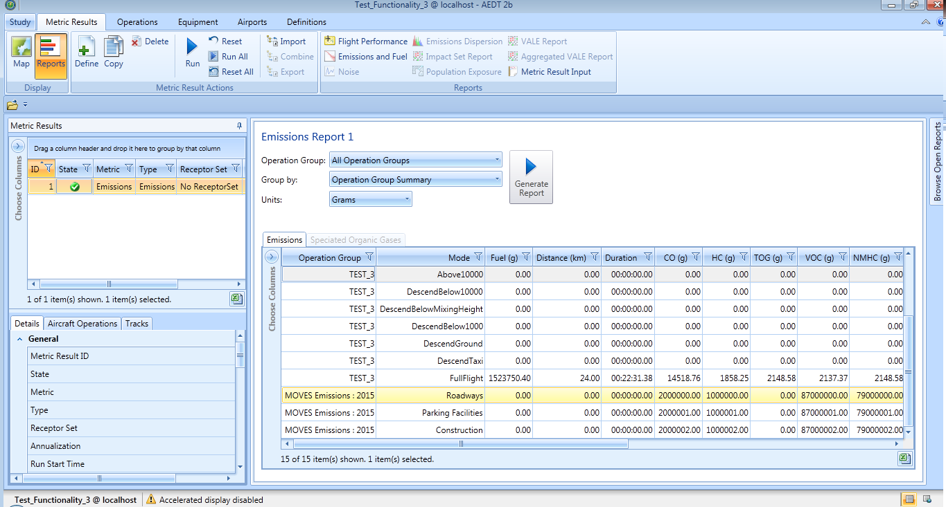
AEDT Emissions Inventory Results

Slide 23
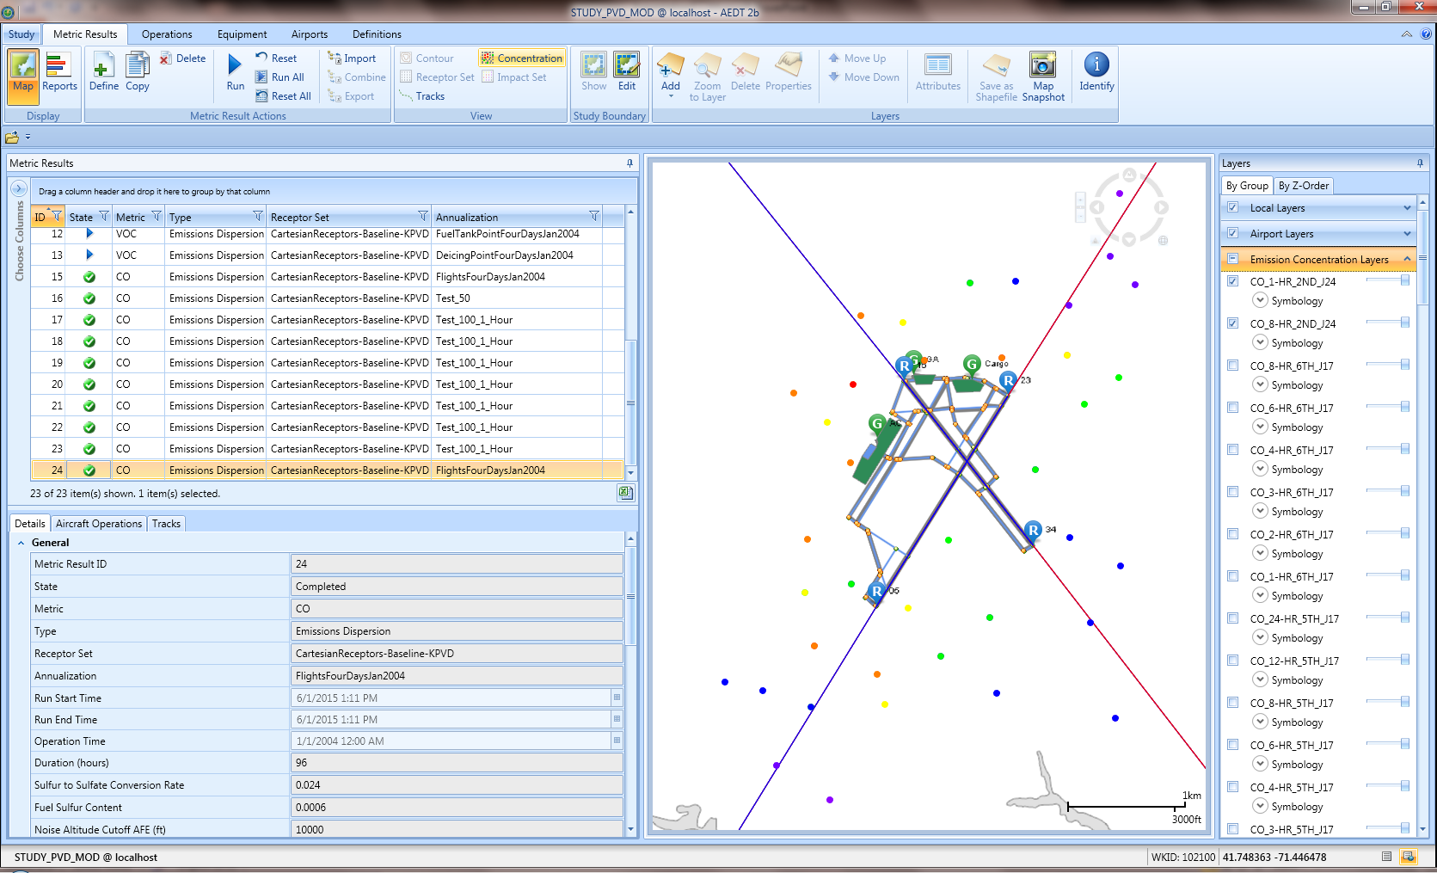
AEDT Dispersion Analysis Results

Slide 24
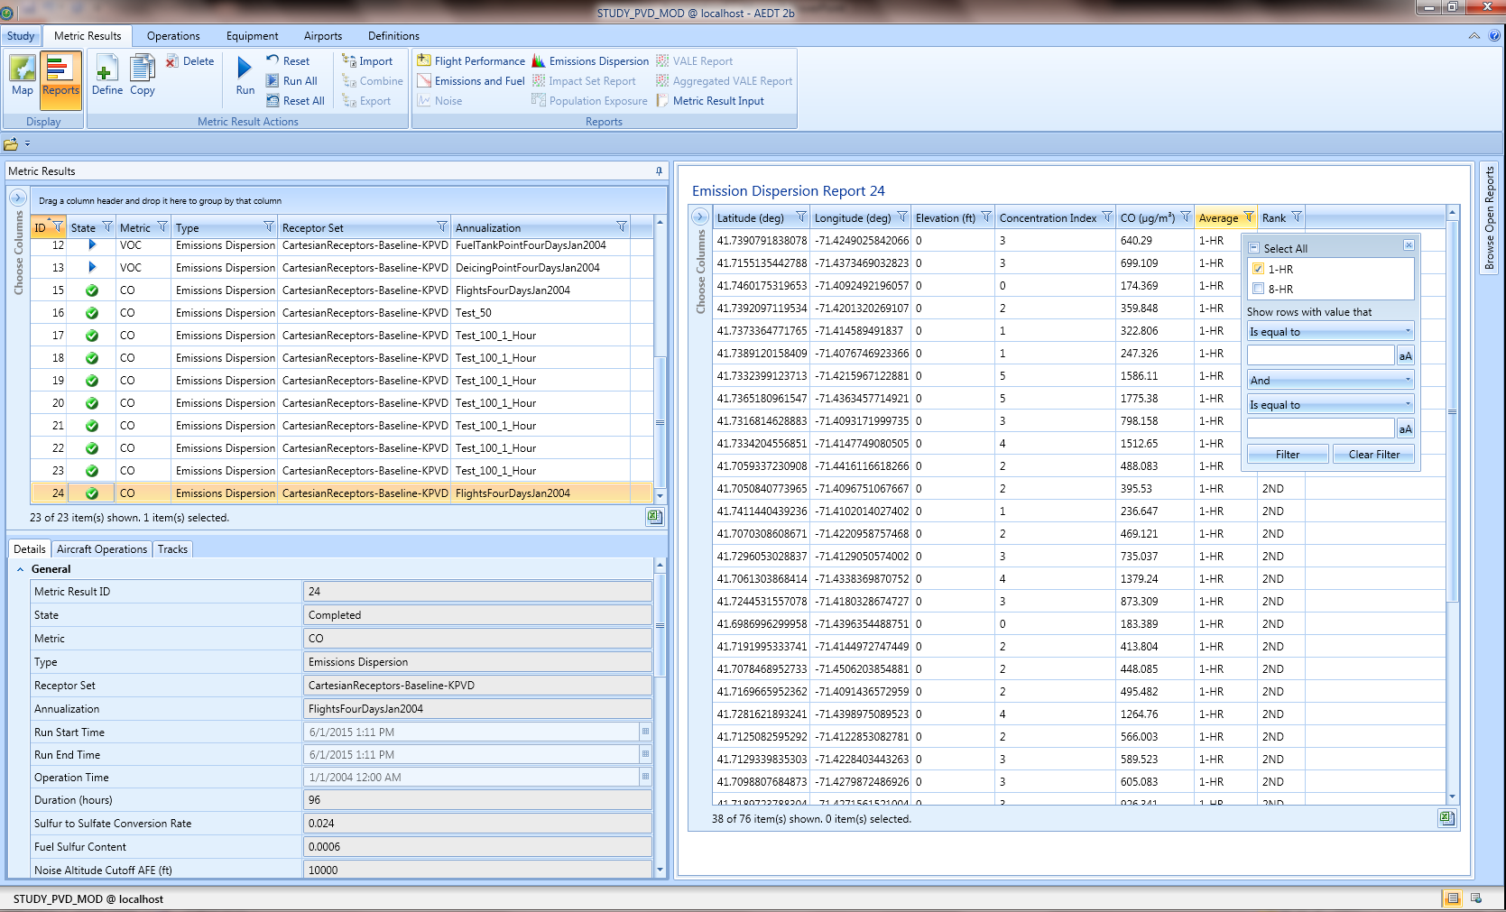
AEDT Dispersion Analysis Results

Slide 25
Questions?
George Noel
Email: george.noel@dot.gov
AEDT Website
https://aedt.faa.gov/

