Slide 1
MOVES Project Level Sensitivity Analysis Update
Transportation Research Board 93rd Annual Meeting
Transportation and Air Quality Committee, ADC20
Presented By:
George Noel – Volpe
Mark Glaze - FHWA
1/13/2014

Slide 2
History of MOVES Sensitivity Analysis
MOVES Project Level Analysis Began in November 2012
Is a complement analysis to the Regional Level Sensitivity Analysis – Report released in December 2012
Focused on three variables associated with the Project Level Domain
Age Distribution
Fleet Mixture (Link Source Type)
MOVES Drive Schedules
Average Speed, Link Drive Schedule, and Operating Mode Distribution
Coordinate with NCHRP 25-38 to avoid overlapping analyses
Volpe to complete draft report January 2014 and final report release March 2014

Slide 3
Age Distribution Analysis
The Project Level applied more meaningful variations
Reached out to the Transportation Planning Board (TPB) of the Metropolitan Washington Council of Governments (MWCOG)
Provided Age Distribution data for each MOVES source type
For each source type analyzed, divided the Age Distribution into age groups based upon the trends observed from the TPB of MWCOG data.
Analyzed the effects of vehicle aging on Passenger Cars, Transit Buses, Single Unit Trucks and Combination Trucks

Slide 4
Age Distribution Passenger Car Analysis and Results
Passenger Car
Vehicle Age Range | Baseline Age Fraction | Scenario 1 | Scenario 2 | Scenario 3 | Scenario 4 | Scenario 5
0-3 years | 0.32 | -5% | -10% | -20% | -30% | -45%
4-7 years | 0.22 | -2% | -5% | -7.50% | -10% | -20%
8-12 years | 0.26 | 5% | 10% | 20% | 30% | 50%
13-17 years | 0.14 | 4% | 8% | 15% | 20% | 30%
18-30 years | 0.06 | 2.50% | 5% | 7.50% | 10% | 25%
Average Vehicle Age | 7.48 | 7.68 | 7.86 | 8.21 | 8.53 | 9.24
Source Type | Pollutant | Case | Average Age | Emission Rate (gram/vehicle-mile) | Percent Change
Passenger Car | NO_{X} | Baseline | 7.48 | 0.2929 | -
 |  | Scenario 1 | 7.68 | 0.3017 | 2.91%
 |  | Scenario 2 | 7.86 | 0.3104 | 5.63%
 |  | Scenario 3 | 8.21 | 0.3246 | 9.76%
 |  | Scenario 4 | 8.53 | 0.3367 | 12.99%
 |  | Scenario 5 | 9.24 | 0.37 | 20.84%

Slide 5
Fleet Mix (Link Source Type)
Conduct Fleet Mix Sensitivity Analysis for multiple cases
Geographic Area Data Source
Passenger Car to Passenger Truck Ratio
Heavy Duty Truck Mix
Heavy Duty Truck Type Mix
Transit Bus Mix
Utilized Fleet Mix data provided by Georgia Tech
Compared composite emissions rates to the ‘Baseline Case’ specific to the scenario/cases that were analyzed

Slide 6
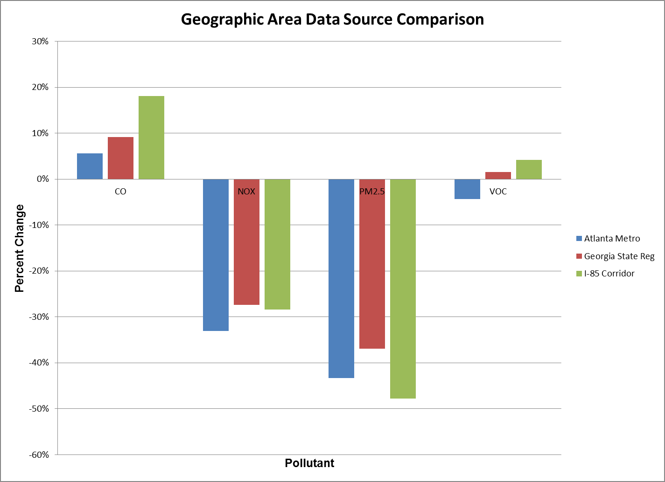
Fleet Mix Geographic Area Data Source Results

Slide 7
Average Speed compared to Drive Schedule and Operating Mode Distribution
The Project Level Sensitivity Analysis compared using Average Speed for defining a link to:
Highway Capacity Manual (HCM) derived Drive Schedule/Operating Mode Distributions
Trip based Empirical Data provided by Georgia Tech
Link Types analyzed
Cruise Conditions
Arterial
Freeway
Intersection Links
Approach
Queue
Acceleration

Slide 8
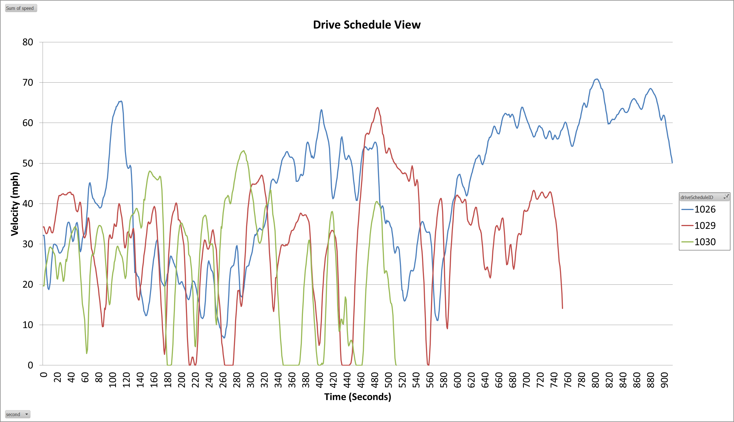
Example: MOVES Default Drive Schedules

Slide 9
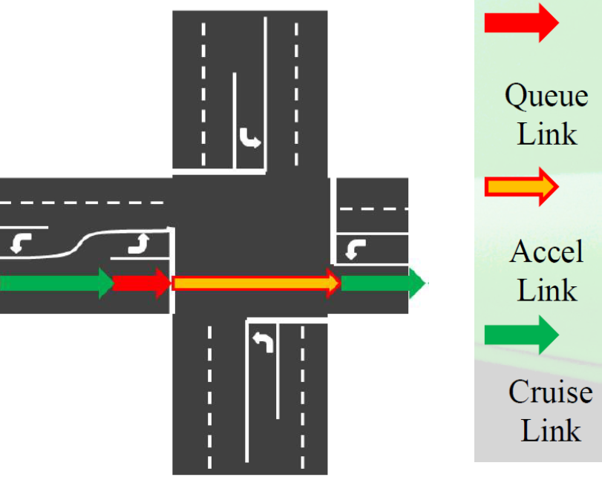
Average Speed
The user will specify an average speed for a link
The average speed and distance assigned to the link determines the Source Operating Hours spent of the link.
The average speed should represent the conditions of the roadway segment being analyzed
The Average Speed approach utilizes embedded MOVES drive schedules in the Default Database

Slide 10
Average Speed compared to constant approach speed Drive Schedule
Road Type | Link Type | Scenario | CO Emissions Rates (gram/veh-mile) | Percent Change Compared to Average Speed | PM2.5 Emissions Rates (gram/veh-mile) | Percent Change Compared to Average Speed
Urban Unrestricted Access | Approach | 25 mph Average Speed | 3.6880 | -27.12% | 0.0504 | -36.64%
 |  | Constant 25 mph Drive Schedule | 2.6876 |  | 0.0320
Urban Unrestricted Access | Approach | 35 mph Average Speed | 3.1387 | -24.33% | 0.0374 | -38.41%
 |  | Constant 35 mph Drive Schedule | 2.3752 |  | 0.0230
Urban Unrestricted Access | Approach | 45 mph Average Speed | 2.7569 | -19.77% | 0.0314 | -35.52%
 |  | Constant 45 mph Drive Schedule | 2.2118 |  | 0.0203

Slide 11
Project Level Sensitivity Results Summary
Variations in Age Distribution can have a significant effect on emissions rates
An older average age does not always equate to higher emissions rates (Transit Bus Scenario)
For passenger cars when the average age increases by a year then the emissions rates increase was in the 10% percent range for CO, VOC, and NO_{X}. The emissions rate increase in PM_{2.5} was approximately 5%.
Getting the fleet mix accurate for your project is important
The ratio between passenger cars and passenger trucks is important primarily for CO
Getting the ratios between single unit and combination trucks are important
However there is very little change in emissions rates between the short haul and long haul designations
Observed slightly lower emissions rates when increasing proportion of long-haul vehicle types for NO_{X} and PM_{2.5}.
Still analyzing average speed compared to link drive schedule and operating mode distribution

Slide 12
Sensitivity Questions – Drive Schedule
What is the difference in emissions rates between using average speed versus user provided link drive schedule/operating mode distribution?
The default drive schedules utilized when using average speed might not represent the exact profile you want to model
Link might only have deceleration and idle
Link might only have cruise with no deceleration or acceleration
How detailed do you have to be?
Individual drive schedules for each vehicle on the link?
Does it matter if you are more detailed?

